Slide 1
Greater Manchester One-stop Lung Cancer Clinic (Cancer Treatment & Optimisation Programme)
Professor Matthew Evison
Consultant Chest Physician
Lung Cancer & Thoracic Surgery Directorate, Wythenshawe Hospital, Manchester University NHS Foundation Trust
Associate Medical Director, Greater Manchester Cancer
MASHC Honorary Clinical Chair, Faculty of Biology, Medicine & Health, University of Manchester
Lisa Galligan-Dawson
Director of Performance, Greater Manchester Cancer

Slide 2
Key challenge in GM: making treatment decisions in ‘higher risk’ patients with NSCLC referred for thoracic surgery
Thoracic surgery clinic
(Referred from sector MDT)
High risk MDT
Anaesthetic clinic
+/- additional tests
Oncology clinic
Thoracic surgery clinic
Source of delayed pathways and poor outcomes (upstaging & poor experience)
January 2022 – May 2022 = 95 patients
Time from Referral to Decision to Treat (DTT): Mean 28 days, Median 20 days, range 3-207
Time from Referral to First Definitive Treatment (FDT): Mean: 48 days, Median 41 days, range 13-228
47% of the patient harms recorded in GM (20/21) relates to lung cancer through 104-day reviews

Slide 3
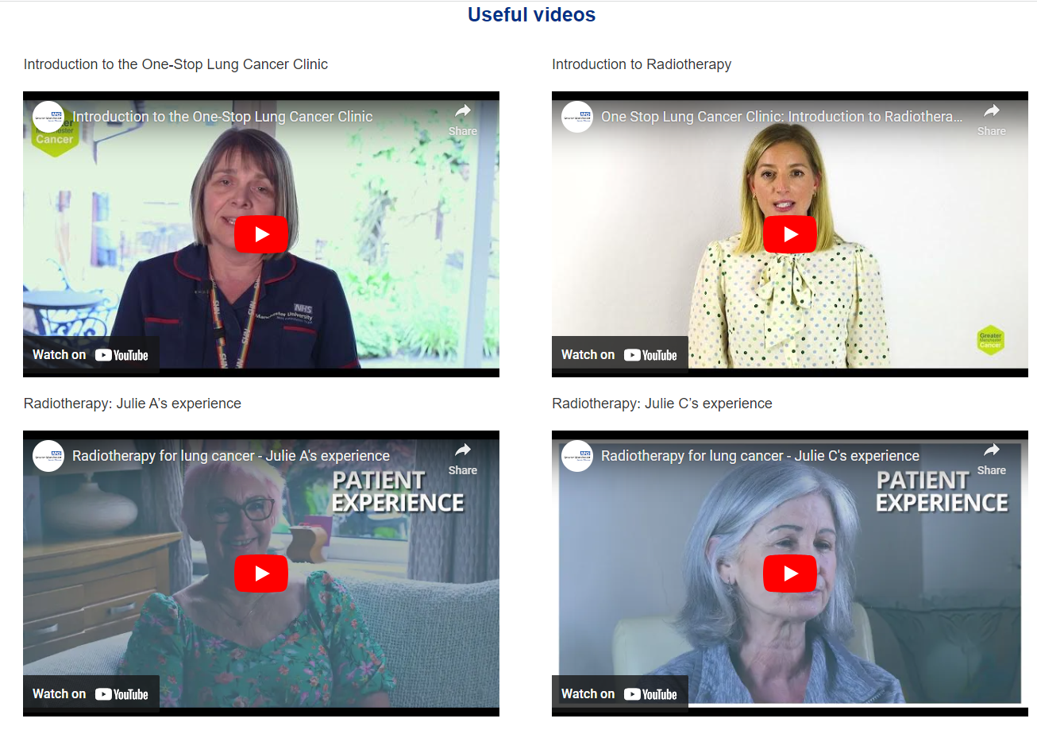
GM One-Stop Lung Cancer Clinic
https://gmcancer.org.uk/lungclinic

Slide 5
The GM One Stop Lung Cancer Clinic
Patient & family
Shared decision making & optiisation
Lung cancer physicians
Thoracic anaesthetists
Clinical oncologists
CURE Tobacco dependency team
Thoracic surgeons
Prehab
4cancer
Oncogeriatrics
Cancer Nurse Specialists

Slide 6
Clinic structure
8am: Arrival
Dedicated private taxi company contract, transport provided FOC
8-9am: Standardised nursing assessment and CNS/surgeon initial meeting
Sit-stand test, pro-BNP, tobacco dependency, alcohol, physical activity & prehab
9-10am: One stop clinic MDT
Presented by surgical team, chaired by chest physician
9-10am: Patient information videos
Surgery, radiotherapy, prehab, CURE
10-12.45pm: Consultations
Thoracic surgery, thoracic anaesthesia, clinical oncology, CURE, prehab, oncogeriatrics, chest physician
12.45-1pm: Wrap-up meeting

Slide 7
GM One Stop Lung Cancer Clinic: Outcomes (115 pts) 88% of patients made a treatment decision on the day of clinic
Mean 5 days: Saving of 23 days
Median 4 days: Saving of 16 days
Mean 27 days: Saving of 21 days
Median 26 days: Saving of 15 days

Slide 8
The GM One Stop Lung Cancer Clinic

Slide 9
 |  | Pre-One-stop Implementation n=94 | Post-One-stop Implementation n=114
Prehabilitation (prehab4cancer) | Patients referred for Prehab | 64/94 (68%) | 92/114 (81%)
 | Uptake of prehab | 49/94 (52%) | 74/114 (65%)
Frailty n (%) | Patients screened for frailty (documented CFS) | 45 (48%) | 114 (100%)
 | Frailty intervention (Oncogeriatrics) | 4 (4%) | 46 (41%)
Tobacco dependency n (%) | Patients with tobacco dependency receiving specialist support / treatment | 5/34 (15%) | 30/33 (91%)
Malnutrition | Screening for malnutrition | 64/94 (68%) | 114/114 (100%)
 | Intervention in moderate/high risk | 1/9 (11%) | 19/19 (100%)
Alcohol dependency | Patients screened for high-risk alcohol intake | 4/94 4% | 114/114 100%
 | Appropriate alcohol intervention protocol followed | 0/94 0% | 114/114 100%

Slide 10
 | Cohort | Pre-Implementation of One Stop n=94 | Post Implementation of One Stop n=114
Treatment modality | Surgical resection | 69/94 (73%) | 72/114 (63%)
 | Curative-intent radiotherapy | 25/94 (27%) | 42/114 (37%)
Healthcare utilisation | Hospital appointments to reach treatment decision | 230 in 94 patients | 114 in 114 patients
 | Mean (±95% CI) | 2.4 | 1
Surgical length of stay (days) | Mean (±95% CI) | 9 | 7
 | Median (IQR) | 7 (4-10) | 6 (4-8)
Mortality | 30-day mortality n (%) | 0/94 0% | 2/114 1.8%
 | 90-day mortality n (%) | 4/94 (4.3%) | 2/114 1.8%
 | 12-month mortality n(%) | 12/94 (12.8%) | 4/114 (3.5%)

Slide 11
Experience of care: GM One Stop Lung Cancer Clinic

Slide 15
Health economic analysis
Partnered with AstraZeneca to deliver a comprehensive cost evaluation
Phase 1: Robust pathway cost comparison analysis (in submission)
IG completed to generate access to GMs SDE (secure data environment) – first non-research access in England
Phase 2: Full health economics assessment including wider health determinants
Pathway cost comparison per patient
Table provides the cost per patient for cohort 1 (higher-risk patients with early-stage lung cancer) pre- and post-implementation of the OSLCC pathway.
Post-implementation, the cost for a cohort 1 patient decreased by 9.5%

Slide 16
The GM One Stop Lung Cancer Clinic Evolution
How do you deliver rapid & effective multimodality treatment services?
Patient & family
Shared decision making & optimisation
Lung cancer physicians
Thoracic anaesthetists
Clinical oncologists
CURE Tobacco dependency team
Thoracic surgeons
Prehab
4cancer
Oncogeriatrics
Cancer Nurse Specialists
‘Surgical friends meeting’. Day prior to one-stop

Slide 17
GM One-stop lung cancer clinic – curative intent multimodality treatment
Launch November 2023
132 referrals to date
78% make a decision on the day
88% commencing neoadjuvant treatment have completed surgery

Slide 18
GM Cancer Alliance Structure - UK
Programme Boards
Pathway Boards
Health Inequalities
Neuro-Oncology
Head and Neck
Breast
Lung
Hepato-Pancreato-Biliary
Colorectal
Sarcoma
Urology
Haemato-oncology
Gynaecology
Oesophago-gastric /Upper-GI
Skin
Acute Oncology
Joint Planning & Delivery Committee
Early Diagnosis
GM Cancer Programme Assurance Group (PAG)
Workforce & Education
GM Cancer Board
Provider Federation Board
GM ICB
NHSE
Personalised Care
GM Cancer Strategy and System Risk Assurance Group (SSRAG)
Faster Diagnosis, Operational Improvement and Treatment Variation
Digital and Innovation
Targeted Lung Health Check

Slide 19
The GM One Stop Lung Cancer Clinic
Conclusions
Successful delivery of complex cancer care in a supportive environment
True multi-disciplinary & patient centred working
Clear evidence of substantial pathway improvement
Clear evidence of provision of comprehensive optimisation
A 10% increase in 1-year survival despite more functionally/physiologically impaired patient cohort
Important themes of success:
Addressing inequalities: Provide transport, information (all languages/easy-read)
Strong leadership & project management within the cancer alliance
Robust governance processes within the cancer alliance
A scale-able and transferable across multiple cancer pathways

Slide 20
Roll Out
GM OG CTOC – go live 01 May 25
GM HPB – scoping phase
GM Pelvic Prostate – scoping phase
GM H&N – scoping phase (to enhance an existing service)

Slide 21
Acknowledgements
Sarah Lyons: Programme manager, One-stop lung cancer clinic
Dr Jon Chung, Dr Kavita Sivabalah, Dr Patrick Goodley, Jenna Lane: Data analysis for One Stop Lung Cancer Clinic Evaluation
Thoracic Surgery
Felice Granato
Kandadai Rammohan
Annabel Sharkey
Vijay Joshi
Eustace Fontaine
Som Ghanti
Chest Physicians
Nicola Sinnott
Phil Crosbie
Richard Booton
Haval Balata
Chris Craig
Clinical Oncology
David Woolf
Neil Bayman
Kathryn Banfill
Jenny King
Claire Barker
Nursing & CNS
Kath Hewitt
Siobhan Keegan
Karen Peplow
Julie Watts
Oncogeriatrics
Cassandra Ng
Prehab4cancer: Kirsty Rowlinson-Groves, Jack Murphy
CURE: Helen Huddart

Slide 22
Questions & Discussion
https://gmcancer.org.uk/lungclinic

