Slide 1
Re-audit of frozen sections in thoracic pathology
Nidhi Bhatt

Slide 2
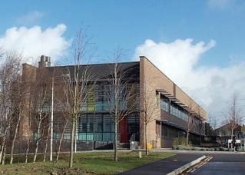
Background
In 2016, UHBW Cellpath merged with, and moved to, NBT
Bespoke frozen section protocol developed for thoracic surgical patients to minimise delay causes by transport
Clinical effectiveness project undertaken in 2017 to validate the protocol*
*Digital pathology is a practical alternative to on-site intraoperative frozen section diagnosis in thoracic surgery Histopathology 2019, 74, 902–907. DOI: 10.1111/his.13804

Slide 3
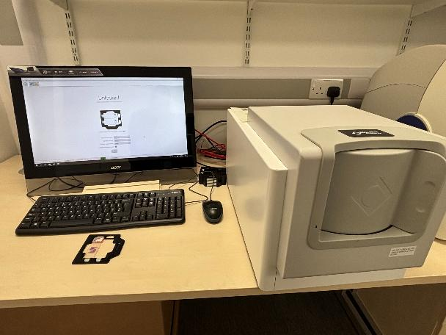
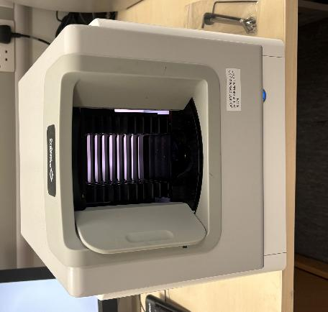
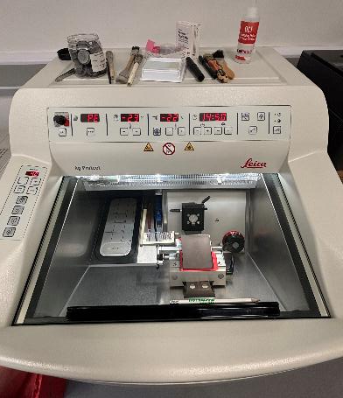
Frozen section pathway UHBW → NBT
Specimen dissected by surgeons and tissue for frozen section (FS) selected
Sent to the Essential services laboratory (ESL) in UHBW
Glass slides formed and scanned with whole slide image scanner
Images sent to NBT and reported digitally

Slide 4
Audit standards
No national guidance, agreed locally
90% frozen sections reported in 30 minutes
Exceptions – >3 specimens sent simultaneously
95% frozen section diagnoses correlate with final diagnosis
Exceptions – sampling discrepancy

Slide 5
Method
All thoracic FS between 01/01/2024 and 31/12/2024 identified from LIMS (using specimen type codes)
Data collection – step times from specimen receipt to results phoned recorded
Reports reviewed as appropriate

Slide 6
Data overview
95 thoracic cases underwent FS
1 case excluded
Staging mediastinoscopy of 9 LN stations = 142 min
14 cases had 2 specimens sent simultaneously
80 cases had a single FS

Slide 7
Turnaround time – cases with 2 specimens
21% (n=3) reported in 30 min
78% (n=11) took >30 min
4 – multiple sections required for assessment – took >40 min
1 – scanner failure – took 106 min
1 – delay in pathologist being notified – took 42 min
5 – inherent delay in processing specimens sequentially – took 31-39 min
Except for the 4 cases with multiple sections, processing time contributed most to the delay

Slide 8
Turnaround time – cases with 1 specimen
58% (n=46) reported in 30 min
42% (n=34) took >30 min
3 – scanner failures – (43, 70 and 127 min)
5 – multiple sections required for assessment (most ~40-45 min)
7 sections examined to confirm bronchial margin clearance in one case(70 min)
1 – delay in connecting to theatres (8 min wasted)
1 – pathologist not made aware scans available (took 43 min)
24 – no clear cause for delay identified though processing time contributed the most

Slide 9
Turnaround time - overall
52% met the audit standard
Average overall TAT = 34.8 min (32 min in the last audit)
Average and median lab TAT (processing + scanning) = 30 min
Average and median reporting time = 6 min

Slide 10
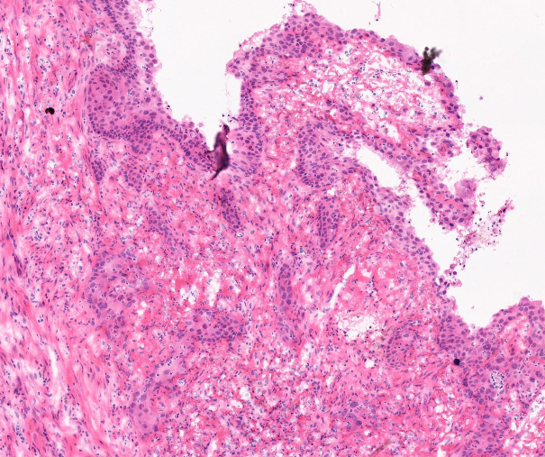
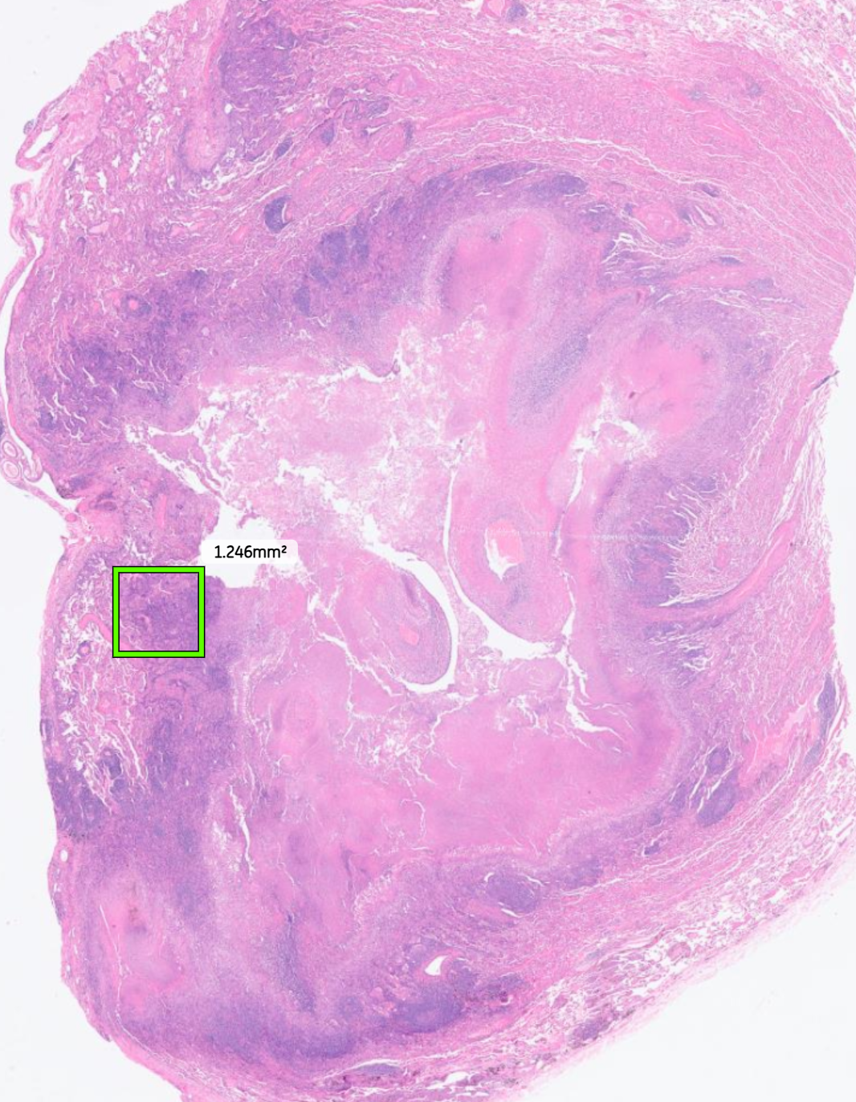
Diagnostic accuracy
98% (n=94) FS diagnoses correlated with final diagnosis
2% (n=1) case was downgraded from squamous cell carcinoma to squamous metaplasia on final histology
cT1N0 PET avid, partly cavitating lesion in a current smoker
FS interpretation considered appropriate in the clinical context

Slide 11
Next steps/actions
Investigate lab times further to see if any improvements possible
Better communication within pathology and with surgeons
Consider blue lighting multi-part FS to NBT main lab

