Slide 1
SWAG Cancer Alliance
Non-Hodgkin Lymphoma Treatment Variation CAG discussion
March 2025

Slide 2
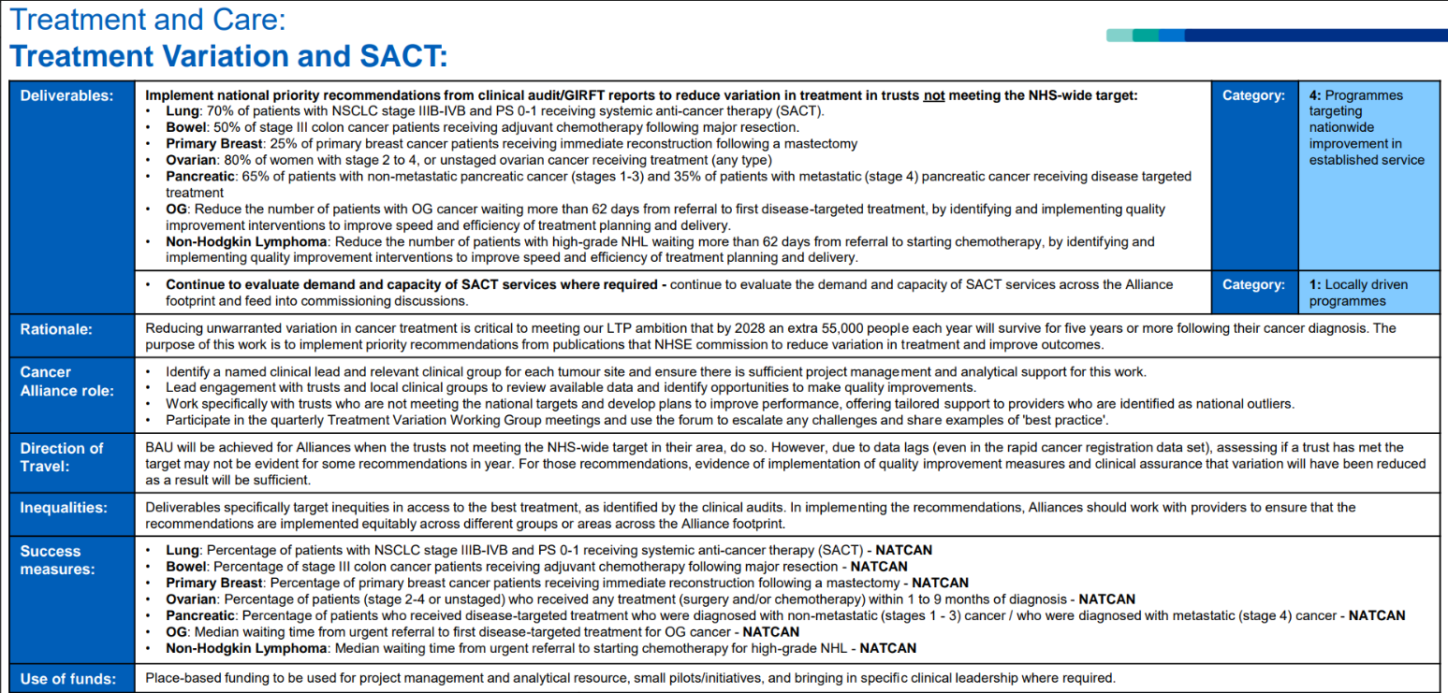
2025/26 NCP Treatment Variation Deliverables
National Cancer Programme Deliverable is to reduce the number of patients with high-grade NHL waiting more than 62 days from referral to starting chemotherapy, by identifying and
implementing quality improvement interventions to improve speed and efficiency of treatment planning and delivery
Success measure: Median waiting time from urgent referral to starting chemotherapy for high-grade NHL

Slide 3
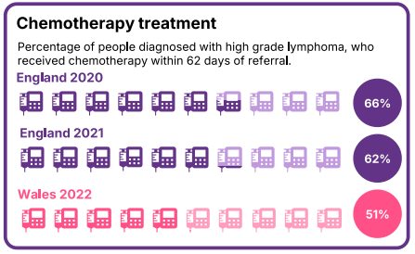
2025/26 Treatment Variation: How National audit recommendation for focus is decided

Slide 4
2025/26 Treatment Variation: How National audit recommendation for focus is decided

Slide 5
2025/26 Treatment Variation Success Measures Benchmarking most recent
*Peer alliances identified using methodology used to identify peer hospitals by Model Hospital

Slide 6
2025/26 Treatment Variation Success Measure most recent

Slide 7
2025/26 Treatment Variation work programme
Resources are available to support this work
c30k (tbc) available to deliver NHL pathway actions / activities: allocation process tbc but not ringfenced
SWAG Core team project manager
Recognise that conversations could focus on data completeness, quality and target yet to be set, and though important ask of the CAG is…..
Please guide project manager by:
Suggest actions / activities required to reduce the number of patients with high-grade NHL waiting more than 62 days from referral to starting chemotherapy
Thank you

