Slide 1
HPB Cancer Clinical Advisory Group
Dr Charlotte Chamberlain PhD
Palliative Care Consultant, UHBW
Honorary Senior Lecturer University of Bristol
NPaCA State of the Nation Report 2024 - National Cancer Audit Collaborating Centre
Notes:
The audit will be a really important tool, helping us to accelerate national efforts to improve the care and treatment of patients diagnosed with pancreatic cancer.
It will gather real world information from databases across England and Wales, allowing better comparisons to be made, and revealing where shortfalls need to be addressed.
Pancreatic cancer is one the least survivable cancers, with virtually no improvement seen in survival rates in the UK over 40 years from the 1970s.
But the data that tells us that is ten years old. So, are new treatments having a positive impact?
A priority for each audit in NATCAN is the development of explicit quality improvement (QI) goals. The aim is to improve the results of all forms of cancer care, as well as the experience that patients have during diagnosis and treatment. The QI goals are developed in collaboration with a wide range of stakeholders including professional bodies, patient charities and patients themselves.
Where available, national evidence-based standards of care, such as those published by the National Institute of Clinical Excellence (NICE), underpin the improvement goals of each cancer audit. NATCAN and the audit teams review clinical performance against these goals and shine a light on areas where improvements are needed.

Slide 2
NPaCA State of the Nation Report 2024 - National Cancer Audit Collaborating Centre
Notes:
This first State of the Nation report provides an overview of the pattern of care and outcomes for people diagnosed with pancreatic cancer between January 2020 to December 2021 in England, and January 2022 to December 2022 in Wales. This includes 10 of the performance indicators for England, and 7 out of the 10 performance indicators for Wales outlined in the NPaCA Quality Improvement Plan 2024. Fewer indicators are reported for Wales due to differences in data availability, notably data items about MDT discussion, involvement of a CNS and prescribing of PERT, were not available for this report.
To further support quality improvement activities, NPaCA also publishes quarterly reports of data quality metrics and, from October 2024 (England only), will publish a subset of performance indicators.

Slide 3
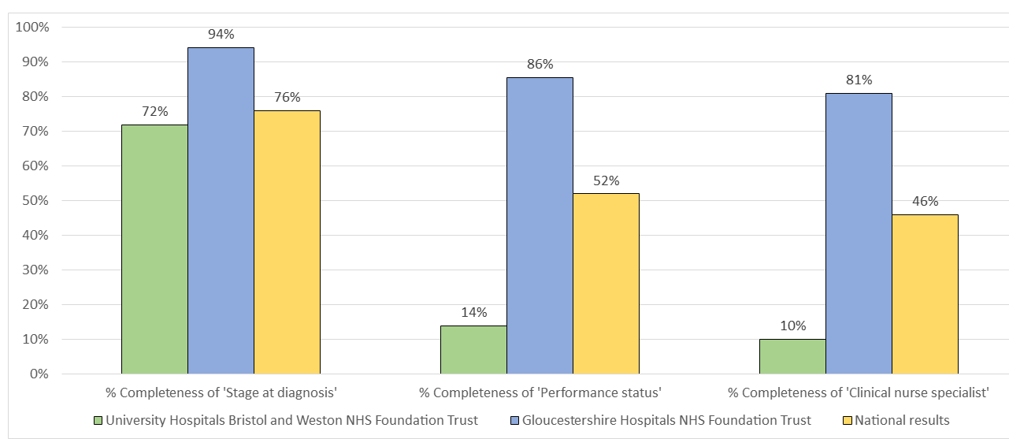
NPaCA State of the Nation Report 2024 - National Cancer Audit Collaborating Centre

Slide 4
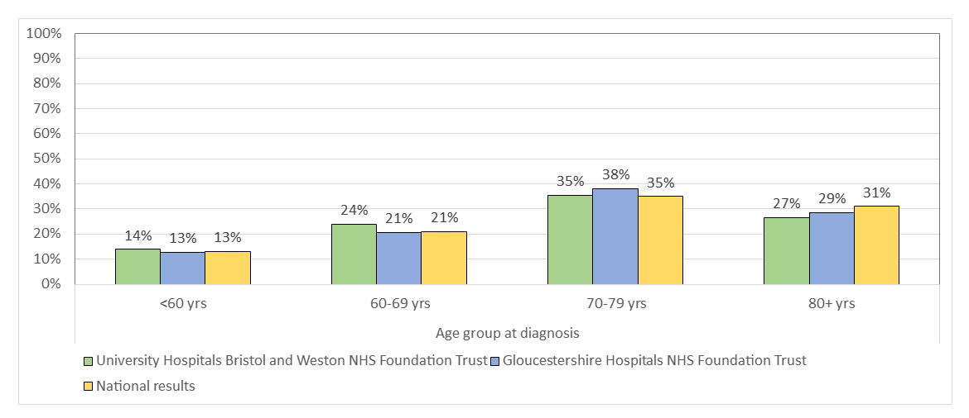
NPaCA State of the Nation Report 2024 - National Cancer Audit Collaborating Centre

Slide 5
NPaCA State of the Nation Report 2024 - National Cancer Audit Collaborating Centre
Notes:
Reminder that nearly 3 out of every 4 patients diagnosed with pancreatic cancer will die within a year- priority is obviously to get more people surviving longer, but wouldn’t want that to be at the expense of caring for the current 75%...

Slide 6
Quarterly Data Dashboards 10 April Next Clinical Reference Group mtg 13/5
A consultation opens in March, inviting input from all users of NATCAN audit results
Patients Groups and Charities
Clinical Reference Groups
Cancer Alliance
Provider-level contacts (clinical, MDT co-ordinator roles and cancer managers) in England and Wales.
User survey, focus groups and stakeholder workshop sessions
NPaCA State of the Nation Report 2024 - National Cancer Audit Collaborating Centre

Slide 7
Dashboard feedback
Do you use it? And if not, why not?
What dashboard content and features work well?
What content and features work less well?
What content would you like to see added (and why)?
How can the dashboard design be improved
to make the results easier to interpret for you(/your teams)?
Notes:
NPaCA State of the Nation Report 2024 - National Cancer Audit Collaborating Centre

