Slide 1
Remote Monitoring &
Supported Self-Management using My Medical Record (MMR)
Chelsey Gilmour – Remote Monitoring Project Manager
Haematology CAG, 26th March 2025

Slide 2
Project outline
Following cancer diagnosis (+/- treatment), patients are stratified to a follow-up pathway that suits their needs and provides rapid access to clinical support when needed.
Supported self-management – Enables the patient to take a leading role in their follow up with support from the specialist cancer team:
Consultant, Clinical Nurse Specialist and Cancer Support Worker
Remote monitoring – The My Medical Record (MMR) website provides access to test results, enabling the patient and care team to routinely monitor the patients’ follow-up and action as required.
MMR, owned and managed by University Hospital Southampton (UHS), is the only system currently offering both clinical tracking and patient access to cancer follow-up information.

Slide 3
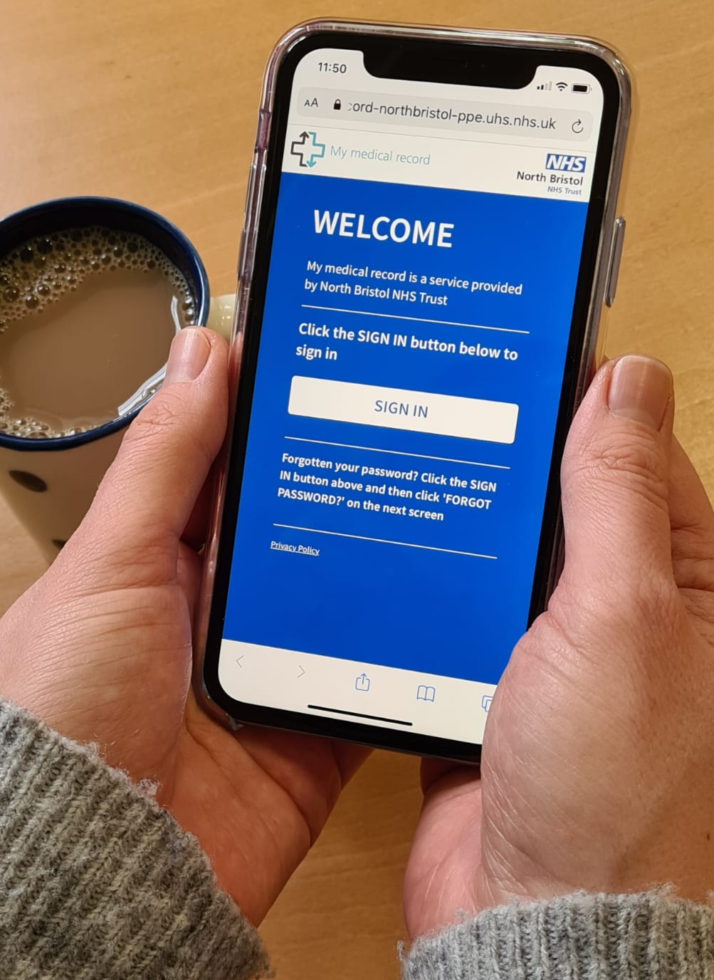
My Medical Record for patients
Supporting patients to self-management
Introduce supported self-management – timing pathway-specific
Consultant / CNS to discuss with patient
Invitation letter and demonstration video shared
Consent to access the website
Registration; login details provided
Provides:
Access to test results and clinic letters
Online symptom questionnaires
Monitoring plan
Secure messaging to and from the cancer support team
Access useful general and specific information about condition (leaflets, websites, videos, etc.)
Access 24/7 from any device

Slide 4
My Medical Record for clinicians
Cancer Support Team carry out remote monitoring
All patients are registered to a specific clinical protocol
Patients’ test results routinely tracked on MMR
Results are confirmed by letter and any actions needed
Face to face appointments arranged as required
Clinical team can securely message and receive messages from the patient
Benefits:
Digital approach to standardised follow up care
Clinical tracker
Accessible support and information for patients
Clinical time released/reallocated

Slide 5
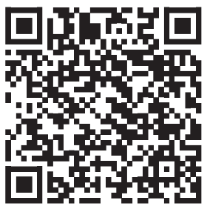
Lymphoma remote monitoring using MMR
Progress to date:
Remote monitoring protocols agreed (high grade and low grade lymphomas)
Live since February 2025
Consultant & CNS review and refer patients for MMR follow-up
CSW sends invitation letter, discusses with patient and registers
11 lymphoma patients registered for remotely monitored follow up
All registered patients access MMR and submit online symptom questionnaires
Comms – demonstration video, leaflet, quick user guide, public webpage
Next steps:
Continue inviting patients following individual reviews
Patient feedback and impact evaluation
Funding agreed to continue, CLL pathway in 2025
MMR App

Slide 6
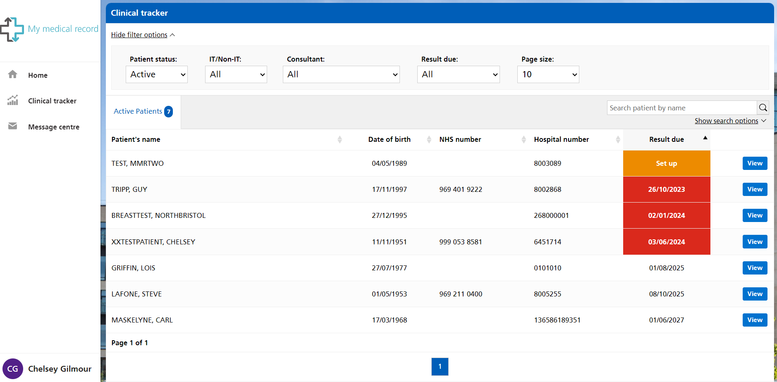
Clinical view (tracker)

Slide 7
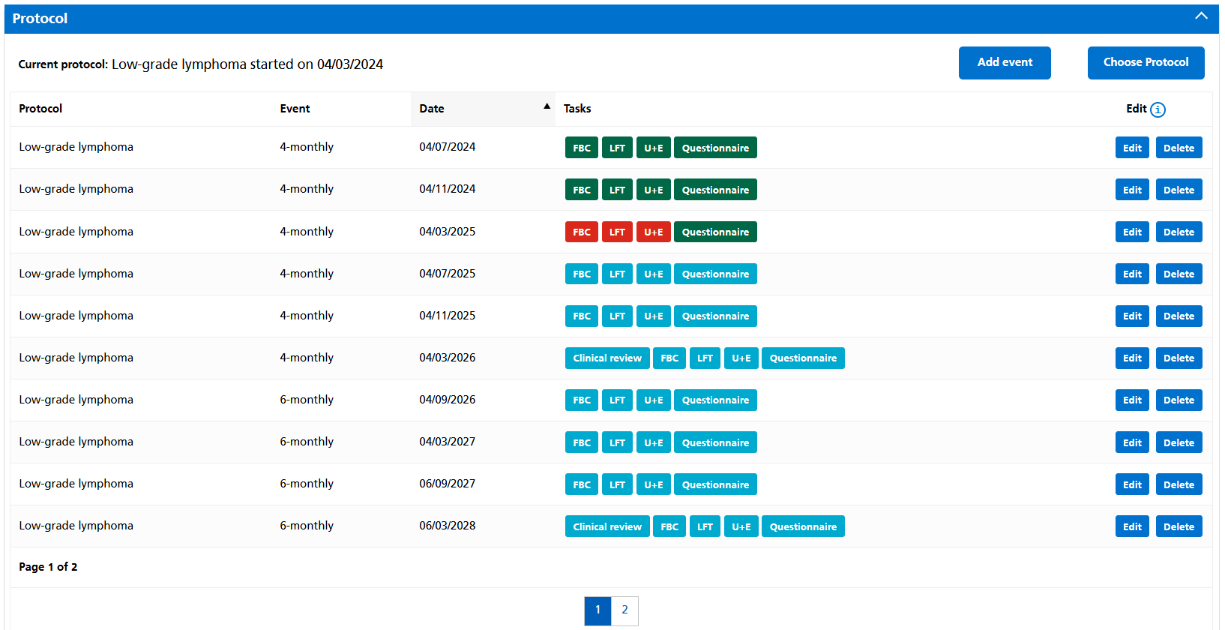
Clinical view (tracker)

Slide 8
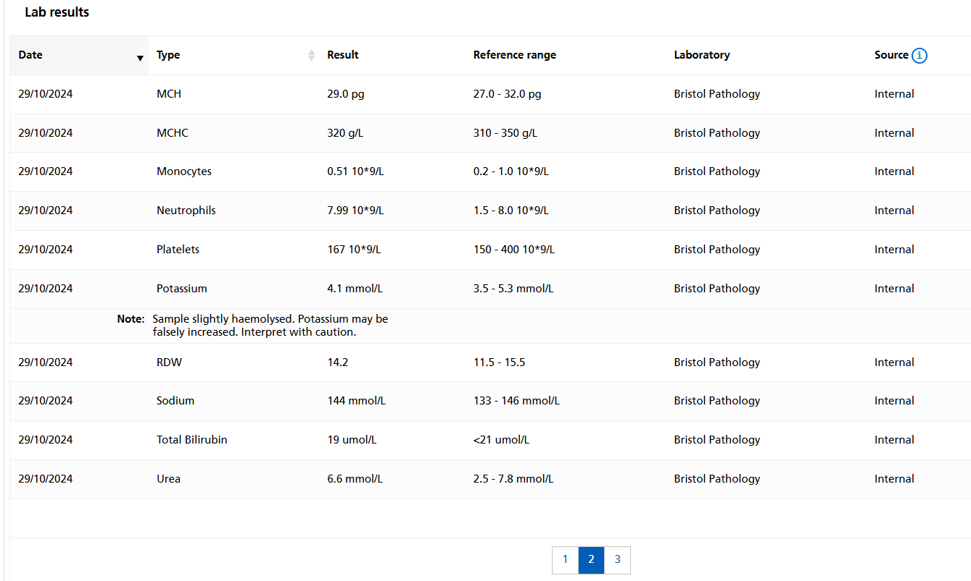
Clinical view (tracker)

Slide 9
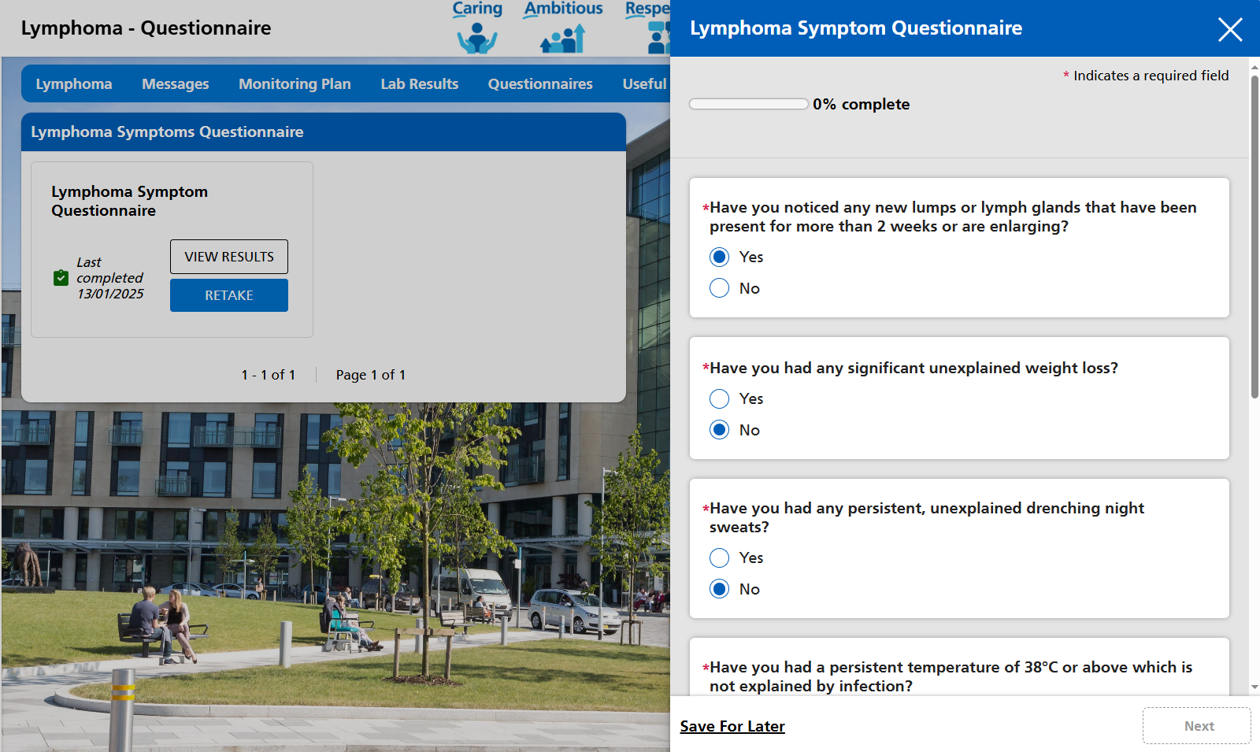
Patient view

Slide 10
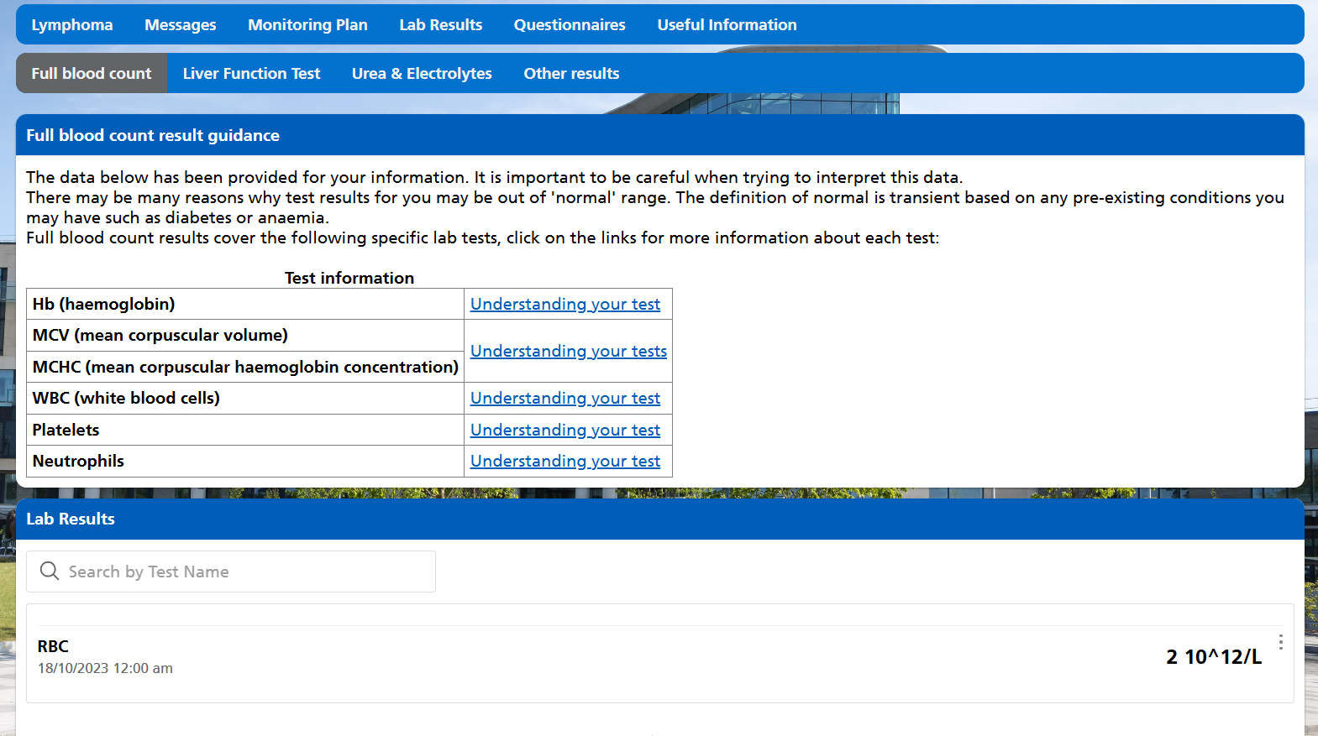
Patient view

Slide 11
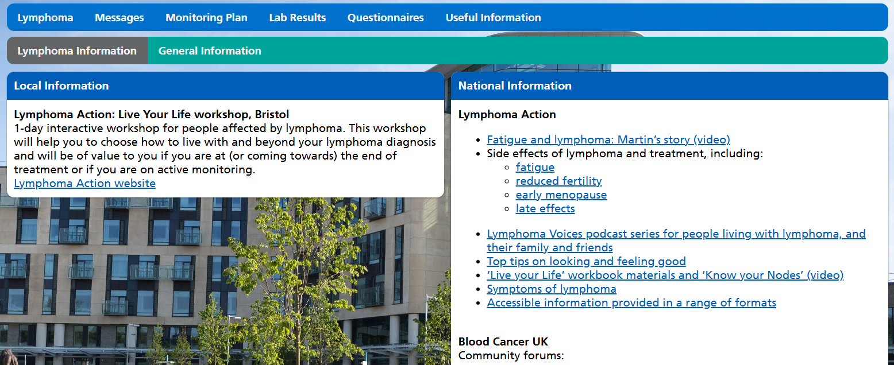
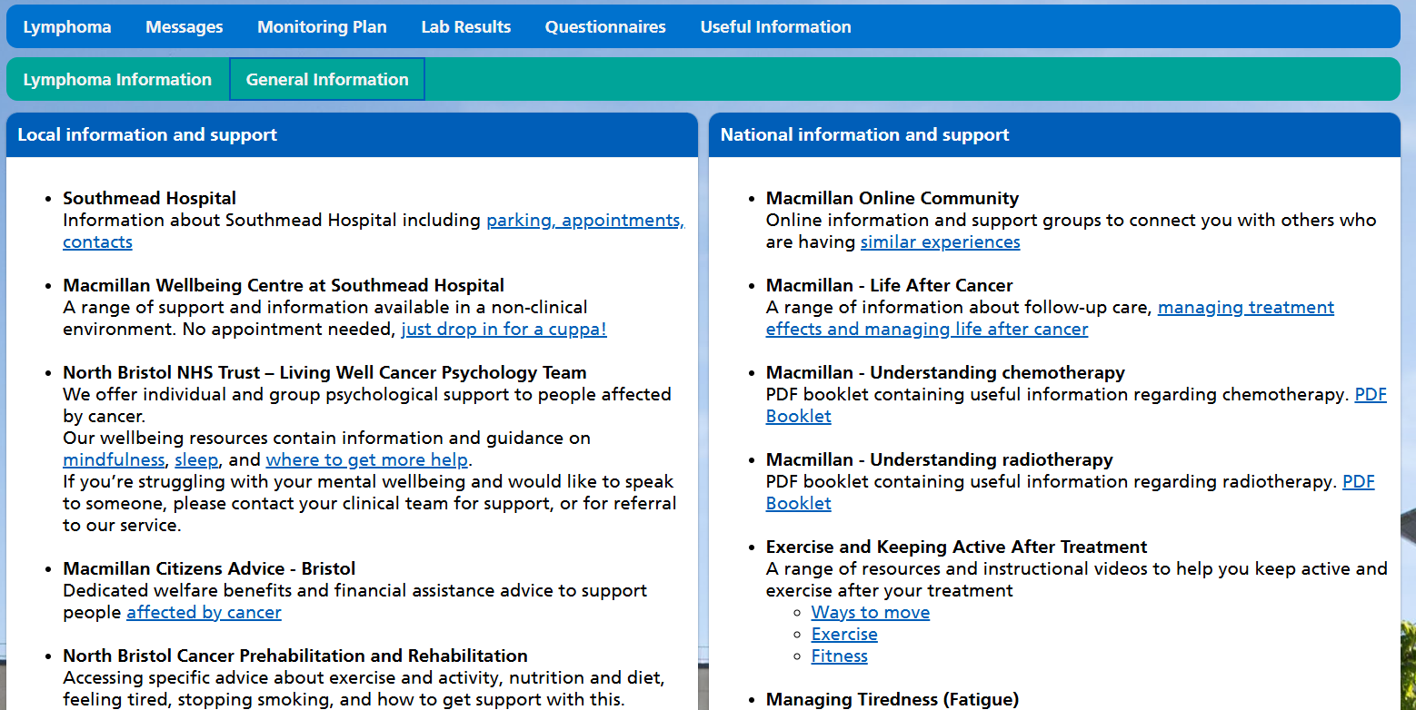
Patient view

Slide 13
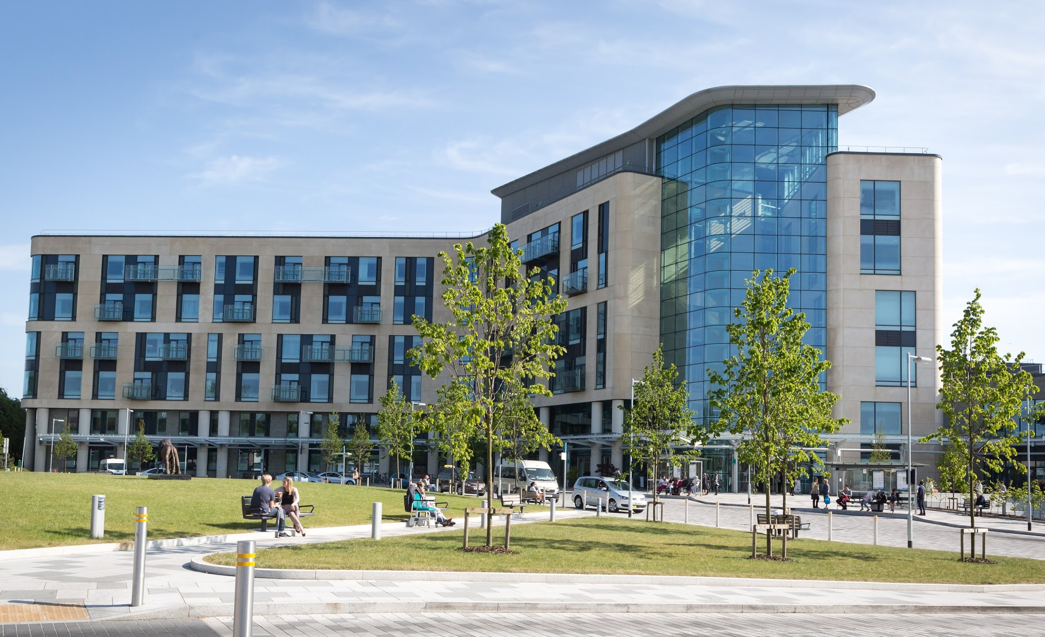
Thank you for listening
Chelsey Gilmour – Remote Monitoring Project Manager
Chelsey.Gilmour@nbt.nhs.uk

