Slide 1
uBJP & SFLC testing

Slide 2
uBJP & SFLC risk stratification in the community
Monoclonal FLC can be demonstrated in the urine by IFE & quantitated as urinary BJP. However, this is less sensitive than measuring serum kappa and lambda FLC levels and calculating the FLC ratio as FLC are reabsorbed by the renal tubules after filtration. Consequently, these latter tests should be performed whenever a new paraprotein is discovered or when monoclonal gammopathy in suspected in the absence of a detectable paraprotein.
Recommendations:
Upon detection of a new M-protein, IFE should be performed to confirm the type of monoclonal protein and a serum FLC assay should also be carried out to measure FLC levels and calculate the FLC ratio
Stern et al. Investigation & management of MGUS. A BSH good practice paper. BJHaem 2023;202:734-744

Slide 3
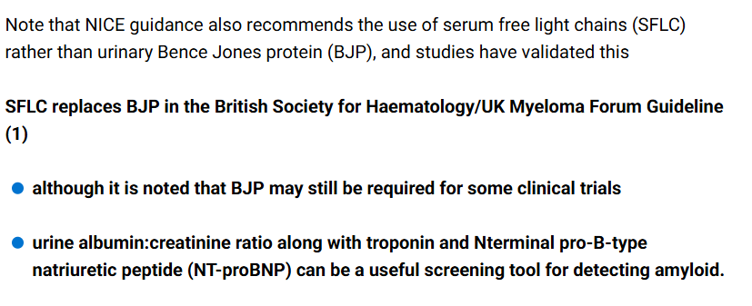
GP note book

Slide 4
Risk stratification of MGUS
Stern et al. Investigation & management of MGUS. A BSH good practice paper. BJHaem 2023;202:734-744

Slide 5
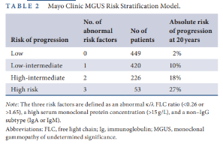
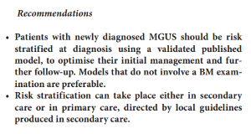
Risk stratification of MGUS
Stern et al. Investigation & management of MGUS. A BSH good practice paper. BJHaem 2023;202:734-744

Slide 6
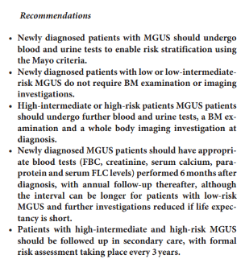
Risk stratification of MGUS

Slide 7
ESR??

Slide 8
New reference ranges for SFLC

Slide 9
Thoughts?
Cost
May be unallocated funds in GP budget to support preliminary lab work
Cost saving in staff times, but this is hard to quantify
Increase costs of reagents etc
SWAG guidelines for GPs to Ix
SWAG guidelines for GPs to FU/discharge from FU

Slide 10
Referring to secondary care
Consensus re 2WW only for symptomatic MM
Other PPs can be referred by urgent/routine pathway

