Slide 1
SWAG Network Haematological Cancer Clinical Advisory Group
Research Update
Sally Moore
26/03/2025

Slide 2
National Haem Cancer Research Recruitment
Apr 24 - Mar 25
Apr 23 - Mar 24
Data cut: 10/03/2025
Source: ODP All Portfolio

Slide 3
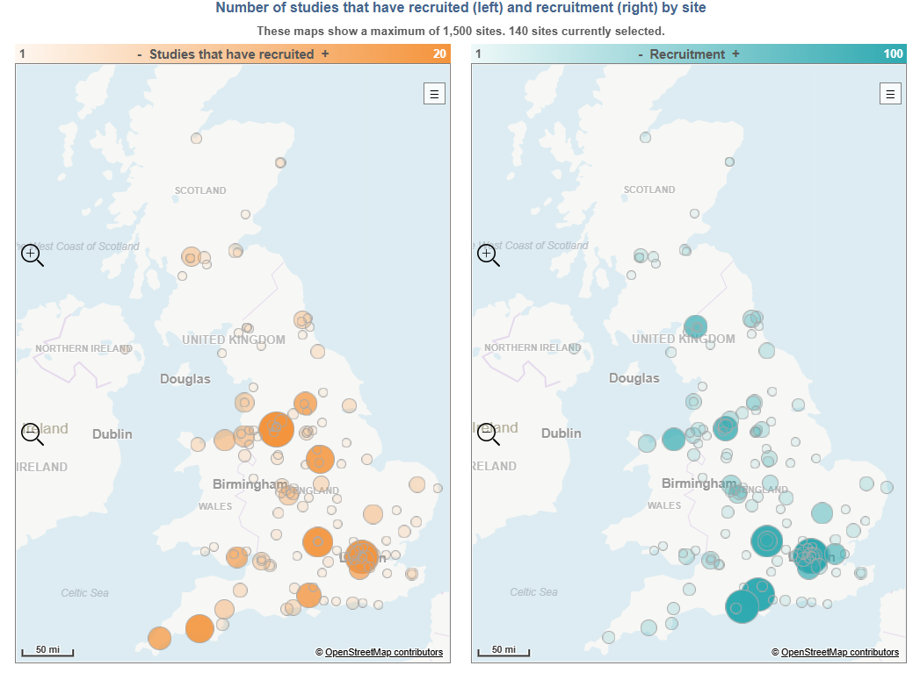
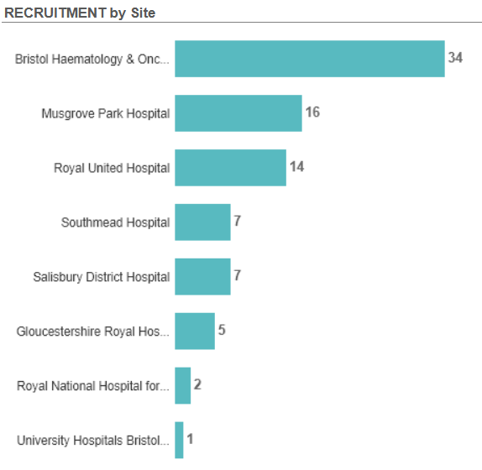
Research Activity by Site 2024/2025

Slide 4
Open studies in SWAG Region
Royal United Hospitals Bath NHS FT | 16
MITHRIDATE Trial Version 2.0 10-June-2019 | 1
RADAR (UK-MRA Myeloma XV) | 10
RAINBOW | 2
Rare and Undiagnosed Diseases Study (RUDY) | 2
REMoDL-A | 1
Somerset NHS Foundation Trust | 16
Biology and genetics of smouldering myeloma | 4
Biomarker Driven Antifungal Stewardship: The BioDriveAFS Trial. V1.0 | 5
CA057-008 - 480Kd vs Kd | 2
CPI-0209 in Patients with Advanced Tumors | 1
RADAR (UK-MRA Myeloma XV) | 3
REALITY | 1
Gloucestershire Hospitals NHS FT | 5
A Phase 3 Study in Myelofibrosis of Navtemadlin vs Placebo as Add-on Therapy to Ruxolitinib | 1
MITHRIDATE Trial Version 2.0 10-June-2019 | 1
RADAR (UK-MRA Myeloma XV) | 3
Page 1 of 2
Data cut: 20/03/2025
Source: ODP All Portfolio

Slide 5
North Bristol NHS Trust | 7
MITHRIDATE Trial Version 2.0 10-June-2019 | 2
STATIC | 5
University Hospitals Bristol And Weston NHS FT | 34
ALLTogether1 | 3
DETERMINE | 5
MajesTEC-7 | 1
PROPEL | 1
RADAR | 1
RADAR (UK-MRA Myeloma XV) | 5
SEQoL: scaled collection of QoL data among HCT recipients | 16
VICTOR | 2
LCH-IV | 1
Salisbury NHS Foundation Trust | 7
P22-905 | 2
PROPEL | 1
STATIC | 4
Page 2 of 2
Data cut: 20/03/2025
Source: ODP All Portfolio

Slide 6
Studies In set-up/under consideration in SWAG Region
CPMS ID | Short Name | Title | Planned Opening | Planned Closure | Sample Size UK | Sponsor
66203 | BGB-11417-108 | A Phase 1/2 Open-label Study to Investigate the Safety of Sonrotoclax Ramp-up Schedule(s) in Adult Patients With Hematological Malignancies. | 31/08/2025 | 31/08/2026 | 11 | Beigene USA, Inc.
65995 | Phase 1/2 Study of Enzomenib (DSP-5336) in Adults with Acute Leukemia | A Phase 1/2, Open-Label, Dose-Escalation, Dose-Expansion Study of DSP 5336 in Adult Patients with Acute Leukemia and Other Selected Hematologic Malignancies, with and without Mixed Lineage Leukemia (MLL) rearrangement or Nucleophosmin 1 (NPM1) Mutation | 30/04/2025 | 30/09/2026 | 14 | Sumitomo Pharma Oncology, Inc
64943 | A Phase 1 Study of the CTPS1 Inhibitor STP938 in Adults with High Risk Essential Thrombocythaemia | An Open-Label, Phase 1b study to evaluate safety, tolerability and preliminary activity of the CTPS1 inhibitor STP938 in adult subjects with high risk essential thrombocythaemia who are resistant to or intolerant of hydroxycarbamide therapy | 17/03/2025 | 17/03/2026 | 20 | Step Pharma
64056 | BRUIN-CLL-211 | A Phase 2, Open-Label, Randomized Study Evaluating the Efficacy and Safety of 3 Doses of Pirtobrutinib in Participants with Relapsed or Refractory Chronic Lymphocytic Leukemia/Small Lymphocytic Lymphoma Who Previously Received Treatment with a Covalent Bruton Tyrosine Kinase Inhibitor | 02/12/2024 | 06/02/2026 | 18 | Eli Lilly And Company Limited
63896 | DREAMM-10 - 214828 - GlaxoSmithKline - Multiple Myeloma (0018/1509) | A Phase 3, randomized, open-label study of belantamab mafodotin administered in combination with lenalidomide and dexamethasone (BRd) versus daratumumab, lenalidomide, and dexamethasone (DRd) in participants with newly diagnosed multiple myeloma who are ineligible for autologous stem cell transplantation (TI-NDMM)-DREAMM-10 | 16/06/2025 | 29/05/2026 | 15 | GSK Research & Development Limited
Data cut: 20/03/2025
Source: ODP All Portfolio

Slide 7
Studies In set-up/under consideration in SWAG Region (cont)
CPMS ID | Short Name | Title | Planned Opening | Planned Closure | Sample Size UK | Sponsor
63826 | INCA 34176-357 | A Phase 3, Randomized, Double-Blind, Placebo-Controlled Study of Axatilimab and Corticosteroids as Initial Treatment for Chronic Graft-Versus-Host Disease | 24/02/2025 | 26/09/2025 | 18 | Incyte Biosciences Int. Sarl
63553 | R7945-ONC-22110 | A First-in-Human (FIH) Phase 1/2 Study to Assess Safety, Tolerability, and Preliminary Anti-Tumor Activity of REGN7945, an anti-CD38 x anti-CD28 Costimulatory Bispecific Monoclonal Antibody, in Combination with Linvoseltamab, an anti-BCMA x anti-CD3 Bispecific Monoclonal Antibody, in Participants with Relapsed/Refractory Multiple Myeloma | 03/03/2025 | 31/08/2028 | 39 | Regeneron Pharmaceutical Inc
58177 | MODIFY | Isatuximab and Iberdomide as immunotherapy for high risk smouldering myeloma | 31/03/2025 | 30/09/2027 | 63 | University College London
56024 | Bomedemstat vs Hydroxyurea for Essential Thrombocythemia | A Phase 3, Randomized, Double-blind, Active-Comparator-Controlled Clinical Study to Evaluate the Efficacy and Safety of Bomedemstat (MK-3543) versus Hydroxyurea in Cytoreductive Therapy Naïve Essential Thrombocythemia Participants | 31/05/2025 | 15/04/2026 | 24 | Merck Sharp & Dohme Corp.

Slide 8
Be Part of Research is a UK-wide service that helps people find and take part in health and care research across nearly every health condition.
A resource for:
patients or their families keen to get involved in research
Researchers looking for target population for research
https://bepartofresearch.nihr.ac.uk/

Slide 9
Associate Principal Investigator
Scheme
Six month in-work training opportunity, providing practical experience for healthcare professionals starting their research career.
People who would not normally have the opportunity to take part in clinical research in their day to day role have the chance to experience what it means to work on and deliver a NIHR portfolio trial under the mentorship of an enthusiastic Local PI.
CIs working with a CTU can register their study on the scheme
https://www.nihr.ac.uk/health-and-care-professionals/career-development/associate-principal-investigator-scheme.htm

Slide 10
Principal Investigator Pipeline Programme
(PIPP)
Overview
Research delivery nurses or midwives
12 to 18 months
Free if you’re eligible
Live virtual lessons, online learning and hands-on experience
Cohort 4 applications open at the end of March 2025
Please email nursingandmidwifery@nihr.ac.uk for more information
https://www.nihr.ac.uk/career-development/clinical-research-courses-and-support/principal-investigator-pipeline-programme

Slide 11
NIHR ODP https://odp.nihr.ac.uk/
Open data platform. Data on performance across whole RDN, including all specialty areas
NIHR Be Part of Research https://bepartofresearch.nihr.ac.uk/
See which studies are open across the country
Find a Clinical Research Study (ODP) http://csg.ncri.org.uk/portfolio/portfolio-maps/
Search for a study to fit criteria. Good for horizon scanning, eligibility criteria

Slide 12
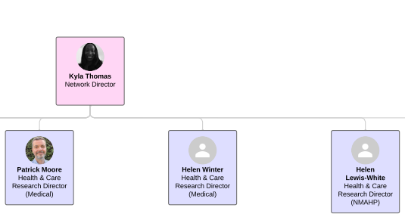
Specialty & Settings Support SWC RRDN
Cancer Specialty Lead: Mark Beresford (RUH)
Haematology Specialty Lead: Sally Moore (UHBW)
Palliative Care Specialty Lead: Vacant
Imaging Specialty Lead: Hedvig Karteszi (UHBW)
Hospital Settings Lead: Edward Carlton (UoB)
National Cancer Specialty Leads: Jonathan Wadsley, Amarnath Challappalli, Lizzie Smyth

Slide 13
RRDN Contacts
swc.rrdn@nihr.ac.uk
Study Support Service Manager: claire.matthews@nihr.ac.uk
CAG Research Lead: sally.moore@uhbw.nhs.uk

