Slide 1
Breast pain pathway / service
Case For Change
14.03.2025
Connecting and Empowering the Delivery of Cancer Care Across SWAG Communities

Slide 2
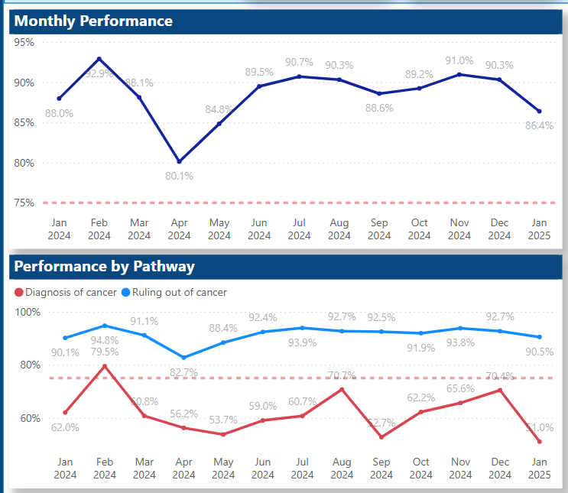
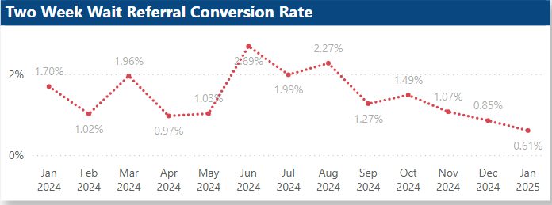
Current state analysis
Breast FDS
There has been an increasing trend in breast urgent suspected cancer (USC) referrals for several years, with 2023/24 activity increasing by almost 50,000 compared to 2022/23 activity. This represents a 10 percentage points increase in yearly activity.
SWAG for same period 9.6% increase (2,500 more patients than 22/23) – has remained fairly stable since
SWAG benchmark as one of the most vulnerable breast service provisions in April 2024 34.1% of patients seen within 14 days improved to 56% in January but services remain under pressure and propped up by WLIs triple assessment
An alternative high quality, safe and effective pathway for women with breast pain only, outside of the One Stop Clinics, would allow greater capacity for rapid review of women with red-flag symptoms (breast cancer incidence 5-6%) within the OSC.
Association of Breast Surgery: Position Statement on Breast Pain Updated February 2024
Breast FDS
Breast symptomatic
Connecting and Empowering the Delivery of Cancer Care Across SWAG Communities

Slide 3
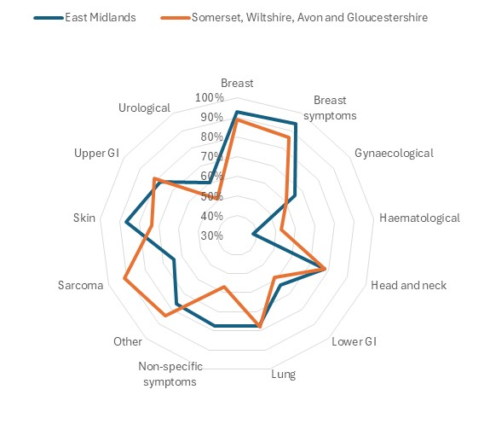
FDS Profile
Using the Model Hospital methodology identified peer Cancer Alliances – matched with East Midlands and significant opportunity identified in aspiring to match their breast performance – key transformations – early adopters of breast pain pathways
East Midlands has significantly higher FDS standard than SWAG in the following cancer types:
Skin
Breast
Breast Symptoms
Gynaecological
Lower GI
Non-Specific Symptoms
Urological
There could be an opportunity to improve in these areas.
Data source: CWT

Slide 4
Drivers for change
National Cancer Programme Planning Pack 2025.26
Currently up to 20% of USC referrals are identified as breast pain only symptoms. Evidence from local and national evaluations suggest that this imaging does not need to be provided for the vast majority, with only 5% of breast pain only referrals requiring imaging, and 0.4% of breast pain only referrals being diagnosed with cancer (half the national screening rate). Establishing the breast pain pathway will enable more diagnostic capacity to be used for appropriate higher risk patients, especially in one-stop clinics.
Audit been undertaken GHFT, RUHB and NBT, planned SFT c7% demand release potential
British Society of Breast Radiology statement in February 2023 confirms that “patients presenting with breast pain (general or focal) ONLY should not be offered imaging”.
Major staff shortages within the breast imaging profession, with 12% of mammographic workforce posts vacant and staffing has not increased in line with demand
During the COVID-19 pandemic NHS England stated that “Based on NG12, in the absence of associated red flag symptoms, i.e. lump or skin changes, breast pain alone is not a symptom of cancer and should not be automatically referred on an urgent cancer pathway.”
Connecting and Empowering the Delivery of Cancer Care Across SWAG Communities

Slide 5
Drivers for change
ASPIRE (Breast Pain Pathway Rapid Evaluation) Information about the ABS ASPIRE (Breast Pain Pathway Rapid Evaluation) Project – Interim report Summer 2025 but remains open
Capacity pressure on breast unit diagnostic services is recognised and to address this several units have developed specific pathways for the management of patients with isolated breast pain or mastalgia with different pathways at various stages of development, implementation and evaluation.
Consistent with a commitment to “no innovation without evaluation” ABS, with iBRA NET, are running a multicentre platform study to evaluate these pathways and to deliver them as a collaboration between the iBRA-NET and the ABS Academic and Research Committee & Clinical Practice & Standards Committee.
The primary outcome will be pathway safety measured by the number of breast cancers diagnosed in the 12 months following assessment. Patient satisfaction and costs of different approaches will also be assessed.
The incidence of breast cancer in women with breast pain only symptoms (no lumps, nipple or skin symptoms) is 0.4%, as reported both in the largest consecutive series of women attending a symptomatic breast clinic, and in the most recent literature review, but reports in the literature vary. This figure is approximately half the detection rate in asymptomatic women screened by the national breast screening programme (9.2 per 1,000 women screened in 2021-22)).
Association of Breast Surgery: Position Statement on Breast Pain Updated February 2024
Connecting and Empowering the Delivery of Cancer Care Across SWAG Communities

Slide 6
Future State Vision
SDF 25/26 Funding provision
For dedicated new staffing roles to support implementation of breast pain service and/or clinical triage process (i.e. pump priming), or clinic space in community / primary care for delivery of breast pain service.
Communication and education activity to increase breast pain awareness in primary care and patients
For project support to implement and monitor clinical triage process, or other breast sustainable improvements identified in provider action plans.
Evaluation of local services
inclusion in ABS ASPIRE trial remaining open iBRA-NET collective
Include patient satisfaction, safety, and cost-effectiveness
NCP success metrics
Increase in numbers of providers live by Q2 and transitioned to BAU by Q4 for breast pain services
Improvement in breast suspected cancer FDS performance
Improvement in FDS performance for patients diagnosed with cancer on suspected breast cancer pathways, for the top quartile of providers
% point increase in patients who have had a FDS clock stop within 7 and 14 days recorded with cancer ruled out
Connecting and Empowering the Delivery of Cancer Care Across SWAG Communities

Slide 7
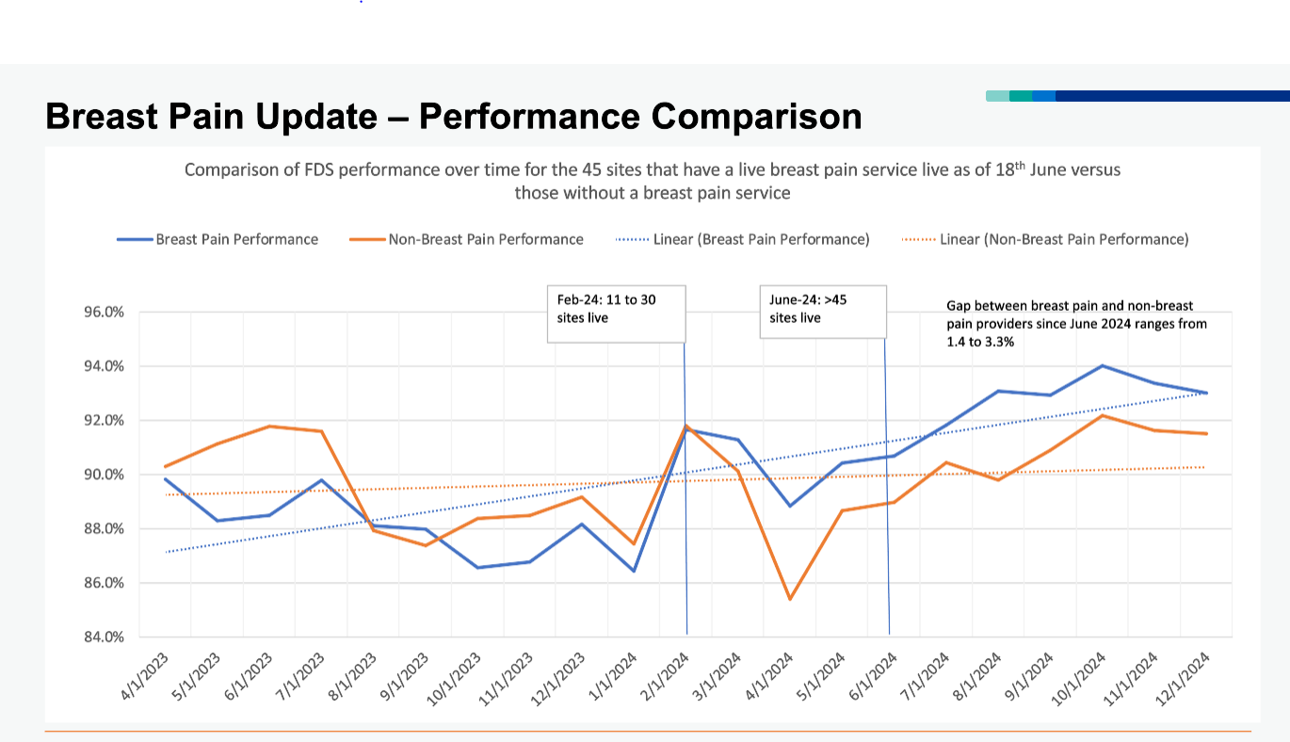
Benefits of Change
Triple assessment capacity release:
BNSSG Audit found 10% of patients referred with Breast pain only (and that is with the straight to mammogram pathway pilot) for over 40s
GHFT: 97 patients identified through referral triage between 06.05.2024 – 27.08.2024 c4% reduction in triple assessment demand
YDH Audit 2022 found 20% of triple assessment attendees were for breast pain only
Across SWAG at 7% (modest modelling) this year would have saved c2000 triple assessment clinic imaging
Patient experience:
YDH 100% felt reassured or very reassured and would
recommend
East Midlands CAs; approximately 98.5% of Patients would
recommend the service to friends and family
Impact on Performance of services where introduced:
Mid Notts BPC freed up 13 appointments for USC patients
per week at Sherwood Forest Hospitals https://sthk.merseywestlancs.nhs.uk/media/.resources/63f7699bbb6795.45060995.pdf
Connecting and Empowering the Delivery of Cancer Care Across SWAG Communities

Slide 8
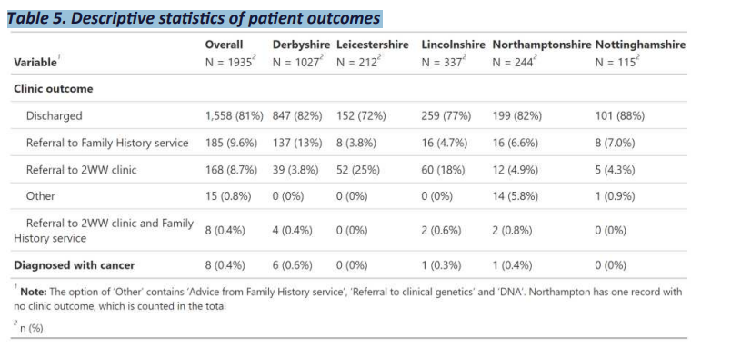
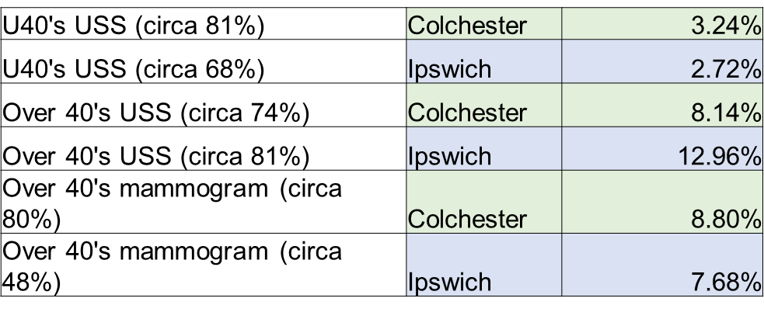
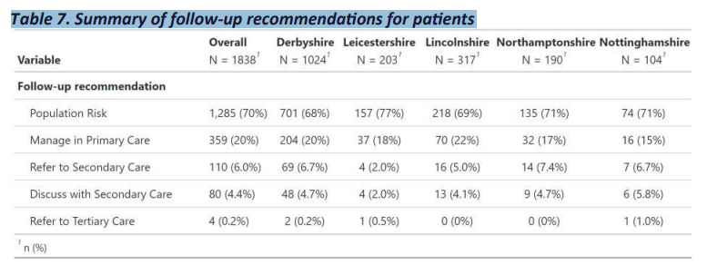
Benefits of Change
ESNEFT Modelling ESNFET breast pain pathway evaluation - Cancer Alliances Workspace - FutureNHS Collaboration Platform
Estimated imaging savings, based on % of those patients that would have gone onto imaging in a 2WW clinic
East Midlands
East Midlands
Redirection of 1987 patients to cBPC in the 1st year of the pilot from triple assessment:
All sites were cost effective in the 1st year CBR £1.23
with improved utilisation CBR could rise to 1.87, meaning that for every £1 spent, the health system receives £1.87 back in benefits, this is reflective of the higher number of appointments through the clinics and therefore benefits generated, at the same cost level.
file:///C:/Users/nb26307/Downloads/Final%20EM%20Breast%20Pain%20Clinic%20Evaluation%20120923.pdf
https://bmjopenquality.bmj.com/content/13/4/e002882
Connecting and Empowering the Delivery of Cancer Care Across SWAG Communities
Notes:
ESNEFT: Reduction in 2WW has not been evidenced due to extraordinary circumstances :
At time of implementing pain clinic, we were receiving 33% increase in number of referrals and this has continued
Have also received increase in referrals from neighbouring CCG , due to their local hospital 2WW pressures – breast pain model needs to be adopted by a whole system approach
Utilisation is key to releasing the benefits. Leicestershire were unable to realise
Not fully quantified or evaluated EM is only evaluated important to do broader local model evaluation for broader evidence

Slide 9
Risks of not changing
Mid Nottinghamshire PC BPC Transforming the 2-week wait (2WW) pathway: management of breast pain in primary care
There have been numerous unsuccessful attempts at transferring the management of patients with breast pain back from Secondary Care into Primary Care, including attempts by Secondary Care specialists at educating local Primary Care practitioners. The likely reasons why this has not been widely successful include:
1. GPs may have been reluctant to state and reassure patients that breast pain only is not a sign of breast cancer.
2. It is important for the clinician who examines the patient to be experienced in clinical examination of the breast. The vast majority of GPs simply do not see enough cancers and do not have the necessary breadth of clinical experience of examining the normal breast across the spectrum of ages.
3. It has also been reported that GPs have limited confidence in assessing familial risk and in ‘counselling on risk’.
Prior attempts in Mid-Notts at managing patients within the community using existing structures had a limited impact on reducing 2WW referrals. Therefore, centralising the management of these patients within a specialist setting was deemed crucial to provide effective patient care.
Continued requirement to stand up additional activity
Many providers set up additional clinics but despite this breast FDS performance has declined c2% over the past 6 months – running to stay still!
Funding sub optimally targeted
In January 2025 patients diagnosed within 28 days was 40% lower than patients with cancer ruled out withing 28 days
Poorer experience for both breast pain patients, suspected and those ultimately diagnosed with cancer
Increased workforce pressures and impact on wellbeing
Connecting and Empowering the Delivery of Cancer Care Across SWAG Communities

Slide 10
Proposed solution: ABS ASPIRE
Dedicated breast pain pathway: face to face appointment with a clinician
Telephone: telephone assessment and mammogram for >40s
Self-managed: Given information and self-managed for a period of time
GP Managed: Breast pain patients managed entirely by GPs
Imaging Only: Participants sent letter to have mammogram, not examined
Control (2WW/ OSC)
Connecting and Empowering the Delivery of Cancer Care Across SWAG Communities

Slide 11
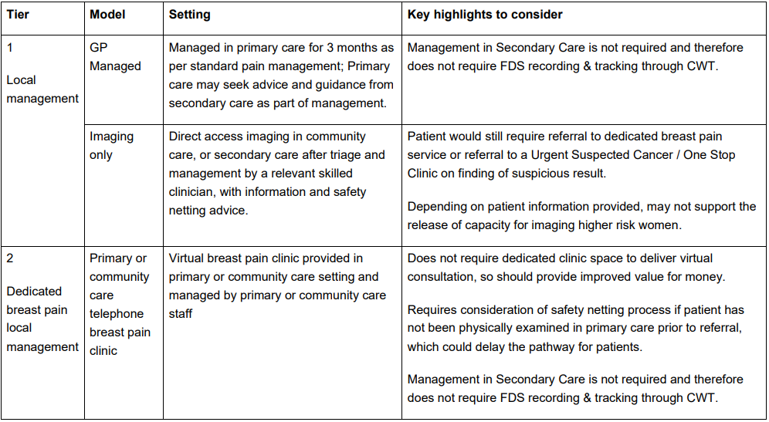
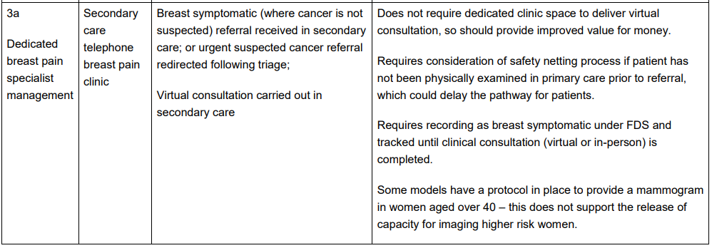
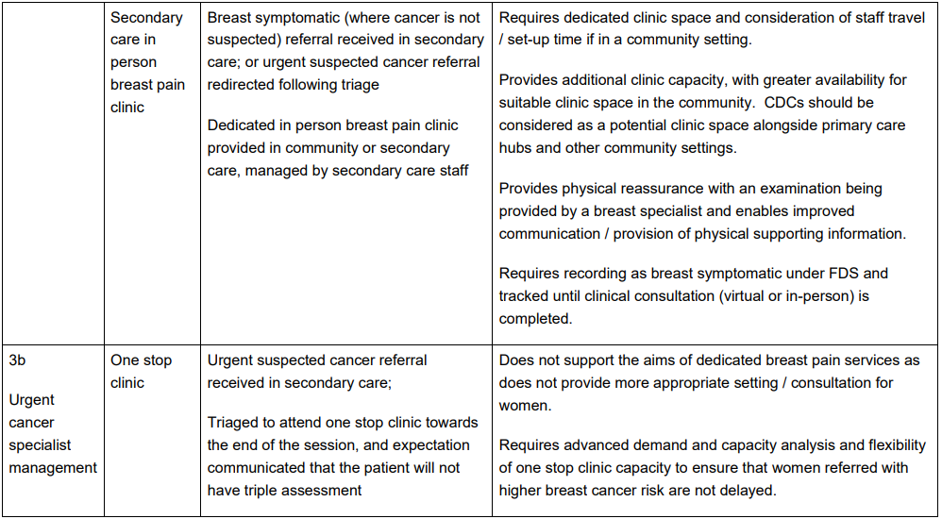
Proposed solution
Connecting and Empowering the Delivery of Cancer Care Across SWAG Communities

Slide 12
Implementation Considerations
There will be local variation in how service models are designed and operated because:
• There are limited fully implemented and evaluated models on which to design a
national best practice model;
• There is an opportunity to develop new and innovative approaches to build the
evidence base for the most effective service models; and
• Local systems have differing existing delivery models and infrastructure for breast
services.
Opportunities for missed screening pathway associated with HI work
Connecting and Empowering the Delivery of Cancer Care Across SWAG Communities

