Slide 1
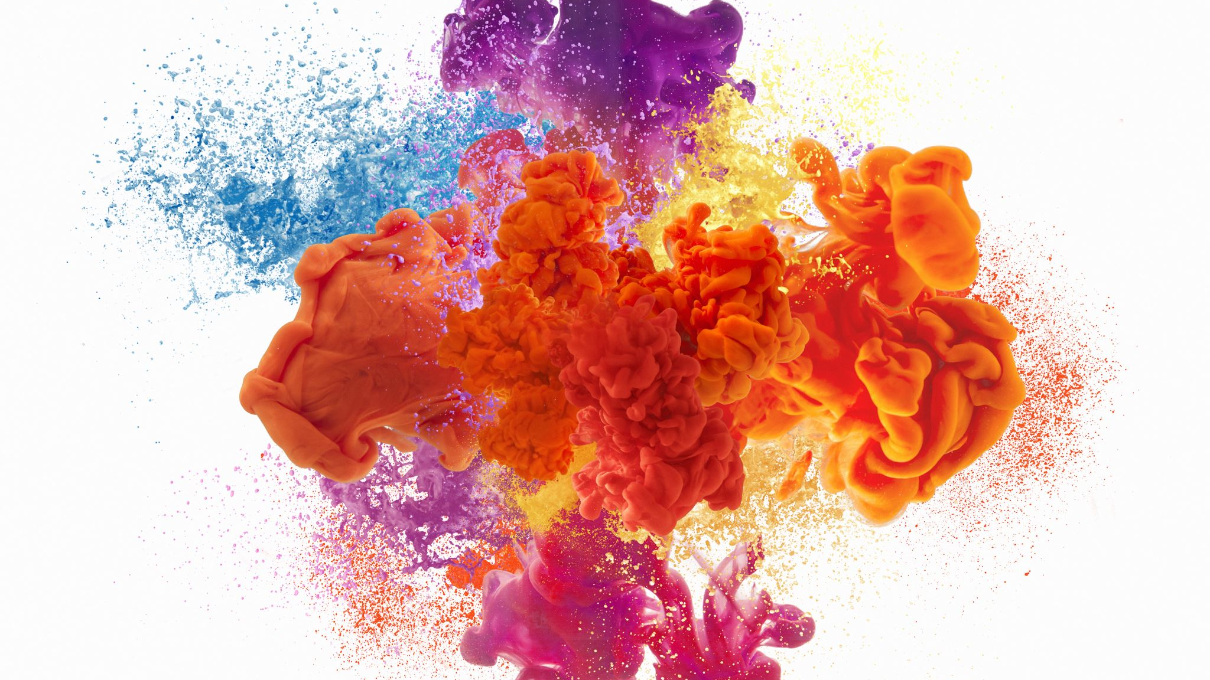
Association between bacteriobilia and post-operative complications following Whipple pancreaticoduodenectomy- A multi-centre UK cohort study
Luke Taylor
James Skipworth
Dept of HPB Surgery, UHBW

Slide 2
What Do We Know
It is well reported that ERCP with disruption of the ampullary complex introduces bacteria into the biliary system in up to 90% of patients.
Emerging evidence suggests that such alterations to the biliary microbiome contribute to post-op complications, including SSI and POPF.
Bacteria cultured from the biliary system following ERCP are often multi-species and multi-resistant.

Slide 3
What Have We Done?
Consecutive Whipple's data collected from three tertiary centres (Bristol, Leeds, Guildford) over a 5-year period.
Data regarding demographics, peri-operative antibiotics, bacterial growth and sensitivity/resistance (from intra-operative bile samples), post-op complications.
Comparison of patient groups:
Sterile bile culture
Bile cultures sensitive to peri-operative antibiotics
Bile cultures not sensitive to peri-operative antibiotics

Slide 4
Demographics
Demographic | Subgroup | Number
Sex
 | Male | 209(55%)
 | Female | 174(45%)
Age, years (IQR) |  | 68 (59-73)
Body Mass Index (IQR) |  | 25 (21.88-28.0)
ASA Grade
 | 1 | 22(57.4%)
 | 2 | 242(63.2%)
 | 3 | 95(24.8%)
 | 4 | 1(0.0%)

Slide 5
Biliary Intervention and Risk of POPF
Pre-operative Biliary Intervention
 | Yes | 180(47%)
 | No | 203(53%)
Post-operative Pancreatic Fistula Risk Score
 | Low (1-2 points) | 133(34.7%)
 | Medium (3-6 points) | 173(45.2%)
 | High (7-10 points) | 77(20.1%)
Positive Bile Culture
 | Yes | 136(35.5%)
 | No | 247(64.5%)

Slide 6
Peri-operative antibiotic usage
Antibiotic | Number
Co-Amoxiclav | 131
Amoxicillin/Metronidazole/Gentamicin | 53
Cefuroxime/Metronidazole | 128
Co-amoxiclav/Gentamicin | 3
Teicoplanin/Metronidazole/Gentamicin | 23
Not recorded | 45

Slide 7
Bacterial Growth
Bacteria | No. pts
Monomicrobial | 42(42%)
Polymicrobial | 94(69%)
Gram Negative
E.coli | 44(32.4%)
Klebsiella | 37(27.2%)
Enterobacter | 19(14%)
Coliform | 22(16.2%)
Citrobacter freundii | 10(7.3%)
Gram Positive
Enterococcus | 69(50.1%)
Streptococcus | 14(10.3%)

Slide 8
Antibiotic Sensitivities
Antibiotic | Number of bile samples containing sensitive bacteria
Ciprofloxacin | 44
Gentamicin | 43
Co_Trimoxazole | 35
Amoxicillin | 22
Co_Amoxiclav | 22
Piperacillin-Tazobactam | 21
Cefuroxime | 10
Meropenem | 8

Slide 9
Post-operative Complications
Complication | Sterile Bile n=244 | Sensitive bile n=36 | Non-Sensitive Bile n=100 | p Value
Length of stay Days, median (IQR) | 11(8-19) | 15(11-22) | 20(13-28) | < 0.0001
Clavien-Dindo Score (%) |  |  |  | 0.0379
0 | 98 (40%) | 15 (42%) | 25 (25%)
1 | 46 (19%) | 3 (8%) | 17 (17%)
2 | 59 (24%) | 7 (19%) | 25 (25%)
3 | 31 (13%) | 8 (22%) | 23 (23%)
4 | 7 (3%) | 3 (8%) | 7 (7%)
5 | 3 (1%) | 0 (0%) | 3 (3%)
Surgical Site Infection (%)
Superficial | 25 (10%) | 8 (24%) | 34 (34%) | < 0.0001
Intra-abdominal | 33 (14%) | 4 (12%) | 21 (21%) | 0.1157
Roberts Fistula Risk Score (IQR) | 4(2-6) | 4(2-7.25) | 4(2-6) | 0.7967
Post-Operative Pancreatic Fistula (POPF) (%) |  |  |  | < 0.0007 (Fischer’s exact combined analysis)
No Fistula | 204 (83%) | 27 (80%) | 63 (63%)
Biochemical | 23 (9%) | 5 (15%) | 12 (12%)
Grade B | 14 (6%) | 2 (6%) | 14 (2%)
Grade C | 5 (2%) | 2(6%) | 11 (11%)

Slide 10
Controls Fistula risk vs POPF Fistula risk vs Sterility
Box plot demonstrating correlation between Fistula risk score and risk of clinically relevant pancreatic leak (POPF).
Box plot demonstrating similar fistula risk score in patient cohorts with bile that was sterile; bile containing bacteria sensitive to peri-operative antibiotics; and bile containing bacteria non-sensitive to peri-operative antibiotics.

Slide 11
Untreated Bile is a risk factor for POPF
 | No POPF | Biochemical | Grade B | Grade C | P value
Sterile | 204(%) | 23(%) | 14(%) | 5(%)
Bacteriobilia sensitive to peri-op Abx | 27(%) | 5(%) | 2(%) | 2(%) | 0.33
Bacteriobilia not sensitive to peri-op Abx | 63(%) | 12(%) | 14(%) | 11(%) | < 0.0001
All Bacteriobilia | 90(%) | 17(%) | 16(%) | 13(%) | 0.0015

Slide 12
Length of Stay
Patients with bacteriobilia experienced longer hospital stays than those with sterile bile (median of 11 days sterile vs. 18 days bacteriobilia; p < 0.0001).
Patients with bacteriobilia not sensitive to antibiotics experienced the longest in-patient stay (median of 15 days vs 20 days; p < 0.0001)

Slide 13
Conclusions
Pre-op biliary instrumentation is a known risk for bacteriobilia
Use of incorrect antibiotics is associated with increased risk of Clavien-Dindo complications, SSI, CR-POPF and LoS.
The tailoring of peri-operative antibiotics to local biliary microbiomes may be a further crucial strategy for the reduction of rates of SSI and POPF following PD.
These results would suggest that broad-spectrum, extended courses of antibiotics are likely to be associated with improved SSI and POPF rates following PD. Individualised genomic approaches could be considered in future via the sampling of bile at biliary intervention

