Slide 1
Radiological, surgical and histopathological correlation in Pancreaticoduodenectomy with venous resection
21st March 2025
HPB CAG
Daniel Liu
Max Levy
James Skipworth
Dept of HPB Surgery, Bristol Royal Infirmary

Slide 2
Introduction
Venous involvement
Function of tumour location vs. Indicator of aggressive tumour biology
Median survival similar
Venous invasion into the media or intima may be associated with poor prognosis
R1 is important determinant of survival
However, R1 dependent on histopathology
R1 rates highly variable in studies (10-85%)
Determination of pre-op venous involvement
Pre-op planning crucial to facilitate R0 resections in those with more advanced disease

Slide 3
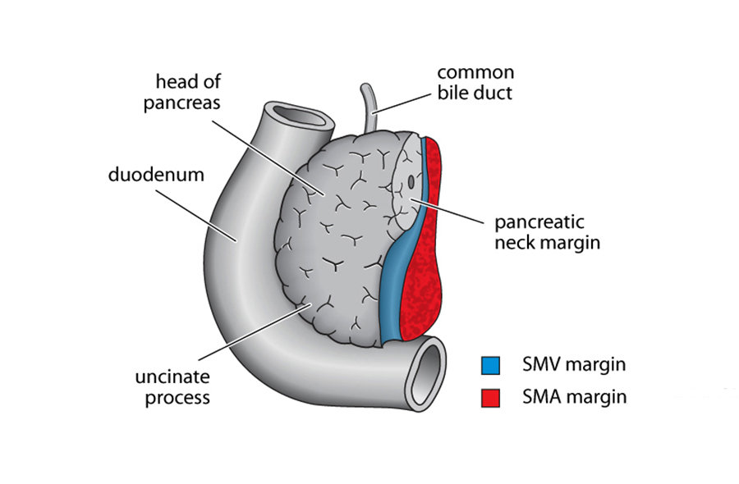
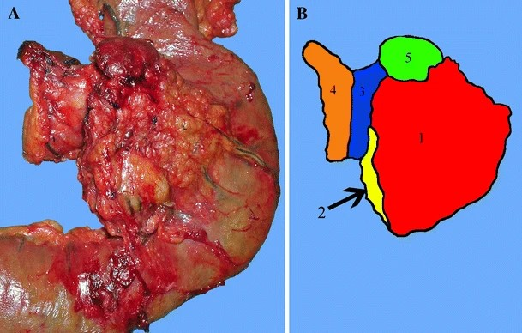
Anterior Figure showing histological margins
in a Whipple’s specimen (red SMA; blue PV/SMV)
Posterior Figure showing histological margins
in a Whipple’s specimen (orange SMA; blue PV/SMV)

Slide 4
Methods
Records identified
(n=259)
Review of pts undergoing Whipple pancreaticoduodenectomy with venous resection
Correlation between radiology (immediate pre-op scan), surgery and histopathology
Data from prospective surgical databases
1st January 2020 to 31st December 2023 (4 years inclusive)
Screened for TP or PD
Excluded
(n=130)
Underwent Vein resection
Excluded
(n=109)
Patients included
(n=20)

Slide 5
Radiology
Of the 20 pts:
6 patients had scans which showed no radiological venous involvement (but venous resection at surgery as considered involved)
7 patients underwent Neoadjuvant chemotherapy (FOLFIRINOX)
Median time interval scan to surgery– 40 days

Slide 6
Radiology
PACT-UK template (n=20)

Slide 7
Radiology
Terms to define vascular involvement (n=20)

Slide 8
Surgery
All 20 pts- Vein felt subjectively to be involved at time of surgery
Vascular resection en bloc with specimen

Slide 9
Histology
Venous involvement on Histology (n=20)

Slide 10
Histology/Radiology Correlation
 | Histology – Venous Involvement
Radiology Reporting |  | Involvement | No involvement
 | Contact or more | 4 | 10
 | No contact | 1 | 5
Sensitivity = 80%
Specificity = 33%
 | Histology – Venous Involvement
Radiology Reporting |  | Involvement | No involvement
 | Deformity or more | 2 | 3
 | No deformity | 4 | 11
Sensitivity = 50% ↓
Specificity = 79% ↑

Slide 11
Conclusions
Radiological reporting and interpretation can be complex
PACT-UK template assists with standardisation of reporting
Histology reporting- No consistent reporting of venous resection
There appears to be no clear correlation between radiological report of contact and/or deformity and histological reporting of venous involvement
Potential suggestions moving forwards:
Radiology- More consistent use of PACT-UK template
Surgery- Clarify vein resection by including on requests and marking the vein with sutures- particularly in complex resections
Histology- Consistently report presence and involvement of veins

Slide 12
Limitations
Small numbers
No data from inoperable pts i.e. may have been reported as venous involvement but found to be locally advanced/inoperable
Retrospective use of prospectively-collected data

Slide 13
References
Porembka, Matthew R., et al. "Radiologic and intraoperative detection of need for mesenteric vein resection in patients with adenocarcinoma of the head of the pancreas." HPB 13.9 (2011): 633-642.
Gómez-Mateo, María Carmen, et al. "Pathology reporting of resected pancreatic/periampullary cancer specimen." Surgery for pancreatic and periampullary cancer: principles and practice (2018): 247-280.
Fukuda, Saburo, et al. "Significance of the depth of portal vein wall invasion after curative resection for pancreatic adenocarcinoma." Archives of surgery 142.2 (2007): 172-179.
RCPA protocol for pancreas resection -https://www.rcpa.edu.au/Manuals/Macroscopic-Cut-Up-Manual/Gastrointestinal/Pancreas/Pancreas-resection

