Slide 1
Pancreatic Case Finding Pilot
HPB CAG – 21st March 2025

Slide 2
Overview
Scope: testing if a targeted intervention in primary care, improves the number of referrals for people aged 60+, with new onset diabetes (NOD) and weight loss (NG12).
Protocol:
(1) regular searches of patient GP records to identify people aged 60+ with NOD
(2) GP appointment to check for weight loss
(3) Liver function test, creatinine and full blood count (and CA19-9) done in primary care
(4) eligible people referred directly for CT scan
Numbers will be small: early modelling suggests approx. 30 people aged 60+ per GP practice, per year, have NOD; and research shows between 0.8 - 1% of people with NOD have pancreatic cancer.
Funding: fixed funding will be provided for set-up, conducting data-searches and project management and variable funding will be provided to primary care per appointment and secondary care per referral.
Roll-out: we are rolling out in two phases. Phase one will launch in April and include 10 PCNs (50 GP practices) and Phase two will launch in September. Pilot sites will run for two years.
SWAG CA have been successful and will be starting the pilot in Phase one alongside East Midlands & North Central London.

Slide 3
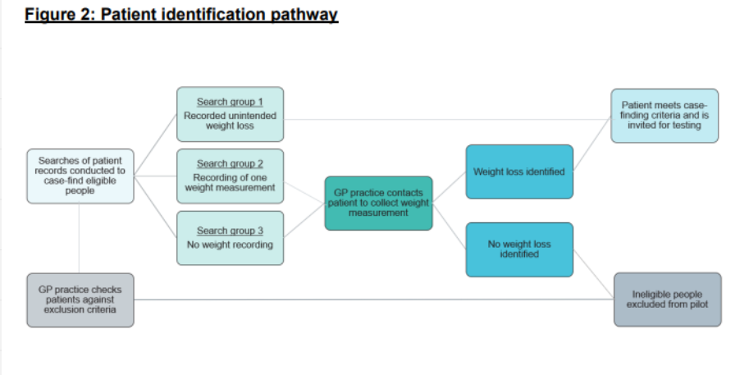

Slide 4
Local Approach
Having weekly task and finish groups to ensure all PCNs are ready for launch
We have 5 confirmed PCNs taking part Frome, Mendip, Southeast Somerset, Three Valleys Health & Devizes and a further 2 are being considered by the national team (North & South Gloucester and SWIFT)
Ardens have created a report for each PCN to use to find the patients – onboarding and training is starting now to ensure everything is in place to run the first search in June
We will be utilising our NSS pathways to conduct the CT scan for eligible patients

Slide 5
Heading
T&F groups hosted every Tuesday between 12-1
First search will be run in June 2025
Any questions, please contact leah.pearson@nbt.nhs.uk or amelia.randle@nhs.net

