Slide 1
Breast Surgery Clinical Gateway Review
Somerset Wiltshire, Avon & Gloucestershire (SWAG)
North Bristol NHS Trust
Gloucestershire Hospitals Foundation Trust
Somerset Foundation Trust
Royal United Hospitals Bath NHS Foundation Trust
Salisbury District Hospital Foundation Trust

Slide 2
Areas of excellence to share
High functioning MDTs with broad adoption of MDT streamlining and participation in National MDT streamlining pilot
Consistent reduction in breast reconstruction rates each Quarter
Clinical trials nurse representation at MDTs, excellent trials support and recruitment, commitment to associate PI scheme
Day case rates above 75% with GHFT and NBT with very high rates
SWAG 2024/5 to date 87.4% FDS, 96.3% 31-day, performing above both targets
Multidisciplinary workforce
Triple assessment at all SWAG providers for all USC referrals
Dedicated secondary breast care nurse specialist​ provision
Multi-site Pilot of Breast MDT: Functional algorithm
Mainstream genetic testing with R208 CNS network, receiving genomic education and training from SW GMSA
Dedicated Breast Units
Increasing inclusion of Breast pain pathways in ABS ASPIRE trial
Patient experience
Workforce and primary care training programmes
Provider specific:
GHFT; LICAP Flap access, community-based imaging,
SDHFT: improved LOS and enhanced links to therapy team, BRA events and secondary cancer support group
SFT: County wide vacuum biopsy service, Breast 111 service, YDH Breast pain service and modular day case facility
NBT: Local flap service, academic surgeon attached to the University of Bristol

Slide 3
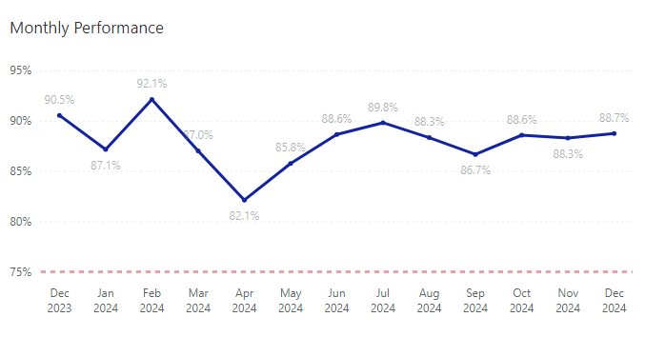
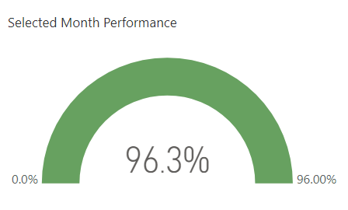
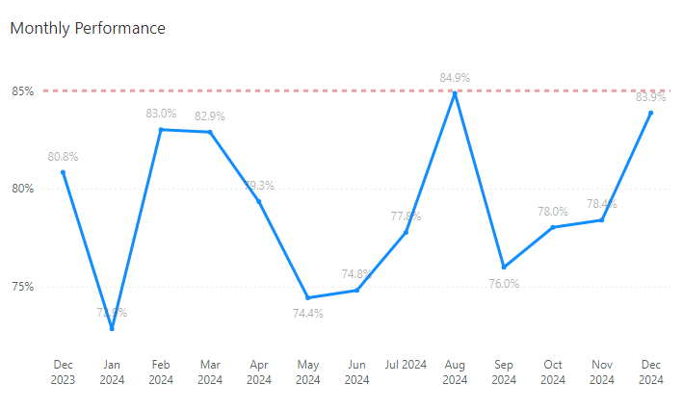
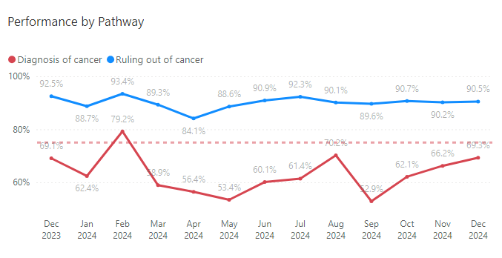
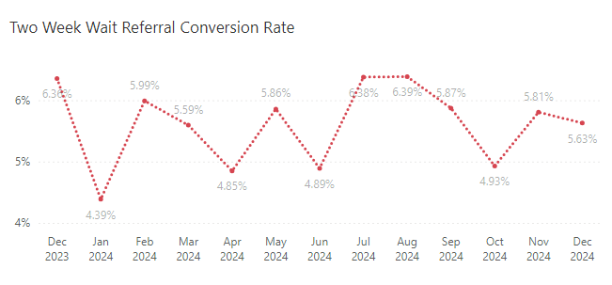
SWAG Breast FDS Performance
SWAG Breast 31d Performance April-December 2024
SWAG Breast 62d Performance

Slide 4
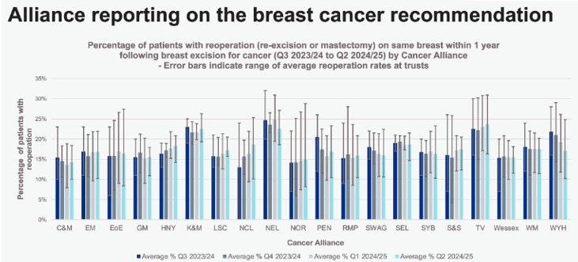
Key metrics reviewed in 2024
Notes:
? Range of reoperation rates at trusts – error bars

Slide 5
Current challenges and opportunities
Challenges
Increased rates of benign disease and referral rates combined with reduced rates of physical examination prior to referral
National Radiologist / radiographer workforce
Equipment and Estates constraints
Workforce sickness
Wait times for Reconstruction, DIEP flaps worsened
Older operating theatres without laminar flow
Pathology resource constraints
Increasingly complex patient presentations
Reliance on insourcing for sufficient activity
Oncology: Clinical capacity constraints, pre-assessment capacity and Increasing length and complexity of oncology treatments
Opportunities
Newer estates
Upgrades to PACS and USS equipment
Screening mobile unit renewal
Digital pathology maturity and reporting uptake increase opportunity
Breast pain pathways
Southmead new Bristol Elective Care Centre backfill reduce limitations on breast reconstruction in main theatres
Non-medical workforce roles
Workforce succession pipeline planning

Slide 6
Future vision for breast services across SWAG CA
Equipment and estates upgrades to
Breast pain pathways implemented, evaluated and adapted to meet ABS guidelines (tbc)
Risk stratified demand appropriate resourcing to reduce reliance on insourcing and outsourcing
Fully optimise non-medical workforce
Achieve the 62-day breast cancer wait times target
Optimise already excellent day case rates, streamlined MDTs, genomics and trials activities
Review and implement, where supported by robust impact evidence, new technologies such as Ai supported by Health Innovation Network
Improved access to breast reconstruction with Bristol Elective Centre opening in 2025
Improve equitable access to complex oncological treatments

Slide 7
Anything else you wish to highlight for GIRFT
Cancer Patient experience survey
Information / communication to and about patient was above 80% for all associated KLOEs with main point of contact and ease of contact also above 80%
Enough privacy was always given to the patient when receiving diagnostic test results 96%
Care team patient centred planning KLOE’s above 90%
Information about treatments and response to ..(Surgery, chemotherapy and Radiotherapy) >79%
Opportunity to improve information regarding hormones and immunotherapy
Opportunity to improve experience post treatment
Operational
2024 Performance and activity levels require additional to baseline BAU triple assessment and surgical activity
Opportunity to realise theatre productivity improvement if remove theatre staffing gaps
Importance of maintaining staff wellbeing to prevent burnout
Develop advanced practice roles
Reducing HER2 delays could prevent interim planning and multiple MDTs

