Slide 1
Coeliac plexus block
Robbie Adamson HPB endoscopy fellow
Bristol Royal Infirmary

Slide 2
The problem…
Survival from pancreatic cancer remains bleak
28% at 1 year, 5% at 5 years
Severe pain complicates 70-80% of cases
Contributing to anorexia and weight loss
Pain relief improves quality of life (and maybe survival?)
Opioid analgesia often associated with significant adverse effects
Cancer Research UK
Zhong et al 2013

Slide 3
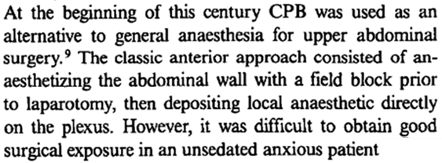
Nothing new…
(conceptually)

Slide 4
Our APPROACH

Slide 5
Anterior (Eus) Vs Posterior (perc)
Anterior
Posterior
Avoids retro-crural space
Allows doppler control
Possibility (although rare) of neurological complications such as paraesthesia or paralysis caused by spasm or thrombosis of the anterior spinal artery
Avoids the need for endoscopy
Arcidacono, 2011. Cochrane review

Slide 6
Neurolysis Vs Block
CPB
CPN
Bupivacaine and triamcinolone
Classically utilised in chronic pancreatitis
Provides analgesia for 10-12 weeks
Safe to repeat
Bupivacaine and alcohol
Longer lasting pain relief (up to 2 years) if delivered to the correct area
Increased risk of side effects
Abscess formation
Fibrosis
Initial increase in discomfort
Although rare, infarction of spleen, stomach or pancreas has been reported as well as diaphragmatic paralysis
Both associated with transient hypotension and diarrhoea which can last 1-2 weeks because of blockade of sympathetic NS at the coeliac plexus

Slide 7
timing
Typically a salvage approach after a stepwise increment in oral analgesics has failed to control pain or side-effects have become intolerable
Earlier intervention may be beneficial
Hypothesis that if performed too late neural pathway is less amenable to intervention
Earlier pain more likely to be secondary to coeliac plexus involvement rather than visceral or somatic nerves in disseminated disease
We will offer intervention at the time of tissue acquisition if the pain is typical and the diagnosis seems clear

Slide 8
The data…

Slide 9
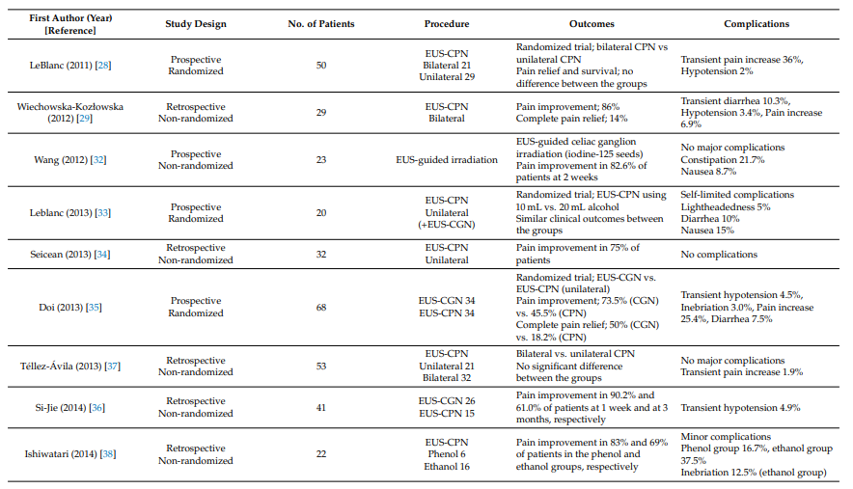
Minaga et al, 2018

Slide 10
1145 patients
67% pancreatic, 37% non-pancreatic
Bilateral posterior approach most common by far
Non-radiologically guided 32%, CT guided 28%, radiograph 34%, fluoroscopy 5%, ultrasound <1%
Inclusion of single arm trials and RCTs
Good to excellent pain relief was reported in (89%) of patients during the first 2 weeks
Partial to complete pain relief continued in approximately 90% of patients alive at 3 months post-block and in 70%-90% until death even if beyond 3 months post-block
Adverse effects transient, including local pain (96%), diarrhoea (44%), and hypotension (38%); complications occurred in 2%

Slide 11
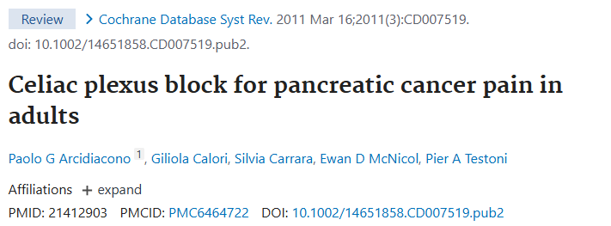
Cochrane review
6 RCTs including 358 participants with pancreatic cancer
Percutaneous, intraoperative and EUS guided therapy
All neurolysis
Mean difference in VAS score -0.43 in CPN group (95% CI ‐0.73 to ‐ 0.14 P = 0.004)
-0.44 at 8 weeks but CI -0.73 to 0.01
Significant heterogeneity at 12 weeks
More significant reduction in opioid use
-51.7mg opioids at 4 weeks (95% CI ‐82.1 to ‐19.43, P =0.002)
Sustained until death - ‐48.52mg (95% CI ‐68.82 to ‐28.22)
No major complications
Significantly lower constipation

Slide 12
7 studies, 196 individuals Vs 207 controls
All with pancreatic cancer
Percutaneous Vs intraoperative Vs EUS Vs combination – no subgroup analysis
CPN and CPB with a variety of differing preparations
Mean pain score reduced by 38% at 4 weeks in the intervention group (p=0.005)
No statistical significance at 8 and 12 weeks
⁓50% mean reduction in opiate/NSAID use which was sustained until death (p=0.005)
Similar adverse affects to other studies

Slide 13
10 RCTs, 646 individuals
7 percutaneous vs 3 EUS
CPN + medical management Vs medical management alone
Pain intensity score 0-10 at weeks 4, 8 and 12
All with pancreatic cancer
Mean pain score -0.58 in CPN group at 4 weeks (p=0.034)
-0.46 at 8 weeks (p=0.08)
-1.35 at 12 weeks (p=0.17)
Adverse effects often transient but include
Hypotension in 35% of patients – 2 required vasopressors
Drunkenness in 7%
Diarrhoea in 15% - mostly transient, one required octreotide until death

Slide 14
Our data…

Slide 15
Feb 24 – Jan 25
47 procedures in total.
Cholangiocarcinoma 1
Chronic pancreatitis 18
Gastric cancer 1
Pancreatic cancer 27
5 were repeat procedures – twice for one patient, once for 3 others
Of cancer cases, 14 still alive (/29)
Further work needed to fully understand benefit

Slide 16
quality improvement
Dedicated phoneline and email address for patients to book repeat procedures

Slide 17
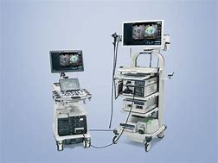
The growing demand of eus…
Procedures increasing by around 100 a year (despite significant decrease in pancreatic cyst work)
High proportion of 2WW and urgent work
Increasing demand for therapeutic interventions such as biliary drainage, hepaticojejunostomy and cyst drainage that can often negate surgical intervention
Challenging training pathway requiring fellowship or similar

Slide 18
THANK YOU
Robbie Adamson
Robbie.adamson3@uhbw.nhs.uk

