Slide 1
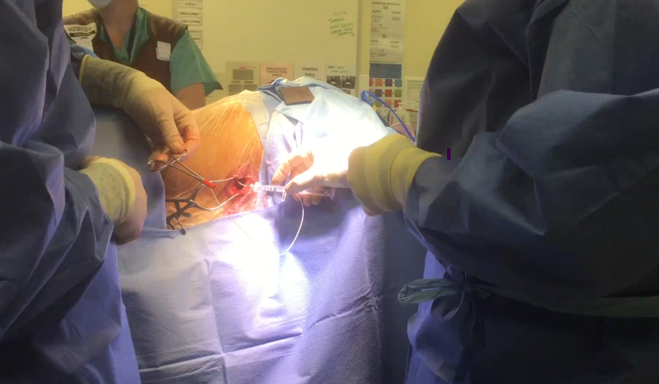
Changing Minds
Dr Somnath Bagchi
21/03/2025

Slide 2
Disclosures
Advisory Board of Medtronic
Received honorarium from ESTEVE
Attended cadaver course sponsored by Boston-Scientific
Attended Neuromodulation meeting sponsored by NEVRO

Slide 3
How Big is Cancer Pain Burden?
2015- 2.1 million people suffering from cancer
In 2018-19: 66.4% patients have advanced cancer with poor pain control = 1.3 million
458 patients received intervention – blocks or ablation
30 intrathecal pumps for cancer pain
Estimated in 2030 – 4 million people will suffer from cancer.
Duarte RV, Sale A, Desai P, Marshall T, Eldabe S. The Unmet Need for Intrathecal Drug Delivery Pumps for the Treatment of Cancer Pain in England: An Assessment of the Hospital Episode Statistics Database. Neuromodulation. 2020 Oct;23(7):1029-1033. doi: 10.1111/ner.13264. Epub 2020 Sep 18. PMID: 32946160.

Slide 4
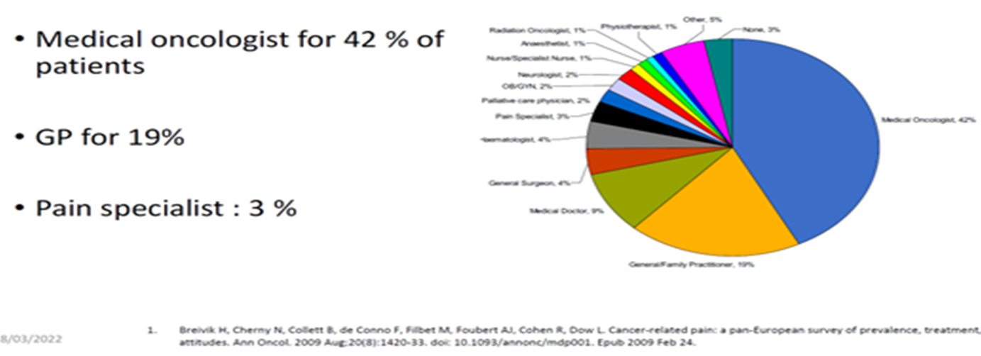
Who Manages Cancer Pain?
UK Based study in 2012 - British J of General Practice Feb 2014
37% of Out-of-Hours oncological emergencies are managed by GPs
Pain (30.8%), N&V (12.1), Agitation (6.1%), Breathlessness (6.0%)

Slide 5
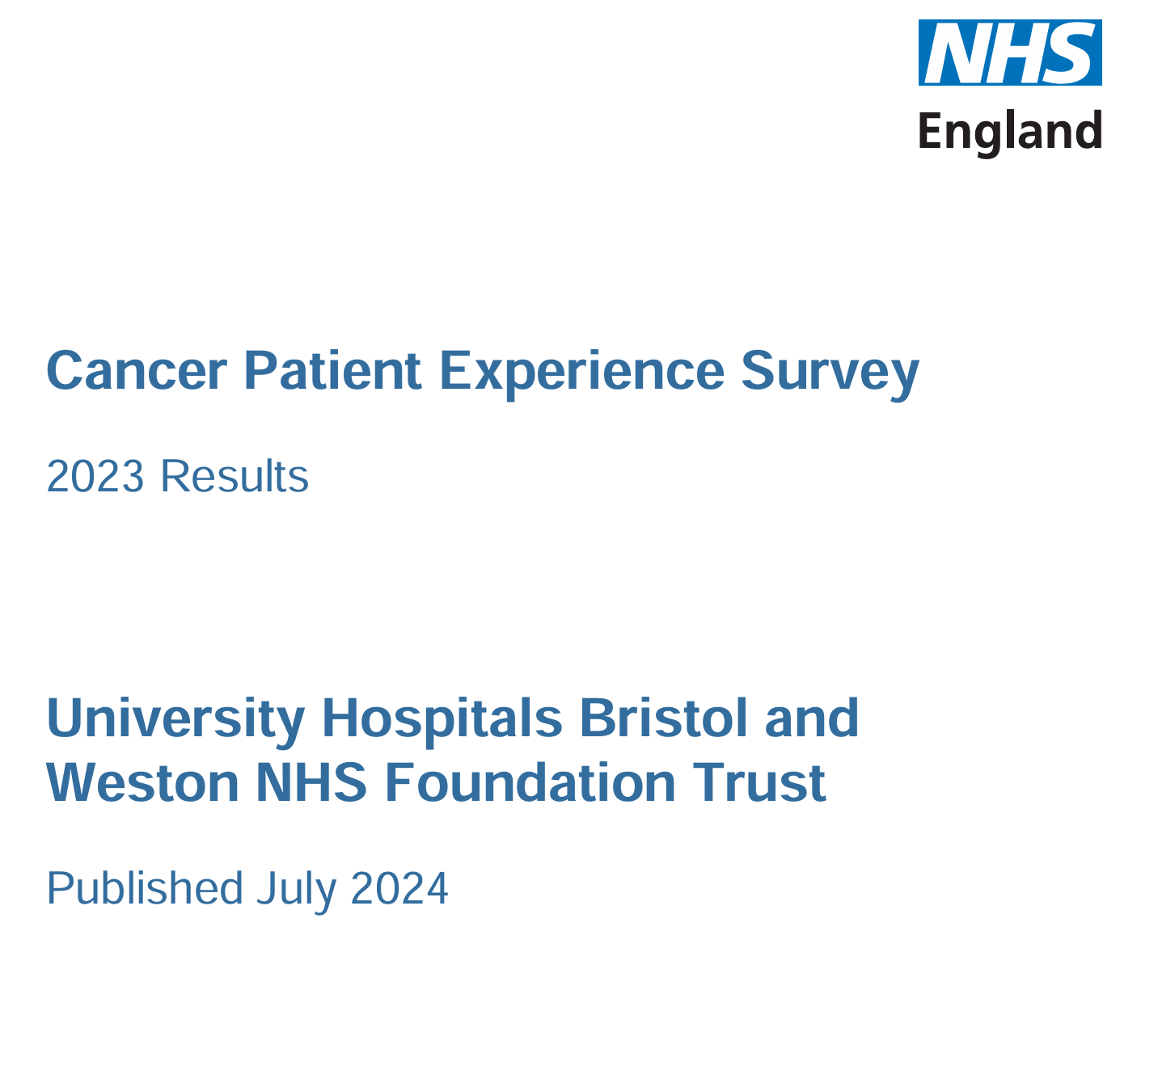
CPES-2023-Trust-University-Hospitals-Bristol-and-Weston-NHS-Foundation-Trust-RA7.pdf

Slide 6
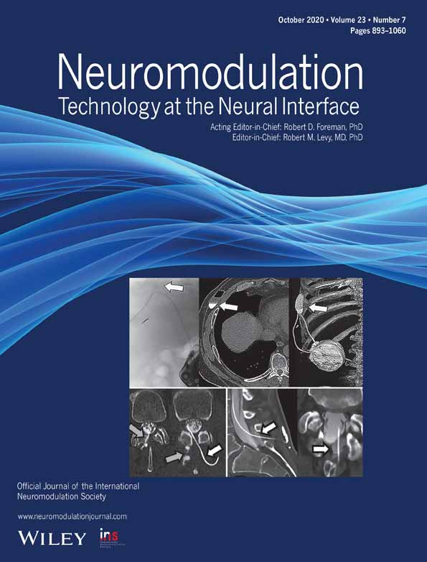
Neuromodulation 2020;
IDDS is the GOLD STANDARD for Managing Refractory Cancer PAIN

Slide 7
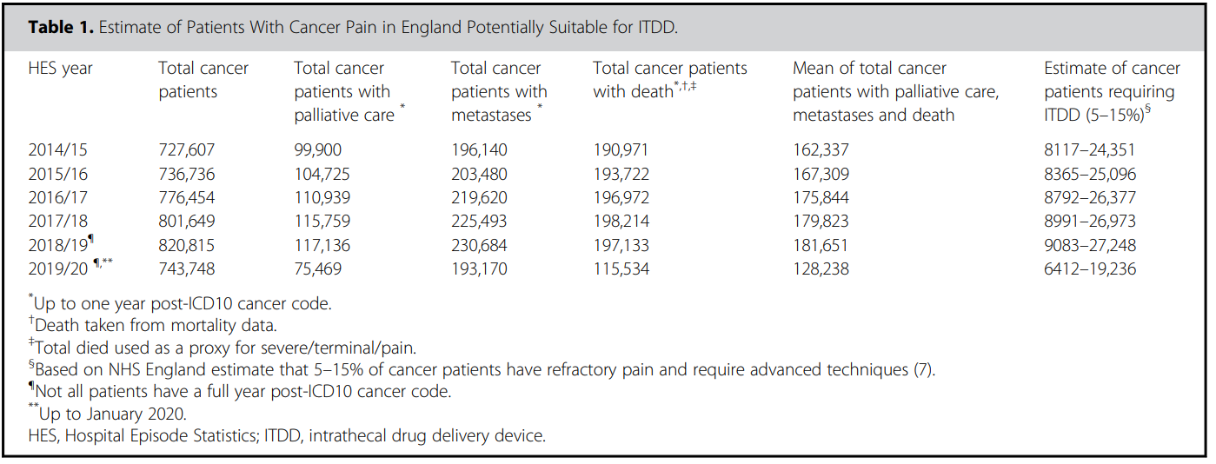
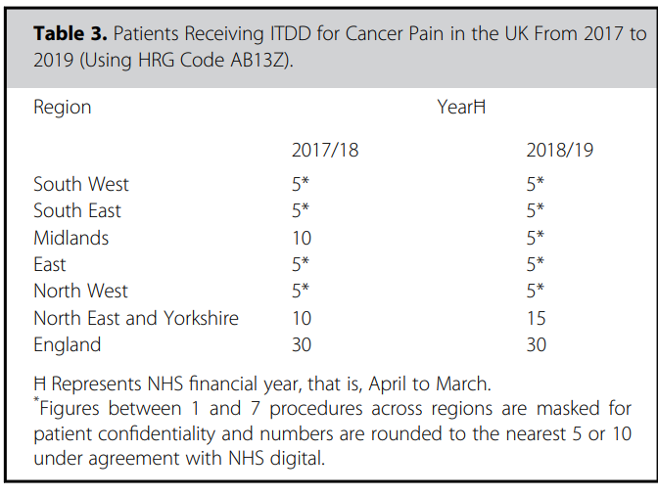
Neuromodulation 2020;

Slide 8
Role of Intervention
WHO 2019:
Start opioids in level 1
Not recommended interventions
No consideration for decreased cancer survival with opioids
No consideration for the long- term consequences
Practice review: Evidence-based and effective management of pain in patients with advanced cancer Emma J Chapman1:Palliative Medicine 2020, Vol. 34(4) 444–453 (Leeds)
Conclusion: interventions commonly recommended by guideline are not supported by evidence
Classifies IDDS amongst the treatments that must be used for cancer pain, even if the level of evidence has been deemed as moderate

Slide 9
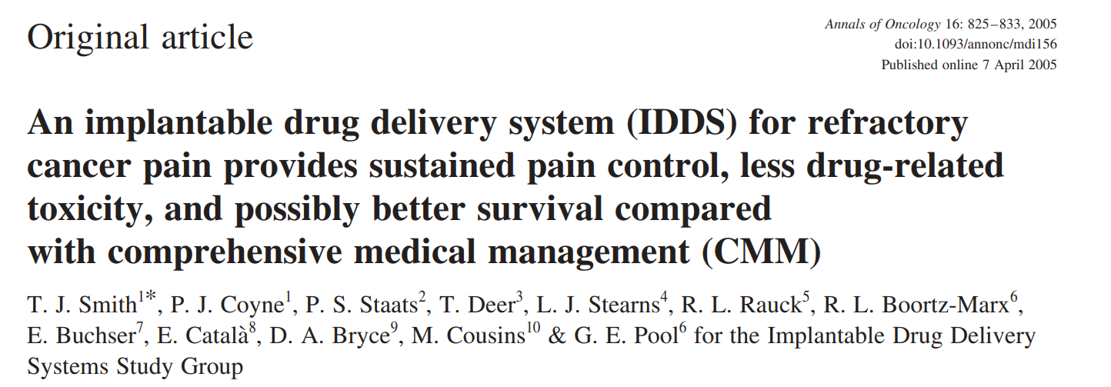
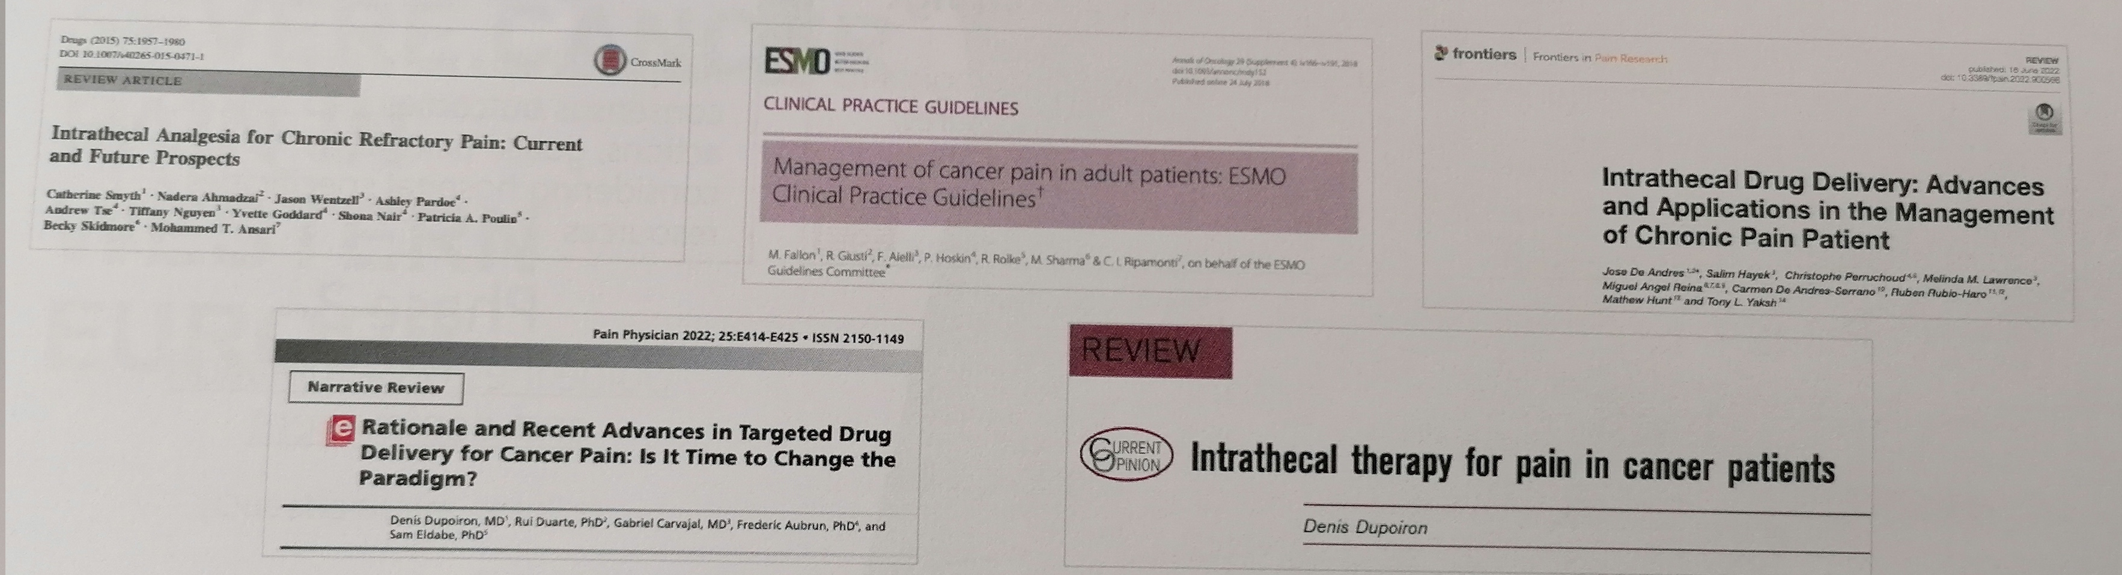
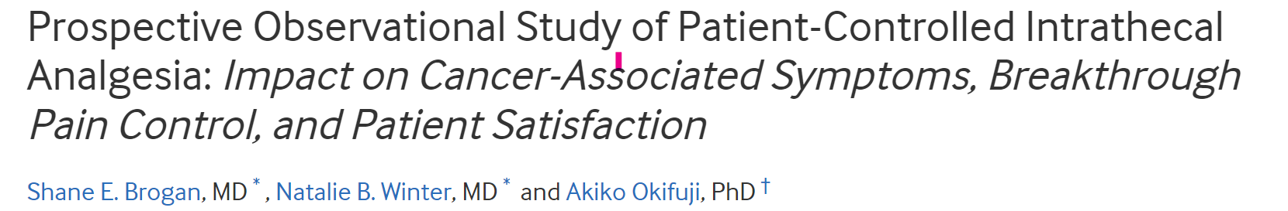
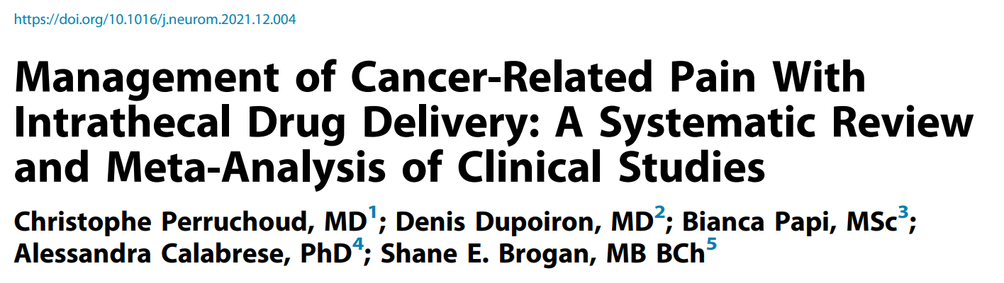
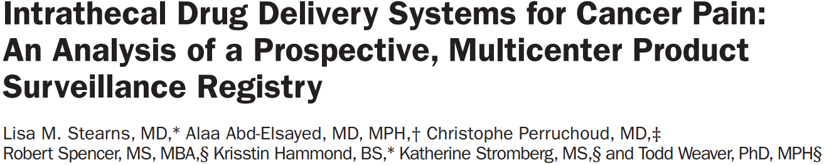
All published literature from 1990 to 2019
4-5 weeks/ 6-12 weeks />6 m
Meta-analyses show a statistically significant and sustained decrease in cancer pain with IDD, compared with baseline. Systemic opioid consumption was reduced on average by >50% after IDD.

Slide 10
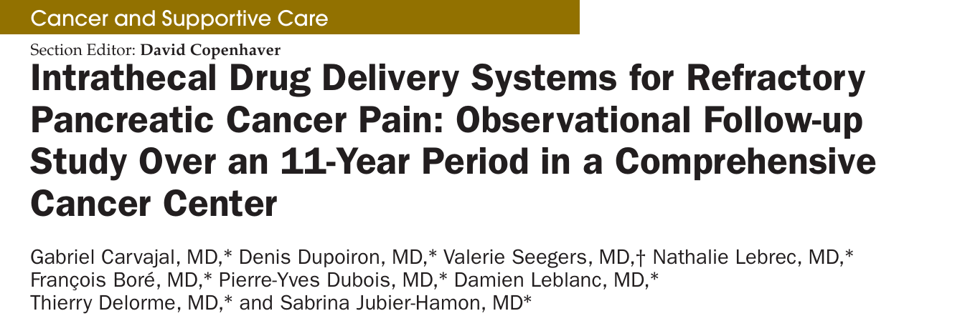
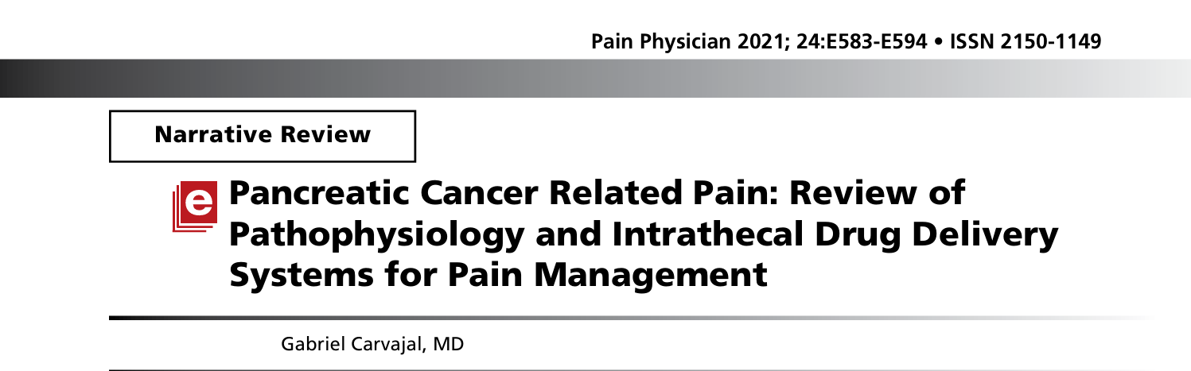
Evidence in Hepatobiliary Cancers

Slide 11
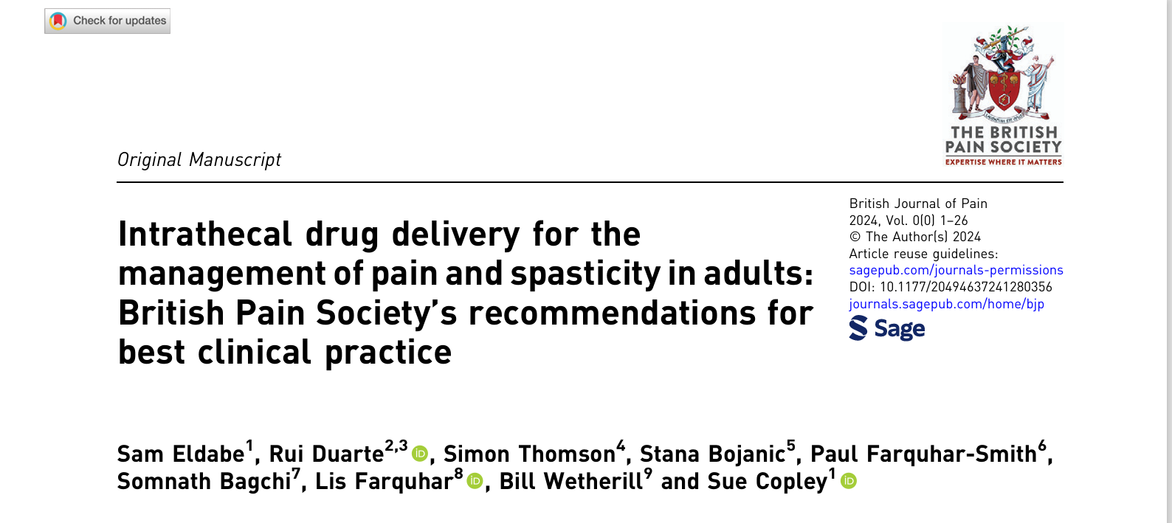

Slide 12
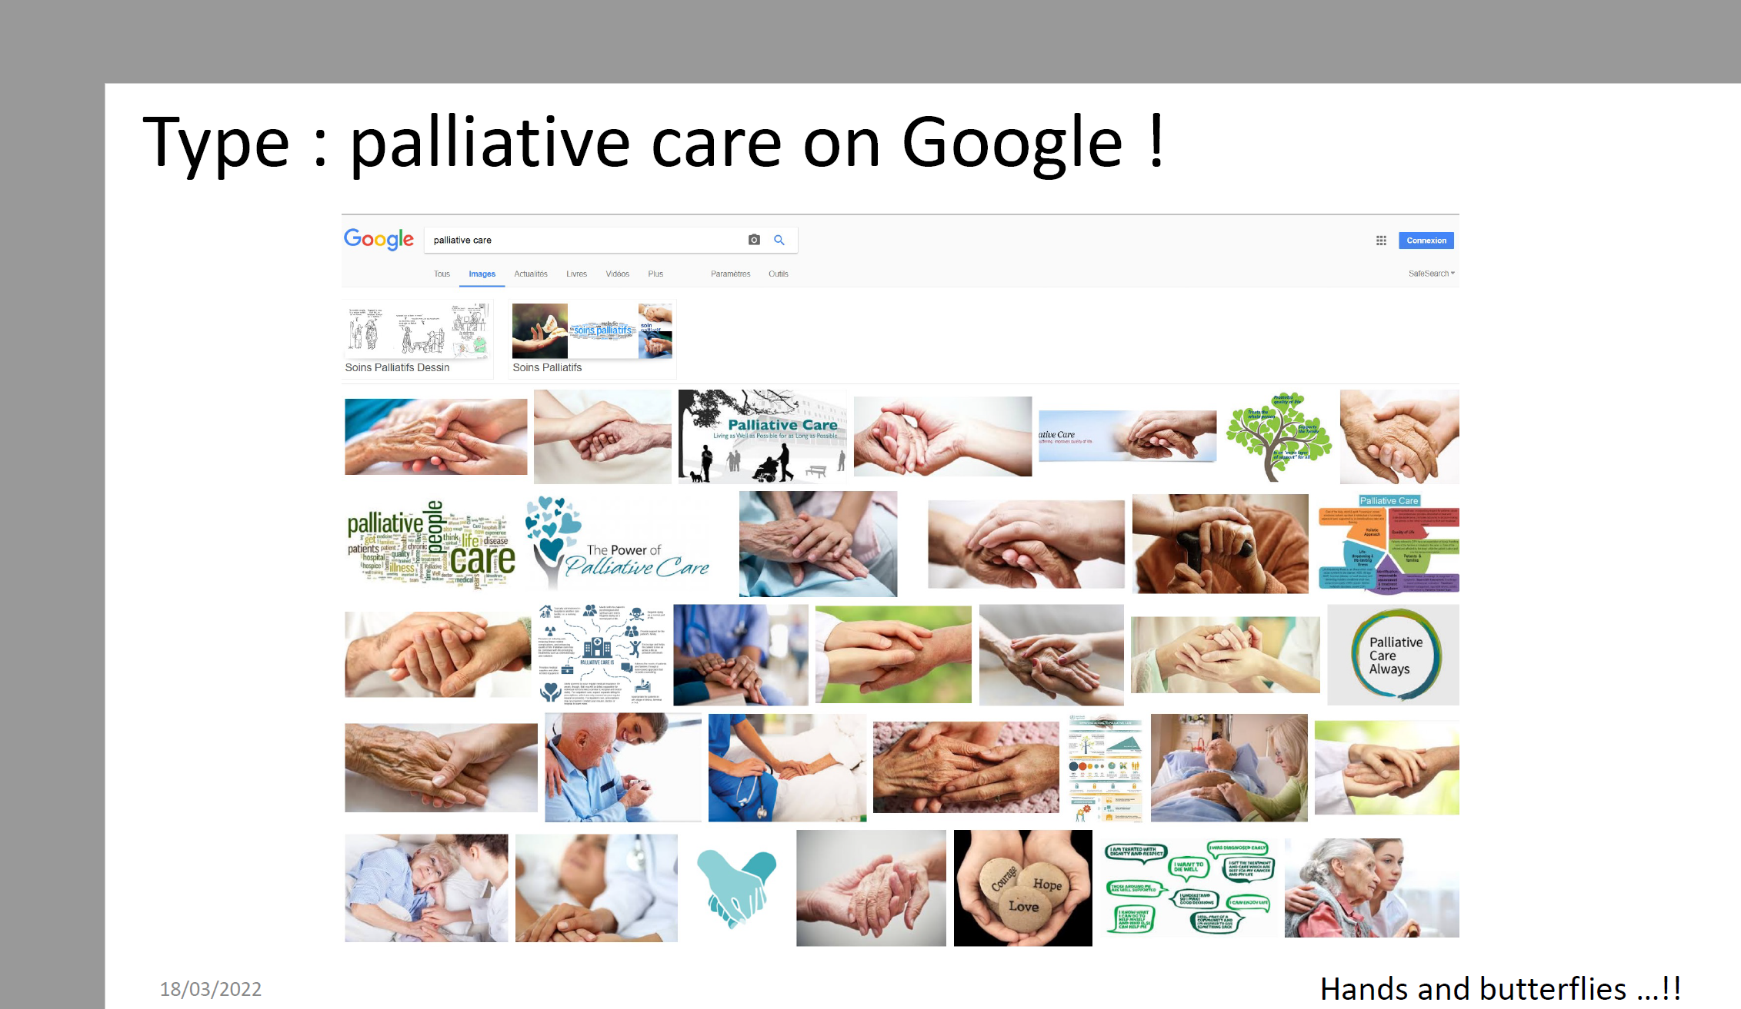

Slide 13
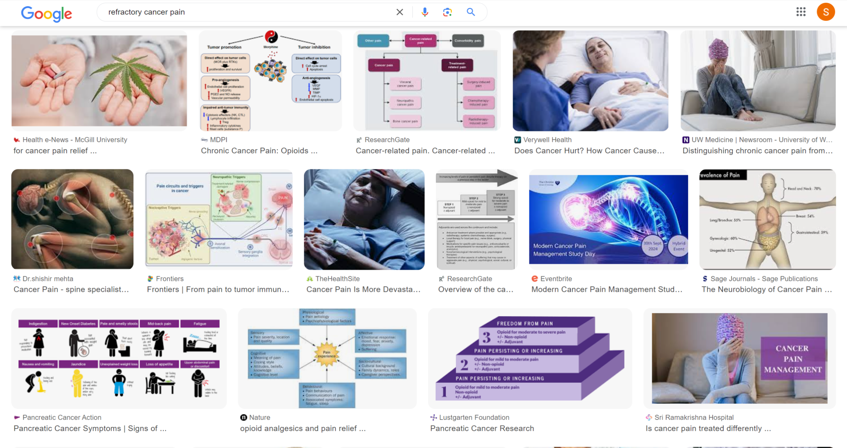
Type Refractory Cancer Pain on Google!

Slide 14
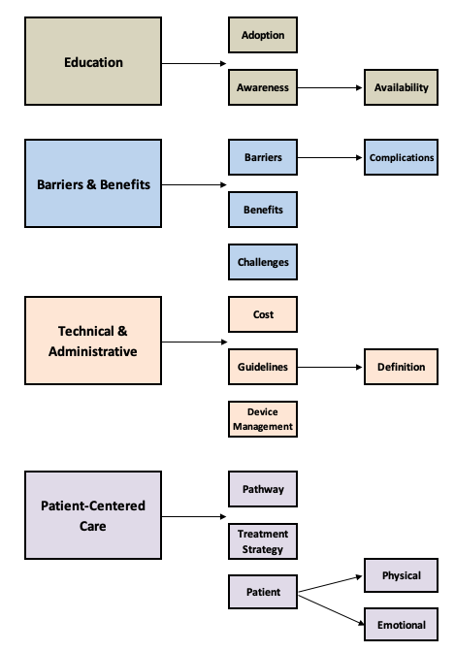
Where is the Problem?
Referrals
Training
Management
Complex Patients
Complications
doi.org/10.3389/fpain.2025.1481245:Barnosky, Brown, Bagchi et al 2025

Slide 15


Aim of Today’s Presentation
Cancer Pain Management is not Palliative Care

Slide 16
Myths Vs Facts
Many patients get Side Effects but not all and in most case it can be managed
90% of the cancer related Pain can be reasonably well Managed
Will get Side Effects/Addiction from Medications
People with Cancer must endure the Pain
Addictions are specific diagnosis & not very common in Cancer Patients
Pain & Severity of the disease are not related
Increasing Pain means My Disease is getting worse
Pumps are dangerous
Pumps contain risks but they are not dangerous
When Pumps Implanted Early and Timely they can improve QoL
If I start Medications Early, I shall run out of options
Many Pain Relieving Medications & procedures are available

Slide 17

Indications for IDDS
Patients with intractable localized pain
Despite well-administered background treatment, with morphine doses of around 300 mg/d in oral morphine equivalent but pain is a major concern
Adverse side effects ruling out analgesics
For the following locations, early access to the technique is eecommended:
- Pelvic cancers or cancers with painful pelvic secondary sites
- Pancreatic cancer, liver cancer
- Pancoast-Tobias syndrome with a strong neuropathic component
- Hyperalgesic localized bone metastasis o Sarcomas o ENT cancer.

Slide 18
Contraindications
ABSOLUTE CONTRAINDICATIONS
Intracranial hypertension
Brain metastases with risk of herniation (brain imaging less than one month prior)
Obstacle to CSF circulation in catheter path: spinal cord invasion or compressive vertebral fracture (recent spinal imaging).
RELATIVE CONTRAINDCATIONS
Aplasia, neutropenia, thrombopenia
Haemostasis disorders or anticoagulant treatment not stopped
Epiduritis (MRI useful),
Infection
Abdominal pocket not feasible (permeation nodules, stomas, ascites, etc.)
Severe undernutrition
Certain specific cancer treatments (notably bevacizumab).

Slide 19
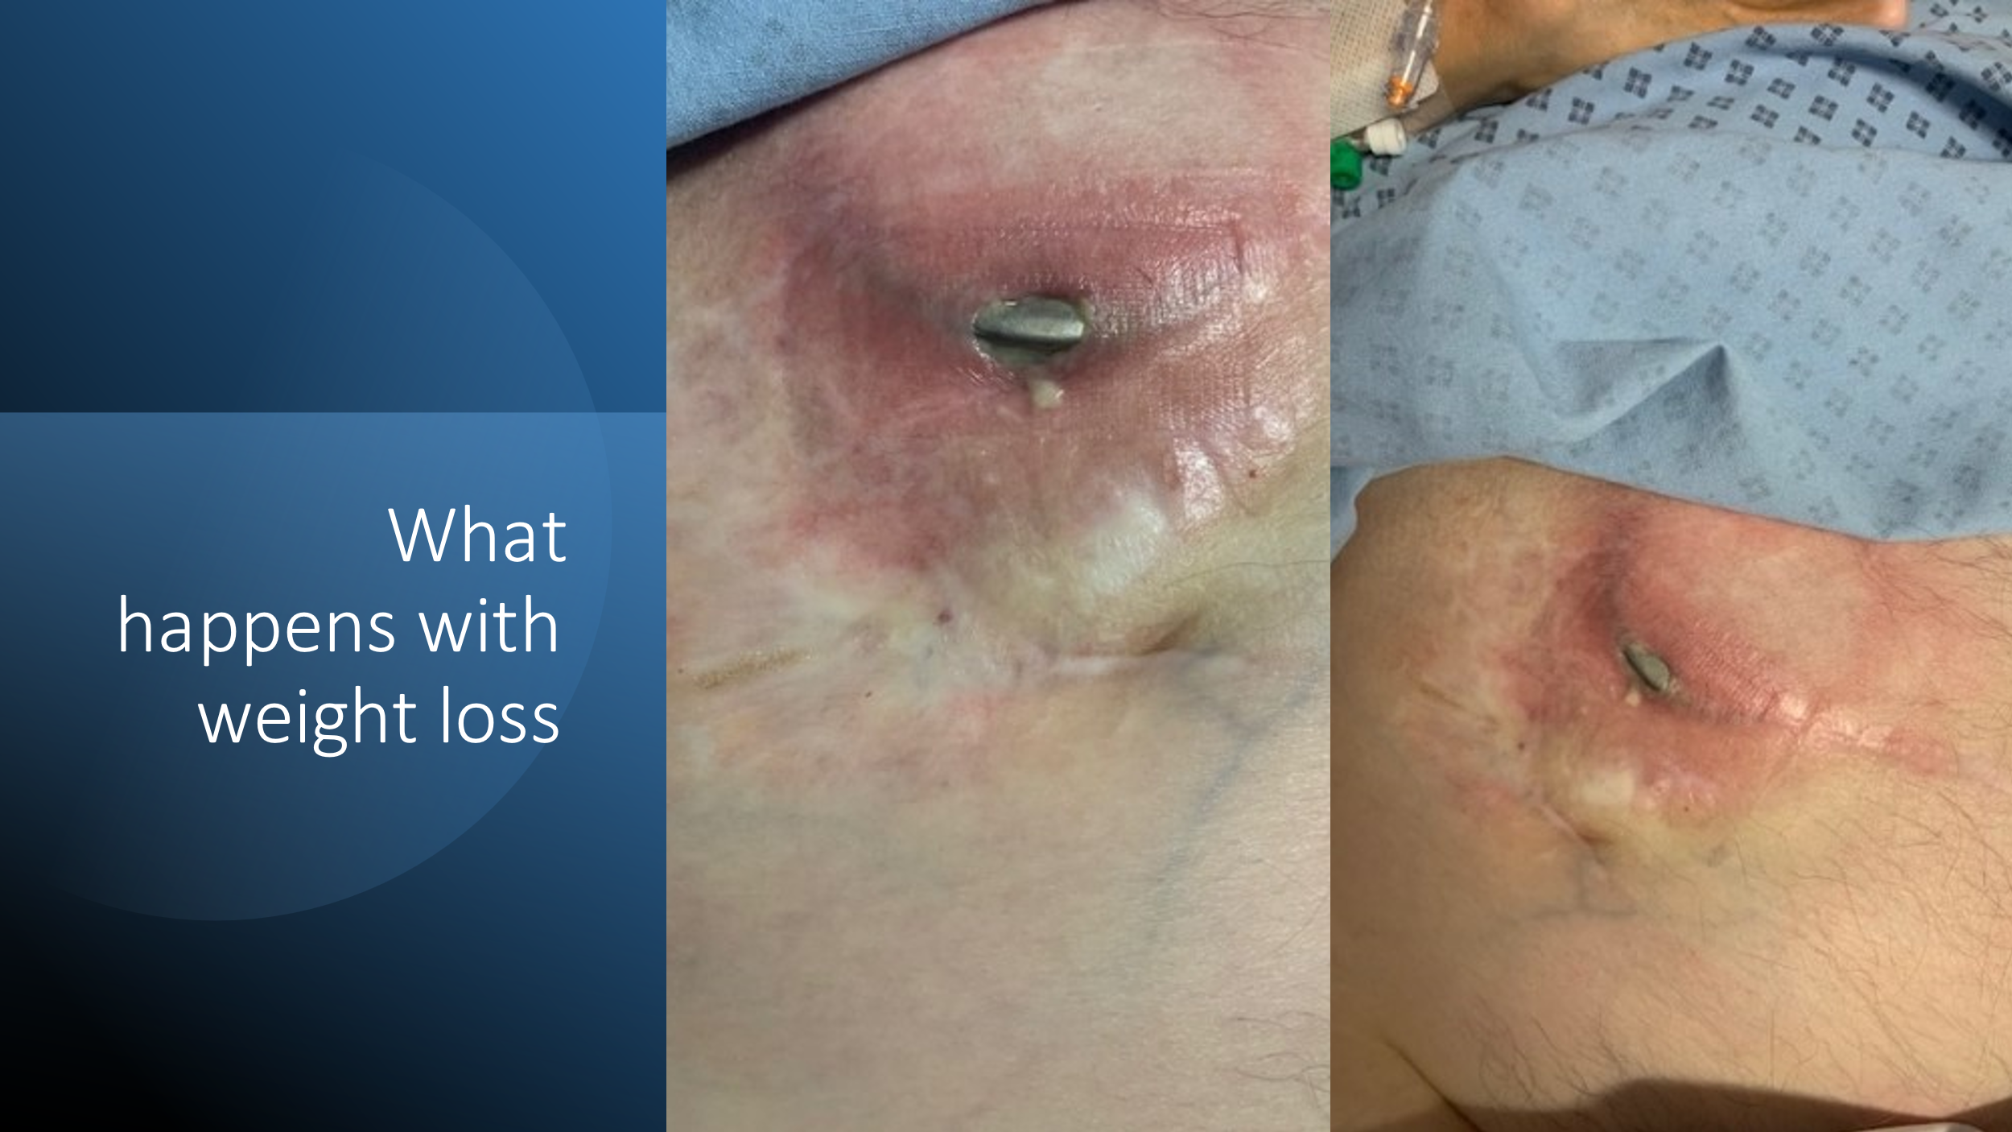
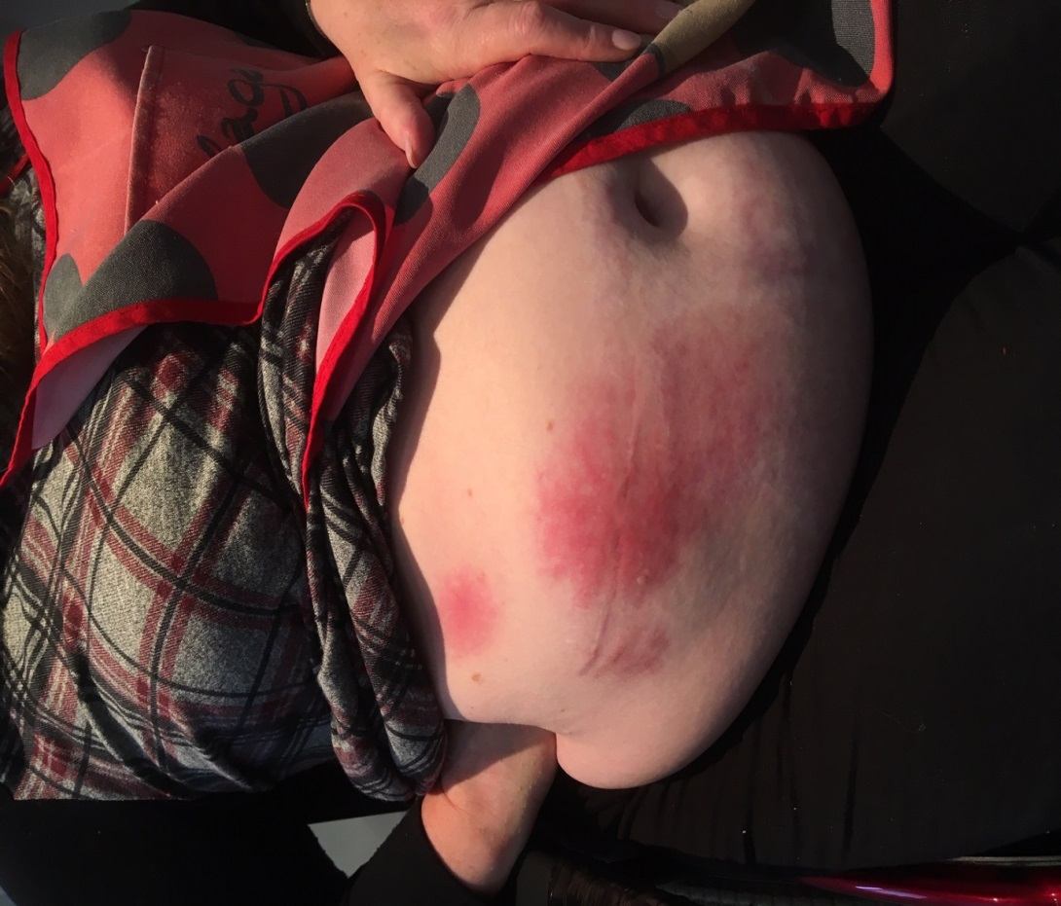
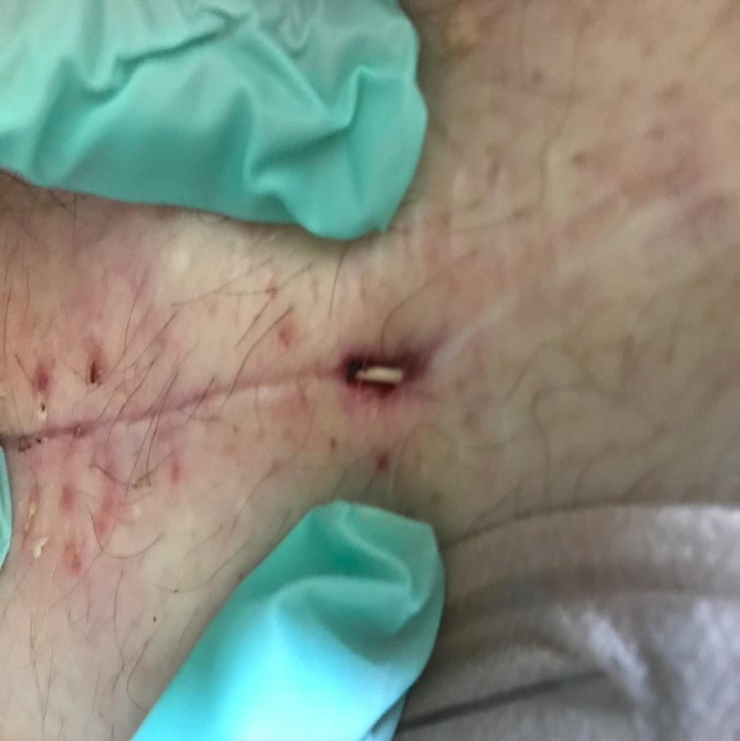
Complications
Allergic Reaction to Pump

Slide 20

How have we done at St Luke’s?
Clinics – from April 2019
Patients: 160+ / year
On an average 2-4 new patients/clinic
Ward based interventions: 16
Procedures: Simple Blocks: 88
Neurolytic ablations: 25 ---- 2 SHP& 9 IT Phenol & 19 Coeliac Plexus
Intrathecal Pumps- 53
Further Psych Support – 9
Qutenza Application- 14
Addiction Service – 3 Patients

Slide 21
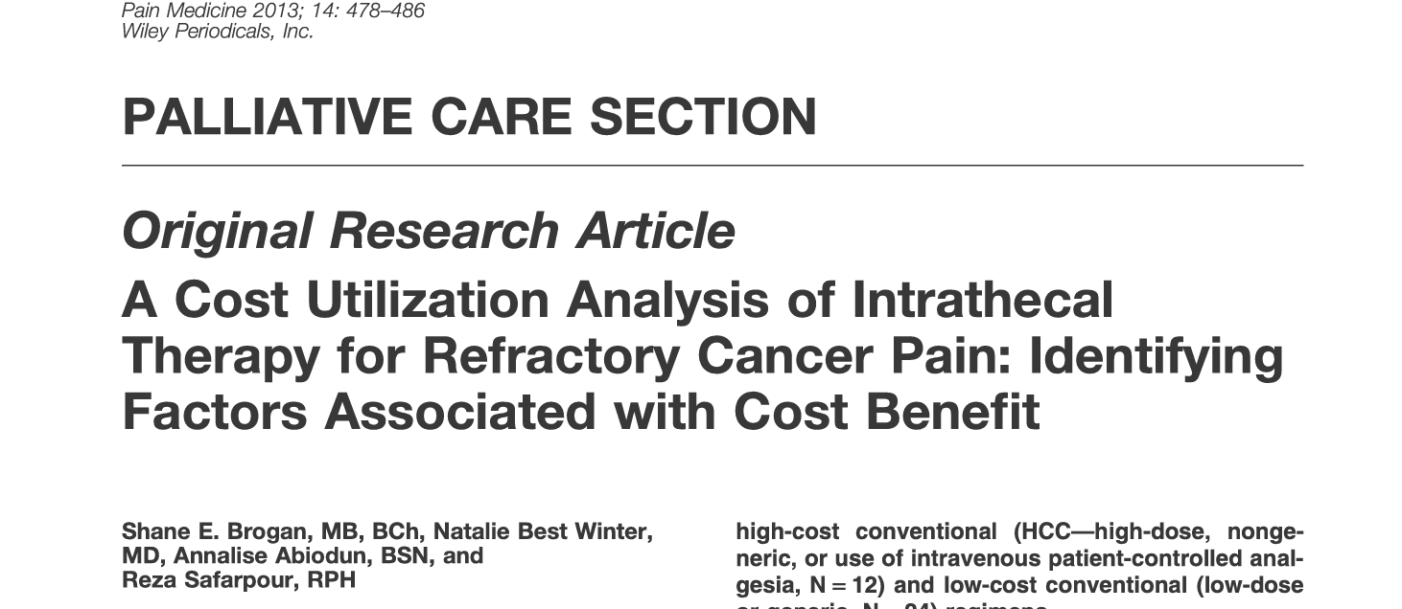
How the service is Running Now? 3 phases
Referrals
Continuing Care
Preparation and Implant
Referral from Onco / CNS (email) with poor or good prognosis
Patients are seen jointly
If found suitable have a discussion for Intervention
Consent email pack
Returns in 2 weeks with a yes or no

Slide 22
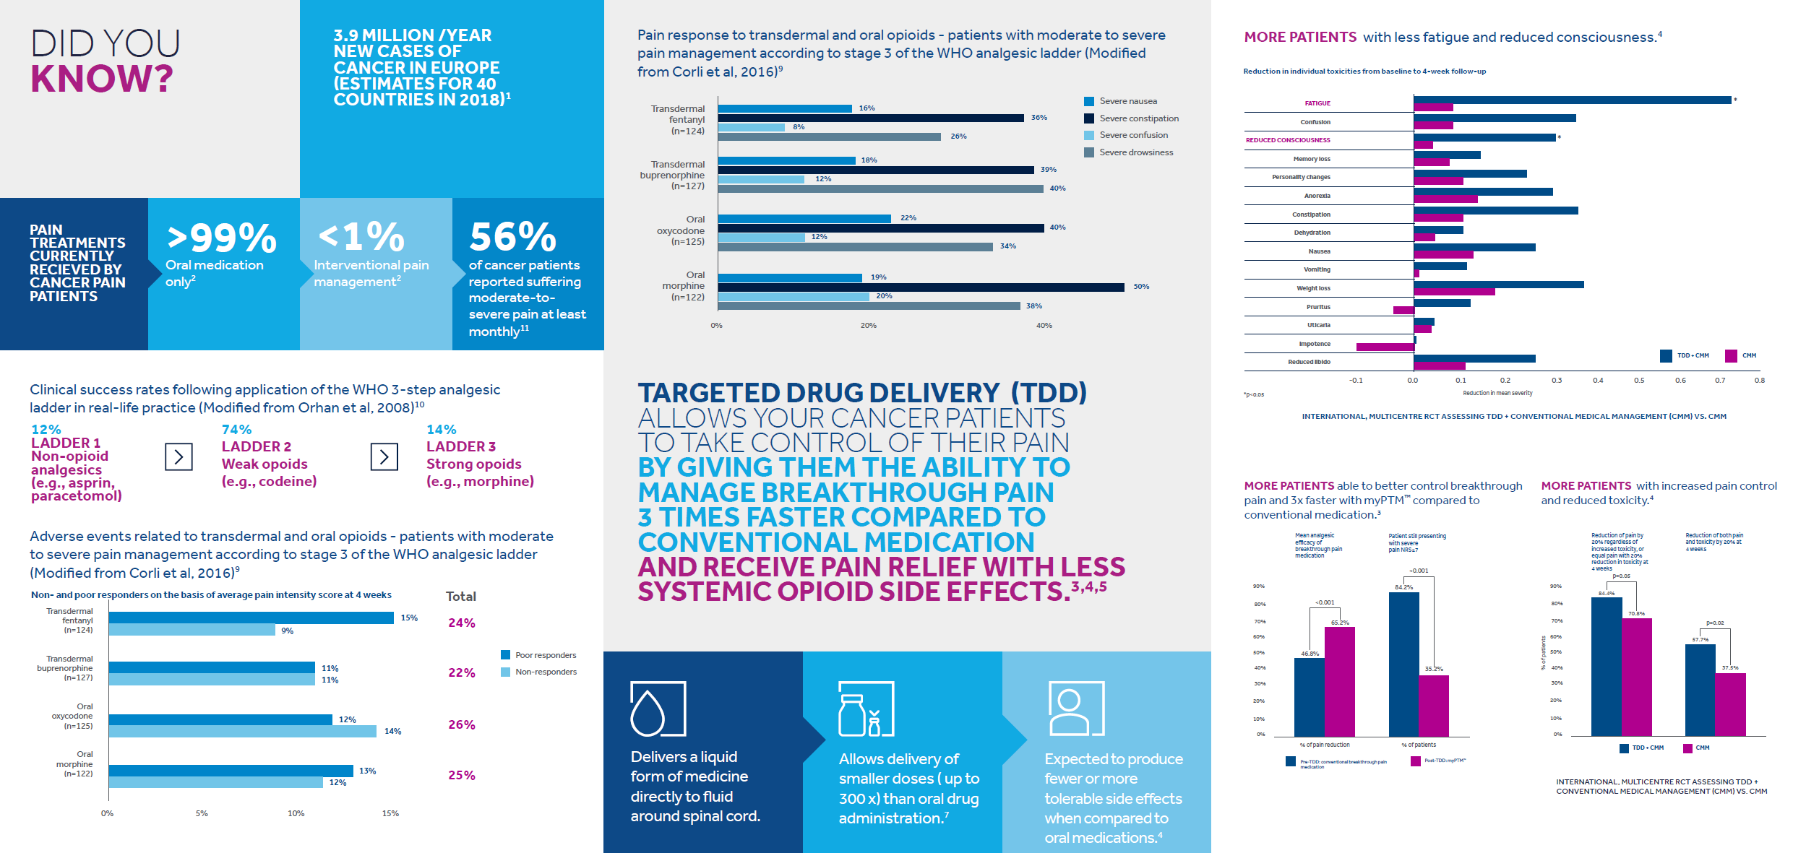
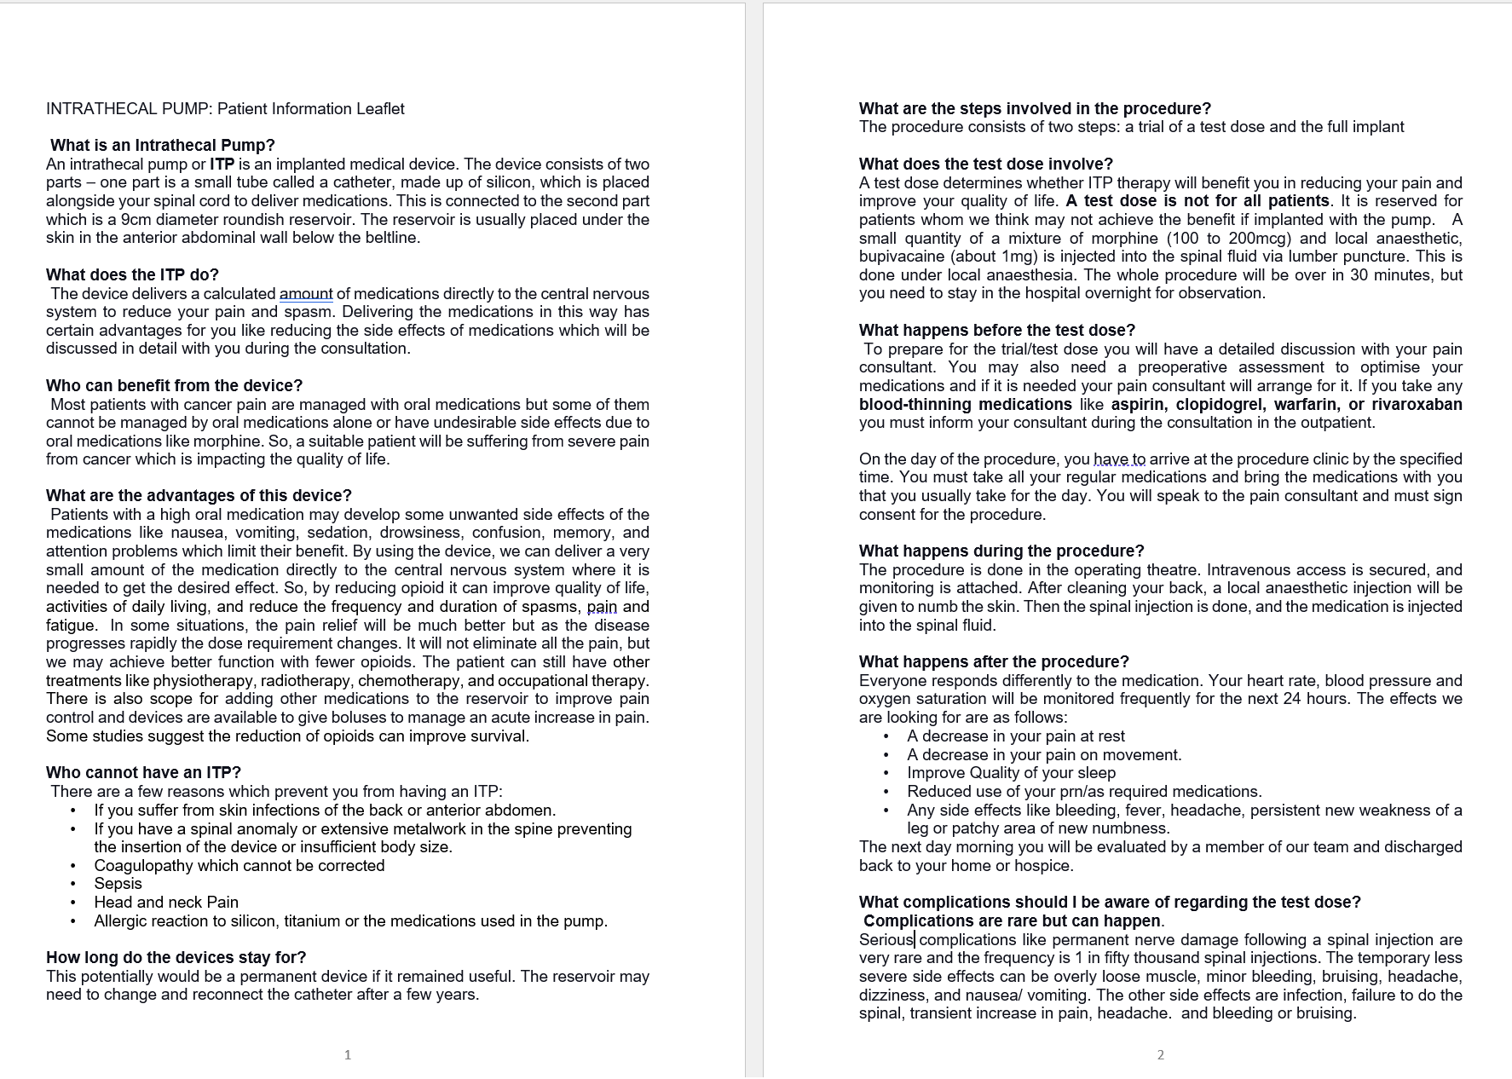
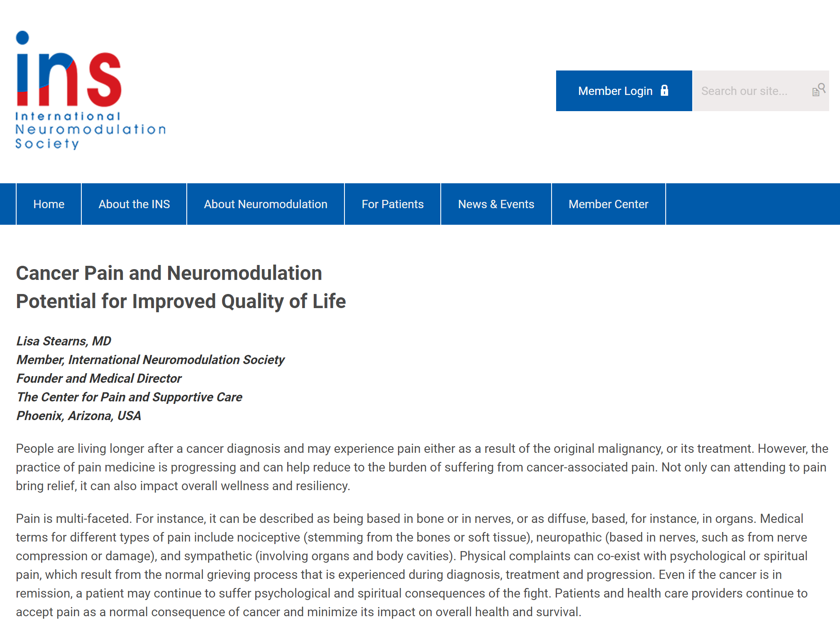
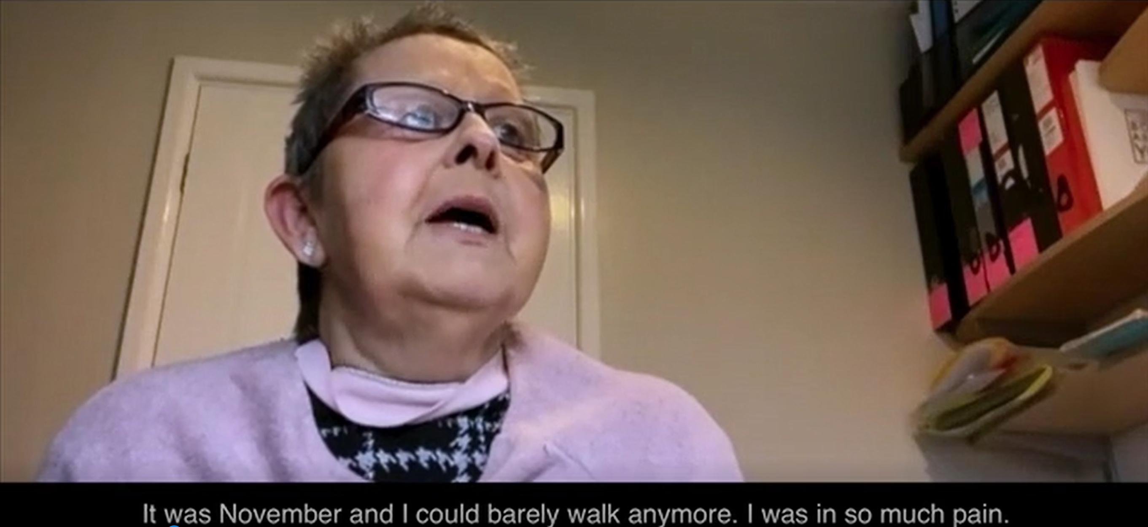
Consenting Pack

Slide 23
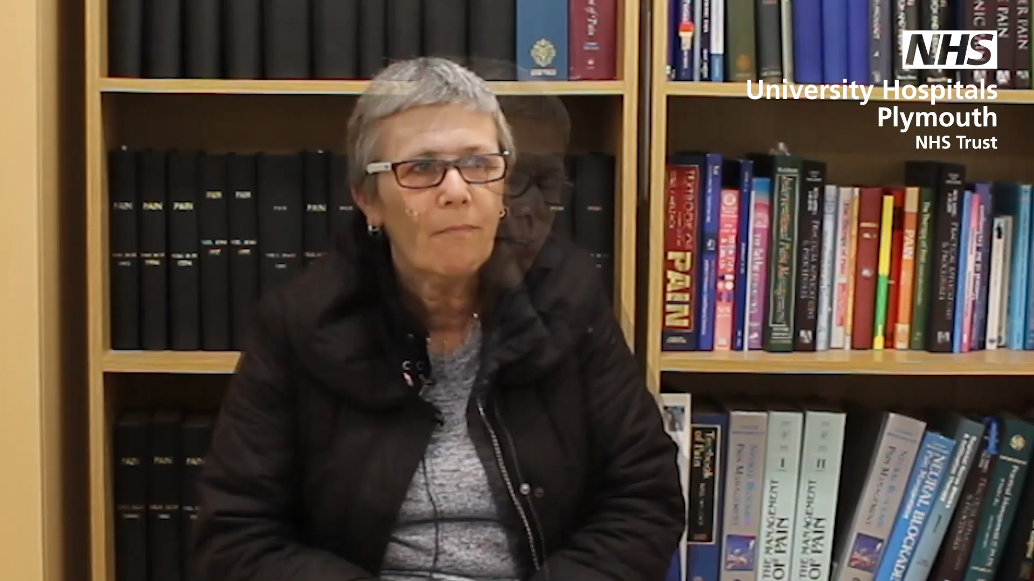
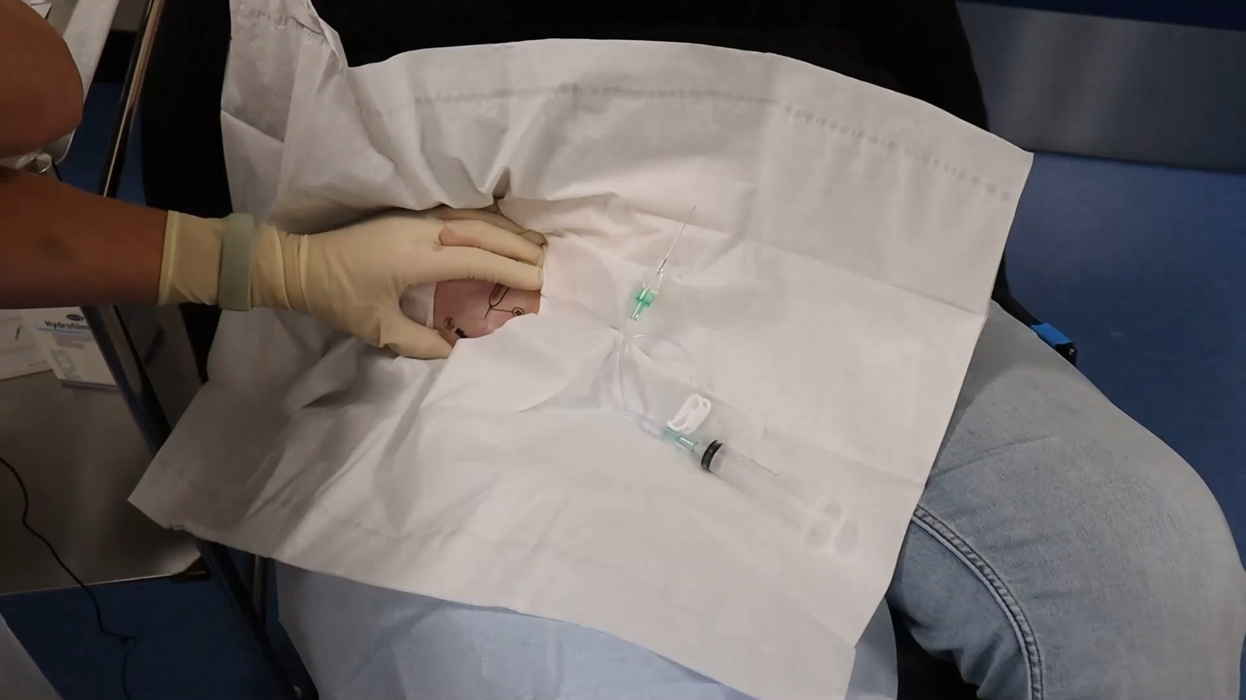
Consenting

Slide 24
How the service is Running Now? 3 phases
Referrals
Continuing Care
Preparation and Implant
Referral from Onco / CNS (email)
Patients are seen jointly
If found suitable have a discussion for Intervention
Returns in 2 weeks with a yes or no
MDT
Trial
Review and Preassessment
Follow the checklist
Implant
Admission

Slide 25
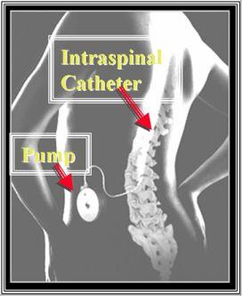
Highlight 3 Controversies
Trial or No Trial?
Catheter Tip Placement
What Drugs?

Slide 26
Trial?
A Case for Trial
RA 38 ϙ with 2 kids 12 and 10years old: Rectal CA
Psychiatric history ++ with previous ECT, Trazadone, Venlafaxine, Quetiapine, Lithium 1gm
Pain meds Oxycodone MR 300mg BD+ Oxynorm 20mg 4hrly + Pregabalin 25mg BD
Family dynamics
1st visit in Dec 2022 – walked out halfway
After Christmas Break : she was again referred by community health care team: Neighbours called police
Discussed again: Does not want another bulge on abdomen, another operation , GA, hospitalisation
Successful trial
MDT – Psyh worried
Got Implanted on 4th Feb 2023 – now off all oral pain meds – went for a holiday in Spain.
On Bupivacaine 5.1mg /day + Morphine 1.7 mg + PTM with bupivacaine bolus 0.15mg with 6 activation in 24 hrs

Slide 27
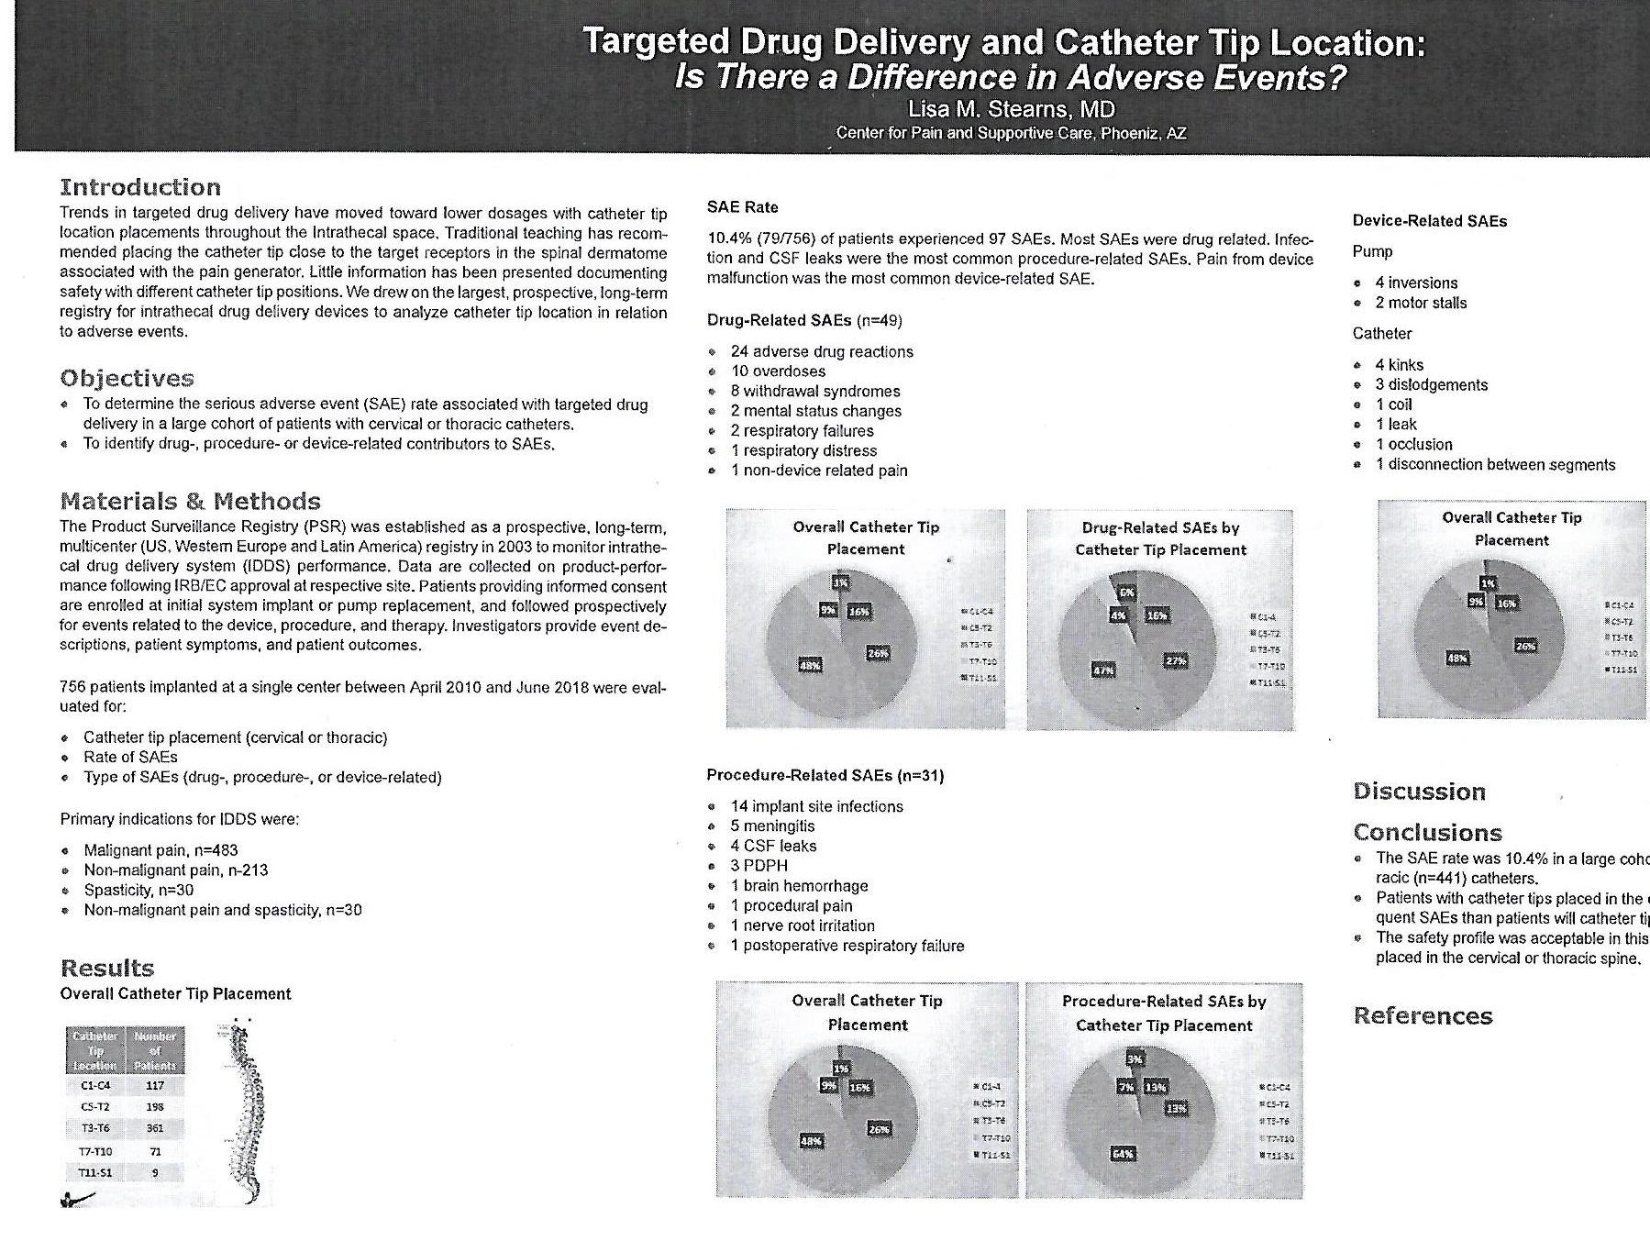
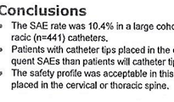
Catheter Tip Placement

Slide 28
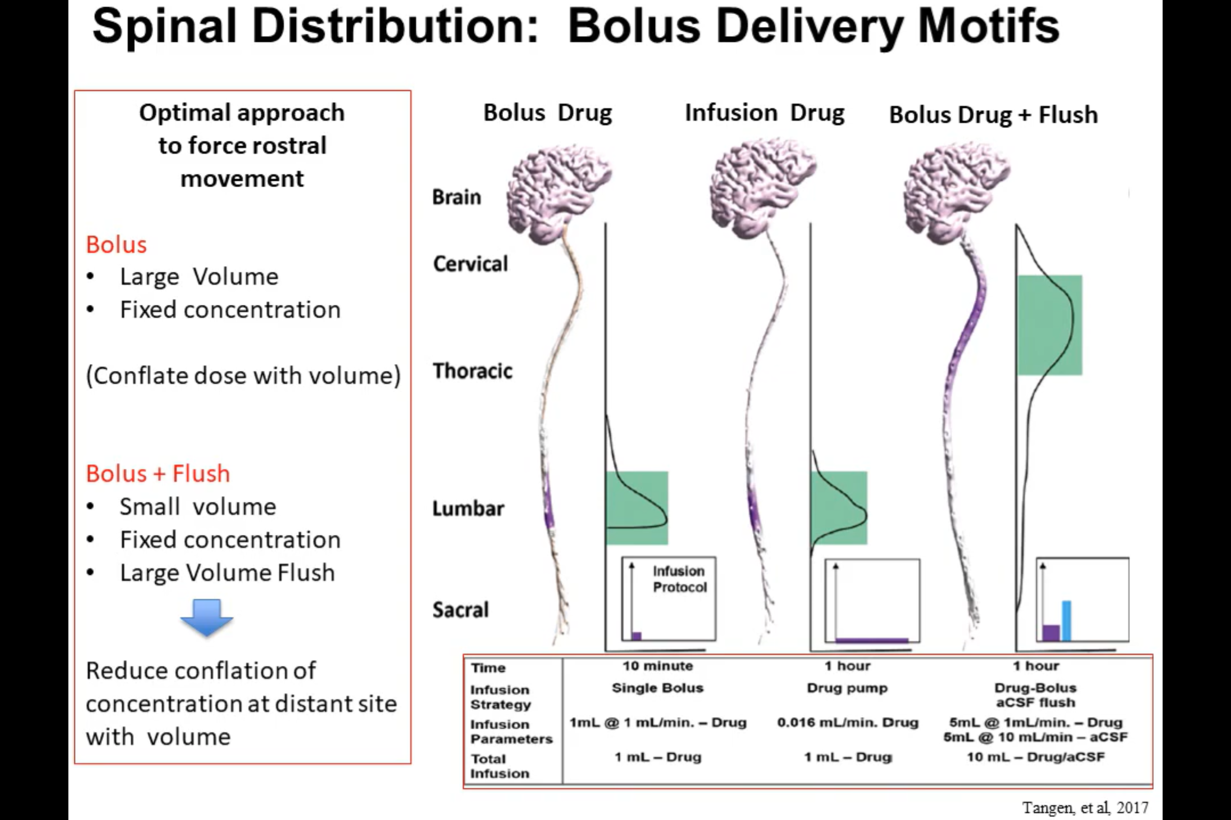
Catheter tip @ T6

Slide 29
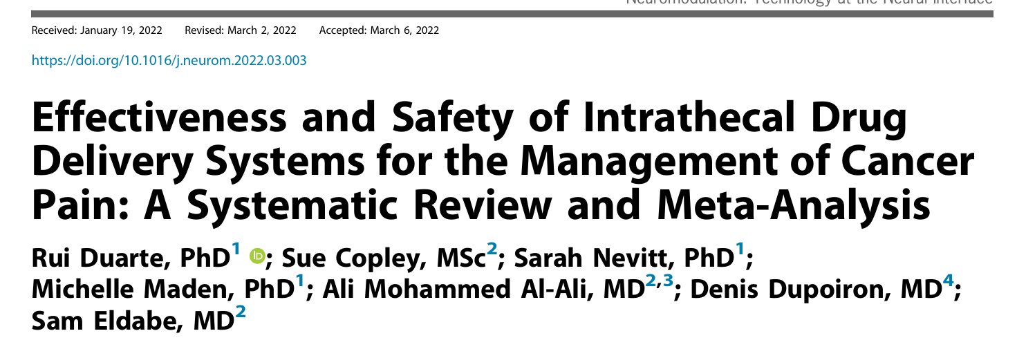
What Drugs : Combinations
Bupivacaine is the first drug as the bolus dose is based on it
Bupivacaine is fast acting
It wear off in 100mins +/- 20mins
Morphine is slow to start – 20 to 30 minutes works of few hours
A combination also helps to lower individual amount of drug

Slide 30
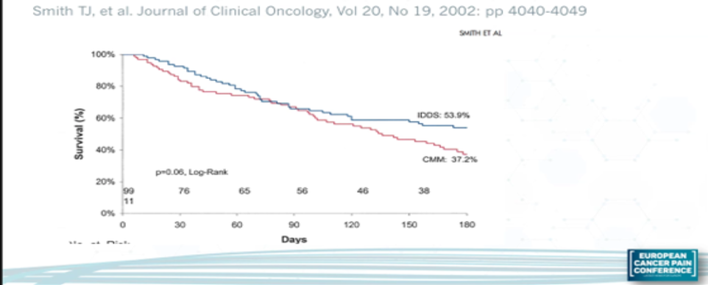
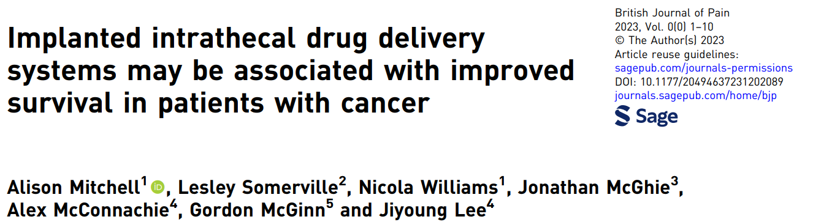
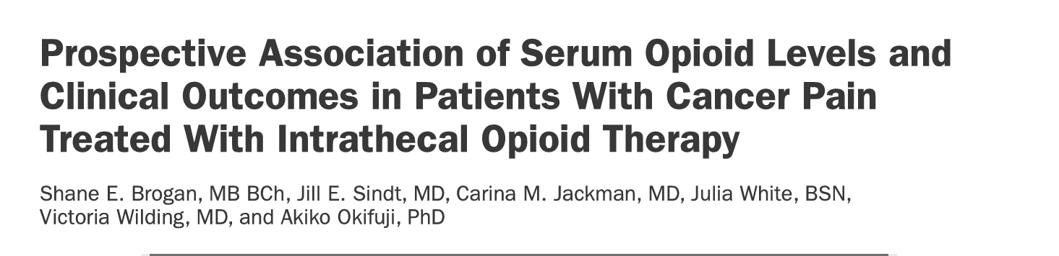
Impact on Survival :

Slide 31
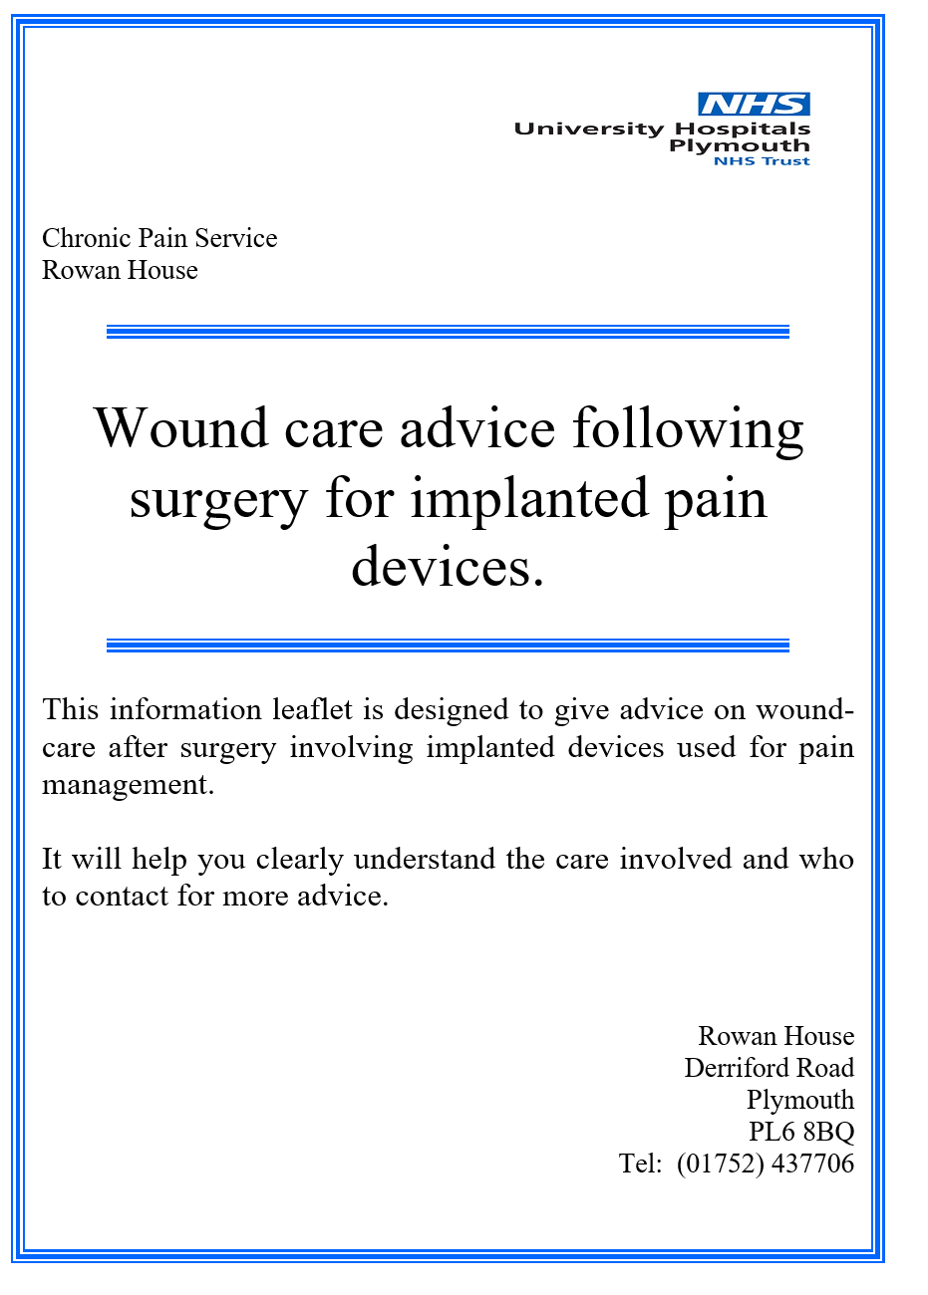
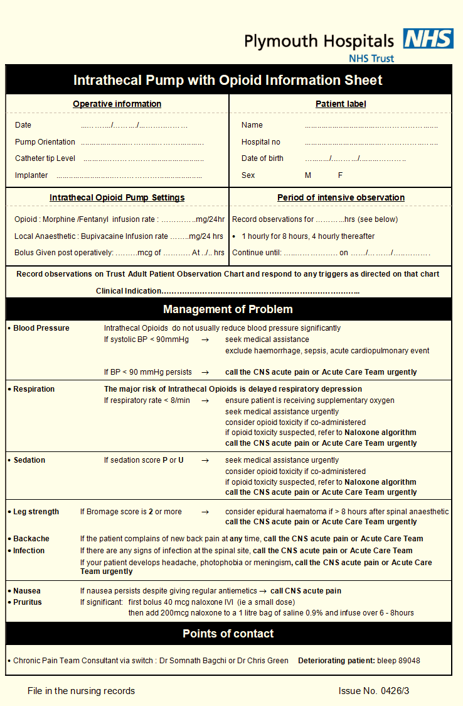
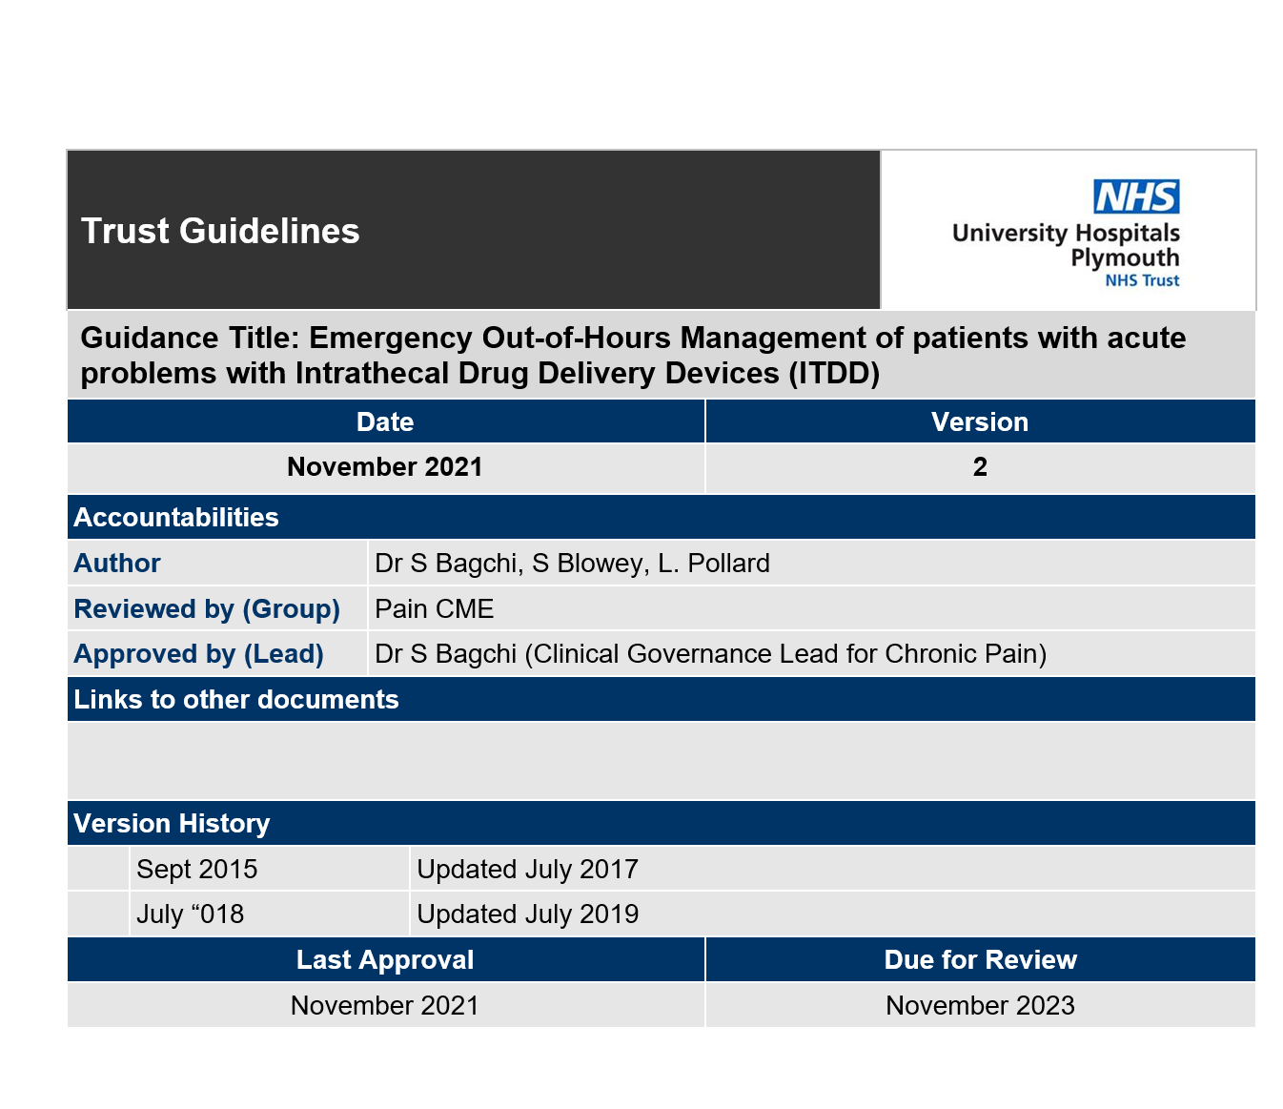
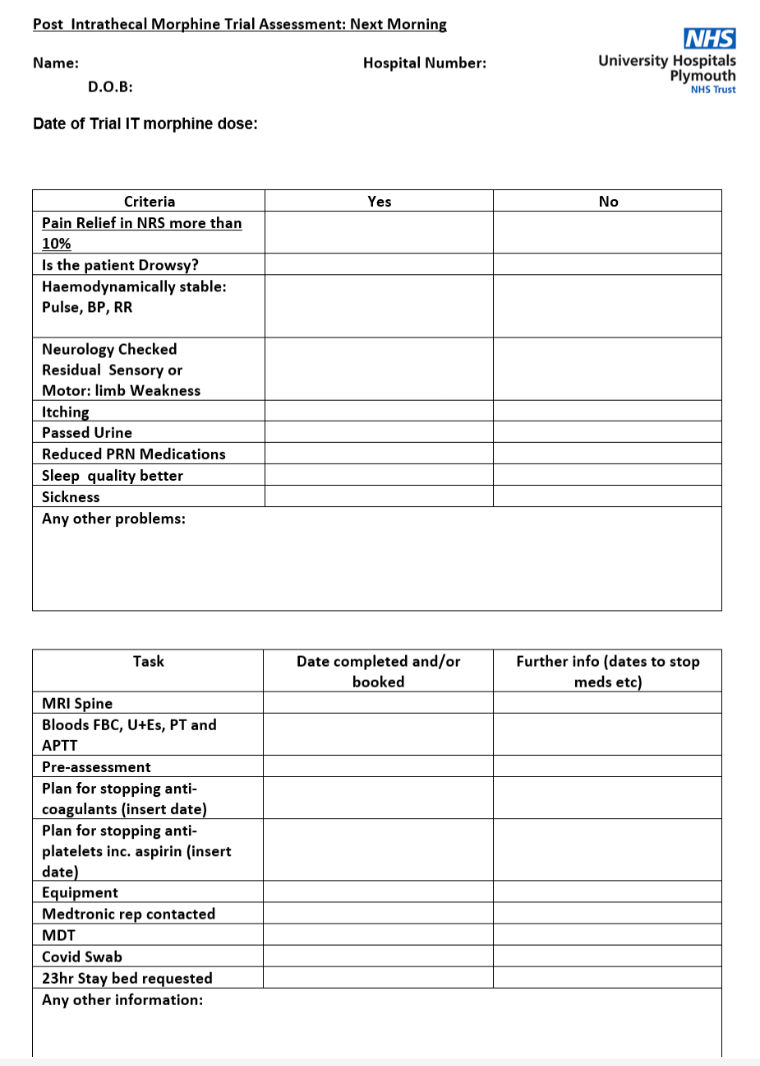
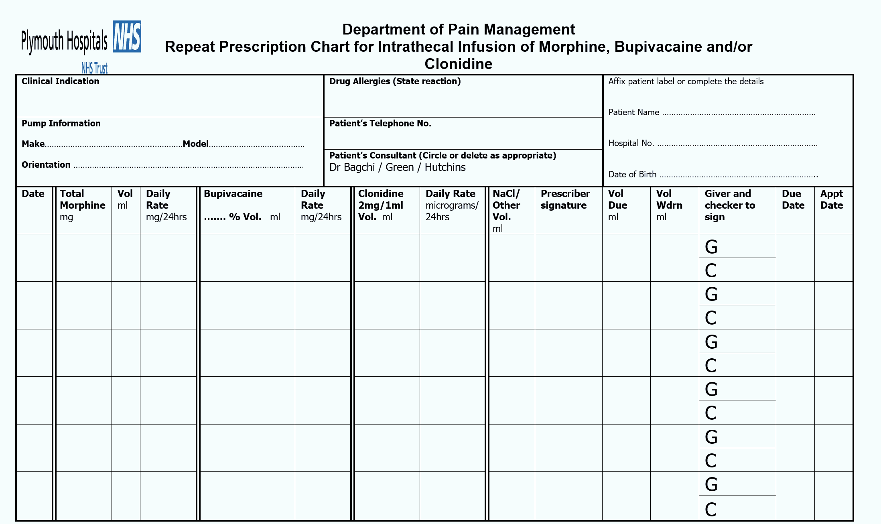
Protocolised

Slide 32
How the service is Running Now? 3 phases
Referrals
Continuing Care
Preparation and Implant
Referral from Onco / CNS (email)
Patients are seen jointly
If found suitable have a discussion for Intervention
Returns in 2 weeks with a yes or no
MDT
Trial
Review and Preassessment
Follow the checklist
Implant
Admission
Follow up
Titration
MRI
EMERGENCY Management

Slide 33
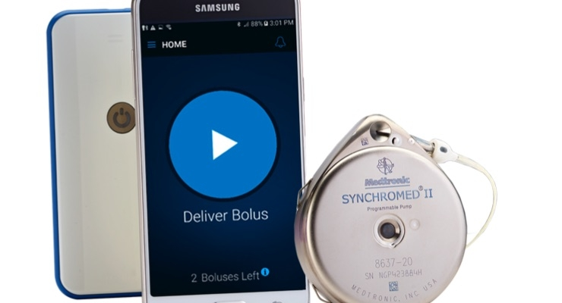
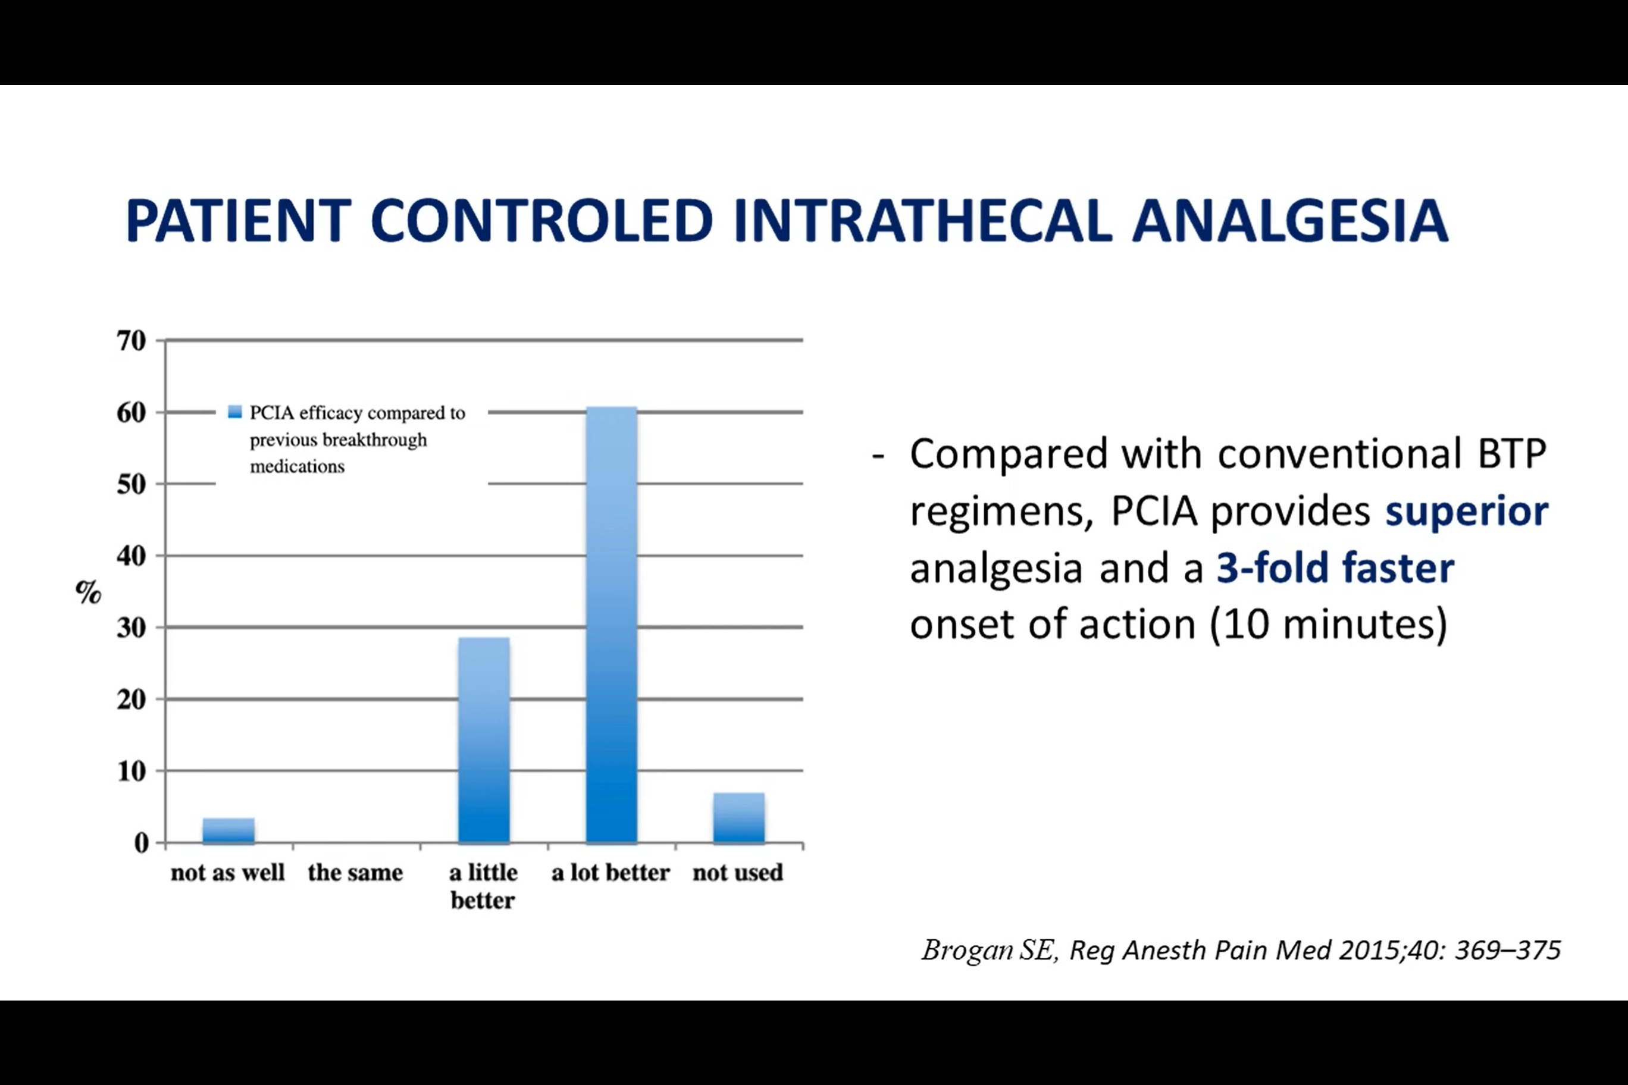
Personal Therapy Manager
Bolus based on Bupivacaine conc: As Bupivacaine is the first Drug
0.1-0.3 mg of bupivacaine bolus.
Volume= dose/conc
For bupivacaine 0.2 mg bolus, volume will be 0.2/15 = 0.013 ml
Now morphine conc is 5mg/ml
So 1 ml contains 5mg morphine
Therefore 0.013 ml will contain 0.066mg of morphine.
One bolus will give 0.2mg of bupivacaine + 0.066mg morphine

Slide 34
Preparing the ward, Family, Junior Doctors, GP
If the patient is in pain – can I give opioids? - Yes
If MRI is needed? What to do?- Pump can continue but must be checked
Do refilling involves GA? – No
How frequently you need to refill? – 6 weeks to 6 months
What is Personal Therapy Manager? A device to give boluses for incidental pain
Post op pain – can the patient have opioids? – Yes
Why I have pain after the pump ? The catch up Game – Pain will be there but you will be more functional, clear headed and manage things better

Slide 35
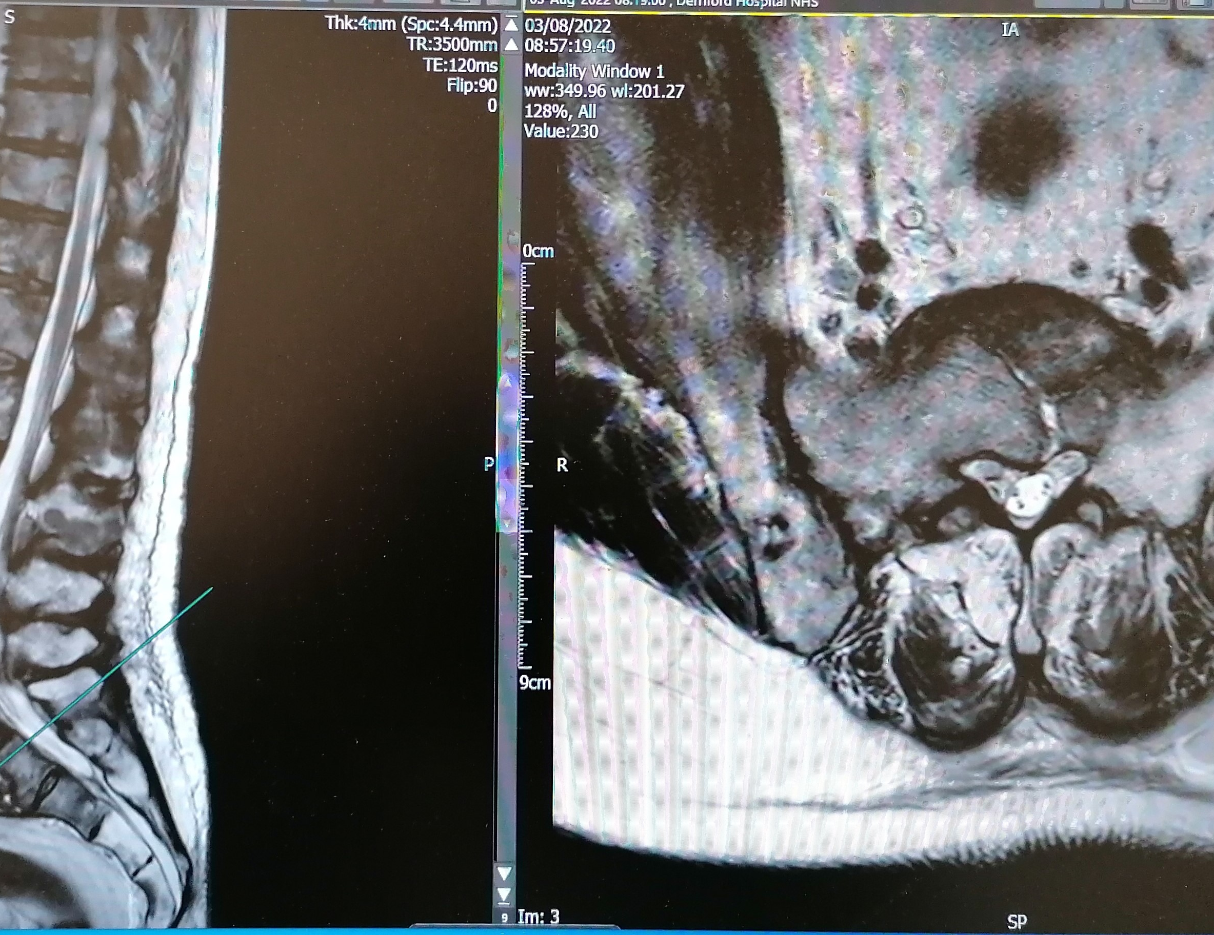
Case : Timely referral? You will never find a perfect patient
61-year-old single working at dockyard suffers from expressive aphasia.
Got admitted with sudden back pain and MRI shows:
6 weeks in the wards: bed bound
Got Implanted on 4th Oct 2022
Discharged on 6th Oct
Walked with Zimmer frame and independent – last clinic was on 25th August – passed away on 4th September 2024 in sleep

Slide 36
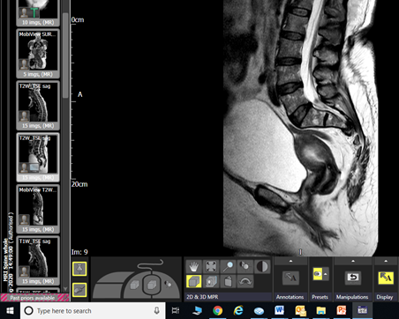
Case - SP
61 ϙ - metastatic breast ca – mostly in pelvis
She was confused, incoherent, on oxycodone, tapentadol, pregabalin, amitriptyline, ketamine infusion ------ about 6m to 12m
Had a couple of local blocks – not much effective – so had ITP 05/19
Mobile, off most meds, on PTM, visited mother at Herefordshire, kids at Stratford on Avon
Hip joint op- failed but still mobile on wheelchair but can transfer, ----- “Has a Life”

Slide 37
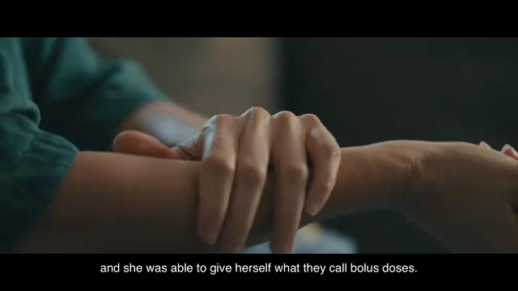

Slide 38
Results (43 cases)
Opioid Reduction: Most patient had opioids along with the pumps as prn medications
Preop OME use 256.26
Post op OME use 49.11
Mean reduction 207.15
Pain Scores: There was a decrease in pain score at 3-4 weeks from the preimplant level of an average of 8.9 (range 8-10) to 1.5 (range 0-6). The reduction of pain continued in the 6-12 weeks period but slightly increased to 3.45 (range 0-10). The median pain score at this point remained 2 but 2 patient had a pain 10 and the other 6 which skewed the average score

Slide 39
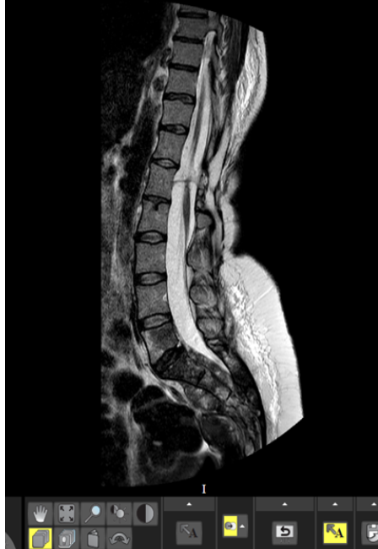
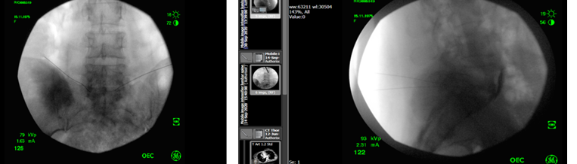
Case2---CS
44ϙ with a spinal bifida
Background pain across the back lifelong – but new pain along the L leg with sensitivity
MRI shows a big mass pressing on the sacral plexus
Maldevelopment of the posterior elements of the spine – no question of spinal – can we do something else?

Slide 40
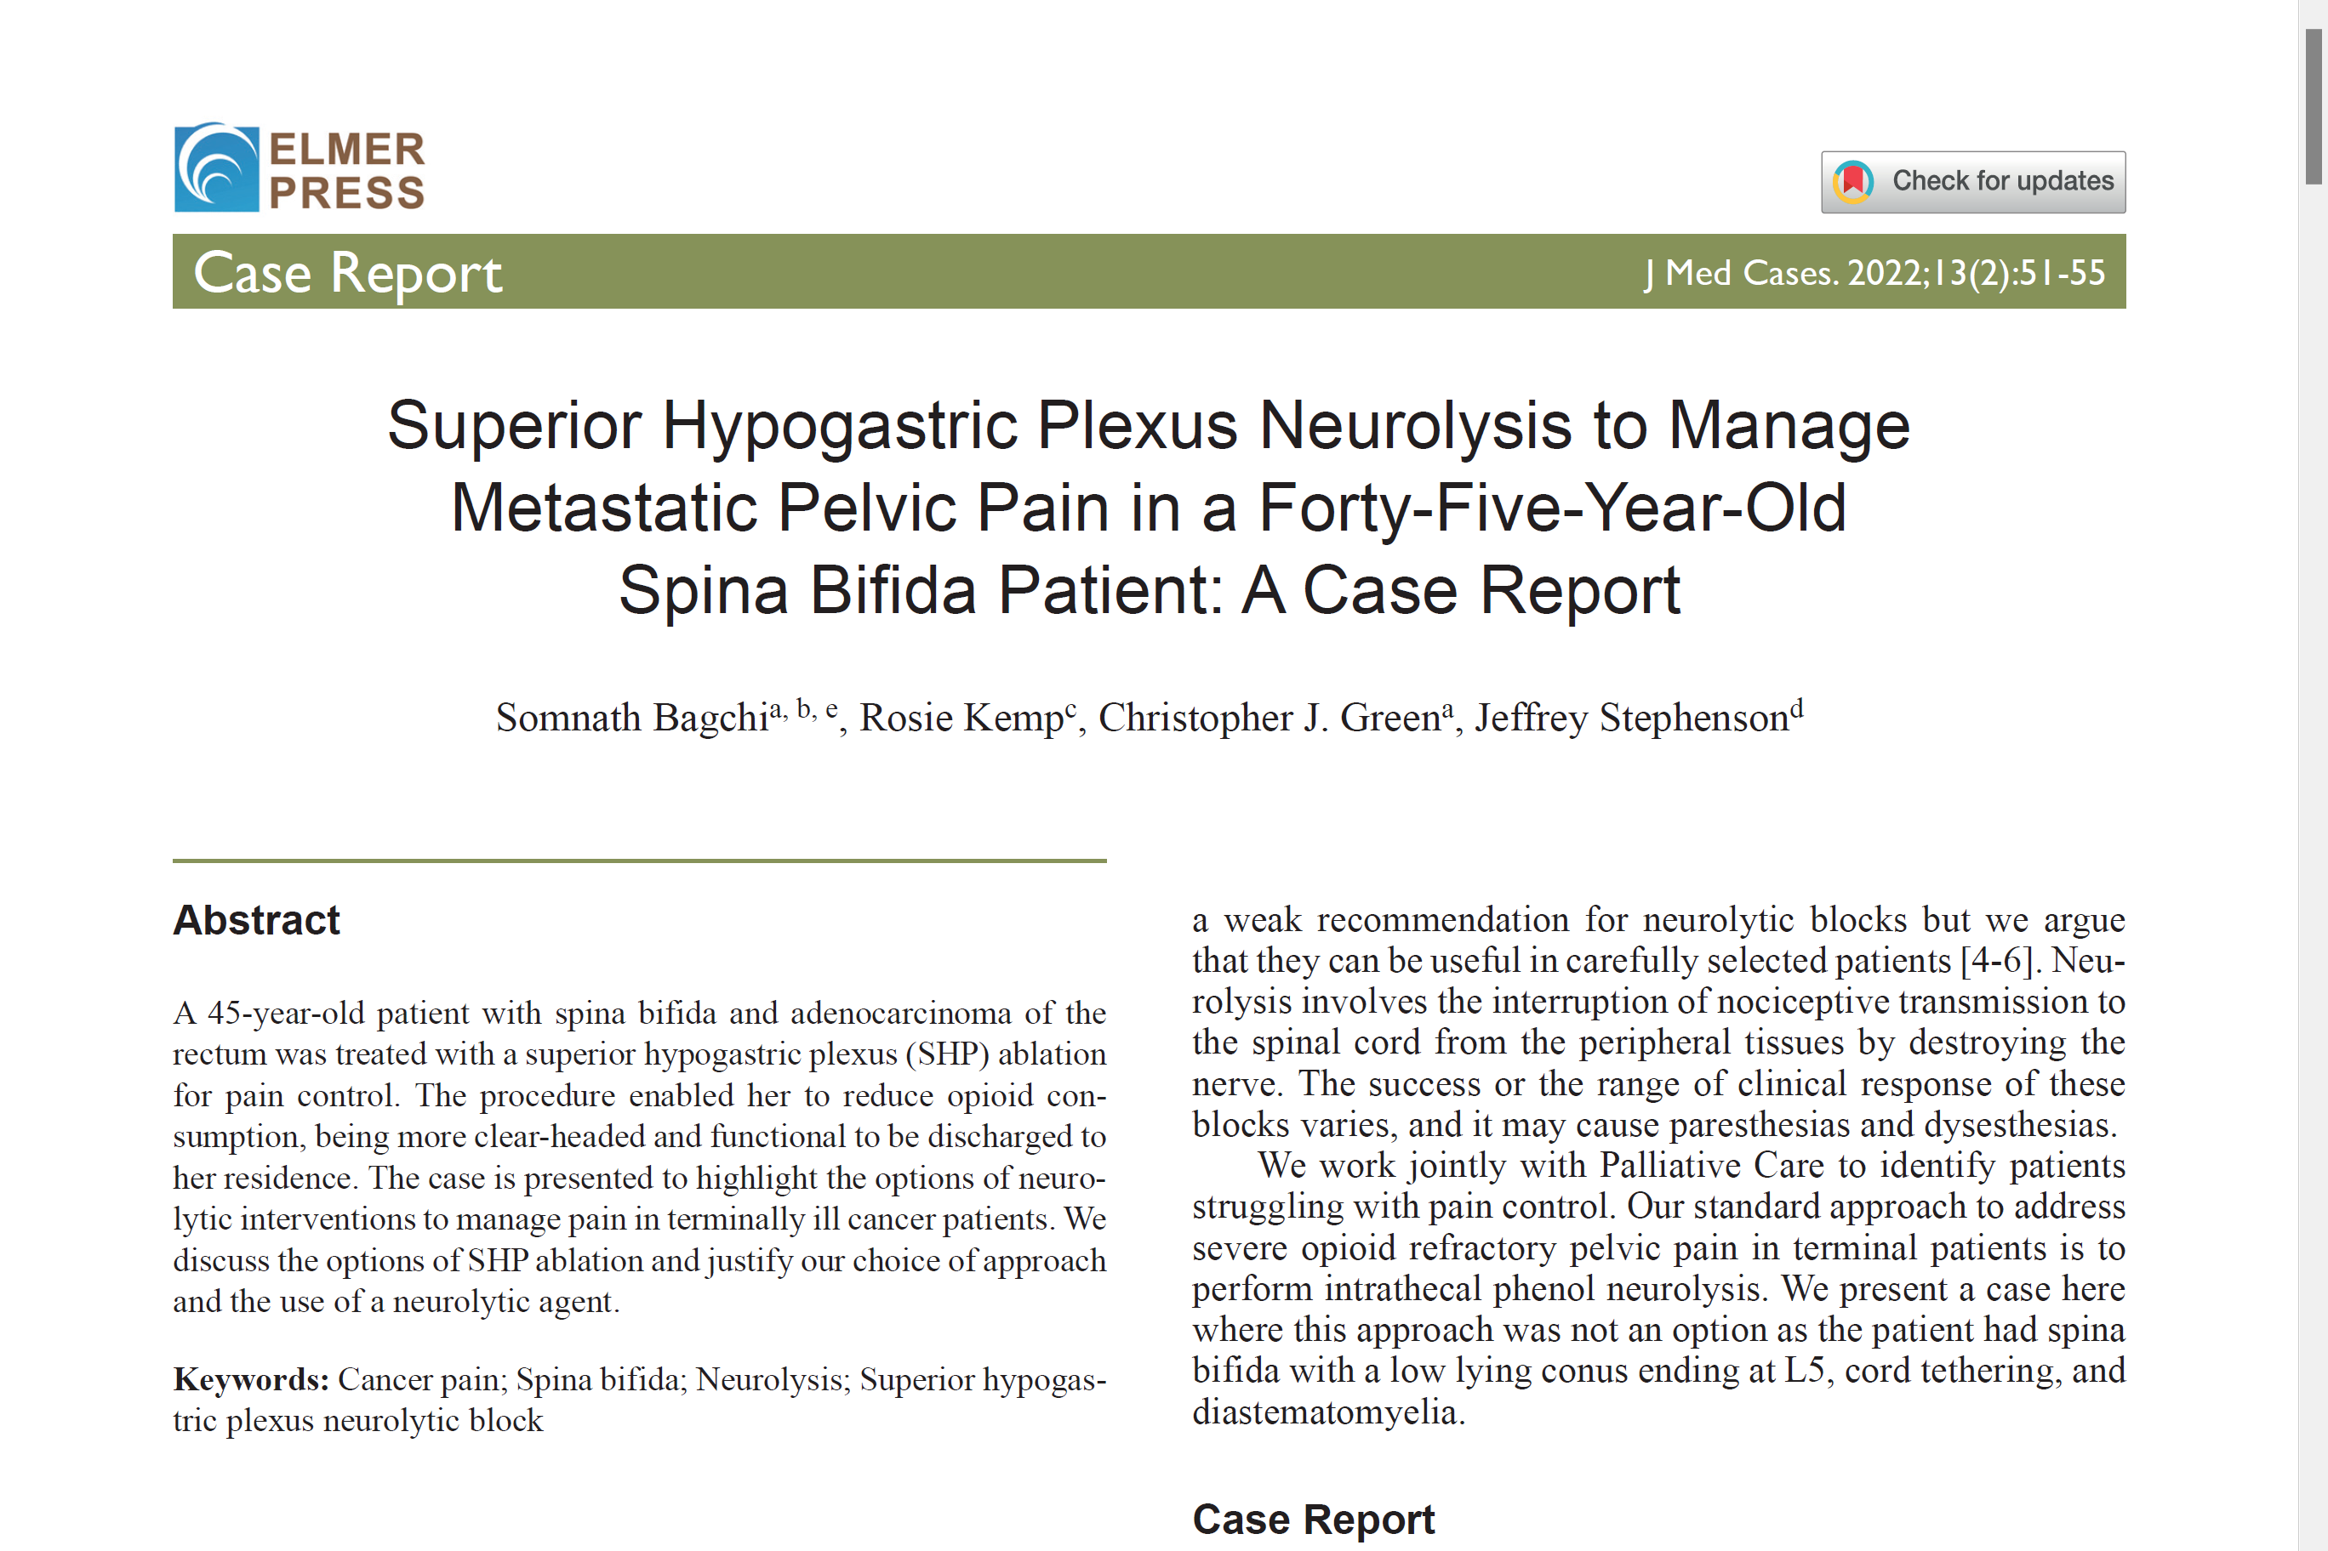

Slide 41
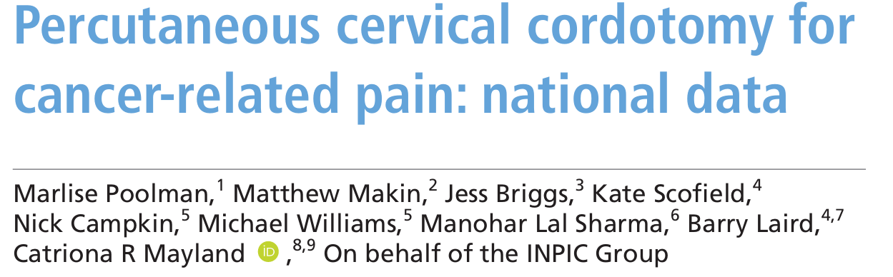
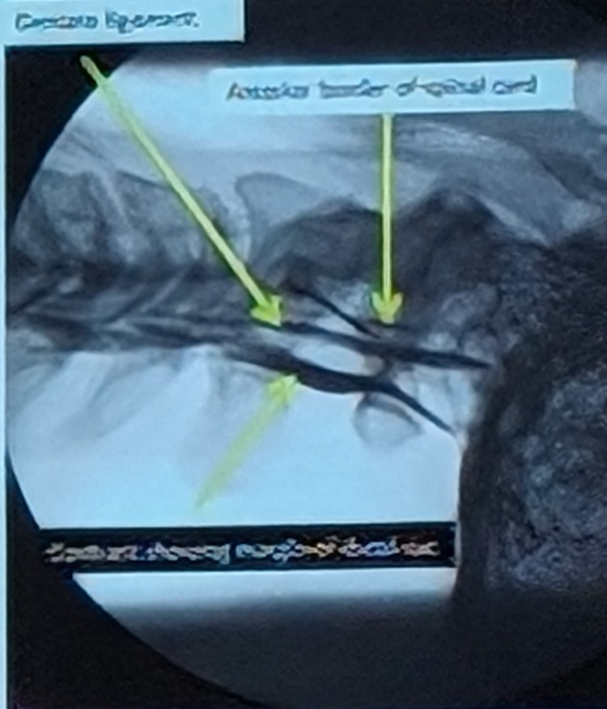

Percutaneous Cordotomy
Heat lesion of LSTT leads to contralateral side pain relief below C4.
Refractory Unilateral pain with life span likely to be <1 year
UK based prospective study #159
90 unilateral Mesothelioma
Survival 1.3 months (0.6 -2.8m)
Pain relief at 2 weeks from 6 to 2 (range 1-9)
Reduction in opioid by 50%
6 patients had immediate complication
20 patients died before FU

Slide 42
Some Important Blocks
Cervical Epidural: Effective for head and neck ca./ anat is distorted/ Epidural space is fibrosed and significant capillary action
Selective root block: Brachial Plexus ablation with 0.2-0.5 ml of alcohol 80% relief for 4 weeks.
Paravertebral block: 4% phenol
Intrathecal phenol for rectal Ca in non- functioning bladder and bowel
Caudal / ganglion impar block / RF
Superior Hypogastric plexus for Pelvic pain.
RF of Sympathetic chain

Slide 43



Blocks in Hospice
Tunnelled epidural
Intrathecal Phenol
Peripheral nerve blocks with landmark technique
Challenges
Almost no monitoring
No US – landmark
Different environment
No help
No equipments

Slide 44







Slide 45



Coeliac Plexus Block – most hyped
My Personal data: 60% pain relief for 3-8 weeks with ↓30% OME
Cochrane: identified 102 potentially eligible studies:
At 4 weeks : Pain scores
(42%) were significantly lower in
the CPB group. Opioid consumption was also significantly lower than in the control group.
At 8 Weeks: the data is
heterogenous

Slide 46

Thinking Outside the Box

Slide 47



What’s Next ?
Creating Awareness -
Publications & Presentations
Research: PIPS-B Study
Finances
Qualitative Study

Slide 48



Thank You
s.bagchi@nhs.net

