Slide 1

Interventions for intractable cancer pain
Dr Nilesh Chauhan
Consultant In Anaesthesia & Pain management

Slide 2
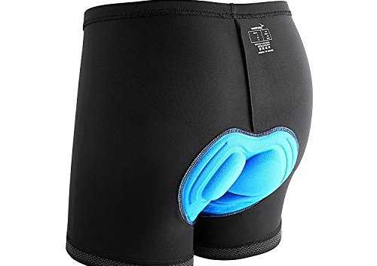
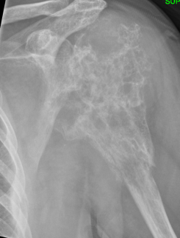
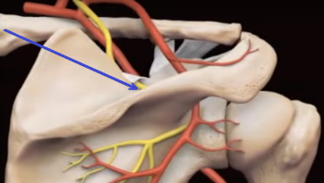
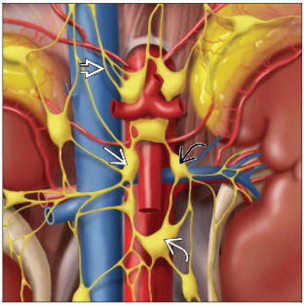
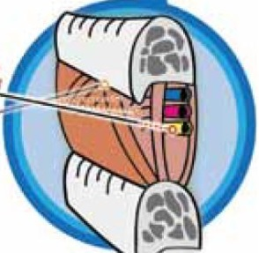
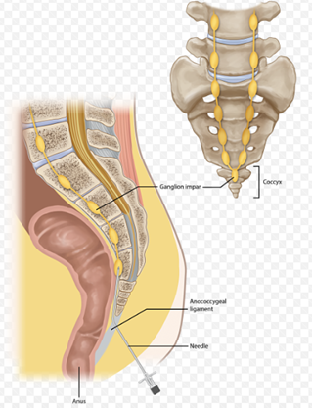
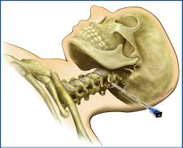
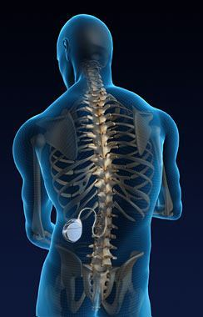
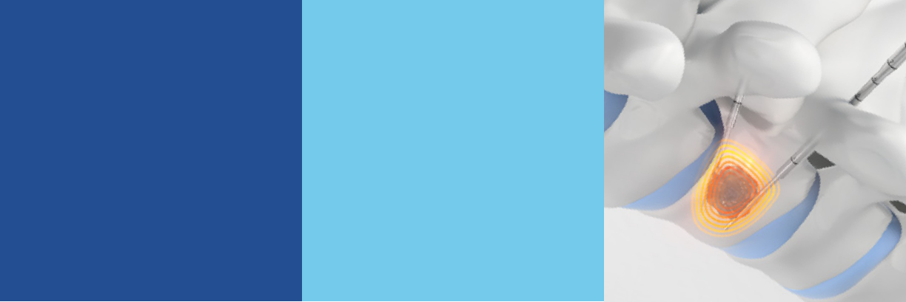
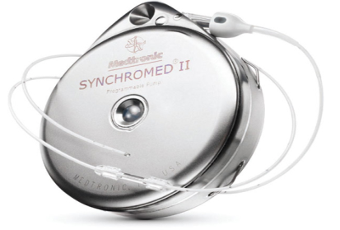



Slide 3
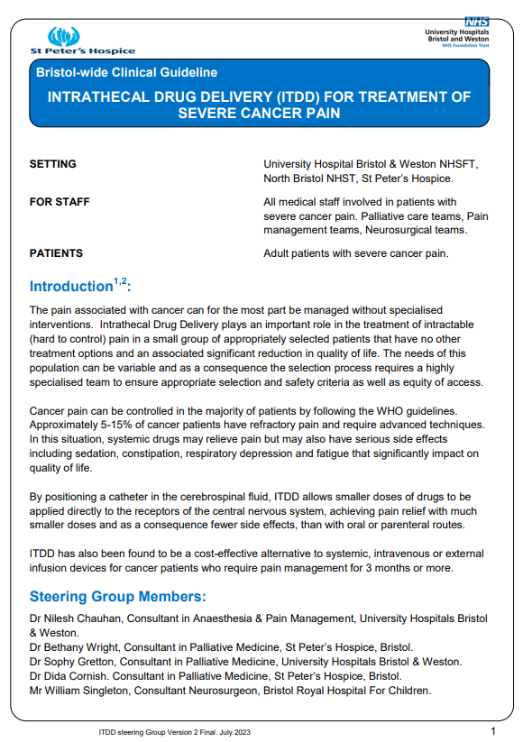
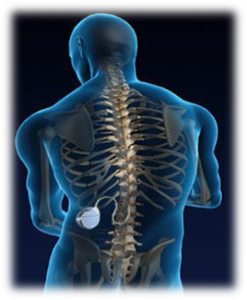
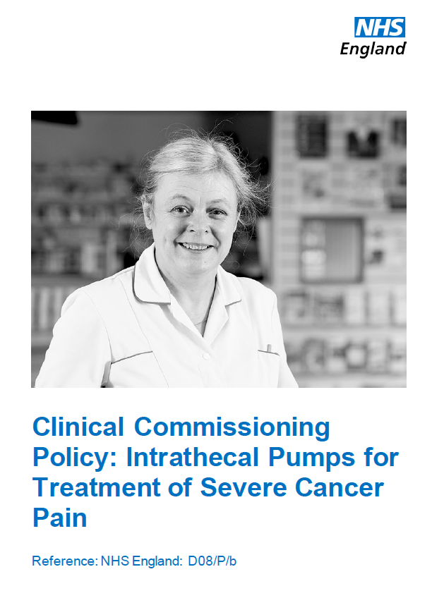
Intrathecal Drug Delivery (ITDD)

Slide 4

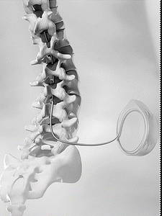
ITDD
Clinical Commissioning Policy: Intrathecal Pumps for Treatment of Severe Cancer Pain
5-15% of cancer patients have refractory pain
systemic drugs may relieve pain but may also have serious side effects
Placing a catheter in the cerebrospinal fluid, ITDD allows smaller doses of drugs to be applied directly to the receptors of the CNS
Cost-effective alternative to systemic, IV or external infusion devices for cancer patients who require pain management for 3 months or more

Slide 5
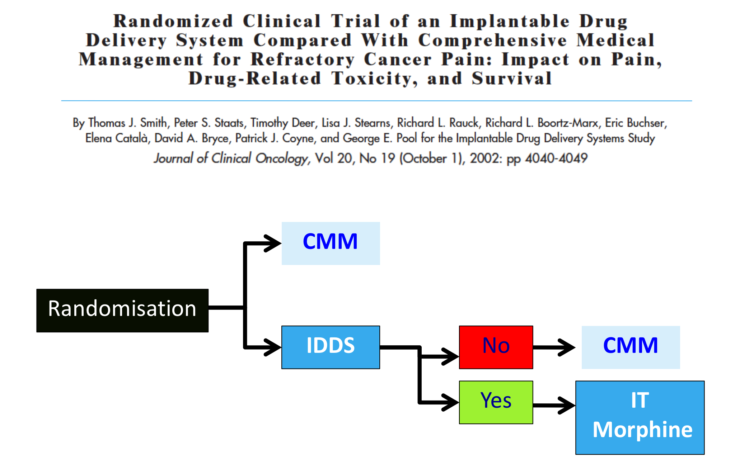
Notes:
Study presented at Rome conference
Primary outcome > 20% VAS and >20 % toxicity reduction. 200 pts powered to detect the >20% reduction
Showed reduction in VAS and toxicity

Slide 6
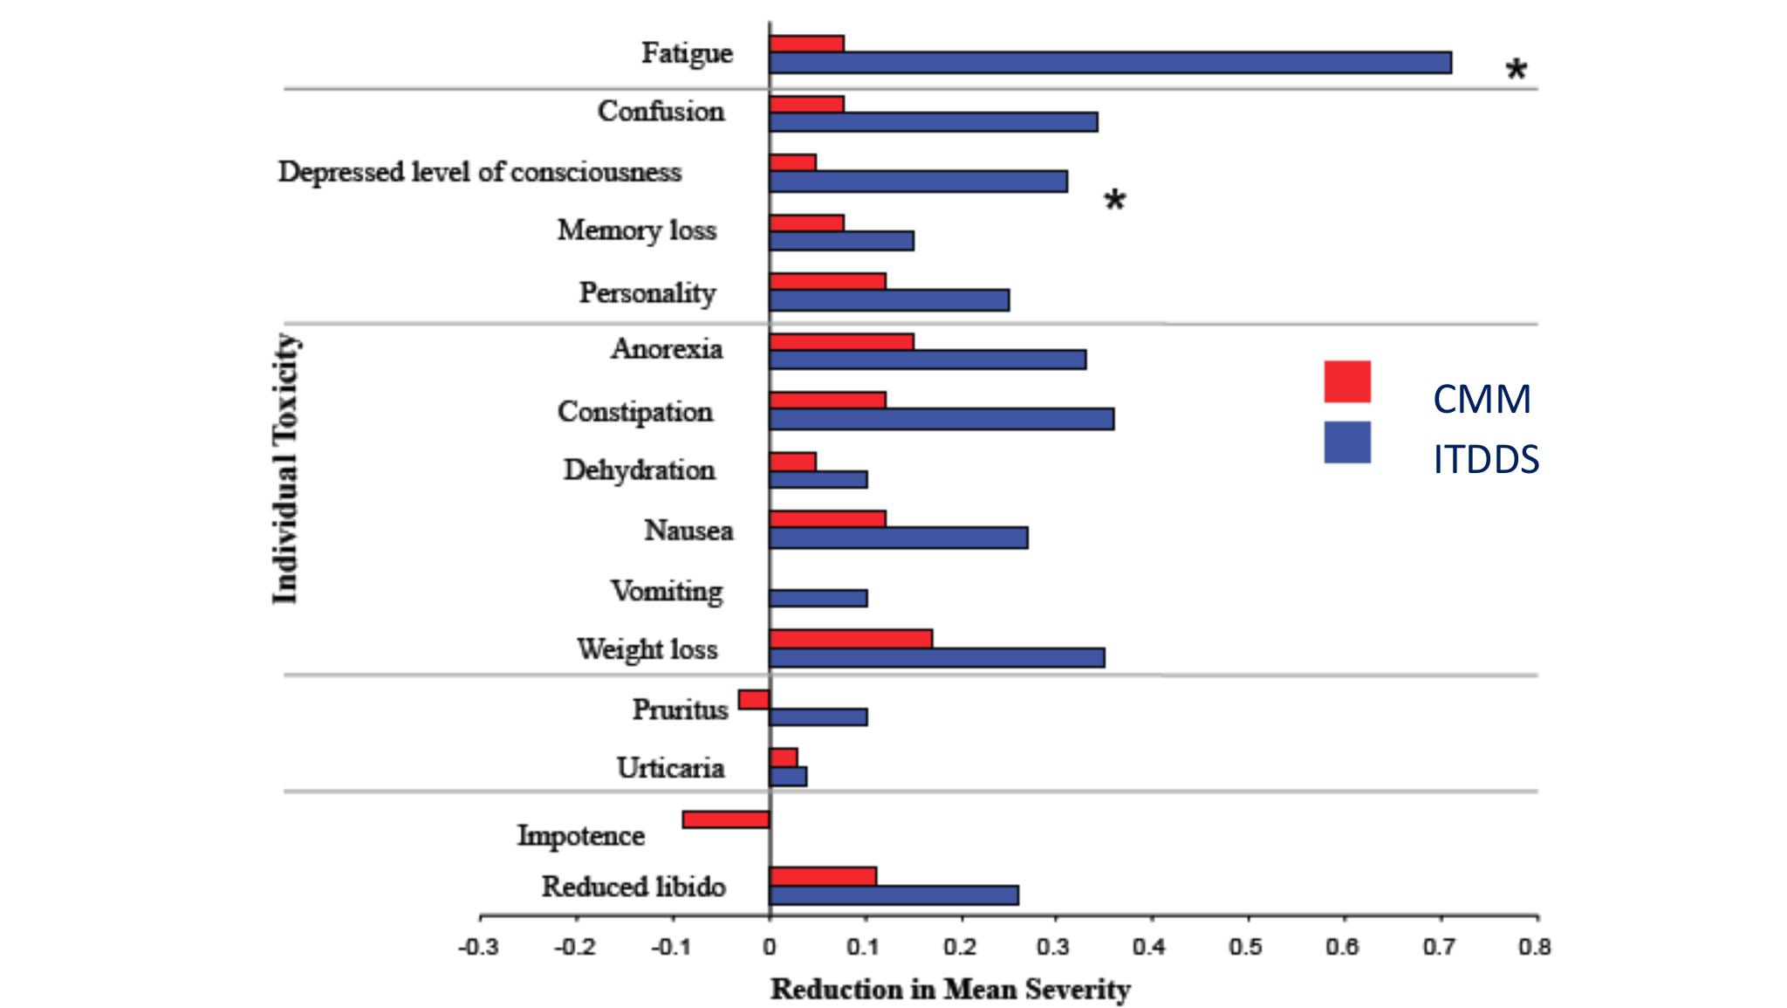
Side effects

Slide 7
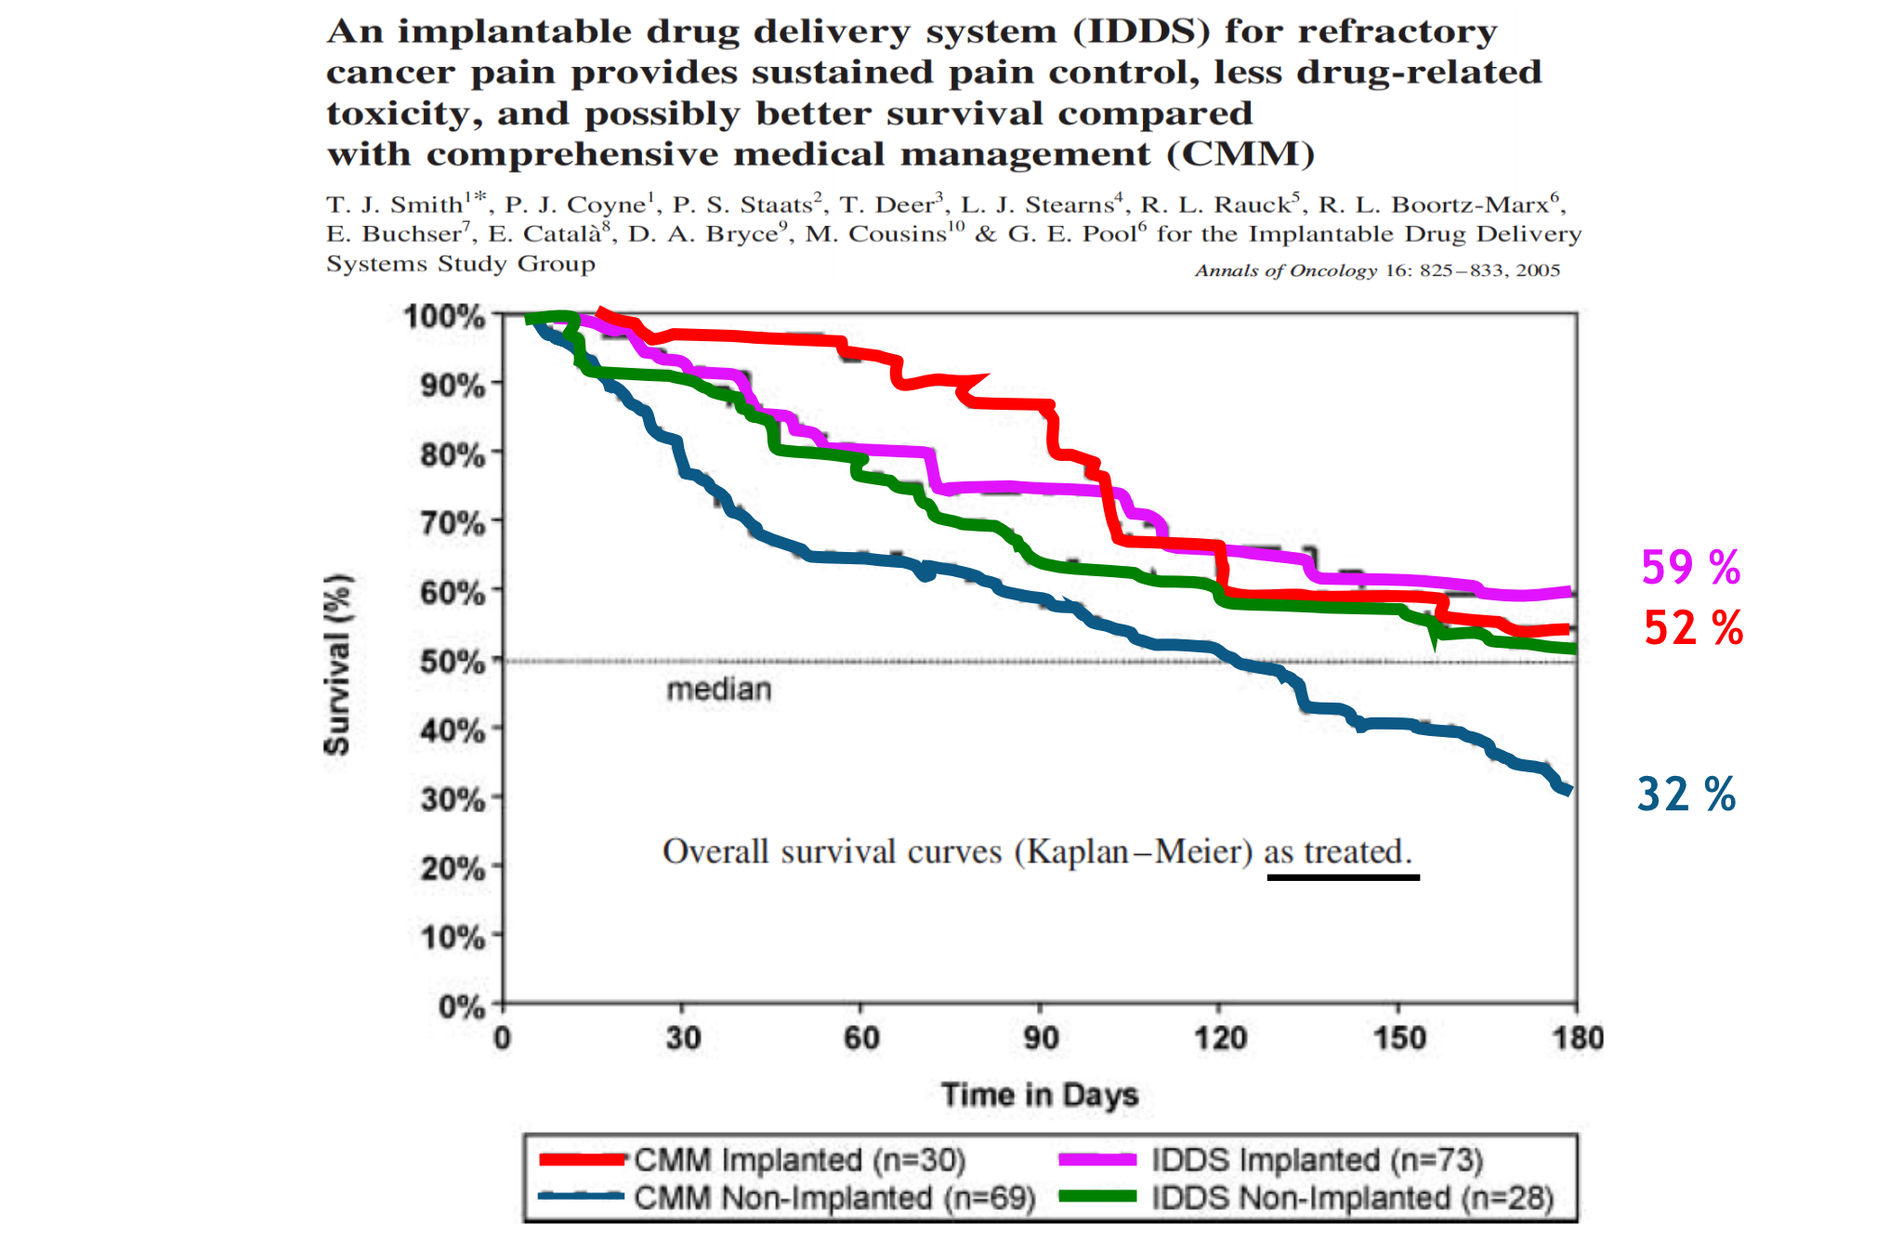

Slide 8
ITDD – eligible criteria
Severe pain of known origin that has failed to be satisfactorily managed despite conventional and specialised pain management or where that pain control is partially achieved but with unacceptable side effects.
Life limiting diagnosis: Prognosis and life expectancy (>3-6 months),
Pain usually perceived below the diaphragm (e.g. spinal, pelvic or lower limb tumour).
A trial of properly managed oral/transdermal opioids has achieved some pain reduction however continued use is limited by high opioid toxicity. (>100mg/day oral morphine equivalent)

Slide 9
ITDD – other criteria
Consideration of social and medical support systems
Within reasonable distance of UHB and St Peter’s hospice to attend appointments,
Fitness to undergo surgery and anaesthesia.

Slide 10
ITDD – contraindications
Pregnancy or nursing mother or planning to get pregnant,
Any concomitant treatment or medical condition that would render ITDD administration hazardous,
Infection, (likely to have repeated septic episodes)
Un-correctable bleeding disorder,
Logistical difficulties with after care including pump refills, funding of ongoing ITDD.

Slide 11
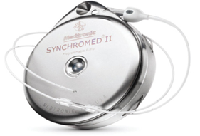
Eligible patients to be discussed by the MDT palliative care team – work up to include bloods, MRI head and whole spine
Referral for Pain Clinic assessment
Admission to BRI for trial
Admission to BRI for implantation by neurosurgeons
Outpatient refills at Pain Clinic (Central Health Clinic)

Slide 12
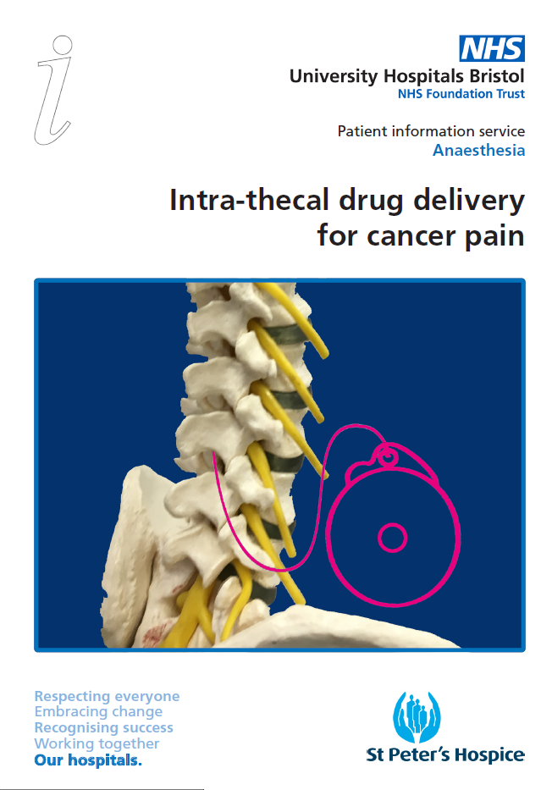

Slide 13
Complications
Overall 3% for lifetime of implant:
  Drug infusion related
  Neurological – requiring urgent investigation
  Infection
  CSF leak
  Catheter displacement

Slide 14
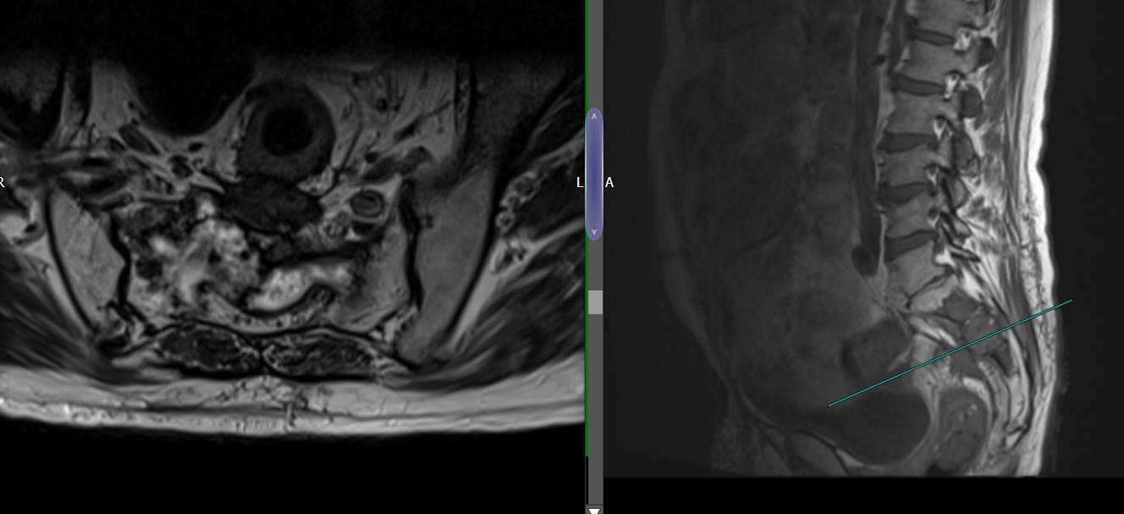
59yr male, good functional status
Rectal adenoCa, prev surgery, chemo/radiotherapy
Local recurrence with liver, lung mets (stable) sacral mass involving sacral nerve roots
Pregabalin 200mg tds
Naproxen, Nefopam, amitriptylline 30
Conazepam
Oxycodone – side effects.
Break from palliative chemo due to pain/side effects of analgesics
Assessed in pain clinic

Slide 15
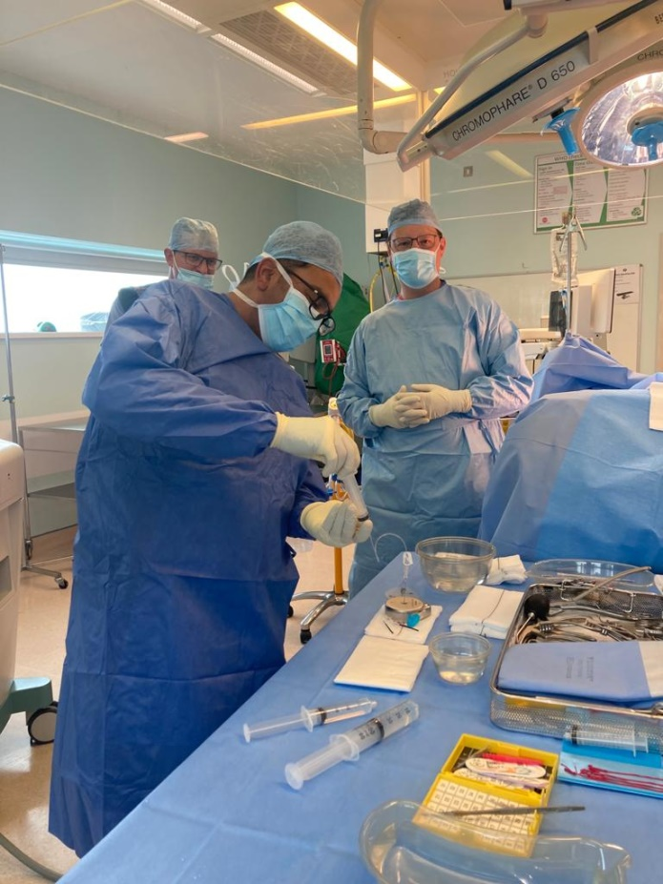
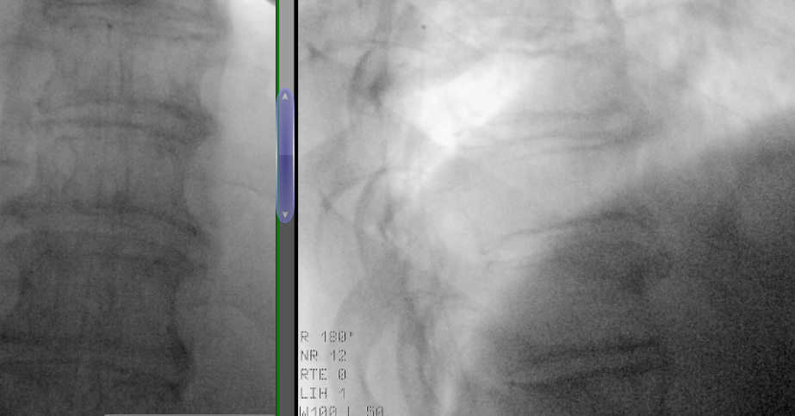
Acute admission with pain – hourly 10mg oxynorm – test dose spinal 300mcg morphine + 2.5mg L-bupivicaine
Successful – no opioids required for 24hrs
Proceed to implantation – theatre 8 HGT
Catheter to T9

Slide 16
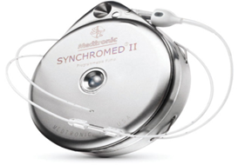
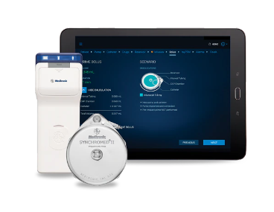
40ml Medtronic Synchromed II pump
Plymouth (Dr Som Bagchi) and Phoenix (Dr Lisa Stern) recipe
600mg Bupivicaine + 200mg Morphine (total 40mls)
Starting rate:
  0.73mg/day bupivicaine + 0.24mg/day morphine
Plan to titrate by 10% weekly till effective

Slide 17
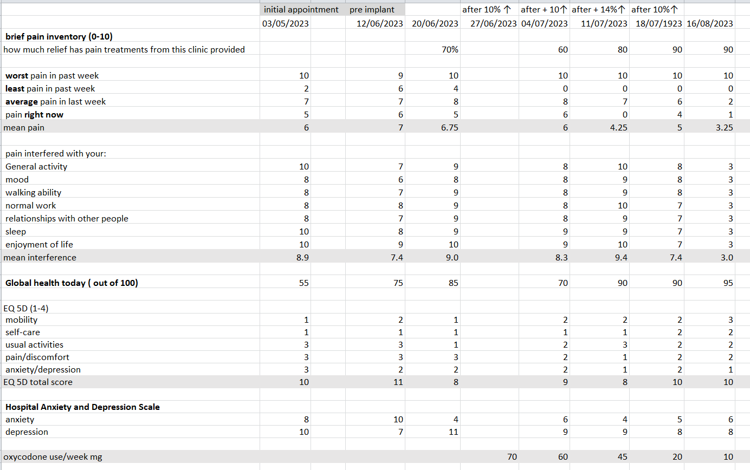

Slide 18
Complications

Slide 19
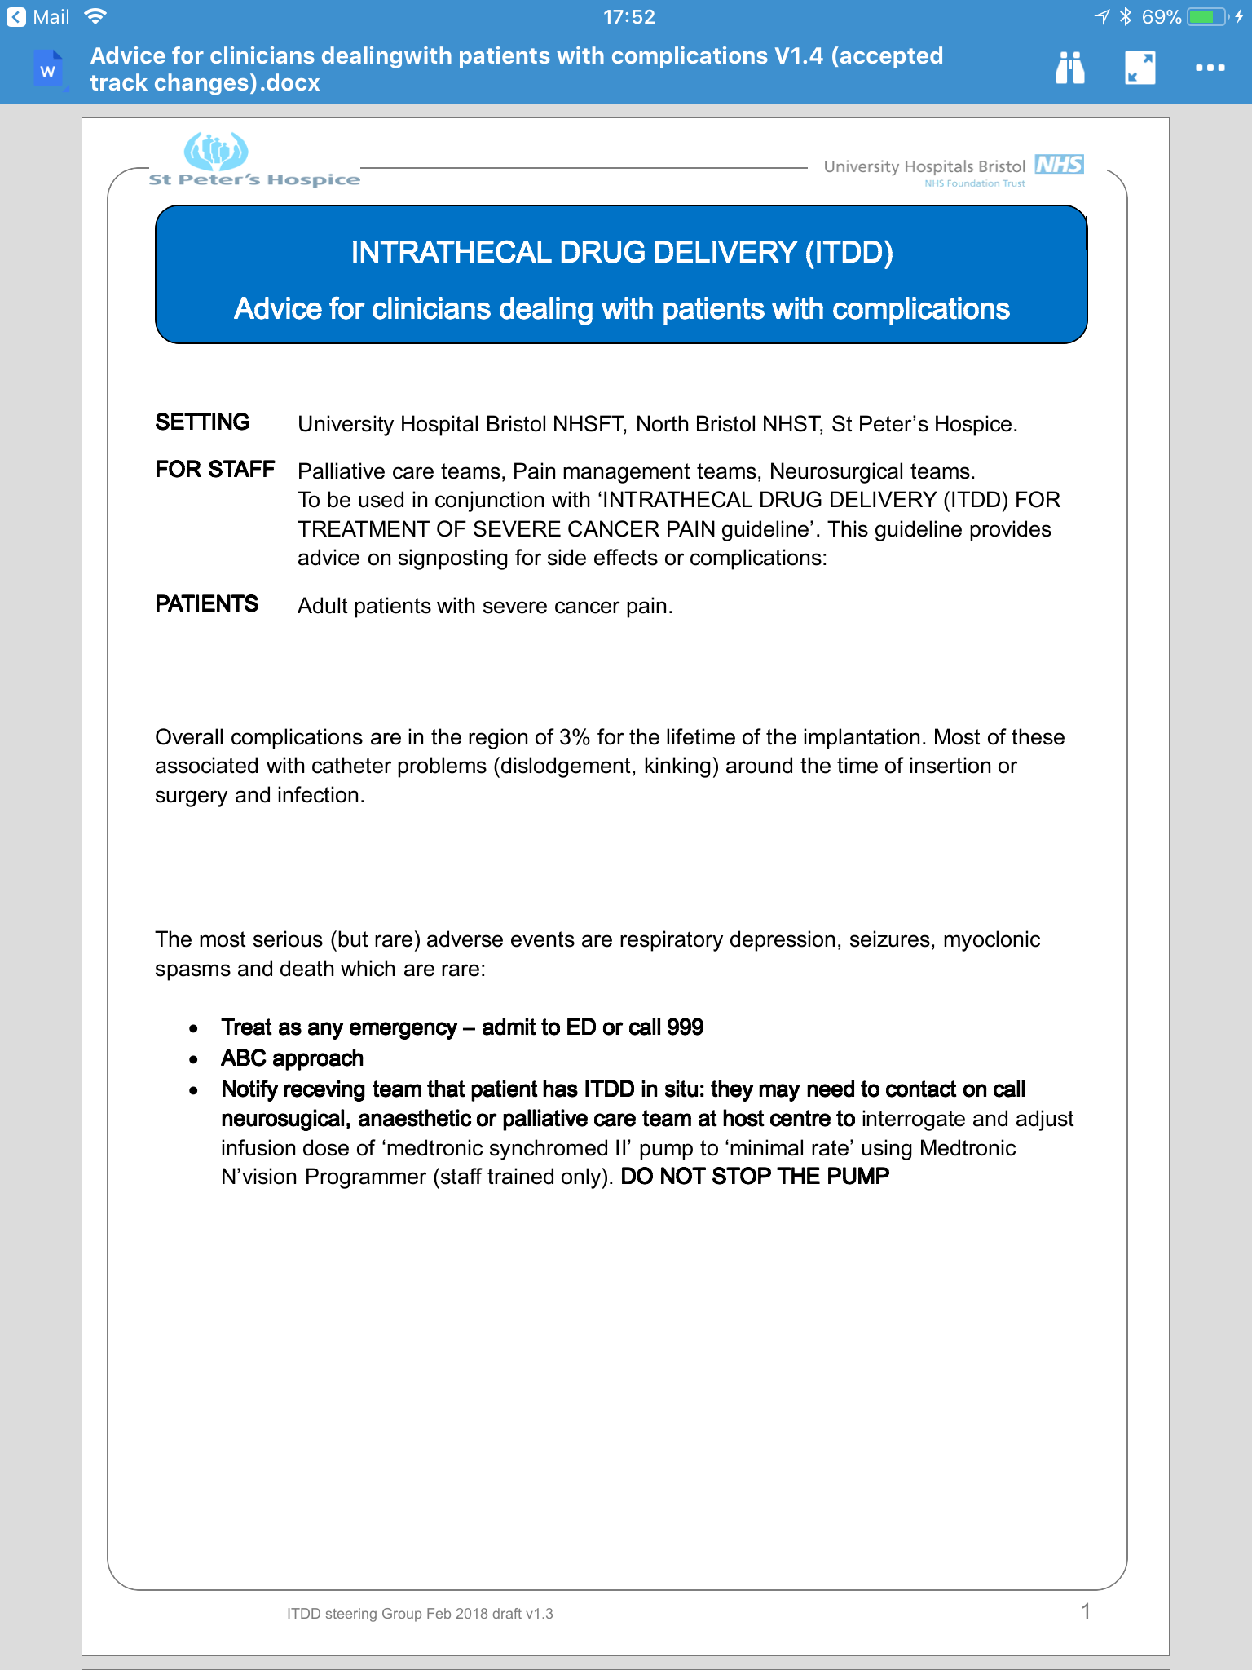

Slide 20
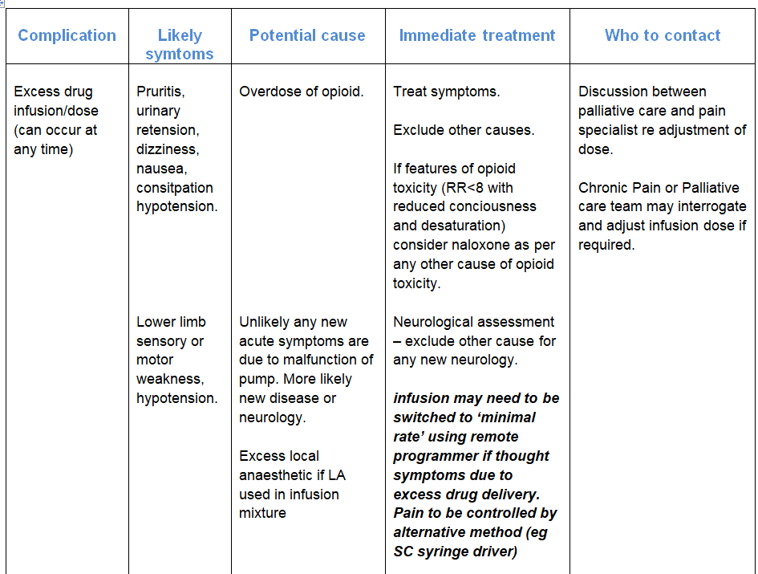

Slide 21
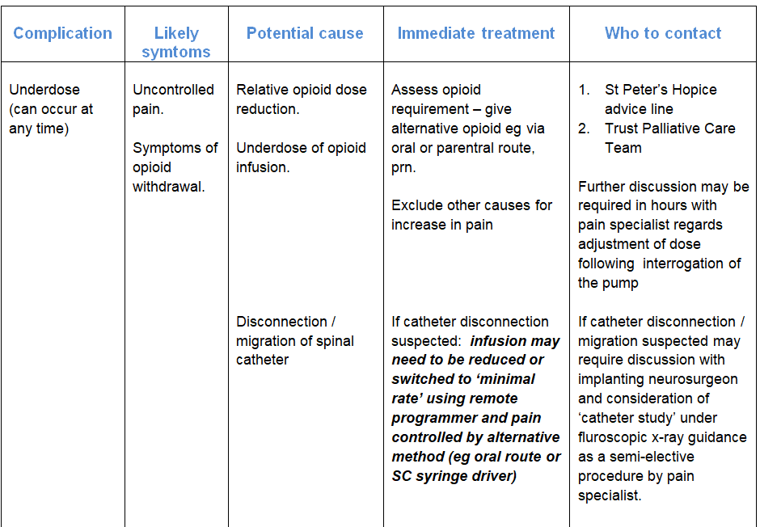

Slide 22
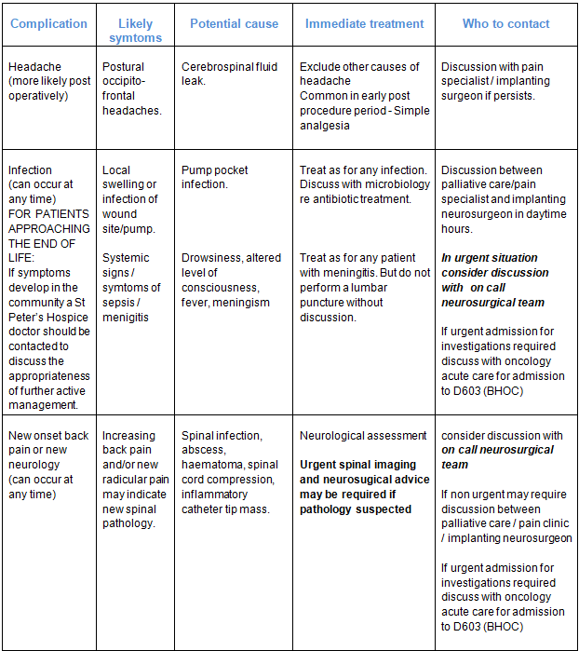

Slide 23
Contacts
St Peter’s Hospice 24hr Advice line – 0117 9159430
Pain Management Clinic – 0117 3427575
Palliative and Supportive Care team UHBW via switch
Acute Oncology – ward D603
Adult Neurosurgical On Call –Southmead Hospital

Slide 24
Summary - ITDD
Severe (infra-diaphragmatic) pain despite adequate trial of conventional analgesia or with unacceptable side effects.
>100mg/day oral morphine equivalent (or less if side effects)
Good performance status (fit to undergo GA and attend OP appts)

Slide 25


Started regular rounds with UHBW SPCT and joint OP clinic in BHOC
Unmet need? Your pts with life limiting diagnosis, pain and >100mg/OME
Early CPB block +/- neurolytic?
Suitable for ITDD
    - Chemo window?
    - Spine Imaging

Slide 26
CHRONIC PAIN MANAGEMENT CLINIC
Central Health Clinic, Tower Hill,
Bristol BS2 0JD
Nilesh.chauhan@uhbw.nhs.uk
helen.hopkins@uhbw.nhs.uk (clinic co-ordinator)
Tel: 0117 342 7575

Slide 27






1st Wednesdays of the month 8.30 - 9.30am on Teams
Complex cancer pain – MDT
Forum to discuss any difficult to manage cancer pain patients
Consideration of interventional procedures
Palliative care, interventional radiologist and pain specialist presence
All welcome
If you would like discuss a patient at the meeting, please email
Bethany.wright1@nhs.net
Regular meetings take place 1st Wednesday of every month

