Slide 1
A regional audit on the management of locally advanced rectal cancer: Total neoadjuvant therapy vs long course chemoradiotherapy
Manuela Amaya
Alex maling
David messenger
Tom strawson-smith

Slide 2
Outline
Background
Practice changing trials – 2024 update
Previous local audits
Regional Project

Slide 3
Background – TNT vs LCCRT
Use of total neoadjuvant therapy for high risk LARC followed by surgery, or adopting a non-operative management (NOM) approach
Landmark trials: RAPIDO, PRODIGE-23, OPRA
Improved disease-free survival, overall survival and rates of organ preservation
Substantial variation in the choice of TNT sequence and regimen across the world
High Risk Features
CRM +
Enlarged lateral LNs
N2
EMVI +
T3/4

Slide 4
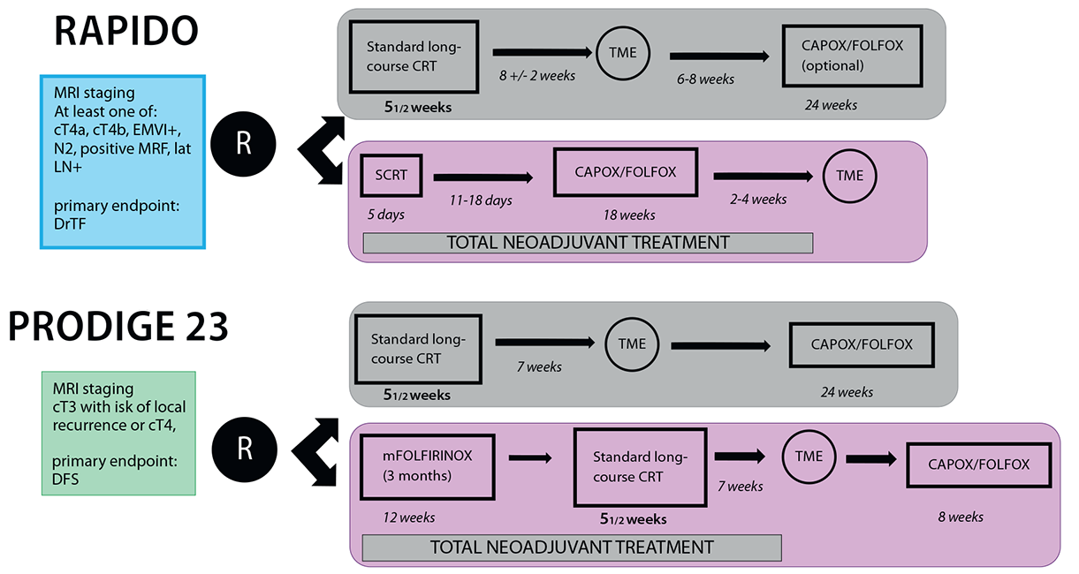
PRACTICE CHANGING TRIALS
The Changing Landscape of Neoadjuvant Therapy in Rectal Cancer. May 2021. BSMO meeting 2021.

Slide 5
Organ preservation
OPRA Trial – Phase 2 RCT
Compared timing of LCCRT and NAC (CAPOX or FOLFOX) – induction vs consolidation
Patients with cCR or near cCR were assigned to watch and wait (WW)
Patients with an incomplete response and residual tumour underwent TME
No difference in 3-year DFS between groups
WW in patients who achieve a cCR is a viable treatment strategy – 50% of patients

Slide 6
Clinical Outcomes | RAPIDO (Exp vs Std) | PRODIGE-23 (Exp vs Std)
Primary endpoint | 3-yrs DrTF | 3-yrs DFS
3-yrs primary event 5-yrs 7-yrs | 23.7% vs 30.4% (6.7%) 27.8% vs 34% (7%) | 76% vs 69% (7%) 73.1% vs 65.5% (7.6%) 67.7% vs 62.5%
HR (95% CI) p value | 0.75 (0.6 – 0.96) p=0.019 | 0.69 (0.49-0.97) p= 0.034
pCR rate | 28.4% vs 14.3% | 27.5% vs 11.7%
Local relapse rate | 8.7% vs 5.4% at 3 yrs 11.7% vs 8.1% at 5yrs P = 0.007 | 5.3% vs 8.1% at 7 years
Distant relapse rate | 23% vs 30.4% at 5 yrs | 20.7% vs 27.7% at 7 years
3-yrs OS 5-yrs OS 7-yrs OS | 89.1% vs 88.8% 81.7% vs 80.2% | 90.8% vs 87.7% 86.9% vs 80% 81.9% vs 76.1%
TRIAL UPDATES

Slide 7
Previous LOCAL audits
UHBW: Single Centre Experience of Total Neoadjuvant Therapy Compared with Long Course Chemoradiotherapy (LCCRT) Alone for Locally Advanced Rectal Cancer 2021 - 2022
Somerset FT: Total Neoadjuvant Therapy for Rectal Cancer – A review of local data 2021-2024

Slide 8
Results – baseline characteristics
TNT | SFT (n = 60) MPH (n= 38) YDH (n=22) 3 years 2021 - 2024 | UHBW (n = 41) 2 years 2021-2022
Median Age (years) | 62 | 60
Performance Status (%) 0 1 | 75 25 | 76 24
CRM + (%) | 43 | 46
T3 (%) T4 (%) N2 (%) | 67 20 37 | 75 15 51
EMVI + (%) | 67 | 64

Slide 9
Treatment protocol – number of patients

Slide 10
Outcomes – complete response rates & WW

Slide 11
Conclusions & Future work
UHBW
- Higher rates of pCR in TNT but similar rates of organ preservation vs LCCRT
- Long term recurrence data needed to confirm outcomes
- Audit local watch and wait practice and outcomes
SOMERSET FT
- Outcomes similar to trials (although short follow up period)
- Long term follow up needed
- Evaluate outcomes for patients treated with LCCRT alone

Slide 12
Regional audit - Project aims & objectives
To establish current practise of LARC across SWAG Network
Compare outcomes between TNT and LCCRT
Establish tolerability of neoadjuvant treatment
Assess current watch and wait practices
Suggest regional clinical guidelines

Slide 13
Methods
Regional audit - SWAG Trusts
Lead in each trust with supervising consultant if lead is a trainee
Local lead responsible for registering audit locally, and identifying patients from surgical, radiotherapy and chemotherapy databases
Data collection via REDCap - https://redcap.uhbw.nhs.uk/

Slide 14
Inclusion/exclusion criteria
Adults >18 years
Histological and/or radiological diagnosis of locally advanced rectal cancer (metastatic patients excluded)
Rectal radiotherapy between January 2021 and December 2023 : TNT or LCCRT alone
Patients on Watch & Wait protocol – any treatment between January 2013 and December 2023

Slide 15
Audit criteria
Total neoadjuvant therapy should be offered to patients with rectal tumours with any of the following features; T3, T4, N1, N2, EMVI and/or tumour deposits, and threatened or involved CRM or inter-sphincteric plane.
Assessment of clinical response in patients treated with TNT should be performed within 8 (+/-) 4 weeks after TNT if treated with LCCRT, within 2- 4 weeks after TNT if SCRT used, and within 8 (+/-) 2 weeks if treated with LCCRT alone.
Patients who achieve a complete clinical response should be offered a discussion regarding the risks and benefits of NOM.
Patients on W&W protocol should have clinical examination OR flexible sigmoidoscopy every 3-6 months for 2 years, then every 6 months for a total of 5 years AND MRI rectum every 6 months for up to 3 years, AND CT chest/abdomen every 6 to 12 months for a total of 5 years.
Pathological complete response rates in patients treated with TNT should be at least 28%
Local recurrence rates of less than 8% at 3 years in TNT patients

Slide 16
audit timeline
November 2024: Identification of study lead from each trust, and distribution of protocol.
December 2024: REDCap user account registration and identification of eligible patients.
January 2025 to April 2025: Data Collection to be complete by 30th April 2025
May 2025 to July 2025: Data analysis and submission of abstracts for publication

Slide 17
Questions?

Slide 18
References
Neoadjuvant chemotherapy with FOLFIRINOX and preoperative chemoradiotherapy for patients with locally advanced rectal cancer (UNICANCER-PRODIGE 23): a multicentre, randomised, open-label, phase 3 trial Conroy, ThierryBorg, Christophe et al.The Lancet Oncology, Volume 22, Issue 5, 702 – 715
Short-course radiotherapy followed by chemotherapy before total mesorectal excision (TME) versus preoperative chemoradiotherapy, TME, and optional adjuvant chemotherapy in locally advanced rectal cancer (RAPIDO): a randomised, open-label, phase 3 trial Bahadoer, Renu RØstergaard, L. et al. The Lancet Oncology, Volume 22, Issue 1, 29 – 42
Total neoadjuvant therapy with mFOLFIRINOX versus preoperative chemoradiation in patients with locally advanced rectal cancer: 7-year results of PRODIGE 23 phase III trial, a UNICANCER GI trial.. Conroy, ThierryBorg, Christophe et al. JCO 41, LBA3504-LBA3504(2023).
Organ Preservation in Patients With Rectal Adenocarcinoma Treated With Total Neoadjuvant Therapy. Garcia-Aguilar, Julio et al. Journal of clinical oncology : official journal of the American Society of Clinical Oncology vol. 40,23 (2022): 2546-2556. doi:10.1200/JCO.22.00032
Total Neoadjuvant Treatment for Locally Advanced Rectal Cancer Patients: Where Do We Stand? Valentina Daprà et al. Int. J. Mol. Sci. 2023, 24(15), 12159;

