Slide 1
The Diagnostic Accuracy of FIT in adults under 50 years
David Messenger
Consultant Colorectal Surgeon & Colorectal Cancer MDT Lead UHBW
University Hospitals Bristol & Weston

Slide 2
Rationale: the Problem
Rapid increase in early onset colorectal cancer (EOCRC)
Defined as CRC diagnosis in patient aged <50 years
Patients <50 years now account for 10% of new diagnoses in SWAG
South-West England experiencing most rapid increase in EOCRC in UK
70% of EOCRC patients diagnosed with stage III/IV disease
Distal tumours predominate
55-60% in either sigmoid or rectum
75% sporadic in nature
55% 10-year overall survival vs. 85% if known genetic component

Slide 3
Rationale: FIT use
Faecal immunohistochemical test (FIT) introduced in diagnostic pathways
Screening – expanding to adults aged 50-74 years
Symptomatic 2WW
Diagnostic performance well established
2WW referral based on ≥3% CRC risk in symptomatic population
Current NICE recommendation of ≥ 10µg/g faeces
Negative predictive value (NPV) 99.4% + at this value
A good ‘rule out’ test if negative

Slide 4
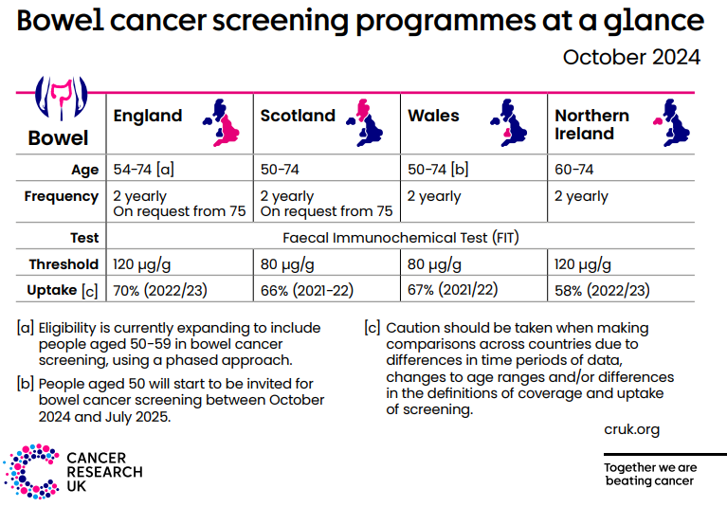
Rationale: FIT thresholds
Bowel Cancer Screening Programme
Symptomatic 2WW pathway
NICE DG56, August 2023
Recommendation for threshold reduction to 20µg/g
Clear knowledge gap about diagnostic performance in young adult population

Slide 5
Evidence base for FIT in adults <50 years
Only 4 studies to date attempting to assess diagnostic accuracy
Study | Total FIT (n) | CRC (n) | Prevalence (%) | PPV @ 10µg/g | NPV @ 10µg/g
Symptomatic
Juul et al., Br J Cancer 2018 | 848 | 4 | 0.5 | 7.0 | NS
D’Souza et al. Col Dis 2021 | 1103 | 16 | 1.5 | 6.8 | 99.7
Pin-Vieitio et al. UEGJ 2021 | 8866 | 27 | 0.3 | 7.3 | 99.9
Total | 10817 | 47 | 0.4 | - | -
Screened
Kim et al., Dig&Liv Dis 2017 | 21942 | 4 | 0.02 | NS | NS

Slide 6
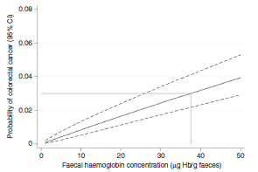
Previous study in SWAG in adults ≥50 years
Total FIT (n) | CRC (n) | Prevalence (%) | Sensitivity (%) | Specificity (%) | PPV @ 10µg/g | NPV @ 10µg/g
3890 | 43 | 1.1 | 84.3 | 85.0 | 7.0 | 99.8
3% risk of CRC
37µg Hb/g
(95% CI: 26 - 50)
Br J Cancer 2021

Slide 7
Aims
Determine diagnostic accuracy of FIT in population with sufficient cases and tests
Determine FIT thresholds that correspond to 3% CRC risk
PPV α Prevalence

Slide 8
Methodology
Conducted across SWAG Alliance
All symptomatic adults 18-50 years presenting to primary care with lower gastrointestinal and who had FIT
From 01/01/2022 to 10/07/2023
All adults 18-50 years with new diagnosis of CRC
From 01/01/2022 to 10/07/2024
Ensure at least one-year follow period where CRC could be diagnosed
Obtained from all Trusts undertaking CRC resections within SWAG
Datasets linked by NHS number

Slide 9
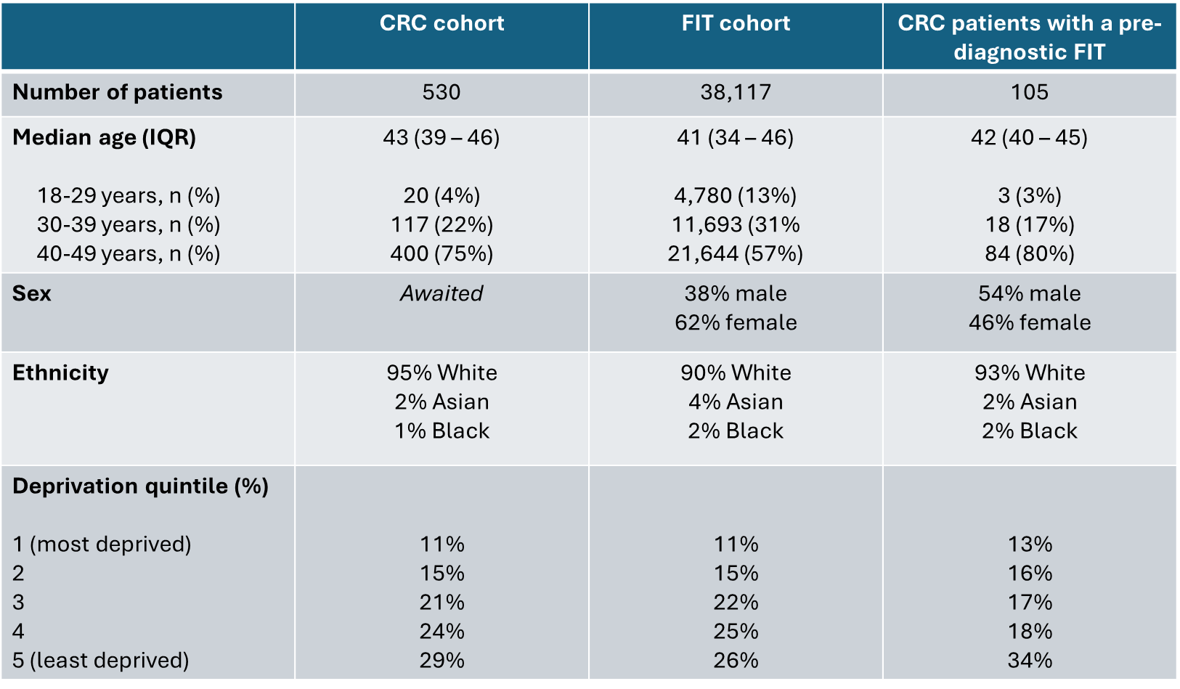
Results: Demographics

Slide 10
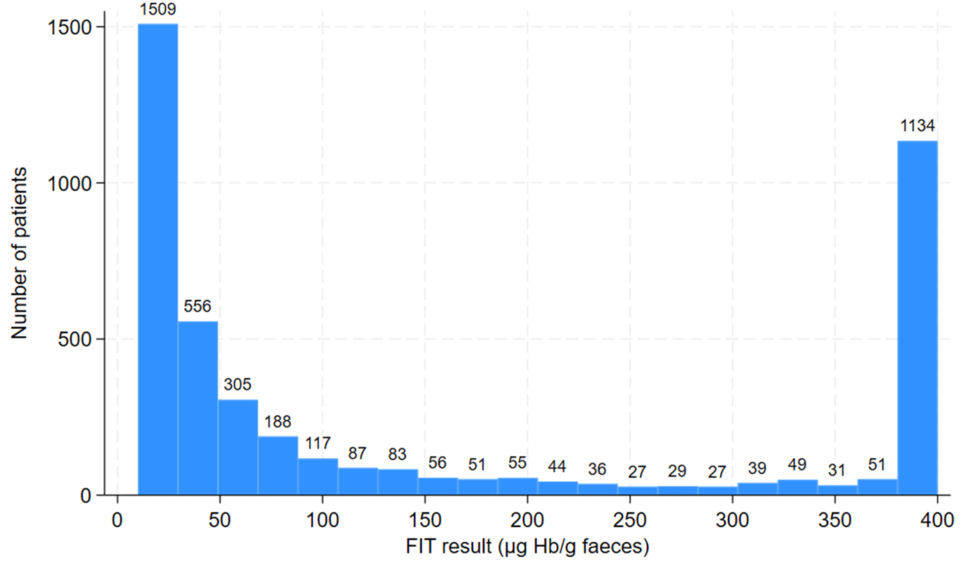
Results: FIT result distribution ≥10µg/g
FIT ≥10µg/g in 11.7%

Slide 11
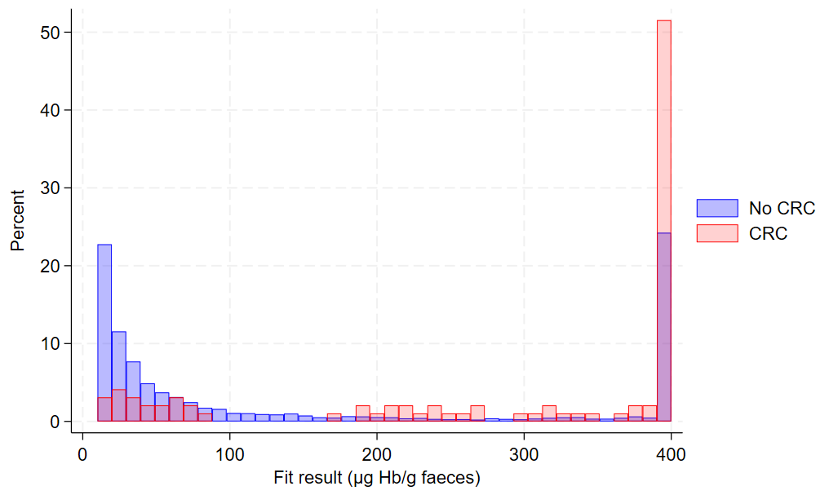
Results: FIT result (≥10µg/g) by CRC status

Slide 12
Results: Diagnostic performance @10µg/g

Slide 13
Results: FIT thresholds in 18-39 years
Threshold | Sensitivity | Specificity | PPV | NPV
10 | 90.5 (90.0 – 90.9) | 87.8 (87.3 – 88.3) | 0.9 (0.8 – 1.1) | 99.99 (99.97 – 100)
20 | 85.7 (85.2 – 86.3) | 90.5 (90.0 – 90.9) | 1.1 (1.0 – 1.3) | 99.98 (99.96 – 100)
30 | 81.0 (80.4 – 81.6) | 91.8 (91.4 – 92.2) | 1.3 (1.1 – 1.4) | 99.97 (99.95 – 100)
40 | 76.2 (75.5 – 76.8) | 92.7 (92.3 – 93.1) | 1.3 (1.1 – 1.5) | 99.97 (99.94 – 99.99)
50 | 71.4 (70.7 – 72.1) | 93.2 (92.8 – 93.6) | 1.3 (1.2 – 1.5) | 99.96 (99.93 – 99.99)
75 | 61.9 (61.2 – 62.7) | 94.2 (93.9 – 94.6) | 1.4 (1.2 – 1.5) | 99.95 (99.91 – 99.98)
100 | 61.9 (61.2 – 62.7) | 94.8 (94.4 – 95.1) | 1.5 (1.3 – 1.7) | 99.95 (99.91 – 99.98)

Slide 14
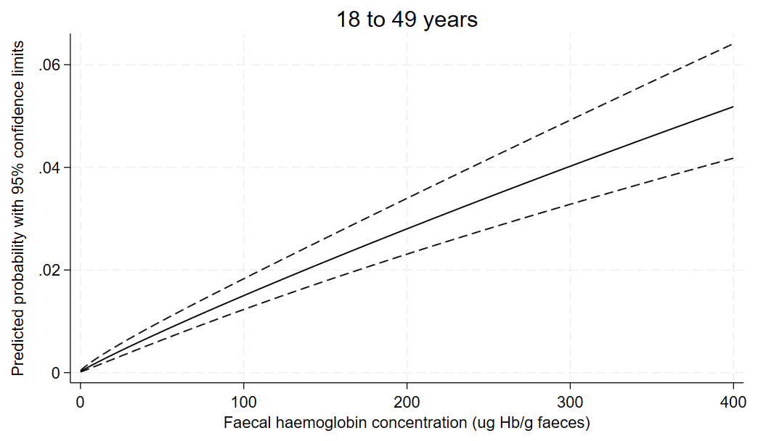
Results: Individual risk of CRC by FIT result
3% risk of CRC
213ug Hb/g
(95% CI: 173 - 266)

Slide 15
Results: Compared to previous studies
Study | Total FIT (n) | CRC (n) | Prevalence (%) | PPV @ 10µg/g | NPV @ 10µg/g
Symptomatic
Juul et al., Br J Cancer 2018 | 848 | 4 | 0.5 | 7.0 | NS
D’Souza et al. Col Dis 2021 | 1103 | 16 | 1.5 | 6.8 | 99.7
Pin-Vieitio et al. UEGJ 2021 | 8866 | 27 | 0.3 | 7.3 | 99.9
Total | 10817 | 47 | 0.4 | - | -
SWAG study | 38117 | 105 | 0.28 | 2.2 | 99.98

Slide 16
Conclusions
The diagnostic performance of FIT in adults <50 years is at least as good as in adults ≥50 years
FIT threshold @10µg/g corresponds to lower PPV than previously reported
Lower prevalence of CRC in adults <50 years in SWAG population
May reflect increased use of FIT
20% of NBT laboratory processing in adults <50 years
Appears an appropriate threshold for adults aged 40-49 years
FIT threshold should be increased in adults aged 18-39 years
20 or 30µg/g appear suitable based on sensitivity and specificity

Slide 17
Future Directions
Determine predictive accuracy of FIT for high-risk polyps & CRC in adults <50 years in symptomatic population
Include blood tests, polyp/tumour pathology into predictive model
Determine predictive accuracy of FIT in asymptomatic population
Tailored screening based on polygenic and environmental risk scoring

Slide 18
Thank you!
Early Detection of Colorectal Cancer in Young Adults research team
Dr Sarah Bailey, University of Exeter
Dr Melissa Barlow, University of Exeter
Mr Ryan Preece, University of Bristol & Severn Deanery
Mr Adam Chambers, University of Bristol & Severn Deanery
Dr Adrian Heaps (& Team), Severn Pathology Laboratory Manager, NBT
Dr Helen Winter, Clinical Director, SWAG Clinical Alliance
Cancer Managers at UHBW, NBT, Gloucestershire, RUH Bath & Salisbury

