Slide 1
FIT and IDA

Slide 2
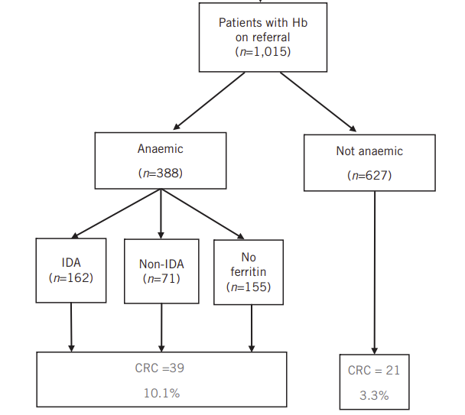
The concern
Pretest probability with IDA is higher than for other symptoms
Nottingham and East Sussex reported (tiny numbers of) FIT negative cancers in patients with IDA
Chapman et al. BJS Open 2019
Cunin et al. Surg 2021
Mashlab et al. Ann R Coll Surg Engl 2018; 100: 350–356

Slide 3
ACPGBI/BSG recommendations
Recommend using FIT10 to triage patients for colonoscopy
Still consider OGD +/- CT for negative FIT
Based on larger more recent studies
Show anaemia plus FIT higher PPV (>30%)
IDA and negative FIT still have high NPV (>98%)
Hernandez et al. Frontiers in Medicine 2024
D’Souza et al BJS 2021

Slide 4
Suggest
Examine local data
Number of IDA referrals with and without FIT
Outcome of investigations with and without FIT
Review recommendations based on our own population

