Slide 1
CNS update January 2025
By S Lovell January 2025

Slide 2
NBT CNS team
CNS - increased to x3 with a 2.2wte in Feb 2024. Chris Millman, Becky Peach and Sally Lovell
Now 2 nurses working everyday with 3 on Tuesdays for MDT and clinic.
CSW/Navigator – Hannah Hilton started joint CSW/navigator role Jan 2024, from Sept 2024 reduced to 0.5wte CSW role only. Covering Tues/Weds/Thurs. However, as HH is amazing she is still tracking scans and results within her CSW hours.
Navigator role was advertised but no successful applicants.
Currently, trust-wide navigator roles are unfunded and awaiting decisions regarding future funding.
Supported by CNS Admin Sharon Grant.

Slide 3
Improvements and developments over past 12 months
Benign letters sent to patients following MDT has reduced from 11-week turnaround to 2 weeks.
HNA’s offered:
- 2023 – 16
- 2024 – 107
HNA’s completed:
- 2023 – 9
- 2024 – 64
3rd Nurse – enables CNS team to visit inpatients, attend PDC appointments, respond to more patient phone calls and enquiries, triage in a timely manner, attend speciality OPAs (Thoracic/Urology/Neurosurgery/T&O) to support patients.
CNS follow-up clinics – in the planning, due to commence when I am trained and signed off to triage independently.
End of treatment Summaries are in production. Draft copies agreed for both Plastics and Retroperitoneal patients. Now with the Personalised Care and Support Lead for Cancer for conversion into an electronic version on care-flow. Plan to then integrate them into use.

Slide 4
Triaging
CNS team triage referrals to Sarcoma. Triages received via 2WW referral, routine MDT referral and tertiary referrals. Options on triage include Reject referral, Accept to Main MDT or Accept to Radiology MDT. Prior to CNS triaging all referrals were discussed at Main MDT and were automatically booked OPA’s
In 2024 the CNS team triaged a total of 1348 referrals.
Out of the 1348 referrals; 233 patients were diagnosed with a Sarcoma.
(2023 – 1204 referrals; 206 patients were diagnosed with a Sarcoma)

Slide 5
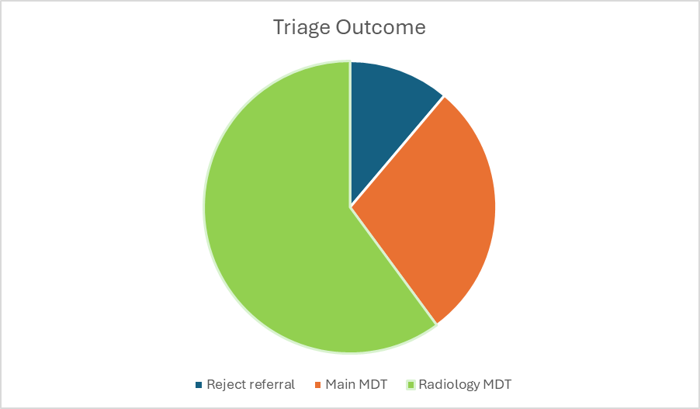
Triaging
What does this mean for the wider team?
807 patients triaged to the radiology MDT, instead of Main MDT.
out of these 807, 430 did not need OPA’s.
150 rejected referrals. Either did not meet the referral criteria or had not had appropriate imaging performed.
Total OPA’s saved - 580 in 2024.

