Slide 1
Remodeling ENT Head & Neck pathways at UHBW
Mr Oliver Dale
ENT Head & Neck Consultant
Contributors: Alex Walkden, Tugba Karagoz, Ross Mercer, Abhinaya Chandra, Rungphloy Jaroenchasri, Andy Hill, Ilko Genkov, Amin Daoud

Slide 2
Background
Two-week wait introduced in 2000 and abolished in 2023 in favour of a new Faster Diagnosis Standard
Targets:
28-day Faster Diagnosis Standard (75%)
62-day referral to treatment standard (85%) UHBW 51.8%
31-day decision to treat to treatment standard (96%)

Slide 3
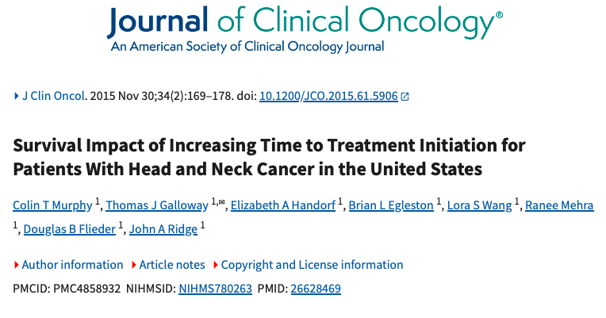

Slide 4
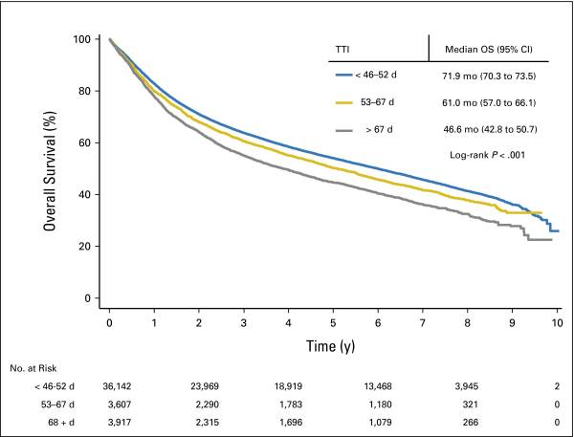

Slide 5
Background at UHBW
Fast-track referrals have increased
120-150 new ENT fast-track referrals per week at UHBW
70 new slots available for head and neck patients
UHBW September 2023 – August 2024 (12 months)
6308 Head and Neck fast track referrals
164 cancers diagnosed (114 ENT, 49 Max Fax, 1 orbital)
Likelihood of cancer = 2.6%
114 ENT cases

Slide 7
7 Day Snapshot
1 week of ENT Head and Neck Fast track referrals

Slide 8
7-day Snapshot: ENT Fast-track referrals at UHBW Week commencing 22nd July 2024
N=144

Slide 9
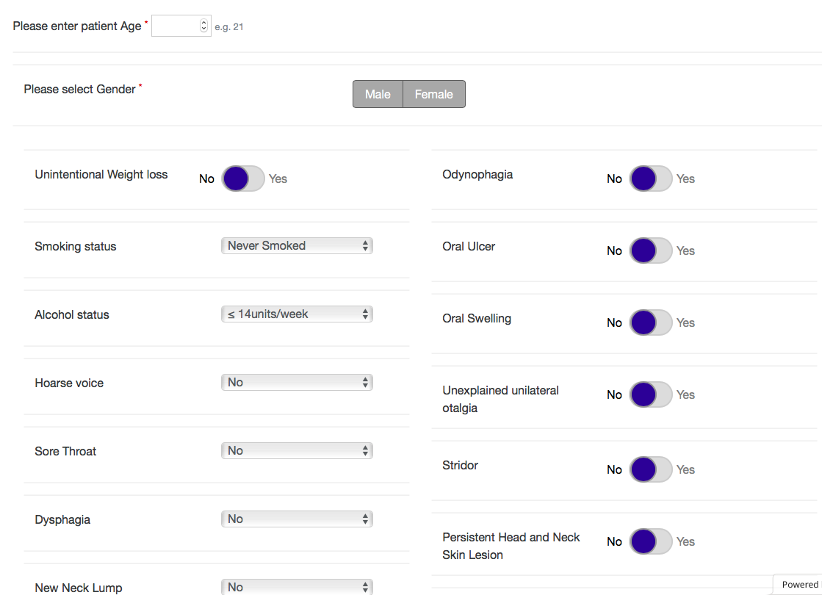
Head & Neck Risk Calculator
Risk Score | Management
>7.1 | Urgent – Suspicion of cancer
2.2-7.1 | Urgent clinic
<2.2 | Routine clinic

Slide 10
7-day Snapshot: ENT Fast-track referrals at UHBW Week commencing 22nd July 2024
N=144
Median Risk score: 1.53 (Range 0.02 – 95.2)
Risk score | Number of patients
<1 | 50 (35%)
1-2.2 | 28 (19%)

Slide 11
7-day Snapshot: ENT Fast-track referrals at UHBW Week commencing 22nd July 2024
N=144

Slide 12
Radiological evidence of malignancy?
Risk Scores for those with radiological evidence of malignancy:
10.00.
10.35.
2.95.
28.36.
3.38.
95.22.

Slide 13
7-day Snapshot: ENT Fast-track referrals at UHBW Week commencing 22nd July 2024
N=144

Slide 14
7-day Snapshot: ENT Fast-track referrals at UHBW Week commencing 22nd July 2024
N=144
Cancer diagnosis
5/144 (3.5%)
2 x oropharynx, 2 x sinonasal, 1 x lymphoma
Risk Score < 1 in 35%
Tests performed
55 (38%) scanned
16 (11%) Booked for surgery
62 (43%) Follow up arranged
Time to first appointment:
Mean 24.6 days (range 0 – 63 days)
20/145 (14%) seen within 2 weeks

Slide 15
1 year Overview – All cancers
All Head and Neck Cancer diagnoses at UHBW 2023-2024

Slide 16
1 year overview: ENT malignancies identified via Head & Neck Fast-track 2023-2024
N=114

Slide 17
1 year overview: ENT malignancies identified via Head & Neck Fast-track 2023-2024
N=114
Median risk score = 25
Range 2.95 - 99.5

Slide 18
We have a problem
Referrals exceed capacity (144 referrals vs 70 new slots)
Low rate of malignancy (2.6%)
Long time to first appointment (mean 25 days)
Low risk score on large proportion (54% < 2.2, 35% < 1)
High proportion referred for diagnostics (38%)
High proportion of follow ups (43%), low rate of PIFU (8%)
Evidence this may be impacting on 62-day referral to treatment (51.8%)

Slide 19
Remodeling Head & Neck services
Triage
Consultant delivered care

Slide 20
Remodeling Head & Neck services - Aims
Earlier diagnosis of cancer
Expedite high risk patients
Reduce delays to scans, theatre and MDT discussion
Earlier reassurance for non-cancer cases
Reduce unnecessary appointments and investigations
Relieve pressure on outpatients, diagnostics and theatres

Slide 21
New model - Triage of fast-track referrals Pilot
Triage
ANP Telephone triage ‘first appointment’
Triage day after referral received
Risk calculator applied
Letter generated with risk score
Risk score (>7.1): Straight to consultant clinic within 2 weeks
Moderate risk (2.2 - 7.1): Urgent fast track appointment
Low risk (1 - 2.2): Urgent fast track appointment
Very low risk (0 - 1) : Offer routine appointment with safety netting, come off fast track.

Slide 22
New model – Exceptions to triage
Neck lumps – not triaged
Highest likelihood of malignancy
Straight to H&N clinic within 2 weeks
Epistaxis with nasal blockage – not triaged
Not included in risk calculator – urgent rhinology appointment
Unilateral glue ear
Not included in risk calculator
Diagnosis often incorrect
Urgent otology clinic
Triage

Slide 23
New model – Roving clinic
Consultant clinics reduced to 6 patients
Consultant adopts ‘roving’role
Consultant opinion on all patients seen by team
Increased access to radiology and theatres
MRI and USS within 48 hours
Ringfenced panendoscopy slots on theatre lists
Consultant delivered care

Slide 24
Triage Pilot: Results
63 patients telephone triaged
5 DNA (no answer)
High risk (Score >7.1) = 16 (25%)
Moderate risk (Score 7.1-2.2) = 13 (21%)
Low risk (Score 2.2-1) = 11 (17%)
Very low risk (Score < 1) = 23 (37%)
High risk:
Mean 9.7 days from referral to F2F appt

Slide 25
Roving clinic pilot
Consultant delivered care
2 pilot roving clinics January 2025
Outcomes for 51 consecutive patients analysed
(Post-ops, long term cancer follow ups and specialist procedures excluded)
Results compared to matched group
51 consecutive patients
Time of year (Jan-Feb 2024)
Case mix and seniority of clinician matched

Slide 26
Roving clinic pilot: Results
Consultant delivered care

Slide 27
Roving clinic pilot: Results
Consultant delivered care

Slide 28
What are the benefits for the department?
Conventional model
July 2024
N=145
72 Discharged
62 Followed up
11 PIFU
55 Scanned
Extrapolated roving model
N=145
91 Discharged
26 Followed up
13 PIFU
4 Telephone FU
17 Write with results
39 Scanned

Slide 29
What are the benefits for patients?
Consultant delivered care
High risk cases seen quicker
Mean time to first Face-to face appointment = 9.7 days
(Mean 24.6 days previously)
Radiology quicker
Ringfenced appointments within 3 days
Patients reassured at an earlier stage
Telephone triage day after referral
Reducing face to face appointments (advice, prescriptions and PIFU for very low risk patients)
Triage

Slide 30
The Concern: Will we miss cancer by using telephone triage?
UHBW April 2020-September 2020 (COVID-19 pandemic)
Head and neck referrals triaged using risk calculator
Mixture telephone and face to face appointments.
5 months
2024 patients
How many patients were discharged and subsequently diagnosed with Head & Neck cancer within 4 years?
8 patients - All had face to face appointments.

Slide 31
1 year overview: ENT malignancies identified via Head & Neck Fast-track 2023-2024
N=114
Median risk score = 25
Range 2.95 - 99.5

Slide 32
Workforce impact
145 fast track patients per week
50 straight to clinic bypassing triage
95 patients to Triage clinics
Band 8a ANP
12 patients per clinic
8 clinics per week
19 fewer FUs required per week
BUT Consultants lose 6 patients per clinic per week = 63
44 patient capacity deficit (approx. 4 clinics)
Funding required for 1 band 8a ANP and 1 ENT middle grade doctor

Slide 33
Conclusion
Demand on head and neck services increasing
Pilot data supports adoption of new model
Clear benefits for patients and the department
Low level of risk
Will require funding for additional staff

Slide 34
What are the benefits for the department?
Fewer follow-ups per week
Dependent upon FUs required for PIFU/telephone/write group
All require FU = 2 fewer appointments per week
Half required FU = 19 fewer appointments per week
None require FU = 36 fewer appointments per week (3 clinics)
16 fewer scans requested per week
Educational benefit for trainees and middle grades

