Slide 1
SWAG Head and Neck – National Cancer Programme Priority Pathway Focus 25/26

Slide 2
SWAG H&N 22/23 BPTP implementation
https://www.england.nhs.uk/wp-content/uploads/2018/04/B1130-head-and-neck-cancer-implementing-a-timed-diagnostic-pathway-07-06-2024.pdf

Slide 3
SWAG H&N 22/23 BPTP implementation status
 |  |  |  | UHBW | GHFT | SDH | SFT
 | Day | Pathway Step | Question | Answer (select from drop down) | Answer (select from drop down) | Answer (select from drop down) | Answer (select from drop down)
GP Referral | -3 - 0 | GP and GDP referral and locally agreed minimum dataset | Does the local referral pathway include a minimum dataset (MDS)? | Yes | Yes | Yes | Yes
 |  | Patient information resources co-developed with patients | Do patient information resources exist in primary care for suspected colorectal cancer pathways? | Yes |  | No | Yes
Clinical Triage | By day 3 | Clinically led triage and local protocols need to be in place to reduce delays | Who delivers clinical triage of suspected H&N cancer referrals? |  | Other clinical team member | Consultant | Consultant
 |  |  | Patient information provided in consultation or OPA/Clinic | Yes | Yes | Yes | Partial
One-Stop | By day 10 | Straight to one-stop clinic provision for all eligible patients | Is straight to one-stop available for eligible patients? | No | Yes | Partial | Yes
 |  |  | Is an outpatient appointment offered to patients not eligible for one-stop? | Yes | Yes | Yes | Yes
Scans/tests | By day 20 | Histopathology results taken during procedures should be reported within 7 calendar days | Histopathology reported within 7 days ? | Partial | Partial | No | Partial
 |  | CT / MRI dedicated all tumour cancer slots from clinical triage, and/or follow-up from one-stop clinic investigations | Dedicated CT/MRI slots available? | No | No | No | No
 |  |  | MRIs conducted within 7 calendar days of biopsies | No | No | No | Yes
 |  |  | MRI/CT reported within 5 Calendar days | Partial | No | Yes | Partial
 |  | PET-CT scan, if required, should be carried out (to nationally agreed service specifications) and reported within 10 calendar days of request | PET-CT reported within 10 calendar days? | Partial | no | No | No
MDT | By day 28 | MDT for review and planning of potential treatment options, with alternative treatment options pre-agreed based on potential outcome of further tests | Are all patients discussed at MDT to confirm treatment plan? | Yes | Yes | Yes | Yes
 |  |  | Are alternative treatment options pre-agreed based on outcome of further tests? | Yes | Yes | Yes | Yes
 |  | Treatment options discussed at multi-disciplinary outpatient clinic | Are patients informed of their diagnosis within 28 days? | Yes | Yes | Partial | Yes
Notes:
Triage and Straight to 1 stop variable
Challenging diagnostics access and waits
MDT planning in place

Slide 4
SWAG H&N 22/23 BPTP implementation
 |  |  |  | UHBW | GHFT | SDH | SFT
 | Day | Pathway Step | Question | Answer (select from drop down) | Answer (select from drop down) | Answer (select from drop down) | Answer (select from drop down)
Pathway Navigators |  | Pathway Navigation. Patients should be supported through their pathway via (as far as possible) a single point of contact with SMS/email appointment reminders. This may be delivered through Pathway Navigator roles or from existing members of the care team, with the approach tailored to suit the pathway. The role may include coordination of appointments and providing information/guidance about each part of the diagnostic process, as well as an overall timeline to patients and carers. They help to ensure there is a robust handover of patients to onward care services and support them to access additional services during and immediately after their diagnosis. The Pathway Navigator role provides additional opportunities to link people with community support and third sector services including psychosocial resources and ensure that patients accessibility needs are considered throughout their care. | Pathway Navigator in post? | Yes | Yes | Yes | Yes
 |  |  | If Pathway Navigator in post is this Permanent/fixed term (if FT when is the end date) | Fixed term | Permanent | Permanent | Fixed Term
 |  |  | Please describe the approach for pathway navigation within your trust? | Head and neck patients pre-diagnosis are supported by the fast track/MDT coordination team - they are given a number by GP as part of the referral process. They can then call with any questions about their pathway and appointments. There has not been much take up of this by patients. | The Pathway navigator role is part of a larger coordinater role. The pathway navigator elements include chasing up the booking of investigations and actioning of results. This role is a combination of administration, clinic organisation, clinical team and patient support. | Navigator works closely with CNS Team to contact patients and book in patients for diagnostics including scopes and scans. Navigator tracks patients at teritary centres for treatment and chases updates. | Navigator is involved from when the patient has an X-ray and goes on to have a CT scan, they are also present in OPA and also support with the any follow up. They work closely with the CNSs to support patients through the pathway and also chasing pathology reports.
 |  |  | Are you evaluating the role of the navigator to inform a business case for sustaining? | Yes |  | No | Yes
 |  |  | Have Patient evaluations been conducted? | No |  | No | No
Notes:
All had pathway navigators in post at that time, risks re sustainability flagged SFT but perhaps broader am finding out? – role is patient facing but others permanent at the time

Slide 5
SWAG H&N: CAG Work Under consideration/ way
UHBW head and neck service has seen a 13% increase in urgent suspected cancer referrals since April compared to the same period last year. The conversion rate is 2.6% and most patients are discharged at first appointment. Propose model trial aimed to reducing waiting times, improving patient experience, and reducing the number of tests requested unnecessarily. The model uses risk-stratified triage, telephone appointments, and consultant supervision of multiple ANP/resident doctor streams. Two consultant leads, one ENT, one OMFS. £238,254 to fund the project for one year. That is to employ 1 WTE specialist doctor, 1.5 WTE ANPs, and 0.5 WTE specialist dentist. These roles will sit across both our OMFS and ENT teams.
H&N Institute Proposal – Bristol and Bath ?SWAG wide approach
Two-Week Wait Referrals: Neck Lump Service change post centralisation and Thyroid Cancer Pathway for NBT/UHBW
Patient experience work
Sentinel lymph node biopsy for H&N cancer patients as per NICE Guidance
Low risk thyroid MDT triage / reform
Panendoscopy QI project
RUH access to dentistry / digital intra-oral scanner rental
Robotic surgery
PET CT at BRI: Area identified, and initial plan being drawn up, very early days
Notes:
SLNB understand equipment and staff now in place but pathology capacity insufficient as will significantly increase workload in pathology - ? Did providers explore referring to alternative centres
Neck lump clinic on the agenda
Panendscopy and dental screening
?PET CT scanner based at UHBW - ? Escalated to the CA at Southmead – suspect challenging but will raise - I have asked Alliance medical for summary of any conversations on this
I have had recent meetings with Jenny Keebles and Griff Griffiths regarding a site location for a Digital PET scanner at BRI. They have identified an area for us to explore and our property team are currently drawing up initial plans on how it would fit on the site.
Once this is done we have to present our case to the ‘Space’ committee and then the exec board for consideration.
The caveat to all of this is that we need NHSe approval for a new Digital Scanner in the Bristol region, which they may not grant until the new Tender is completed at the end of the year.
We also have outlined plans to build a PAD for a mobile scanner at the Weston Hospital site.

Slide 6
SWAG Urology: National Cancer Programme 25/26 Priority pathway deliverables:
Improvement plans for tumour sites where FDS H&N below 75% and where H&N 62d performance is in the bottom quartile or under 50% in Q2
Ensure funding delivers genuine additionality specifically to add diagnostic capacity and address 31-day surgical performance where >25% of patients are waiting more than 31 days
Deliver targeted interventions for Suspected H&N Cancer by Q4 potentially including review of best practice, streamlining dental referrals, implementing risk stratification tools and improving information for high-risk populations.
Clear triage and safety netting​
Review and plan to address the variation in cancer vs non-cancer FDS performance
Pilot endoscope-i, telescopic referral pathway for identified low performing (>75% FDS) services by Q4.
Explore benefits of lumps and bumps clinics to inform further rollout
Establish the model and baseline one-stop clinics (either ENT, OMF, or neck)
Notes:
Q2 FDS Somerset and Gloucestershire <75%
31 day none with >25% treated after 31 days from DTT
62 d less than 50% Salisbury presumably sit outside CAG

Slide 7
SWAG – H&N FDS Q2
Notes:
Somerset and Gloucestershire as 75% is the threshold

Slide 8
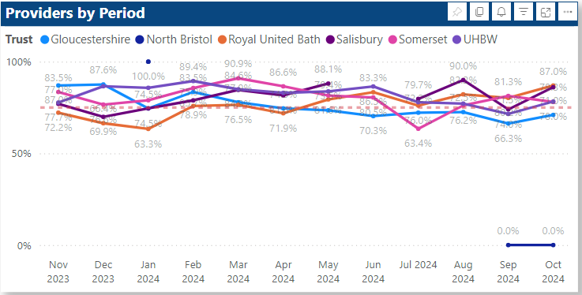
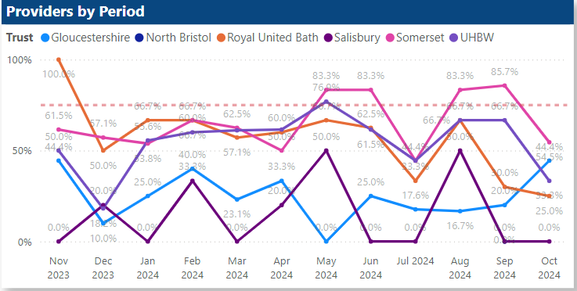
SWAG H&N FDS
Cancer ruled out
Cancer diagnosed

Slide 9
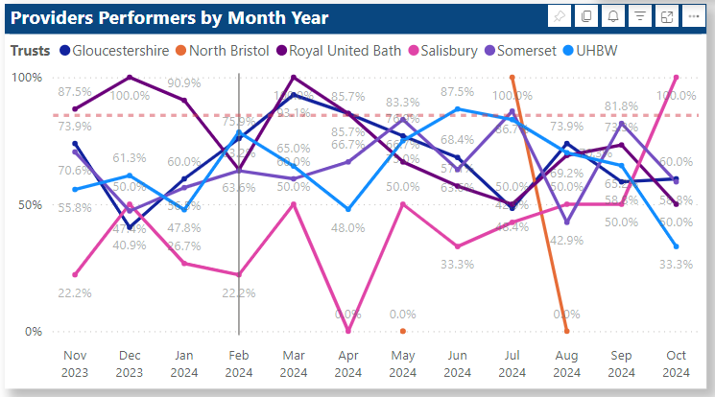
SWAG H&N 62-day
Notes:
Reduction in variation

Slide 10
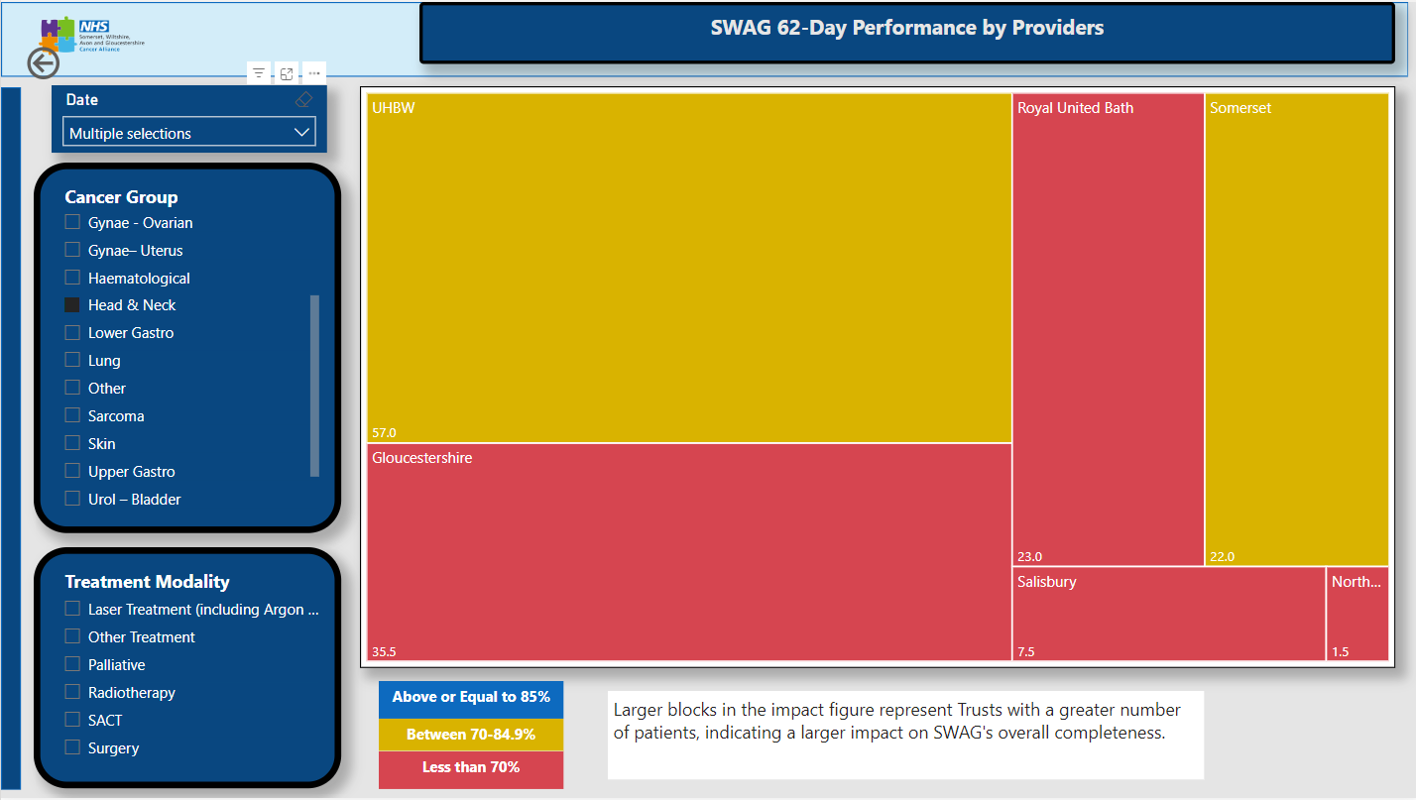
SWAG H&N 62 day
75.4%
63%
77.3%
59.2%
46.7%
Notes:
Re > 50% just Salisbury though GHFT consideration of 62 day improvement plan

Slide 11
SWAG H&N Summary
? Opportunities for SWAG supported CAG directed work
Re-baseline re BPTP and GIRFT recommendations, with cancer/non cancer review
SWAG wide institute and network digital image sharing framework procurement complete
Restorative dentistry
Risk stratification, triage and safety netting
Patient information
Telescopic referral pathway
Notes:
he procurement of the network digital Image Sharing framework is completed. The
Network digital partner is Intelerad, a nationally recognised PACS/RIS provider that is the
incumbent supplier to two network Trusts, the SW Peninsular Network and in the Thames
Valley.
• A series of roadshows and virtual engagement events are being planned to showcase the
TPACS/RIS and image sharing solutions. These are planned for early 2025
• The development of business cases to support Partner Trusts in adopting the Network
Image Sharing Solution at the earliest opportunity, is progressing well

