Slide 1
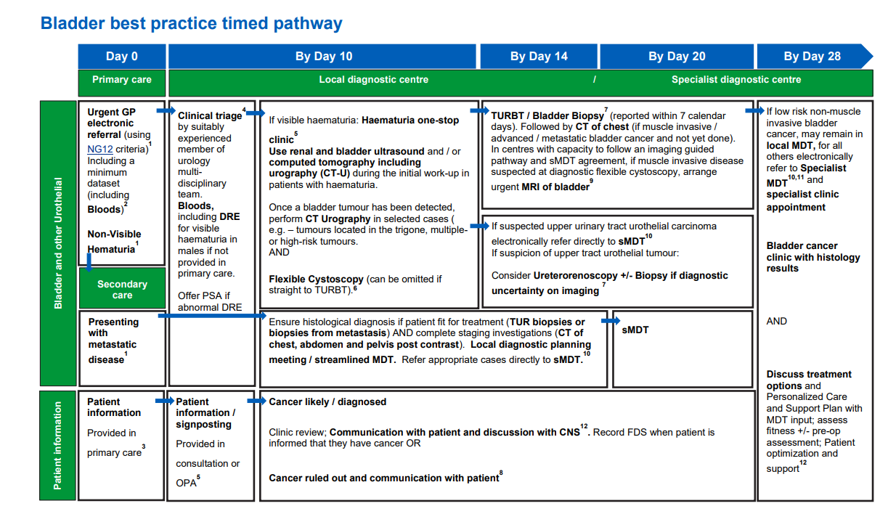
SWAG Urology – Bladder Deep Dive

Slide 2
SWAG Urology – Bladder Deep Dive: Pathway analysis findings
Undertaken at each SWAG provider during Q2 24/25
Broadly based on Best practice timed pathway milestones with local adaptations
Demonstrates variation in pathway step order across SWAG
Marked delays between each diagnostic milestone at RUH Bath
Imaging reporting at all providers <10 days CT and MRI
Histopathology reporting (excepting Bath) >10 days
Broad variation in time to MDT Day 29-68
TURBT c20 days from request to perform at all providers
Caveat small sample 30 patients, variable routes through pathway and identification USC challenging

Slide 3
SWAG Urology – Bladder Deep Dive: Pathway detail – 1 stop
CA | Provider | 1 stop Haematuria | If no are there plans to set up 1 stop | Do GPs refer directly to the service? | Clinical triage | Challenges requesting pre-referral bloods | 1 stop diagnostics | Nursing / AHP flexicystoscopy
SWAG | GLOUCESTERSHIRE HOSPITALS NHS FOUNDATION TRUST | Yes (post CTU) | N/A | Yes | Yes: Consultant | Occasionally but picked up with GP | USS and Flexi cystoscopy CTU requested at triage and reported prior to 1 stop | New 1 stops by consultant and registrar / follow ups by N/S
SWAG | NORTH BRISTOL NHS TRUST | Yes | N/A | Yes | No | No | Flexi-cystoscopy | Yes
SWAG | ROYAL UNITED HOSPITALS BATH NHS FOUNDATION TRUST | Yes | N/A | Yes | Yes: Admin & N/S | No | US and flexi-cystoscopy | Yes
SWAG | SALISBURY NHS FOUNDATION TRUST | No | Aspiration but access to radiology and cystoscopy results blocker: USS and flexi sig same day where possible, but not routine | N/A | Yes: N/S | N/A |  | Yes
SWAG | SOMERSET NHS FOUNDATION TRUST | No | 3 day service aspiration CTU to flexi (unable to achieve currently). One stop blocker CT hot reporting | N/A | Yes: Admin & N/S | N/A | N/A | At MPH Yes / YDH planning
Notes:
1 stop variation and clinical triage – admin , N/S led, Consultant
No CTU in 1 stop
Non medical flexi- broadly but sl. variation
CTU / CT KUB position in pathway varies: SWAG CAG; CT KUB will replace CTU for visible Haematuria in patients more than or equal to 50 to reduce risk of radiation exposure – SWAG CAG Clinical Guidelines

Slide 4
SWAG Urology – Bladder Deep Dive: Pathway detail - Further
CA | Provider | Ring fenced TURBT | Pre-op Ax challenges | Histology Innovations | Digital pathology | MDT SoC | Diagnostic clinic provision ringfenced | Diagnostic clinic provision
SWAG | GLOUCESTERSHIRE HOSPITALS NHS FOUNDATION TRUST | No | No | Looking at Ai | Consideration | No | Yes | Not N/S led usually 7 days post MDT 9 patients per clinic
SWAG | NORTH BRISTOL NHS TRUST | No | Yes |  | Yes 100% scans but validation of all pathologists is challenging on time in job plans | Yes: Deontics | Yes | CNS clinics, CTU results clinics. N/S led Yes scheduled after MDT by 3-5 days 5 clinics/wk. Each clinic holds 3 patients. = 15 patients.
SWAG | ROYAL UNITED HOSPITALS BATH NHS FOUNDATION TRUST | No | No: established drop in Pre-op for cancer |  |  | Yes: CAG presented | Yes | N/S led
SWAG | SALISBURY NHS FOUNDATION TRUST | No adhoc as needed |  | Challenges with capacity outsource template biopsies |  | Yes | Yes | N/S led within 7 days of MDT
SWAG | SOMERSET NHS FOUNDATION TRUST | Yes |  |  |  | Streamlining meeting | Yes | N/S led CNSs will see patient to tell them they need staging, MDT discussion and then to a results clinic with a consultant to plan treatment.
Notes:
TURBT for all longest delay in pathway at c 20 days book to perform plus histology >10 days
Digital Pathology not well informed in call for evidence but understand all providers have digital histopathology
GHFT not N/S led diagnostic clinic provision

Slide 5
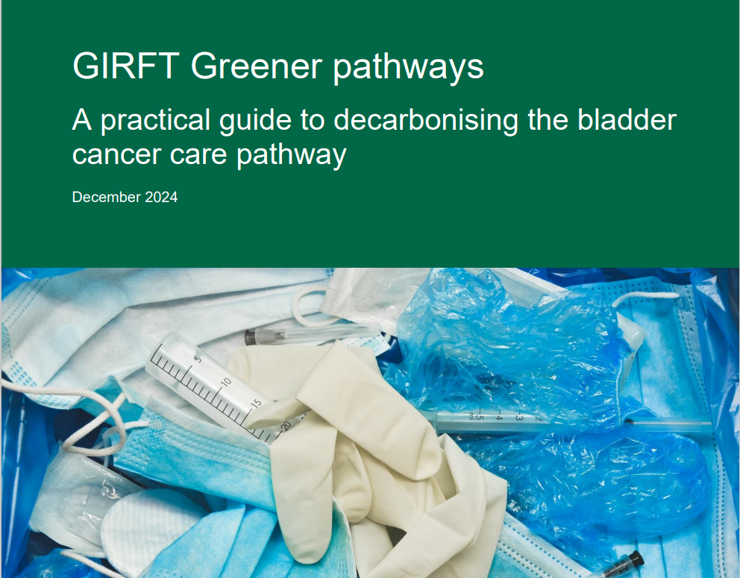
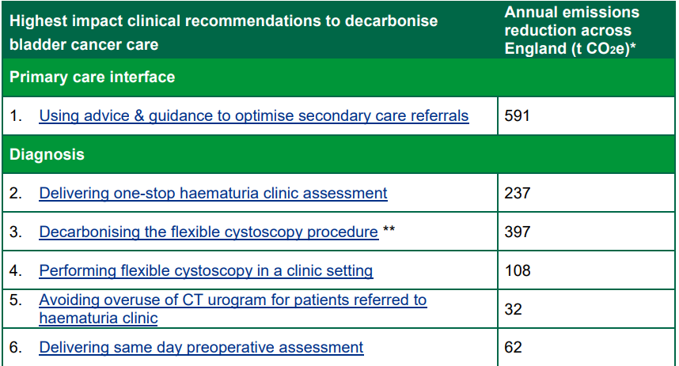
SWAG Urology – Bladder Deep Dive

Slide 6
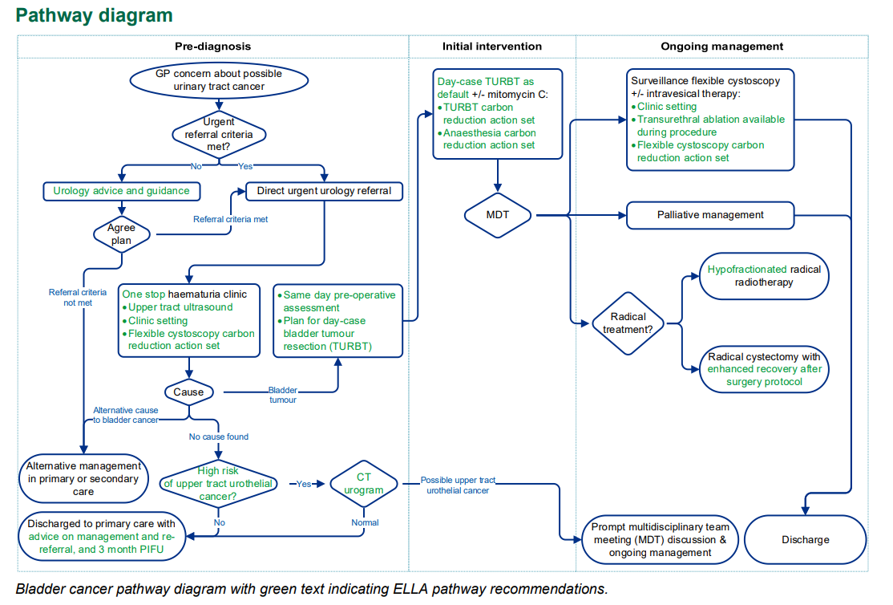
SWAG Urology – Bladder Deep Dive

Slide 7
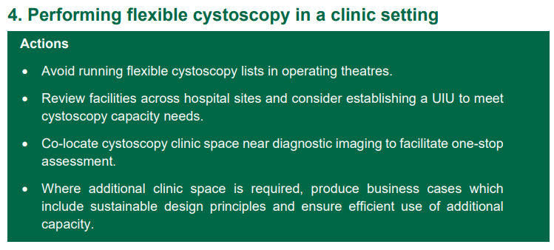
SWAG Urology – Bladder Deep Dive
https://bursturology.com/identify-calculator/

Slide 8
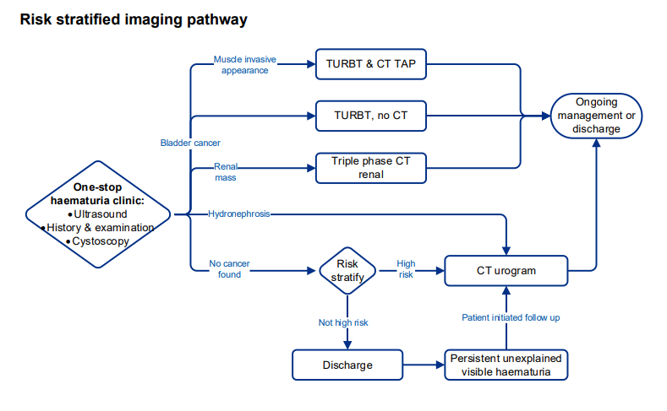
SWAG Urology – Bladder Deep Dive
Notes:
Tighten criteria for CTU / CT TAP / CT renal

Slide 9
SWAG Urology: National Cancer Programme 24/25 Priority pathway deliverables: Bladder
Improvement plans at challenged providers (urology FDS below 60 or in tiering) where challenges have been identified through bladder pathway analysis
Provide pathway change funding and ensure appropriate clinical and management capacity and capability available to undertake local USC pathway improvement work, including assurance and reporting processes.
Cancer Alliances should have a named lead for pathway improvement for Urology in particular.​
Work directly with providers to support pathway analysis and provide expert advice, including supporting the development of provider plans and aligning allocations of place-based funding.​ Providing programme management and project support to those providers to develop local action plans for improvement and track progress against the plan.​
Bring together provider and system partners to ensure diagnostic capacity through commissioning and prioritisation of sufficient cystoscopy and CT capacity for the bladder cancer pathway, exploring the use of CDC capacity for lower risk patients
Addressing patterns of referrals and diagnostic testing of low-risk patients through implementing wider use of prognostic predictive tools at both referral and triage.​
Providing the crucial link with other programmes to ensure success, including in particular Getting It Right First Time (GIRFT) and Diagnostics programmes.​
Notes:
Low risk bladder would be non high risk going on PIFU for CTU

Slide 10
SWAG Urology: National Cancer Programme 25/26 Priority pathway deliverables: Bladder
Improvement plans for tumour sites where FDS Urology below 65% and where Bladder 62d performance is in the bottom quartile or under 50%;each of our providers fall into 1 or other if not both
Ensure funding delivers genuine additionality specifically to add diagnostic capacity and address 31-day surgical performance
Deliver targeted interventions for Suspected Bladder Cancer by Q4, including, increased TURBT capacity, one-stop haematuria service implementation,
Link to capacity in urology investigation units
Clear triage and safety netting​
Assess the availability of Gateway C GP training on signs/symptoms/referral criteria for cohorts with low risk of cancer​ e.g and reducing referrals of multiple UTIs. ​
Review and plan to address the variation in cancer vs non-cancer FDS performance

Slide 11
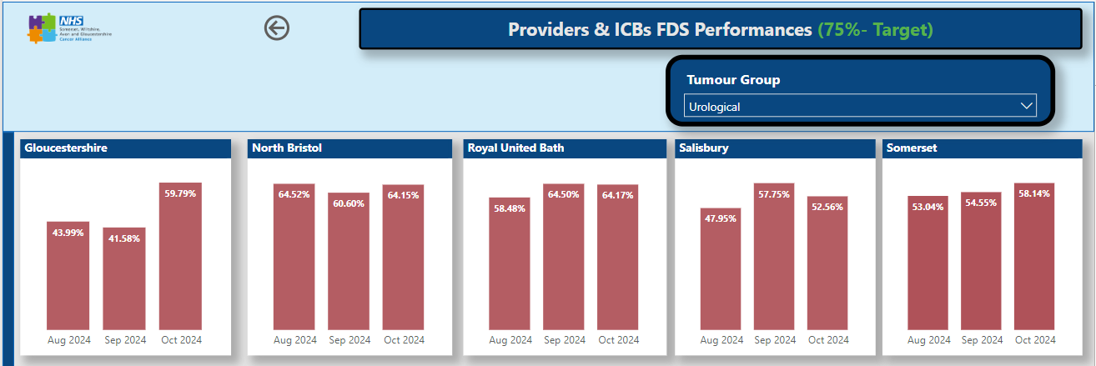
SWAG Urology – Bladder Deep Dive: FDS Urology
Notes:
Benchmarking Dorset Hospitals c80% post prostate improvement work, Maidstone, Derbyshire, Northampton shire

Slide 12
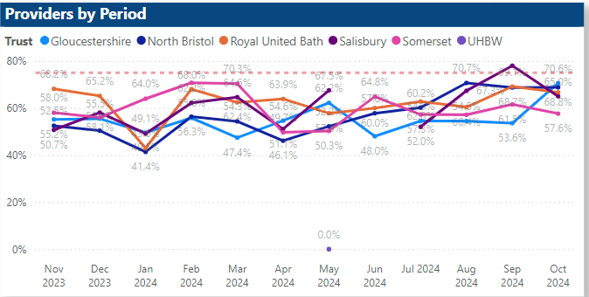
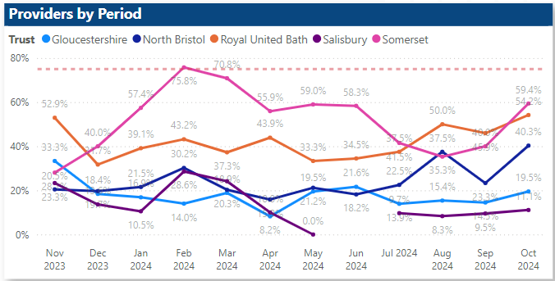
SWAG Urology – Bladder Deep Dive: FDS Urology
Cancer ruled out
Cancer diagnosed
Notes:
prostate included which may account for the variation for the variation between cancer diagnosed and not diagnosed
Pathway analysis reports patient informed varies between 0-379 days with median between 23-35 – caveat is majority of patients don’t have cancer so median is unlikely to be the experience of those with cancer ruled out and increasingly not communicated via OPA incurring less delays

Slide 13
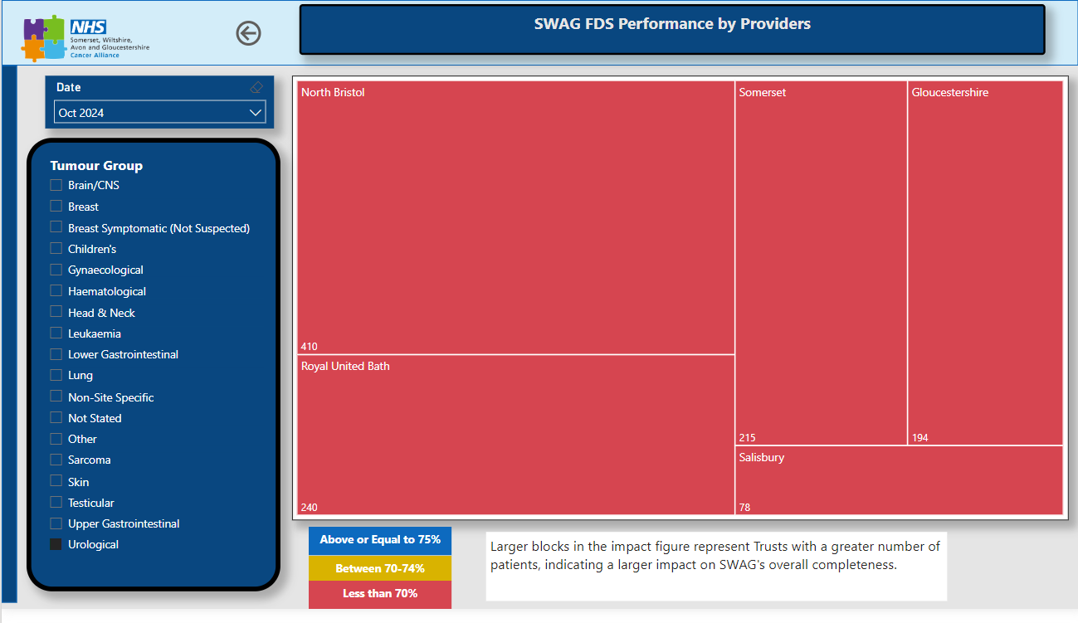
SWAG Urology – Bladder Deep Dive: Performance contribution

Slide 14
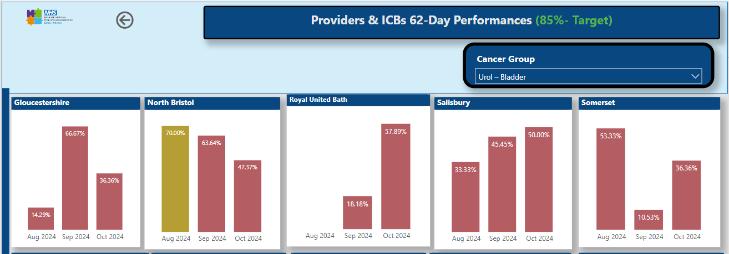
SWAG Urology – Bladder Deep Dive: 62-day bladder
7/6/5.5 patients
10/5.5/9.5 patients
3/5.5/9.5 patients
3/5.5/6 patients
7.5/9.5/11 patients

Slide 15
SWAG Urology – Bladder Deep Dive: Performance contribution

Slide 16
SWAG Urology: Bladder Summary
? Opportunities
CAG suggestions
Reduce pathway CT variation
Adopt GIRFT bladder cancer care pathway uniformly.
SWAG wide 1 stop (USS and Flex cystoscopy) roll out.
Reduce any current overuse of CTU.
Explore opportunities to standardise triage and safety netting
Increase TURBT capacity and ring fence
Deeper dive into specific opportunities / challenges
Bladder specific cancer v non cancer
Explore digital pathology maturity opportunities
Local workshops / visits

