Slide 1
Genomics Update
SWAGGER 13th December 2024
Matilda Bradford
SW GMSA Lead Genetic Counsellor for Cancer
matildabradford@nhs.net

Slide 2
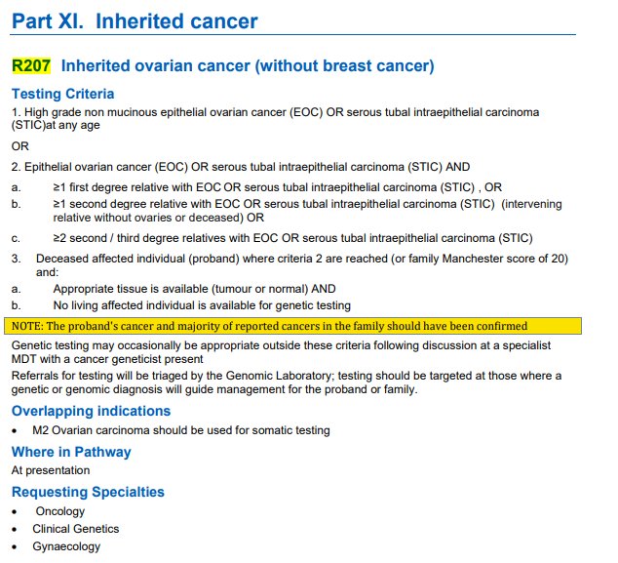
Mainstreaming: R207
Mainstreaming in place at all sites for R207 (ovarian panel)
National genomic test directory testing criteria for rare and inherited disease

Slide 3
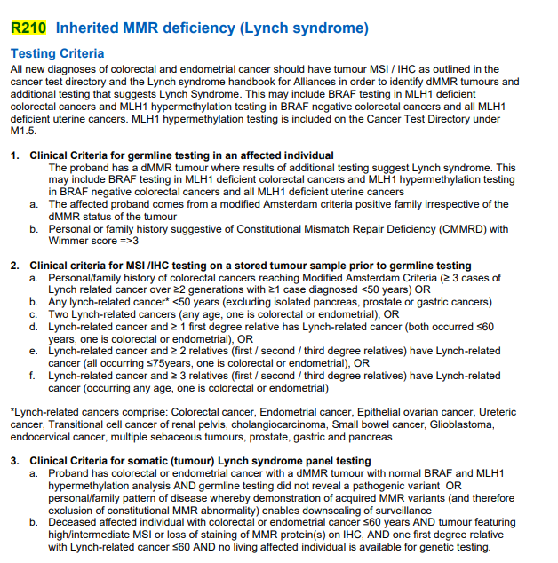
Mainstreaming: R210
CNS colleagues trained and mainstreaming in place at most SW sites for R210 (Lynch panel)
National genomic test directory testing criteria for rare and inherited disease

Slide 4
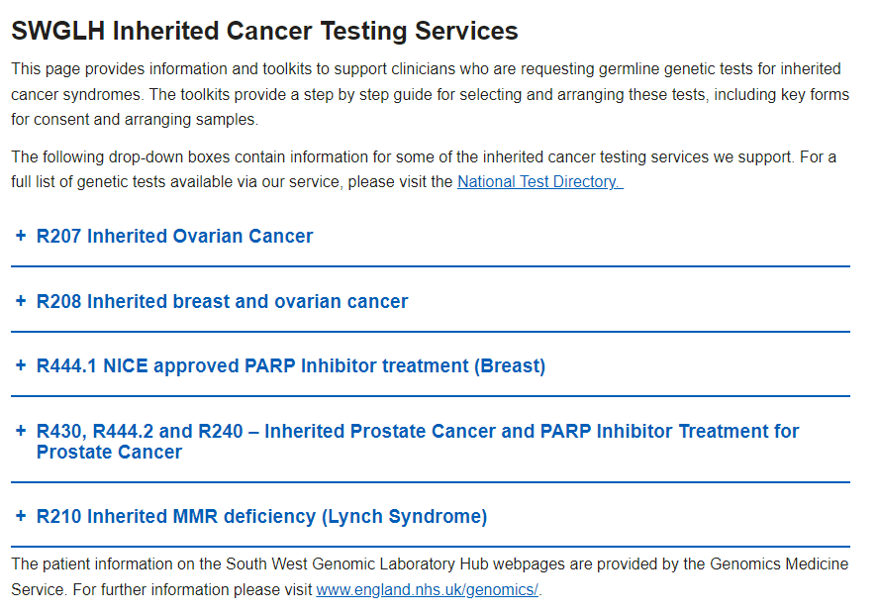
Resources: Toolkits
Please make use if you are mainstreaming!
SWGLH Inherited Cancer Testing Services | North Bristol NHS Trust
Notes:
Covers sample reqs, consent, transport all key forms inc consent and PIS, TAT,

Slide 5
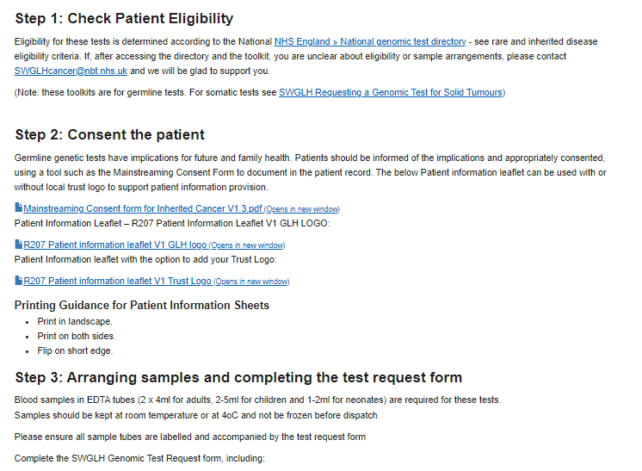
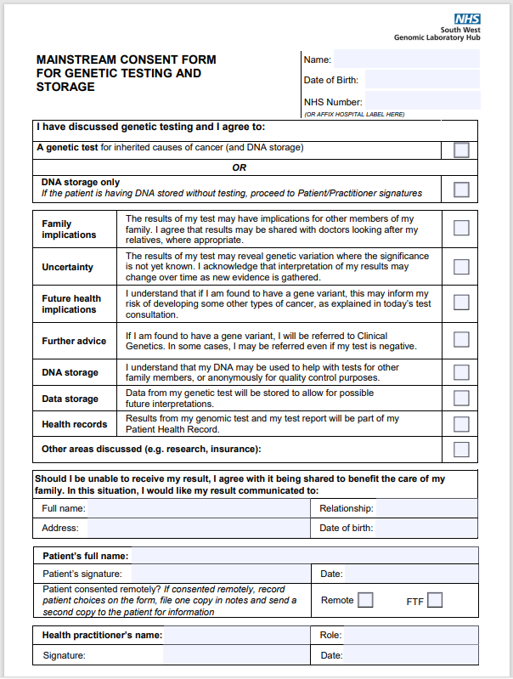
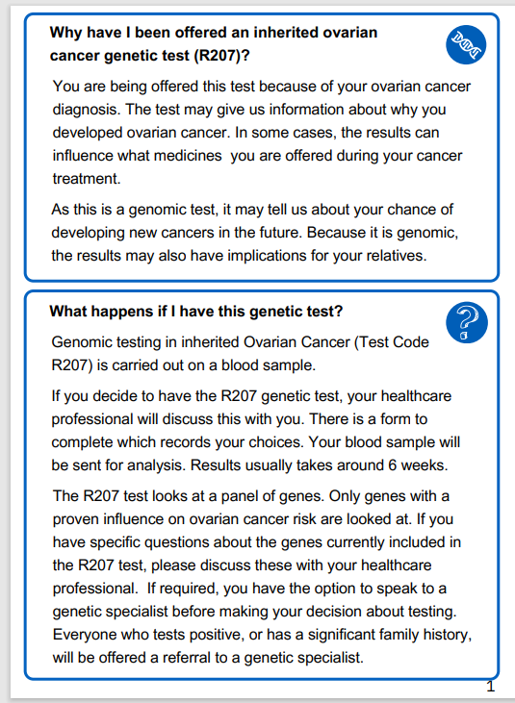
Resources: Toolkits
Template letters: pending PPIE review
Notes:
Covers sample reqs, consent, transport all key forms inc consent and PIS, TAT,

Slide 6
After results
Quick access (4-12 weeks) referrals for patients requiring follow in Genetics:
Positive results
VUS
Triaged assessment for:
Negative with significant family history
Negative with abnormal IHC / MSI
Notes:
Covers sample reqs, consent, transport all key forms inc consent and PIS, TAT,

Slide 7
Complex cases?
Regional Lynch Expert Meeting: Monthly, Mondays at 12:30-13:30 on teams – Monday 20th December
Contact: rduh.lynch-polyposis@nhs.net for information, invites and case referral forms

Slide 8
Further training and support
Lynch mainstreamer competency framework: Microsoft Word - Competency training and evidence form.docx
Lynch video resources: https://medical.gsk.com/en-gb/webinars-and-events/lynch-syndrome-mainstreaming/
Future online and FTF training for mainstream genetic care

Slide 9
NICE NG241 – Genetic testing
Overview | Ovarian cancer: identifying and managing familial and genetic risk | Guidance | NICE.
Questions about test eligibility: contact Ruth Cleaver or Matilda Bradford
RDUH Gynae and Genetics have completed an assessment clarifying we cannot deliver this locally. Ruth Cleaver is happy to share if your service also needs to produce this.
Statement anticipated from RCOG
Notes:
Clinical genetics services are agreed nationally that they cannot currently implement NICE Guidance NG241 Overview | Ovarian cancer: identifying and managing familial and genetic risk | Guidance | NICE.
There is ongoing work to expand testing but no immediate plan to match the NGTD to this guidance.
Additional detail
As discussed on 12/09, there are a number of issues with the NG241 spec including it’s clash with the current test directory (NGTD). Other issues include: the fact that the ovarian cancer MDT structure does not exist; that the specified eligibility criteria relies on complex calculations not easily or widely in use; the need for additional clinical and laboratory resources to support this new work; that recommendations are inequitable and out of step with what we offer for other cancer types.
The majority of clinical genetics centres want to continue expanding testing but with a strong preference that this includes widening access to more breast cancer patients and unaffected at-risk individuals from breast/ovarian cancer families, implemented equitably across cancer types so that all individuals at the same risk of carrying germline pathogenic variants benefit from the same risk reducing interventions. UKCGG will continue to work with the National Genomic Medicine Service to try to progress this.

Slide 10
NICE NG241 – Management
Overview | Ovarian cancer: identifying and managing familial and genetic risk | Guidance | NICE.
Ovarian cancer MDTs as described have yet to be developed
UK Genetics community favour expanding resources for patients with a greater chance of benefitting from genetic testing and surveillance
For women declining surgery: Ca125 screening is not evidence based. Consider discussion of surgical timing in high risk clinic.
(Approach of PROTECTOR study for women in no-surgery / tubes-only removal: Low threshold for USS or Ca125 with persistent abdominal symptoms).
Notes:
Clinical genetics services are agreed nationally that they cannot currently implement NICE Guidance NG241 Overview | Ovarian cancer: identifying and managing familial and genetic risk | Guidance | NICE.
There is ongoing work to expand testing but no immediate plan to match the NGTD to this guidance.
Additional detail
As discussed on 12/09, there are a number of issues with the NG241 spec including it’s clash with the current test directory (NGTD). Other issues include: the fact that the ovarian cancer MDT structure does not exist; that the specified eligibility criteria relies on complex calculations not easily or widely in use; the need for additional clinical and laboratory resources to support this new work; that recommendations are inequitable and out of step with what we offer for other cancer types.
The majority of clinical genetics centres want to continue expanding testing but with a strong preference that this includes widening access to more breast cancer patients and unaffected at-risk individuals from breast/ovarian cancer families, implemented equitably across cancer types so that all individuals at the same risk of carrying germline pathogenic variants benefit from the same risk reducing interventions. UKCGG will continue to work with the National Genomic Medicine Service to try to progress this.

Slide 11
Questions
matildabradford@nhs.net
ruth.cleaver@nhs.net

