Slide 1
SWAG Cancer Alliance
Targeted Lung Health Check Programme (TLHC)
Connecting and Empowering the Delivery of Cancer Care Across SWAG Communities

Slide 2
Key National TLHC Stats
Over 75 TLHC sites live across England
Over 900,000 people have attended a lung health check
Nearly 2 million people sent an invite
Over 75% of lung cancers
found at an early stage
(1 or 2)
Over 560,000 low dose CT scans completed
This slide contains the latest programme data as of Oct 2024, reflecting data up to the end of Aug 2024

Slide 3
Key SWAG TLHC Stats
Over 36,000 people have attended a lung health check
131 lung
cancers found:
81% stage I-II
Over 300 people have quit smoking because of the support
Over 17,000 low dose CT scans completed
Over 62,000 people sent an invite

Slide 4
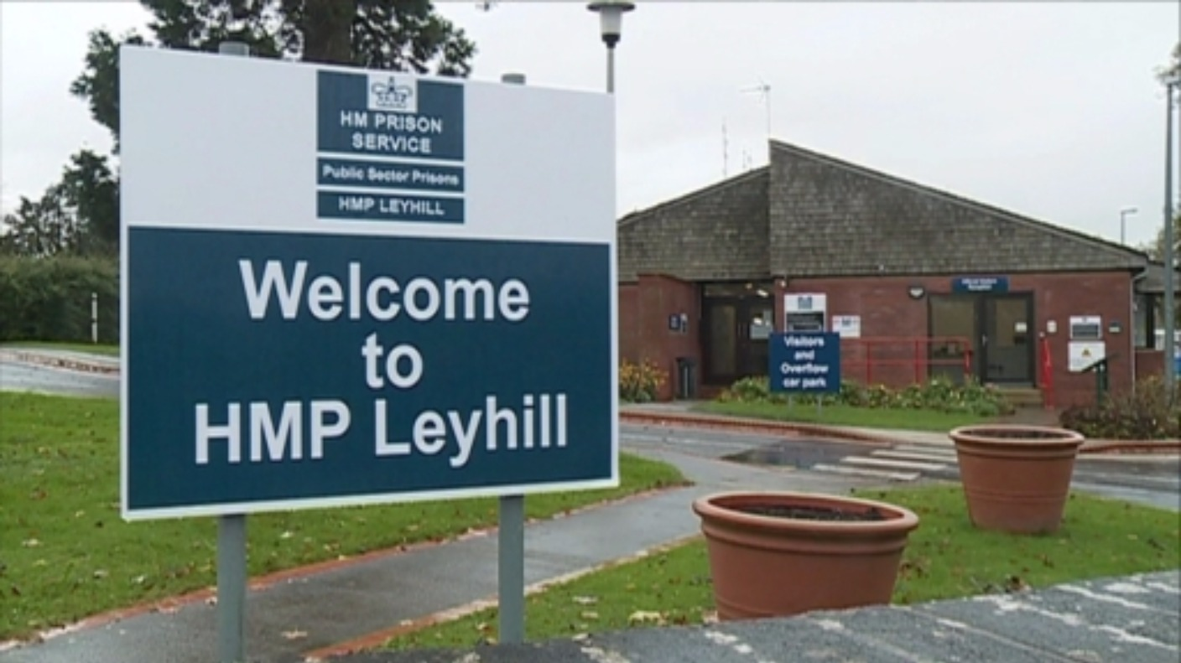
Key SWAG TLHC Stats
37 referred for CT
1 person not suitable for scan, 1 declined scan
70 assessments
completed,
18 DNAs
31 low risk – no CT needed
2 days of on-site scanning planned for Dec

Slide 5
Site Plan – Subject to change
BNSSG
CONCORD MENDIP PCN
4PCN (BNSSG) PCN
MENDIP VALE PCN
CONNEXUS PCN
YATE & FRAMPTON PCN
BRIDGE VIEW & GORDANO PCN
FOSS (FIRECLAY & OLD SCHOOL SURGERY) PCN
Somerset
CHARD, ILMINSTER & LANGPORT (CLICK) PCN
TONE VALLEY PCN
WEST MENDIP PCN
FROME PCN
NORTH SEDGEMOOR PCN
Glos and BSW
GLOUCESTER INNER CITY PCN
SARUM CATHEDRAL
DEVIZES PCN
ASPEN PCN
FOREST OF DEAN PCN
SARUM WEST PCN
We have been ahead of Schedule in BNSSG, currently scanning in 4PCN and Mendip Vale
Have been relatively on plan in Somerset, recent delays might impact this
Behind in Glos due to delay in launching
Delays in BSW due to delays in setting up in Salisbury

Slide 6
SRM Split – Forward Plan
Average weekly SRM discussion numbers >100… ~2 hours
Plan to devolve to individual ICBs
First devolution will be Somerset – clinical team established and experienced
Ultimately aiming for 3-4 independently functioning hubs (ICB-led) by April 2026
Conversations starting with ICB leads
Challenges around radiology cover

Slide 7
Challenges & Management
Delays in launching in Gloucestershire area, increasing workload elsewhere
Launching in Gloucester in Jan ’25, start scanning on 3rd of Jan (hopefully!)
Primary care workload and management of incidental findings – refusal to sign DSA
Coronary artery calcification ~58%
Radiological emphysema ~40% - Spirometry not currently offered within programme
No TLHC funding for incidental finding
Collective action/ Wok to rule
Recent NI changes impacting Primary care resource/funding
Working with national team to provide a national solution, impacting projects across the country
National taskforce to standardise management/advice – IF protocol awaiting final sign off
Under new guidance mild findings won’t be reported, ~60% CAC and ~80% Emphysema
Letters written to participants with advice based on severity, symptoms & smoking status, including signposting to parallel resources e.g. over 40s health check

Slide 8
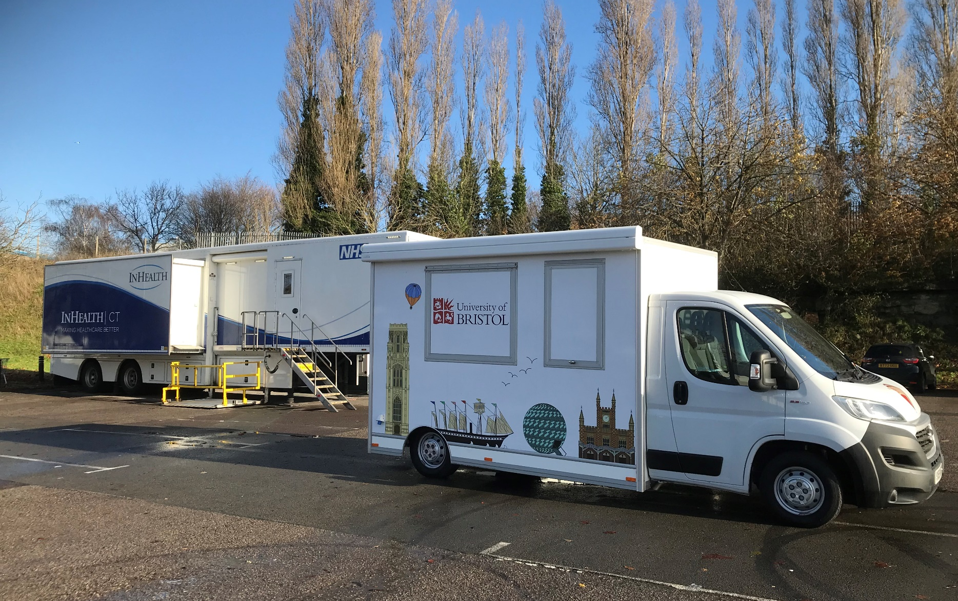
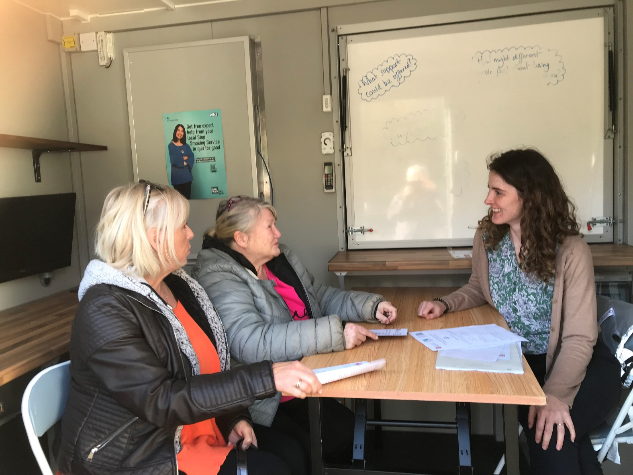
Research
Swap to stop nudge theory
Readiness to quit
IMPALA
IARC biomarkers collaboration

Slide 9
Thank you
Clinical Leads
Anthony Edey
V Masani
Local Clinicians & Radiologists
Andy Low
Sarah Foster
Danial Fox
Lynne Armstrong
Stephen Lyen
Henry Steer
Claire Parker
Phil Raines
Catherine Thompson
SWAG team
Hassan & Ruth

