Slide 1
Radical Management of Oesophago-gastric Cancer Some local data
Tom Bird
Cameron Blair
Jemma Harrison
Sophie Chua

Slide 2
PART ONE Perioperative FLOT for Oesophago-gastric cancer – BHOC/WGH/MPH/YDH data

Slide 3
FLOT4: phase III clinical trial
716 patients from Germany
MAGIC (ECF/ECX) vs FLOT chemotherapy
Resectable gastric and GOJ adenocarcinoma
4 preoperative and 4 postoperative cycles of FLOT
Similar safety profiles
FLOT (2-weekly cycles):
Docetaxel (50mg/m2)
Oxaliplatin (85mg/m2)
5-fluorouracil (2600mg/m2)
Leucovorin (200mg/m2) – 24hr infusion

Slide 4
Median OS: 35mo (95%CI 27- 46) vs. 50 months (95%CI 38-NR)
Est 3yr OS: 48% (95%CI 43-54) vs. 57% (52-62)
Est 5yr OS: 36% (95%CI: 30-42) vs. 45% (38-51)

Slide 5
ESOPEC: phase III clinical trial
438 patients from Germany
CROSS vs FLOT chemotherapy
Lower oesophageal & junctional adenocarcinoma

Slide 7
Methods
Cohort commencing FLOT: March 2018 - March 2023
Minimum of 6 months follow-up
Retrospective analysis
Audit gained local institutional approval with UHBW audit team
Notes:
At BHOC and WGH – 66 patients were given FLOT for locally resectable oesophageal, GOJ or gastric cancers (oesophageal gets grouped in because of the MAGIC trial and its believed that lower oessophageal cancers respond in a similar way so despite no oesophageal patients receiving FLOT in the FLOT4 trial they were still used for these patients)
This was a retrospective analysis done in June 2023
Patient list was obtained and then we collected data from all patient electronic medical records and chemotherapy prescribing records
This service evaluation was approved by the local UHBW audit team
Metastatic disease and squamous histology excluded
On day one, docetaxel (50mg/m2), oxaliplatin (85mg/m2), 5-fluorouracil (2600mg/m2) were administered intravenously and a 24-hour infusion of leucovorin (200mg/m2) was started
OS and PFS were estimated using the Kaplan-Meier method with SPSS software

Slide 8
Patient Cohort
 | MPH/YDH (n=56) | UHBW (n=66) |  | FLOT4-AIO (n=356) | ESOPEC (n=221)
Age (years)
Median (IQR) | 68 (60-73) | 64 (58-71) |  | 62 (54-69) | 63
<60 | 13 (23.2%) | 21 (32%) |  | 155 (44%)
60-69 | 17 (30.4%) | 26 (39%) |  | 116 (33%)
≥70 | 26 (46.4%) | 19 (29%) |  | 85 (24%)
Sex
Male | 46 (82.1%) | 57 (86%) |  | 268 (75%) | 89%
Female | 10 (17.9%) | 9 (14%) |  | 88 (25%)
Primary tumour location
Oesophageal | 21 (37.5%) | 31 (47%) |  | 0 (0%)
GOJ | 24 (42.9%) | 24 (36%) |  | 198 (56%)
Stomach | 11 (19.6%) | 11 (17%) |  | 158 (44%)
cT stage
T1 | 0 (0%) | 0 (0%) |  | 3 (1%) | 20%
T2 | 9 (16.1%) | 5 (8%) |  | 49 (14%)
T3 | 34 (60.7%) | 51 (77%) |  | 267 (75%) | 79%
T4 | 11 (19.6%) | 10 (15%) |  | 28 (8%)
unknown | 2 (3.6%) | / |  | /
cN stage
N- | 27 (48.2%) | 27 (41%) |  | 77 (22%) | 22%
N+ | 28 (50%) | 39 (59%) |  | 279 (78%) | 78%
unknown | 1 (1.8%) | / |  | /

Slide 9
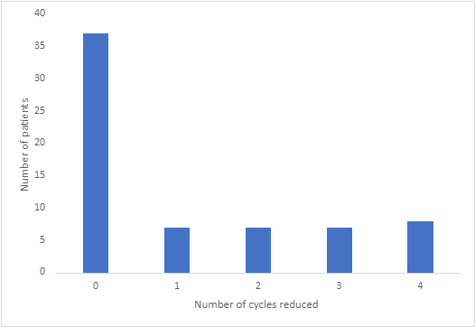
Chemotherapy Statistics
94% (78% MPH) of patients received 4 cycles of FLOT compared to 90% of patients from the FLOT4 trial
52% (43% MPH) of patients received 100% of all doses in all 4 cycles compared with 81% in the FLOT4 trial
No deaths on or within 30 days
of last chemotherapy dose
Notes:
In terms of the ability to deliver chemo – 94% of patients received 4 cycles of FLOT compared to 90% of patients from the FLOT4 trial
And 52% of patients received 100% of all doses in all 4 cycles – which is lower than the trial which had 81% of patient receiving all 4 cycles at 100%
Out of 257 total cycles, 29% of cycles were given at a reduced dose (and the graph on the right shows you how many cycles were reduced for each patient so most patients had no reductions and then there was an equal spread in terms of whether 1,2, 3 or 4 cycles were reduced)
We found that there weren’t any deaths on chemo or within 30 days
Suggests most people were able to tolerate FLOT
We weren’t able to collect full side effect profile due to time constrainst and lack of data
94% = 62 patients
Other 48% required dose reductions or omissions
How many cycles delayed out of all 257 cycles
257 cycles took place out of a potential of 264 cycles

Slide 10
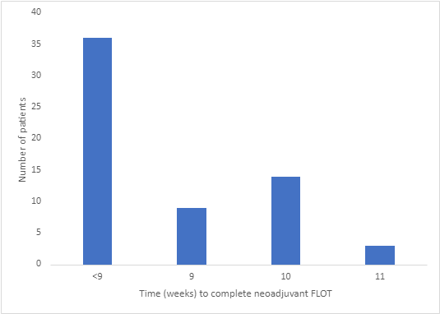
Chemotherapy Delays
Neoadjuvant FLOT took ≥9 weeks for 42% of patients (61% MPH)
Individual dose delays >7 days occurred in 7% (17/257) of cycles compared to 3% in the FLOT4 trial
Notes:
In terms of the ability to deliver chemo – 94% of patients received 4 cycles of FLOT compared to 90% of patients from the FLOT4 trial
And 52% of patients received 100% of all doses in all 4 cycles – which is lower than the trial which had 81% of patient receiving all 4 cycles at 100%
Out of 257 total cycles, 29% of cycles were given at a reduced dose (and the graph on the right shows you how many cycles were reduced for each patient so most patients had no reductions and then there was an equal spread in terms of whether 1,2, 3 or 4 cycles were reduced)
We found that there weren’t any deaths on chemo or within 30 days
Suggests most people were able to tolerate FLOT
We weren’t able to collect full side effect profile due to time constrainst and lack of data
94% = 62 patients
Other 48% required dose reductions or omissions
How many cycles delayed out of all 257 cycles
257 cycles took place out of a potential of 264 cycles

Slide 11
Chemotherapy Summary
 | OEO5 ECX | MAGIC ECX | ST03 ECX | NEOAEGIS | FLOT4 FLOT | ESOPEC FLOT | UHBW | MPH/ YDH
All pre-op Chemo given | 81% | 91% | 89% | 91% | 90% | 87% | 94% | 79%
Started post-op chemo | n/a | 58% | 55% | 50% | 61% | 63% | 23% | 45%
Completed all cycles | n/a | 44% | 41% | 34% | 46% | 53% | 17% | 34%
Notes:
In terms of the ability to deliver chemo – 94% of patients received 4 cycles of FLOT compared to 90% of patients from the FLOT4 trial
And 52% of patients received 100% of all doses in all 4 cycles – which is lower than the trial which had 81% of patient receiving all 4 cycles at 100%
Out of 257 total cycles, 29% of cycles were given at a reduced dose (and the graph on the right shows you how many cycles were reduced for each patient so most patients had no reductions and then there was an equal spread in terms of whether 1,2, 3 or 4 cycles were reduced)
We found that there weren’t any deaths on chemo or within 30 days
Suggests most people were able to tolerate FLOT
We weren’t able to collect full side effect profile due to time constrainst and lack of data
94% = 62 patients
Other 48% required dose reductions or omissions
How many cycles delayed out of all 257 cycles
257 cycles took place out of a potential of 264 cycles

Slide 12
Patient timelines
Bristol/WGH
Median: 5 days
75%: ≤ 11 days
90%: ≤ 18 days
Median: 46 days
75%: ≤ 54 days
90%: ≤ 67 days
End of FLOT
CT
(and then MDT)
Surgery
Minimum: 27 days ; Median: 48 days ; 75%: ≤ 62 days ; 90%: ≤ 75 days
MPH/Yeovil
Median: 13.5 days
75%: ≤ 21 days
90%: ≤ 22 days
Median: 50 days
75%: ≤ 57 days
90%: ≤ 75 days
End of FLOT
CT
(and then MDT)
Surgery
Minimum: 33 days ; Median: 60 days ; 75%: ≤ 76 days ; 90%: ≤ 87 days
FLOT4: 4 weeks
ST03: 5-6 weeks
OEO5: 4-6 weeks
ESOPEC: 4-6 weeks
MAGIC: <6 weeks
NEOAEGIS: 3-10 weeks
Notes:
In terms of the ability to deliver chemo – 94% of patients received 4 cycles of FLOT compared to 90% of patients from the FLOT4 trial
And 52% of patients received 100% of all doses in all 4 cycles – which is lower than the trial which had 81% of patient receiving all 4 cycles at 100%
Out of 257 total cycles, 29% of cycles were given at a reduced dose (and the graph on the right shows you how many cycles were reduced for each patient so most patients had no reductions and then there was an equal spread in terms of whether 1,2, 3 or 4 cycles were reduced)
We found that there weren’t any deaths on chemo or within 30 days
Suggests most people were able to tolerate FLOT
We weren’t able to collect full side effect profile due to time constrainst and lack of data
94% = 62 patients
Other 48% required dose reductions or omissions
How many cycles delayed out of all 257 cycles
257 cycles took place out of a potential of 264 cycles

Slide 13
Surgical Outcomes
 | MPH/YDH (n=56) | UHBW (n=66) | FLOT4-AIO (n=356) | ESOPEC (n=191)
Surgical Data
Received tumour resection | 38 (68%) | 50 (76%) | 336 (94%) | 86%
Achieved margin-free (R0) resection | 25 (66%) | 29 (58%) | 301 (90%) | 94%
Tumour Stage (ypT) *
≤T1 | 8 (21%) | 8 (16%) | 88 (26%)
T2 | 8 (21%) | 10 (20%) | 44 (13%)
T3 | 16 (42%) | 23 (46%) | 165 (49%)
T4 | 4 (11%) | 9 (18%) | 37 (11%)
Not applicable | 2 (5%) | 0 (0%) | 2 (1%)
Nodal Status (ypN) *
N0 | 19 (50%) | 24 (48%) | 174 (52%) | 51%
N1 | 8 (21%) | 11 (22%) | 55 (16%) | 49%
N2 | 6 (16%) | 12 (24%) | 47 (14%)
N3 | 3 (8%) | 3 (6%) | 57 (17%)
Not applicable | 2 (5%) | 0 (0%) | 3 (1%)
Notes:
In terms of the ability to deliver chemo – 94% of patients received 4 cycles of FLOT compared to 90% of patients from the FLOT4 trial
And 52% of patients received 100% of all doses in all 4 cycles – which is lower than the trial which had 81% of patient receiving all 4 cycles at 100%
Out of 257 total cycles, 29% of cycles were given at a reduced dose (and the graph on the right shows you how many cycles were reduced for each patient so most patients had no reductions and then there was an equal spread in terms of whether 1,2, 3 or 4 cycles were reduced)
We found that there weren’t any deaths on chemo or within 30 days
Suggests most people were able to tolerate FLOT
We weren’t able to collect full side effect profile due to time constrainst and lack of data
94% = 62 patients
Other 48% required dose reductions or omissions
How many cycles delayed out of all 257 cycles
257 cycles took place out of a potential of 264 cycles

Slide 14
Surgical Outcomes
 | MPH/YDH (n=56) | UHBW (n=66) | FLOT4-AIO (n=356) | ESOPEC (n=191)
Surgical Data
Received tumour resection | 38 (68%) | 50 (76%) | 336 (94%) | 86%
Achieved margin-free (R0) resection | 25 (66%) | 29 (58%) | 301 (90%) | 94%
Tumour Stage (ypT) *
≤T1 | 8 (21%) | 8 (16%) | 88 (26%)
T2 | 8 (21%) | 10 (20%) | 44 (13%)
T3 | 16 (42%) | 23 (46%) | 165 (49%)
T4 | 4 (11%) | 9 (18%) | 37 (11%)
Not applicable | 2 (5%) | 0 (0%) | 2 (1%)
Nodal Status (ypN) *
N0 | 19 (50%) | 24 (48%) | 174 (52%) | 51%
N1 | 8 (21%) | 11 (22%) | 55 (16%) | 49%
N2 | 6 (16%) | 12 (24%) | 47 (14%)
N3 | 3 (8%) | 3 (6%) | 57 (17%)
Not applicable | 2 (5%) | 0 (0%) | 3 (1%)
Notes:
In terms of the ability to deliver chemo – 94% of patients received 4 cycles of FLOT compared to 90% of patients from the FLOT4 trial
And 52% of patients received 100% of all doses in all 4 cycles – which is lower than the trial which had 81% of patient receiving all 4 cycles at 100%
Out of 257 total cycles, 29% of cycles were given at a reduced dose (and the graph on the right shows you how many cycles were reduced for each patient so most patients had no reductions and then there was an equal spread in terms of whether 1,2, 3 or 4 cycles were reduced)
We found that there weren’t any deaths on chemo or within 30 days
Suggests most people were able to tolerate FLOT
We weren’t able to collect full side effect profile due to time constrainst and lack of data
94% = 62 patients
Other 48% required dose reductions or omissions
How many cycles delayed out of all 257 cycles
257 cycles took place out of a potential of 264 cycles

Slide 15
Surgical Outcomes (2)
 | OEO5 ECX | MAGIC ECX | ST03 ECX | FLOT4 FLOT | NEOAEGIS | ESOPEC FLOT | UHBW | MPH/ YDH
Tumour surgery | 82% | 81% | 86% | 94% | 88% | 86% | 76% | 68%
R1 | 30% | NR | 25% | 10% | 18% | 5% | 42% | 34%
Notes:
In terms of the ability to deliver chemo – 94% of patients received 4 cycles of FLOT compared to 90% of patients from the FLOT4 trial
And 52% of patients received 100% of all doses in all 4 cycles – which is lower than the trial which had 81% of patient receiving all 4 cycles at 100%
Out of 257 total cycles, 29% of cycles were given at a reduced dose (and the graph on the right shows you how many cycles were reduced for each patient so most patients had no reductions and then there was an equal spread in terms of whether 1,2, 3 or 4 cycles were reduced)
We found that there weren’t any deaths on chemo or within 30 days
Suggests most people were able to tolerate FLOT
We weren’t able to collect full side effect profile due to time constrainst and lack of data
94% = 62 patients
Other 48% required dose reductions or omissions
How many cycles delayed out of all 257 cycles
257 cycles took place out of a potential of 264 cycles

Slide 16
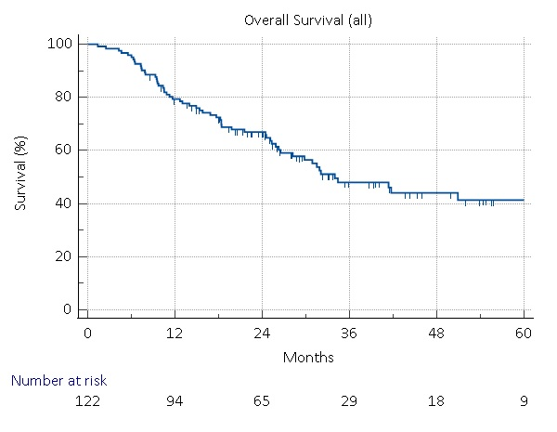
Overall Survival
Median: 34.0 months
3yr OS: 46.1%
4yr OS: 41.3%

Slide 17
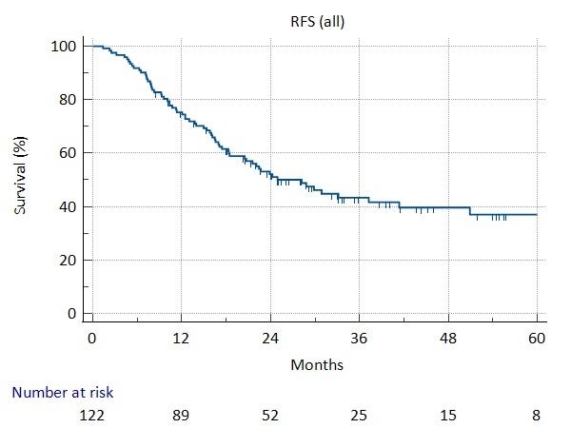
Relapse-Free Survival
Median: 28.2 months
3yr RFS: 43.4%
4yr RFS: 39.6%

Slide 18
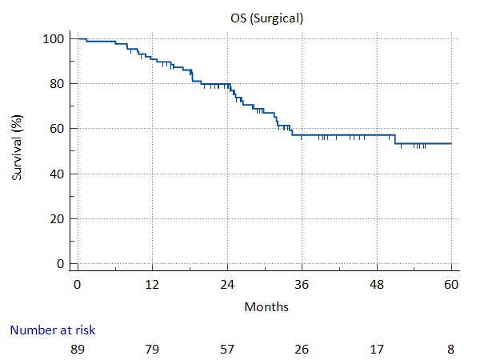
Overall Survival (Surgery cohort)
Median: NR
3yr OS: 53.4%
4yr OS: 53.4%

Slide 19
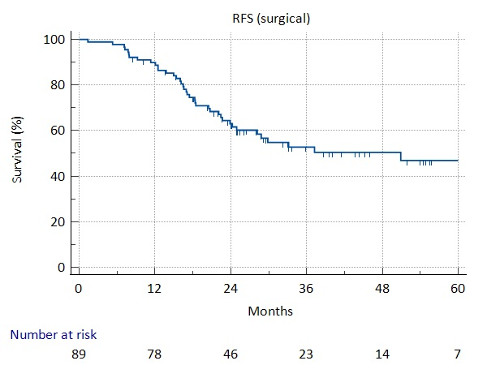
Relapse-Free Survival (Surgery cohort)
Median: 50.9 months
3yr RFS: 52.8%
4yr RFS: 50.4%

Slide 20
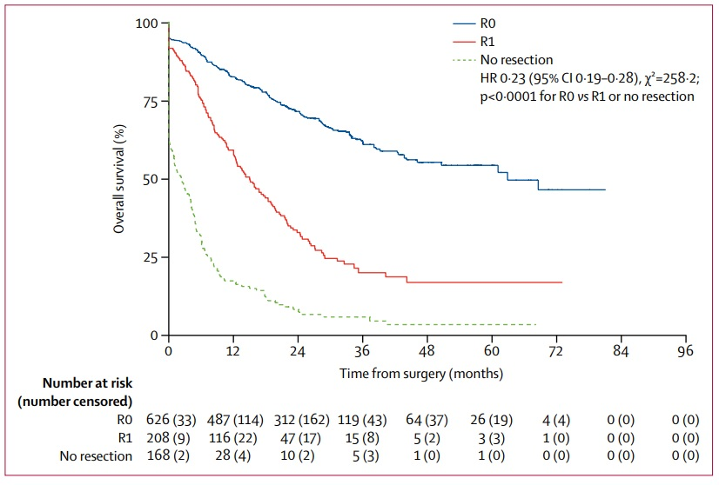
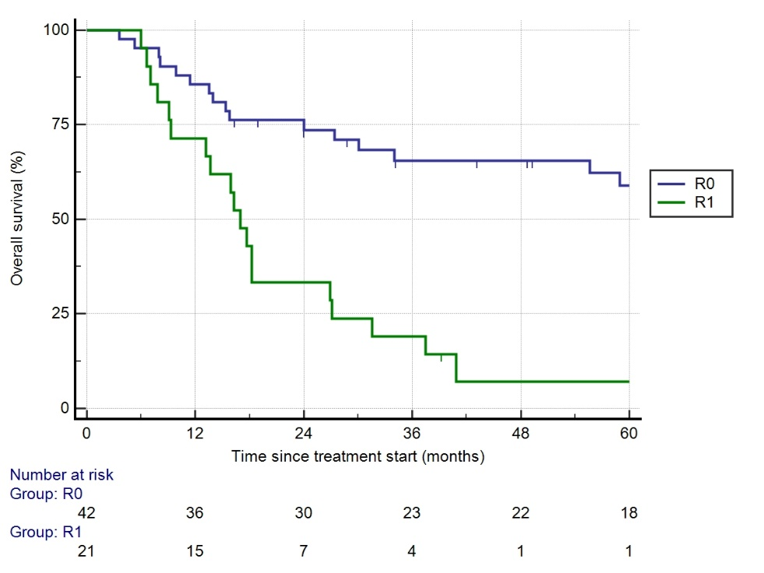
Margin status (1)
ST03 data
UHBW pre-FLOT data – ECX/CAPOX generally

Slide 21
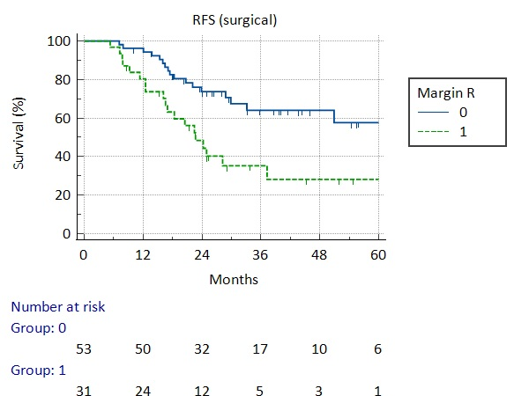
Margin Status (Surgery cohort)

Slide 22
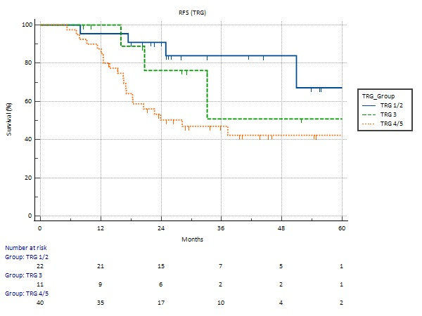
TRG (Surgery cohort)

Slide 23
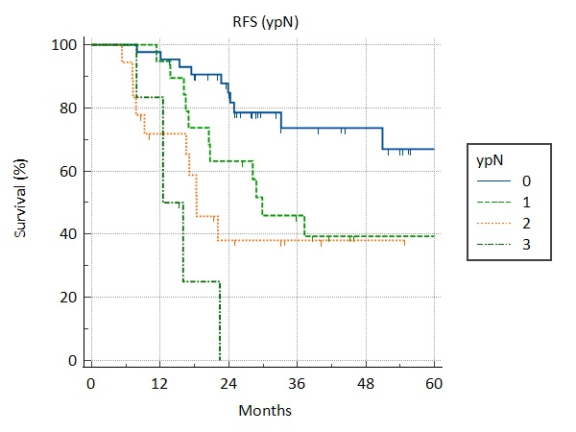
ypNodal Status (Surgery cohort)

Slide 24
FLOT Summary/Discussion Points
Tolerability of FLOT seemed acceptable
Continued audit of timeline to surgery useful
20-25% patients not having surgery too high?
Survival outcomes appear favourable for real world populations

Slide 25
PART TWO Definitive Chemoradiation BHOC/WGH data

Slide 26
SCOPE1 Study
dCRT a standard of care for SCC
Used for Adenoca not suitable for surgery
SCOPE: Negative study but important benchmark
Comprehensive Radiotherapy Quality Assurance
PET-CT for staging 86%

Slide 27
SCOPE trial
Overall Survival
Relapse-Free Survival
 | Median | 3yr OS
All | 34.5 mo | 47.2%
SCC | 35.9 mo | 47.8%
Adenoca | 25.8 mo | 43.8%

Slide 28
Methods
Retrospective case series using chemo/radiotherapy databases
All patients commencing definitive chemoradiation as principal treatment modality
Excluded FLOT/abandoned surgery cases
Sept 2018 – June 2023
Either 11 week (6w chemo + 5w CRT) or 5 week CRT schedules
Included patients taking part in SCOPE2
Routine 12-week CT and endoscopic assessment
Survival analysis taken from date of treatment commencement

Slide 29
Results
81 patients
All PET staged
Vast majority have EUS

Slide 30
Cohort Characteristics

Slide 31
Treatments
1 on-treatment death (acute vascular event)
All patients who completed the full planned radiotherapy dose did so within 32 days (four-and-a-half weeks) with no delays – in line with RCR guidelines

Slide 32
Relevant toxicities
6.9%

Slide 33
Overall Survival
Median: Not reached
Est 3 yr OS: 63%
Est 4yr OS: 58%

Slide 34
Overall Survival
Median: Not reached
Est 3 yr OS: 63%
Est 4yr OS: 58%
 | Median | 3yr OS
All | 34.5 mo | 47.2%
SCC | 35.9 mo | 47.8%
Adenoca | 25.8 mo | 43.8%

Slide 35
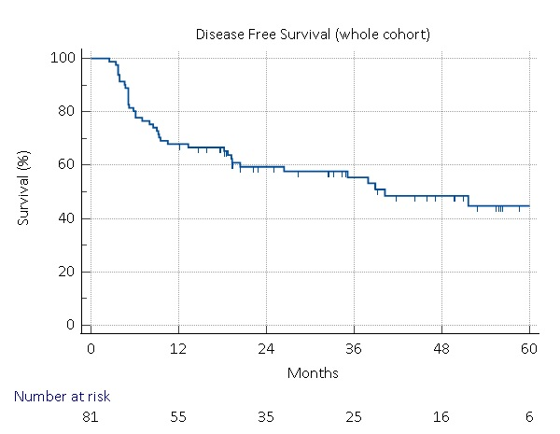
Disease-Free Survival
Median: 40.2 months
Est 3 yr DFS: 55%
Est 4yr OS: 49%
A salvage oesophagectomy was attempted as second-line treatment in three patients who had recurred locally.
Prognosis of patients with confirmed relapse was poor, with median survival after relapse being just 6.1 months

Slide 36
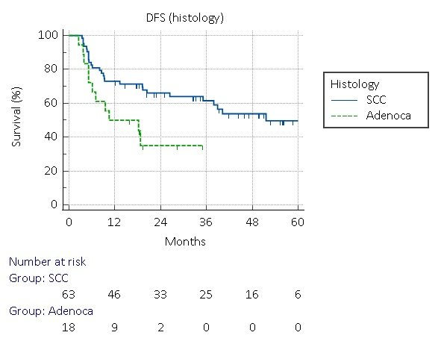
SCC vs. Adenoca (DFS)
DFS (SCC)
Median: 51.6 months
Est 3 yr DFS: 61%
Est 4yr DFS: 54%
DFS (Adenoca)
Median: 10.5 months

Slide 37
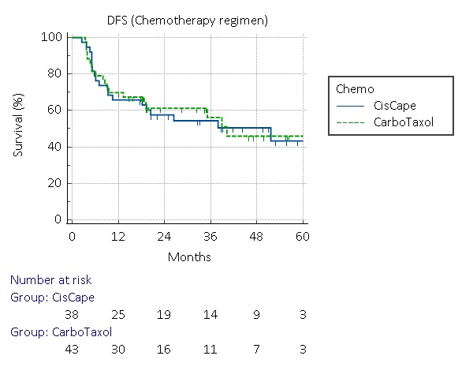
Chemotherapy Backbone

Slide 38
dCRT Summary/Discussion Points
SCC Survival outcomes appear favourable compared to SCOPE1 trial
Adenoca. outcomes poorer
Weight loss rates an area of focus
Chemotherapy backbone approach seems appropriate
SCOPE2 trial results awaited

