Slide 1
Portal Venous Embolisation
Mark Callaway
November 14th

Slide 2
Aims
To discuss Portal Venous embolisation
To review the service in UHBW
To compare against published Standards and Guidelines

Slide 3
Too make the Inoperable Operable

Slide 4
Portal Vein Embolisation
Converts non surgical candidates to resection
Embolise the portal vein to promote hypertrophy
FLV 30%

Slide 5
Portal Vein Embolisation
Calculate Liver volume
GA
Contra or ipsilateral approach
Glue the portal vein
Cyanoacryl glue :lipiodol 1:9
Wait 6 weeks

Slide 6
Portal Vein Embolisation

Slide 7
Portal Vein Embolisation

Slide 8
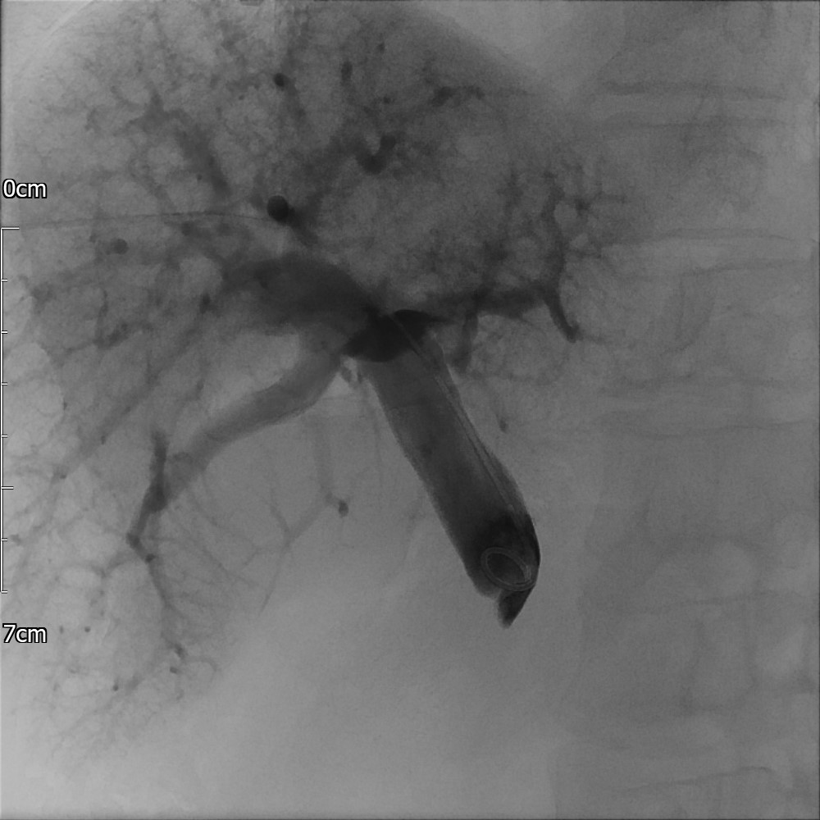
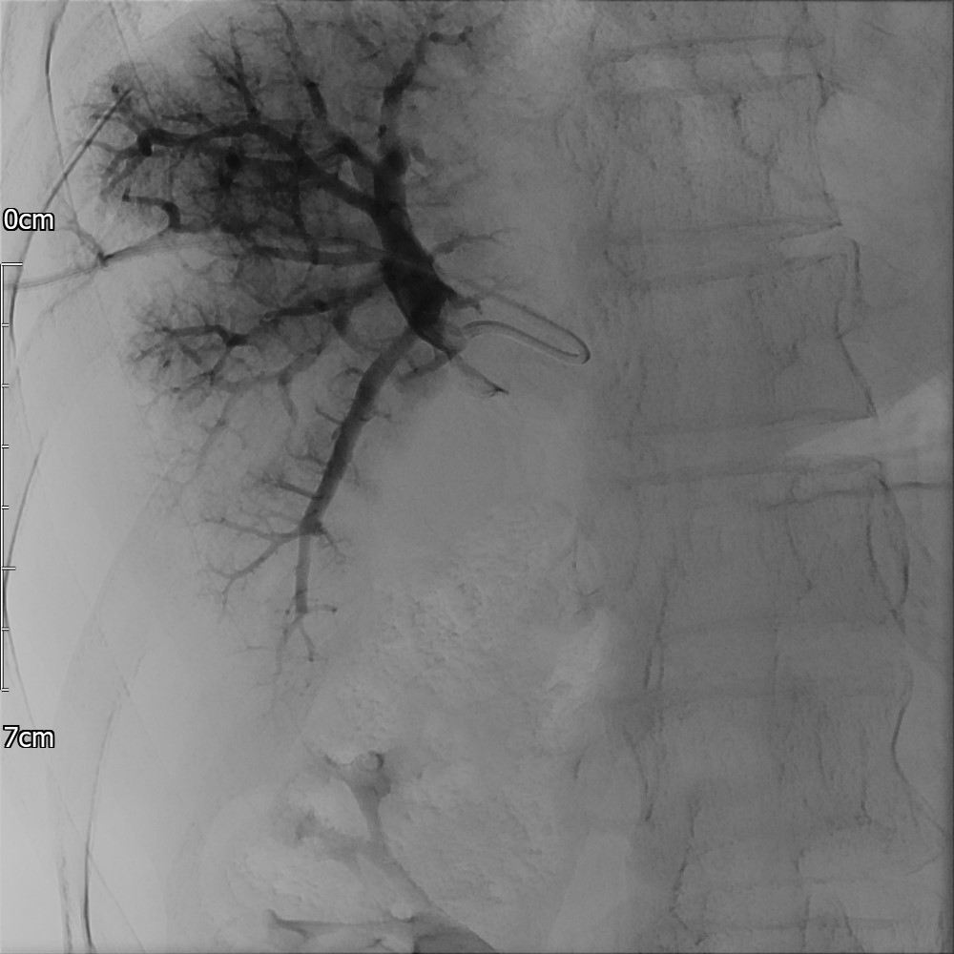
Portal Vein Embolisation

Slide 9
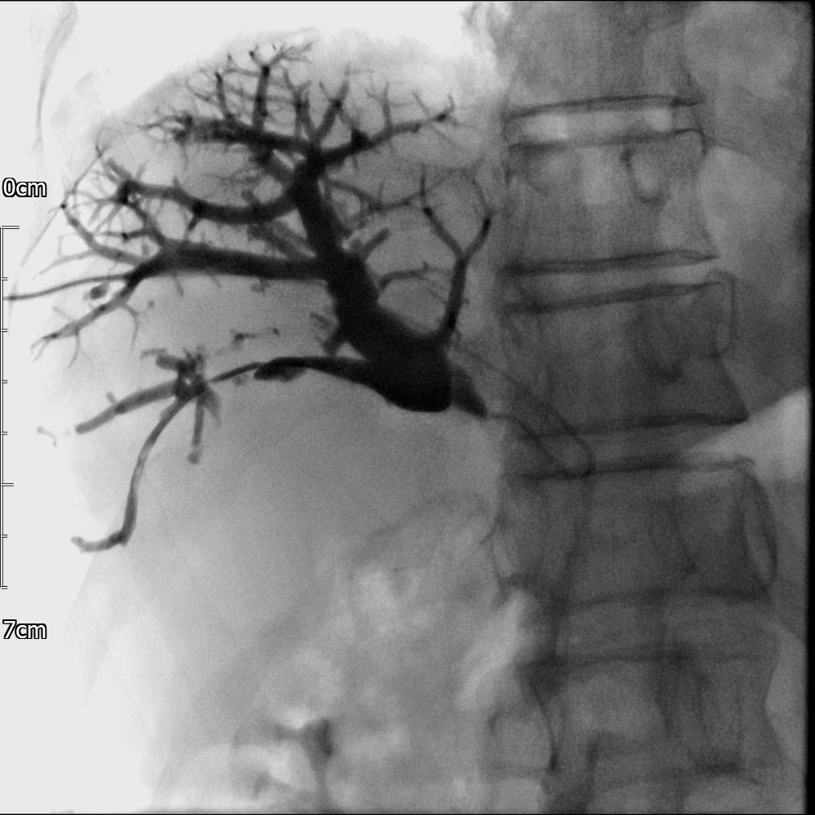
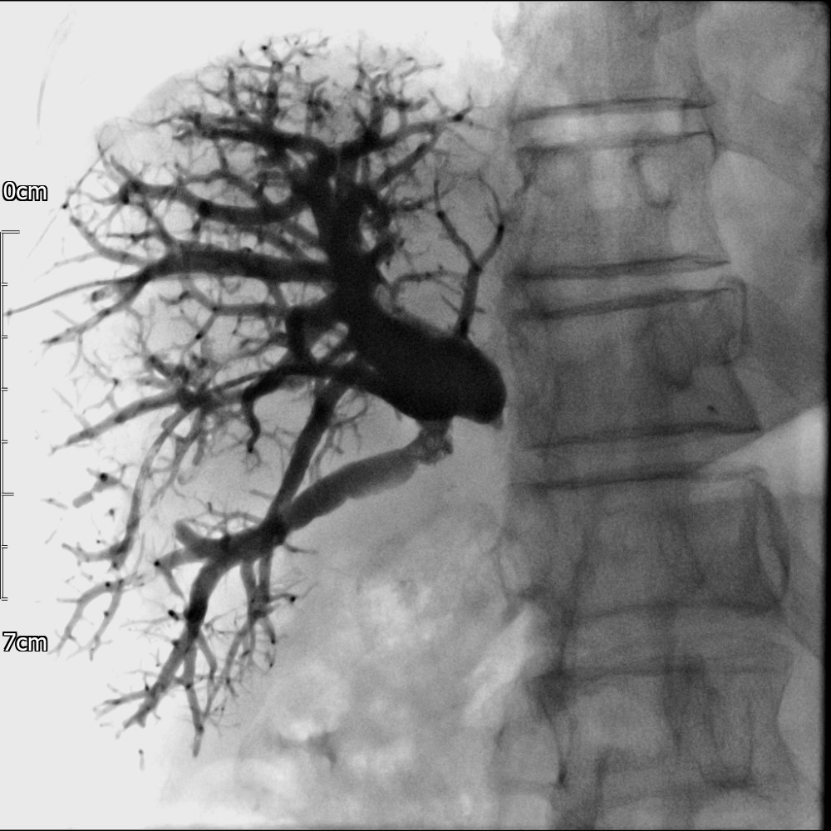
Portal Vein Embolisation

Slide 10
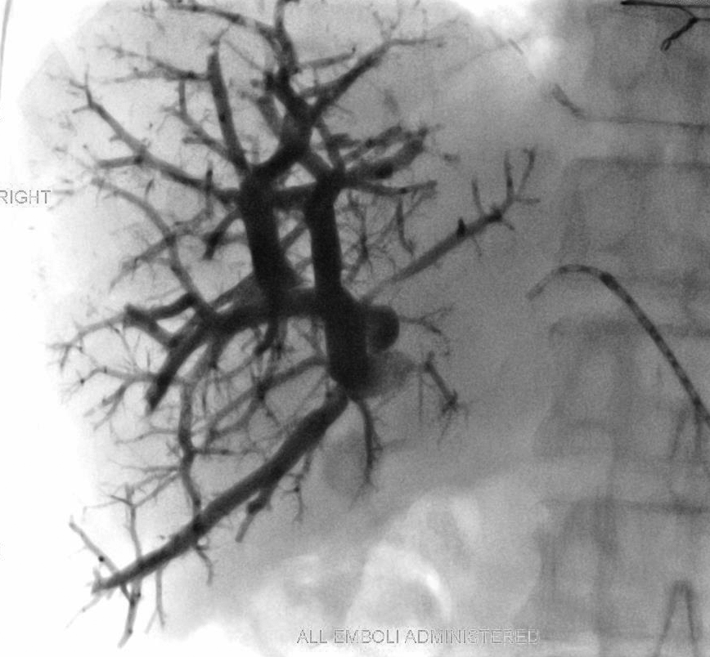
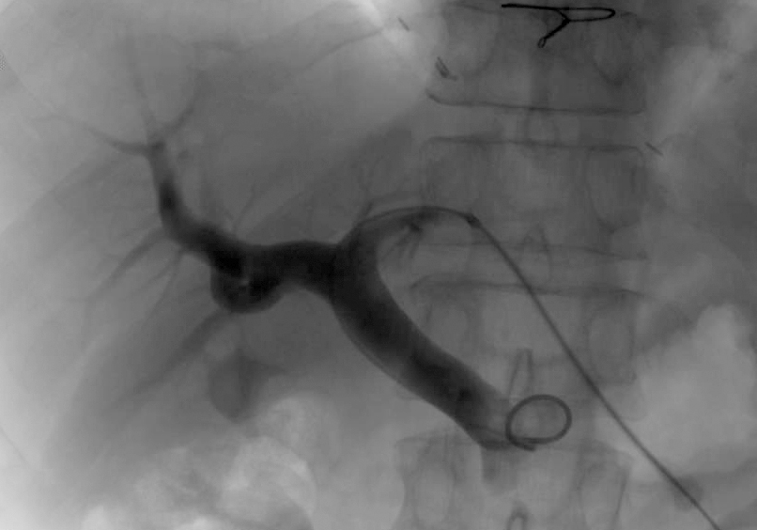
Portal Vein Embolisation
Contra lateral Approach

Slide 11
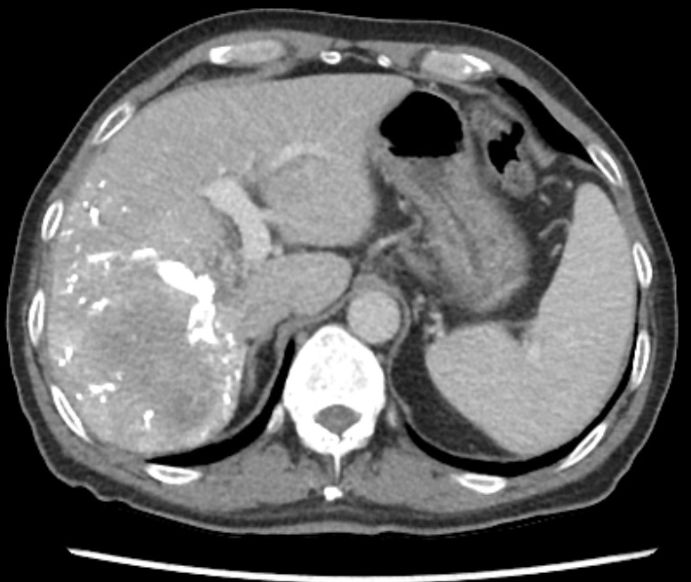
Portal Vein Embolisation

Slide 12
Portal Vein Embolisation

Slide 13
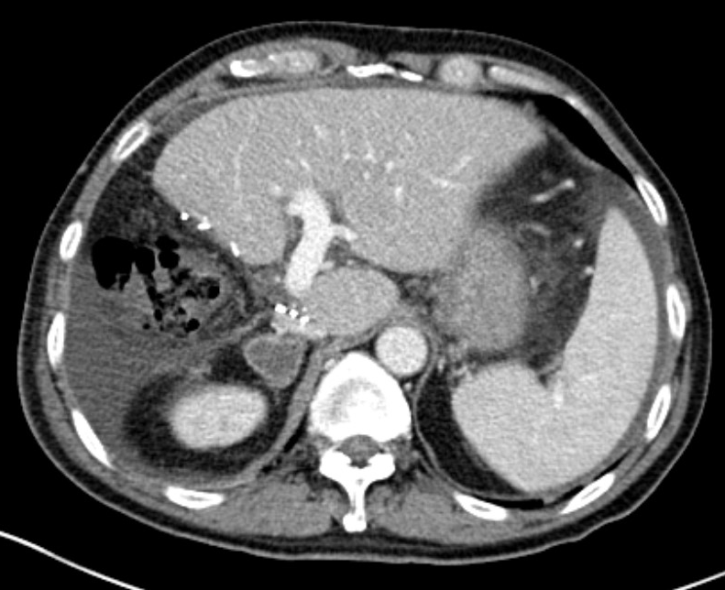
Portal Vein Embolisation

Slide 14
Portal Vein Embolisation
Bristol Experience
First started in 2011
40 patients
27 males
Mean age 67 (41-82)
61.5% Operated on Post PVE

Slide 15
Portal Vein Embolisation
Technically possible in 39/40 cases
1:9 Cyanoacryl glue: Lipiodol
Portal vein thrombosis - 2 cases
Insufficient hypertrophy - 1 case
Mean 9.25 weeks to Surgery
Mean Vol. 25% to 39%

Slide 16
Outcome
Colorectal
19 cases
1 patient new metastasis
18 operable (95%)

Slide 17
Outcome
HCC
5 cases
5 resected
3 patients died within a year
One patient still alive over 10 years, one over 5 years

Slide 18
Outcome
Intrahepatic Cholangiocarcinoma
3 cases
3 operable
One survived past 5 years

Slide 19
Outcome
Cholangiocarcinoma
12 cases
1 still going through
1 benign disease
3 operable (25%)

Slide 20
Outcome
Cholangiocarcinoma
2 PVT
2 Insufficent hypertrophy
1 CVA peri operative
4 unresectable
Mean survival 8 months

Slide 21
Outcome

Slide 22
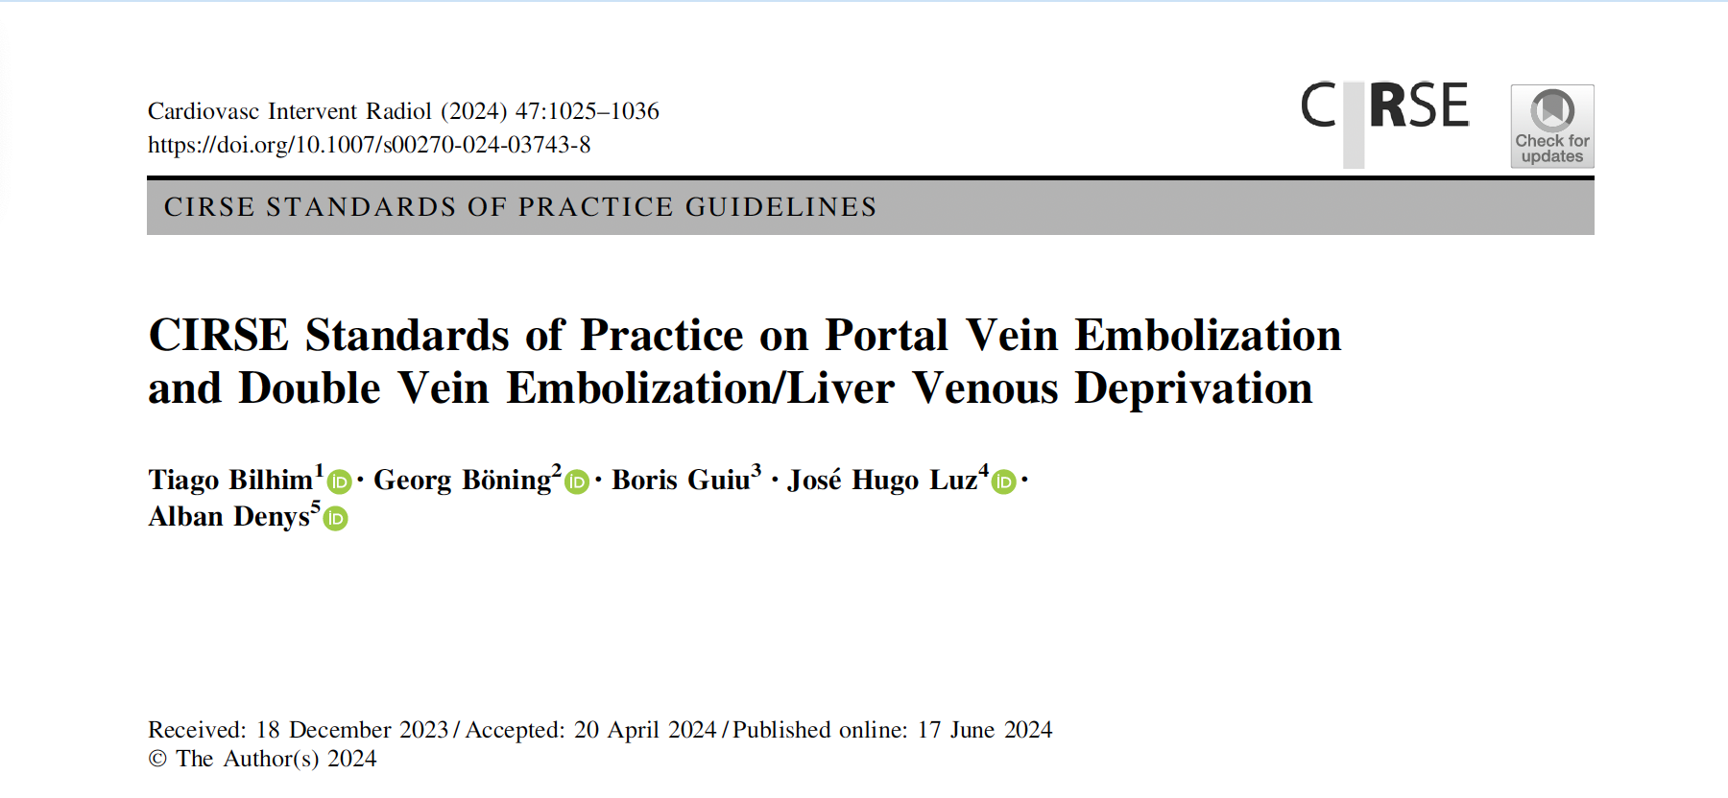
Portal Vein Embolisation

Slide 23
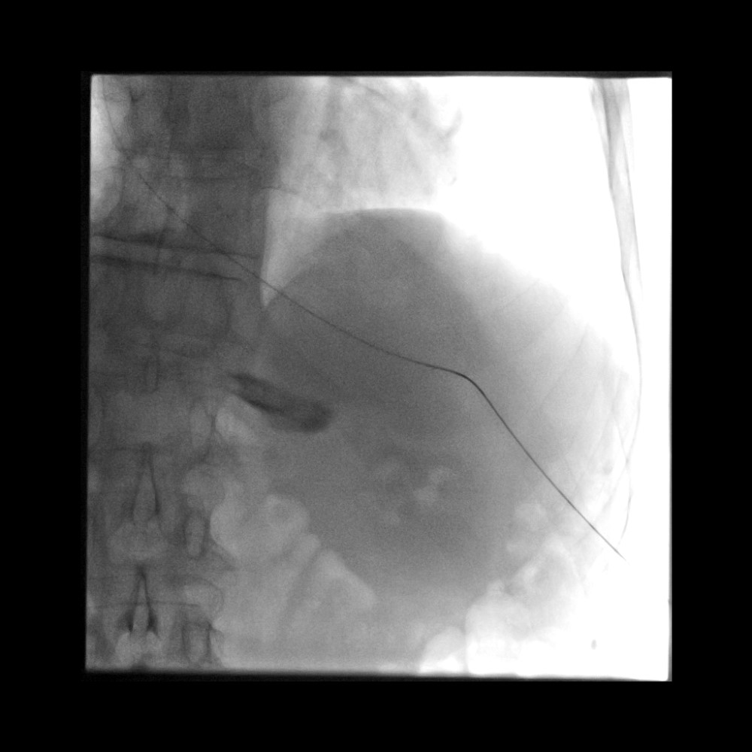
PVE

Slide 24
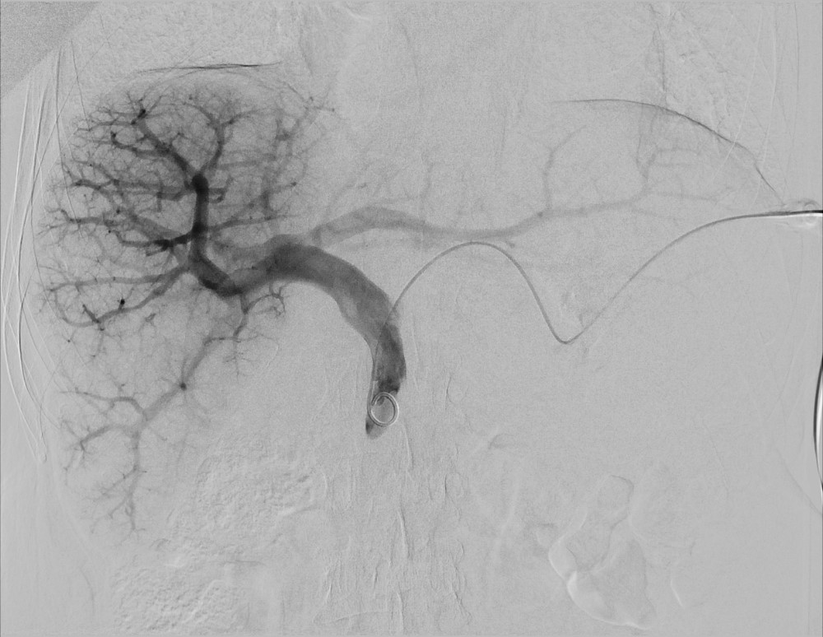
PVE

Slide 25
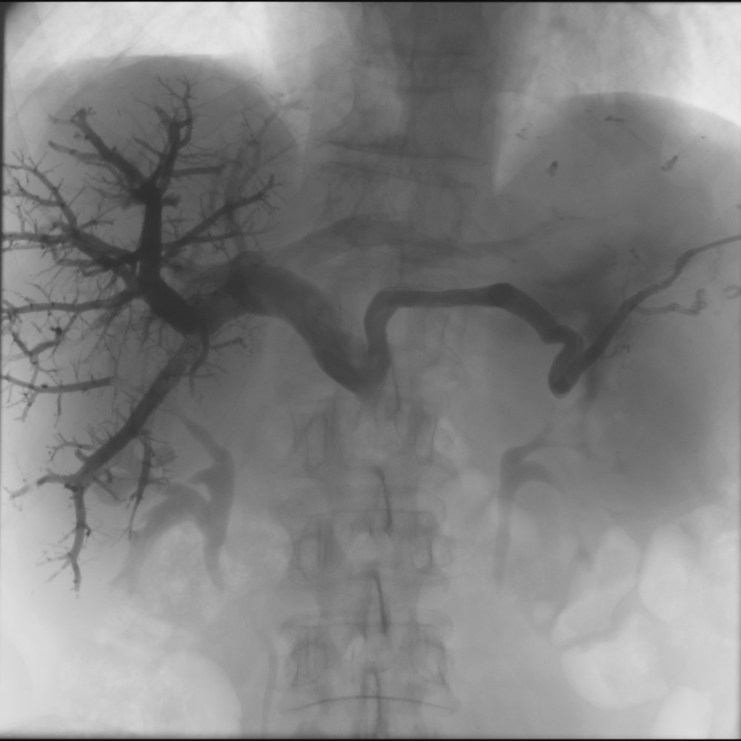
PVE

Slide 26
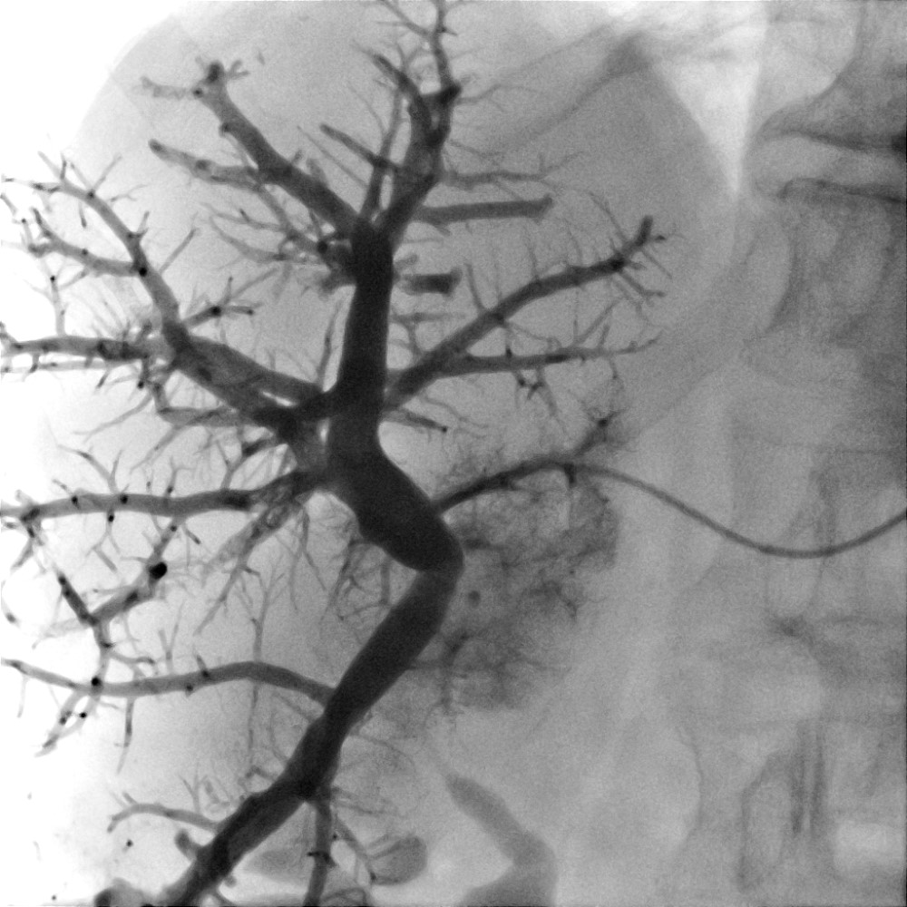
PVE

Slide 27
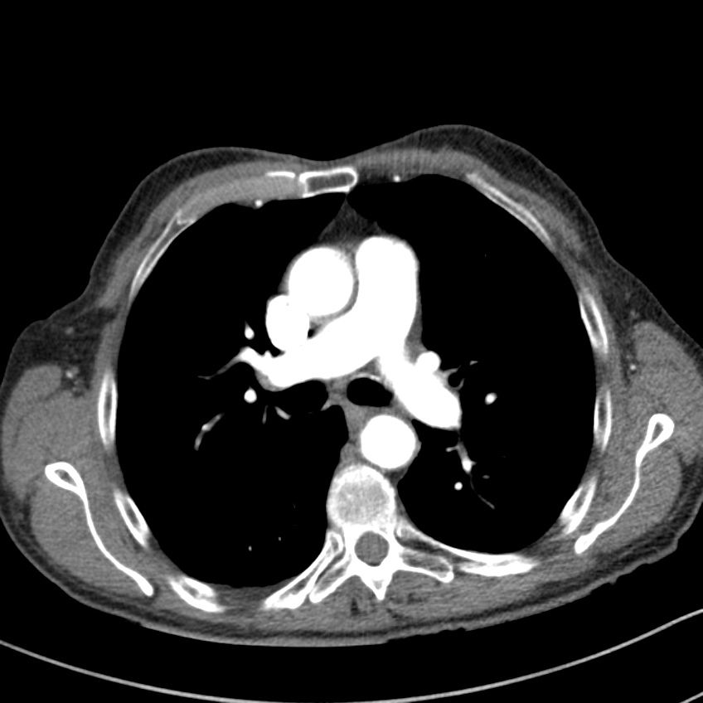
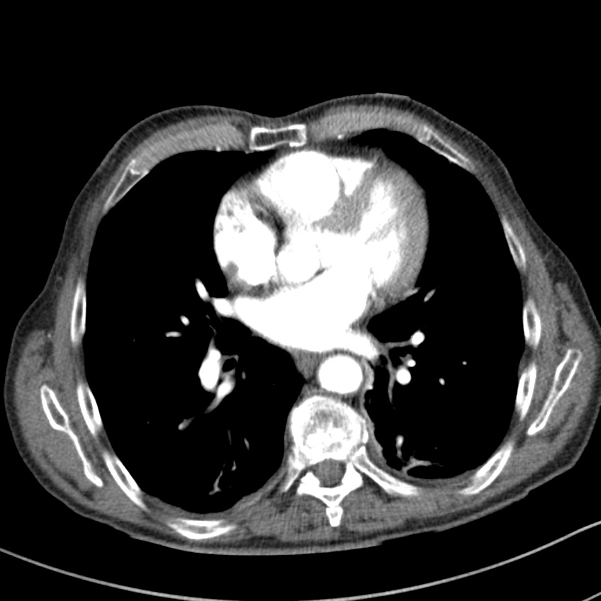
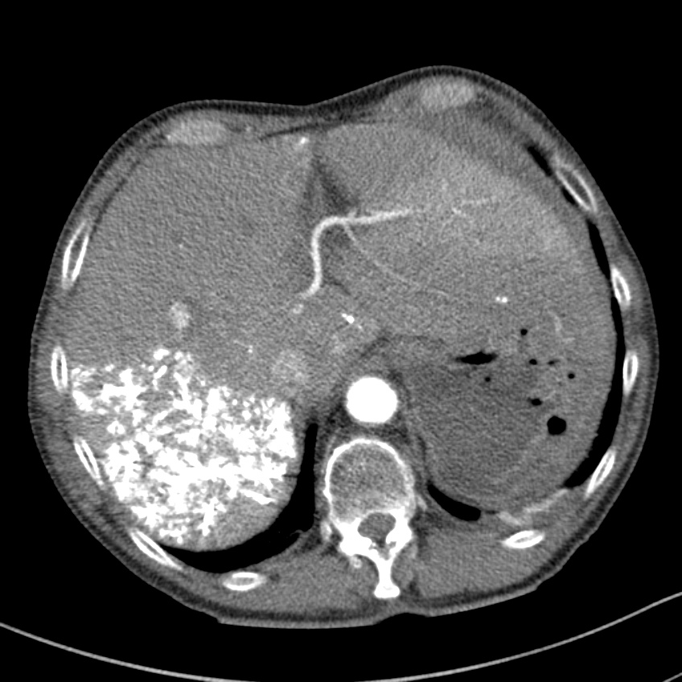
PVE
CTPA

Slide 28
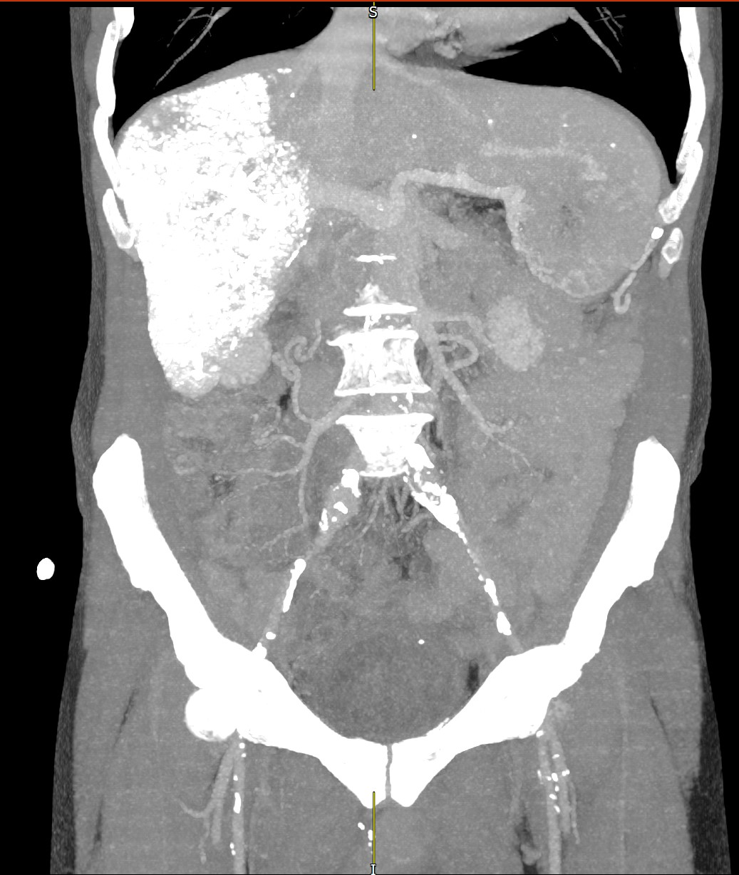
PVE

Slide 29
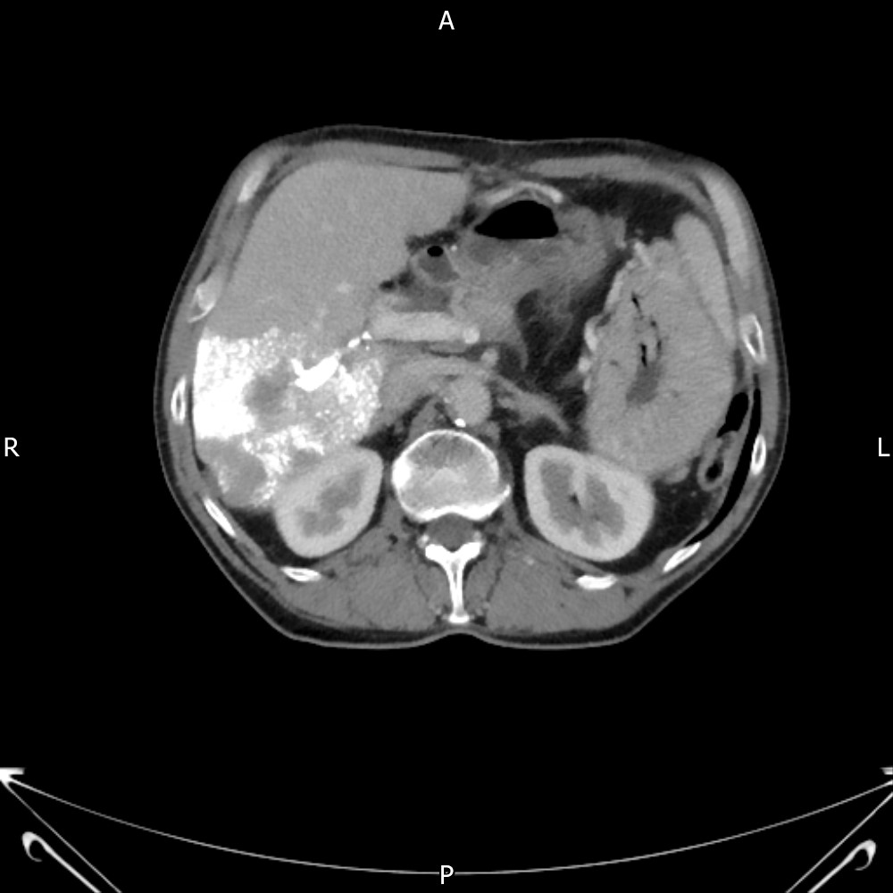
PVE
PVE via the Left Gastric vein

Slide 30
Portal Vein Embolisation
Conclusion
Very good results in solid tumours – probably not doing enough
Very poor results in biliary tumours – probably doing too many

Slide 31
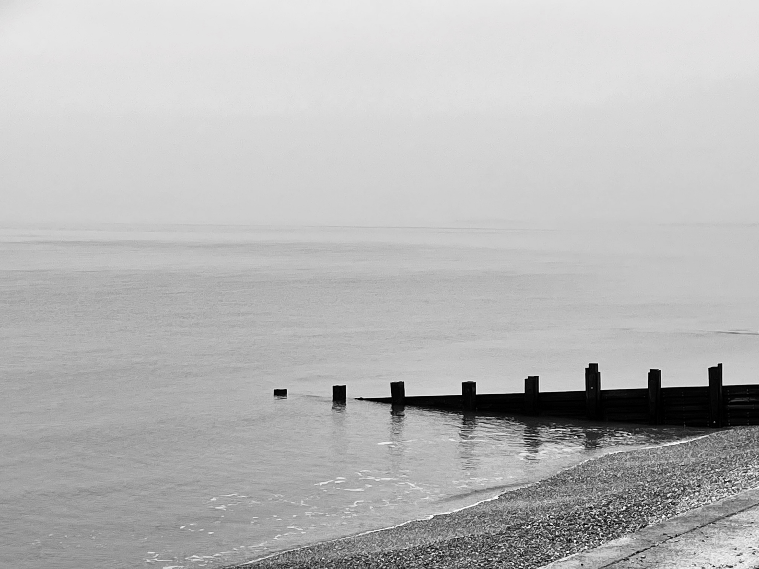
Mark.Callaway@UHBW.nhs.uk

