Slide 1



Whole Genome Sequencing
of Brain Tissue (WGS)
Ruth Cleaver
SWGMS Cancer Lead/SWGLH Rare Disease Lead
Consultant in Clinical Genetics (Peninsula)
Sarah Haywood
SWGMS Genomic Healthcare Professional
@SWGenomics / @SWGLH / @NHSgms

Slide 2
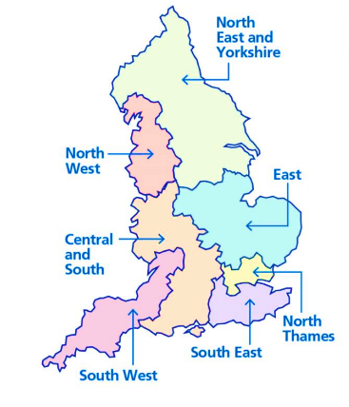
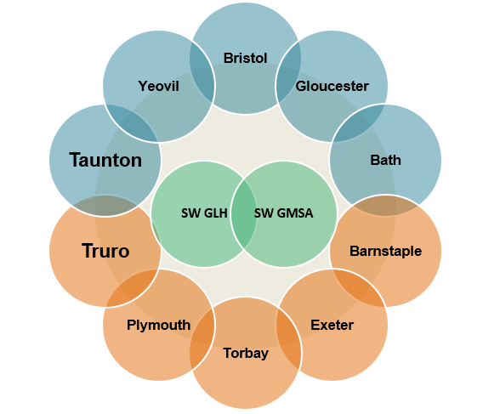
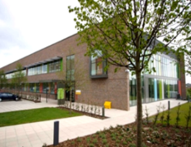

SW Genomic Medicine Service
The NHS Genomic Medicine Service provides equitable genomic technology-driven care for the country’s 55 million population:
National co-ordination and oversight from NHSE Genomics Unit
Common national standards, protocols and contracts
A single National Genomic Test Directory
Genomic testing for patients affected by rare genetic conditions and for cancer patients
GMSA partnerships to support delivery and education
SW Genomic Laboratory Hub (SWGLH)
SW Genomic Medicine Service Alliance (SWGMSA)
Bristol Clinical Genetics
Peninsula Clinical Genetics
9 Acute Trusts
6 Integrated Care Boards
2 Pathology Networks
Bristol
Laboratory
Exeter
Laboratory
Population: 4.4 million
Notes:
This slide gives a brief overview of the South West Genomic Medicine Service (SW GMS) which serves a population of aprox 4.4 million and the National Genomic Medicine Service
The SW GMS is comprised of the South West Genomic Laboratory Hub (SW GLH), the Bristol and Peninsula Clinical Genetics Services, based at UHBW and RDUH respectively, all of which are supported by the South West Genomic Medicine Service Alliance (SW GMSA).
The South West Genomic Laboratory Hub (GLH) The South West Genomic Laboratory Hub (GLH) is made up of two partner laboratories, the Bristol Genetics laboratory at NBT and the Exeter Genomics laboratory at the RDUH.
The Bristol lab provides core testing for example cytogenetics and cancer genomic testing as well as specialist renal and cardiac testing. The Exeter lab provides specialist endocrine testing and is the national provider of rapid whole genome sequencing for acutely unwell babies and children, which I will come to on my next slide.
We are delighted that the SW GLH is delivering all of the commissioned testing within the required turn around times (TATs) and has some of the fastest TATs for cancer genetic testing in England.
The clinical genetics services cover one of the largest combined geographical regions in the country, with Bristol covering those regions in blue circles and the Peninsula service those in orange.
We work alongside 2 pathology networks and 6 ICBs.

Slide 3
Whole Genome Sequencing pathway for brain tissue
Suitable fresh tissue sample
>30% cellularity and <20% necrosis
At MDT: confirmation of a suitable sample and decision to send for WGS
WGS is an adjunct to SOC testing
National Test Directory shows eligibility
Notes:
TAT about three months? C wragg
WGS – not able to do all that is included in SOC eg. methylation.

Slide 4
Whole Genome Sequencing pathway for brain tissue
Utility, equity and management of results
Equity of access to testing
Genomic Tumour Advisory board
Clinical Genetics support for patients with germline variants
Turnaround time
Targeted treatments and Trials
Notes:
Utility - a bit unknown, more about clinical trials etc than clinical decisions in the early weeks post diagnosis
TAT about three months? Cwragg

Slide 5
Whole Genome Sequencing pathway for brain tissue
Support and Resources
SWGMS can support clinicians
Resources
Bristol Labs need TOF
ROD and Germline sample to proceed with WGS
www.nbt.nhs.uk/south-west-genomic-laboratory-hub

Slide 6

WGS Pathway: Brain Tissue
1) Tissue for histopath (standard tests)
2) fresh tissue sample for WGS (min. 15 x 2 mm in plain universal container with saline-soaked gauze)
3) Or freeze in theatre in a Coakham pot
Transport to cell path lab within 2h or can store in fridge up to 24h
Whenever the patients tissue sample is found not to be suitable for WGS it will be discarded as per local pathology criteria.
If a sample contains less than 30% tumour or more than 20% necrosis then this will not be eligible for WGS
Do not discuss WGS unless suitability of the sample has been confirmed
Patient Information in various languages
These can be provided at the initial diagnostic appointment
NHSE Patient Information for Cancer
NHSE Patient Information for Cancer - Easy Read
NGRL Patient Information Research
WGS GMS Test Order Form - Cancer
Request using a via OCS or GMS Test Order Form V2.1
Send directly to Bristol Labs
2x4ml EDTA
Record of Discussion
Confirms a discussion about the test has taken place
Confirms if an offer for research access (NGRL) has taken place
Email:SWGLHexports@nbt.nhs.uk
WGS = whole genome sequencing
TOF = test order form
RoD = record of discussion
SWGLH = South West Genomics Laboratory Hub
NGIS = National Genomics Informatics System
NGRL= National Genomic Research Library
Transport frozen with dry ice or Intelsius Orca M Box
For more information- https://www.nbt.nhs.uk/south-west-genomic-laboratory-hub/swglh-sample-test-information
Results returned to clinical team
Discussion available at Genomics Tumour Advisory Board if required

Slide 7

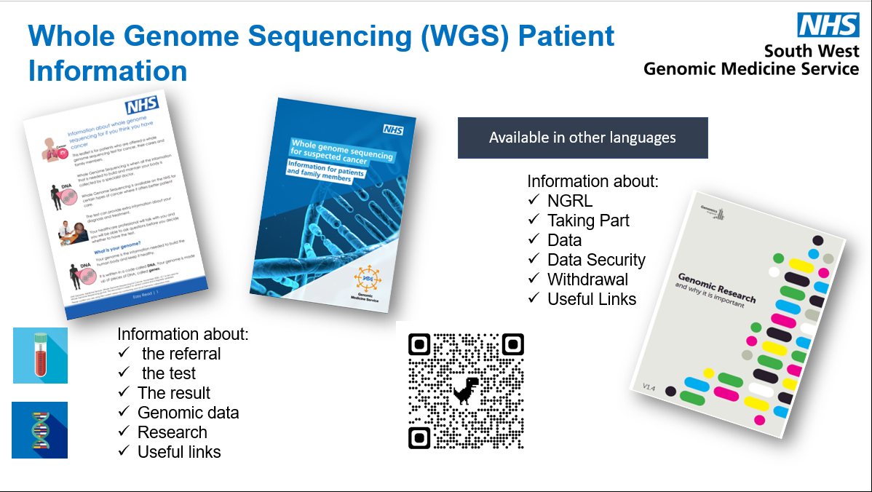
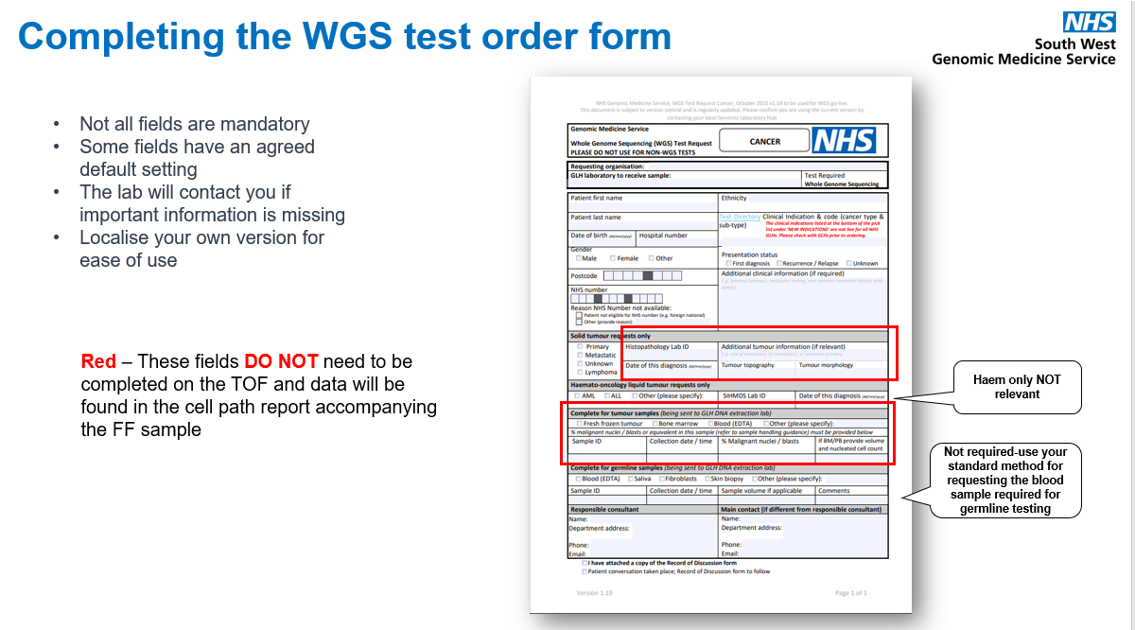
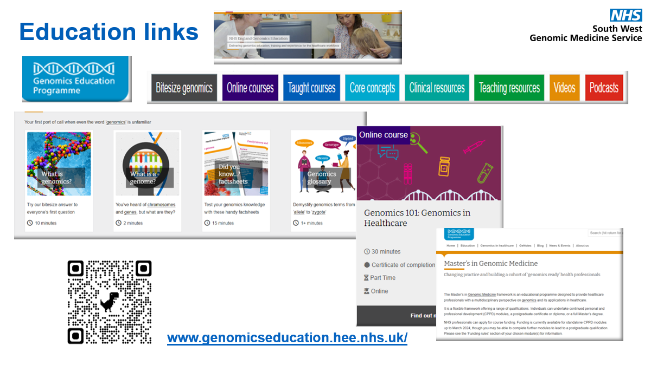
Picture Guide.

Slide 8

Any Questions ?

