Slide 1
Remote Monitoring &
Supported Self-Management using My Medical Record (MMR)
Chelsey Gilmour – Remote Monitoring Project Manager
Emma Bedggood – Personalised Care & Support Lead for Cancer
Haematology CAG, 10th July 2024

Slide 2
Project outline
Following treatment for cancer, patients are stratified to a follow-up pathway that suits their needs and provides rapid access to clinical support when needed.
Supported self-management – Enables the patient to take a leading role in their follow up with support from the specialist cancer team:
Consultant, Clinical Nurse Specialist and Cancer Support Worker
Remote monitoring – The My Medical Record (MMR) website provides access to test results, enabling the patient and care team to routinely monitor the patients’ follow-up and action as required.
Notes:
EB

Slide 3
My Medical Record project
Aims:
Empower patient with knowledge and resources to self-manage
Reduce the need for face-to-face outpatient appointments
Digitally supporting PSFU pathways
NBT progress:
Post-RALP pathway live with >200 patients registered, Colorectal with >260 and Breast with >220
Recruited two Remote Monitoring Cancer Support Workers (fixed term)
Lymphoma go-live Aug/Sept 2024. Protocol reviewed, pathway written, MMR website, letters, symptom questionnaire
Kidney and Bladder to follow in Autumn 2024
Target of 3,000 patients registered in total by March 2025
Comms – GP liaison, NBT website, leaflets, video, internal comms
Supporting accessibility, inequalities, patient support requirements
Notes:
EB

Slide 4
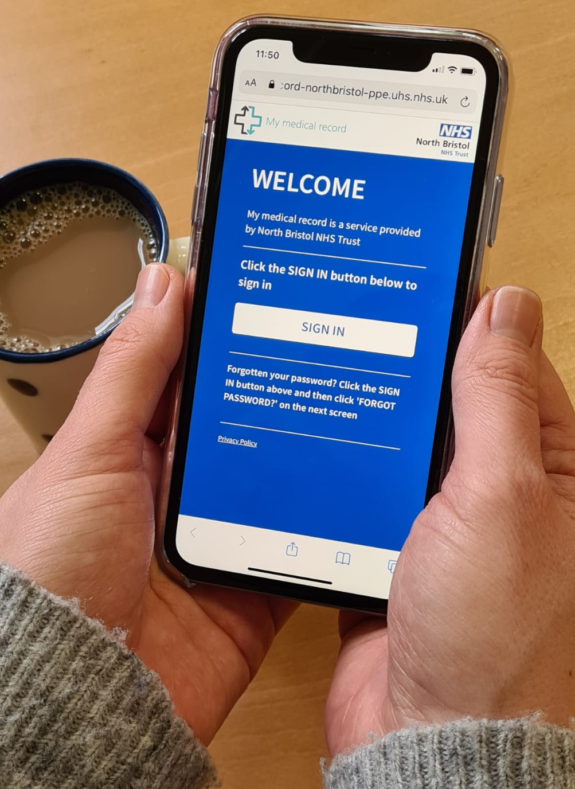
My Medical Record for patients
Supporting patients to self-management
Introduce supported self-management – timing pathway-specific
Consultant / CNS to discuss with patient
Choice to access the website – IT and non-IT patients
Introduction and demo video shared
Registered onto MMR
Access own results, letters and resources
Provides:
Access to real time test results and clinic letters
Post-treatment monitoring plan
Secure messaging to and from the clinical team
Access useful general and specific information about condition (leaflets, websites, videos, etc.)
Access 24/7 from any device
Notes:
CG

Slide 5
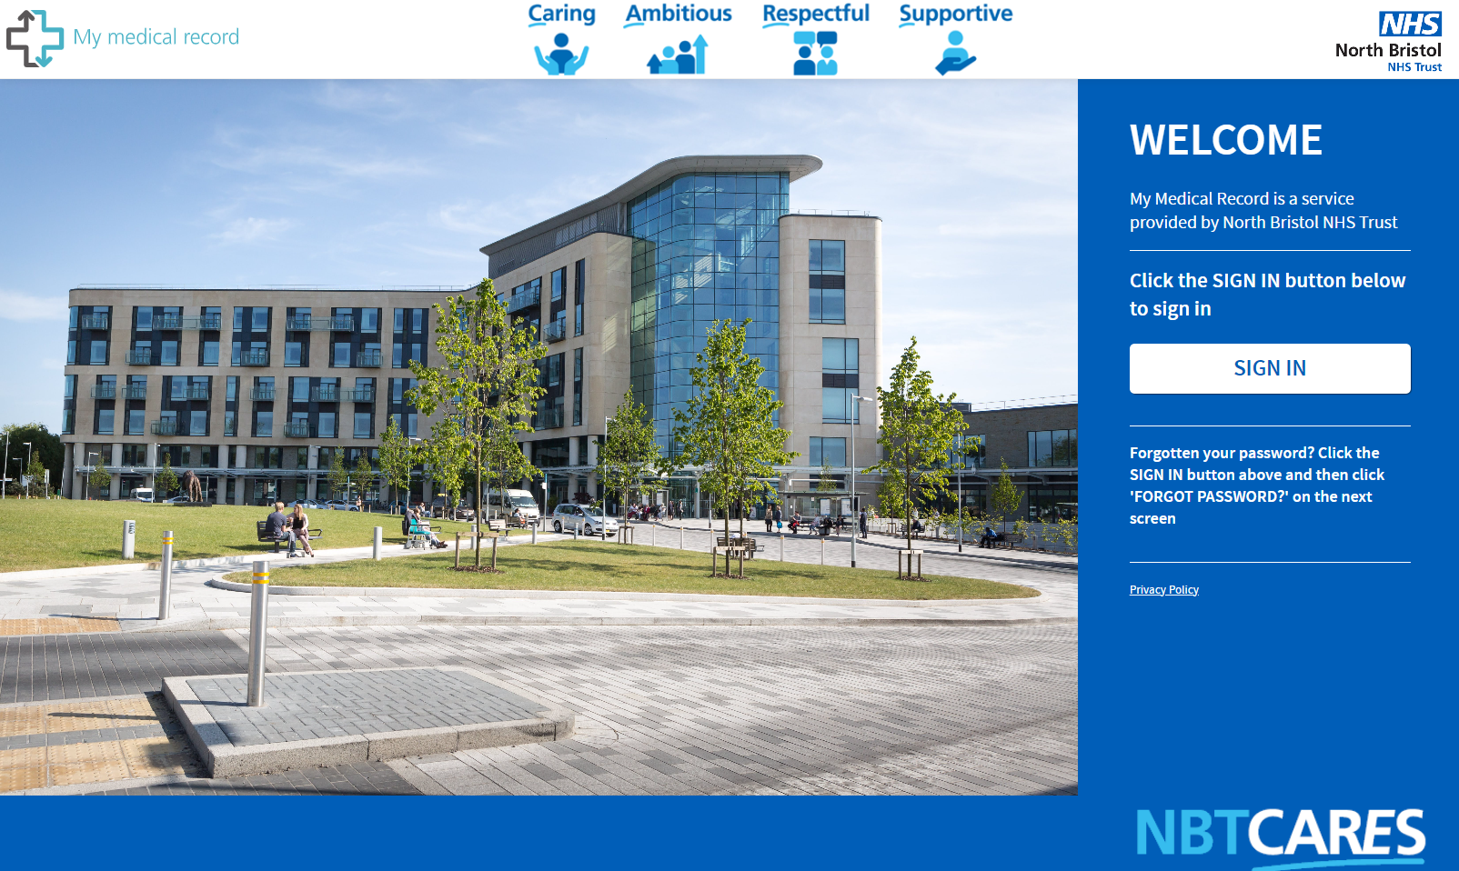
My Medical Record - Patient login page
Notes:
CG

Slide 6
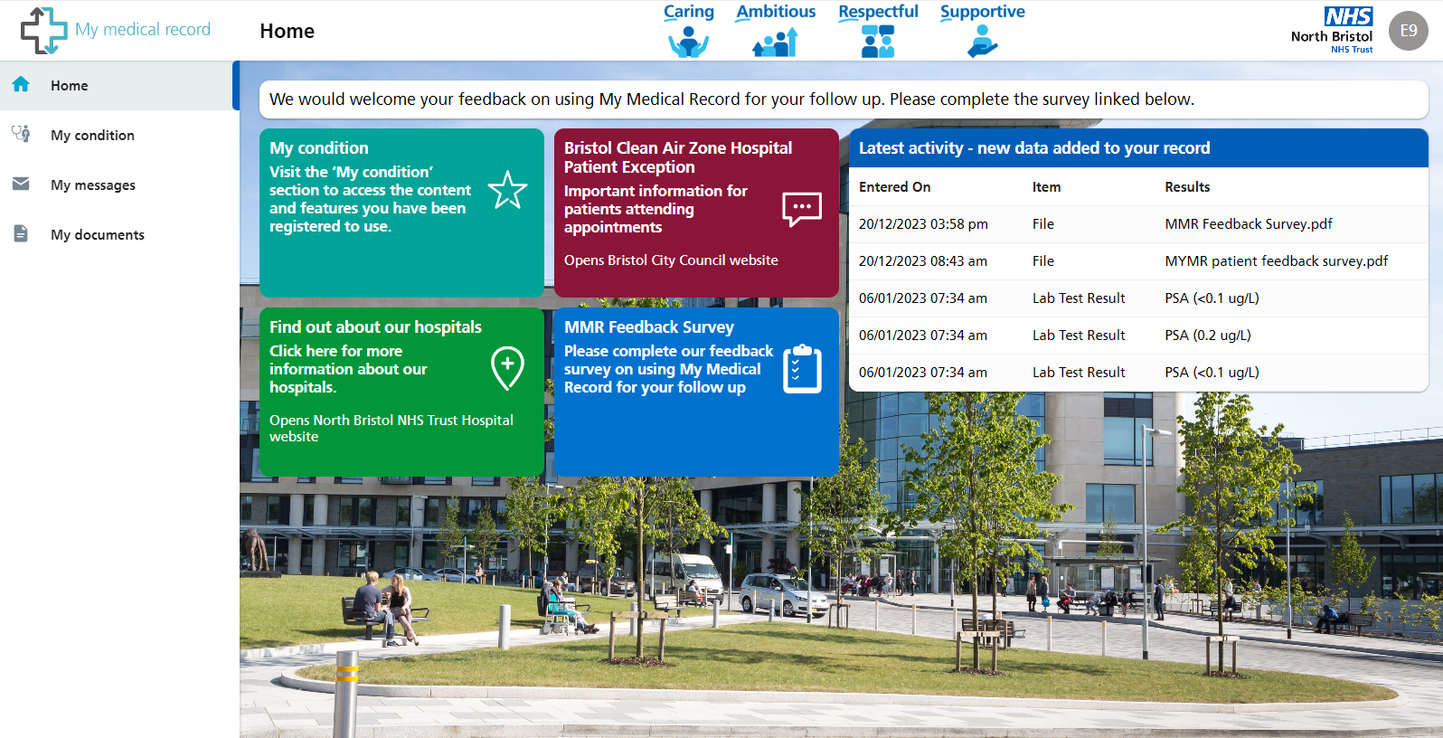
Patient home page
Notes:
CG

Slide 7
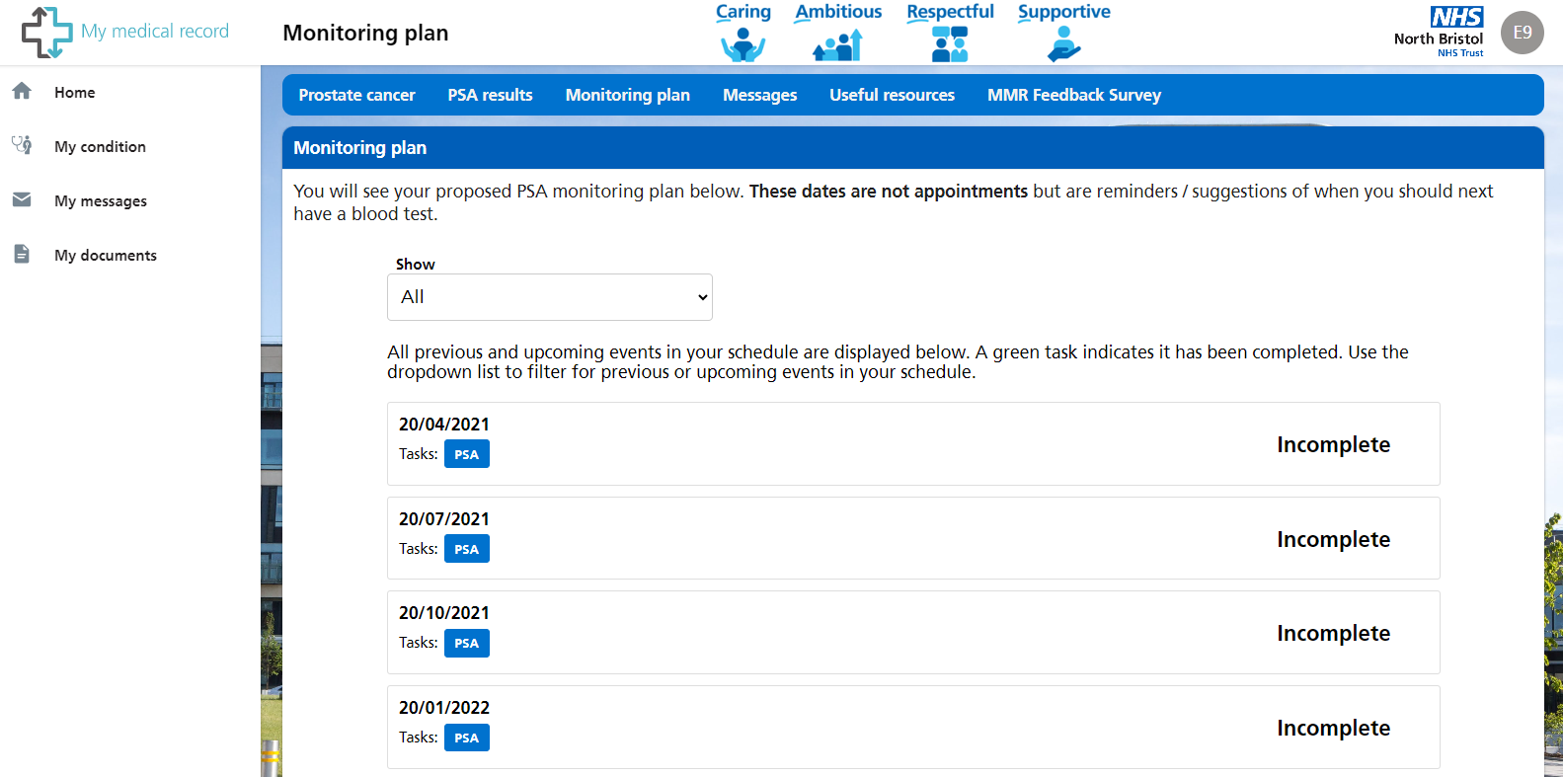
Remote monitoring plan
Notes:
CG

Slide 8
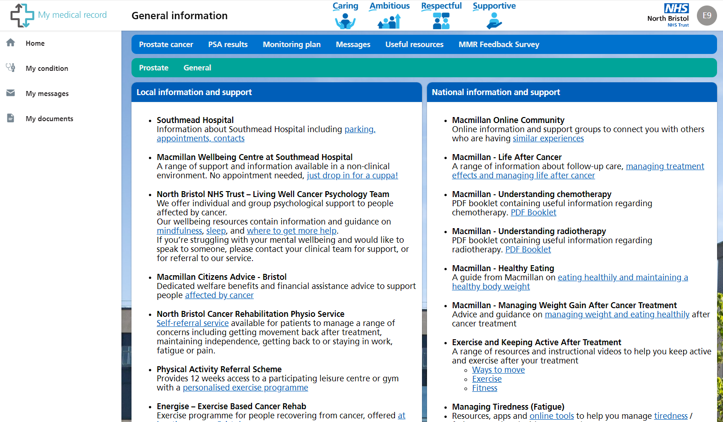
Patient resources page
Notes:
CG

Slide 9
My Medical Record for clinicians
Cancer Support Team carry out remote monitoring
All patients are registered to a specific clinical protocol
Post-treatment monitoring plan provided
Patients’ test results routinely tracked on MMR by RM CSWs
Results are confirmed by letter and any actions needed
Face to face appointments arranged as required
Clinical team can securely message and receive messages from the patient
Benefits:
Digital approach to standardised follow up care
Accessible support and information for patients
Clinical time released
Notes:
EB

Slide 10
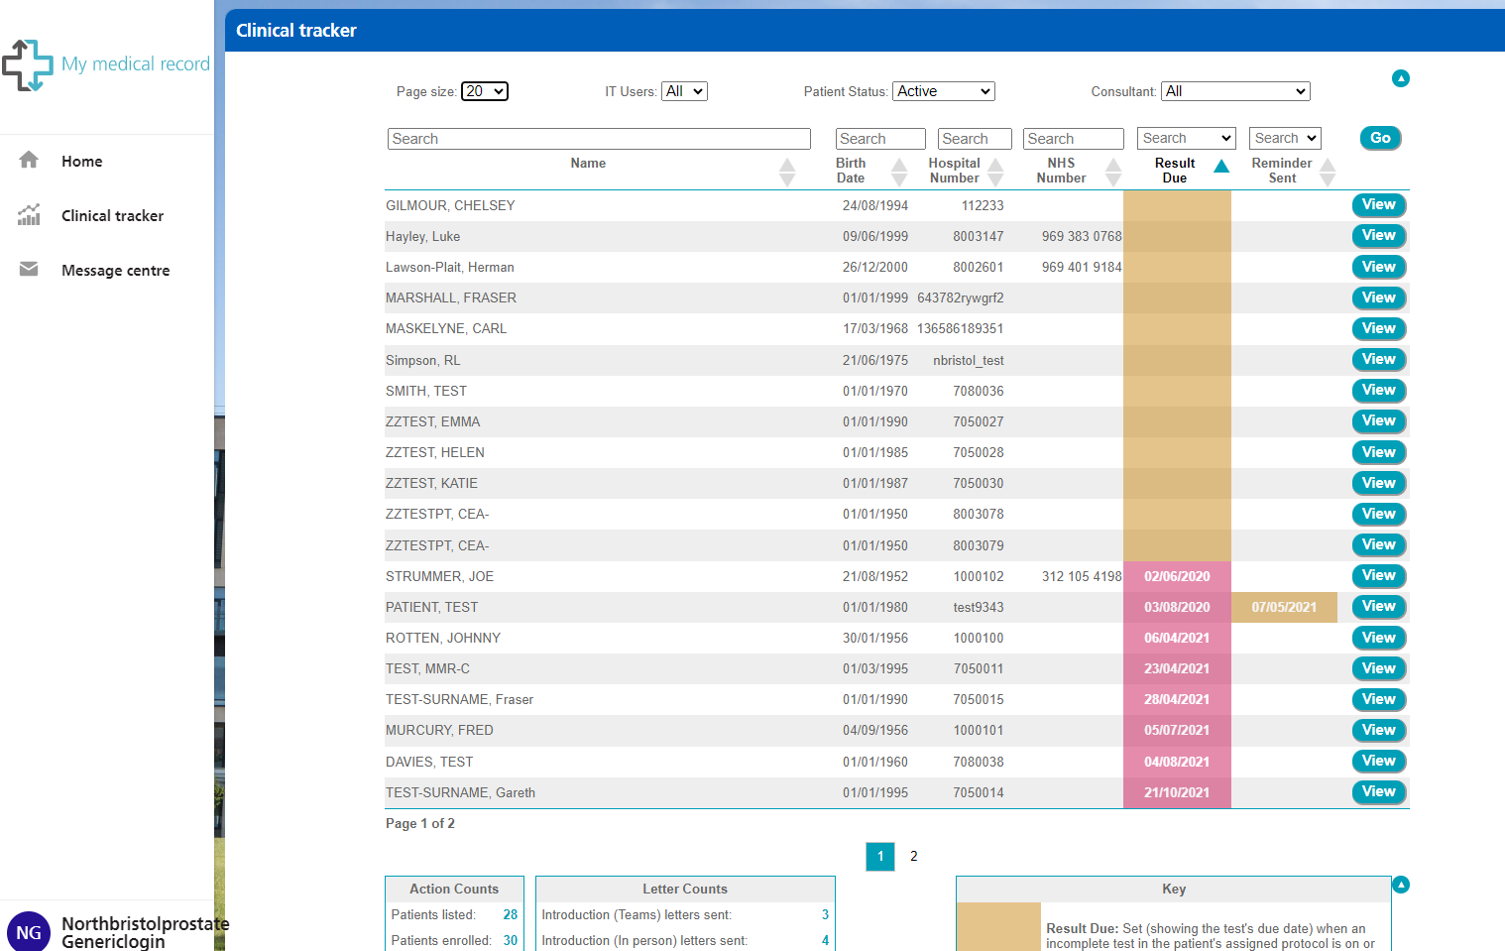
Clinical view - tracker page
Notes:
CG

Slide 11
Patient feedback – Post-RALP patients
IT users: What do you like about using MMR for your follow up? – 7 responses
“Ability to find out blood results quickly and even same day”
“It is quick and is direct from the hospital so the specialist would see any results”
“Easy to use, keeps me in contact and up to date, peace of mind”
Non-IT users: Are you happy with the way in which the Urology Cancer Support Team provide your follow up? – 12 responses
11/12 said Yes
What could be improved?
“Not easy to find the website via google”; “Only an easier log in [web] address”
“Response time to questions”
“Could offer basic self help support and ideas”
Do you have any other questions or comments?
“More information about issues following prostate removal surgery”
“Can’t seem to find any groups of my age that have had prostate cancer”
“Brilliant way to self manage”; “It is a great service”
Notes:
CG

Slide 12
Project actions now and future
Continue user feedback collection – “You said, We did” approach
Implement in other cancer sites and teams – Breast, Lymphoma, Kidney, Bladder
Work with associated workstreams – NBT, UHBW, Cancer Alliance and beyond
Continued integrated working with NBT, UHS and other IT suppliers
Detailed project evaluation and closure report for each cancer site as transition to business as usual
Lessons learned
Project governance structure:
NBT Cancer Board provide oversight and governance signoff
Monthly multi-professional Task & Finish Group
Weekly highlight report to Deputy Chief Operating Officer and Assistant Chief Nursing Officer – Cancer Services
Notes:
CG

Slide 13
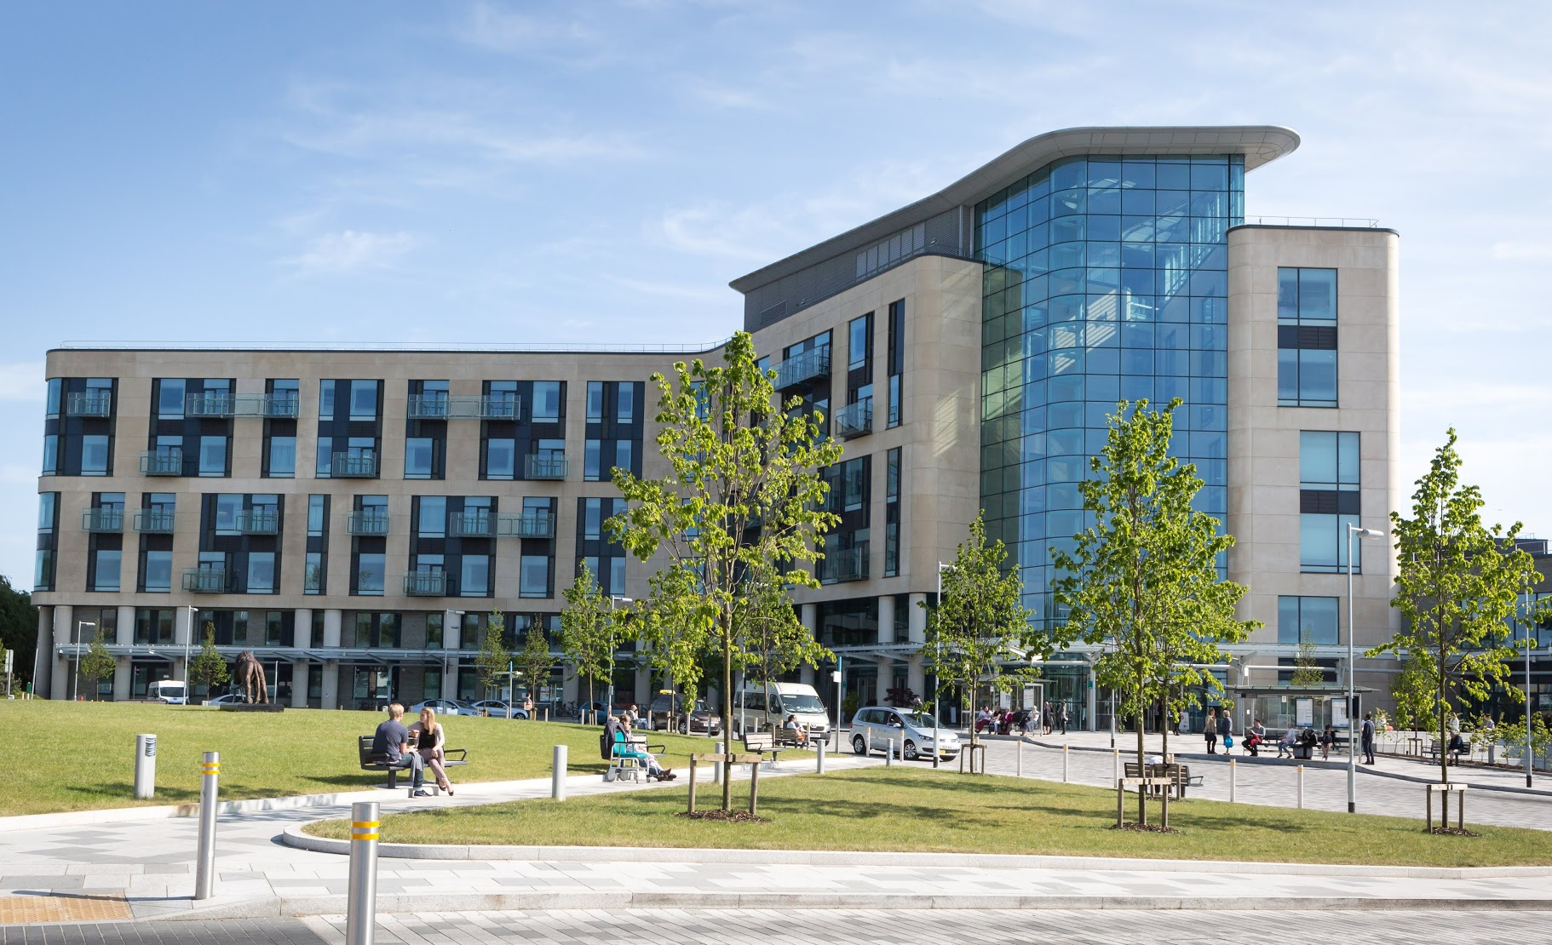
Thank you for listening,
any questions?
Chelsey Gilmour – Remote Monitoring Project Manager
Chelsey.Gilmour@nbt.nhs.uk

