Slide 1
SWAG Personalised Care Strategy 2024
Brain & CNS Cancer Clinical Advisory Group
July 2024
Catherine Neck: (Programme Manager, Early Diagnosis & Personalised Care, SWAG Cancer Alliance)
Andy Holness: (Patient & Public Voice SWAG Cancer Alliance)

Slide 2
SWAG Personalised Care Strategy 2024
The Team
Catherine Neck (Programme Lead)
Gina Jones (Patient & Public Voice)
Andy Holness (Patient & Public Voice)
Elli Hanman (GHNFT Cancer Services Lead Nurse)
Louise Roche (GHNFT Personalised Care Project Manager)
Lucy Osborne (SFT Personalised Care and Support Lead)
Luke Curtis (SNFT Lead Cancer Nurse)
Ellie Lewis (UHBW Personalised Care & Support Manager)
Kirsty Hastie (RUH AHP Lead)
Emma Bedggood (NBT Personalised Care and Support Lead for Cancer)

Slide 3
SWAG Personalised Care Strategy 2024
The Journey So Far
Launch Day – July 2023
Strategy on a page – 100 Days
SWAG Board Approval
SWAG PPV Presentation
Parallel Early Wins
WMTY - NBT Electronic Patient Records
WMTY – Macmillan eHNA
WMTY – Education Invites
Mapping Tool

Slide 4
Your Cancer, Your Care, Your Way
SWAG Personalised Care and Support Strategy
Our vision
Everyone affected by - and working in - cancer will come together as an alliance to enable and deliver consistent, quality, personalised cancer care and support.
Our mission
To provide all those affected by cancer with the best care possible, tailored to their individual needs and preferences, through innovation and working together.
Our values
Person centred
Compassionate
Collaborative
Innovative
Equitable
Understanding what matters to the individual and involving them in the decision-making about their care in a way that suits them.
Incorporating what matters to the individual and those close to them in an empathetic, respectful and dignified way.
Working together with the individual, those close to them, the NHS and other care and support providers, to create a coordinated and seamless care experience.
Seeking new and better ways to provide personalised care and support for individuals and those close to them.
Ensuring that every individual feels they have access to and receive quality care based on their needs.
Individuals and those close to them understand what personalised care looks like, feels like, and how to get it.
Those providing health care and support understand what personalised care looks and feels like and how to deliver it.
We will work with individuals, those close to them, and other providers to deliver care and support that is coordinated and seamless.
Everyone affected by – and working in - cancer is involved in driving forward innovation in personalised care through an all-encompassing partnership approach.
Engage with all communities and groups to remove barriers and build trust to improve peoples’ experiences and outcomes in cancer care.
Our approach
We will deliver personalised care through a range of approaches, based on “what matters to you”, including holistic assessments, care and support planning, prehabilitation, rehabilitation, treatment summaries, and social and psychological support.

Slide 5
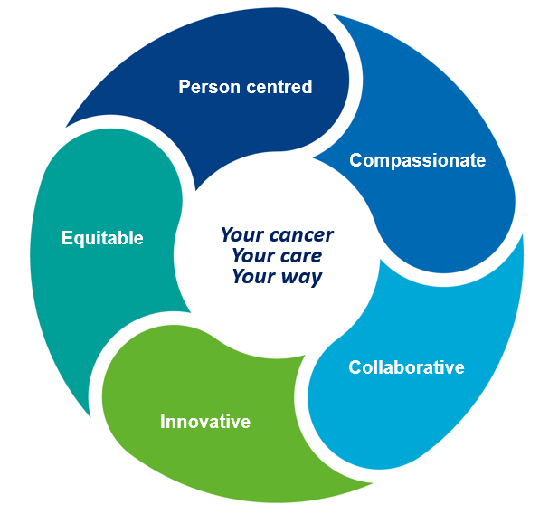
Our Values
Our values underpin the SWAG personalised care and support strategy.
We have used the same colours so it is easy to see how the values run through our work as the “golden thread”.
Innovative

Slide 6
Your Cancer, Your Care, Your Way
Supported Shared Decision Making
Data Sharing
Data Sharing
SWAG Best Practice Leadership
Multi Professional Workforce
Supported Ownership of Health & Wellbeing
Education in Personalised Care Approaches
Education on Sources of Support
Supported Care & Treatment Conversations
Training in Innovation Quality Improvement
Understanding Care & Support Options
Named Care Co-ordinators
Education on Availability of Treatments
Education in Shared Decision Making
Understanding Shared Care
Effective and Meaningful Communication
Training in Quality Improvement
Collecting and Sharing Local Data
Understanding what personalised care looks like
Education in Asking “What Matters To You?”
Commitment to Continuous Improvement
Co-production with Communities
Training in
Co-Production
Enabled to say
“What matters to me”
For Individuals & Those Close To Them
Person Centred
For Staff
Compassionate
For Staff, Individuals & Those Close To Them
Collaborative
For Staff, Individuals & Those Close To Them Innovative
For Staff, Individuals & Those Close To Them
Equitable

Slide 7
SWAG Personalised Care Strategy 2024
Next Steps
Alliance Wide Mapping
Sharing Initiatives & Learnings
Initial Focus – WMTY – Patients & Staff

Slide 8
SWAG Personalised Care Strategy 2024
How Might The CAG Support This Work?

Slide 9
SWAG Personalised Care Strategy 2024
Thank You

