Slide 1
SWAG Network Brain & CNS Cancer
Clinical Advisory Group
Research Update - Claire Matthews
17/07/2024

Slide 2
National Brain Cancer Research Recruitment
Apr 24 - Jul 24
Apr 23 - Mar 24
Source: ODP All Portfolio
Data cut: 16/07/2024

Slide 3
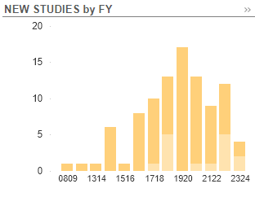
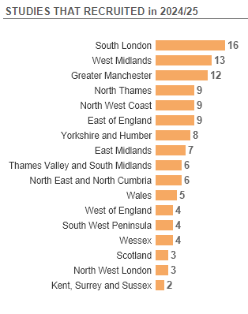
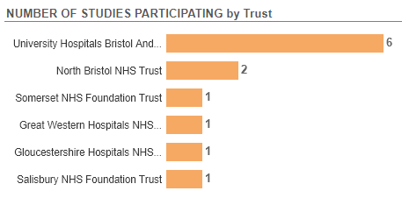
Apr 2023 - July 2024
Source: ODP All Portfolio
Data cut: 16/07/2024

Slide 4
Studies open to recruitment (Brain cancer as managing or supporting specialty)
CPMS ID | Short Name | Sites | Opening | Closure | Sample Size Eng | Eng Recruits
54113 | LOGGIC/FIREFLY-2 | BHRC | 23/10/2023 | 04/11/2024 | 26 | 7
53094 | PRIMALung (EORTC 1901-LCG) | BHOC, Chelt | 19/12/2022 | 30/04/2026 | 68 | 28
52902 | ARISTOCRAT | BHOC | 03/02/2023 | 01/08/2024 | 174 | 19
45956 | FUTURE GB | NBT | 18/12/2020 | 31/10/2023 | 332 | 273
44006 | Tessa Jowell BRAIN MATRIX - Platform Study | BHOC | 24/11/2020 | 01/01/2025 | 800 | 295
42202 | SIOP-HRMB | BRHC | 19/01/2021 | 15/10/2027 | 202 | 32
41890 | BTB | NBT | 31/01/2020 | 31/01/2025 | 500 | 367
18503 | SIOP Ependymoma II | BRHC, NBT | 12/02/2016 | 12/02/2026 | 230 | 215
18137 | PARADIGM (Cancer) | BHOC, Chelt, RUH | 03/03/2015 | 30/04/2024 | 143 | 141
15941 | NIHR BioResource - Rare Diseases | UHBW, Salis, RUH,NBT | 13/09/2012 | 30/11/2024 | 22000 | 20767
8630 | Molecular Genetics of Adverse Drug Reactions (MOLGEN) | RUH, NBT, UHBW, Somerset | 01/06/2009 | 30/04/2026 | 3000 | 3424
4663 | AIP | Yeov, UHBW, Somerset, Salis, NBT | 01/03/2007 | 31/12/2037 | 8500 | 5233
54825 | APPROACH | BHOC | 17/01/2024 | 31/05/2031 | 234 | 11
Sources: ODP All Portfolio, EDGE, CRN WE ODP Dashboard
Data cut: 16/07/2024

Slide 5
DETERMINE
Determining Extended Therapeutic indications for Existing drugs in Rare Molecularly defined Indications using a National Evaluation platform trial
Aim:
Evaluate the efficacy of licensed targeted therapies in unlicensed indications, in rare adult, paediatric and TYA cancers with actionable genomic alterations (including common cancers with rare actionable alterations)
Identify genomic,transcriptomic and immune contextual influences on response to therapy
The ultimate aim is to transition positive findings to the NHS (Cancer Drugs Fund [CDF]) to provide new treatment options for patients with rare malignancies.
Arm 1 Alectinib
Arm 2 Atezolizumab
Arm 3 Entrectinib
Arm 4 Trastuzumab in combination with pertuzumab
Arm 5 Vemurafenib in combination with cobimetinib
*Access to NGS/ WGS may be important for access to targeted therapies for example the DETERMINE trial.

Slide 6
Studies in set-up in SWAG region
CPMS | Short Name | Title | Site | Planned Opening | Planned Closure | Sample Size Eng | Sponsor | CI
53649 | CAAA603C12101: Phase Ib study with [177Lu]Lu-NeoB in Glioblastoma | CAAA603C12101: Phase Ib Dose Finding Study Assessing Safety and Activity of [177Lu]Lu-NeoB in Combination with Radiotherapy and Temozolomide in Subjects with Newly Diagnosed Glioblastoma with MGMT methylated and unmethylated promoter status | BHOC | 31/01/2024 | 30/03/2024 | 4 | Novartis Pharma AG | -
Source: ODP All Portfolio
Data cut: 16/07/2024

Slide 7
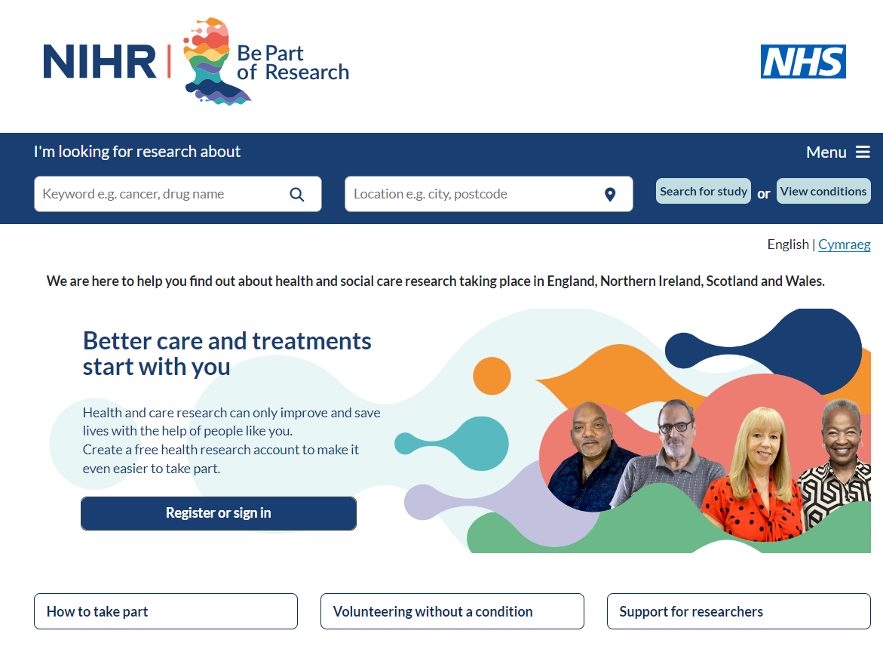
Sharing Information about research
How do you share information with clinical colleagues?
Word of mouth, WhatsApp group, circulated list of studies?
Sharing information with patients

Slide 8
Associate PI Scheme
https://www.nihr.ac.uk/health-and-care-professionals/career-development/associate-principal-investigator-scheme.htm
A six month in-work training opportunity, providing practical experience for healthcare professionals starting their research career. People who would not normally have the opportunity to take part in clinical research in their day to day role have the chance to experience what it means to work on and deliver a NIHR portfolio trial under the mentorship of an enthusiastic Local PI.
Brain Cancer Studies on the scheme:
FUTURE GB
Tessa Jowell BRAIN MATRIX - Platform Study
ARISTOCRAT
SIOP Ependymoma II
MOLGEN
NIHR BioResource - Rare Diseases

Slide 9
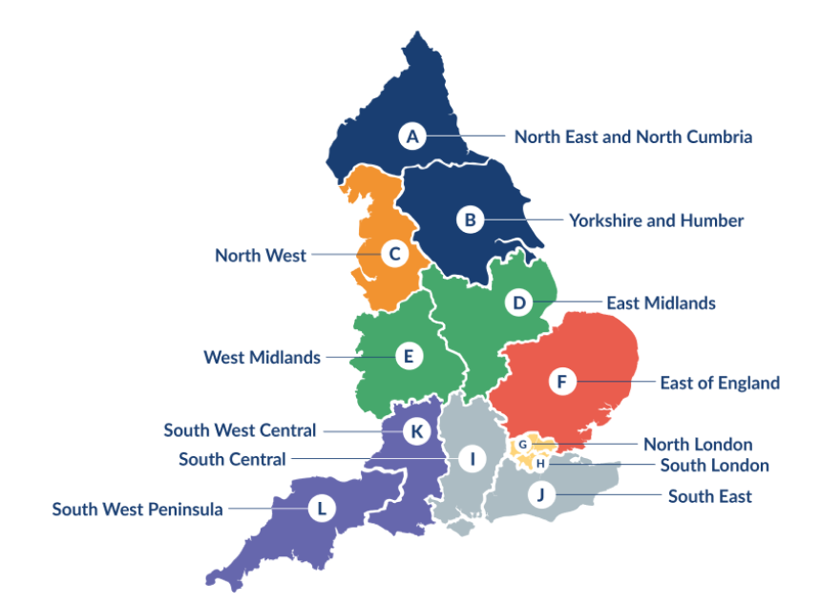
Clinical Research Network Transition to Research Delivery Network
Launching Oct 2024
The NIHR RDN has 2 primary purposes:
To support the successful delivery of high quality research, as an active partner in the research system
To increase capacity and capability of the research infrastructure for the future
SW Central - covering Dorset and Salisbury in addition to current region
Network Director: Kyla Thomas
Operations Director: Stephen McGlynn
Strategic Development Director: Ifan Jones
We have just appointed two new senior leadership roles:
Dr Helen Winter and Dr Patrick Moore - Joint RRDN Health and Care Research Directors (Medical)
Helen Lewis-White - RRDN Health and Care Research Director (Nurse, Midwife or Allied Health Professional)

Slide 10
NIHR ODP
Open data platform. Data on performance across whole CRN,
including all specialty areas
NIHR Be Part of Research
See which studies are open across the country
National Cancer Research Institute Portfolio Maps
View current national portfolio of open, closed and ‘in set up’ cancer studies
Find a Clinical Research Study (ODP)
Search for a study to fit criteria. Good for horizon scanning, eligibility criteria

Slide 11
Research Delivery Manager
claire.matthews@nihr.ac.uk
Research Portfolio Facilitator
rebecca.pienaar@nihr.ac.uk
Brain Cancer Sub-specialty Lead
christopher.herbert@uhbw.nhs.uk
Notes:
Section separator template using the motifs.

