Slide 1
SWAG Network Oesophago-gastric (OG) Cancer
Clinical Advisory Group
Research Update
Claire Matthews & Sharath Gangadhara
08/12/2023

Slide 2
National Recruitment to Upper GI Cancer Studies
Apr 22 - Mar 23
Apr 23 - Dec 23
Data cut 01/12/2023
Source: ODP All Portfolio

Slide 3
National vs Regional Recruitment to Upper GI Cancer Studies Apr 2019 - Mar 23
National Recruitment
SWAG region Recruitment
Data cut 01/12/2023
Source: ODP All Portfolio

Slide 4
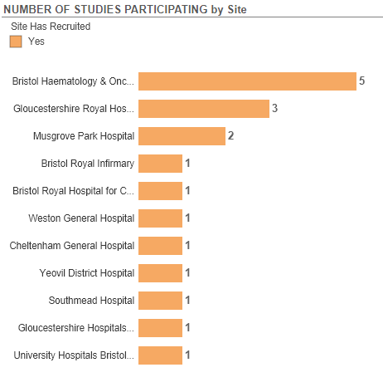
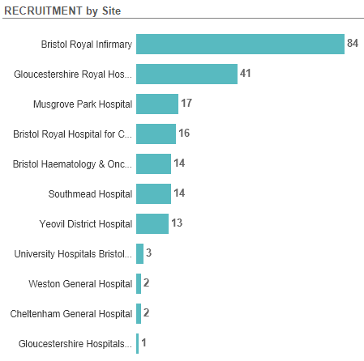
Recruitment to Upper GI Cancer Studies SWAG Region Apr 2023 - Dec 23
Data cut 01/12/2023
Source: ODP All Portfolio

Slide 5
SWAG region Open OG Cancer Studies
CPMS | Short Name | Open | Closure | Target Eng | Eng Recruits
55905 | Surveillance After Resection of Oesophageal aNd Gastric cancer trial (SARONG) | 09/06/2023 | 31/10/2025 | 800 | 49
54878 | AspECT EXceL | 24/05/2023 | 31/01/2024 | 1287 | 214
54168 | Gastric Platform Study | 01/09/2023 | 20/03/2024 | 8 | 2
50774 | Augmented biomarker response in oesophagogastric cancer | 28/02/2022 | 01/09/2024 | 858 | 257
50090 | Ph1b/3 Bemarituzumab in Advanced Gastric Gastroesophageal Cancer | 30/06/2022 | 14/12/2024 | 26 | 9
49425 | HERIZON-GEA-01 | 11/04/2022 | 30/06/2024 | 11 | 5
44579 | DESTINY-Gastric 03 | 15/07/2021 | 31/08/2024 | 9 | 8
42784 | Early diagnosis of upper digestive tract disease | 01/10/2019 | 01/08/2024 | 300 | 101
42715 | WAKING: Wnt and checKpoint INhibition in Gastric cancer | 11/02/2020 | 31/10/2023 | 52 | 38
42573 | Pembrolizumab & Chemoradiation in Oesophageal Carcinoma Participants | 06/08/2020 | 18/01/2024 | 32 | 24
42082 | Non-Invasive Testing for Early Oesophageal Cancer and Dysplasia | 19/08/2019 | 01/10/2024 | 900 | 766
20358 | SCOPE 2 | 15/12/2015 | 30/11/2025 | 306 | 321
18432 | PLATFORM | 23/02/2015 | 31/03/2025 | 694 | 1112
8880 | OCCAMS: Multicentre Study Determining Predictive Biomarkers & Targets for Oesophageal Adenocarcinoma | 19/07/2010 | 31/03/2026 | 5000 | 3980
Data cut 06/12/2023
Source: ODP All Portfolio

Slide 6
SWAG region In Setup OG Cancer Studies
CPMS ID | Title | Planned Opening | Planned Closure | Sample Size Eng | Sample Size UK | Sponsor
59351 | Impact of feedback from Real-time, electronic symptom monitoring on post-discharge recOvery after Surgery for oEsophago-gastric cancer: a multi-centre randomised controlled trial: The ROSE study | 01/04/2024 | 15/01/2026 | 206 | 206 | UNIVERSITY HOSPITALS BRISTOL AND WESTON NHS FOUNDATION TRUST
57395 | AZD0901 CLDN18.2 ADC: A Master protocol, Open Label, Phase 2a Study of AZD0901 as Monotherapy or in Combination with Anti-cancer Agents in Participants with advanced or metastatic solid tumors expressing Claudin 18.2 | 29/02/2024 | 19/08/2025 | - | 8 | AstraZeneca UK Limited
55713 | PICCOS: Pressurised IntraPeritoneal Aerosolised Chemotherapy (PIPAC) in the management of cancers of the colon, ovary and stomach: a randomised controlled phase II trial of efficacy in peritoneal metastases. | 15/01/2024 | 30/04/2026 | 0 | 216 | CARDIFF & VALE UNIVERSITY LHB
Data cut: 07/12/2023
Source: ODP All Portfolio

Slide 7
Topics for discussion
SARONG
Vaccine trials
Targeting HER2 neo-adjuvant
PICCOS

Slide 8
Surveillance After Resection of Oesophageal aNd Gastric cancer (SARONG) Trial
Do we need a RCT in oeosophageal and gastric cancer surveillance?
Currently, national or international guidelines do not provide a routine surveillance for the detection of recurrent disease in patients without symptom or evidence of residual disease after treatment for oesophago-gastric cancer with curative intent.
There has yet to be a randomised controlled trial (RCT) that has compared survival between oesophago-gastric cancer patients undergoing different surveillance protocols.
There is considerable interest in the oesophago-gastric cancer community in pursuing this.

Slide 9
Multi-centre, open-label, two-arm, parallel design, superiority Randomised Controlled Trial.
The study aims to determine whether intensive surveillance after completing curatively intended treatment improves survival and health-related quality of life in patients with oesophageal or gastric cancer.
The SARONG study will recruit adults (aged 16 years or over) receiving surgical resection for curatively intended treatment of oesophageal or gastric cancer with or without neoadjuvant/adjuvant chemo(radio)therapy/ immunotherapy.
Participant will be randomised to either standard of care or intense surveillance intensive surveillance (including radiological scans (chest and abdomen) and clinical review) every 6 months for 36 months post-randomisation along with an endoscopy at 12 months post-randomisation.
952 patients (476 in each of two trial arms) will be recruited over a period of 32 months from approximately 24 sites in the UK.

Slide 10
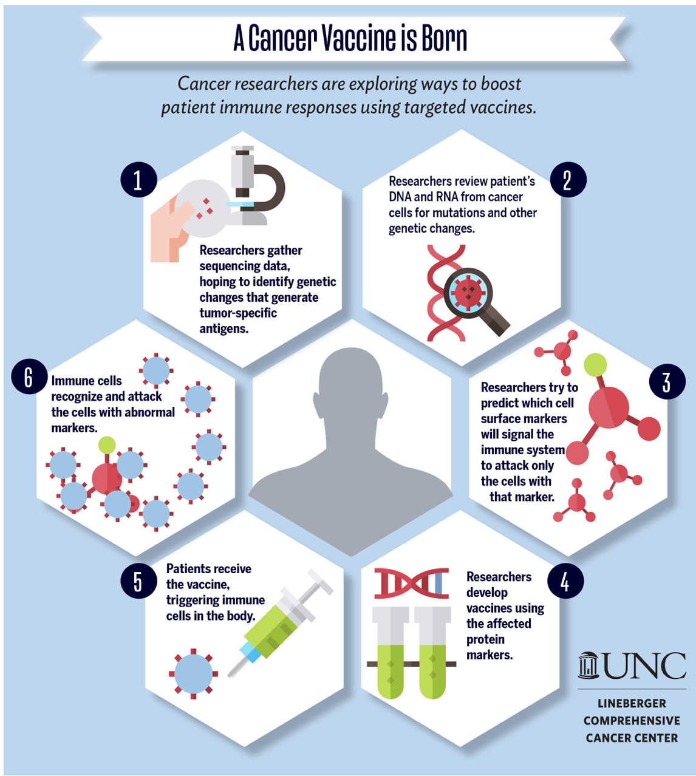

Slide 11
Vaccine Trials
A Phase 1, Open-Label, Multicenter Study to Assess the Safety, Tolerability, and Immunogenicity of mRNA-4157 Alone and in Combination in Participants with Solid Tumors
MODERNA.
Global Target 65, UK 15 In set-up
Site Name --- PI NHS Tayside, Dundee Scotland --- Russell Petty Oxford University Hospitals NHS Foundation Trust --- Eileen Parkes University College London Hospital --- Martin Forster The Christie NHS Foundation Trust --- Fiona Thislethwaite - CI

Slide 12
Neo-adjuvant strategies
Perioperative Tailored Treatments for Gastric Cancer: Times Are Changing. Int J Mol Sci. 2023 Mar 2;24(5):4877.

Slide 14
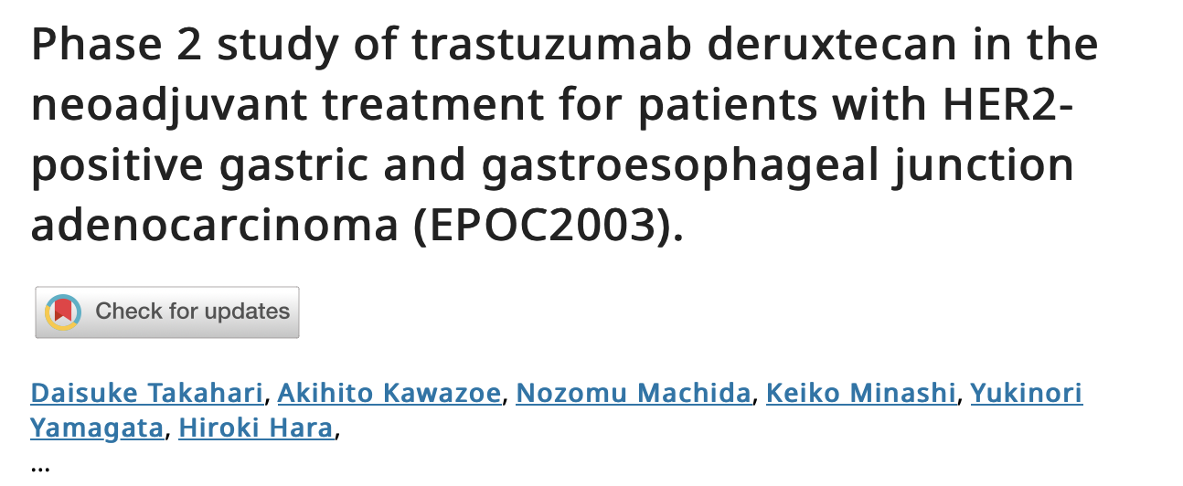
DESTINY-Gastric01 study-higher objective response rate with T-DXd than physician's choice of chemotherapy (51.3%, vs. 14.3%, Shitara K, et al. NEJM 2020). Prolonged overall survival (median 12.5 vs. 8.4 months, hazard ratio 0.59)
High response rate or major pathological response (MPR), which is defined as the proportion of subjects with < 10% residual tumour may be associated with favourable survival outcomes after preoperative chemotherapy
Previously untreated locally advanced gastric and GEJ adenocarcinoma with clinical stage of T2-4 and/or N+ without distant metastasis.
Main cohort- patients with HER2 overexpression-（IHC）3+ or IHC2+/ in situ hybridization（ISH）+ by local assessment.
Cohort 2- HER2-low expression (IHC1+ or 2+ with ISH negative) with HER2-extra cellular domein (ECD) higher than 11.6 ng/ml
Patients will receive 3 cycles of T-DXd (6.4mg/kg) by intravenous infusion every 3 weeks followed by surgery at 3 to 8 weeks after last T-DXd infusion.

Slide 15
Pressurised IntraPeritoneal Aerosolised Chemotherapy (PIPAC) in the management of cancers of the colon, ovary and stomach: a randomised controlled phase II trial of efficacy in peritoneal metastases (PICCOS)
Inclusion Criteria
Visible measurable peritoneal lesion(s) on computerised tomography (CT) imaging
PM from histologically proven primary adenocarcinoma (any subtype) of stomach or Siewert
type 3 gastro-oesophageal junction tumour
Any Human Epidermal Growth Factor Receptor 2 (HER2) status or Combined Positive Score (CPS)
Exclusion criteria
Extra-peritoneal metastases (with the exception of retroperitoneal lymph nodes)
Prior systemic anti-cancer therapy, radiotherapy or surgery for stomach cancer
Gastric or duodenal stent in-situ
Gastro-oesophageal junction Siewert Type 1 or Type 2 tumour
Symptoms and/or radiology suggestive of impending and/or current bowel obstruction
Uncontrolled and persistent ascites

Slide 17
Associate PI Scheme
https://www.nihr.ac.uk/health-and-care-professionals/career-development/associate-principal-investigator-scheme.htm
A six month in-work training opportunity, providing practical experience for healthcare professionals starting their research career. People who would not normally have the opportunity to take part in clinical research in their day to day role have the chance to experience what it means to work on and deliver a NIHR portfolio trial under the mentorship of an enthusiastic Local PI.
CIs working with a CTU can register their study on the scheme
https://www.nihr.ac.uk/health-and-care-professionals/career-development/register-your-study-for-the-associate-principal-investigator-scheme.htm

Slide 18
API Scheme OG Cancer Studies open in SWAG Region
CPMS ID | Study Short Name | Sites
18432 | PLATFORM | RUH, GHFT, UHBW, Weston, Musgrove Park, Salisbury, Yeovil
20358 | SCOPE 2 | BHOC, Musgrove Park, Glos, Cheltenham
42715 | WAKING: Wnt and checKpoint INhibition in Gastric cancer | BHOC
55905 | SARONG | BRI in set up
50774 | Augmented biomarker response in oesophagogastric cancer | Yeovil, Salisbury
50090 | Ph1b/3 Bemarituzumab in Advanced Gastric Gastroesophageal Cancer | BHOC

Slide 19
Cancer PES survey results 2022 - Q58 research
National Results

Slide 20
Cancer PES survey results 2022 - Q58 research
SWAG regional results
SWAG region results PDF

Slide 21
Talking about research
https://learn.nihr.ac.uk/

Slide 22
https://bepartofresearch.nihr.ac.uk/

Slide 23
The Participant in Research Experience Survey (PRES) is a way for those taking part in research to anonymously share feedback about their experience.
This feedback helps us to improve
research delivery and ensure the best possible experience is being provided.
The survey is delivered across all 15 regions of the National Institute for Health and Care Research (NIHR) Clinical Research Network (CRN).
Notes:
This report is the analysis of responses received from the beginning of April 2022 until the end of March 2023.
Responses showed that the majority of people taking part in research had a positive experience, with their interaction with research delivery colleagues being an essential part of this experience.

Slide 24
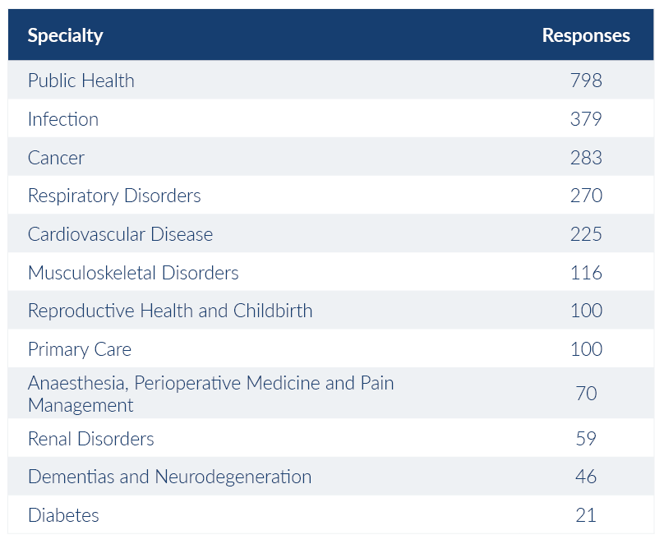
Who responded?
Notes:
Responses were received across 22 of 31 specialty areas. The chart above shows the specialties with over 20 responses. The large number of responses from public health studies is due to high recruitment from ALSPAC (Children of the 90s), a large-scale birth cohort study with 25,000 participants each year.

Slide 25
What was positive about your research experience?
1,837 (70%) respondents left a comment explaining what made their
research experience positive. From these comments we identified the
following themes
• 864 comments mentioned the research delivery staff
• 537 comments related to contributing to improving healthcare
• 457 comments related to good communication
• 272 comments said the research study was easy to take part in
• 241 comments related to having a good experience
• 203 comments mentioned experiencing personal benefits
• 48 comments said "everything" was positive
• 41 comments related to where the research took place
• 35 comments mentioned gaining a feeling of hope
• 27 comments related to financial reimbursement
• 19 comments related to travel
Notes:
The same themes were identified in the 2021/22 PRES report, suggesting the positive aspects of taking part in research have remained the same. Comments related to good communication have increased from 21% to 25%, suggesting that studies may have improved how they communicate with participants.

Slide 26
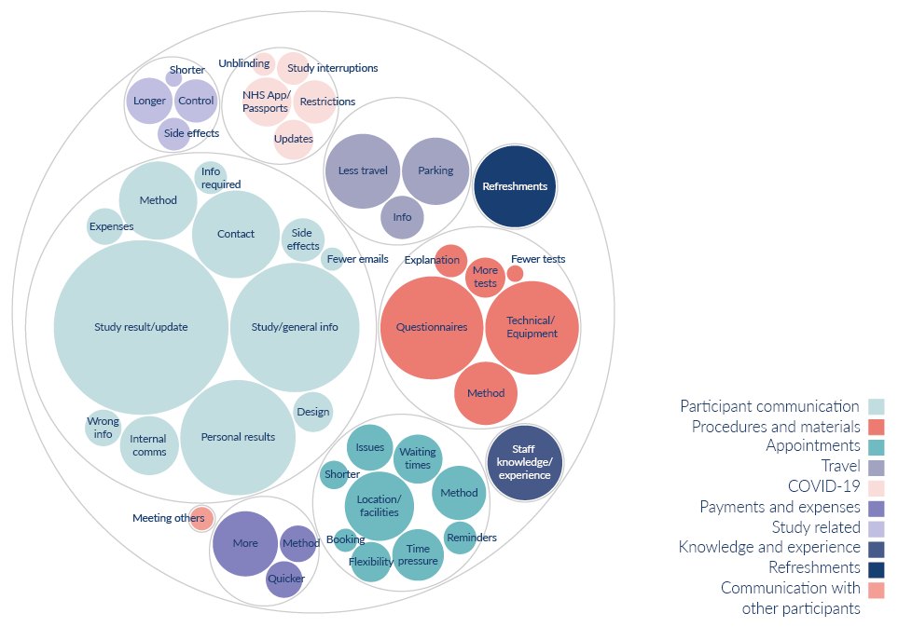
What would have made your research experience better?
603 respondents (23%) left a comment about what could have made their research experience better. From these comments we identified the following themes:
310 comments related to participant communication
98 comments related to procedures and materials
67 comments were about appointments
45 comments related to travel
28 comments were linked to COVID-19
26 comments were about payments and expenses
25 comments were about refreshments
20 comments were study related
20 comments were about knowledge and experience
2 comments mentioned they’d like to communicate with other participants
Notes:
Although fewer participants (23%) left comments about what would have made their experience better (compared to 32% in 2021/22), the themes identified are broadly the same as last year.
Whilst comments about participant communication remain the most common, these have decreased since last year (from 64% to 51%). This also aligns with an increase in positive comments around communication, indicating that studies have improved how they communicate with participants. There has also been a large decrease in the number of comments around appointments (from 27% to 11%), this is likely due to study teams being able to offer more flexibility around appointment times and methods.
Participant communication: Information about the study results/updates, general information about the study or condition, personal results, more contact from the study team, method of communication, information about side effects, internal communication, receiving incorrect information, information about what was required, information about expenses, design of communication, fewer emails.
Procedures and materials: Issues with questionnaires, technical issues with apps/equipment, method of procedures, more explanation about tests or how to use equipment, more or fewer tests
Appointments: Location, method, delays and waiting times, more time during appointments, flexibility over appointment times, issues with appointments, reminders, shorter appointments, booking of appointments
Travel: Less travel less for appointments, free or better parking, better travel information
COVID-19: Issues with travel/vaccine passports, restrictions, more information/updates, study interruptions, unblinding process
Payments and expenses: Wanting payment or to receive more money, time it took to receive payments, method of recognition
Study related: Wanting longer or shorter study, being in the control arm, side effects
Knowledge and experience: When people were approached about taking part in research, feeling like staff didn’t have the knowledge to answer questions or use required equipment. Comments under this theme also relate to awareness of Equity, Diversity, and Inclusion

Slide 27
Next steps
Feedback shared with research delivery staff, partner organisations and members of the public
PRES working group to form projects which aim to improve the participant experience based on the experience received
Full PRES Report
For further info: we.ppie@nihr.ac.uk

Slide 28
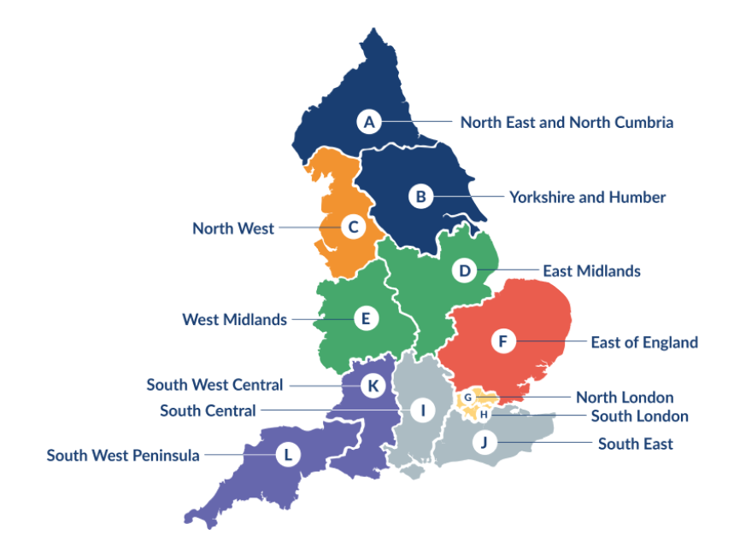
Clinical Research Network Transition to Research Delivery Network
Launching Oct 2024
The NIHR RDN has 2 primary purposes:
To support the successful delivery of high quality research, as an active partner in the research system
To increase capacity and capability of the research infrastructure for the future
Will operate as 1 organisation across England, through a network of 12 Regional Research Delivery Networks (RRDNs) and a central Coordinating Centre (RDNCC)

Slide 29
NIHR ODP https://odp.nihr.ac.uk/
Open data platform. Data on performance and restart across whole CRN, including all specialty areas
NIHR Be Part of Research https://www.ukctg.nihr.ac.uk/
See which studies are open across the country
National Cancer Research Institute Portfolio Maps http://csg.ncri.org.uk/portfolio/portfolio-maps/
View current national portfolio of open, closed and ‘in set up’ cancer studies
Find a Clinical Research Study (ODP) http://csg.ncri.org.uk/portfolio/portfolio-maps/
Search for a study to fit criteria. Good for horizon scanning, eligibility criteria

Slide 30
LCRN Contacts
Research Delivery Manager
claire.matthews@nihr.ac.uk
Research Portfolio Facilitator
rebecca.pienaar@nihr.ac.uk
Sub-specialty Lead
sharath.gangadhara@nhs.net

