Slide 1
SWAG Network Urological Cancer
Clinical Advisory Group
Research Update - Claire Matthews
06/06/2024

Slide 2
National Urological Cancer Research Recruitment
Apr 23 - Mar 24
Apr 24 - Jun 24
Source: ODP All Portfolio
Data cut: 03/06/2024

Slide 3
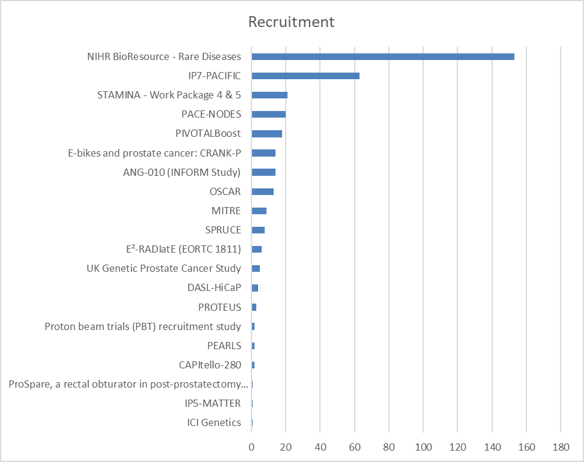
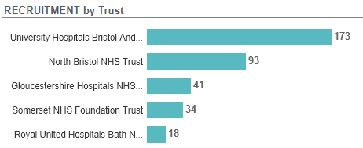
Site activity SWAG region
Mar 23-Jun 24
Source: ODP All Portfolio
Data cut: 03/06/2024

Slide 4
Open studies
42 Studies open in SWAG region
Full list:
https://docs.google.com/spreadsheets/d/1d3FW-tjnMM5DymXfAWg74E8xQqz0WyC4/edit?usp=sharing&ouid=116508400395350162569&rtpof=true&sd=true
Next slide shows studies open in the last 12 months - 8 studies
Not all sites confirmed
Source: ODP All Portfolio
Data cut: 03/06/2024

Slide 5
Studies opened in last 12 months
CPMS ID | Short Name | Sites *unconfirmed | Planned / Actual Opening | Planned / Actual Closure | Sample Size England | England Recruits
60694 | MoonRISe-1 | NBT* | 17/05/2024 | 28/05/2026 | - | 0
54260 | LION | Yeovil*, RUH | 08/05/2024 | 01/04/2025 | 89 | 0
57835 | NHS Cancer Vaccine Launchpad (NHS CVLP) | BHOC, Chelt, RUH, Musgrove, Yeovil | 17/04/2024 | 01/05/2025 | 9951 | 42
55729 | AZD5305 Ph3 Prostate | BHOC*, RUH* | 26/02/2024 | 31/05/2026 | 60 | 2
55776 | Stellar | BHOC* | 08/02/2024 | 22/01/2025 | 4 | 0
57525 | BC-Recon | Musgrove*, Yeovil*, Salisbury* | 22/01/2024 | 15/01/2026 | 3200 | 264
52252 | BO43936 | Musgrove* | 13/11/2023 | 31/08/2024 | 21 | 1
53087 | Trophy U-01 | BHOC*, Musgrove* | 29/09/2023 | 30/09/2024 | 18 | 5
Source: ODP All Portfolio
Data cut: 03/06/2024

Slide 6
Cancer Vaccine Launch Pad (CVLP)
The CVLP is a referral platform and tissue pathway for accessing personalised cancer vaccine trials.
Accelerate the development of cancer vaccines and increase the opportunity for patients to take part in cancer vaccine trials.
Support recruitment into cancer vaccine trials and the transfer of tissue samples to industry partners for genomic sequencing.
Determine whether it is feasible to recruit cancer patients to a platform for personalised cancer vaccine trials.

Slide 7
Progress
NIHR portfolio adopted, registered for Associate PI Scheme.
Supporting recruitment to one colorectal cancer vaccine trial, BNT122-01.
Aim to expand to support more cancer vaccines in a variety of cancer types by the end of 2024.
29 hospitals open to recruitment for the CVLP.
20+ sites in set-up.
Quick site set-up within 4-6 weeks of confirming participation.
Designed to be low administrative burden for sites involved.

Slide 8
SWAG region sites
CVLP sites
Cellular Pathology Genomic Centres (CPGC)
Colorectal Cancer vaccine trial sites
Live:
Gloucester Hospitals NHS Foundation Trust
North Bristol NHS Trust
Royal United Hospitals Bath
Somerset NHS Foundation Trust – Musgrove Park and Yeovil
University Hospitals Bristol & Weston NHS Foundation Trust - BHOC
North Bristol NHS Trust
(Severn Pathology)
Velindre Cancer Centre, Cardiff
Queen Elizabeth Hospital, Birmingham
Guy’s and St Thomas’, London
Torbay Hospital, Torbay

Slide 9
Cancer Vaccine Pathway Studies: Urology
None currently open or in setup in the SWAG region
V940-005 - A Phase 2 Study Evaluating Adjuvant V940/mRNA-4157+Pembro vs Placebo + Pembro in High-Risk Muscle Invasive Urothelial Carcinoma | In Setup, Approval Received
V940-004 - A Phase 2, Randomized, Double-blind, Clinical Study of V940 (mRNA-4157) Plus Pembrolizumab (MK-3475) Versus Placebo Plus Pembrolizumab in the Adjuvant Treatment of Participants With Renal Cell Carcinoma | In Setup, Pending Approval
Mobilize Trial - Phase 1/2 Study of mRNA 4359 Administered Alone and in Combination With Immune Checkpoint Blockade in Participants with Advanced Solid Tumors | Open, With Recruitment
BNT142-01 - First-in-human, open-label, multicenter, Phase I/IIa, dose escalation trial with expansion cohorts to evaluate safety and preliminary efficacy of BNT142 in patients with CLDN6-positive advanced solid tumours | Open, With Recruitment
Modi-1 in Patients with Breast, Head & Neck, Ovarian or Renal Cancer - A Phase 1/2, Multicentre, Open-Label Study of Modi-1 in Patients with Breast, Head and Neck, Ovarian, or Renal Cancer | Open, With Recruitment
A Phase 1, Multicenter, Open-label, Nonrandomized, First-in-human Study of OVM-200 as a Therapeutic Vaccine in Patients with Locally Advanced or Metastatic Non Small Cell Lung Cancer, Ovarian Cancer, and Prostate Cancer | Open, With Recruitment
DURANCE - A phase Ib/II study to assess the safety and activity of DURvalumab (MEDI4736) in combination with S-488210/S-488211 vAccine in Non-muscle invasive bladder CancEr | Open, With Recruitment

Slide 10
Studies in set-up/under consideration in SWAG region
POINTER-PC Pelvis Or Involved Node Treatment: Eradicating Recurrence in Prostate Cancer | Musgrove Park
BO45230 iNEST Personalised Bladder Cancer Vaccine Study | Salisbury
IP9 – ATLAS (Approaches To Long-Term Active Surveillance) | Musgrove,Yeovil
Digistain Study in Solid Tumours | Musgrove, RUH, Salisbury, Yeovil
Duravelo-2 | BHOC, Musgrove, RUH, Salisbury, Yeovil
STAMPEDE2 | BHOC, Cheltenham, Musgrove Park, Great Western, Yeovil
AZD0901 CLDN18.2 ADC A Master protocol, Open Label, Phase 2a Study of AZD0901 as Monotherapy or in Combination with Anti-cancer Agents in Participants with advanced or metastatic solid tumors expressing Claudin 18.2 | Musgrove, Yeovil
WISER-P Version 1.0 | Musgrove, Yeovil
CAAA617D12302: [177Lu]Lu-PSMA-617 in Oligometastatic Prostate Cancer | BHOC
R392101 A phase III, single-arm study to evaluate the efficacy and safety of ONCOFID-P-B (paclitaxel-hyaluronic acid conjugate) administered intravesically to patients with BCG-unresponsive Carcinoma in Situ of the bladder with or without Ta-T1 papillary disease | Musgrove, RUH, Salisbury, Yeovil
21492 A randomized, double-blind, placebo-controlled Phase 3 study of IMP plus androgen deprivation therapy (ADT) compared to placebo plus ADT in patients with high-risk biochemical recurrence (BCR) of prostate cancer | Salisbury, Southmead

Slide 11
Be Part of Research is a UK-wide service that helps people find and take part in health and care research across nearly every health condition.
A resource for:
patients or their families keen to get involved in research
Researchers looking for target population for research
https://bepartofresearch.nihr.ac.uk/

Slide 12
Associate PI Scheme
https://www.nihr.ac.uk/health-and-care-professionals/career-development/associate-principal-investigator-scheme.htm
Free six month in-work training opportunity
Provides practical experience for healthcare professionals starting their research career
People who would not normally have the opportunity to take part in clinical research in their day to day role experience what it means to work on and deliver a NIHR portfolio trial under the mentorship of an enthusiastic Local PI.

Slide 13
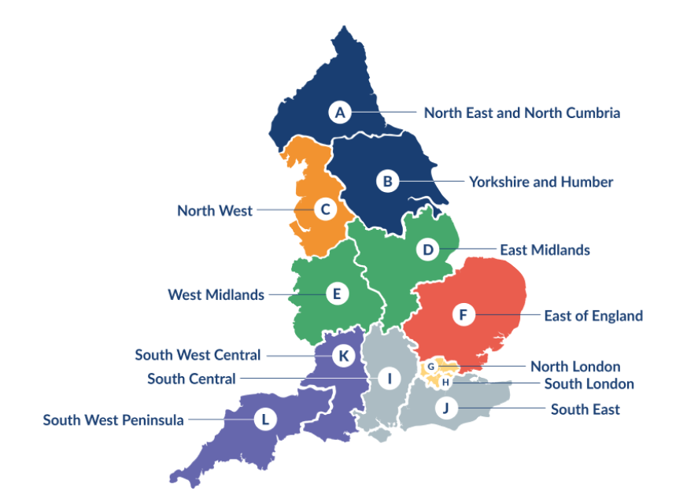
Clinical Research Network Transition to Research Delivery Network
Launching Oct 2024
The NIHR RDN has 2 primary purposes:
To support the successful delivery of high quality research, as an active partner in the research system
To increase capacity and capability of the research infrastructure for the future
Will operate as 1 organisation across England, through a network of 12 Regional Research Delivery Networks (RRDNs) and a central Coordinating Centre (RDNCC)

Slide 14
NIHR ODP
Open data platform. Data on performance across whole CRN,
including all specialty areas
NIHR Be Part of Research
See which studies are open across the country
Find a Clinical Research Study (ODP)
Search for a study to fit criteria. Good for horizon scanning, eligibility criteria

Slide 15
Research Delivery Manager
claire.matthews@nihr.ac.uk
Research Portfolio Facilitator
rebecca.pienaar@nihr.ac.uk
Sub-specialty Lead
Amit.bahl@uhbw.nhs.uk

Slide 16
DETERMINE
Determining Extended Therapeutic indications for Existing drugs in Rare Molecularly defined Indications using a National Evaluation platform trial
Aim:
Evaluate the efficacy of licensed targeted therapies in unlicensed indications, in rare adult, paediatric and TYA cancers with actionable genomic alterations (including common cancers with rare actionable alterations)
Identify genomic,transcriptomic and immune contextual influences on response to therapy
The ultimate aim is to transition positive findings to the NHS (Cancer Drugs Fund [CDF]) to provide new treatment options for patients with rare malignancies.
Arm 1 Alectinib
Arm 2 Atezolizumab
Arm 3 Entrectinib
Arm 4 Trastuzumab in combination with pertuzumab
Arm 5 Vemurafenib in combination with cobimetinib

