Slide 1
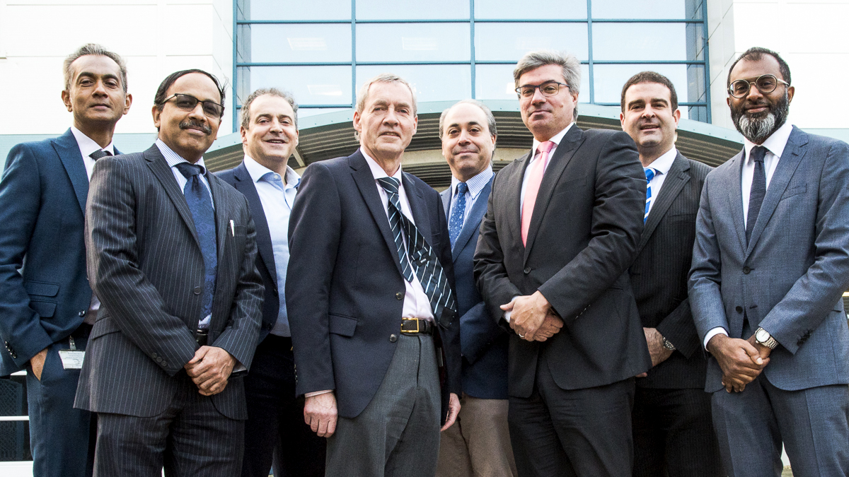
Peritoneal Treatments: Expanding indications
Mr Gui Han Lee
Locum Consultant Surgeon
PMI Basingstoke

Slide 2

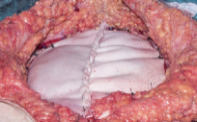


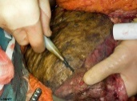
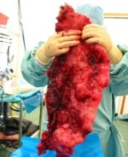
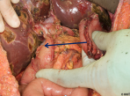
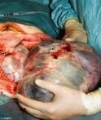

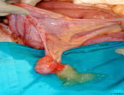

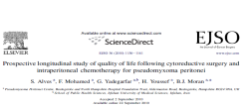

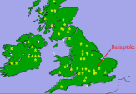

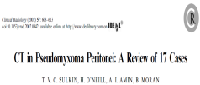



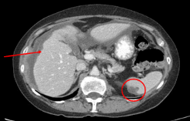
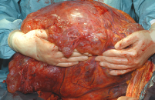



KEY
100 patients
Publications
Procedures
Staff & resources
Surgeons
Biological mesh repair abdominal wall
Electro-evaporation
of liver disease
1000 cases
2000 cases
Gastrectomy for complete CRS
Major tumour debulking
HIPEC
Future directions -Transplant
NSCAG Appendix Specialisation
First case
Data Collection
First CNS
Senior
Manager
Admin / CNS
Management
First
MDT
1994 | 1995 | 1996 | 1997 | 1998 | 1999 | 2000 | 2001 | 2002 | 2003 | 2004 | 2005 | 2006 | 2007 | 2008 | 2009 | 2010 | 2011 | 2012 | 2013 | 2014 | 2015 | 2016 | 2017 | 2018
Outcome First 100
Pathology Consenus
UK National Centre approval
Quality of Life
Radiology
Mesothelioma
1200 cases
Learning- Curve
Colorectal
1000 appendix cases
PSOGI
Basingstoke
Notes:
Back ground to the unit
First case in 1994
Brendna Moran appt 1995
First 100 cases over 8 years
2000 appt UK national centre
Good NHS90 % of population
2nd centre Manchester
Remit evaluation and treatment
Increasign referrals
Transplant 2013

Slide 3
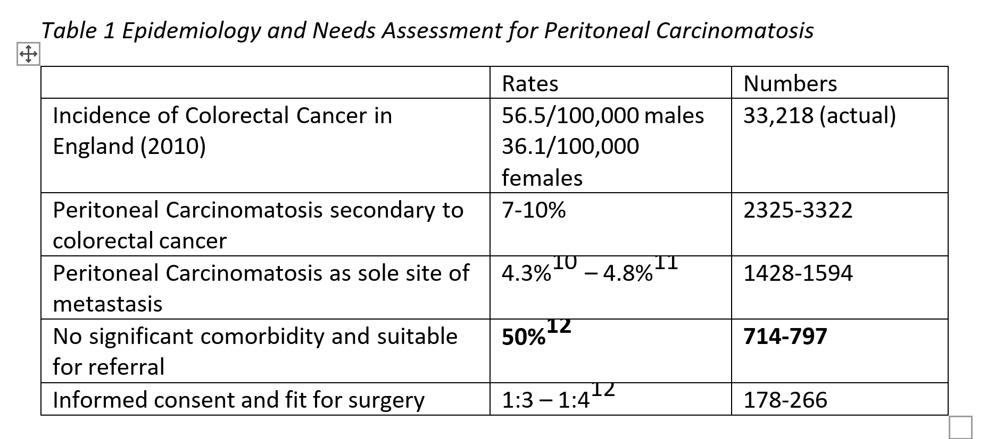

Slide 5
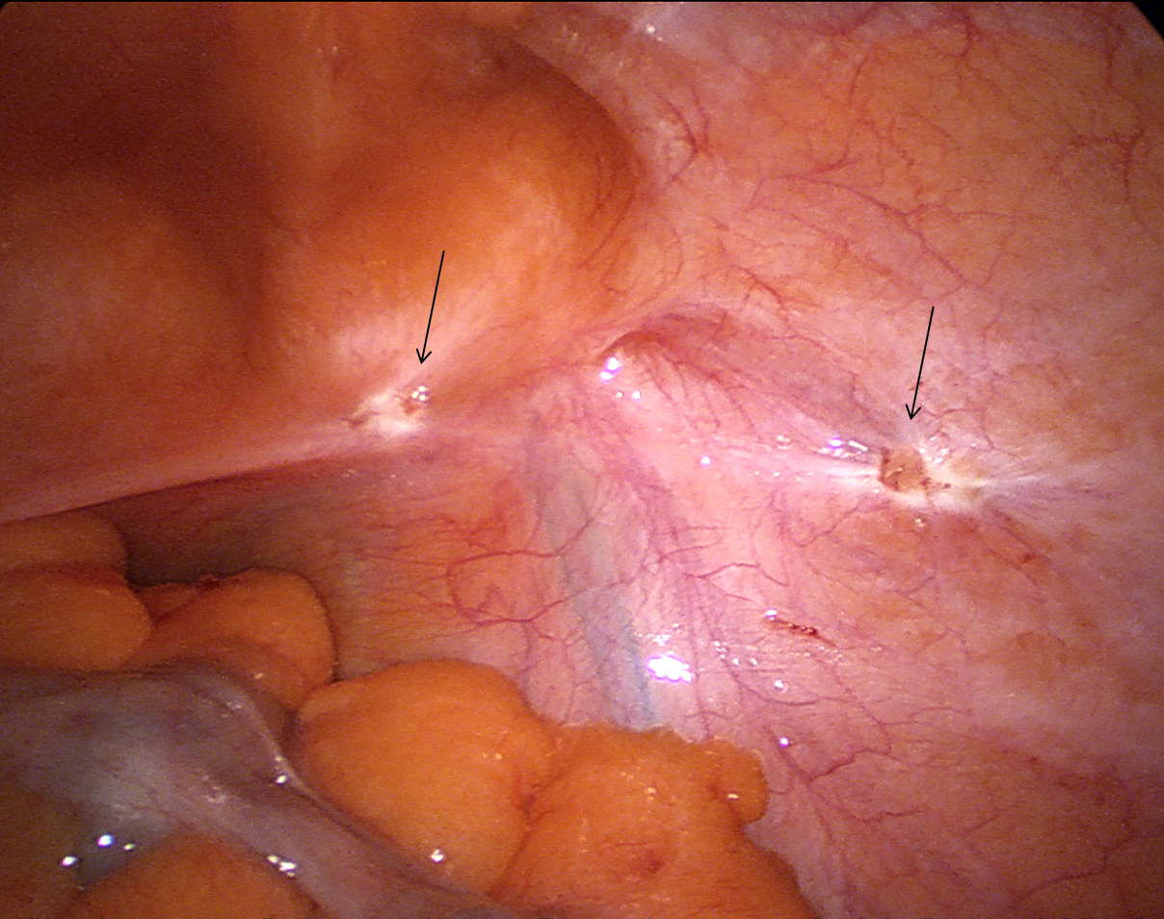
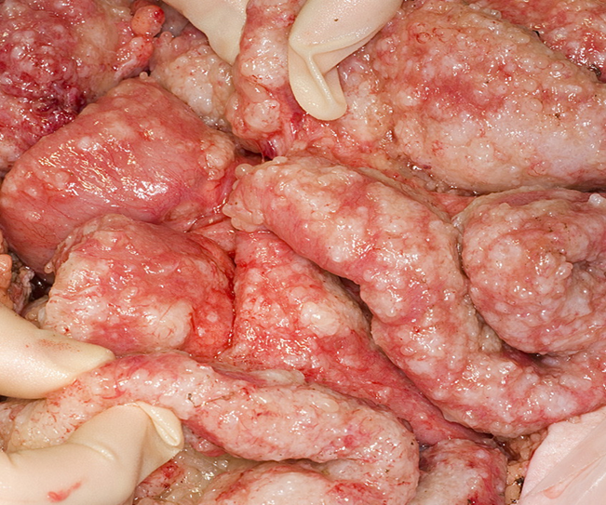
Colorectal Peritoneal Metastases

Slide 6
Selection in practice
  CT (PETCT / MRI)
  SMDT
  Laparoscopy
  Biology/histology
  Trial of time
  PCI < 20
  CC0/CC1
  Funding

Slide 7
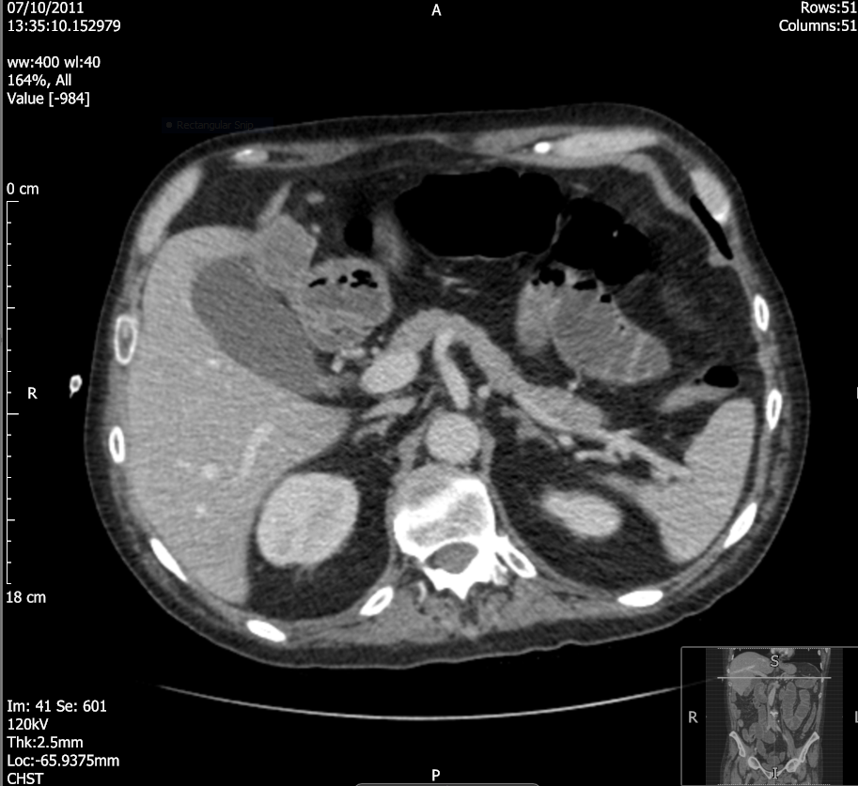
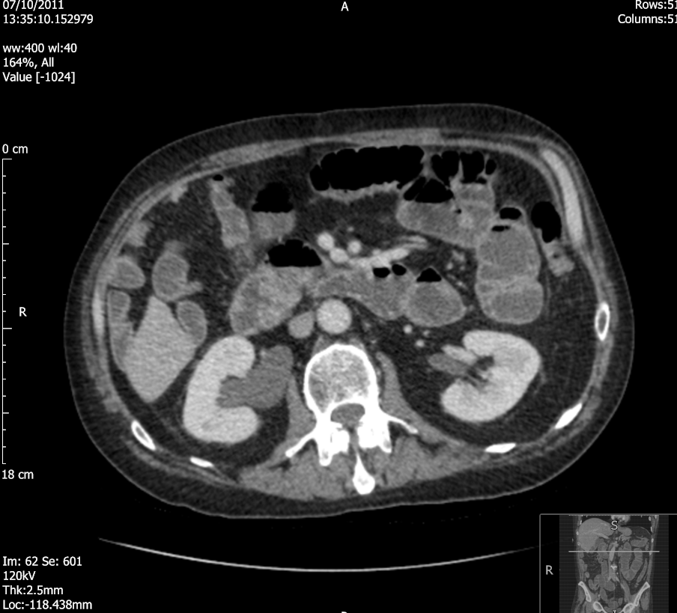
Surgical Anecdote
Right hemi ? Pinched off duodenum
Oct 2011 Disease progression
Hydronephrosis
Septic unwell
Small bowel dilatation

Slide 8
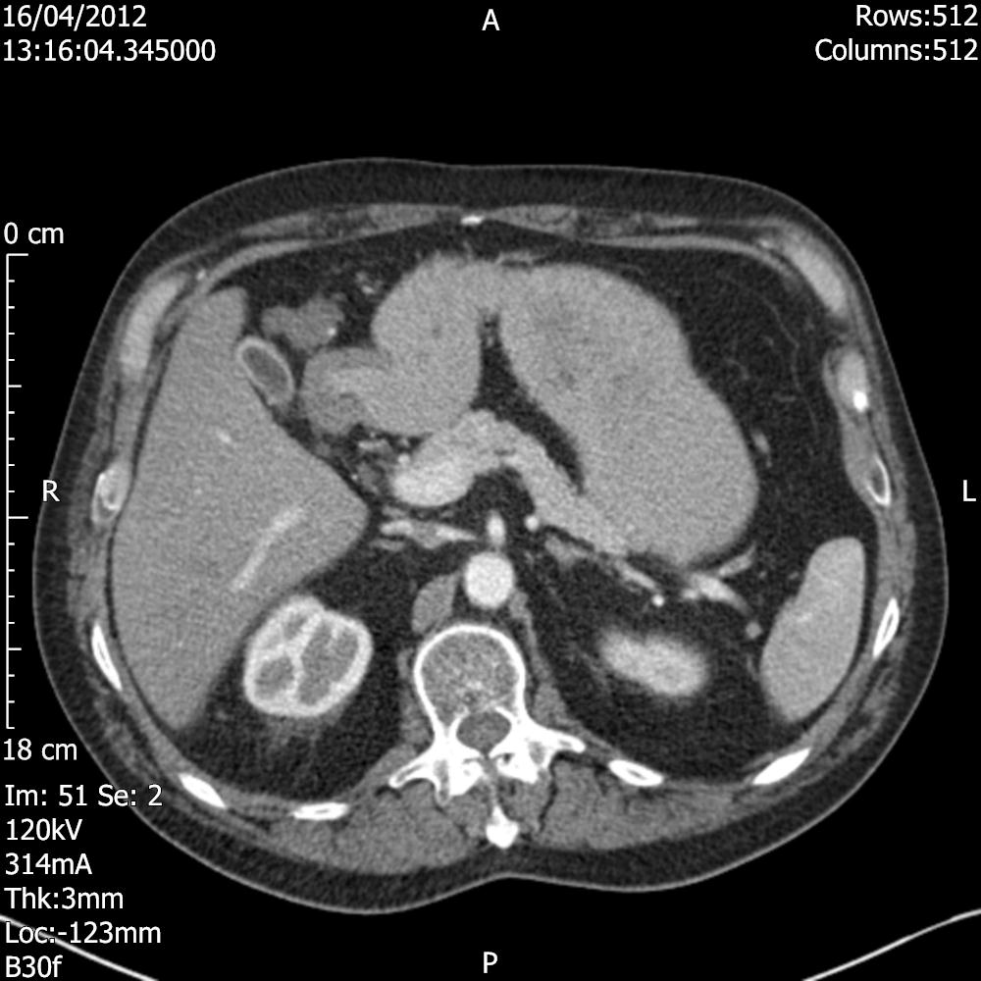
Case
Restart Irinotecan 5 FU bevacizumab added
OGD and Colonoscopy adeno ca in duodenum and anastomosis
CT dramatic response, MRI, MAG renogram
Laparoscopy
CRS and HIPEC

Slide 9
CRS and HIPEC with Extended Multivisceral Resection
Pancreatoduodenectomy with en-bloc ileo-colic anastomosis and loop of small bowel
Wedge resections from liver X2
Right Nephrectomy
Post op stay 3 months pancreatic leak
Team working - Key

Slide 10
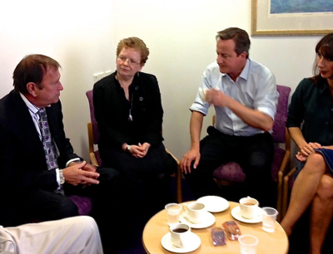
Outcome
Alive & well over 10 years
No further chemo
No disease recurrence

Slide 11
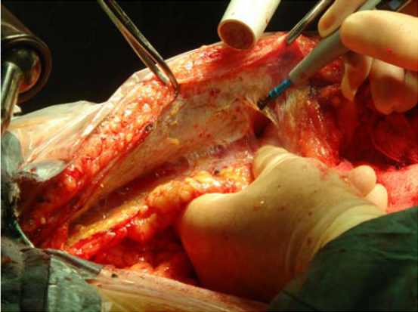
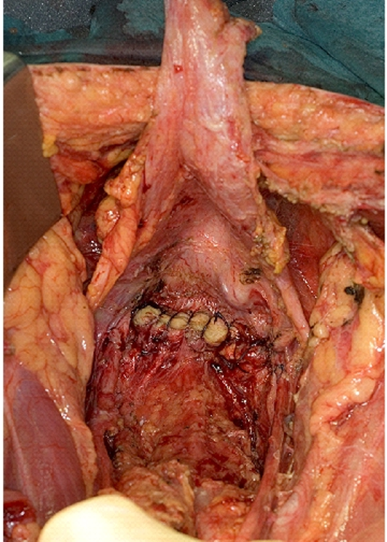
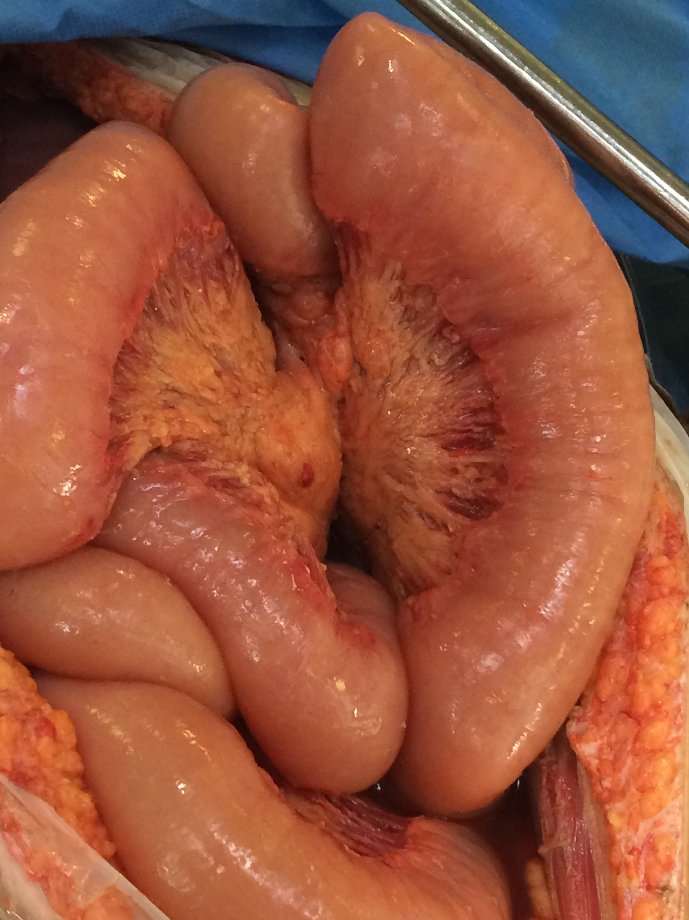

Cytoreduction Surgery (CRS) and
Heated Intraperitoneal Chemotherapy (HIPEC)

Slide 12
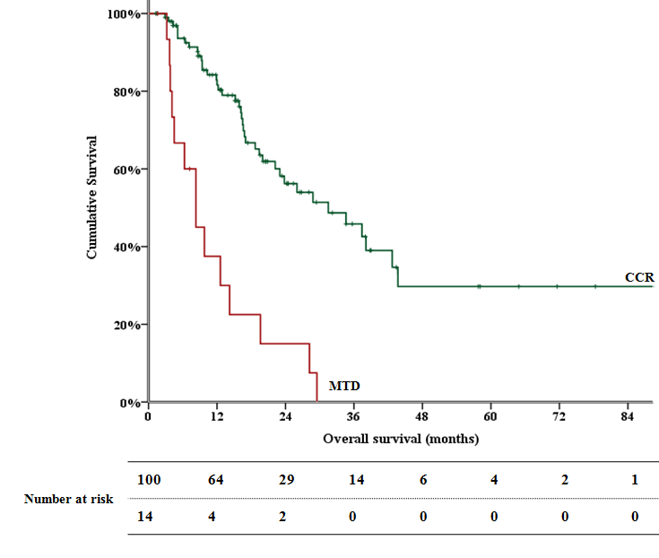
Early experience - Overall survival
46% 3 year survival
30% 5 year survival

Slide 13
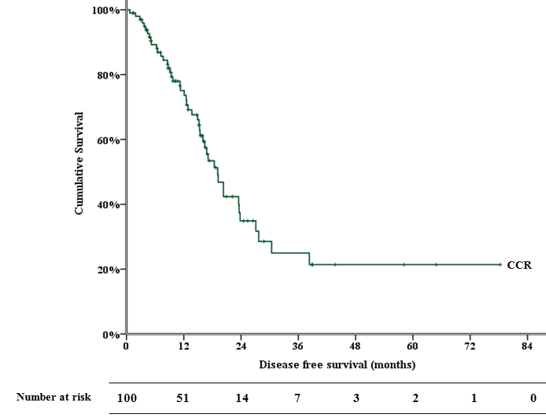
Early experience – Disease Free Survival
21% 5 year DFS

Slide 14
Basingstoke early experience
117 patients Median follow up 15 months
M:F | 44:73 (35%:65%)
Median age (range) | 55(19 -83)
Median PCI (range) | 8 (2-29)
Median length of surgery (range) | 7.5 hours (5.5 – 11)
Median length of stay (range) | 16 days (7-65)
Clavien Dindo Grade 3/4 complications | 14%

Slide 15
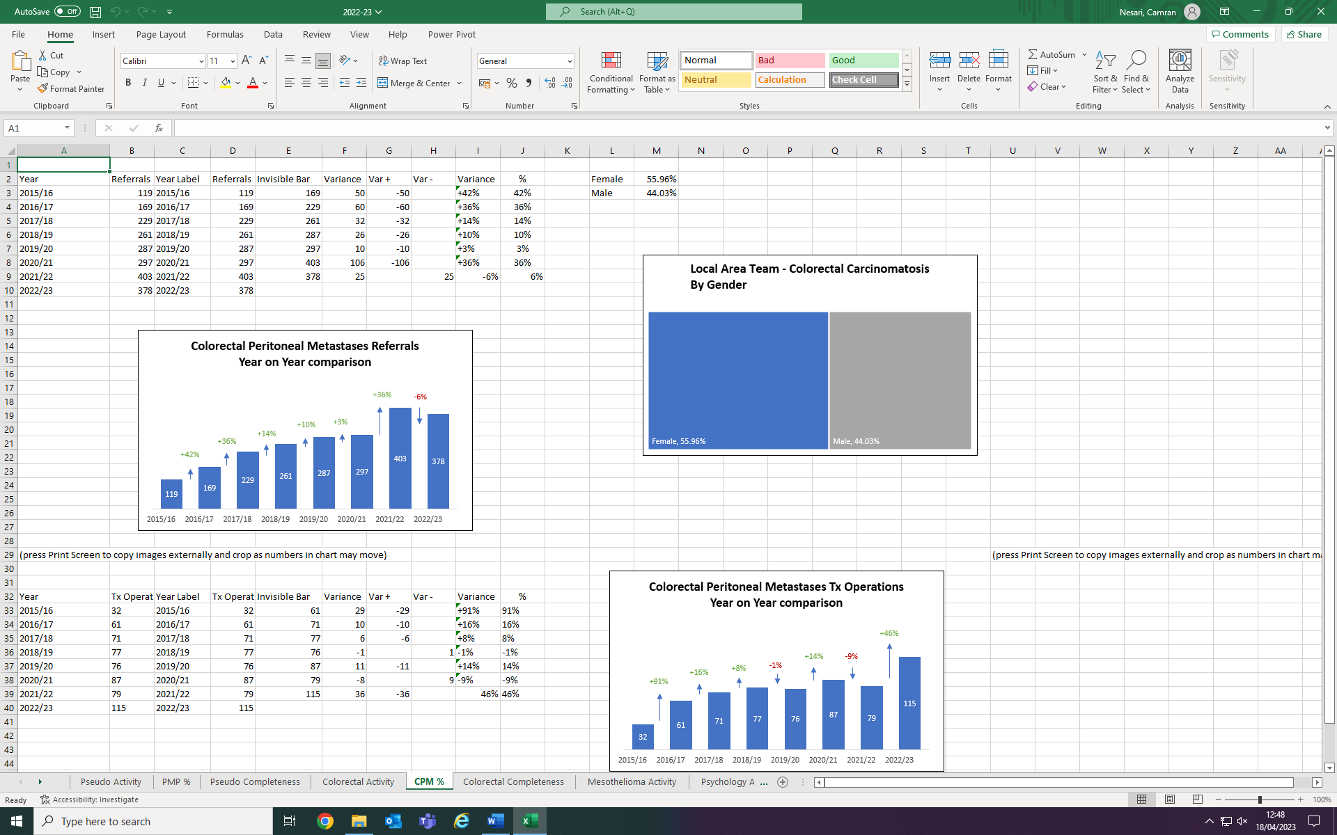
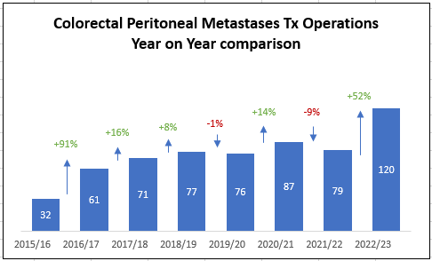
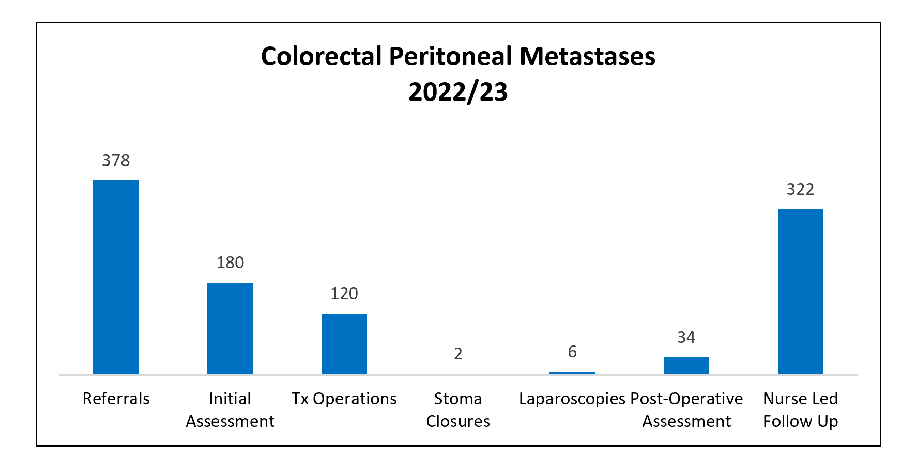
Activity today

Slide 16
What have we learned?

Slide 17
Selection today
  CT MRI (PETCT)
  CRAM/SMDT
  Laparoscopy rarely
  Biology/histology: BRAF mutations/signet ring cells
  Trial of time
  PCI < 20 (<10) PAUSE
  CC0
  Krukenbergs
  Stoma
  Funding
  NACT
Notes:
P: Primary tumour and Peritoneal Cancer Index, estimated by imaging
A: Ascites and abdominal wall involvement
U: Unfavourable sites of involvement
S: Small bowel and mesenteric disease
E: Extra peritoneal metastases

Slide 18
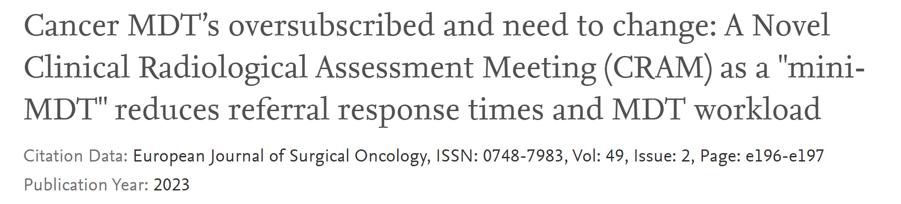
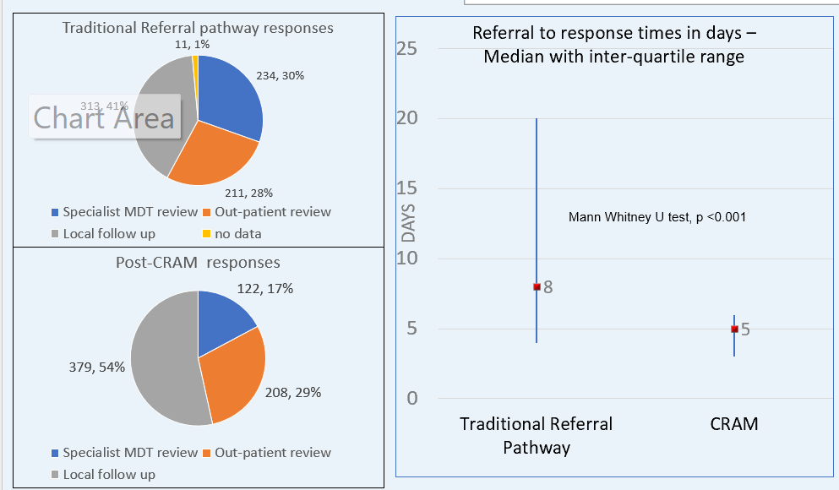
CRAM/SMDT
Weekly Clinical - Radiological Meeting (CRAM)
Review of clinical history and radiology images.
PMI Surgeon
PMI Radiologist
PMI nurse specialist
PMI admin team
Further discussion at Specialist MDT if required

Slide 19
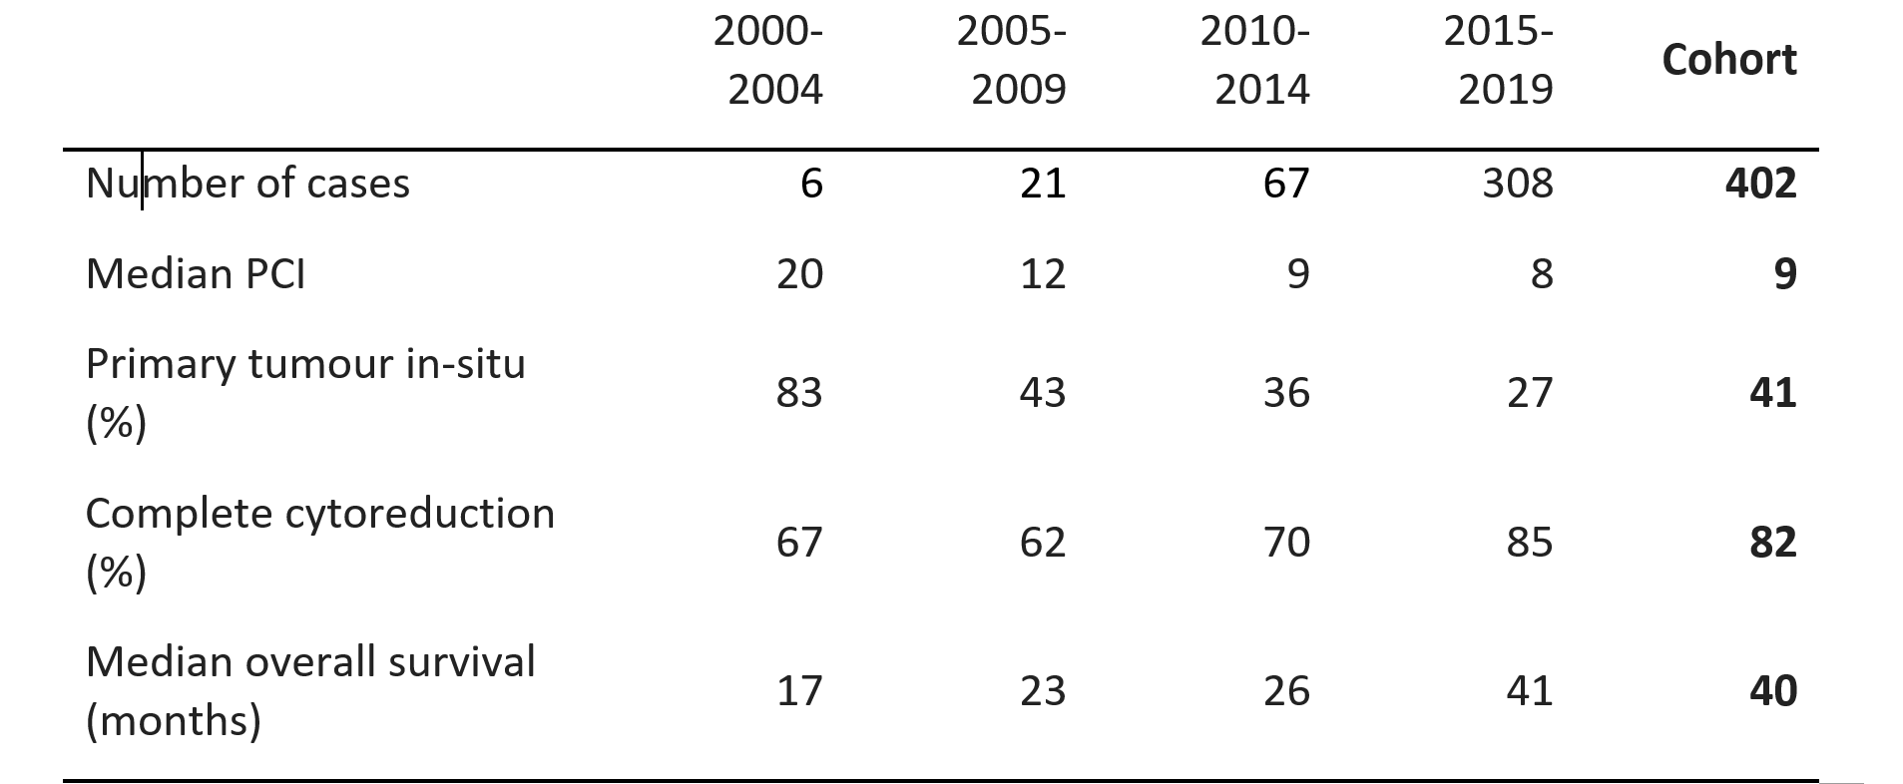
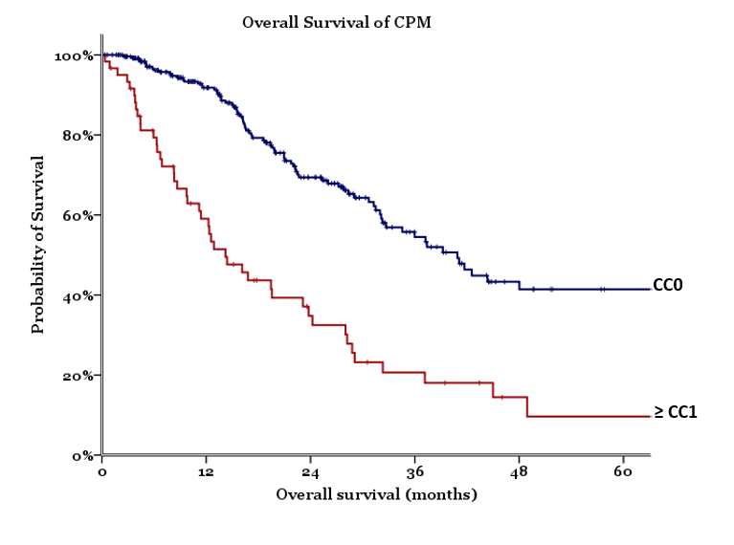
Changing approach

Slide 20
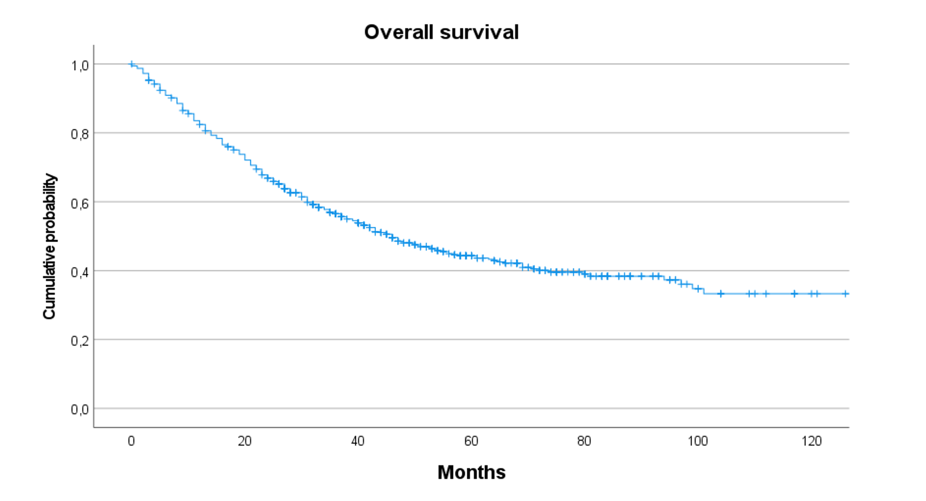
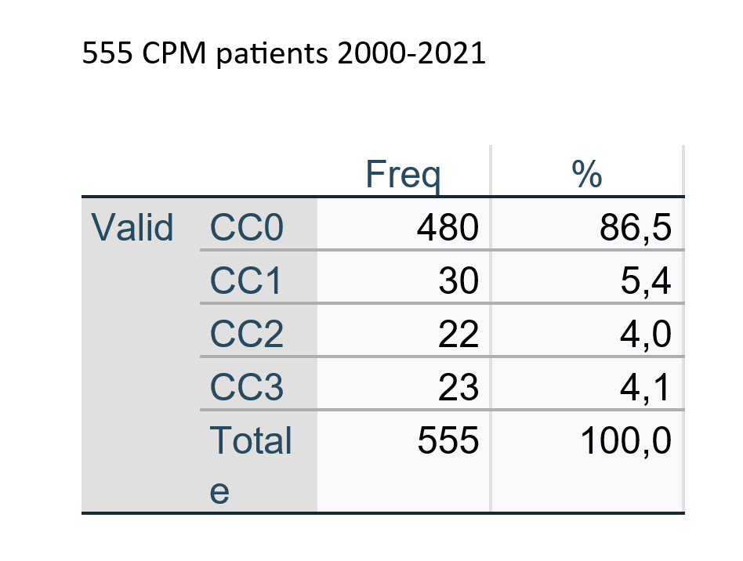
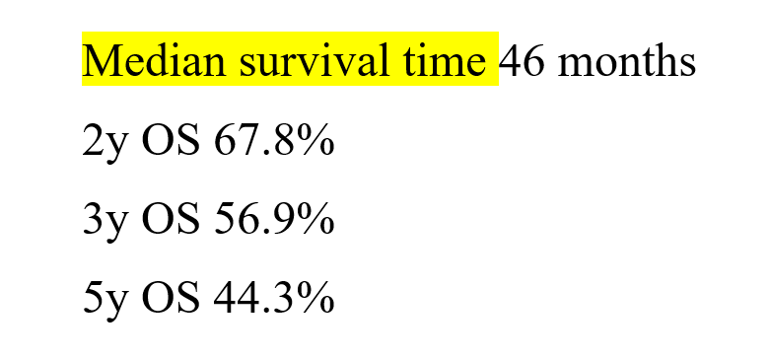
Current Basingstoke outcomes OS

Slide 21
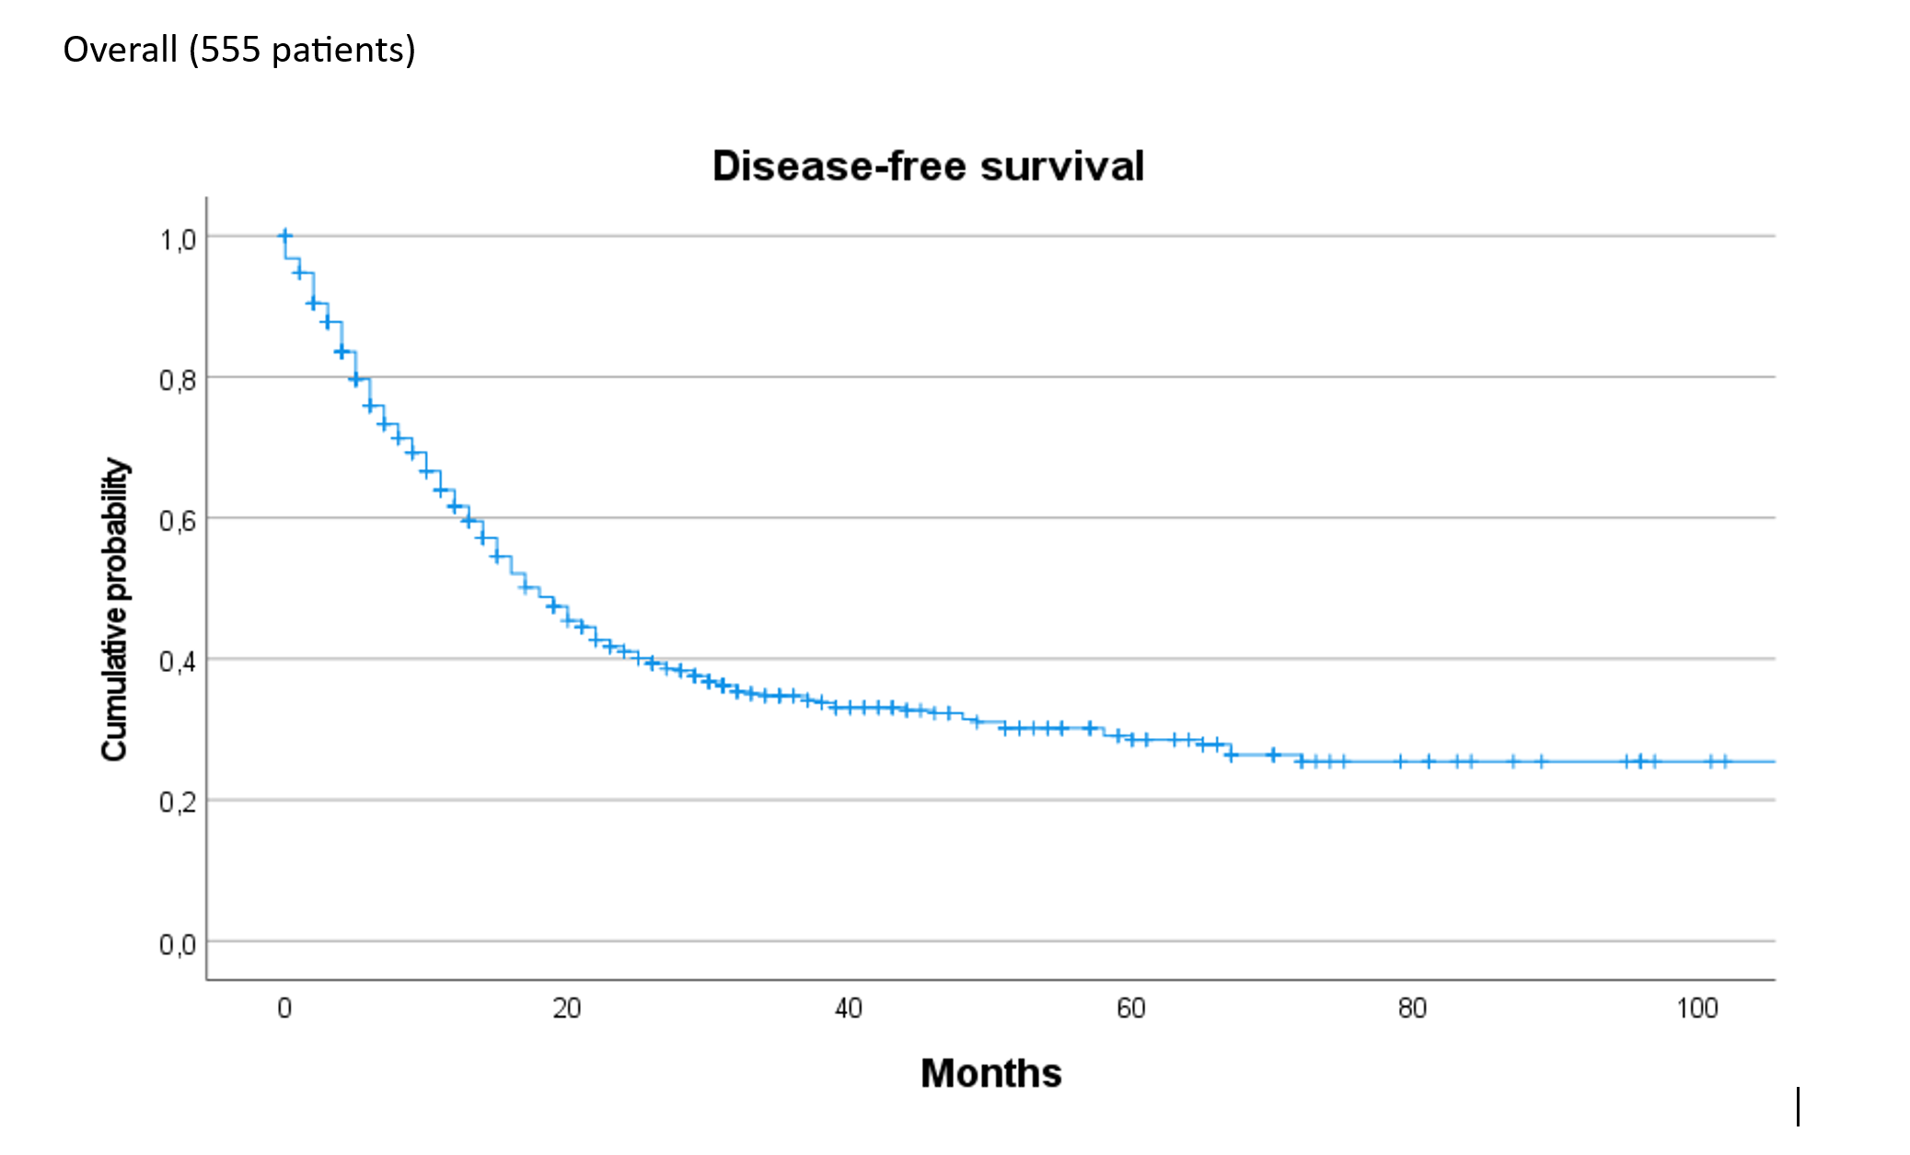
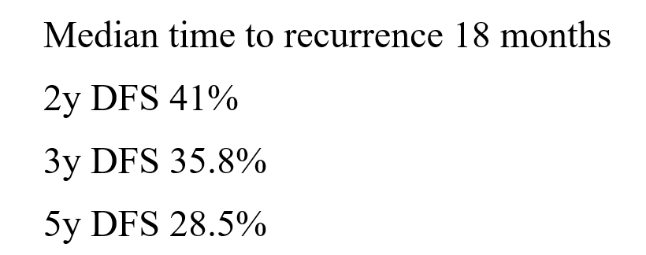
Current Basingstoke outcomes DFS

Slide 22
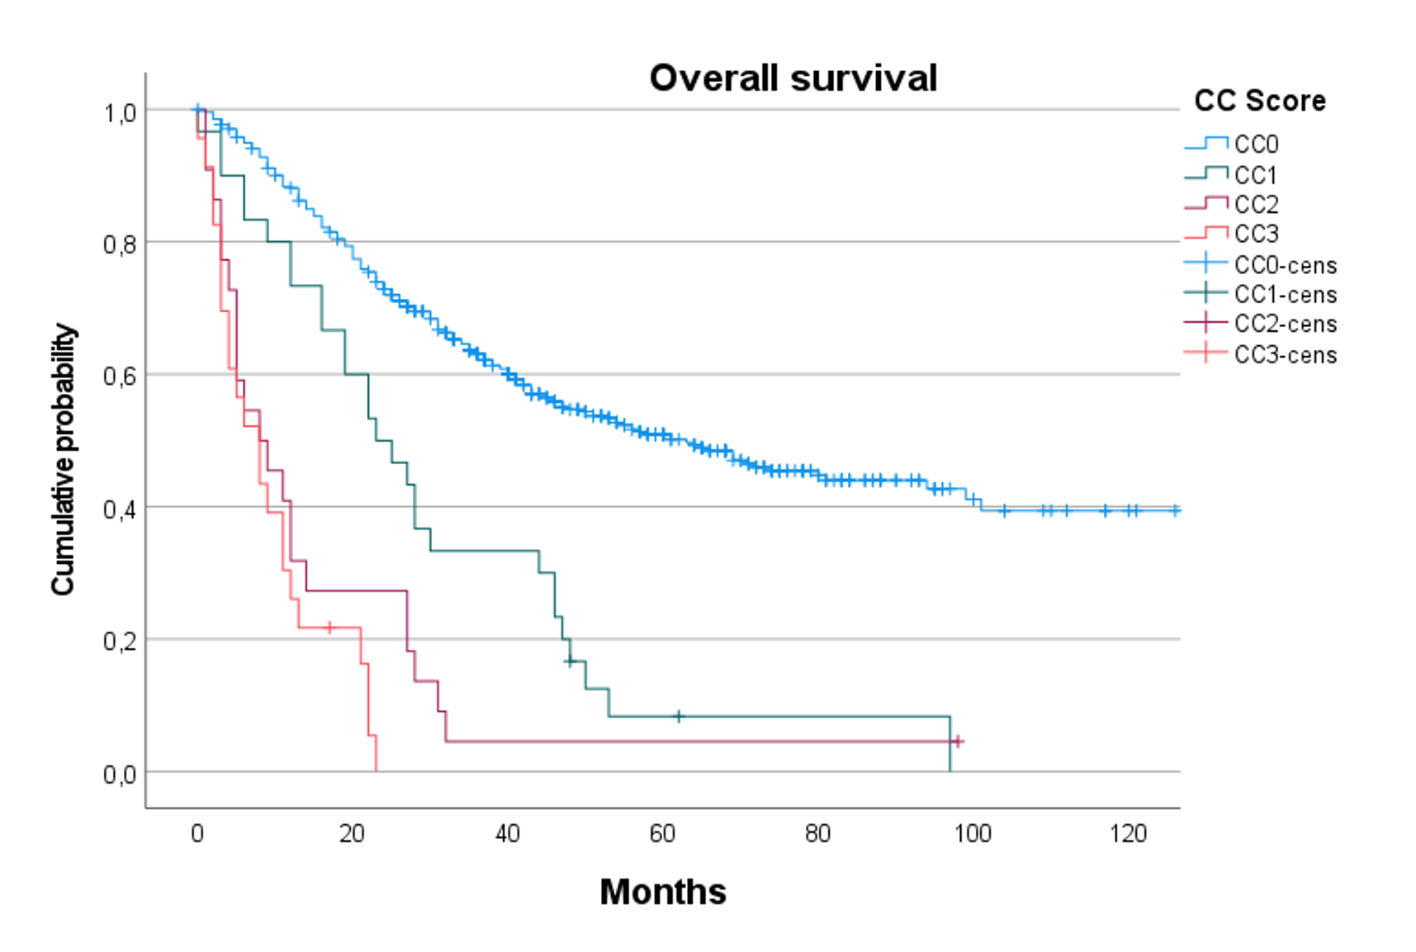
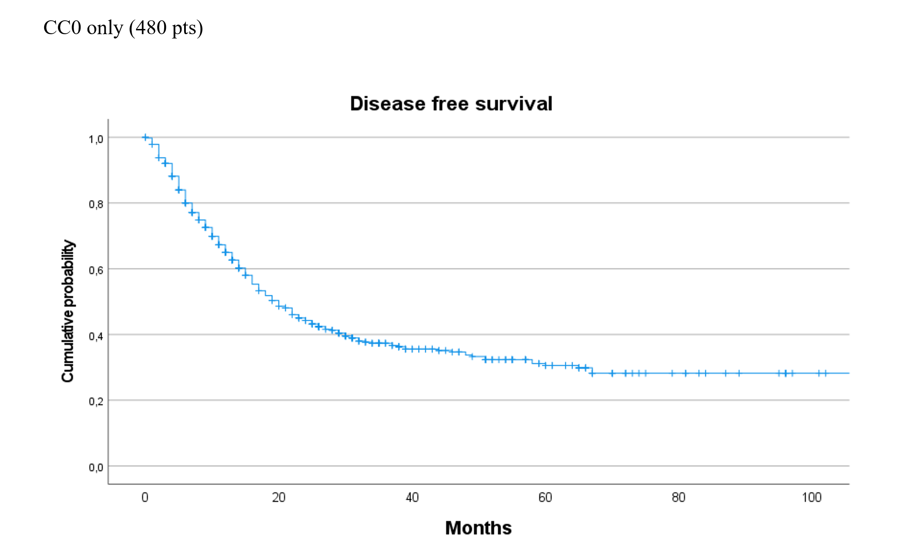
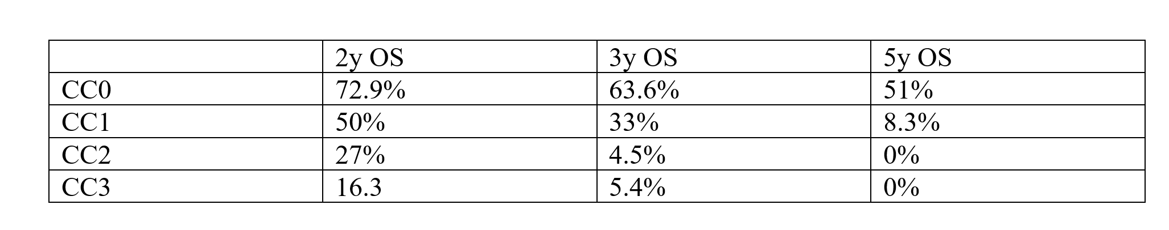
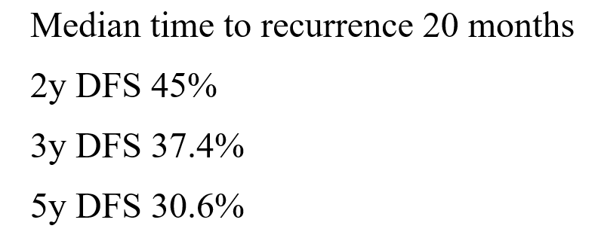
CC score Basingstoke

Slide 23
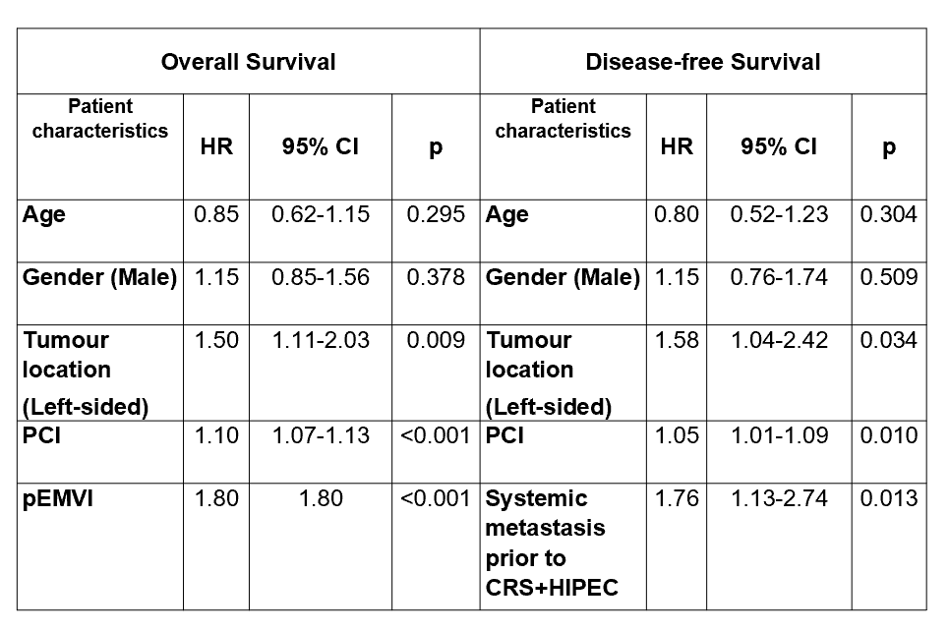
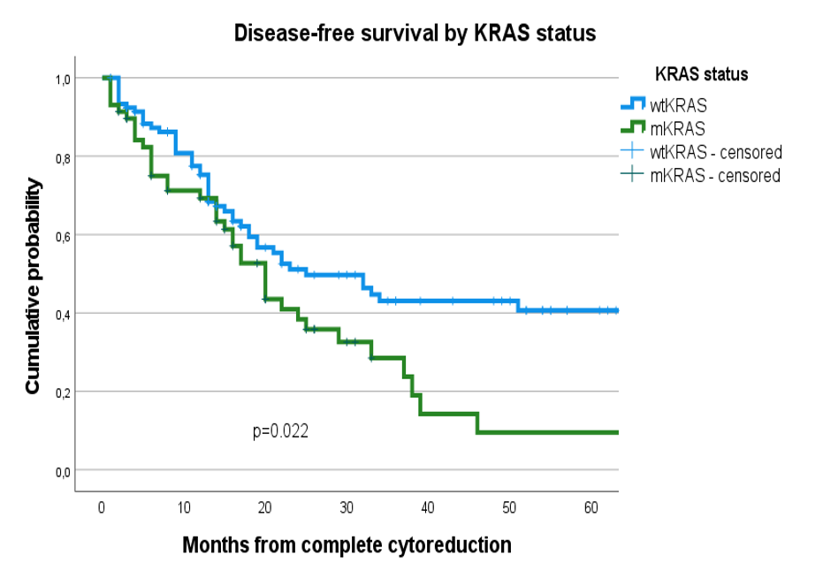
Risk factors

Slide 24
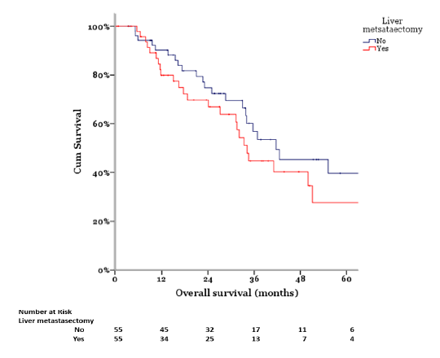
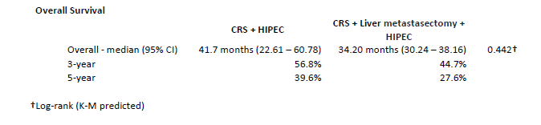
Liver metastatectomy?
CRS + HIPEC
CRS + HIPEC + Liver resection

Slide 25
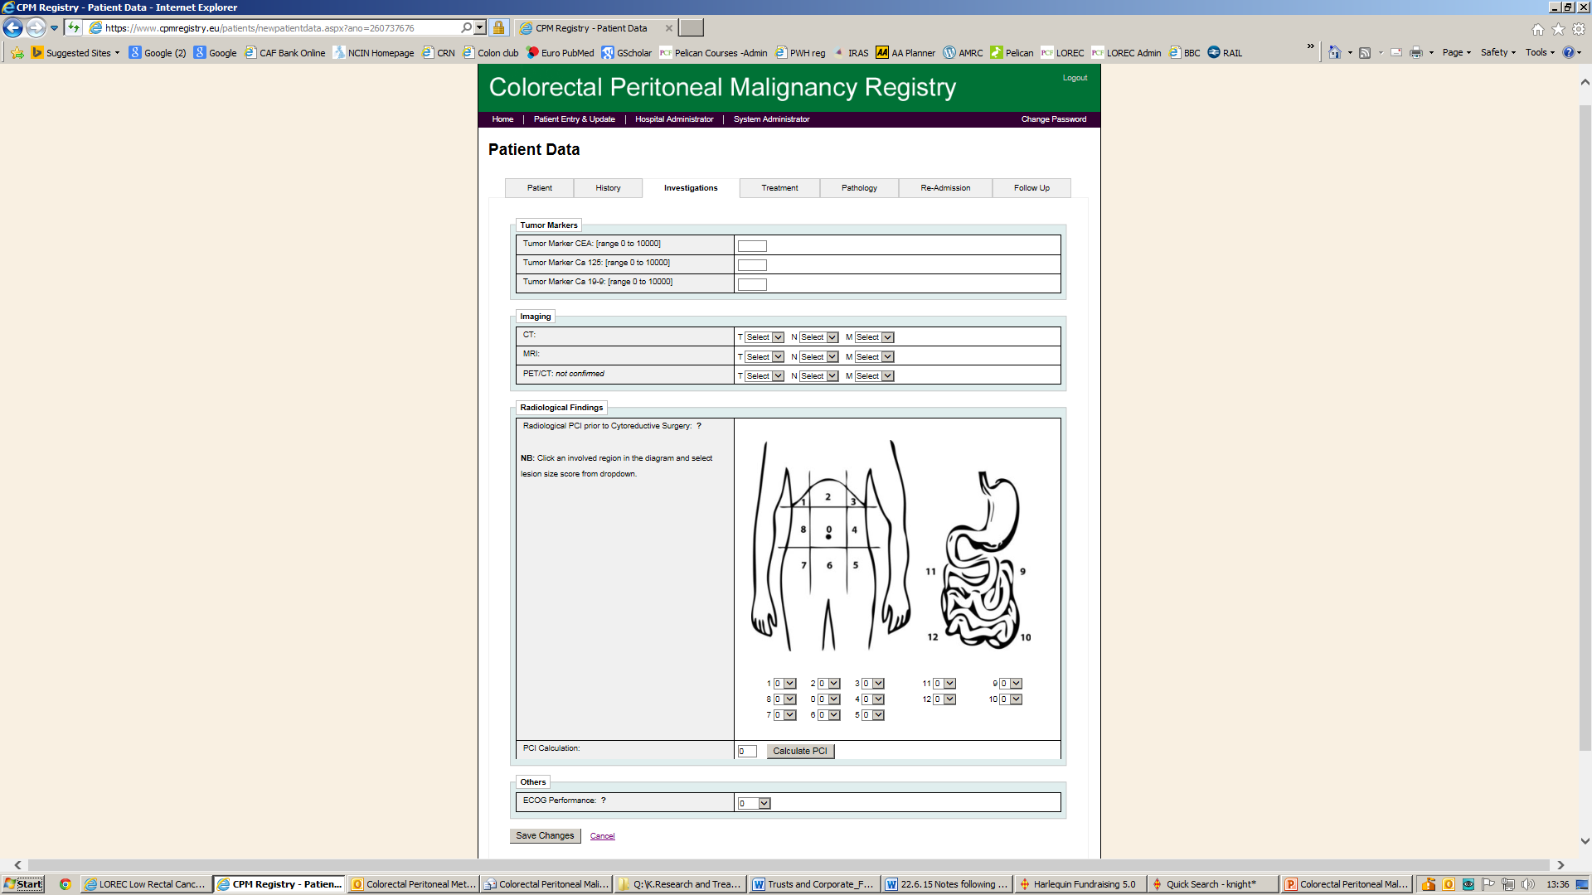


UK and Ireland Colorectal Peritoneal Metastases Registry
Went live Oct 2017
5 units
1138 patients to date

Slide 26
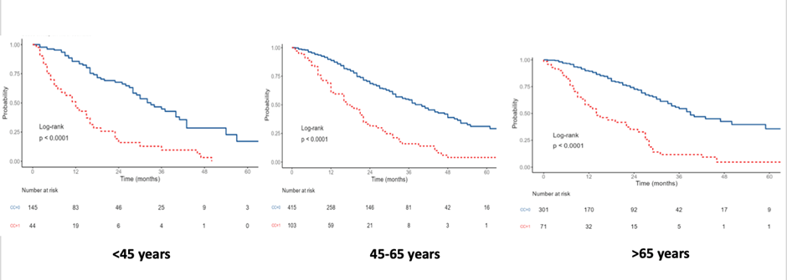
UK and Ireland CPM Registry : 1138 patients
Median survival after complete cytoreduction (overall 38 months)
33 months
40 months
39 months

Slide 27
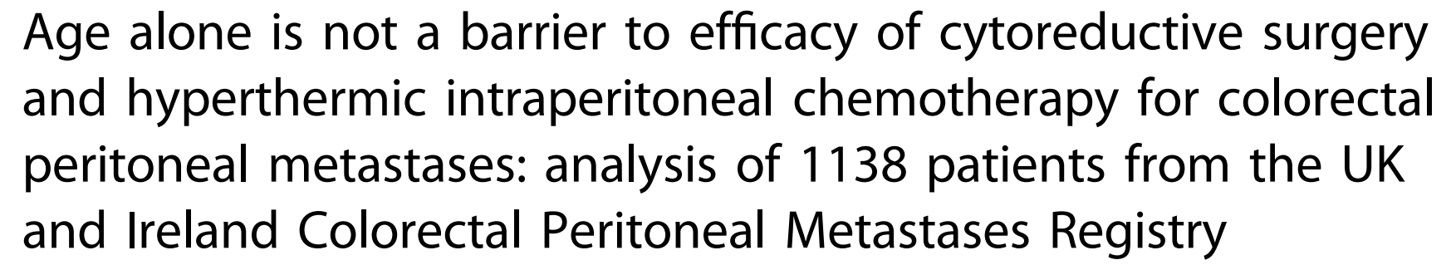
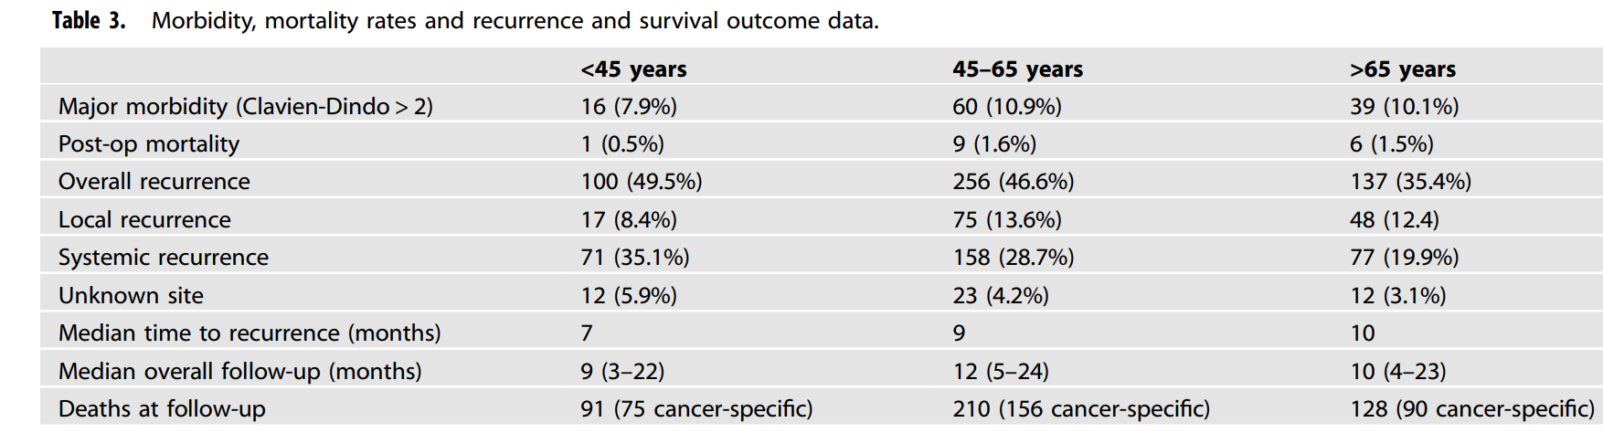

Why do we fail?

Slide 28
Why a multidisciplinary approach is important
Who
recruited?
% RR
Cetuximab arm*
Who determined
liver resectability?
Liver resection rate
Cetuximab arm*
13%
16%
CRYSTAL
General oncologist
71%
General oncologist
OPUS
General oncologist
76%
General oncologist
MDT with liver surgeon
MDT with liver surgeon
33%
60%
CELIM
70%
POCHER
MDT with liver surgeon
MDT with liver surgeon
79%
surgeons MUST work with medical oncologists from the start if best outcomes are to be reproduced
*LLD
Köhne C-H, et al. ASCO 2011 (Abstract No. 3576);
Folprecht G, et al. EMCC 2011 (Abstract No. 6009); Garufi C, et al. Br J Cancer 2010;103:1542–1547

Slide 29
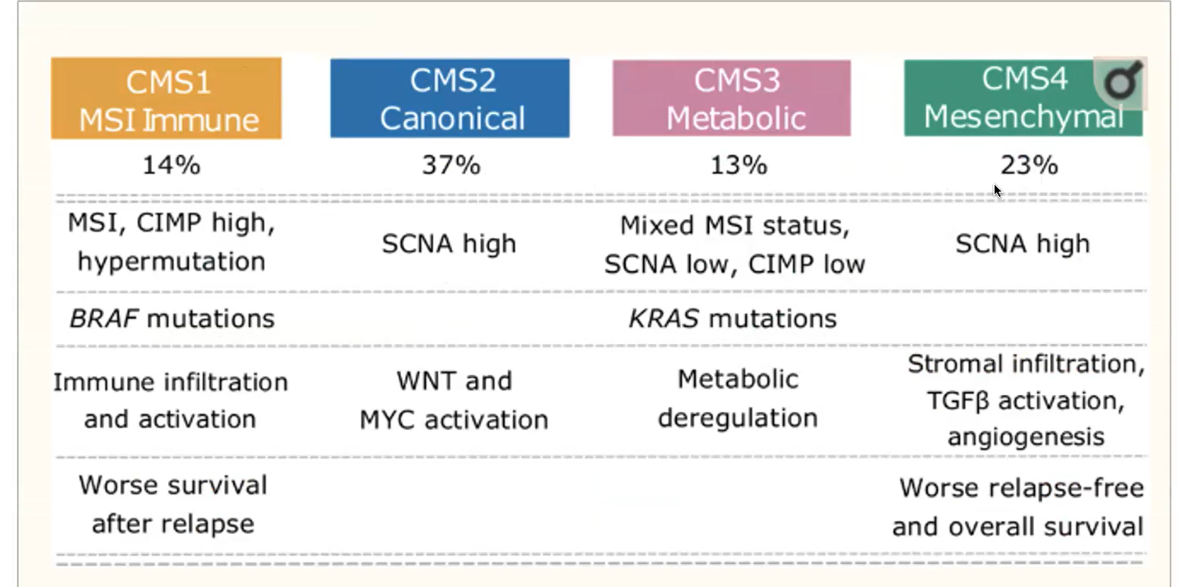
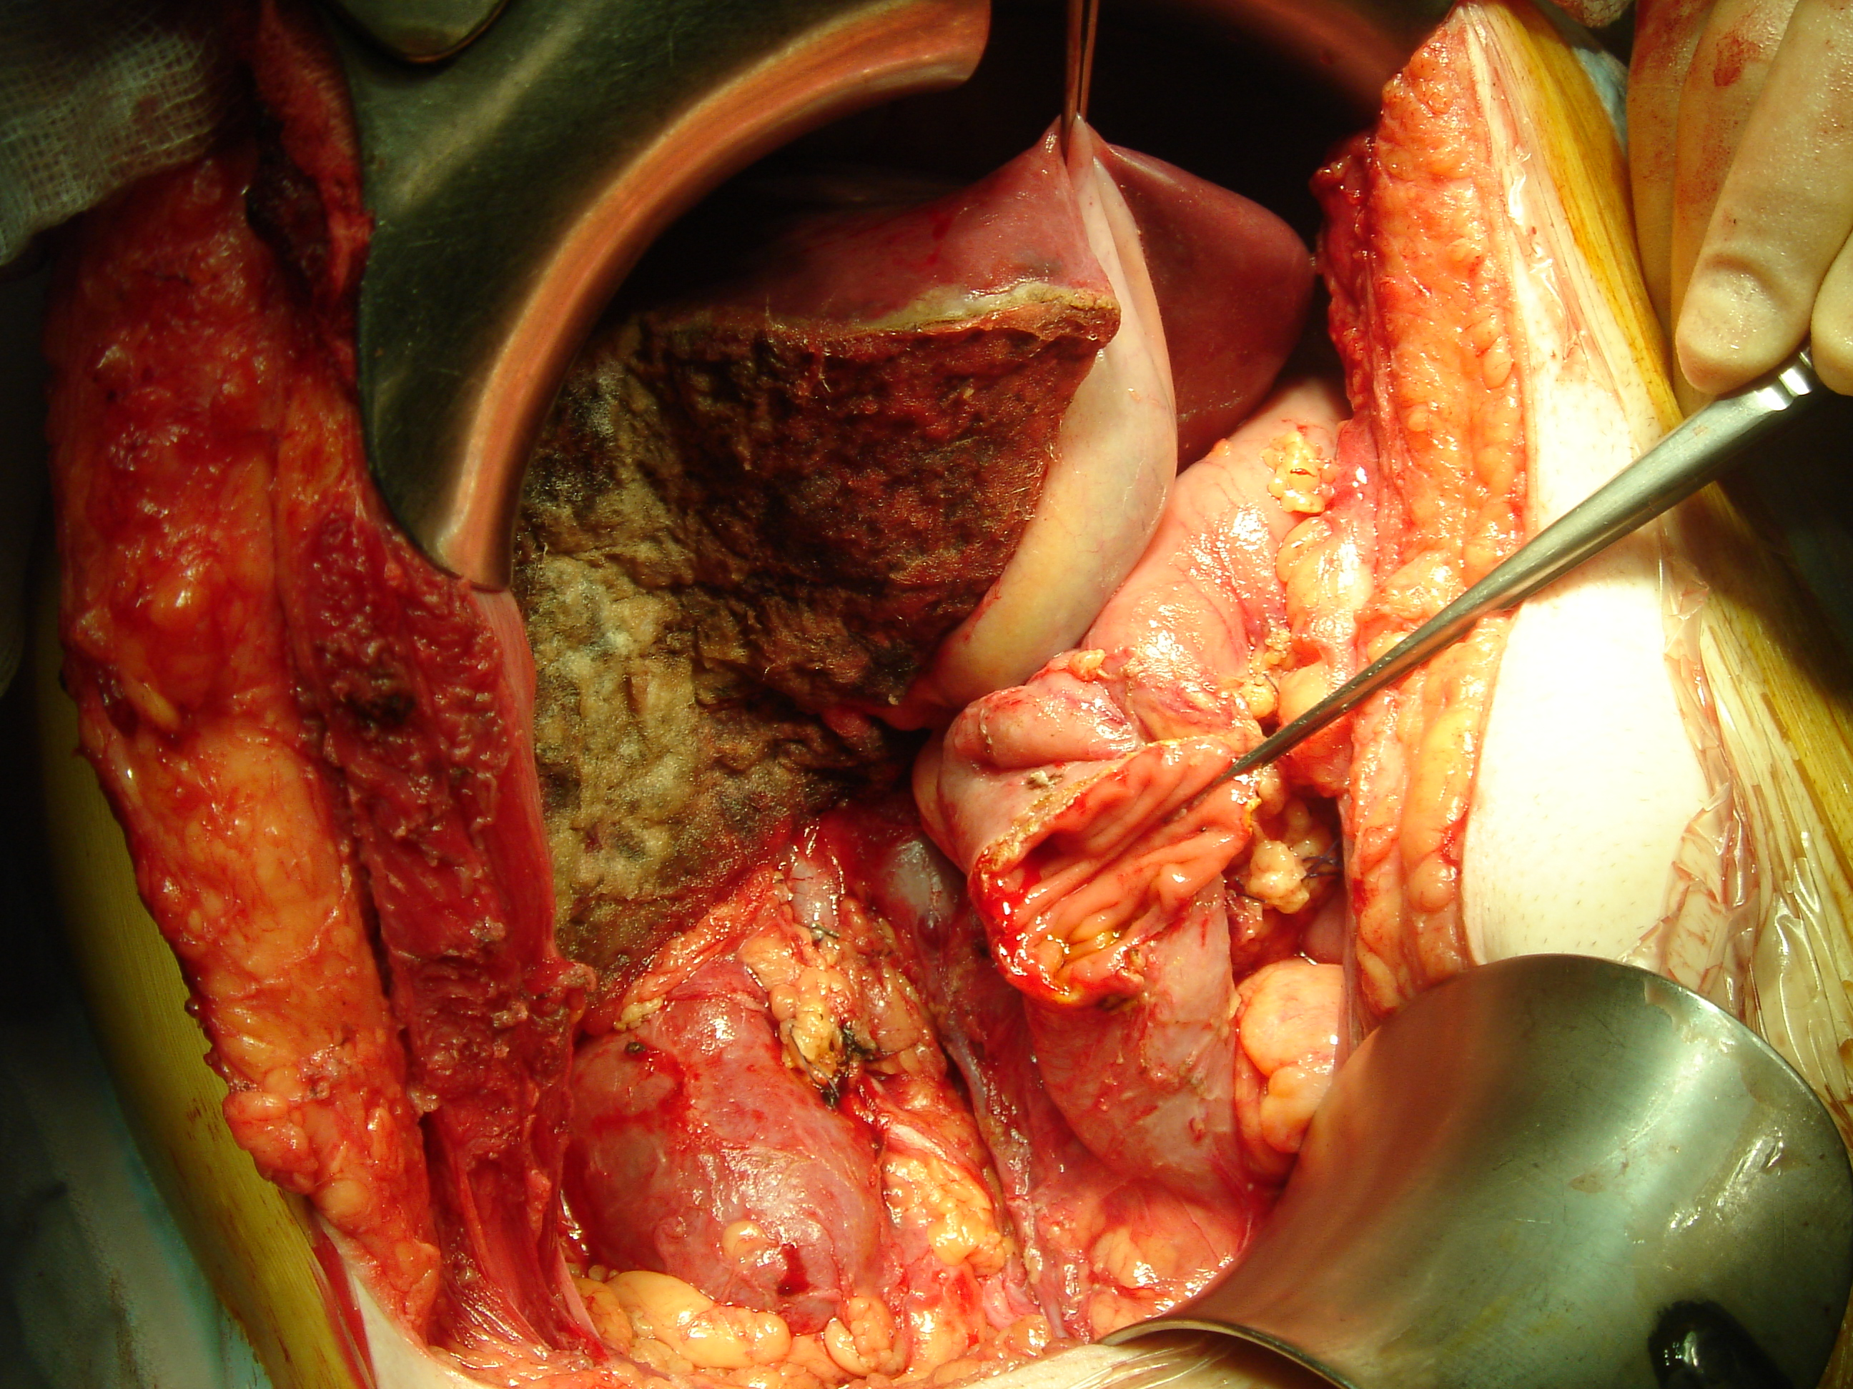

Colon Cancer: Complex vs simple
Molecular
Anatomic
MSI vs MSS
RAS WT vs mutant
Right vs left vs rectal
Young vs old
HER2
BRAF WT vs mutant
Notes:
MSI, microsatellite instability; MSS, microsatellite stable; WT, wild type.#
Consensus molecular subtypes

Slide 30

Multi disciplinary team and individualised care
We need each other
Understanding a common language
Oncologist
  NACT to increase resectability
  NACT Control of disease and trial of time
  NACT to access response
  Preventing recurrence
Surgeon
  Timing and suitability for resection
  Logistics
  Krukenbergs obstruction
  Better outcomes
  Talk to the patient

Slide 31

Questions?

Slide 32














KEY
Re submission for
CPM funding
NHS England
Submission for
Paediatric HIPEC
funding
100 patients
Submission for
mesothelioma
funding
Publications
Procedures
Staff & resources
Surgeons
Pinpoint fluorescence
Transplant
Robotic centre
2500 cases
Senior
Manager
3000 cases
4000 cases
PIPAC
UK First Paediatric
HIPEC
Admin / CNS
Management
Admin / CNS
Management
Admin / CNS
Management
2019 | 2020 | 2021 | 2022 | 2023
Forma 08
Quality of life
CPM Sydney
Genetics-next
Generation Sequencing
Professor Sarah Ennis
HIPEI
Forma 05
Biotest
Mentoring new CPM centre
Euro pmp
Nomogram Prediction Model for survival and recurrence for PMP
Notes:
More science

