Slide 1

Neoadjuvant chemo-immunotherapy pathway
Institutional experience in Leeds
Somerset, Wiltshire, Avon and Gloucestershire (SWAG) Cancer Services
Alex Brunelli
Consultant Thoracic Surgeon and Honorary Clinical Associate Professor
St. James’s University Hospital, Leeds, UK
brunellialex@gmail.com

Slide 2

Disclosures
Consultancy fees and Advisory Board with
Astra Zeneca
BMS
Ethicon
Medtronic
MSD
Roche

Slide 3
CheckMate 816: phase III trial design
Nivolumab 3mg/kg q2w (≤3 cycles) + ipilimumab 1mg/kg (single dose at cycle 1) – arm closed
Resectable stage IB–IIIA
NSCLC (IASLC 7th edition)
ECOG PS 0–1
Available tumour tissue
No prior therapy that targets T cell stimulatory pathways
No known EGFR or ALK alterations
N=350
Nivolumab 360mg q3w
+ platinum-doublet
chemotherapy* q3w (≤3 cycles)
Surgery (within
6 weeks)
R
1:1
Platinum-doublet
chemotherapy* q3w (≤3 cycles)
1
Co-primary endpoints
EFS by blinded independent review
pCR rate by blinded independent review
2
Secondary endpoints
OS
MPR rate
TTDM
*Chemotherapy options: cisplatin, carboplatin, vinorelbine, gemcitabine, docetaxel
NCT02998528
Forde, et al. ASCO 2017 (Abs TPS8577)

Slide 4
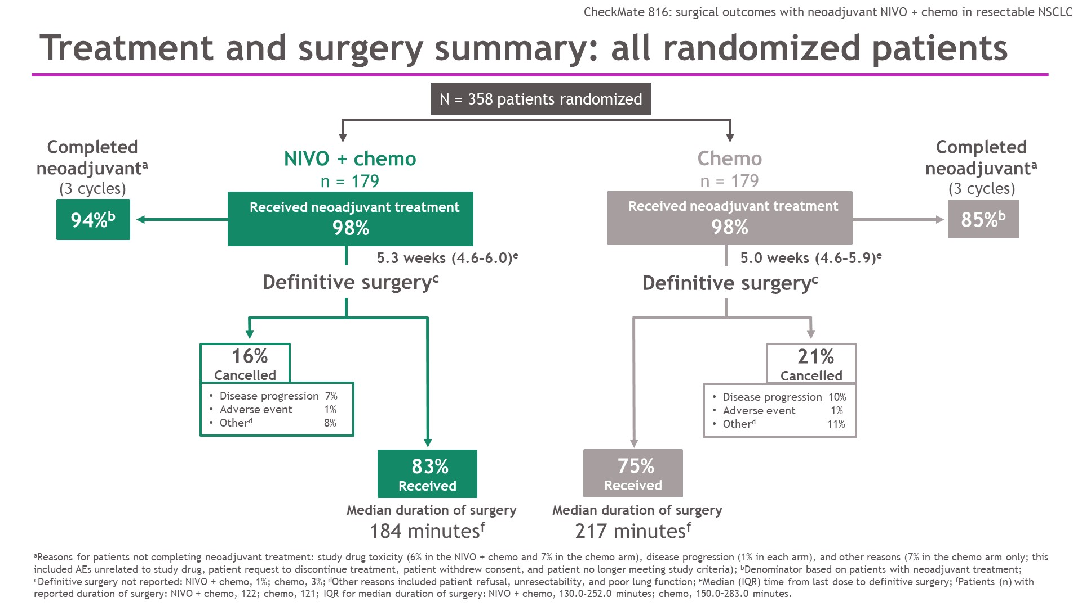
Treatment and surgery summary: all randomized patients
Spicer et al. ASCO 2021

Slide 8
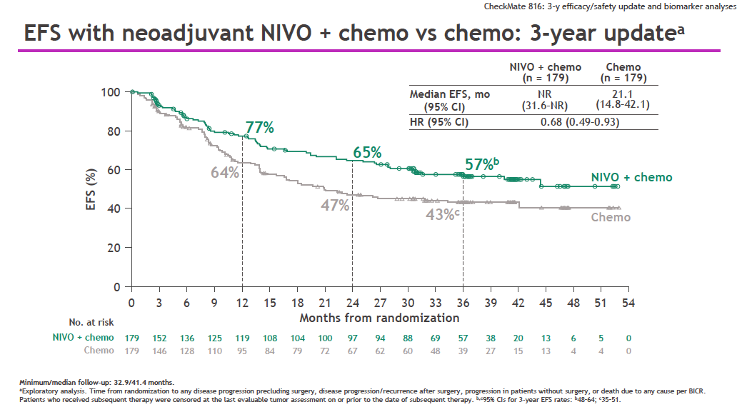
Presented by Patrick Forde @ ELCC 2023

Slide 9
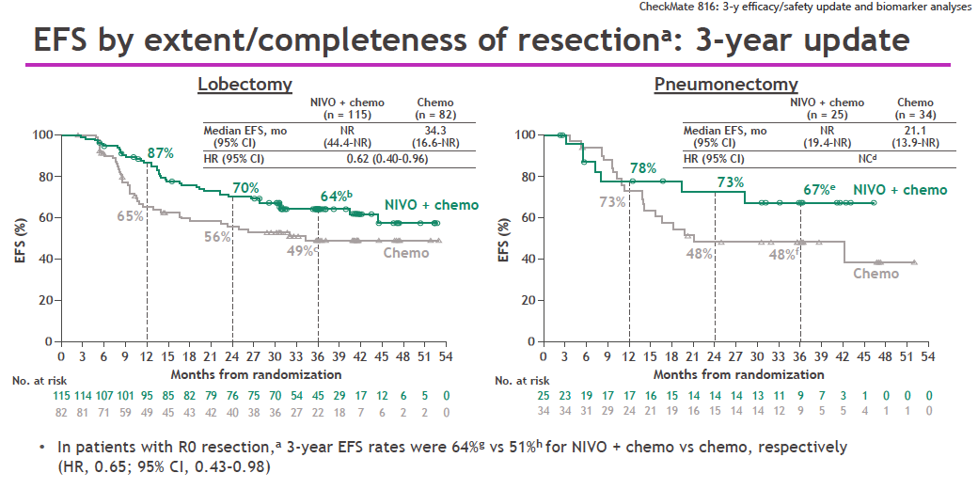
Presented by Patrick Forde @ ELCC 2023

Slide 10
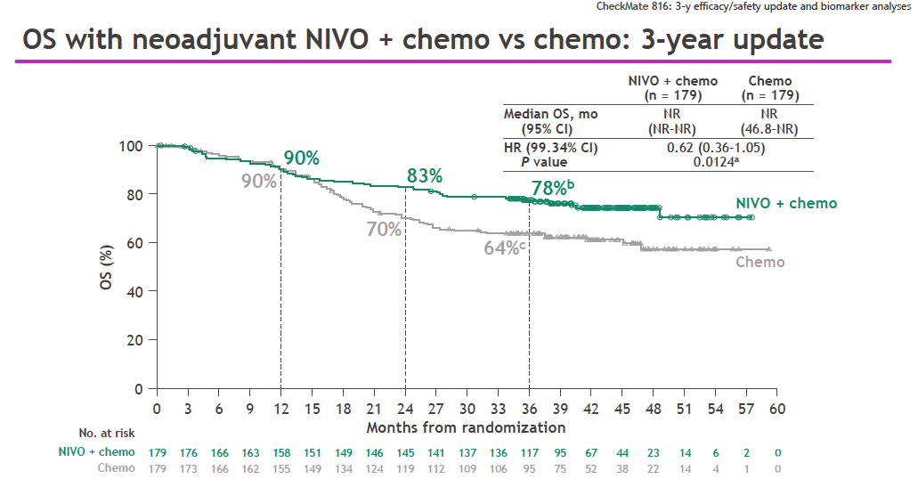
Presented by Patrick Forde @ ELCC 2023

Slide 11


The treatment landscape in the early-stage NSCLC setting is rapidly evolving
Adjuvant
EGFR TKI
Adjuvant CIT
Adjuvant CIT
Adjuvant ALK TKI
ADAURA^{1,2}
NCT02511106
Adj osimertinib in EGFR+ NSCLC
IMpower010^{3,4}
NCT02486718
Adj atezo
KEYNOTE-091 / PEARLS^{7,8}
NCT02504372
Adj pembro
ALINA^{12,13}
NCT03456076
Adj alectinib vs chemo
in ALK+ NSCLC
CHMP positive opinion
Neoadjuvant CIT
Perioperative CIT
Perioperative CIT
CheckMate 816^{5,6}
NCT02998528
Neoadj nivo + chemo
KEYNOTE-671^{9,10}
NCT03425643
Neoadj pembro + chemo & adj pembro
AEGEAN¹¹
NCT03800134
Neoadj durva + chemo & adj durva
CheckMate77T¹⁴
NCT04025879
Neoadj nivo + chemo & adj nivo
2020
Date of first press release
for positive data
2021
2022
2023
2024
Content of this symposium may include information about experimental or investigational compounds, indications and services that are not yet approved in the EU
ALK, Anaplastic lymphoma kinase; CIT, cancer immunotherapy
EGFR, epidermal growth factor receptor; TKI; tyrosine kinase inhibitor
1. US PI TAGRISSO (osimertinib); 2. EMA SmPC TAGRISSO (osimertinib); 3. US PI TECENTRIQ (atezolizumab); 4. EMA SmPC TECENTRIQ (atezolizumab); 5. US PI OPDIVO (nivolumab); 6. EMA SmPC OPDIVO (nivolumab); 7. US PI KEYTRUDA (pembrolizumab)
8. Merck press release (16 October 2023; KEYNOTE-091); 9. Merck press release (16 October 2023; KEYNOTE-671)10. MERCK press release; (28 March 2024; KEYNOTE-671); 11. AstraZeneca press release (09 March 2023; AEGEAN); 12. US PI Alecensa (Alectinib)
13. EMA 2024. Alecensa - CHMP positive opinion (25 April 2024); 14. Bristol Myers Squibb press release (22 September 2023; CheckMate 77T)

Slide 12
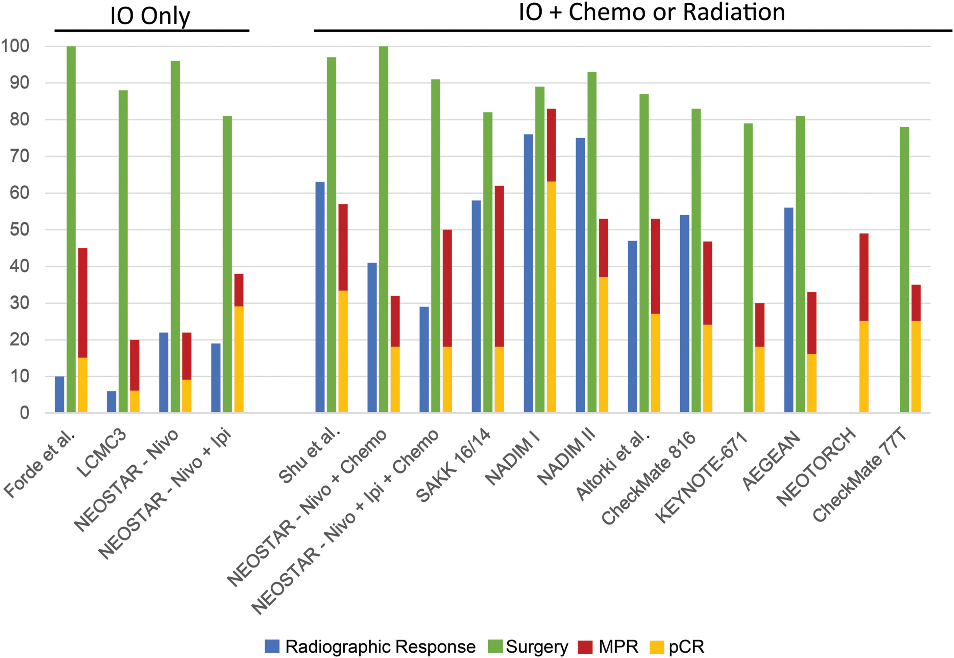
Dunne EG et al. Ann Thorac Surg. 2024 PMID: 38316378

Slide 13
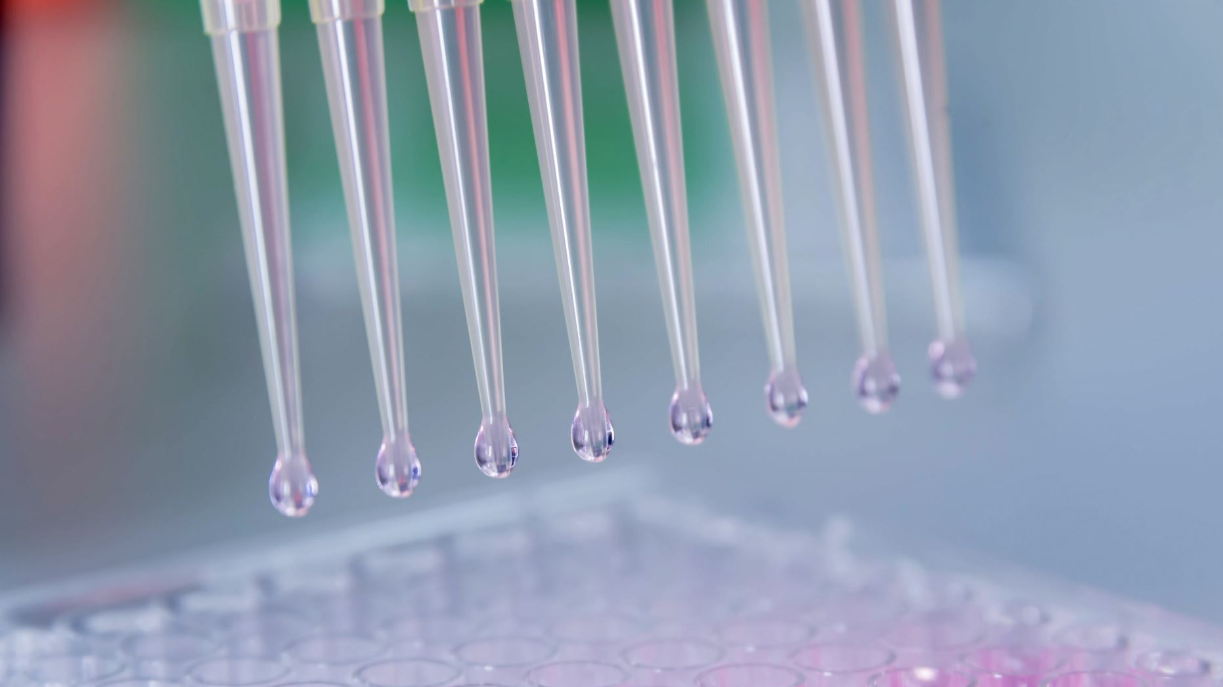
Neoadjuvant nivolumab
Approved in UK in March 2023 in combination with platinum-based chemotherapy
Tumours ≥ 4 cm or node positive (stage IIA or IIB or IIIA or N2 only IIIB tumour according to the UICC/AJCC TNM 8th edition).
NEGATIVE for EGFR 19 or 21 mutation or an ALK gene fusion (NOT a requirement for
squamous histology).
Potentially curative resection to proceed within 6 weeks of completing the final cycle of neoadjuvant nivolumab plus chemotherapy.
ECOG performance status (PS) of 0 or 1.

Slide 14
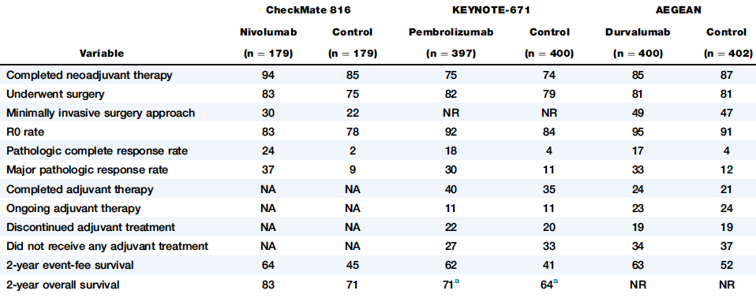
Dunne EG et al. Ann Thorac Surg. 2024 PMID: 38316378

Slide 15
Surgical Outcomes from Phase 3 Trials: IO + Chemo
Trials | Surgery Cancelation PD, AE, Others | R0 for those underwent surgery | Pneumonectomy | Surgery delay Due to AE | Duration of Surgery | Median Hospital Stay | AE related to Surgery Gr3+ | Death related to surgery
CheckMate-816¹ (n=179) | 16% 7%, 1%, 8% | 83% | 17% | 21% 4% | 185 min | 10 days | 41% (90 days) 11% | 1.3%
CheckMate-77T² (n= 229) | 20% 6%, 3%, 12% | 89% | 9% | NA | NA | NA | 41% 12% | NA
AEGEAN³ (n=370) | 19.4% 6.8%, 1.4%, 11.3% | 94.7% | 9.2% | 17.3% 3.1% | NA | NA | 40.2% (90 days) | 2.0%
KEYNOTE-671⁴ (n= 397) | 17.9% 4.1%, 6.3%, 7.5% | 92% | 11.4% | NA | NA | NA | 71.1% (90 days) | 1.8%
NeoTorch (China)⁵ (n=202)/Stage III | 17.8% 2.5%, 3%, 12.3% | 95.8% | 9% | NA | NA | NA | NA | NA
Rationale-315 (China)⁶ (n=226) | 15.9% 2.6%, 2.6%, 10% | 95.3% | 8.4% | 16.3% 6.3% | 2.7 hours | 7 days | 63.7% 11.1% | 1.3%
1. Forde P.M. et al., NEJM 2022;386:1973-1985. 2. Cascone T. et al., ESMO 2023; Kuzdzal J. et al., AATS 2024. 3. Mitsudomi T. et al., WCLC 2023. 4. Wakelee H. et al., NEJM 2023;389: 491-503 5. Lu S. et al., JAMA 2024; 331(3):201-211 6. Yue D. et al., ELCC 2024

Slide 16

Current pathway in Leeds
Patient selected in MDT
Molecular panel and fitness tests
Sees both surgeon and clinical oncologist to assess fitness and discuss neo adj chemo/IO + surgery Vs concurrent chemo/RT
Commences treatment information about timings communicated with surgical nurse coordinator and treating surgeon
Provisional surgical date made
CT after cycle 2 – rediscussed at MDT
Final cycle chemo/IO - additional fitness tests performed
Surgery
Post histology discussed in MDT
1st follow up with treating oncologist with IO tox bloods and follow up survivorship scans requested
Survivorship clinic – CT scans 6,18,36 M plus TFT,9am cortisol, Hba1c + standard bloods 3 monthly year 1 then with CT bloods

Slide 17
Leeds data as of March 2024
As of March 2024, 57 patients were referred to neoadjuvant pathway in Leeds.
35 proceeded to surgery
6 could not proceed to surgery due to disease progression (4) or poor fitness
16 are still in the pathway

Slide 18
Leeds data vs Checkmate 816 cohort
Baseline characteristics
Background | Checkmate 816 | Leeds data
Chemo-IO pathway | 179 | 41
Age ≥65 | 48% | 59%
Gender (female) | 28.50% | 56%
Histology AdenoCarcinoma | 51.40% | 66%
Squamous cell | 48.60% | 32%
Clinical stage IIIA or IIIB | 63% | 61%
stage IIA or IIB | 36% | 39%
PD-L1 > 1% | 49.70% | 60%

Slide 19
Leeds data vs Checkmate 816 cohort
PD-L1 status
Background | Checkmate 816 | Leeds data
Chemo-IO pathway | 179 | 41
PD-L1 status < 1% | 43.6% | 34%
1-49% | 28.5% | 19.5%
>50% | 21.2% | 36.5%
n/a | 6.7% | 10%

Slide 20
Neoadjuvant treatment
Outcome | (%)
Dose reduction | 34%
Patients with only 2 cycles completed | 15%
Carboplatin-based | 91%
Last cycle to surgery (weeks, median) | 5 (4-6)
Surgery delayed >6weeks | 21%

Slide 21
Outcome of neoadjuvant treatment
Outcome | (%)
CT response Stable | 29%
Partial response | 59%
Complete response | 2%
Progressive disease | 10%

Slide 22
%
p<0.001
*Only 2 patients repeated CPET after neoadjuvant chemo-IO
16 patients had their CPET before the start of neoadjuvant
7 patients had their CPET after completion of chemo-IO

Slide 23
%
Checkmate data from Forde PM et al. N Engl J Med. 2022 May 26;386(21):1973

Slide 24
%
Checkmate data from Forde PM et al. N Engl J Med. 2022 May 26;386(21):1973

Slide 25
Surgical outcomes
Outcome | Checkmate 816 (%) | Leeds data (%)
Pneumonectomy | 16.80% | 3%
Bilobectomy | 2.0% | 12%
Lobectomy | 77.20% | 82%
Minimally invasive | 29.50% | 91%
Conversion rate | 11.40% | 23%
Surgery duration (median, IQR) | 184’ | 183’ [136-224]
LoS (days) | 10 [7 - 14] | 4 [3 - 7]
Treatment related mortality | 1.3% | 5.7% (no.2)

Slide 26
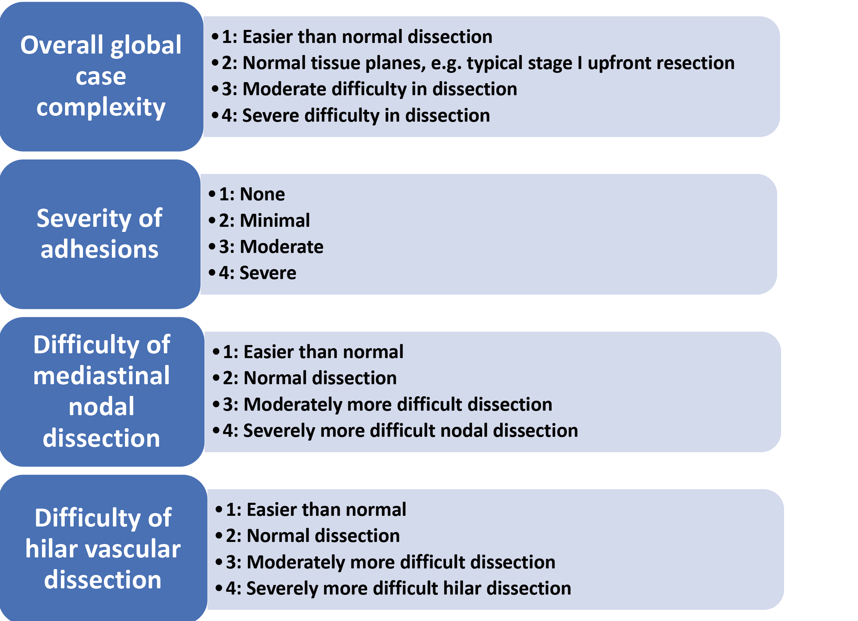
Surgical complexity
Courtesy of Mara B Antonoff, MD Anderson Cancer Center

Slide 27
Surgical complexity
Median score
3
2
3
3
Median estimated blood loss 100 ml (IQR 50-200)

Slide 28
Postoperative pathological outcomes
*All cases with <10% viable cancer cells, including cPR
Outcome | Checkmate 816 (%) | Leeds (%)
R0 | 83.20% | 97%
cPR | 24% | 27%
MPR* | 36.90% | 45.5%

Slide 29
%

Slide 30
%

Slide 31

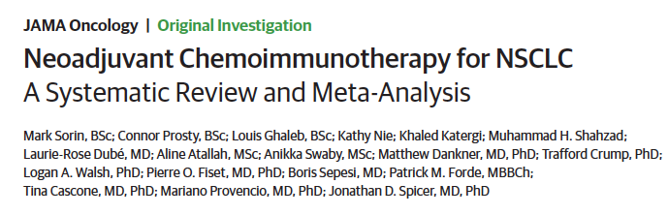
JAMA Oncol. 2024 Mar 21:e240057. PMID: 38512301

Slide 32
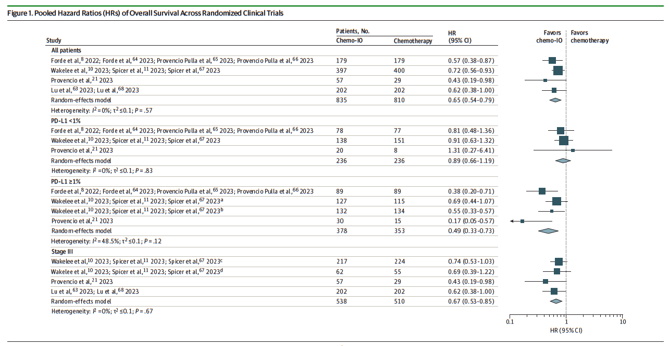
Overall Survival
PD-L1≥1% HR 0.49
Stage III HR 0.67

Slide 33
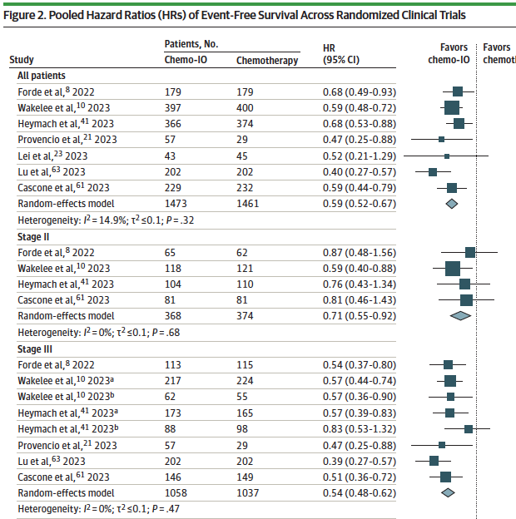
EFS
Stage II HR 0.71
Stage III HR 0.54

Slide 34

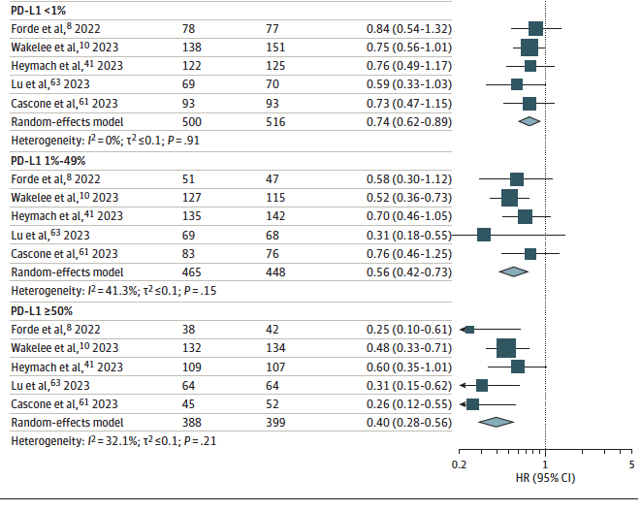
EFS
PD-L1<1% HR 0.74
PD-L1 1%-49% HR 0.56
PD-L1≥50% HR 0.40

Slide 35
KEYNOTE-671 Study Design
Randomized, Double-Blind, Phase 3 Trial
Neoadjuvant Phase
Surgery per Local Standards^{d}
Performed ≤20 wk after
1st neoadjuvant dose
(4-8 wk after last dose if
<4 neoadjuvant cycles)
Adjuvant Phase
Started 4-12 wk after surgery
Pembrolizumab 200 mg IV Q3W
+
Cisplatin and Gemcitabine^{b}
or
Cisplatin and Pemetrexed^{c}
for up to 4 cycles
Pembrolizumab 200 mg IV Q3W
for up to 13 cycles
Key Eligibility Criteria
Pathologically confirmed, resectable stage II, IIIA, or IIIB (N2) NSCLC per AJCC v8
No prior therapy
Able to undergo surgery
Provision of tumor sample for
PD-L1 evaluationª
ECOG PS 0 or 1
Surgery
~786
R 1:1
Placebo IV Q3W
+
Cisplatin and Gemcitabine^{b}
or
Cisplatin and Pemetrexed^{c}
for up to 4 cycles
Placebo IV Q3W
for up to 13 cycles
Surgery
Stratification Factors
Disease stage (II vs III)
PD-L1 TPSª (<50% vs ≥50%)
Histology (squamous vs nonsquamous)
Geographic region (east Asia vs not east Asia)
Dual primary end points: EFS per investigator review and OS
Key secondary end points: mPR and pCR per blinded, independent pathology review and safety

Slide 36
KEYNOTE-671 Results
Interim analysis 1 (IA1): perioperative pembrolizumab regimen significantly improved EFS (HR 0.58, P < 0.00001), mPR (30.2% vs 11.0%, P < 0.00001), and pCR (18.1% vs 4.0%, P < 0.00001)¹
IA2: perioperative pembrolizumab regimen significantly improved OS (HR 0.72, P = 0.00517); EFS benefit maintained²
AE profile: as expected based on the known profiles of the individual treatment components^{1,2}
Results led to perioperative pembrolizumab regimen being approved by the US FDA and included as a category 1 recommendation in the NCCN guidelines³
EFS, IA2²
OS, IA2²
HR 0.59 (95% CI, 0.48-0.72)
HR 0.72 (95% CI, 0.56-0.93)
Pembro arm
Pembro arm
Placebo arm
Placebo arm

Slide 37
Treatment Disposition
Median Follow-Upª: 36.6 months (range, 18.8-62.0)
Presented by J Spicer STS 2024
797 randomly allocated and included in ITT population
Pembrolizumab Arm
397 allocated
Placebo Arm
400 allocated
396 started neoadjuvant therapy
399 started neoadjuvant therapy
71 (17.9%) without in-study surgery^{b}
25 (6.3%) AE
17 (4.3%) progression^{d}
15 (3.8%) physician decision
10 (2.5%) withdrawal of consent
4 (1.0%) patient refusal
82 (20.6%) without in-study surgery^{c}
17 (4.3%) AE
33 (8.3%) progression^{d}
20 (5.0%) physician decision
8 (2.0%) withdrawal of consent
3 (0.8%) patient refusal
1 (0.3%) new anticancer therapy
325 (82.1%) with in-study surgery
317 (79.4%) underwent in-study surgery
290 (73.2%) started adjuvant therapy^{e}
267 (66.9%) started adjuvant therapy^{e}
191 (48.2%) completed adjuvant therapy
174 (43.6%) completed adjuvant therapy

Slide 38
Post Hoc Analysis of EFS in Surgically Relevant Subgroups
Baseline Characteristics
Post Randomization Factors
Presented by J Spicer STS 2024

Slide 39
Surgical Procedure and Completeness, Surgical Population
Procedure
Completeness
Pembro arm
(n = 325)
Placebo arm
(n = 317)
Lobec-
tomy
Bilobec-
tomy
Pneumo-
nectomy
Otherª
R0
R1
R2
Unresectable^{b}
Presented by J Spicer STS 2024

Slide 40
All-Cause Mortality Within 30 and 90 days of Surgery,
Surgical Population
 | Pembro Arm | Placebo Arm
All participants who underwent surgery | n = 325 | n = 317
Within 30 days | 6 (1.8%)ª | 2 (0.6%)^{b}
Within 90 days | 13 (4.0%)^{c} | 5 (1.6%)^{d}
Participants who underwent lobectomy or bilobectomy | n = 282 | n = 264
Within 30 days | 4 (1.4%) | 2 (0.8%)
Within 90 days | 10 (3.5%) | 4 (1.5%)
Participants who underwent pneumonectomy | n = 37 | n = 39
Within 30 days | 2 (5.4%)^{e} | 0
Within 90 days | 3 (8.1%)^{e} | 1 (2.6%)^{f}
Presented by J Spicer STS 2024

Slide 41
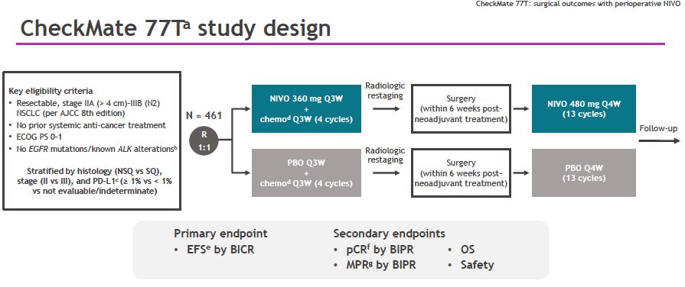

Slide 42
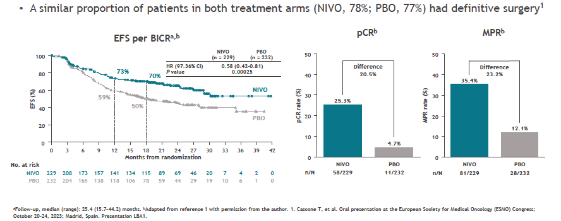

Slide 43
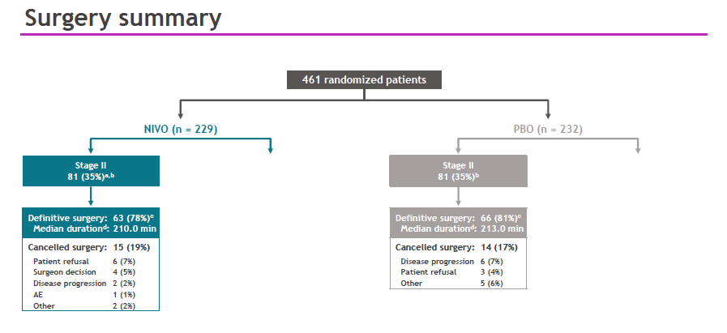

Slide 44
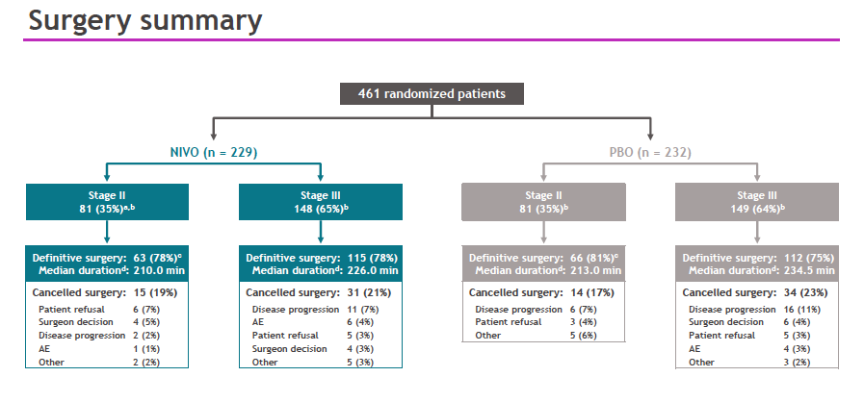

Slide 45
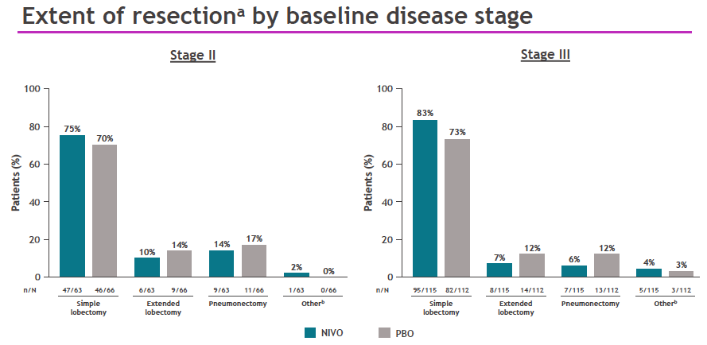

Slide 46
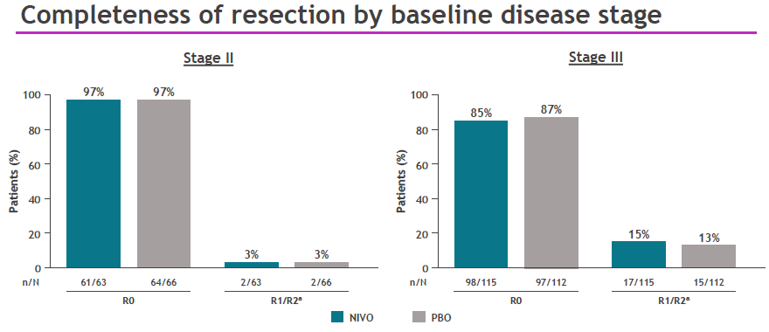

Slide 47
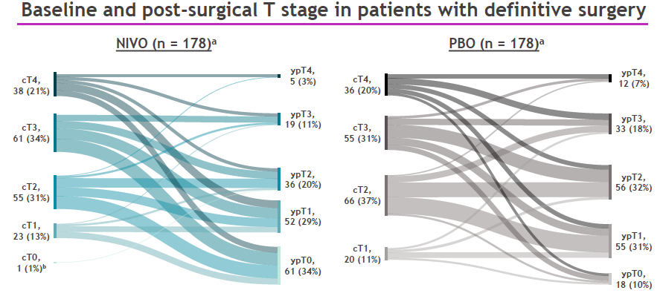

Slide 48
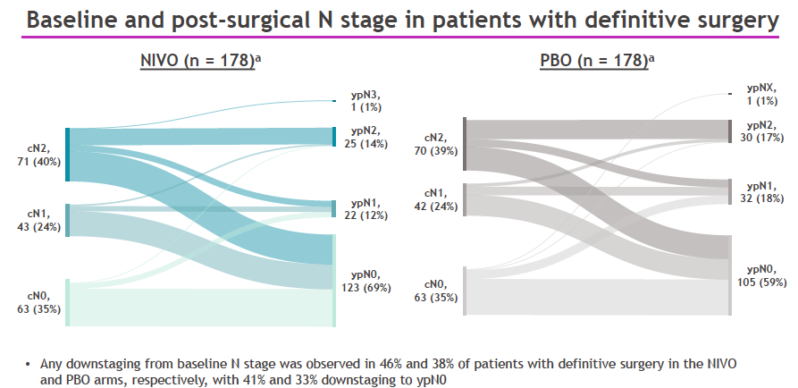

Slide 49
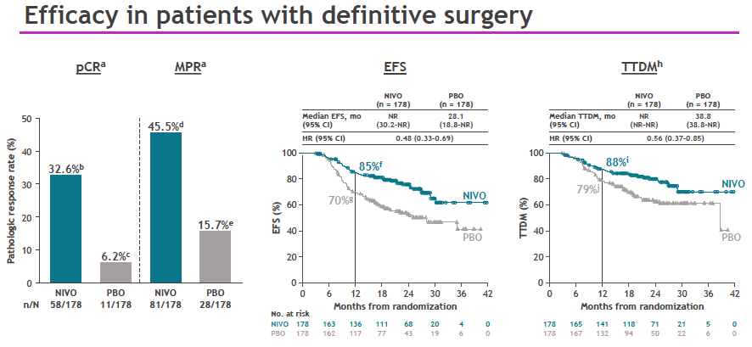

Slide 50
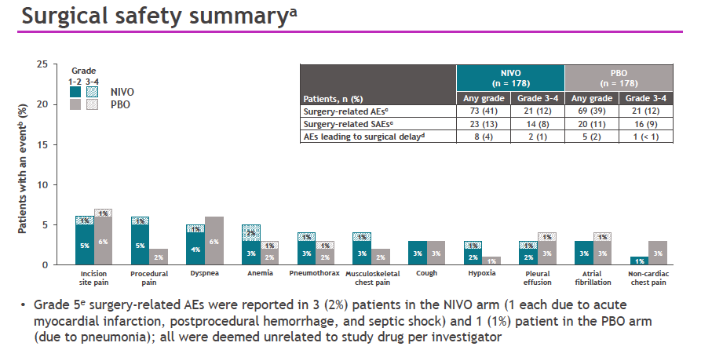

Slide 51
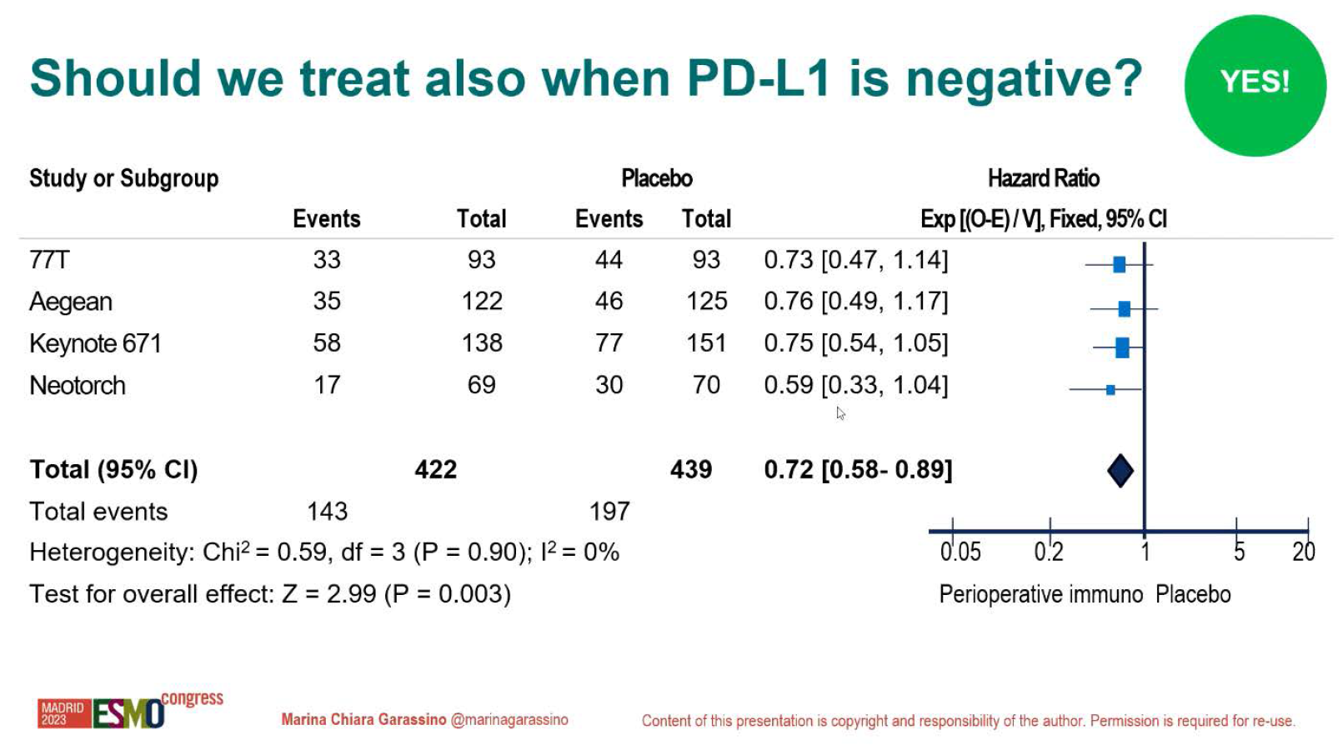

Slide 52
