Slide 1
Lynch syndrome update
Siobhan John
Colorectal CAG
2nd May 2024

Slide 2
Lynch Syndrome - business as usual
 | Short Term | Medium Term | Long Term
Mainstreaming Test Request | Training Nurse Specialists by GMSA | Nurse Specialists have time to mainstream | New nurse specialists have mainstreaming built into training
Clinical Genetics | Support Training | Stop seeing patients to request test Seeing more patients post test Cascade testing volume
Clinical Leadership | GMSA and Cancer Alliance support MDT leads for LS | LS leads part of wider Cancer Service genomics leadership | Genomics as business as usual requires less intensive leadership
Primary Care | Support pathway developments | Family history on referral Aspirin prescribing | Robust clinical records for genomic conditions inc LS

Slide 3
Transition to business as usual
Funding available to support this transition through each cancer alliance – Peninsula and SWAG. Over 2 years.
Possibility of an inherited cancer nursing role (0.4-0.5WTE) per alliance
Development of testing assays
MSI plus being assessed for cost-effectiveness and capacity
Ongoing development of pathways and cascade testing following diagnosis.
GMS working on business case for ICBs and inherited cancer

Slide 4
Mainstreaming Hospitals
Mainstreaming Sites
UHBW – CRC / gynae
UHBW - gynae
NBT – CRC
Glos – CRC
Somerset – CRC / gynae (offering cross cover)
RUH – in training CRC / gynae
Not currently mainstreaming
Glouc - gynae
UHBW -CRC
Tool kit
Mainstreaming consent form
GLH request form
PIL
Template letter
SOP
All pts still referred to clinical genetics but with germline results and seen in appropriate timescale
http://www.genomicseducation.hee.nhs.uk/wp-content/uploads/2024/03/Competency-Training-and-Evidence-form-V1.3-E-PDF.pdf

Slide 5
Regional Expert network
Lynch and Polyposis – SWAG & Peninsula, chaired by Frank McDermott (RDUH)/ gastro and clinical genetics present
Next Meeting Monday May 20th 1230 -1330
MDT discussion for complex patients with inherited cancer/polyps to assist local clinical teams deliver care.
Polyposis patients can also be discussed at monthly National Rare Disease Collaborative Network for hereditary polyposis (RDCN)
For Lynch/ Polyposis
rduh.lynch-polyposis@nhs.net
(f.mcdermott@nhs.net; michael.fung@nhs.net; ruth.cleaver@nhs.net;)

Slide 6
Successes
6 meetings (April, June, July, September, November, Jan 2024)
Admin support and email address ‘rduh.lynch-polyposis@nhs.net’
Referral form and outcome
Multi specialty including paediatrics/ transition of care
Educational element (e.g. lynch like syndrome)
Link with RDCN (For polyposis patients) - KPIs

Slide 7
Remedy – GP practice guidance on referral to clinical genetics
Only 5% of lynch patients are currently diagnosed
main routes to diagnosis of lynch
Post CRC or endometrial cancer reflex testing
National genomics test directory panels R210 and R211
Work performed by Beth Shaw (5th year medical student, BMS) showed significant number of patients present in a single GP practice (~80/8000) with criteria for referral on R210 (family history) panel.
No current guidance on lynch syndrome on remedy.
Current document in production and will be agreed on by all relevant parties before publication.

Slide 8
How to find the patients with familial cancer predisposition syndrome?
Lynch syndrome prevalence 1:400
Bristol GP Surgery with 8 587 patients - should be 17 patients with Lynch syndrome (so far 1 diagnosed)
Beth sent to 6853 patients an AccuRx text message that linked with a SurveyMonkey questionnaire about family history of cancers
SurveyMonkey questionnaire:
Do you have a FH of 3 or more people diagnosed with cancer
Please specify the type of cancer each person was diagnosed with: endometrial bowel other (please specify)
Please specify the relationship these people had to you
Were any of these diagnoses made when your relative was less than 50 years? -Yes -No -Unsure

Slide 9
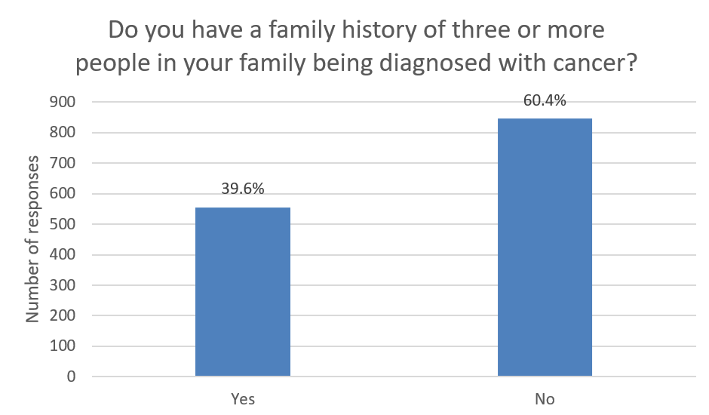
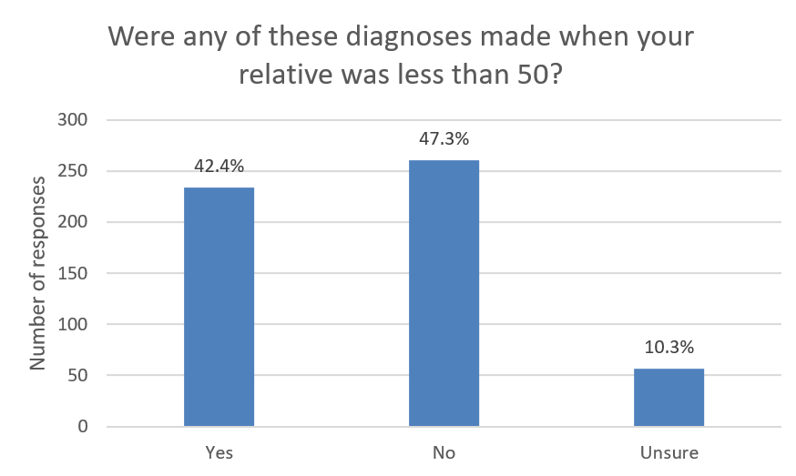
Results survey sent to 8653 pts, 1401 responses (20.4%)
Family history of ≥ 3 relatives with cancer
Cancer Dx in relative < 50 yrs of age
234 people with both of the above
16 patients met Amsterdam criteria

Slide 10
Aspirin prescribing in LS
Aspirin recommended for LS patients
Minimum of 2 years treatment and no longer than 5 years
Dose review on publication of CAPP3
Either 150 mg (if < 70 kg) or 300 mg (if > 70 kg)
Not for > 65 years old, pregnancy or breastfeeding, other standard contraindications
Will be delivered by practice pharmacists
Final draft of guidance currently being ratified by all relevant stakeholders webinar to launch it next week in BNSSG

Slide 11
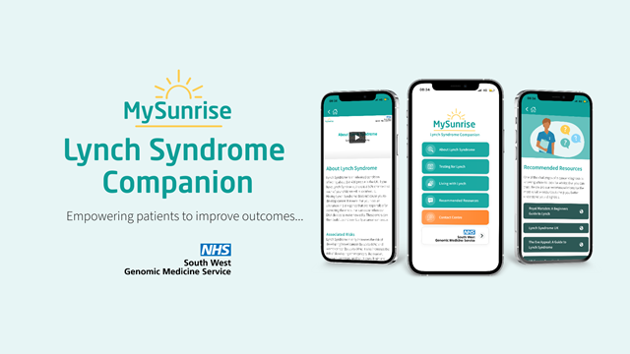
My Sunrise App

