Slide 1
Update prehabilitation to rehabilitation offer at NBT and across bnssg. Reducing the variation in access, outcomes and experience.
Jayne Masters
Cancer Lead Allied health professional
North Bristol Trust

Slide 2
Personalised prehabilitation to rehabilitation for people affected by Cancer
Health optimisation commences in primary care at point of referral to secondary care.
Needs assessment as part of triage and initial contact.
CFS 1-4
METS >8 (DASI)
PGSGA SF total score 0-1
Physical activity levels(PAVS)
Needs assessment (WMTY/HNA)
Prehab for Cancer website - SWAG
Patient information leaflets
BNSSG ICB webpages
BMS/Macmillan videos
Cancer research UK videos
NBT Cancer information and support clinic
Social prescribing
Healthy lifestyle advice/signposting
Promoting knowledge, skills and confidence to maintain or improve current physical and psychological status
Universal
For anyone with a cancer diagnosis.
Cancer diagnosis or high suspicion awaiting staging
Assessment by CNS / Care Navigator/ CSW / Medic
Screen with validated tool - DASI, Rockwood CFS, PGSGA SF, Physical activity vital sign (PAVS)
Referral by MDT or self-referral to pathway to meet complexity of need:
Universal or
Targeted or
Specialist
CFS 1-4
METS 4-7 (DASI)
Expected Length of stay > 3 days.
PGSGA SF total score 2-3
Physical activity levels (PAVS)
Needs assessment (WMTY/HNA)
Targeted intervention
Exercise instructor/ B4 Technical instructor
Community exercise scheme referral to level 4 cancer exercise instructor
Band 4 NHS cancer exercise instructors all have level 2 psychology training
Health coaching
Personalised Care
Rehab Pathway
Targeted
People with cancer with adverse effects of disease / other long-term conditions
Consideration of MDT support- referrals to psychology services or occupational therapy or other professionals
CFS ≥ 5
MET score: <4 (DASI <25)
Expected Length of stay > 3 days.
PGSGA SF total score 4+
Physical activity levels (PAVS)
Needs assessment (WMTY/HNA)
Specialist intervention
Assessment by registered AHP.
Depending on needs: assessment by Physiotherapist, SALT, Occupational therapist or Dietitian
All completed Level 2 psychological skills training
Handover clinical needs to inpatient team prior to any surgery.
Specialist
Complex acute / chronic needs
Severe impairment and/or disability
Low functioning levels/ cardiac or respiratory issues
Low confidence. Significant distress.
High risk of deterioration in function
Universal interventions are applicable to anyone on a cancer pathway.
Targeted interventions are applicable to those with specific needs identified as part of screening that should be assessed, addressed and are modifiable. Adherence and effectiveness should be monitored.
Specialist interventions are applicable to those with complex needs identified as part of screening. Assessment delivered by registered professional. Adherence and effectiveness of intervention should be monitored.
Cancer treatment – curative and non-curative

Slide 3
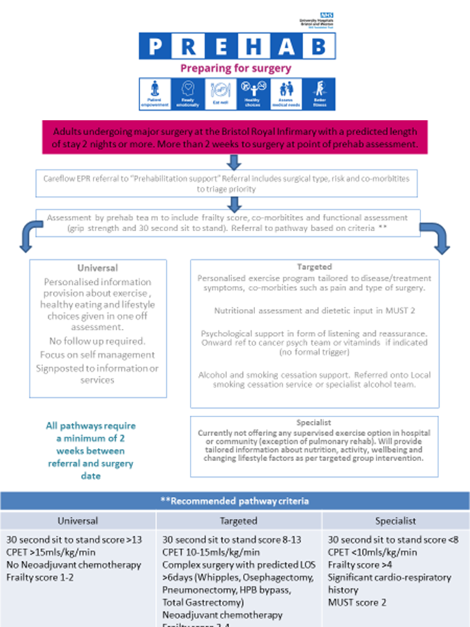
Pathways and next steps

Slide 4
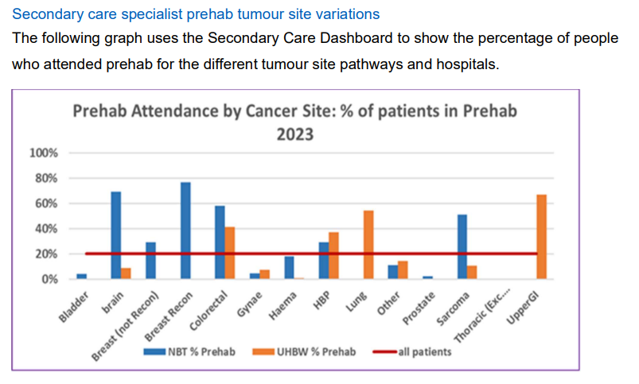

Slide 5
Key recommendations 1
1 set of overarching recommendations that encompass the 4 themes with a recommended approach for implementation.
What | Why
To develop a clear definition of prehab that fully defines the different prehab components (Screening, Referral, Assessment, Universal, Targeted and Specialist Interventions and Monitoring). And use this consistently across the system including Patients, Primary care, Sirona, VCSE and Secondary Care. Making prehab everyone’s business across the BNSSG system. | To ensure that patients and providers know what to expect and who is responsible for delivering each component of prehab. To maximise “Teachable moments” for all people with suspected cancer and definite cancer, including the use of Personalised Prehabilitation Care plans to empower patients to self-manage and reduce duplication or omission of prehab provision by providers.
To identify and make widely available and easily accessible prehab resources for exercise, nutrition, and wellbeing at universal, targeted and specialist levels in different formats including print, digital and apps. | So that staff across the system can easily access and provide patients with the appropriate resource to maximise the benefits of prehab and reduce inequalities due to digital exclusion or language.
To identify, utilise and develop other community based universal and targeted interventions for exercise, nutrition and wellbeing with a clear pathway to ensure they are viable and sustainable. | To enable more people to access prehab closer to home and reduce inequalities of geographical access.
To consider the use of multiple condition activities to promote lifestyle changes that can benefit people regardless of cancer diagnosis. | To increase benefits to other people living with long term conditions as well as cancer and promote longer term adherence to lifestyle changes.

Slide 6
Key recommendations 2
What | Why
To ensure that all cancer patients have access to targeted and specialist nutrition, exercise, and wellbeing interventions regardless of their tumour site, treatment pathway, hospital site or where they live. | To reduce variations and inequalities in who can access targeted and specialist interventions and the type of interventions they can access and where they can access them.
A clear workforce plan that identifies leadership, develops specialist clinicians for specialist interventions, appropriately trained support staff to deliver targeted interventions. A training and education plan for those screening, referring, and delivering universal interventions. | To ensure that the workforce can deliver and develop sustainable prehab services to maximise the benefit whilst reducing inequality through lack of appropriate referrals and provision. To improve links with other initiatives such as waiting well and cancer rehab.

Slide 7
Workforce at NBT – all tumour sites
Substantive (OPs) – impact across bnssg
1.0WTE Physiotherapist (focus Sarcoma and Colorectal, and Breast)
2.0 WTE Dietitian (focus UGI, Colorectal, Haematology)
1.0 WTE B4 Technical instructor (Colorectal and Breast)
Total= 4 WTE
Fixed term contracts (Ops) – impact across bnssg
1.3WTE Neuro-oncology prehab to ERP (ends September 2024)
0.6WTE Physiotherapist (ends September 2025 – focus Breast cancer )
1.0WTE clinical and strategic lead (ends March 2025 – no cancer specific AHP lead across bnssg)
0.4 Dietitian (ends September 2024 – focus UGI)
Total= 3.3WTE

Slide 8
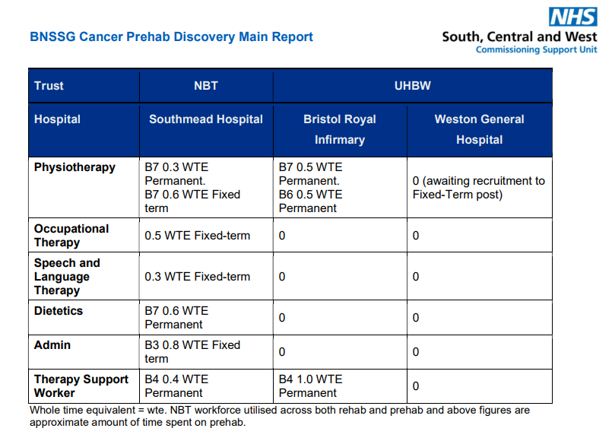

Slide 9
Evaluation

Slide 10
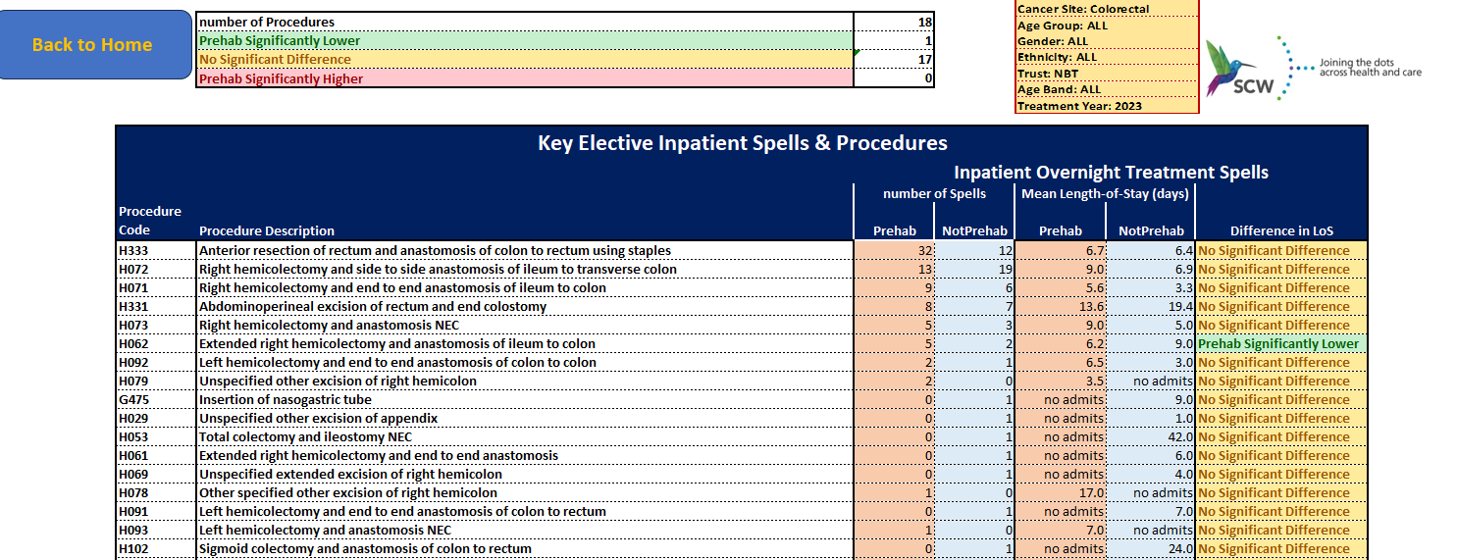

Slide 11
Data: reducing variation in access, outcomes and experience
Prehabilitation referral data 2023 – 24 and forward look 2024 – Colorectal
Mean monthly number of referrals for prehabilitation to NBT AHP prehabilitation service
= 13 referrals per month
Prehabilitation minimum referrals expected in 2024 = 156 for prehabilitation
21/22 NBT delivered surgical care to 238 for colorectal cancer
% referred= 65.5% of total receiving surgical intervention
Data based on
1/1/23 to 31/12/23
NBT LGI cancer team
referred 101 referrals to Physiotherapy prehabilitation service
(no growth accounted for)
1/1/24 to 30/4/24
19 referrals to Dietetic prehabilitation service= 4.75 per month
Future look: expect 57 referrals in 2024
SCR activity data – surgical treatment intervention

