Slide 1
SWAG Network Colorectal cancer
Clinical Advisory Group
Research Update - Claire Matthews & Thomas Strawson-Smith
11/05/2023

Slide 2
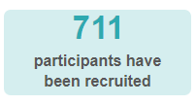
National Recruitment to Colorectal Cancer Studies
Apr 2023 - Mar 2024
2024/2025 to date
Apr 2022 - Mar 2023
Data cut 29/04/2024
Source: ODP All Portfolio

Slide 3
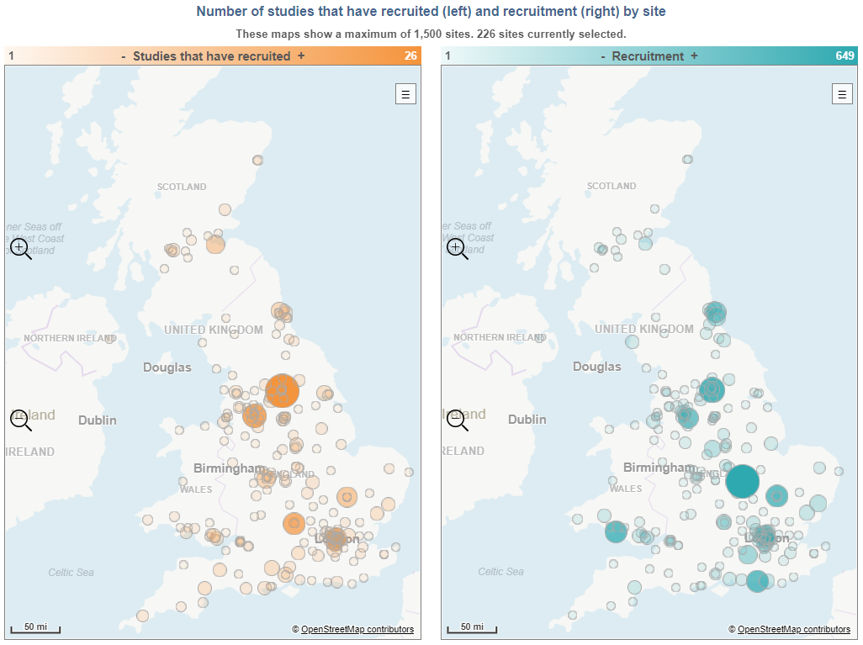
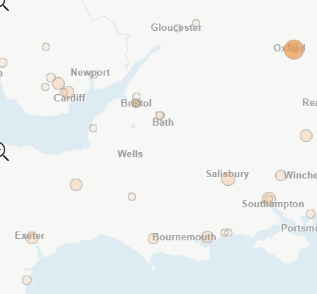
Data cut 29/04/2024
Source: ODP All Portfolio

Slide 4
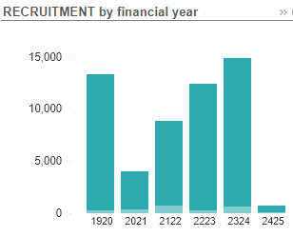
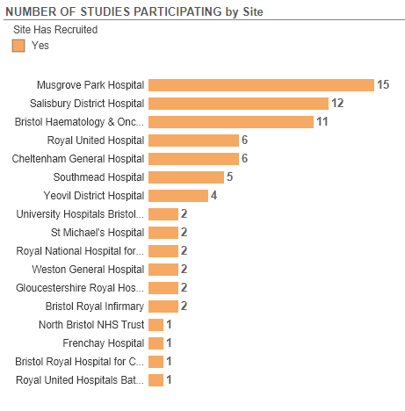
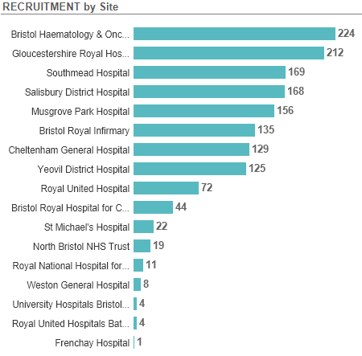
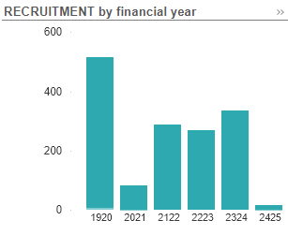
Recruitment to Colorectal Cancer Studies Apr 2019 - Mar 24
National Recruitment
SWAG Region Recruitment
Data cut 29/04/2024
Source: ODP All Portfolio

Slide 5
SWAG region Colorectal Cancer Studies Opened (since Jan 23)
CPMS ID | Short Name | Sites | Opened | Closure | Sample Size England | England Recruits
58458 | ARTEMIS | Musgrove | 21/03/2024 | 01/12/2025 | 118 | 3
55713 | PICCOS | BHOC, RUH, Musgrove, Salisbury | 18/01/2024 | 30/04/2026 | 0 | 0
56318 | CANFit: home-based exercise programme for patients with cancer | Musgrove, Yeovil, Salisbury | 04/12/2023 | 18/10/2024 | 660 | 0
55178 | AZUR-2 | Cheltenham, Yeovil, Musgrove, Salis | 15/11/2023 | 31/12/2025 | 27 | 6
54864 | Lighthouse - v2, 31Mar2023 | Yeovil, Salisbury, | 09/10/2023 | 21/01/2025 | 5000 | 78
52581 | STELLAR-303 | BHOC | 30/08/2023 | 15/08/2024 | 21 | 13
54475 | COLOWISE Trial | Yeovil, Salisbury | 03/07/2023 | 30/06/2024 | 150 | 96
51892 | Correct – MRD I | Salisbury | 30/06/2023 | 29/07/2024 | 51 | 52
52280 | BNT122-01 BioNTech SE Colorectal Cancer 4781/0016 | BHOC, Musgrove, Yeovil | 31/03/2023 | 01/08/2024 | 560 | 148
54218 | Could supported weight loss reduce bowel cancer surgery complications? | Yeovil | 29/03/2023 | 30/06/2024 | 72 | 54
52011 | MOUNTAINEER-03 | BHOC | 26/01/2023 | 29/04/2024 | 15 | 0
Full list of open studies to be circulated
Data cut 29/04/2024
Source: ODP All Portfolio

Slide 6
West of England In Setup Colorectal Cancer Studies
CPMS ID | Short Name | Sites | Planned Opening | Planned Closure | Sample Size UK
57970 | CFT4601 | BHOC | 31/08/2024 | 01/03/2025 | 12
57835 | NHS Cancer Vaccine Launchpad (NHS CVLP) | BHOC, RUH, Musgrove, Yeovil, Chelt, NBT | 29/08/2023 | 01/05/2025 | 10000
57783 | DETECT-2 | BHOC | 15/04/2024 | 30/11/2026 | 832
57349 | Integrated Short-term Palliative Rehabilitation in Incurable Cancer | BHOC | 30/01/2024 | 02/10/2025 | 68
55132 | ACM-001-2022-2-CT-CRC | BHOC, Salisbury | 30/06/2024 | 30/04/2026 | 40
54422 | Phase 3 colorectal cancer | BHOC | 08/09/2024 | 14/08/2025 | 12
44460 | Ondansetron for Low Anterior Resection Syndrome (OARS) | Salisbury | 01/06/2024 | 28/02/2025 | 134
41403 | PRESERVE | Salisbury, Southmead | 28/02/2024 | 30/04/2026 | 146
Data cut 29/04/2024
Source: ODP All Portfolio

Slide 7
Cancer Vaccine Pathway Studies: Colorectal
NHS Cancer Vaccine Launchpad (NHS CVLP):
Establishing a UK Platform to collect Tumour Samples and Perform DNA/RNA Sequencing for the Development of Personalised Cancer Vaccines.
BNT122-01 BioNTech SE Colorectal Cancer 4781/0016
A multi-site, open-label, Phase II, randomized, controlled trial to compare the efficacy of RO7198457 versus watchful waiting in resected, Stage II (high risk) and Stage III colorectal cancer patients who are ctDNA positive following resection
Study Opened Mar 23, recruitment 199/560 (Eng) Sites open in region: BHOC no recruitment recorded
BNT314-01
A first-in-human, open-label, dose escalation trial with expansion cohorts to evaluate the safety and preliminary efficacy of BNT314 in monotherapy and in combination with an immune checkpoint inhibitor in patients with advanced malignant solid tumors
Study opened Mar 24, no recruitment recorded
Sites: Royal Marsden, Christie, Freeman

Slide 8
Cancer PES survey results 2022 - Q58 research
SWAG regional results
SWAG region results PDF

Slide 9
https://bepartofresearch.nihr.ac.uk/

Slide 10
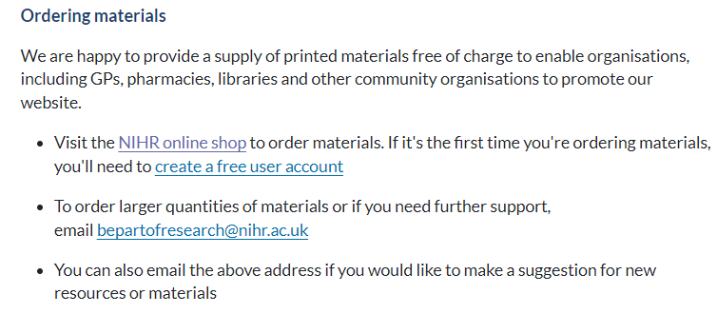
Resources and materials
https://bepartofresearch.nihr.ac.uk/promote-research/Resources/

Slide 11
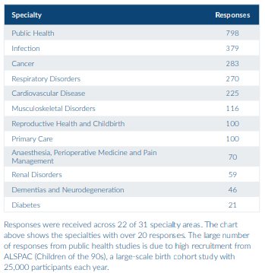
Link to full PRES report

Slide 12
What was positive about your research experience?
1,837 (70%) respondents left a comment explaining what made their
research experience positive. From these comments we identified the
following themes
• 864 comments mentioned the research delivery staff
• 537 comments related to contributing to improving healthcare
• 457 comments related to good communication
• 272 comments said the research study was easy to take part in
• 241 comments related to having a good experience
• 203 comments mentioned experiencing personal benefits
• 48 comments said "everything" was positive
• 41 comments related to where the research took place
• 35 comments mentioned gaining a feeling of hope
• 27 comments related to financial reimbursement
• 19 comments related to travel
Notes:
The same themes were identified in the 2021/22 PRES report, suggesting the positive aspects of taking part in research have remained the same. Comments related to good communication have increased from 21% to 25%, suggesting that studies may have improved how they communicate with participants.

Slide 13
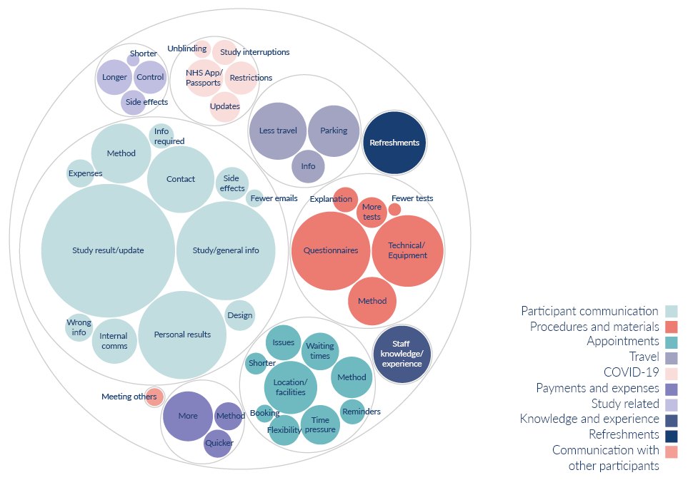
What would have made your research experience better?
603 respondents (23%) left a comment about what could have made their research experience better. From these comments we identified the following themes:
310 comments related to participant communication
98 comments related to procedures and materials
67 comments were about appointments
45 comments related to travel
28 comments were linked to COVID-19
26 comments were about payments and expenses
25 comments were about refreshments
20 comments were study related
20 comments were about knowledge and experience
2 comments mentioned they’d like to communicate with other participants
Notes:
Although fewer participants (23%) left comments about what would have made their experience better (compared to 32% in 2021/22), the themes identified are broadly the same as last year.
Whilst comments about participant communication remain the most common, these have decreased since last year (from 64% to 51%). This also aligns with an increase in positive comments around communication, indicating that studies have improved how they communicate with participants. There has also been a large decrease in the number of comments around appointments (from 27% to 11%), this is likely due to study teams being able to offer more flexibility around appointment times and methods.
Participant communication: Information about the study results/updates, general information about the study or condition, personal results, more contact from the study team, method of communication, information about side effects, internal communication, receiving incorrect information, information about what was required, information about expenses, design of communication, fewer emails.
Procedures and materials: Issues with questionnaires, technical issues with apps/equipment, method of procedures, more explanation about tests or how to use equipment, more or fewer tests
Appointments: Location, method, delays and waiting times, more time during appointments, flexibility over appointment times, issues with appointments, reminders, shorter appointments, booking of appointments
Travel: Less travel less for appointments, free or better parking, better travel information
COVID-19: Issues with travel/vaccine passports, restrictions, more information/updates, study interruptions, unblinding process
Payments and expenses: Wanting payment or to receive more money, time it took to receive payments, method of recognition
Study related: Wanting longer or shorter study, being in the control arm, side effects
Knowledge and experience: When people were approached about taking part in research, feeling like staff didn’t have the knowledge to answer questions or use required equipment. Comments under this theme also relate to awareness of Equity, Diversity, and Inclusion

Slide 14
Next steps
PRES working group formed to identify and implement improvement projects based on the feedback received from participants. The group currently has representation from the CRN WE Direct Delivery Team, Partner Organisations and Research Champions.
Creating a general document/ leaflet about research for the public, talking about the importance of the control arm, how & when you might hear about the results of a study etc.
Some sites are also putting together information about their site (parking, access, facilities, public transport etc)
Information for research staff including tips and guidance

Slide 15
Associate PI Scheme
https://www.nihr.ac.uk/health-and-care-professionals/career-development/associate-principal-investigator-scheme.htm
A six month in-work training opportunity, providing practical experience for healthcare professionals starting their research career. People who would not normally have the opportunity to take part in clinical research in their day to day role have the chance to experience what it means to work on and deliver a NIHR portfolio trial under the mentorship of an enthusiastic Local PI.
CIs working with a CTU can register their study on the scheme
https://www.nihr.ac.uk/health-and-care-professionals/career-development/register-your-study-for-the-associate-principal-investigator-scheme.htm

Slide 16
Principal Investigator Pipeline Programme (PIPP)
https://www.nihr.ac.uk/documents/principal-investigator-pipeline-programme-pipp/33803
A new scheme support research delivery nurses and midwives by supporting them to become Principal Investigators (PIs)
Free of charge for eligible participants
Delivered through a variety of live virtual and on-line classroom environments, combined with real world hands-on experience.
COHORT 2 key dates: Applications opened 1st March 2024
31st May 2024: Close to applications
End June 2024: Applicants notified of outcome of application
September 2024: COHORT 2 begins

Slide 17
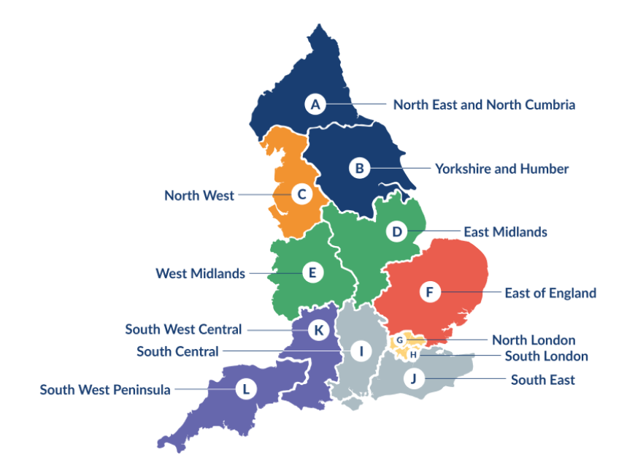
Clinical Research Network Transition to Research Delivery Network
Launching Oct 2024
The NIHR RDN has 2 primary purposes:
To support the successful delivery of high quality research, as an active partner in the research system
To increase capacity and capability of the research infrastructure for the future
SW Central
Network Director: Kyla Thomas
Operations Director: Stephen McGlynn
Strategic Development Director: Ifan Jones
We are recruiting for two new senior leadership vacancies.
RRDN Health and Care Research Director (Medical) - 0.4wte, appropriate clinical salary (e.g. Consultant) or AfC Band 8d, closes 15th May
RRDN Health and Care Research Director (Nurse, Midwife or Allied Health Professional) - 0.4wte, AfC Band 8d, closes 23rd May
You can find both of these roles on NHS Jobs

Slide 18
NIHR ODP
Open data platform. Data on performance across whole CRN,
including all specialty areas
NIHR Be Part of Research
See which studies are open across the country
National Cancer Research Institute Portfolio Maps
View current national portfolio of open, closed and ‘in set up’ cancer studies
Find a Clinical Research Study (ODP)
Search for a study to fit criteria. Good for horizon scanning, eligibility criteria

Slide 19
Research Delivery Manager
claire.matthews@nihr.ac.uk
Research Portfolio Facilitator
rebecca.pienaar@nihr.ac.uk
Sub-specialty Lead
Thomas.Strawson-Smith@uhbw.nhs.uk

