Slide 1
Early Diagnosis: Faecal Immunochemical Testing (FIT)
Deliverables | 80% of LGI urgent suspected cancer referrals to be informed by a FIT result Fewer than 20% of colonoscopies on the LGI urgent suspected cancer pathway to be performed without a FIT result available Minimise the number of colonoscopies performed on the urgent suspected cancer route in patients with a FIT result <10u/gm, normal full blood count and normal examination Support expressions of interest process to select pilot sites to participate in the bowel cancer screening programme FIT@80 pilot programme. |  | Category | 4: Programmes targeting nationwide improvement in established service
Rationale: | FIT use within the Lower GI pathway has increased significantly throughout 2022/23 and 2023/24. However, there is still wide geographical variation in the number of referrals with a FIT and the utilisation of endoscopy based on risk. This year will be about making sure we continue to see FIT fully implemented in line with clinical guidance across all Cancer Alliances to ensure we are fully realising the benefits of FIT, including capitalising on that progress with the first pilot reductions of the FIT screening threshold.
Cancer Alliance role: | Provide programme management support and funding, where required, to fully embed FIT in line with DG56 NICE guidance in primary care, including ensuring that FIT tests are available to meet demand and that FIT results are promptly reported by pathology teams to inform referral. Resource should be focused where PCN performance is lowest as indicated by CAN02 data reports.​ Ensure pathways are in place in secondary care so that only those at highest risk of colorectal cancer are referred for endoscopy and FIT negative (<10) patients with no ongoing clinical concerns are removed from the LGI urgent suspected cancer pathway, making sure clinical triage pathways are updated. Resource should be focussed where hospital performance is lowest as indicated by quarterly report data. ​ Ensure compliance with data collection by promoting appropriate coding practices for the PCN incentive and coordinating collection and submission of quarterly report data.​ Capture and report local intelligence to explain trends in data demonstrating the impact of FIT.​ Support discussions between pathology networks and commissioners to agree FIT commissioning level required to meet demand and forecasted activity in the system. Provide programme management support, and budget where required, to support all endoscopy providers to move to the most up to date National Endoscopy Database Schema, NEDi2.1, which includes a FIT data item. Only once all sites have moved to this schema will the Cancer Alliance FIT data collection be stood down NHS England has agreed that in 2024/25 the NHS Bowel Cancer Screening FIT threshold will be reduced to 80ug/gm in select pilot sites alongside a comprehensive evaluation to understand the systems, workforce and delivery models that need to be in place to enable this change to be delivered sustainably which can be applied to further sites. Cancer Alliances will be asked to support the expressions of interest process for pilot sites to participate in the FIT@80 pilot programme.
Direction of travel: | It is expected that further research, including the Colofit study, will be published in 24/25, supporting risk stratification of patients on the Lower GI urgent suspected cancer pathway using FIT result, age, sex and blood count. Support to implement any change to referral practices will be required to ensure the benefits of FIT are fully realised.
Health Inequalities: | Alliances should analyse PCN IIF data to assess where concerning trends in FIT uptake may be linked to drivers of healthcare inequalities, such as deprivation and ethnicity. Where there are, Alliances should work with PCNs to ensure resources and processes are put in place to address variation in uptake. Focus should be on developing patient education and safety netting approaches to follow up with those who have not returned a kit. Alliances should also look at where methods have been successfully used to increase uptake of FIT in the screening programme and make sure these are applied to the symptomatic pathway where it makes sense to do so.
Success measures: | CAN-02: Percentage of lower gastrointestinal two week wait (fast track) cancer referrals accompanied by a faecal immunochemical test result against agreed trajectory Percentage of LGI FDS referrals that at clinical triage fall into the following FIT bandings: <10 ug/gm; 10 – 100 ug/gm; >100ug/gm; No FIT available; FIT not appropriate, FIT available but no numerical value Percentage of colonoscopies performed on the LGI FDS pathway relative to FIT bandings: <10 ug/gm (against agreed trajectory); 10 – 100 ug/gm; >100ug/gm; No FIT available; FIT not appropriate, FIT available but no numerical value
Use of funds: Place-based | For clinical time or dedicated staffing to support implementation of NICE guidance DG56 in primary care and/or ensure FIT results are used to inform clinical triage for LGI patients in secondary care. Communication and education activity to increase FIT uptake Provide funding to providers to support the move to the most up to date National Endoscopy Database schema, NEDi2.1, which includes a FIT data item.
Relevant guidance |  | Ongoing monitoring and support
NICE DG56 guidance NICE NG12 guidance BSG/ACPGBI guidance FIT primary and secondary care guidance letters |  | Monthly FIT Delivery Group for discussing challenges, solutions and for updates (mandatory for FIT leads) Ad-hoc 1:1 meetings with Cancer Alliance FIT Leads, providers and/ or ICBs, as and when required

Slide 2
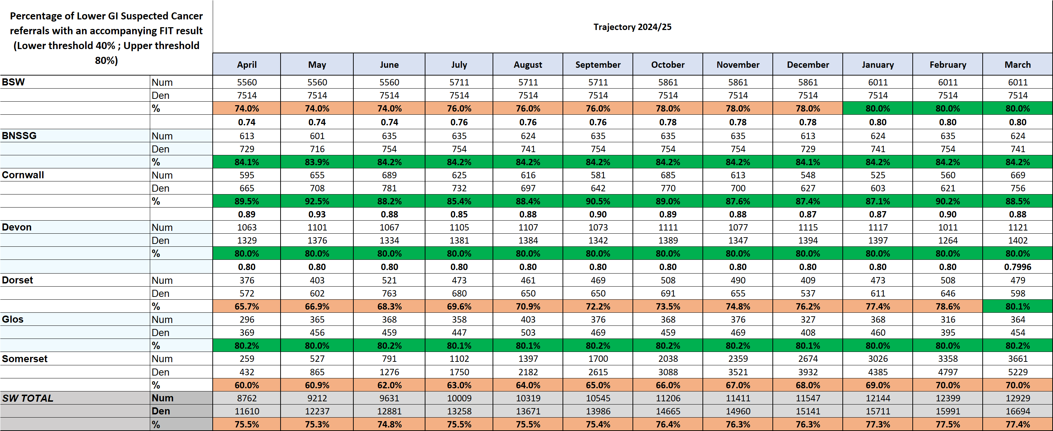
FIT test - breakdown by ICS
All systems apart from Somerset reach the 80% aspiration by the end of the year.

Slide 3
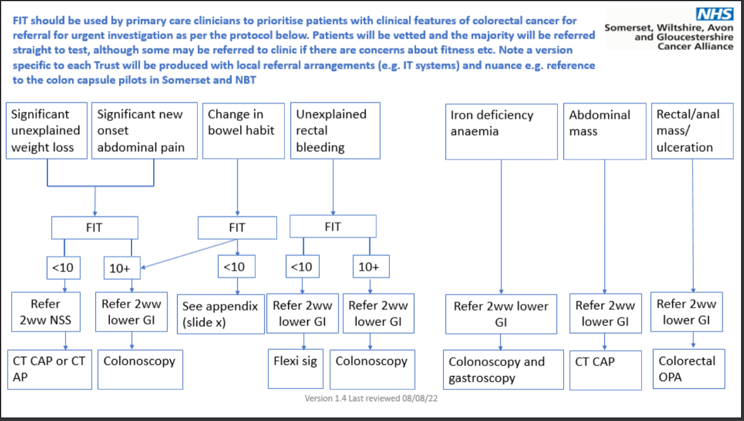
Delivering Quality referrals – Including FIT: SWAG LGI referral pathway v.1.4 published August 2022
Notes:
So the rationale that the group have previously recommended is that patients with IDA and symptoms of concern should be referred straight to the 2WW pathway and not wait for a FIT test, because the FIT result can be misleading in this patient cohort and clinical assessment / colonoscopy would be the ideal first assessment to rule out the right sided CRC associated with IDA.

Slide 4
BSG Guidance:
Bypass Symptoms – IDA
‘Clinical experts commented that referral pathways including other bypass symptoms (such as iron-deficiency anaemia) may be overly cautious and would have been introduced when FIT was relatively new and less widely accepted.
The committee noted that evidence on how iron-deficiency anaemia affects the performance of FIT is unclear (see section 3.7).
It concluded that FIT was still appropriate for people with rectal bleeding or iron-deficiency anaemia.’
BSG currently undertaking a Delphi Review on FIT and IDA

Slide 5
Delivering Quality referrals – Including FIT: NICE guidance published October 2023
1.3 Lower gastrointestinal tract cancers
Colorectal cancer
Recommendations 1.3.1 to 1.3.4 are adapted from NICE's diagnostics guidance on quantitative faecal immunochemical testing to guide colorectal cancer pathway referral in primary care.
1.3.1
Offer quantitative faecal immunochemical testing (FIT) using HM‑JACKarc or OC‑Sensor to guide referral for suspected colorectal cancer in adults:
with an abdominal mass or
with a change in bowel habit or
with iron-deficiency anaemia or
aged 40 and over with unexplained weight loss and abdominal pain or
aged under 50 with rectal bleeding and either of the following unexplained symptoms:
abdominal pain
weight loss or
aged 50 and over with any of the following unexplained symptoms:
rectal bleeding
abdominal pain
weight loss or
aged 60 and over with anaemia even in the absence of iron deficiency. FIT should be offered even if the person has previously had a negative FIT result through the NHS bowel cancer screening programme. People with a rectal mass, an unexplained anal mass or unexplained anal ulceration do not need to be offered FIT before referral is considered. [2023]
1.3.2
Refer adults using a suspected cancer pathway referral for colorectal cancer if they have a FIT result of at least 10 micrograms of haemoglobin per gram of faeces. [2023]
1.3.3
For people who have not returned a faecal sample or who have a FIT result below 10 micrograms of haemoglobin per gram of faeces:
safety netting processes should be in place
referral to an appropriate secondary care pathway should not be delayed if there is strong clinical concern of cancer because of ongoing unexplained symptoms (for example, abdominal mass). [2023]
Notes:
1.3.4
Clinicians should consider if people need additional help, information or support to return their sample. [2023] – FIT HI work
1.3.5
Consider a suspected cancer pathway referral for colorectal cancer in adults with a rectal mass. [2015, amended 2023]
Anal cancer
1.3.6
Consider a suspected cancer pathway referral for anal cancer in people with an unexplained anal mass or unexplained anal ulceration. [2015]

Slide 6
Notes:
IDA pathway developed by Prof James Turvill in York

Slide 7
Delivering sustainable improvement in SWAG Cancer Wait times performance
In 2018, the Prime Minister asked Professor Sir Steve Powis, NHS England’s Medical Director, to lead the first review of cancer waiting times Standards in almost 10 years. This review aimed to make sure that they were appropriately aligned with modern clinical practice, and took into account the recommendation of the 2015 Independent Cancer Taskforce (chaired by Sir Harpal Kumar, then Chief Executive of Cancer Research UK) to remove the two-week wait standard in favour of the Faster Diagnosis Standard.
This review concluded in early 2020, but implementation has been delayed due to the need to focus on restoration of services following the initial phase of the pandemic, and specifically the need to lower the 62-day backlog.
The two-week wait standard in particular has not significantly changed in over 20 years since its introduction; it is increasingly at odds with what is best for patients with the advent of straight to test pathways, the modern reality and convenience of remote consultations, and the impending technological revolution offered by artificial intelligence.
The cancer waiting times dataset will not change because of these changes, including the recording of the point at which a patient is first seen, and providers should continue to submit all data items as they have done previously.
Providers will therefore be able to track time to ‘first seen’ (the current two-week wait) in both local and national datasets for the purposes of managing different phases of the pathway. We will continue to publish the current data breakdowns for the standards.

Slide 8
Delivering sustainable improvement in SWAG Cancer Wait times performance

Slide 10
Delivering sustainable improvement in SWAG Cancer Wait times performance
Aim
We need to ensure that we…
Which requires….
Delivered by…
Improving the diagnostic pathway in Urology at NBT, Gloucestershire, Somerset and Salisbury
Enhanced cancer PTL governance (such as validation, robust escalation thresholds and processes)
Sustainably deliver Faster diagnosis standard (77%)
and
62-day combined standard (70%) equitably across the Alliance
Deliver sustainable improvement
Improving the diagnostic pathway in Skin at NBT, UHBW, Gloucestershire, Somerset and Salisbury
Improved specialty productivity (such as Intelligent Automation of administrative processes, LATP clinic flow, MDT streamlining, STT pathways, teledermatology, navigation)
Improving the diagnostic pathway in Gynaecology at NBT, UHBW, and Somerset
Additional capacity matched to demand and with flex to accommodate variation (such as low risk pathways, CDC, workforce planning and estates)
Improving the diagnostic pathway in Skin at NBT, UHBW, Gloucestershire, Somerset and Salisbury
Reduce variation in performance across our providers
Improving the diagnostic and treatment pathway in LGI at RUH Bath
Ensuring faster diagnosis initiatives and deliverables do not widen health inequalities
Improving treatment pathways in LGI at all providers
Improving treatment pathways in Urology at NBT and Gloucestershire
Improving insights into improvement opportunity and delivery (demand and capacity modelling and pathway analysis)
Improving treatment pathways in Gynaecology at NBT, UHBW, Somerset and Gloucestershire
Ensure services are pro-active and reactive
Improving treatment pathways in Lung at UHBW
Partnerships (e.g., primary and secondary care interface for improved referral quality, turnaround time agreements with diagnostics)
Improving treatment pathways in Skin at Salisbury

Slide 11
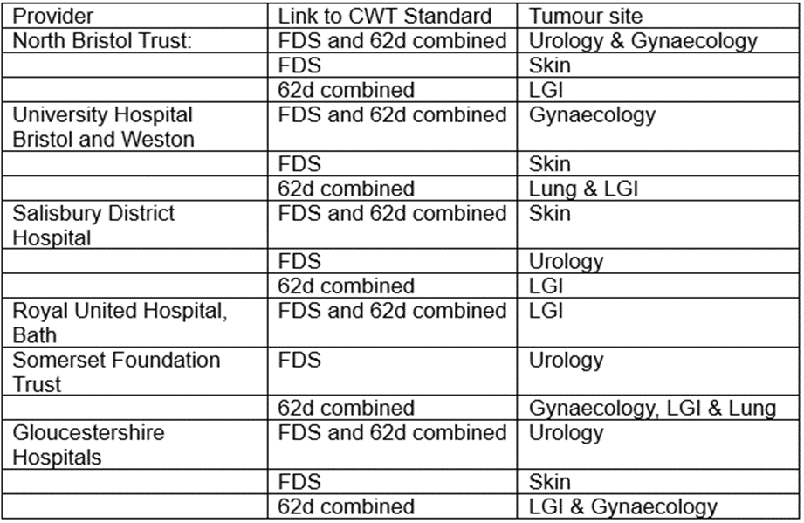
Delivering sustainable improvement in SWAG Cancer Wait times performance

Slide 12
Faster Diagnosis and Operational Performance: Operational Performance
Deliverables: | Improve operational performance: Achieve Faster Diagnosis Standard performance of 77%* and 62 day referral to treatment standard of 70%* by March 2025 (*performance ambitions may be subject to change whilst government negotiations are ongoing). Ensure cancer operational performance is assessed and monitored consistently and is prioritised by ICBs and Alliances during 2024/25. Reduce variation in Cancer Wait Times (CWT) performance and ensure performance outliers are reviewed, themes understood and escalated through Alliance governance and ICB/regional routes as required Run specific projects addressing; i) mitigating known seasonal challenges; ii) rolling out the MDT streamlining guidance; iii) safety netting for abnormal radiology and pathology; and iv) treatment waiting times for radiotherapy.
Rationale: | Ensuring patients receive diagnosis and treatment in a timely way. The CWT standards are an operational requirement for NHS providers and ICBs. The performance expectations for 2024/25 will be set out in NHS Operational Planning Guidance.
Cancer Alliance role: | Working with their respective system(s), Alliances should support the most challenged providers in Tiers 1 and 2 by helping develop and monitor improvement plans, and to direct the proportion of SDF indicatively assigned to operational performance to the most challenged areas for FDS or 62d performance - provide detailed quarterly monitoring of funding/impact and have an agreed protocol with Trusts to monitor. Work with systems, providers and relevant networks (e.g. imaging and pathology networks) to develop and implement plans to improve CWT performance and reduce variation. This year we are asking Alliances to particularly focus on the following activities; 1) working with providers on plans to manage capacity, factoring in usual seasonal changes e.g. Skin services, bank holidays, and agree actions in Q1; 2) rolling out the MDT streamlining guidance, supported by an audit of current implementation in Q1; 3) ensuring trusts have safety netting in place for abnormal radiology and pathology (i.e. ensuring that where an abnormal result is found, that there is a mechanism such as a flag to follow these up), supported by an audit in Q1, with implementation by the end of the year; and 4) working with Radiotherapy Operational Delivery Networks on agreeing 24/25 network priorities, with particular focus on reducing treatment waiting times (Q1). Lead on agreeing local protocols for management of Cancer Waiting Times standards, by; 1) ensuring access policies are in line with national Cancer Waiting Times guidance, and that there is an agreed local IPT reallocation policy across the Alliance - complete Access Policy review by Q2 and review annually in line with CWT guidance updates. 2) where there are concerns regarding referral appropriateness or completeness, facilitate conversations between primary and secondary care and lead on developing guidance or education for referrers where needed. Provide expertise to directly support systems/trusts in understanding the issues affecting performance and be able to offer hands-on management support. This support should be prioritised for those trusts with the most significant challenges, including those in the Tiering process, and the delivery approach should include meeting regularly with providers on a 1:1 basis. Operational performance should form a key part of the Cancer Alliance governance structure, ensuring that improvement against the standards is regularly monitored and discussed at relevant meetings, including the Alliance board and tumour specific working groups. This should include facilitating clinical discussions to improve performance, taking into consideration volumes alongside groups of patients where long waits will likely impact outcomes. Continue to have a nominated performance lead as part of their team to act as the lead and key contact point within the Alliance to discuss operational performance, as well as to represent the Alliance at the national performance leads forum.
Direction of travel: | The primary route for performance assurance is through the Regional Performance and Improvement Teams, with Cancer Alliances providing expertise, advice and practical support to improve performance.
Health Inequalities: | Health inequalities should be considered as part of Alliance’s overall approach to performance standards, including developing policies and processes which align with guidance.
Success measures: | 62 day combined referral to first treatment standard (against system plans) 28 day Faster Diagnosis Standard Performance (against system plans) Narrative updates should be provided quarterly, in line with use of funds, with details of progress being made on interventions to improve performance
Use of funds: Place-based | Trust or Alliance based transformation staff (e.g., Service Improvement Facilitator, Turnaround Directors), to improve CWT performance where not covered by other routes Temporary increases in capacity, both clinical and admin, where not funded via alternative routes (e.g., Waiting List Initiatives, Independent Sector) Improvements to infrastructure to improve tracking of cancer pathways (e.g., developments to Cancer Management or Diagnostic Systems) Training programmes/events to support delivery of improvements to performance
Relevant guidance |  | Ongoing monitoring and support
National Cancer Waiting Times Monitoring Dataset Guidance v12 Elective Improvement Support team (IST) training resources |  | Monthly Alliance Performance Leads meeting Monthly Regional Cancer Performance Meetings Tier 1 oversight meetings (set by Regions)

Slide 13
Treatment and Care: Treatment Variation
Deliverables: | Implement national priority recommendations from clinical audit/GIRFT reports to reduce variation in treatment: Lung: three lung GIRFT recommendations (previously selected by Alliances) Breast: Reduce reoperation rates after breast conservation surgery, whilst supporting safe breast conservation Prostate: >75% of men receiving radical treatment for high-risk/locally advanced prostate cancer Bowel: >50% patients receiving adjuvant chemotherapy after major resection for stage III colon cancer Oesophago-gastric (OG): Reduce the number of patients with OG cancer waiting more than 62 days from referral to curative treatment, by identifying and implementing quality improvement interventions to improve speed and efficiency of treatment planning and delivery |  | Category: | 4: Programmes targeting nationwide improvement in established services (clinical audit/GIRFT asks) 1: Locally driven programmes led by Cancer Alliances (SACT)
 | 2. Complete a bi-annual evaluation of demand and capacity of SACT services - Bi-annually evaluate the demand and capacity of SACT services across the Alliance footprint and identify what factors may lead to delivery issues
Rationale: | 1. Reducing unwarranted variation in cancer treatment is critical to meeting our LTP ambition that by 2028, an extra 55,000 people each year will survive for five years or more following their cancer diagnosis. The purpose of this work is to implement priority recommendations from publications that NHSE commission to reduce variation in treatment and improve outcomes. 2. SACT delivery remains a challenge across the country. A nominated clinical lead for SACT, identified from within the Cancer Alliance, to lead a bi-annual evaluation of demand and capacity across the footprint will enable Alliances to identify any challenges to delivery.
Cancer Alliance role: | 1. Support local expert reference groups/ local pathway boards/ clinical advisory group/ clinical reference groups to develop action plans to support the implementation of the seven national recommendations to reduce variation in treatment. Ensure there is sufficient project management and analytical support at an Alliance and/or trust level to analyse, understand and, where required, report data against the seven recommendations 2. Ensure there is a nominated lead in Cancer Alliance responsible for overseeing and supporting demand and capacity of SACT across their footprint. Complete a bi-annual evaluation of demand and capacity of SACT services, escalating any issues to the ICB. Attend a bi-annual nationally led Alliance SACT Capacity meeting. 3. Alongside the core deliverables, many Cancer Alliances fund and support additional work focused on innovation or variation in treatment practice. In response to requests from Cancer Alliances, the national team will hold a showcase event in 24/25 aiming to highlight these initiatives, share good and innovative practice and potentially support identification of initiatives for future national rollout. Cancer Alliances are asked to contribute to coordinate contributions to this event.
Direction of travel: | The National team will consider BAU achieved when a recommendation’s relevant target has been met for two consecutive reporting quarters. At this point, it will be assumed that activity will continue at a local level, and it is no longer mandatory for Alliances to report nationally in this area. If Alliances wish to continue to report on local work via the quarterly assurance process, they are welcome to.
Health Inequalities: | Deliverables specifically target inequities in access to the best treatment, as identified by the clinical audits. In implementing the recommendations, Alliances should work with providers to ensure that the recommendations are implemented equitably across different groups or areas across the Alliance footprint.
Success measures: | x3 lung metrics (different for each Cancer Alliance) - available here - against agreed trajectory Number of men with high/risk locally advanced prostate cancer not undergoing radical treatment within 12 months of diagnosis against agreed trajectory (TBC, plans for data to be provided nationally by NDRS) Number of re-operations in women after breast conserving surgery (available via Model Hospital) against agreed trajectory Number of stage III colon cancer patients not receiving adjuvant chemotherapy following major resection (TBC, plans for data to be provided nationally by NDRS) Median days OG patients wait from referral to curative treatment (data to be provided by the National Team via CWT data)
Use of funds: | Place-based funding to be used for project management and analytical resource, small pilots/initiatives, and bringing in specific clinical leadership where required
Relevant guidance |  | Ongoing monitoring and support
Treatment Variation workspace on Futures, with past meeting documents Lung GIRFT cancer report and National Lung Cancer Audit National Audits; Bowel, Prostate, Breast. Breast Surgery GIRFT report |  | Existing Treatment Variation Quarterly Working Group for discussing challenges, solutions and updates (for Treatment Variation leads) 1:1 meetings as required to work through specific issues/challenges National workshops led by National Clinical Leads to discuss the context to recommendations and potential solutions Alliance share & learn event to share treatment best practice initiatives/pilots Bi-annual, nationally led, Alliance SACT capacity meeting.
Notes:
National aim >50%
NBOCA 2021/22 data national average 62%.
SWAG breakdown:
NBT 57%
UHBW 60%
GHFT 65%
RUH 66%
Salisbury 65%
SFT 69%.
Plans for RCRD to triangulate stage and combined resection / chemotherapy numerator and denominator

