Slide 1
Treatment and Care: Treatment Variation
Deliverables: | Implement national priority recommendations from clinical audit/GIRFT reports to reduce variation in treatment: Lung: three lung GIRFT recommendations (previously selected by Alliances) Breast: Reduce reoperation rates after breast conservation surgery, whilst supporting safe breast conservation Prostate: >75% of men receiving radical treatment for high-risk/locally advanced prostate cancer Bowel: >50% patients receiving adjuvant chemotherapy after major resection for stage III colon cancer Oesophago-gastric (OG): Reduce the number of patients with OG cancer waiting more than 62 days from referral to curative treatment, by identifying and implementing quality improvement interventions to improve speed and efficiency of treatment planning and delivery |  | Category: | 4: Programmes targeting nationwide improvement in established services (clinical audit/GIRFT asks) 1: Locally driven programmes led by Cancer Alliances (SACT)
 | 2. Complete a bi-annual evaluation of demand and capacity of SACT services - Bi-annually evaluate the demand and capacity of SACT services across the Alliance footprint and identify what factors may lead to delivery issues
Rationale: | 1. Reducing unwarranted variation in cancer treatment is critical to meeting our LTP ambition that by 2028, an extra 55,000 people each year will survive for five years or more following their cancer diagnosis. The purpose of this work is to implement priority recommendations from publications that NHSE commission to reduce variation in treatment and improve outcomes. 2. SACT delivery remains a challenge across the country. A nominated clinical lead for SACT, identified from within the Cancer Alliance, to lead a bi-annual evaluation of demand and capacity across the footprint will enable Alliances to identify any challenges to delivery.
Cancer Alliance role: | 1. Support local expert reference groups/ local pathway boards/ clinical advisory group/ clinical reference groups to develop action plans to support the implementation of the seven national recommendations to reduce variation in treatment. Ensure there is sufficient project management and analytical support at an Alliance and/or trust level to analyse, understand and, where required, report data against the seven recommendations 2. Ensure there is a nominated lead in Cancer Alliance responsible for overseeing and supporting demand and capacity of SACT across their footprint. Complete a bi-annual evaluation of demand and capacity of SACT services, escalating any issues to the ICB. Attend a bi-annual nationally led Alliance SACT Capacity meeting. 3. Alongside the core deliverables, many Cancer Alliances fund and support additional work focused on innovation or variation in treatment practice. In response to requests from Cancer Alliances, the national team will hold a showcase event in 24/25 aiming to highlight these initiatives, share good and innovative practice and potentially support identification of initiatives for future national rollout. Cancer Alliances are asked to contribute to coordinate contributions to this event.
Direction of travel: | The National team will consider BAU achieved when a recommendation’s relevant target has been met for two consecutive reporting quarters. At this point, it will be assumed that activity will continue at a local level, and it is no longer mandatory for Alliances to report nationally in this area. If Alliances wish to continue to report on local work via the quarterly assurance process, they are welcome to.
Health Inequalities: | Deliverables specifically target inequities in access to the best treatment, as identified by the clinical audits. In implementing the recommendations, Alliances should work with providers to ensure that the recommendations are implemented equitably across different groups or areas across the Alliance footprint.
Success measures: | x3 lung metrics (different for each Cancer Alliance) - available here - against agreed trajectory Number of men with high/risk locally advanced prostate cancer not undergoing radical treatment within 12 months of diagnosis against agreed trajectory (TBC, plans for data to be provided nationally by NDRS) Number of re-operations in women after breast conserving surgery (available via Model Hospital) against agreed trajectory Number of stage III colon cancer patients not receiving adjuvant chemotherapy following major resection (TBC, plans for data to be provided nationally by NDRS) Median days OG patients wait from referral to curative treatment (data to be provided by the National Team via CWT data)
Use of funds: | Place-based funding to be used for project management and analytical resource, small pilots/initiatives, and bringing in specific clinical leadership where required
Relevant guidance |  | Ongoing monitoring and support
Treatment Variation workspace on Futures, with past meeting documents Lung GIRFT cancer report and National Lung Cancer Audit National Audits; Bowel, Prostate, Breast. Breast Surgery GIRFT report |  | Existing Treatment Variation Quarterly Working Group for discussing challenges, solutions and updates (for Treatment Variation leads) 1:1 meetings as required to work through specific issues/challenges National workshops led by National Clinical Leads to discuss the context to recommendations and potential solutions Alliance share & learn event to share treatment best practice initiatives/pilots Bi-annual, nationally led, Alliance SACT capacity meeting.

Slide 2
SWAG CA 3 GIRFT Metrics reporting 23/24
All trusts should have an overall radical treatment rate of 85% or more in those patients with NSCLC stages I-II and of performance status 0-2. This includes all treatment modalities (surgery, radiotherapy including SABR, multimodality treatment and therm
Trusts should record and monitor multimodality treatment in stage IIIA disease and offer radical intent treatment as standard in fit patients.
Radical intent treatment should commence by day 49 of the overall NOLCP pathway. Furthermore, for surgery, thermoablation or radiotherapy, treatment should commence by day 16 after the decision to treat in line with NOLCP.
Q4 22/23 - single provider SDHFT see narrative | 75% | Q1 23/24 (completed by 4/6 providers remaining to follow prior to final Q2 submission) | range 75-100% | Q2 23/24 6/6 providers submitted Q2 data | range 37-100% | Q3 23/24 5/6 providers submitted Q3 data | range 50-100%
Q4 22/23 - single provider SDHFT see narrative | 50% | Q1 23/24 (completed by 4/6 providers remaining to follow prior to final Q2 submission) | range 67-100% | Q2 23/24 6/6 providers submitted Q2 data | range 0-100% | Q3 23/24 5/6 providers submitted Q3 data | range 75-100%
Q4 22/23 - single provider SDHFT see narrative | 78%: | Q1 23/24 (completed by 4/6 providers remaining to follow prior to final Q2 submission) | M1 range 0-77.8% M2 range 0-25% | Q2 23/24 6/6 providers submitted Q2 data | M1 range 3-75% M2 range 13-40% | Q3 23/24 5/6 providers submitted Q3 data | M1 range 0-22% M2 range 0-32%

Slide 3
National Lung Cancer Audit (NLCA) State of the Nation Report (2024)
An audit of care received by patients diagnosed with lung cancer in England and Wales during 2022
Notes:
England figures on slide 2 relate to the latest infographic released in the 2024 State of Nation report – note the previous year (2021) figures differ to some of the 2021 figures within the 2023 NLCA data tables. This is due to updates in the rapid registration data.
Previous year figures (2021) for SWAG and providers are based on the 2023 NLCA data tables only, therefore they will not reflect more up to date rapid registration data for 2021.
Risk-adjusted (age, sex (not all indicators), comorbidity, performance status, tumour type) figures for SWAG and providers have been used where possible.
Sources: NLCA-data-tables_SotN-report-2023_20Jul23.xlsx (live.com); NLCA-State-of-the-Nation-Report-2024.pdf (lungcanceraudit.org.uk); NLCA_data-tables_SotN-report-2024_v2.0.xlsx (live.com)

Slide 4
Somerset, Wiltshire, Avon and Gloucestershire
Diagnosis and staging
Survival outcome
1,703
patients were diagnosed with lung cancer in 2022
(1,548 in 2021)
76%
of patients with stage I/II disease, performance status (PS) 0-1 had pathological confirmation of their diagnosis
(79% in 2021)
48%
of patients with a one year survival after diagnosis (adjusted)
(48% in 2021)
52%
of patients presented with stage IV disease
(51% in 2021)
Surgery for non-small cell lung cancer (NSCLC)
Chemotherapy for small cell lung cancer (SCLC)
32%
of patients were diagnosed after emergency presentation (adjusted)
(34% in 2021)
19%
of patients with NSCLC had surgical treatment for their cancer (adjusted)
(17% in 2021)
72%
of patients with SCLC received treatment with chemotherapy (adjusted)
(70% in 2021)
Treatment with curative intent
Systemic anticancer treatment
of patients with NSCLC (stage IIIB-IV, PS 0-1) received systemic anticancer treatment (adjusted)
(61% in 2021)
77%
of patients with NSCLC (stage I/II, PS 0-2) received treatment with curative intent* (adjusted)
(75% in 2021)
54%
of patients with NSCLC (stage IIIA, PS 0-2) received treatment with curative intent** (adjusted)
(54% in 2021)
59%
Key
improving from 2021
worsening from 2021
unchanged from 2021
91%
91%
60%
90%
55%
36%
(88% in 2021)
(91% in 2021)
(63% in 2021)
(90% in 2021)
(60% in 2021)
(40% in 2021)
Sources: NLCA-data-tables_SotN-report-2023_20Jul23.xlsx (live.com) and NLCA_data-tables_SotN-report-2024_v2.0.xlsx (live.com)
*surgery or radical radiotherapy, **surgery, radical radiotherapy or multimodal combination with chemotherapy
For NHS internal use only to inform service improvement discussions

Slide 5
Faster Diagnosis and Operational Performance: Operational Performance
Deliverables: | Improve operational performance: Achieve Faster Diagnosis Standard performance of 77%* and 62 day referral to treatment standard of 70%* by March 2025 (*performance ambitions may be subject to change whilst government negotiations are ongoing). Ensure cancer operational performance is assessed and monitored consistently and is prioritised by ICBs and Alliances during 2024/25. Reduce variation in Cancer Wait Times (CWT) performance and ensure performance outliers are reviewed, themes understood and escalated through Alliance governance and ICB/regional routes as required Run specific projects addressing; i) mitigating known seasonal challenges; ii) rolling out the MDT streamlining guidance; iii) safety netting for abnormal radiology and pathology; and iv) treatment waiting times for radiotherapy.
Rationale: | Ensuring patients receive diagnosis and treatment in a timely way. The CWT standards are an operational requirement for NHS providers and ICBs. The performance expectations for 2024/25 will be set out in NHS Operational Planning Guidance.
Cancer Alliance role: | Working with their respective system(s), Alliances should support the most challenged providers in Tiers 1 and 2 by helping develop and monitor improvement plans, and to direct the proportion of SDF indicatively assigned to operational performance to the most challenged areas for FDS or 62d performance - provide detailed quarterly monitoring of funding/impact and have an agreed protocol with Trusts to monitor. Work with systems, providers and relevant networks (e.g. imaging and pathology networks) to develop and implement plans to improve CWT performance and reduce variation. This year we are asking Alliances to particularly focus on the following activities; 1) working with providers on plans to manage capacity, factoring in usual seasonal changes e.g. Skin services, bank holidays, and agree actions in Q1; 2) rolling out the MDT streamlining guidance, supported by an audit of current implementation in Q1; 3) ensuring trusts have safety netting in place for abnormal radiology and pathology (i.e. ensuring that where an abnormal result is found, that there is a mechanism such as a flag to follow these up), supported by an audit in Q1, with implementation by the end of the year; and 4) working with Radiotherapy Operational Delivery Networks on agreeing 24/25 network priorities, with particular focus on reducing treatment waiting times (Q1). Lead on agreeing local protocols for management of Cancer Waiting Times standards, by; 1) ensuring access policies are in line with national Cancer Waiting Times guidance, and that there is an agreed local IPT reallocation policy across the Alliance - complete Access Policy review by Q2 and review annually in line with CWT guidance updates. 2) where there are concerns regarding referral appropriateness or completeness, facilitate conversations between primary and secondary care and lead on developing guidance or education for referrers where needed. Provide expertise to directly support systems/trusts in understanding the issues affecting performance and be able to offer hands-on management support. This support should be prioritised for those trusts with the most significant challenges, including those in the Tiering process, and the delivery approach should include meeting regularly with providers on a 1:1 basis. Operational performance should form a key part of the Cancer Alliance governance structure, ensuring that improvement against the standards is regularly monitored and discussed at relevant meetings, including the Alliance board and tumour specific working groups. This should include facilitating clinical discussions to improve performance, taking into consideration volumes alongside groups of patients where long waits will likely impact outcomes. Continue to have a nominated performance lead as part of their team to act as the lead and key contact point within the Alliance to discuss operational performance, as well as to represent the Alliance at the national performance leads forum.
Direction of travel: | The primary route for performance assurance is through the Regional Performance and Improvement Teams, with Cancer Alliances providing expertise, advice and practical support to improve performance.
Health Inequalities: | Health inequalities should be considered as part of Alliance’s overall approach to performance standards, including developing policies and processes which align with guidance.
Success measures: | 62 day combined referral to first treatment standard (against system plans) 28 day Faster Diagnosis Standard Performance (against system plans) Narrative updates should be provided quarterly, in line with use of funds, with details of progress being made on interventions to improve performance
Use of funds: Place-based | Trust or Alliance based transformation staff (e.g., Service Improvement Facilitator, Turnaround Directors), to improve CWT performance where not covered by other routes Temporary increases in capacity, both clinical and admin, where not funded via alternative routes (e.g., Waiting List Initiatives, Independent Sector) Improvements to infrastructure to improve tracking of cancer pathways (e.g., developments to Cancer Management or Diagnostic Systems) Training programmes/events to support delivery of improvements to performance
Relevant guidance |  | Ongoing monitoring and support
National Cancer Waiting Times Monitoring Dataset Guidance v12 Elective Improvement Support team (IST) training resources |  | Monthly Alliance Performance Leads meeting Monthly Regional Cancer Performance Meetings Tier 1 oversight meetings (set by Regions)
Notes:
Standards of care diagnostic bundles ? If asked the question what proportion of patients did not require MDT discussion as a result of SoC implementation

Slide 6
SWAG CA Lung 62-day performance
Notes:
Lung backlog RUH increased quite markedly recent weeks
Somerset had work to do but past few months improved 62d

Slide 7
SWAG CA Multi Cancer Blood Test Programme (MCBTP) – Clinical Comms Q&A sessions

Slide 8
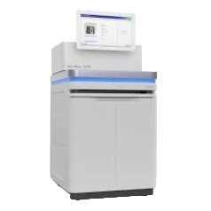
The Galleri® multi-cancer early detection test
Cancer Signal Detected
Machine learning classifier
One or two Cancer Signal Origin(s) (CSO) predicted
Blood plasma isolated
(contains cell-free DNA fragments)
Targeted methylation
analysis of cell-free DNA
(sequencing, mapping, alignment)
Machine learning classifier
Galleri has a CE and a UKCA mark
No Cancer Signal Detected
Adapted from Liu MC, et al. Ann Oncol. 2020;31(6):745-759. DOI:10.1016/j.annonc.2020.02.011.
Notes:
Galleri is a targeted methylation next-generation sequencing-based assay that analyses cell-free DNA isolated from peripheral blood.
cfDNA fragments are analysed to identify methylation patterns that are a signal of cancer.
If a cancer signal is detected, the methylation patterns are examined to predict tissue type or organ associated with the cancer signal, to direct diagnostic work up.
Research has shown that Galleri can detect more than 50 types of cancer.
The product discussed in this presentation has a CE and a UKCA mark, and will be used within its intended use.
In the United States (US), the Galleri® test is an Investigational Device and limited by Federal (or US) law to investigational use. A description of this clinical trial is available on www.ClinicalTrials.gov, as required by US Law.
Notes:
Copyright permissions for inclusion of figure(s) from the manuscript are not needed for this slide.

Slide 9
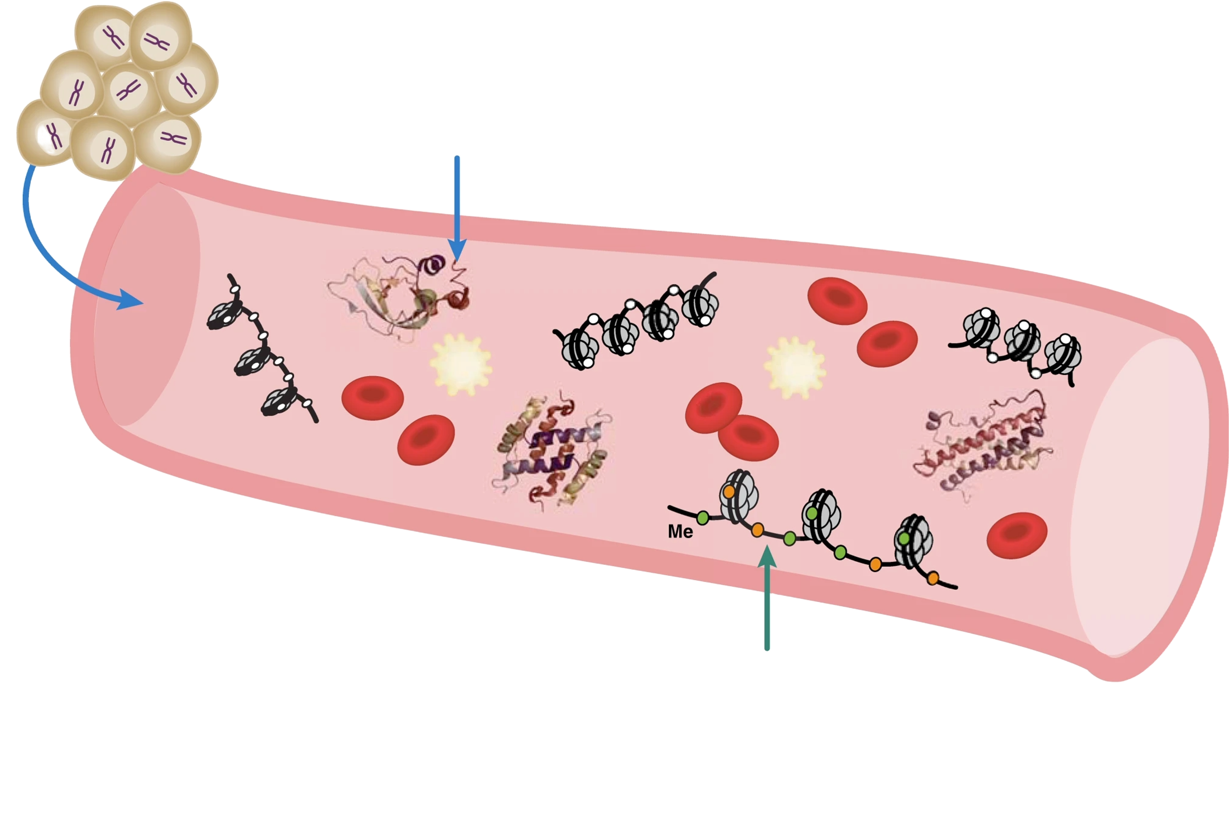
Multi-cancer early detection tests can detect many types of cancer from a sample of blood
Tumour
Tumours shed substances into the blood, such as tumour cells, proteins and tumour DNA (known as cell-free DNA).
Multi-cancer early detection (MCED) tests can detect many different cancers from a sample of blood - screening individuals for any cancer, instead of screening for individual cancers.
MCED tests complement existing screening approaches.
Protein biomarkers
cell-free DNA biomarkers
Figure not to scale. Figure modified from Liu, MC. Br J Cancer 2021;124:1475-1477. DOI: 10.1038/s41416-020-01223-7. ©2021 Michelle C. Liu under a Creative Commons Attribution 4.0 International Licence.
Notes:
Tumours shed substances into the blood – such as tumour cells, proteins and tumour DNA (known as cell-free DNA).
Multi-cancer early detection tests, or MCED tests, look for these biological substances in a blood sample and can be used to screen for several types of cancer at once.
MCED tests would complement existing screening approaches to increase the absolute number of cancers detected (i.e. yield), including those lacking recommended screening programmes.
Notes:
Copyright permissions: Modification of the Liu figure is allowed, as Liu manuscript was published under an unrestricted (CC-BY) license. Statement underneath the figure has been added for proper attribution to the figure.

Slide 10
Measuring cfDNA in the blood
CH₃
Cells shed cell-free DNA into the blood.
cfDNA from cancer cells has specific patterns of methylation that identify it as cancer.
The Galleri® multi-cancer early detection test looks at the pattern of methylation on cfDNA to see if any of it may have come from cancer cells.
CH₃
CH₃
CH₃
CH₃
Image adapted from image by brgfx on Freepik. Galleri is a registered trademark of GRAIL, LLC.
Notes:
All cells shed cell-free DNA (cfDNA) into the blood. cfDNA has a number of uses in healthcare, such as non-invasive prenatal testing to screen for foetal anomalies.
cfDNA from cancer cells has specific patterns of methylation that identify it as cancer.
Notes:
Licence free image. Attribution required: Image by brgfx on Freepix. https://www.freepik.com/free-vector/dna-helix-symbol-isolated-white-background_24093510.htm

Slide 11
Predicting Cancer Signal Origin(s)
The Galleri test has 21 possible Cancer Signal Origins (CSOs)¹
CSO reported | What is included
Anus | Anus
Bladder, Urothelial Tract | Bladder, Renal Pelvis, Ureter, Urethra
Bone and Soft Tissue | Skeletal muscle and other connective tissue, Vascular tissue, Bone and cartilage
Breast | Breast
Cervix | Cervix
Colon, Rectum | Colon, Rectum, Appendix
Head and Neck | Oropharynx, Hypopharynx, Nasopharynx, Larynx, Lip and oral cavity (including oral tongue), Nasal cavity, Paranasal sinuses, Major salivary glands
Kidney | Kidney
Liver, Bile Duct | Liver, Intrahepatic bile duct
Lung | Lung, Bronchus
CSO reported | What is included
Lymphoid Lineage | Lymphoid Lineage
Melanocytic Lineage | Melanocytic Lineage
Myeloid Lineage | Myeloid Lineage
Neuroendocrine Cells of Lung or other Organs | Neuroendocrine Cells of Lung or other Organs
Ovary | Ovary, Fallopian tube, Primary peritoneum
Pancreas, Gallbladder | Pancreas, Extrahepatic bile duct, Gallbladder
Plasma Cell Lineage | Plasma Cell Lineage
Prostate | Prostate
Stomach, Esophagus | Stomach, Esophagus
Thyroid Gland | Thyroid Gland
Uterus | Uterus
¹Klein EA, et al. Ann Oncol. 2021;32(9):1167- 1177. DOI: 10.1016/j.annonc.2021.05.806.
Notes:
The Galleri test takes advantage of the shared biology of cancer, allowing it to look for a cancer signal shared across multiple cancers. If a cancer signal is detected, then the Galleri test predicts the top 1 or 2 organs or tissues that the cancer signal is associated with, called Cancer Signal Origin (CSO), to help guide next steps in the diagnostic evaluation.
The CSO is not a diagnosis of a particular cancer type, rather a prediction of the tissue or organ associated with the cancer signal.
This table includes the cancer classes included in CSO but NOT ALL possible cancer types.
The CSO can help healthcare professionals determine what further diagnostic tests are needed to confirm if cancer is present.

Slide 12
Galleri key performance features
Based on a prospective, observational study of people with and without cancer (NCT02889978)¹​
>50
99.5%
51.5%
Cancer types
Specificity
Sensitivity
Cancer types diagnosed following a ‘Cancer Signal Detected’ result
Proportion of people without cancer who received a ‘No Cancer Signal Detected’ result
Proportion of people with cancer who received a ‘Cancer Signal Detected’ result
The Galleri test does not detect a signal for all cancers and not all cancers can be detected in the blood.
False positive and false negative results do occur.
¹Klein EA, et al. Ann Oncol. 2021;32(9):1167- 1177. DOI: 10.1016/j.annonc.2021.05.806.

Slide 13
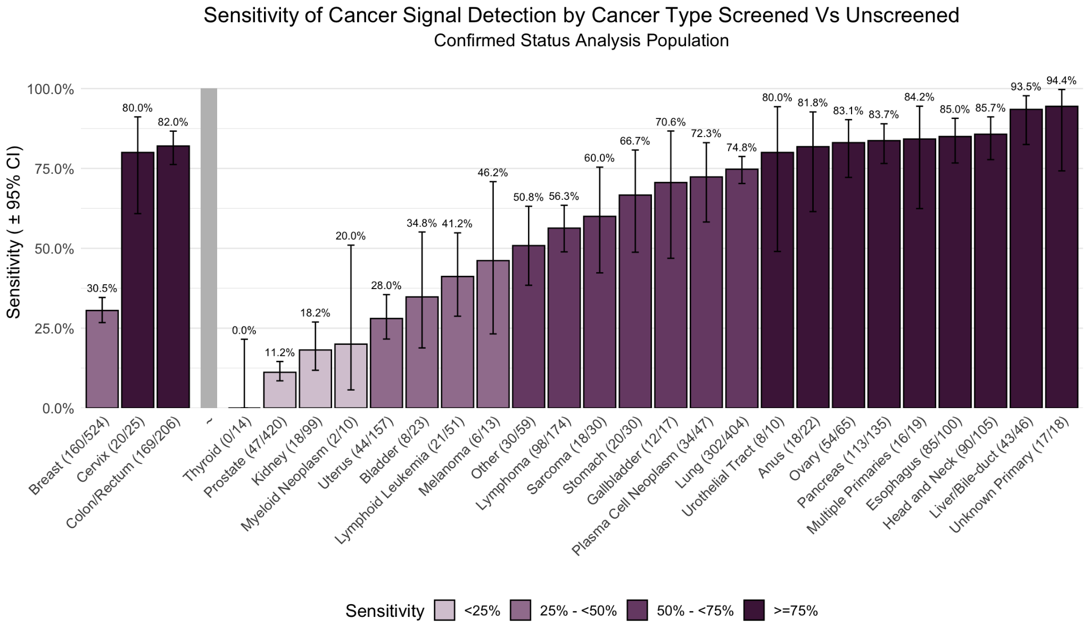
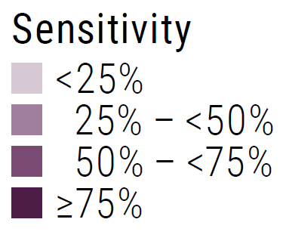
Sensitivity of Galleri cancer signal detection by cancer type¹
Cancers with common screening options: 46.2%
Cancers without common screening options: 53.0%
CCGA3¹
CI, confidence interval. ¹Klein EA, et al. Ann Oncol. 2021;32(9):1167- 1177. DOI: 10.1016/j.annonc.2021.05.806.
Notes:
Substudy 3 of the Circulating Cell-Free Genome Atlas (CCGA3) study reported the sensitivity of the Galleri test by cancer type

Slide 14
Galleri key performance features
Based on a prospective, interventional, return-of-results study in people with and without cancer symptoms (NCT04241796)¹
43.1%
88.0%
Positive predictive value
Cancer Signal Origin (CSO) prediction accuracy
Proportion of people with a ‘Cancer Signal Detected’ result diagnosed with cancer
Proportion of correct first (or second) CSO prediction(s) among participants with cancer and a ‘Cancer Signal Detected’ result
The Galleri test does not detect a signal for all cancers and not all cancers can be detected in the blood.
False positive and false negative results do occur.
CSO, Cancer Signal Origin. ¹Schrag D, et al. Lancet. 2023;402:1251-60. DOI: 10.1016/S0140-6736(23)01700-2.
Notes:
The prospective PATHFINDER study assessed the implementation of the test into practice in the US among asymptomatic people, including return of results and the care pathways of people receiving a ‘Cancer Signal Detected’ result.
This study measured a positive predictive value of 43.1%.
It also reported the accuracy of the test at predicting the tissue or organ associated with the cancer signal – the Cancer Signal Origin (CSO). The proportion of correct first (or second) CSO prediction(s) among participants with cancer and a ‘Cancer Signal Detected’ result was 88.0%.
Note:
The PATHFINDER study also assessed the specificity of the test, which was reported as 99.5%.These slides report the PPV and CSO prediction accuracy from the prospective PATHFINDER study, which confirmed the findings from the retrospective case-control CCGA3 study.

Slide 15
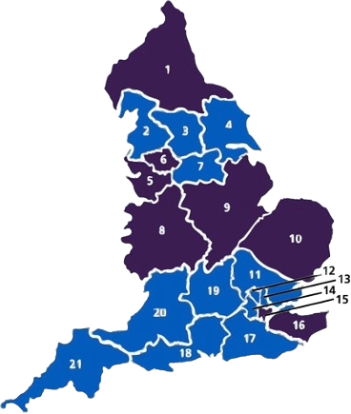
Where the pilot programme would take place
Proposed Cancer Alliances
2 - Lancashire and South Cumbria 3 - West Yorkshire and Harrogate 4 - Humber, Coast and Vale 7 - South Yorkshire and Bassetlaw 11 - East of England – South 12 - North Central London 13 - North East London 14 - RM Partners 17 - Surrey and Sussex 18 - Wessex 19 - Thames Valley 20 - Somerset, Wiltshire, Avon and Gloucestershire (SWAG) 21 - Peninsula

Slide 16
Process overview
Individual invited by NHS England
Invitee books local appointment
Blood sample collected at NHS sites
Blood sample shipped to GRAIL (US)
Galleri test performed and result report returned
Signal detected
Referral to secondary care diagnostic workup
Signal NOT detected
Letter sent
Cancer
No cancer
Participant NOT diagnosed with cancer - safety netting

Slide 17
Communicating test outcome to participants
Invitation
Booking
Biosampling
Testing
Referral
+
‘Cancer Signal Detected’ test result
Participant phoned
Letter sent to participant
Participant’s GP informed electronically
–
‘No Cancer Signal Detected’ test result
Letter sent to participant

Slide 18
Participant referral to secondary care
Invitation
Booking
Biosampling
Testing
Referral
+
‘Cancer Signal Detected’ test result
Central clinical team receives a ‘Cancer Signal Detected’ test report
Nurse informs participant of result by phone
Nurse sends result letter to participant.
GP informed electronically
Participant referred to appropriate non-specific symptoms urgent suspected cancer pathway via e-referral system
Participants who have a cancer signal detected by the test are referred to a non-specific symptoms urgent suspected cancer pathway via the e-referral system
A ‘Cancer Signal Detected’ result is not a diagnosis of cancer.
Diagnostic investigations must take place to confirm if the participant has cancer.

Slide 19
Expected number of referrals is small*
Invitation
Booking
Biosampling
Testing
Referral
Total number of participants in the Multi-Cancer Blood Test Programme =
Up to 1 million
Number of participants per year = 500,000
Estimated number of people with a 'Cancer Signal Detected' result referred per year (1%) = c.5000
<0.5% of all urgent suspected cancer referrals
Estimated number of confirmed cancers per year
= c.2000
*Please note that many of the numbers used are an approximation. Many of these numbers are complex or are uncertain and should not be used as unequivocal data.
Notes:
Of the 500,000 people taking part in the Multi-Cancer Blood Test Programme per year, around 1%, or 5000 people, are expected to receive a 'Cancer Signal Detected' result and be referred to an urgent suspected cancer pathway. This equates to less than 0.2% of all urgent suspected cancer referrals received in the NHS each year.
Around 4 in 10, or 2000 people, are expected to be subsequently diagnosed with cancer.

Slide 20
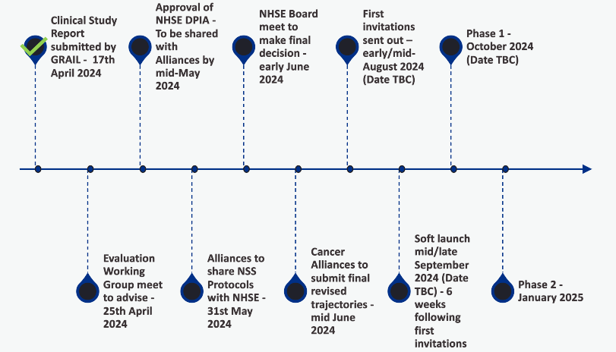
National Updates (23.04.2024)
Everything moved back 5-weeks. Estimating:
Gloucestershire go-live ~23rd Sept
Other 3 ICBs can go-live after
NCP hoping to keep final timeline
Working with current trajectories (5-week delay built in)
Trajectories updates likely June

Slide 21
SWAG CA Multi Cancer Blood Test Programme (MCBTP) – Clinical Comms Q&A sessions
NSS / Site specific interface in SOP development by NSS clinical and operational leads
Clinical communications broadening from those with direct involvement to wider group via these leads
Date and time | Link for meeting
Wednesday 8th May 9.00 – 10.00 | MCBT Q&A session 1
Tuesday 14th May 13.00 – 14.00 | MCBT Q&A session 2
Thursday 16th May 16.30 – 17.30 | MCBT Q&A session 3
Clinical Advisory Group Documents - SWAG Cancer Alliance
Video of_ Professor Peter Johnson - Introduction to the Multi-Cancer Blood Test Programme 130224 - Somerset, Wiltshire, Avon and Gloucestershire (SWAG) Cancer Alliance - FutureNHS Collaboration Platform

Slide 22
England
Diagnosis and staging
Survival outcome
36,886
patients were diagnosed with lung cancer in 2022
(34,235 in 2021)
84%
of patients with stage I/II disease, performance status (PS) 0-1 had pathological confirmation of their diagnosis
(83% in 2021)
48%
of patients with a one year survival after diagnosis
(44% in 2021)
45%
of patients presented with stage IV disease
(48% in 2021)
Surgery for non-small cell lung cancer (NSCLC)
Chemotherapy for small cell lung cancer (SCLC)
32%
of patients were diagnosed after emergency presentation
(35% in 2021)
18%
of patients with NSCLC had surgical treatment for their cancer
(17% in 2021)
71%
of patients with SCLC received treatment with chemotherapy
(72% in 2021)
Treatment with curative intent
Systemic anticancer treatment
of patients with NSCLC (stage IIIB-IV, PS 0-1) received systemic anticancer treatment
(63% in 2021)
78%
of patients with NSCLC (stage I/II, PS 0-2) received treatment with curative intent*
(80% in 2021)
59%
of patients with NSCLC (stage IIIA, PS 0-2) received treatment with curative intent**
(61% in 2021)
60%
Key
improving from 2021
worsening from 2021
unchanged from 2021
89%
83%
67%
92%
60%
48%
(86% in 2021)
(83% in 2021)
(65% in 2021)
(90% in 2021)
(59% in 2021)
(49% in 2021)
Sources: NLCA-State-of-the-Nation-Report-2024.pdf (lungcanceraudit.org.uk); NLCA-State-of-the-Nation-2023-Version-3-November-2023-1.pdf (lungcanceraudit.org.uk) and NLCA_data-tables_SotN-report-2024_v2.0.xlsx (live.com)
*surgery or radical radiotherapy, **surgery, radical radiotherapy or multimodal combination with chemotherapy
For NHS internal use only to inform service improvement discussions

