Slide 1



SWAG Cancer Alliance
Targeted Lung Health Check Programme (TLHC)
Dr Anna Bibby

Slide 2
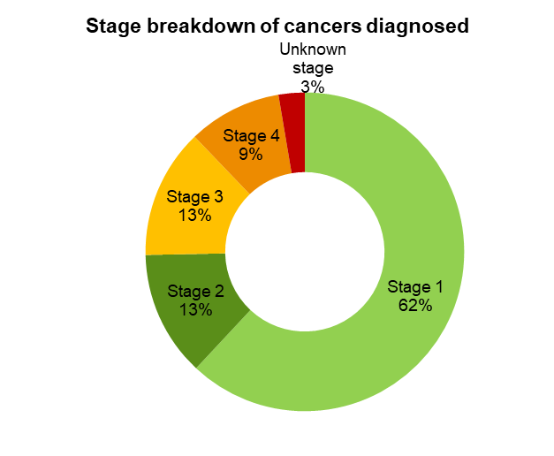
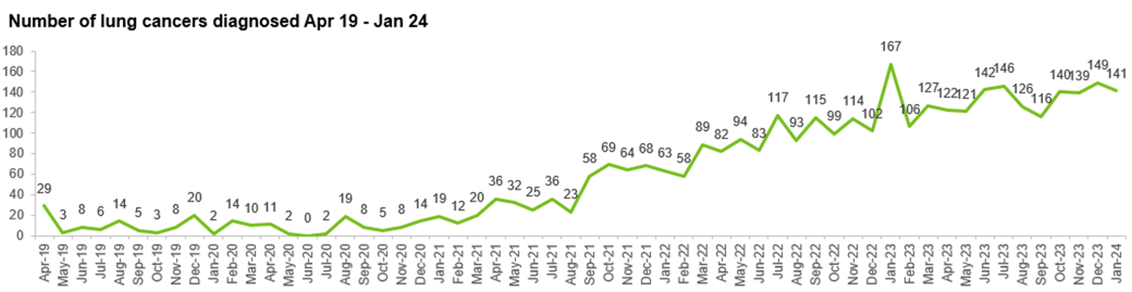
National TLHC activity
Correct as of 31/01/2024

Slide 3
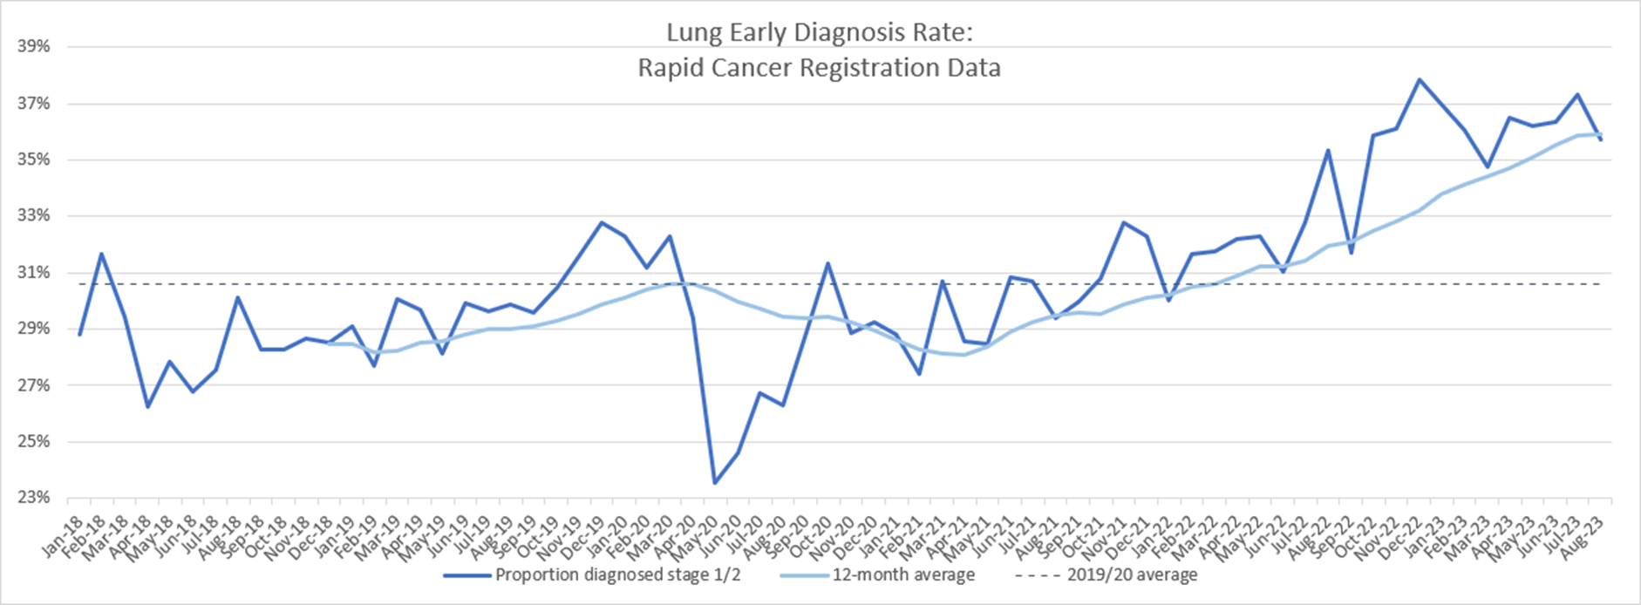
Early diagnosis rates have exceeded pre-COVID rates

Slide 4
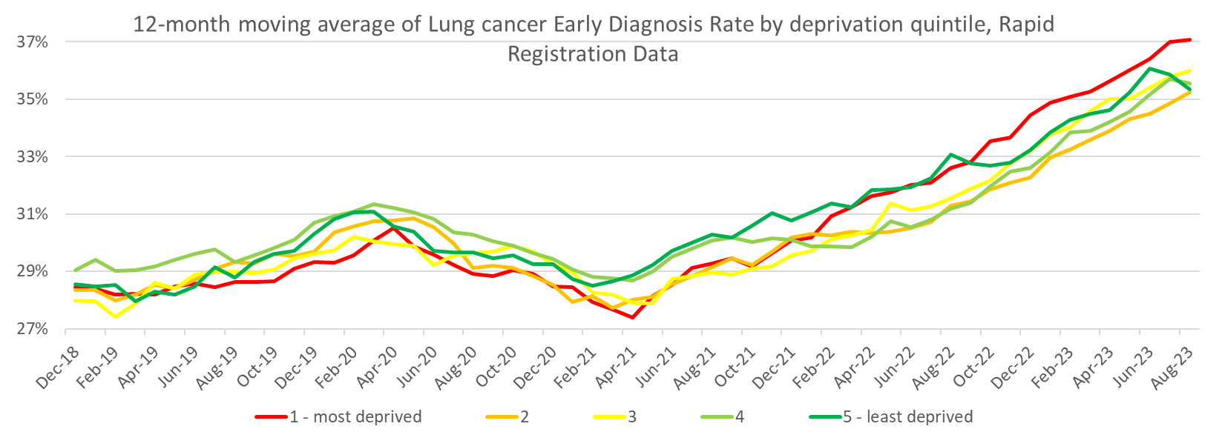
TLHC is reversing health inequity

Slide 5
SWAG activity
 | Bath | Bridgwater | Northern Arc | BIC | SWIFT | Total
Eligible Patients | 4897 | 10600 | 4323 | 6003 | 7138 | 25823
LHC completed | 2989 | 6919 | 2118 | 2768 | 4241 | 14794
High risk | 1299 | 3502 | 1146 | 1488 | 2453 | 7435
Baseline CT scans completed | 1007 | 2813 | 685 | 762 | 2159 | 5267
Referrals to 2WW clinic | 32 | 50 | 25 | 31 | 36 | 174
Cancers found | 17 | 22 | 12* |  |  | 51
Stage 1 | 11 | 9 | 7 |  |  | 29
Stage 2 | 3 | 5 | 1 |  |  | 9
Stage 3 | 2 | 4 | 1 |  |  | 7
Stage 4 | 0 | 4 | 0 |  |  | 5
Unstaged | 1 | 0 | 0 |  |  | 1
 |  |  | * +1 synchronous bowel ca
75% stage I
or II

Slide 6
Incidental findings
1422 SRM discussions (inc nodules)
583 “actionable” incidental findings
65 (~11%) downgraded at SRM based on prior imaging/ clinical info
Most common are dilated thoracic aorta and osteoporotic wedge #
Conversations ongoing re optimal pathway for valve disease

Slide 7
Important incidentals
Coronary artery calcification ~58%
Radiological emphysema ~40%
  Spirometry not currently offered within programme
National taskforce to standardise management/ advice – output awaited
Letters written to participants with advice based on severity, symptoms & smoking status
Including signposting to parallel resources e.g. over 40s health check

Slide 8
Smoking cessation
3343 people offered smoking cessation support
972 accepted
127 successful quits
(excluding Bristol)

Slide 9
Research
~3500 participants enrolled in DART
13 people recruited to SCOOT
£1.4m NIHR Fellowship - IMPALA
Collaboration with UoB ICEP (CRUK) on epigenetic biomarkers
Working with TARG around optimal smoking cessation delivery
Dedicated research fellow post to start Aug 2024
In top 3 research active TLHCs in UK (Manchester, Leeds)

Slide 10

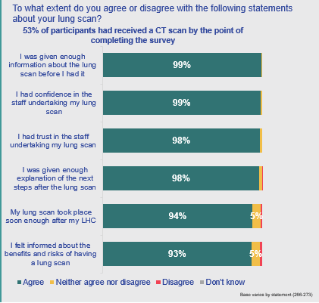
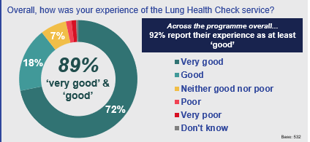



Feedback

Slide 11
Expansion
360,000 eligible people across SWAG
  BSW: 104,064
  BNSSG: 95,260
  Glos: 73,233
  Somerset: 75,207
EOFY 28/29
Translates to 20,000-30,000 TLHC per year
~3500 cancers in total

Slide 12
May 2024
Asda Bedminster – ended 6th of May
Bridgwater Rugby Club - 7th – 10th May (recalls & Cannington)
Sainsburys Trowbridge 11th – 22nd May
Asda Yeovil 23rd – 31st May
Bridgwater Rugby Club - 30th and 31st May (recalls & Cannington)

Slide 13
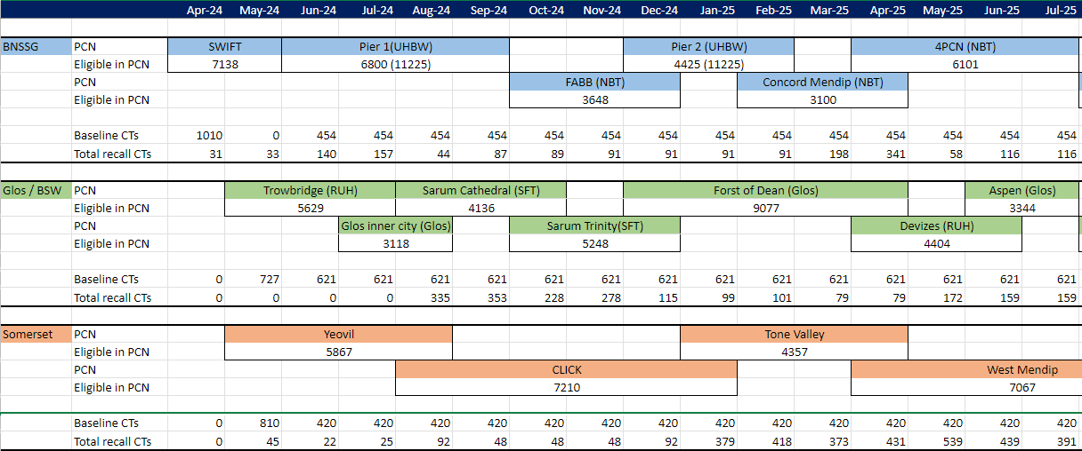
Expansion modelling
Notes:
Mention already 6m delay

Slide 14
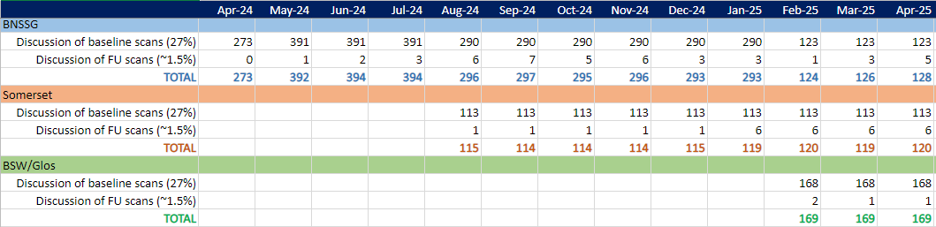
SRM planning

Slide 15
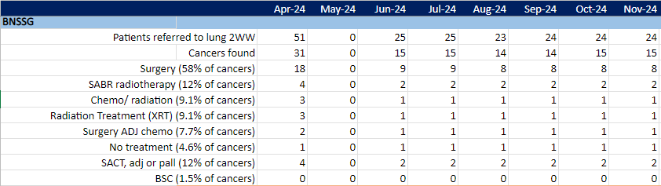
Downstream modelling

Slide 16
Challenges
SRM staffing, esp radiology
Downstream therapeutics, esp thoracic surgery
Downstream diagnostics and caseload management
  Recommend forward planning +/- business cases
Pushback on incidentals
Additional thoughts:
False negatives
MCBT link-up

Slide 17


Discussion

Slide 18
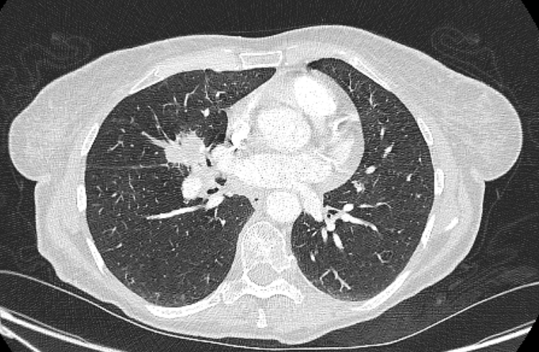
April 2024

Slide 19
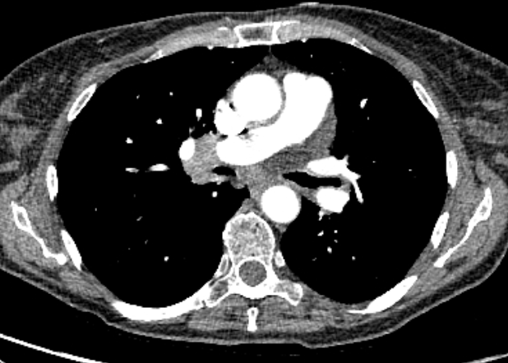
April 2024

Slide 20
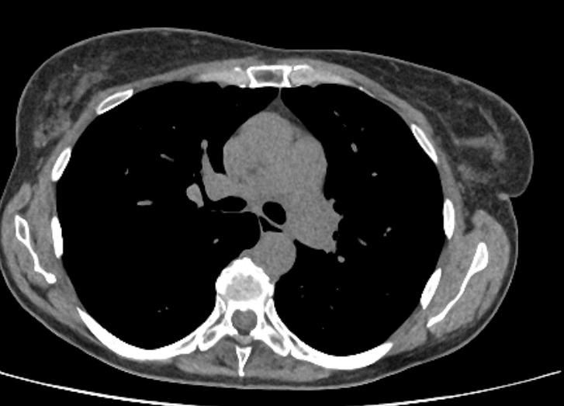
Aug 2023

Slide 21
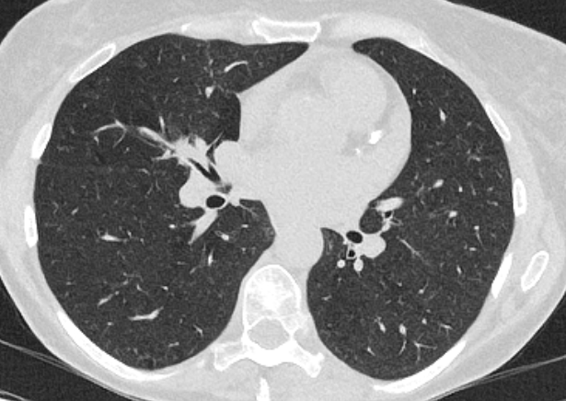
Aug 2023

Slide 22
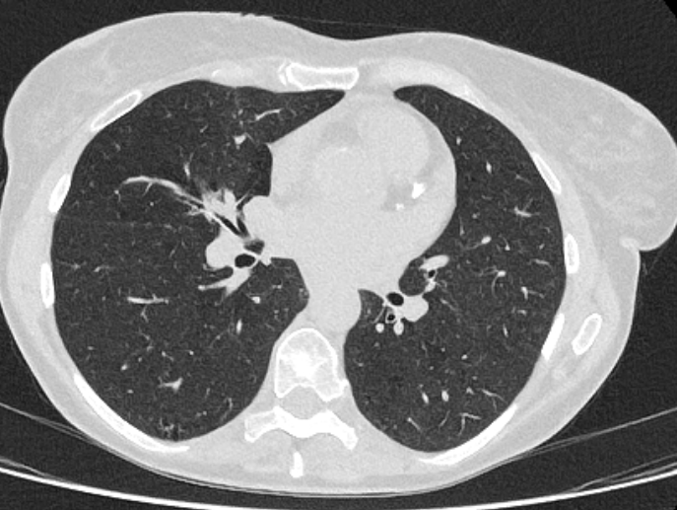
Aug 2023

Slide 23
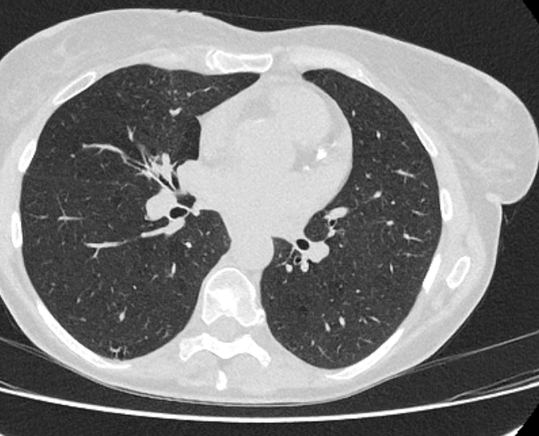
Aug 2023

