Slide 1
Whole Genome Sequencing TYA Lymphoma
Claire Burney – TYA lymphoma/Haematology consultant
Lizzy Hoole – Whole Genome Sequencing Facilitator
South West Genomic Medicine Service Alliance

Slide 2
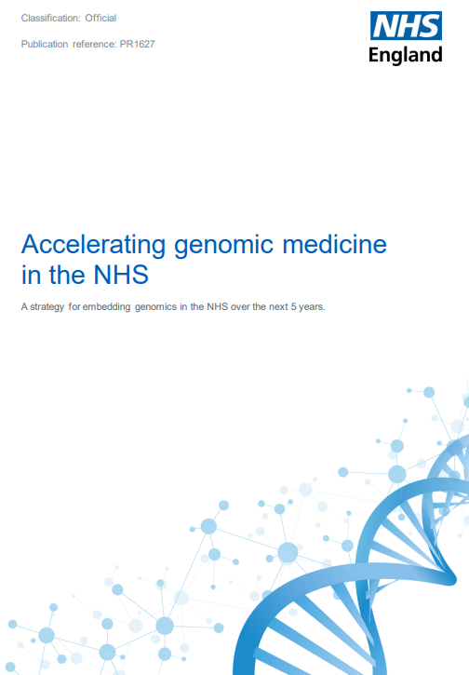
Background
From collaboration and innovation –
Whole Genome Sequencing (WGS) is now available!
Data/Biobanking
The Human genome Project
National Genomics Research Library
2019 NHS Long Term Plan & 2022 Genomics Strategy
A national strategy for genomic medicine
“The NHS will be the first national health care system to offer whole genome sequencing as part of routine care”
Notes:
You may have heard of projects such as The 100k Genomes Project, which was a pilot for the work that is now underway.
Through this previous work, and through bio banking, and lots of data/technology, we have been able to develop a Genomics Medicine Service within the UK whereby we are able to offer Genomic testing in Cancer.
Currently this testing is available to all Paediatric Cancer patients (up to the age of 25yrs), and select disease groups within Adult Cancer.
Our driver for this work stems from the NHS LTP and to deliver the National Genomic Strategy which was released in Oct 2022 - The strategy essentially aims to continue to improve our Genomics services with the UK, and continue mainstreaming it in to routine practice.

Slide 3
Future of genomic medicine: Providing actionable information
Diagnosis
Prognosis
Clinical Trials opening up eligibility
Molecular Markers
WGS provides extra diagnostic reach (structural variants, copy no. variants etc.)
Global patterns of mutation (‘signatures’) proving informative
Defining causal drivers from benign ‘passengers’ is critical
Cancer susceptibility
Therapy selection
Courtesy of Genomics England
Notes:
The future of genomic medicine, is to provide actionable information.
Early analysis shows (65% of) reports identify actionable genes – which enables/leads to personalised medicine.
As we have discussed, this work will aid in the diagnosis and prognosis for our patients. And it provides extra diagnostic reach through identifying specific structural variants, copy number variants etc. Data which is invaluable in furthering our understanding of disease.
Findings have also opened up eligibility for patients to enter further clinical trials. This may drive more research in to specific areas. (e.g. Brain Matrix)
We test both the somatic and the germline, so that we can determine if a variant is specific to the cancer, or if it is inherited.
Tumour disposition genes also found in germline analysis. This enables a preventative approach if a germline variant is identified – wider family testing, screening, preventative surgeries etc.
The data that we will gather from this testing, will hopefully provide clinical utility, enabling further progress in the future, by studying the genome and understanding its applications in practice.
(We are currently offering Genomic testing in Rare diseases which is proving to be hugely beneficial, adult cancers (Haem, Lung, Breast), Lynch Syndrome, and other transformation projects to drive this work, mainstream it, and enable this testing to benefit patient diagnosis, treatment and outcomes.)

Slide 4
Whole Genome Sequencing – TYA Lymphoma
Eligibility & Key points:
All TYA Lymphoma patients aged <25yrs are eligible for WGS testing
WGS testing should be performed alongside standard of care (SoC) testing
SoC diagnostic testing remains the priority
All TYA Lymphoma patients should have a fresh frozen core biopsy taken for WGS
If sufficient material is available this tissue can be used for WGS
Consent (Record of Discussion) is to be obtained AFTER biopsy by clinical team/CNS.
Notes:
Eligibility & Key points:
Hodgkins/Non-Hodgkins patients – therefore as soon as there is a suspicion of Lymphoma a sample should be taken
This is an additional diagnostic test which we are able to offer, alongside SoC testing (maybe in the future this WGS test will replace some of the SoC tests, as it will be come an umbrella test which will include all of the sample information and more!)
SoC testing is the priority, WGS testing will NOT delay standard diagnosis timelines, and if the material taken for diagnosis is not viable, the extra core taken for WGS will be used.
New practice to obtain an additional core biopsy for WGS (this can also be used for biobanking such as Tissue Bank, as the sample is big enough for both)
Tissue viability and availability will be established in an MDT (with pathologist)
Once we know the tissue meets the criteria, tumour content, necrosis, availability etc. CNS’s/Claire B will give info sheets and do WGS paperwork; RoD for consent, and TOF test request etc.
The main thing to note here – is that the new standard of care practice is to obtain sufficient material for WGS testing. Once the diagnostics have been carried out, if there is sufficient material, and consent is in place, this testing can go ahead.
The test can be mentioned at diagnostic biopsy but this is not mandatory, what you can say is ‘we will take the standard diagnostic biopsies, and if there is sufficient material left, you may be eligible for genomic testing which looks more widely at your disease, the clinical team will discuss this more with you later’. The patient does not need to consent upfront.

Slide 5
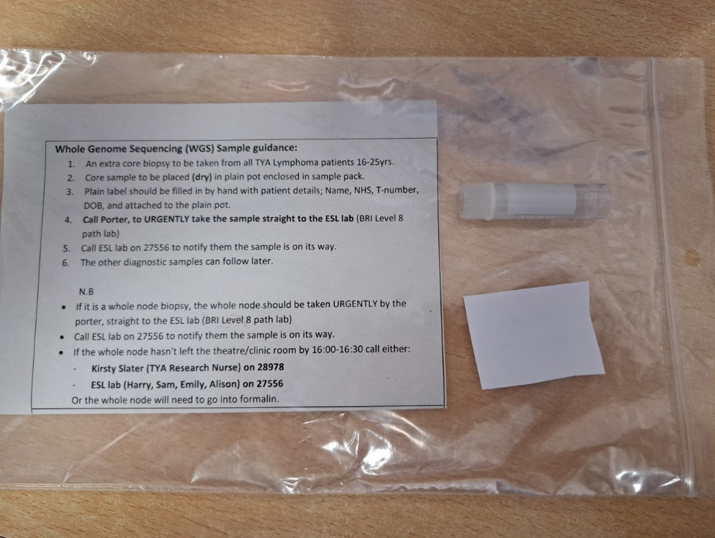
Whole Genome Sequencing – TYA Lymphoma sample packs
Sample packs
Have in dental hospital radiology, Mandy Williams (radiology consultant) has some or contact Molly Grubb (TYA research nurse) on molly.grubb@uhbw.nhs.uk for pack
Green sticker on front of pack
Sample pack contents include:
‘How to’ guide sheet
Sample pot
Blank label (for patient details as no ICE label for it)
Sample needs to be taken urgently by porters to histology lab for processing
Notes:
Green sticker, clearly identifiable. Instructions on sticker to guide how/where to send the sample.
NEEDS TO GO URGENTLY (as soon as it is taken) via the porter, to the ESL lab. This is where it will be ‘snap frozen’ and stored.
The ‘how to’ guide in the pack, guides the clinic staff/radiologist on how to send the sample to the ESL lab urgenty.

Slide 6
Whole Genome Sequencing – TYA Lymphoma requests
If TYA team aware of patient, we will put on the ICE request for biopsy or ask for it in referral letter/email to your team for excision biopsy
If you come across patients we are not aware of, you can add to the ICE request for USS biopsy or initiate at the time of surgery.
If you are performing a surgical biopsy or whole node excision the whole node can be taken fresh to the lab who will split it into some for histology and some for freezing. Please liaise with Molly Grubb at molly.grubb@uhbw.nhs.uk (TYA research nurse) who will assist with this
If the samples for histology are not diagnostic the lab can also use the frozen samples to reach a diagnosis
The lab freeze the sample and store here at UHBW. If patient turns out not to have lymphoma or does not consent to WGS the sample will be destroyed by the lab and not processed

Slide 7
Whole Genome Sequencing – TYA Lymphoma SOP
Notes:
This SOP is now live – and is available on the DMS.

Slide 8
Resources for clinicians:
Happy to chat about it more claire.burney@uhbw.nhs.uk
In-depth summaries:
Requesting WGS
National Genomic Research Library
At-a-glance guides
‘GeNotes’– genomic notes for clinicians
Lots of short courses available - Bitesize Genomics e-learning
Notes:
There are lots of additional resources available if you wish to further your understanding of genomics.
The links on this page all take you to the pages detailed:
National resources developed by HEE and Genomics Education Programme
Web-pages with detailed information about requesting WGS and discussing the research library
At-a-glance guides: one page, to be used as an aide-memoire with key points about requesting WGS for Cancer
Ge-notes – in the clinic, and knowledge hub
Suite of short courses (20-30 mins in length each) in development - first 3 courses (including one about the NGRL)

