Slide 1
Advances in Systemic Anti-Cancer Therapy (SACT):
Driving Faster Treatments and Performance Improvements
SACT CAG
Helen Winter MBBS MSc DPhil
22 March 2024

Slide 2
Overview
Delivery of SACT
Sharing Best-Practice
Need for continuous improvement
Education – workforce and patients
Solution-focused NICE TAGs
Horizon scanning

Slide 3
Delivery of SACT
Streamlining (oral e.g. 5fu to cape)
IP to OP regimens e.g. BEP (TYA)
Ambulatory e.g. autografts
Simplify and accelerate delivery IV to S/C
S/C from SACT DU to OP clinics
Extending interval between therapies
e.g. 3 to 6 weekly IO
Notes:
outpatient injection lists to ensure that we are utilising the fully SACT trained nurses as efficiently as possible/c immunotherapy with atezolizumab (not sure where other immunotherapies are at with this but Kate could answer), sc Phesgo/trastuzumab
Extending interval between treatments with immunotherapy ego 6 weekly
Reviewing in-patient chemo schedules - can any be moved to day units?
Use of oral medication where ever possible - including home delivery of treatments
Supporting clinical trials that are looking at de-escalation e.g. HER2Radical
Non medical prescribers
Use of non chemo trained nurses to administer non-chemo SACT - link to how clinics and day unit time is structured / efficient use of space
Treatments closer to home - I think this is variable across SWAG
3

Slide 4
Sharing Best Practice
Closer to home
Benefits of single prescribing system
e.g. current challenge of Weston and BRI
Health equity
Pharmacogenomics DPYD implementation
MOLGEN About - Institute of Systems, Molecular and Integrative Biology - University of Liverpool
Proactive, rapid implementation of NICE TAGs
Notes:
minimised the length of the First Dose Talk by making pts watch a video instead, but this needs updating. We have been looking into an app to give better info, helping pts self manage and divert some of the calls fro the helpline, also ones with a ‘dashboard’ of toxicies to focus PA appts.
4

Slide 5
NICE TAGs Implementation
Approx 60 new NICE TAGs over 2 years
More adjuvant therapies
Approx. 30 Immunotherapies
New targeted therapies
What are providers doing to implement this?
Exemplar: IDH 1 – approved and Regional webinar in same week

Slide 6
Management of Toxicity
Multi-professional education
Ongoing education programme
Patients education
“We have minimised the length of the First Dose Talk by making pts watch a video instead, but this needs updating. We have been looking into an app to give better info, helping pts self manage and divert some of the calls from the helpline, also ones with a ‘dashboard’ of toxicities to focus PA appts”
SDEC capacity
Shared resources – do once for region
Keep up to date
Notes:
regionI guess more shared resources such as extravasation policy, SACT nurse training- standardised practice- all this saves time redoing and updating policies which can be shared. Such as Mg/diarrhoea etc? With a general policy we could just have a sop for any local practicesinimised the length of the First Dose Talk by making pts watch a video instead, but this needs updating. We have been looking into an app to give better info, helping pts self manage and divert some of the calls fro the helpline, also ones with a ‘dashboard’ of toxicies to focus PA appts.
6

Slide 7
Education and ACCEND
SWAG led on National IO education forum
SWAG piloting cLINK on learning about genomics in flow of work
First draft of SWAG ACCEND with Excellence
Establish links with UK SACT education network, South West SACT nurses, UKONS, BOPA, Community pharmacies
PCN education e.g. IO presentations

Slide 8
new approach to our PACs (pre-assessment clinics- quite rigid/ chemo-focused and could be modernised/ digitalised in some parts) - could free us up to see the complex and new patients!

Slide 9
Monoclonabs – not needing SACT nurses
Rheumatology

Slide 10
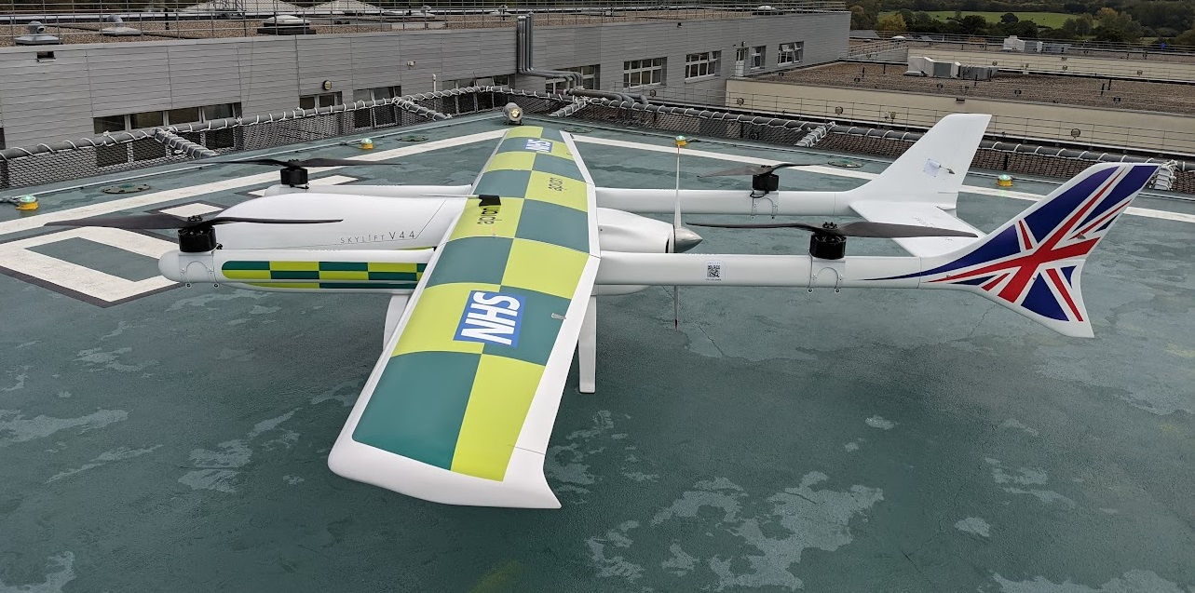
What’s coming
Prehab (CAR-T & IO), wearables, virtual wards
Prehab in IO – SWAG BMS MacMillan pilot
Ambulatory complex therapies
Supporting trials of de-escalation
CAR-T, TILs, vaccines
RPA, AI and drones!
https://www.england.nhs.uk/greenernhs/whats-already-happening/drone-deliveries-of-vital-chemotherapy-to-the-isle-of-wight/
This revolutionary way of transporting life-saving chemotherapy drugs reduces a four-hour journey time – by road and sea – to a 30-minute flight.

Slide 11
Acknowledgements
Sally Long, SACT lead UHBW
SWAG SACT chairs Jeremy Braybrooke and Emma Cattell and Becca from SFT
SWAG Pharmacy lead Kate Gregory, Rachel Palmer Genomics Lead Pharmacist
Rachel Dommett, CTYA clinical lead
Adam Dangoor, Sanne Lugthart

