Slide 1
SWAG Protocols update March 2024
Kate Gregory
Lead Pharmacist for SWAG Protocols – SWAG Cancer Alliance
Divisional Lead Oncology Pharmacist – UHBW

Slide 2
New Protocols – progress…
Protocols activity Oct 23-Mar 24 (and comparison with previous reports:
Total NICE protocol activity since Jan 2021:
Activity | Oct 23-Mar 24 | Nov 22- Sept 23 | Nov 21-Oct 22
New protocols issued | 11 | 36 | 24
Protocols reviewed/amended | 27 | 34 | 19
Protocols drafted (a/w review or sign off) | 23 | 19 | 12
Activity | Number | Current status (March 2024) | Previous report (Sept 2023)
Total new NICE TA since Jan 2021 | 101 | N/A | N/A
Protocols available | 72 | 71% | 72%
Protocols in progress | 13 | 13% | 13%
Protocols to be developed | 16 | 16% | 14%

Slide 3
New NICE TA since last report – Progress…
Date | NICE TA/Indication | Protocol Status
10th April 2024 | TBC - Cabozantinib with nivolumab for untreated advanced renal cell carcinoma | Needs draft
3rd April 2024 | TBC - Dostarlimab with platinum-based chemotherapy for treating advanced or recurrent endometrial cancer with high microsatellite instability or mismatch repair deficiency. | Drafted - with gynae team
27th March 2024 | TBC - Daratumumab, bortezomib, cyclophosphamide and dexamethasone for newly diagnosed systemic amyloid light chain (AL) amyloidosis in adults | Needs draft
TBC | TBC - Selinexor with bortezomib and dexamethasone for previously treated multiple myeloma | Draft started - NBT to review
20th March 2024 | TA957 - Momelotinib for treating myelofibrosis-related splenomegaly or symptoms | Need draft
6th March 2024 | TA954 - Epcoritamab for treating relapsed or refractory diffuse large B-cell lymphoma after 2 or more systemic therapies | Needs draft
21st February 2024 | TA952 - Talazoparib for treating HER2-negative advanced breast cancer with germline BRCA mutations | Needs draft
7th February 2024 | TA951 - Olaparib with abiraterone for untreated hormone-relapsed metastatic prostate cancer | Needs draft
7th February 2024 | TA950 - Nivolumab-relatlimab for untreated unresectable or metastatic melanoma | Published
31st January 2024 | TA948 - Ivosidenib for treating advanced cholangiocarcinoma with an IDH1 R132 mutation after 1 more more systemic treatments | Needs draft
31st January 2024 | TA947 - Loncastuximab tesirine for treating relapsed or refractory diffuse large B-cell lymphoma and high-grade B-cell lyphoma after 2 or more systemic treatments | Drafted - with Lisa Lowry
17th January 2024 | TA946 - Olaparib with bevacizumab for maintenance treatment of high-grade epithelial ovarian, fallopain tube or primary peritoneal cancer | Published
10th January 2024 | TA944 - Durvalumab with gemcitabine and cisplatin for treating unresectable or advanced biliary tract cancer | Drafted - with Liz Toy
13th December 2023 | TA939 - Pembrolizumab plus chemotherapy with our without bevacizumab for persistent, recurrent or metastatic cervical cancer | Published
22nd November 2023 | TA931 - Zanubrutinib is recommended as an option for treating untreated CLL if there is a 17p deletion or TP53 mutation or there is no 17p deletion or TP53 mutation but FCR or bendamustine & rituximab are unsuitable or in relapsed or refractory CLL. | Drafted - with Laura Percy
18th October 2023 | TA927 - Glofitamab for treating relapsed or refractory diffuse large B-cell lymphoma after 2 or more systemic treatments | Drafted - with Lisa Lowry
25th October 2023 | TA917 - Daratumumab with lenalidomide and dexamethasone for untreated multiple myeloma when a stem cell transplant is unsuitable. | Published

Slide 4
Protocol work – Oct 23-Mar24
Oncology
Tumour site | New protocols issued | Protocols reviewed/amended | Protocols in development
Breast | EC-paclitaxel Ribociclib | Carboplatin and paclitaxel Dose dense EC-paclitaxel Paclitaxel 3 weekly/Paclitaxel weekly Palbociclib Atezolizumab and nab-paclitaxel | MMM
CNS |  |  | Jakacki
Colorectal | Pembrolizumab (MSI-H) |  | Lonsurf
Germ Cell |  | TIP
Gynae | Pembrolizumab (MSI-H) Pembro/Bev/Carbo/Taxol | Olaparib & Bevacizumab Trametinib | Treosulfan version update – a/w references before final sign off Dostarlimab, carbo, taxol Dostarlimab
Head & Neck |  | Nivolumab
Lung | Mobocertinib Entrectinib Nivo/Pem/Platinum | Atezolizumab/Bevacizumab/Carboplatin/Paclitaxel Carboplatin, paclitaxel and pembrolizumab Atezolizumab Atezolizumab, carboplatin & etoposide | Dabrafenib/trametinib

Slide 5
Protocol work – Oct 23-Mar24 cont’d
Sarcoma |  |  | Irinotecan & Temozolomide VDC/IE MAP Mifamurtide
Skin | Nivolumab-relatlimab | Pembrolizumab Nivolumab Dabrafenib & trametinib Encorafenib & binimetinib
Thyroid |  |  | Dabrafenib/trametinib
Upper GI | Pembrolizumab (MSI-H) | Carboplatin and paclitaxel Paclitaxel weekly Capecitabine and temozolomide FLOT | Modified FOLFIRINOX and FOLFIRINOX currently being reviewed for hepatic impairment alignment Lonsurf Durvalumab/cis/gem
Urology | Carboplatin & gemcitabine | Atezolizumab
Tumour Agnostic | Entrectinib

Slide 6
Protocol work – Oct 23-Mar24 cont’d
Haematology
Tumour site | New protocols issued | Protocols reviewed/amended | Protocols in development
Leukaemia | Asciminib | Acalabrutinib | Fedratinib – with MPN group for approval Zanubrutinib
Lymphoma |  | R-CODOX-M/R-IVAC | Brentuximab vedotin A-CHP Glofitamab Loncastuximab tesirine
Myeloma | DRd | Daratumumab, bortezomib, dex | Carfilzomib/Len/Dex Selinexor, bortezomib, dex All myeloma protocols currently undergoing review and transfer to new template

Slide 7
Protocol Template – what’s new?
Trialling new protocol template with the DRd (myeloma) protocol currently released to the website
Change to ordering of protocol with hyperlinks to jump to different sections
Additional information added:
Response rates from trial
Additional information re: investigations required
Toxicity/side effect profile more detailed
Additional information on management of drug specific toxicities

Slide 8
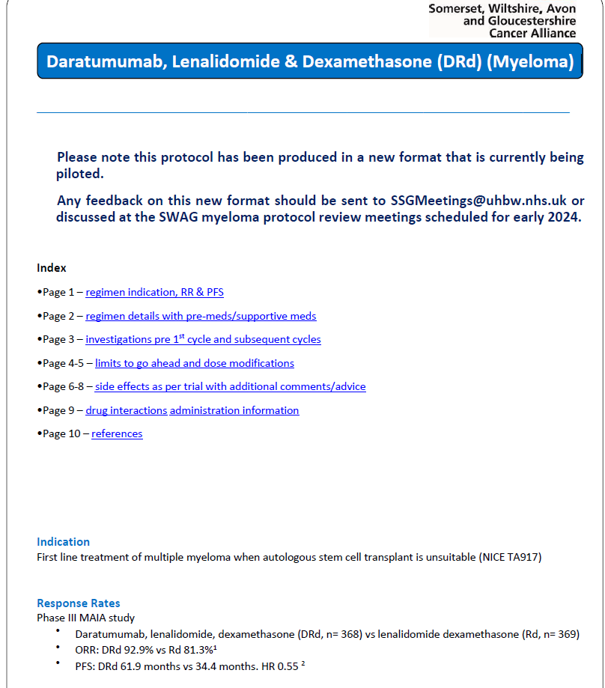
New Protocol Template
Protocol index with hyperlinks
Additional information re: response rates and PFS from trial

Slide 9
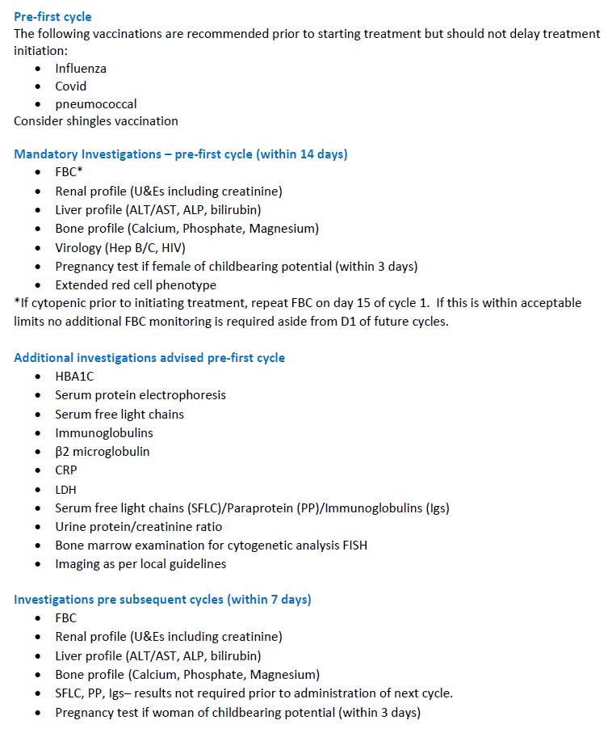
New Protocol Template
Other pre-treatment considerations included
All investigations in list instead of table under mandatory/ advised with validity period in title

Slide 10
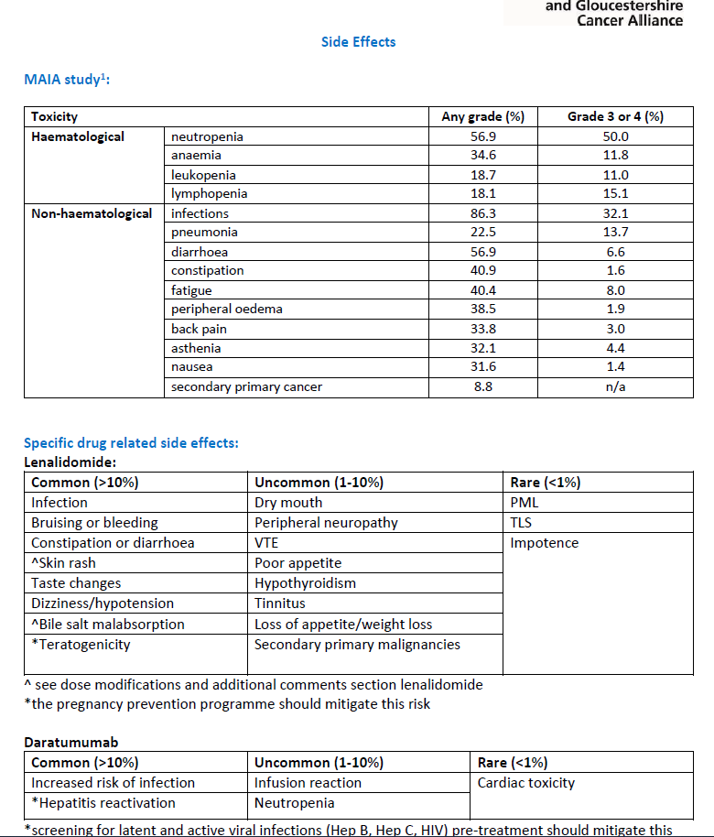
New Protocol Template
Additional detail on rates of toxicity and side effect profile for each drug

Slide 11
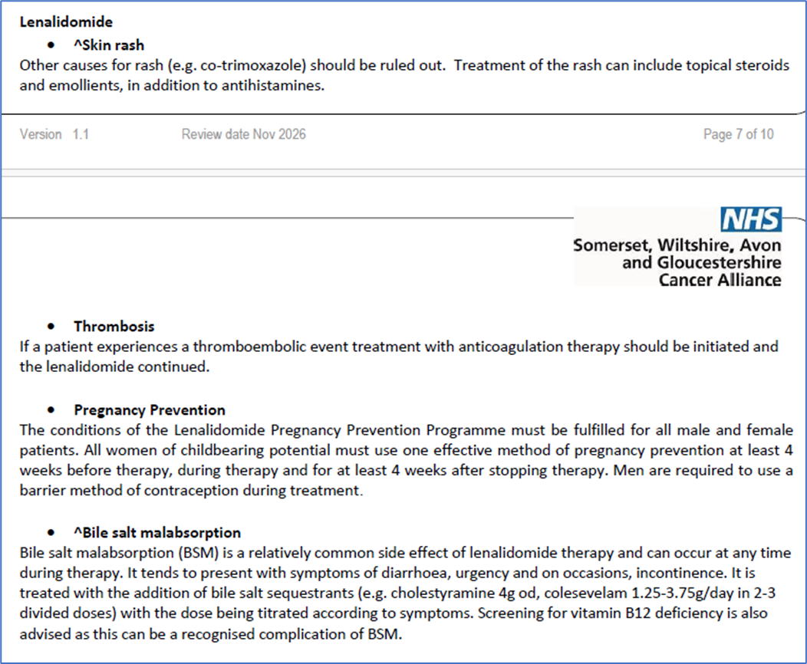
New Protocol Template
Additional information on management of specific toxicities

Slide 12
Feedback on new template
Positive | Negative | Suggestions
Easy to navigate | Protocol less clear/concise due to additional information | Move blood group and antibody screen to mandatory investigations as feels risks being missed otherwise
Useful to have RR/PFS for interest | Concern information may be missed if use hyperlinks to skip sections | Include reaction info in administration information so easily accessible when needed.
Toxicity rates and outlines for specific drugs more helpful than previous design | Information used for every cycle e.g. admin moved to end of document. Key information should be at beginning/easily accessible | Non-medics are using information at both the beginning and the end of the document i.e. dosing at beginning and administration at end - ? keep closer together to prevent lots of back and forth within the document
Positively received in haem CAG when demoed | Supportive medication and additional supportive medication headings confusing – may not read both | Suggest remove RR/PFS to later in document as only used during initial prescribing rather than for all cycles. Include treatment related mortality info too.
 | Loss of extravasation info | Consider changing index into a table and adding ‘back to top’ hyperlink to each page for easier navigation
 |  | Reformat review information to list versions and sign off dates
 |  | Remove generic recommendations not specific for prescribing this protocol to streamline and make protocol more concise.
NB. Feedback from minimal staff to date, perhaps as single protocol so only used by a subset of the network staff

Slide 13
New template – next steps?
Increased feedback from wider network – most feedback from UHBW/NBT to date
Adjust template in response to feedback received
Roll out as part of myeloma protocol update once approved
New haematology protocols to use new template and move across with updates
Consultation on if wish to mirror in oncology too

