Slide 1
Panendoscopy QIP
Siona Growcott¹, Jessica Lunn², Oliver Dale³, Graham Porter³ and Sarah Hargreaves⁴
Clinical Oncology Fellow¹, ENT SpR², ENT Consultant³, Clinical Oncology Consultant⁴
University Hospitals Bristol and Weston NHS Trust

Slide 2
Introduction
Panendoscopy is a crucial part of the work-up for suspected head and neck cancers
Provides additional information which is not available from neck biopsy and imaging, e.g.
primary tumour diagnosis
to assess involvement of midline structure
Assists with decision making for unilateral/bilateral neck irradiation and radiotherapy planning

Slide 3
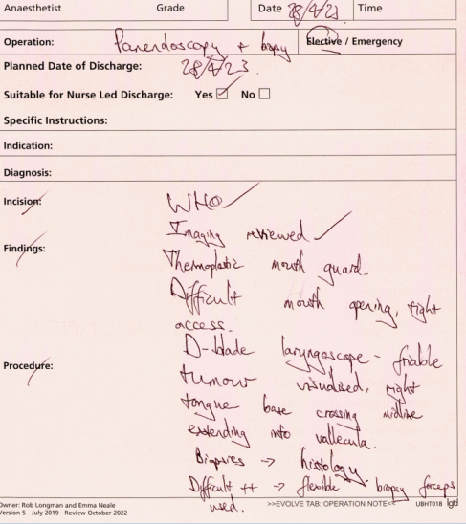
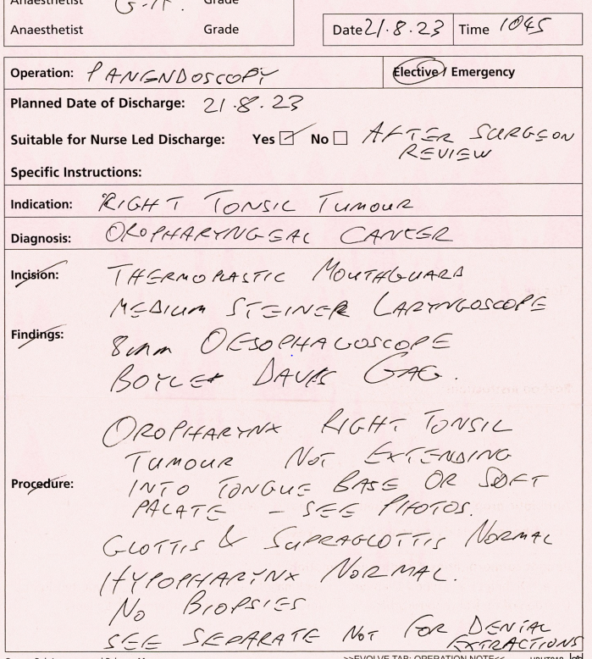
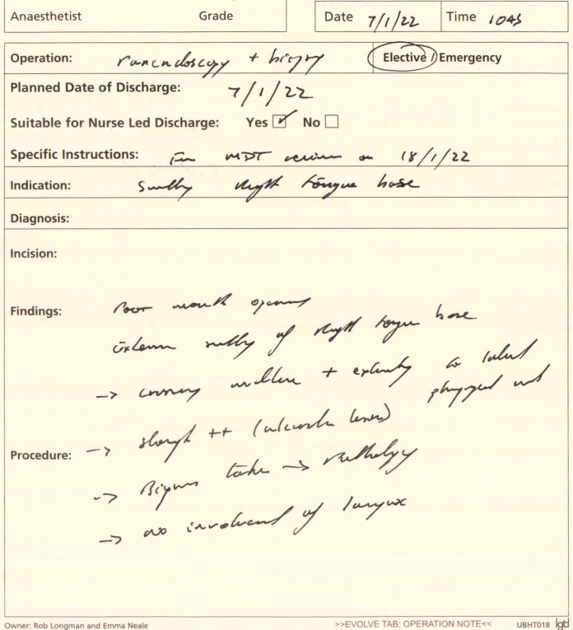
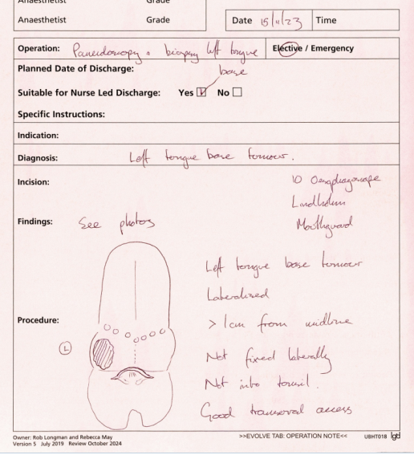
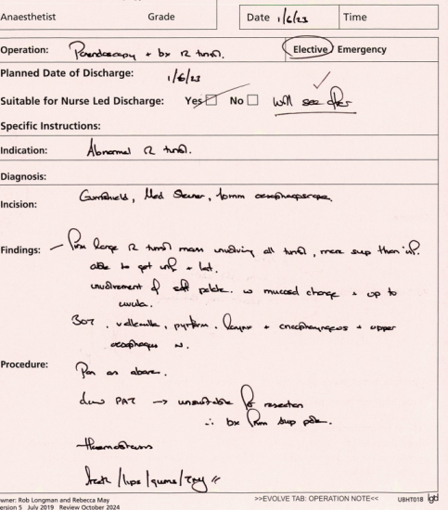
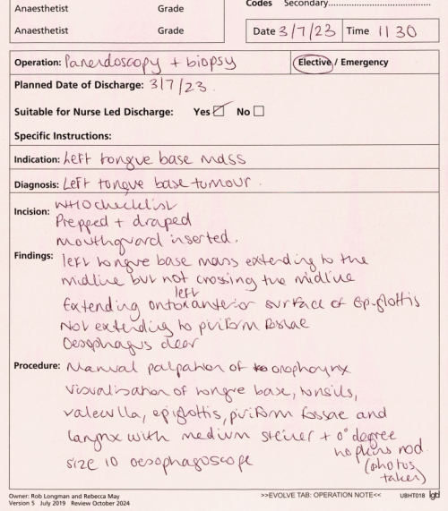
Issues with current operation note
Generic operation note which does not apply to panendoscopy
'White space' – no prompts to record specific findings
Documentation not standardised
Handwritten records – variable legibility

Slide 4
Issues with current operation note
Generic operation note which does not apply to panendoscopy
'White space' – no prompts to record specific findings
Documentation not standardised
Handwritten records – variable legibility
No set auditable standard for panendoscopy operation notes

Slide 5
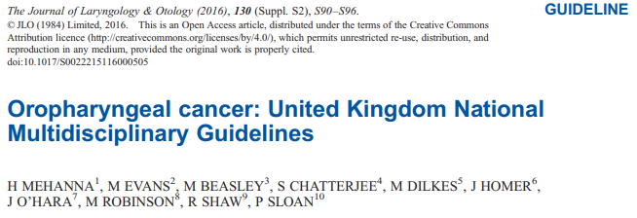
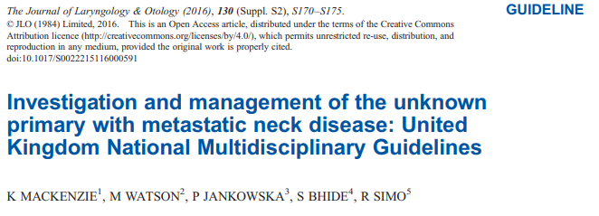
Panendoscopy assessment recommendations for oropharyngeal cancer and CUP (2016)
EUA and panendoscopy strongly recommended
Assess disease extent
Assess resectability of primary tumour
Exclude second primaries, esp in hypopharynx or oesophagus
Panendoscopy to be timed after all imaging
Each subsite should be examined under direct vision
Palpation of oral cavity and tongue base
Biopsy any suspicious lesion
Take photographs

Slide 6
RCR consensus statement (2022)
Unilateral treatment
Bilateral treatment
Notes:
Head and neck cancer - RCR consensus statements | The Royal College of Radiologists
RCR goes further – Details what we as oncologists want from panendoscopy – whether tumour is lateralised/not lateralised – as this affects oncological management

Slide 7
Aims of QIP
To standardise panendoscopy reports to:
improve consistency in documentation
better assist unilateral/bilateral neck treatment decision making
aid radiotherapy planning

Slide 8
PDSA Cycle 1
Plan: Panendoscopy op notes reviewed pre-intervention (baseline measurement)
Do: 52 notes reviewed
Study: Panendoscopy op notes assessed against our combined RCS, UK MDT and RCR criteria
Act: New panendoscopy proforma created
52 panendoscopy reports reviewed between 05/01/2023 and 13/12/2023
90% were oropharynx primaries
No set standard, so audit criteria derived from:
Royal College of Surgeons 'Good Surgical Practice' (2014),
UK National MDT Guidelines (2016),
Head and Neck cancer RCR consensus guidelines (2022)

Slide 9
PDSA Cycle 1
Criteria | %
Panendoscopy report legible | 85
Palpation findings recorded | 51
Review areas recorded | 73
Photographs on Evolve | 65
Diagram | 42
Resectability recorded | 23
Larynx – Cord mobility documented | -
Larynx – Involvement of supra/subglottis noted | -
Hypopharynx – Tongue base involvement noted | -
Hypopharynx – Cricopharyngeus noted | -
Oropharynx - Record of whether disease lateralised (>10mm from midline) or not lateralised | 63
Oropharynx - Tongue base involvement / no involvement documented | 92
Oropharynx - Soft palate involvement / no involvement documented | 70
Oropharynx - Posterior pharyngeal wall involvement / no involvement documented | 25
Plan: Panendoscopy op notes reviewed pre-intervention (baseline measurement)
Do: 52 notes reviewed
Study: Panendoscopy op notes assessed against our combined RCS, UK MDT and RCR criteria
Act: New panendoscopy proforma created

Slide 10
PDSA Cycle 1
Criteria | %
Panendoscopy report legible | 85
Palpation findings recorded | 51
Review areas recorded | 73
Photographs on Evolve | 65
Diagram | 42
Resectability recorded | 23
Larynx – Cord mobility documented | -
Larynx – Involvement of supra/subglottis noted | -
Hypopharynx – Tongue base involvement noted | -
Hypopharynx – Cricopharyngeus noted | -
Oropharynx - Record of whether disease lateralised (>10mm from midline) or not lateralised | 63
Oropharynx - Tongue base involvement / no involvement documented | 92
Oropharynx - Soft palate involvement / no involvement documented | 70
Oropharynx - Posterior pharyngeal wall involvement / no involvement documented | 25
Plan: Panendoscopy op notes reviewed pre-intervention (baseline measurement)
Do: 52 notes reviewed
Study: Panendoscopy op notes assessed against our combined RCS, UK MDT and RCR criteria
Act: New panendoscopy proforma created

Slide 11
PDSA Cycle 1
Criteria | %
Panendoscopy report legible | 85
Palpation findings recorded | 51
Review areas recorded | 73
Photographs on Evolve | 65
Diagram | 42
Resectability recorded | 23
Larynx – Cord mobility documented | -
Larynx – Involvement of supra/subglottis noted | -
Hypopharynx – Tongue base involvement noted | -
Hypopharynx – Cricopharyngeus noted | -
Oropharynx - Record of whether disease lateralised (>10mm from midline) or not lateralised | 63
Oropharynx - Tongue base involvement / no involvement documented | 92
Oropharynx - Soft palate involvement / no involvement documented | 70
Oropharynx - Posterior pharyngeal wall involvement / no involvement documented | 25
Plan: Panendoscopy op notes reviewed pre-intervention (baseline measurement)
Do: 52 notes reviewed
Study: Panendoscopy op notes assessed against our combined RCS, UK MDT and RCR criteria
Act: New panendoscopy proforma created

Slide 12
PDSA Cycle 1
Criteria | %
Panendoscopy report legible | 85
Palpation findings recorded | 51
Review areas recorded | 73
Photographs on Evolve | 65
Diagram | 42
Resectability recorded | 23
Larynx – Cord mobility documented | -
Larynx – Involvement of supra/subglottis noted | -
Hypopharynx – Tongue base involvement noted | -
Hypopharynx – Cricopharyngeus noted | -
Oropharynx - Record of whether disease lateralised (>10mm from midline) or not lateralised | 63
Oropharynx - Tongue base involvement / no involvement documented | 92
Oropharynx - Soft palate involvement / no involvement documented | 70
Oropharynx - Posterior pharyngeal wall involvement / no involvement documented | 25
Plan: Panendoscopy op notes reviewed pre-intervention (baseline measurement)
Do: 52 notes reviewed
Study: Panendoscopy op notes assessed against our combined RCS, UK MDT and RCR criteria
Act: New panendoscopy proforma created

Slide 13
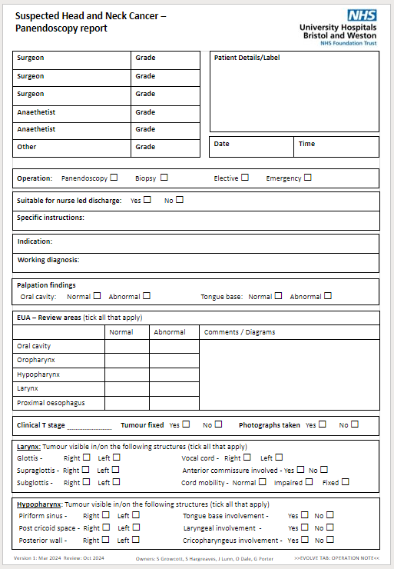
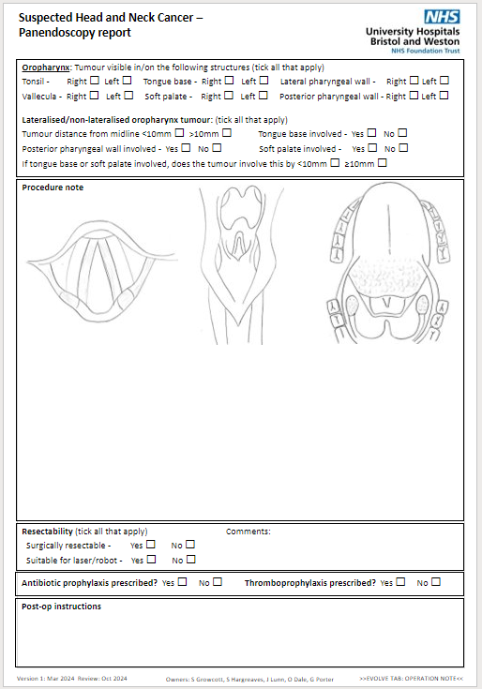
PDSA Cycle 1
Plan: Panendoscopy op notes reviewed pre-intervention (baseline measurement)
Do: 52 notes reviewed
Study: Panendoscopy op notes assessed against our combined RCS, UK MDT and RCR criteria
Act: New panendoscopy proforma created

Slide 14
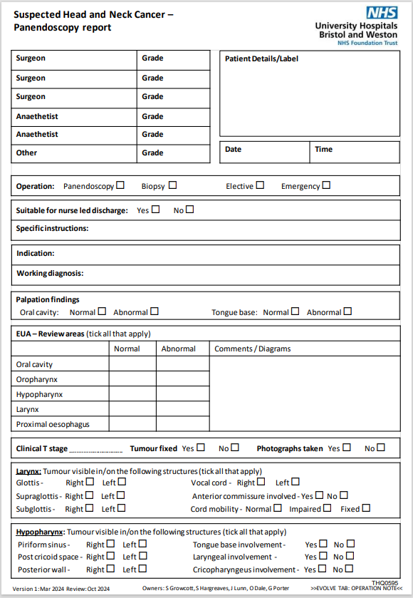
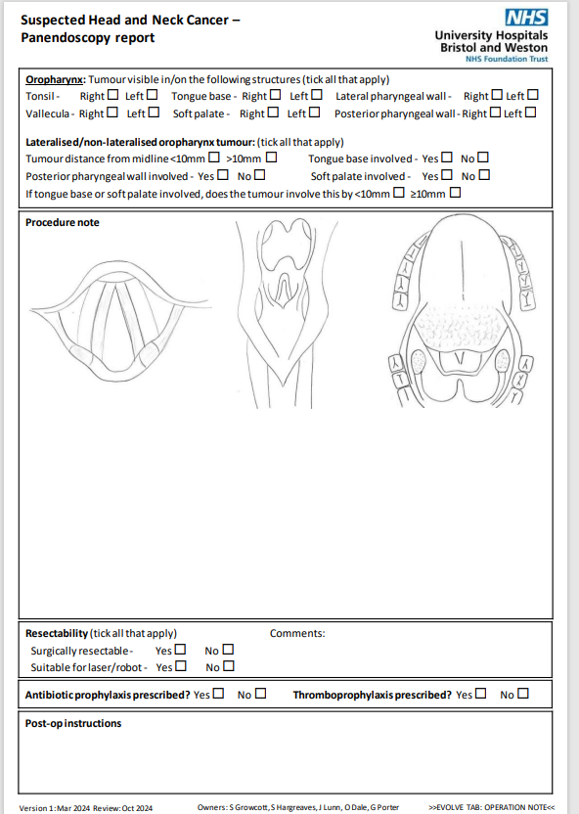

Slide 15
PDSA Cycle 2 PDSA Cycle 3
Plan: Survey ENT SpRs
Do: Send survey to all trainees and specialty doctors in the deanery
Study: Analyse responses
Act: ?Further improvements needed to the form
Plan: Review panendoscopy proforma after 6 months (aim Oct 2024)
Do: Audit proforma use / compliance against our derived criteria
Study: Analyse data
Act: ?Further improvements needed to the form ?Consider digital form

Slide 16
Summary
Panendoscopy is a crucial part of the work-up for suspected head and neck cancers and invaluable for radiotherapy planning and decision making
Documentation could be improved, especially for midline structure involvement, resectability, diagrams and photos
Next steps: Proforma roll out imminent, then PDSA cycles 2 and 3

Slide 17
Examples of good QIPs/advice
Improving patient safety by reducing the incidence of missed medications in elective surgical patients.pdf (bgs.org.uk)
Improving the Quality of Information Recorded on Operation Notes in the Department of Head & Neck Oncology - 2nd - C Goss & F Los QIP Poster.pdf
RCS PDSA cycle RCS England Trainees Guide to a Quality Improvement Project 2021.pdf

