Slide 1
Development and Implementation of a Functional Algorithmic Database for Breast Cancer Treatment Pathways:
Collaboration between the Breast Units at Royal United Hospitals Bath and North Bristol NHS Trust and the Computer Science Department at the University of Bristol.
Nicola Laurence ( RUH)
Rachel Ainsworth (NBT)
Lamb Chen (UoB)
Elijah Durston-Rand (UoB)
Blaise Sheehan (UoB)
Josh Chatten (UoB)

Slide 2
Evolution of a Concept
MDT: Established for all patients on a cancer pathway
Streamline simple cases ( ABS tool box ) MDT : to allow more
time to discuss complex cases
Treatment Summary : algorithms set up through
Cerner Millennium with Power form.

Slide 3
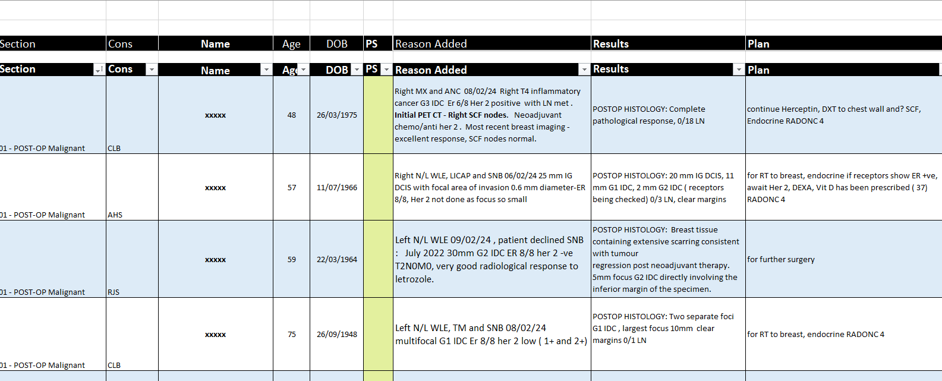
Example of Current MDT list at RUH :

Slide 4
However, now :
Nuanced treatment pathways with tight eligibility criteria
New Treatments : Abemaciclib, olaparib.
De-escaltation : partial radiotherapy, omission of radiotherapy, Oncotype Dx
Family History : complex pathways for mainstream testing R208 and R444
Result:
increased time to prepare the MDT
omissions
errrors

Slide 5
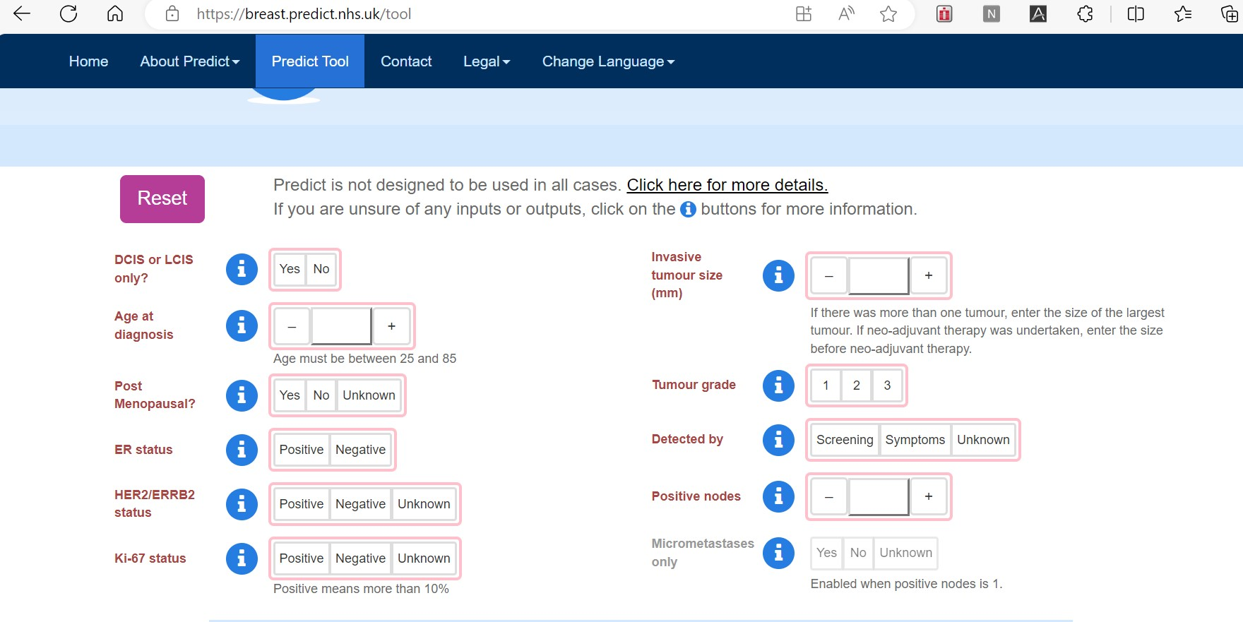
Predict breast cancer: used for decision making for chemotherapy, web based, free app
University of Cambridge.
Based on well established prognostic data:

Slide 6
Previous experience with a functional database
Cerner Millennium and Treatment Summaries

Slide 7
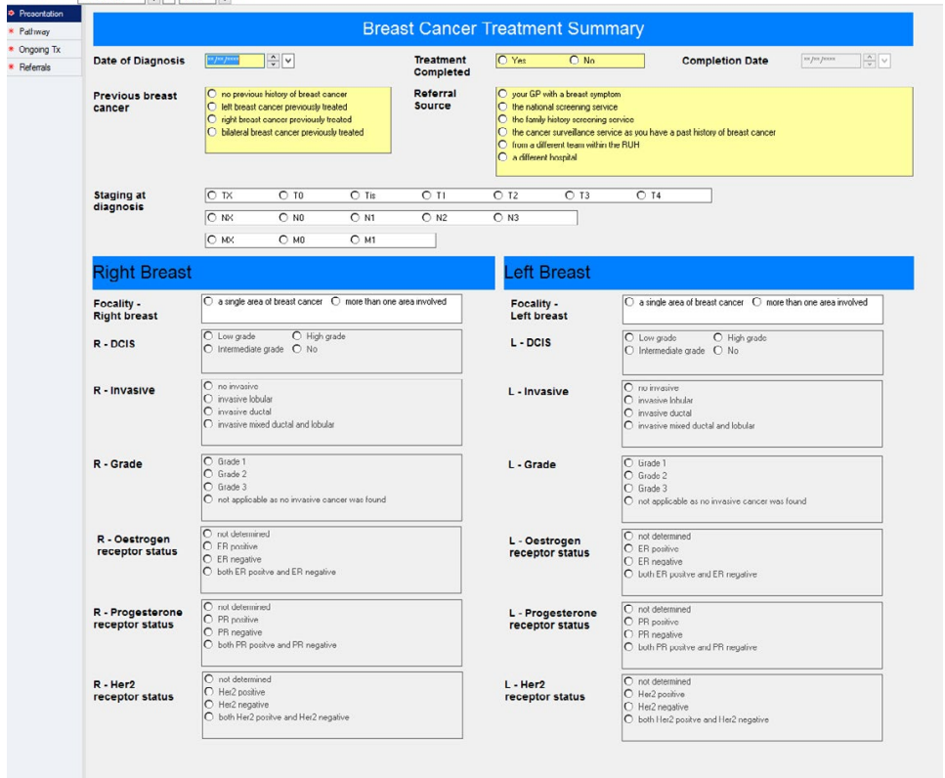

Slide 8
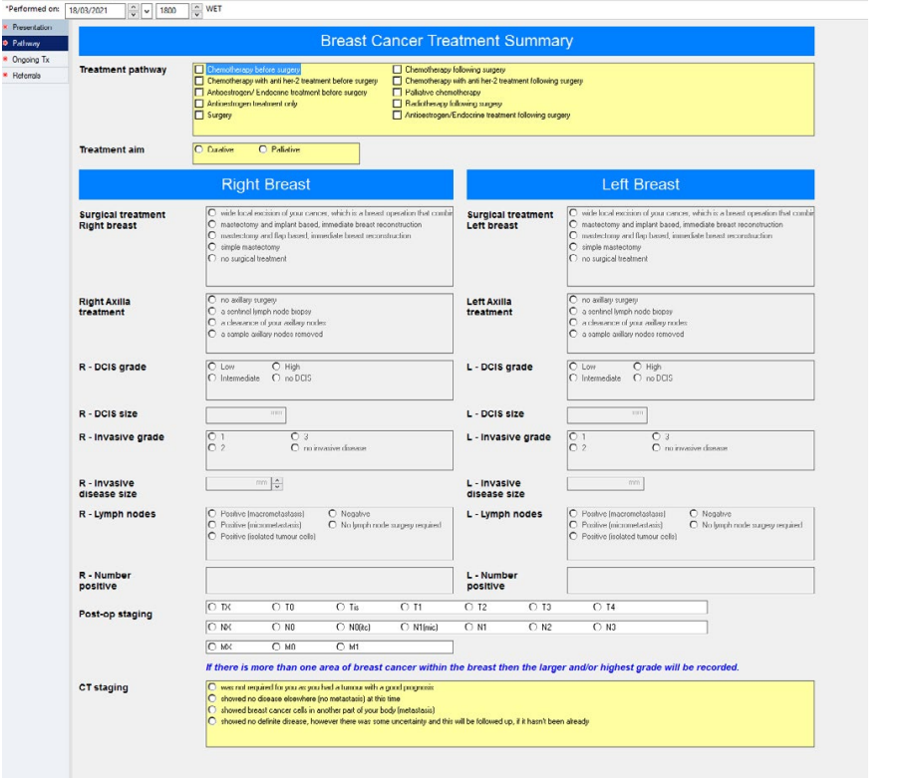

Slide 9
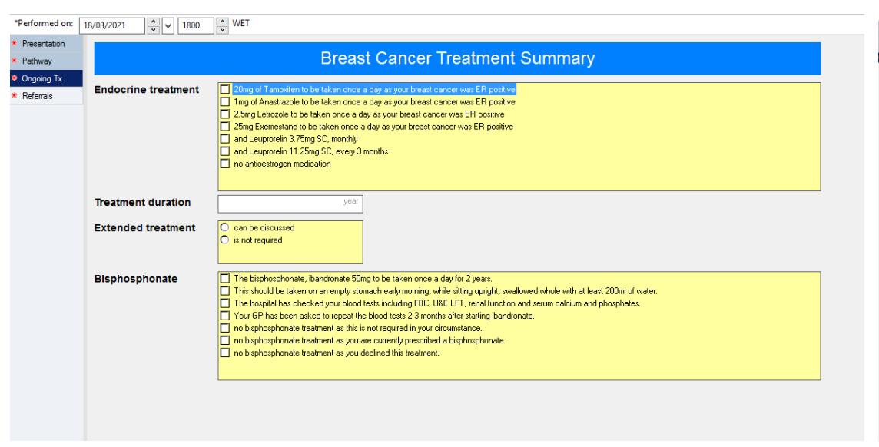

Slide 10
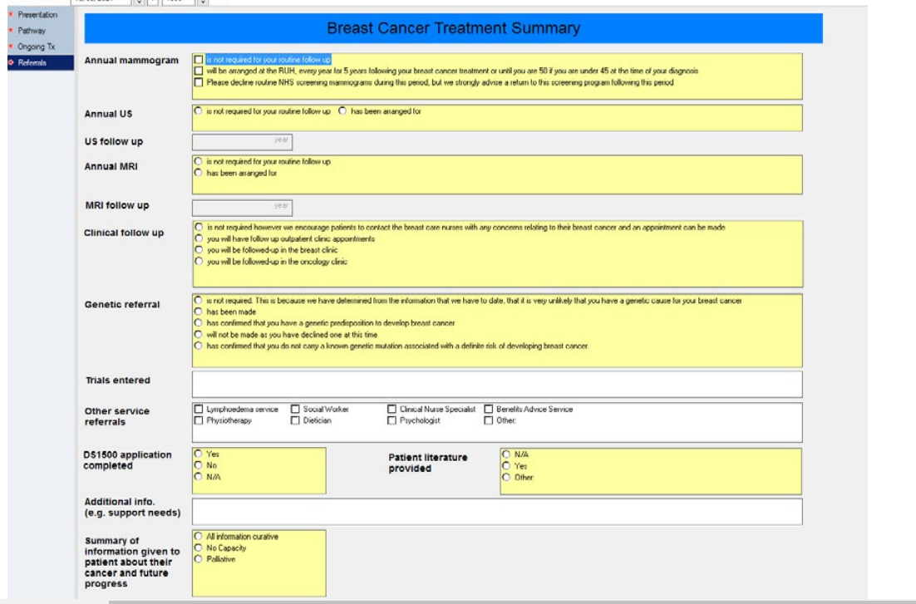

Slide 11
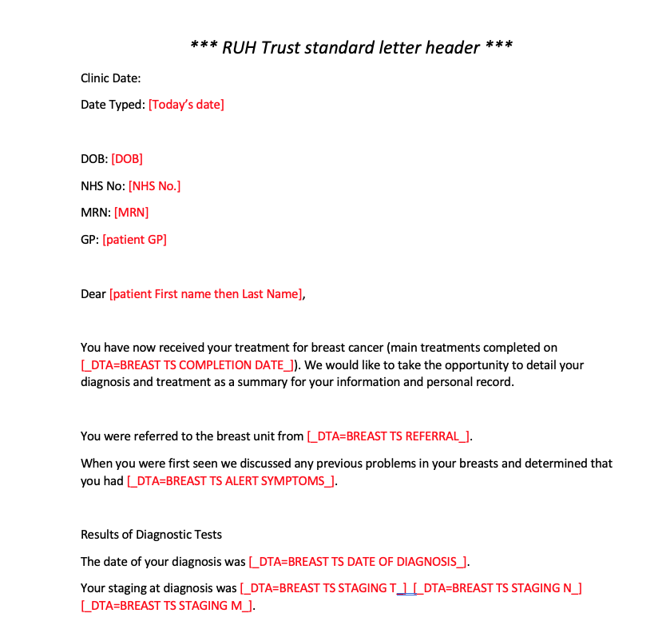

Slide 12
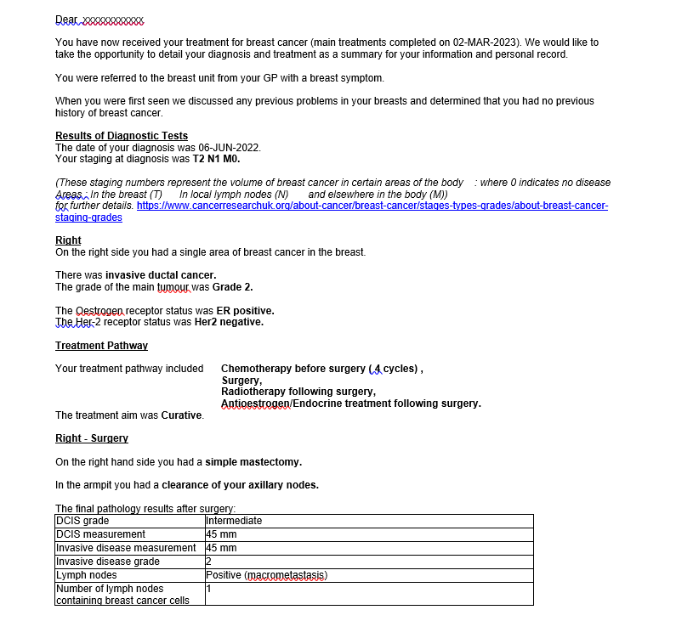

Slide 13
Objective:
Combine functional aspect of Predict with a Database to
Accurately aid multiple decisions made at the MDT.
To create a database of predictive data and pathways for future planning, audit and research.
To collaborate with a university and students to aid their development and understanding of medical pathways with relation to future working.
Project:
First stage : create inclusion and exclusion criteria on excel spreadsheet
for a variety of investigations and treatments.
Second stage: Students to create an app and database using algorthimic software
Third stage: Introduction into clinical practice with close audit to ensure accuracy
Fourth stage: Updates

Slide 14
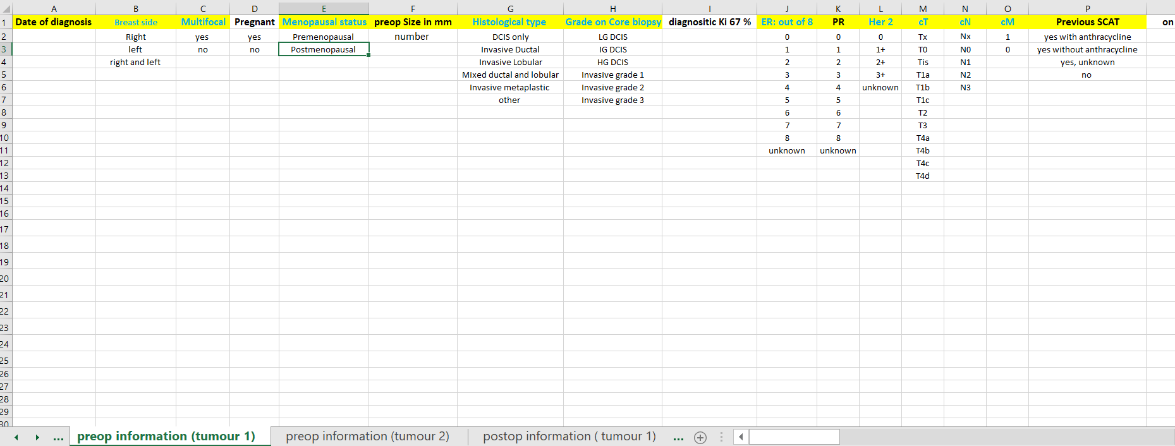
Example pages of parameters, inclusion and exclusion criteria:

Slide 16
Mainstream testing R444/ PARP
eligible
not eligible
Her 2 0 or 1+ or 2+ and
neoadjuvant SCAT and
ER 0 or 1 or 2 or 3 and
all pTN except pT0N0
OR
Her 2 0 or 1+ or 2+ and
neoadjuvant SCAT and
ER 4 or 5 or 6 or 7 or 8 and
CPS + EG score > or = 3
OR
or her 2 ( 0 or 1+or ,2+ ) and
no neoadjuvant SCAT
and ER 0 or 1 or 2 or 3
and pN1 or pT2 or pT3 or pT4
OR
or Her 2 ( 0 or 1+ or 2+ )and
no neoadjuvant SCAT
and ER 4 or 5 or 6 or 7 or 8
and pN2 or pN3

