Slide 1
Transoral Robotic Surgery & Management of the Unknown Primary in Head & Neck Cancer
Mr Oliver Dale FRCS (ORL-HNS) PhD
Consultant ENT Head & Neck and Thyroid Surgeon
University Hospitals Bristol

Slide 2
Robotics at UHBW - Timeline
2018 – Need for robot identified
2019 – Working group of consultants established to identify specialties and volume of cases
2021 – Division of surgery presented proposal to Clinical Strategy Development Group
2022 – Project group established to develop Strategic Outline case and then business case
2023 – 2 x Da Vinci Xi robots purchased £5m
Sept 2023 – First robotic case

Slide 3
What is robot assisted surgery?
Notes:
Medical device which allows minimally invasive surgery. 4 arms – only 3 used in Head and Neck. 1 camera – can be 0 or 30 degree, and 2 instruments. Grasper with bipolar, and a cutting monopolar. Not autonomous, controlled by a surgeon in the same room. Requires an assistant who is scrubbed. Da Vinci Xi is the 4th iteration of the device.

Slide 4
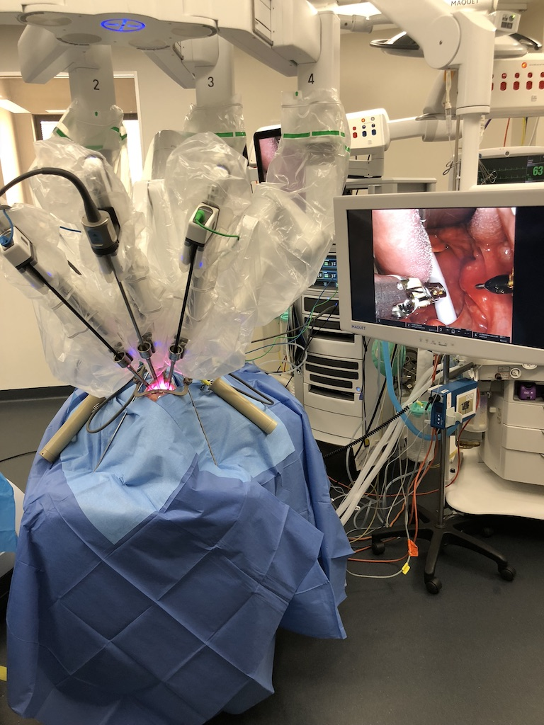

Slide 5
Theatre Layout
S
ANAESTHETIC
CONSOLE
A
PATIENT CART
CONSOLE
BIPOLAR
SLAVE MONITOR
ROBOT
S
P
SCRUB
S
N
N

Slide 6
Case Selection
Tonsil tumours
T1/T2, mobile
Confined to tonsil fossa
Can resect up to ½ soft palate
<50% posterior pharyngeal wall resection
Tongue Base tumours
T1/T2
No significant muscle invasion
Not crossing midline
Unknown primary
Tonsillectomy (bilateral)
Tongue base mucosectomy- UL vs BL

Slide 7
UHBW Robotic surgery
Tongue base mucosectomy and bilateral tonsillectomy (n=2)
Primary site identified:
1 tonsil SCC
1 synchronous right and left tongue base SCCs
Mean length of stay: 1.5 days
September 2023 – March 2024
20 cases
9 lateral oropharyngectomy (3 PATHOS)
9 tonsillectomy
2 tongue base mucosectomy & bilateral tonsillectomy
Lateral oropharyngectomy (n=9)
Margins: 8 clear (>5mm), 1 close (1-4mm)
5 had ENE in involved neck nodes
Adjuvant treatment
3 none
4 RT
2 CRT
Mean length of stay:
Primary cases (n=8) = 4.75 days
Salvage case (n=1) = 18 days
Complications (all cases)
2 readmissions with bleeding (no return to theatre)
1 First bite syndrome (resolving)

Slide 8
Post-operative pain scores

Slide 9
Pain protocol
Post-op
Paracetamol 1g QDS
Naproxen 500mg BD
Codeine 30mg QDS
Oromorph 5-10ml PRN
Tramadol 100mg QDS PRN
Aspirin gargles 300mg TDS (not swallowed)
Dexamethasone 6.6mg BD 48hrs
PCA – only if required (n=1)

Slide 10
Post-op swallowing outcomes
N=4
Tumour site = Tonsil
T1 = 1
T2 = 3
Adjuvant treatment:
None = 2
Radiotherapy = 2

Slide 11
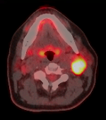
The role of robotics in Head & Neck SCC with unknown primary
Squamous cell carcinoma on FNA/core biopsy from cervical node
No primary tumour on:
Examination including nasendoscopy
MRI
PET-CT
2-4% of H&N SCC

Slide 12
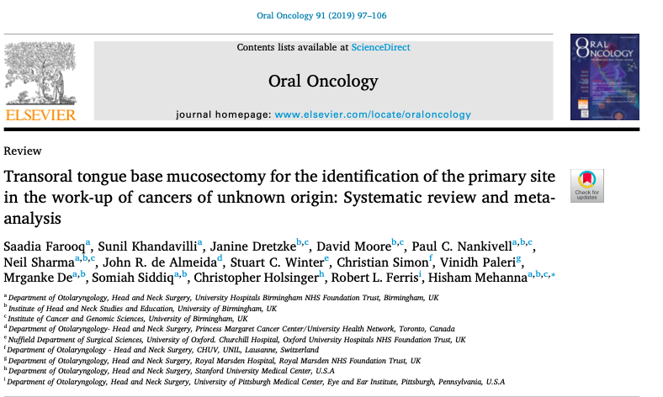

Slide 13
21 studies eligible
556 patients
Primary site identified by TORS/TLM in 78% of cases
Tumours were ipsilateral in 97% (n=419)
In patients where a primary was identified:
64% ipsilateral tongue base
31% ipsilateral tonsil
2% contralateral tongue base
1% contralateral tonsil

Slide 14
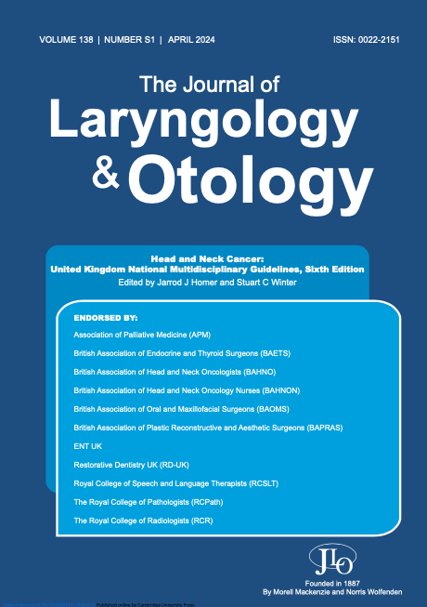
Management of unknown primary Head & Neck SCC
Producing guidelines challenging
Paucity of contemporary trial data
Variable case definition
Low incidence of cases

Slide 15
Multistage meta-consensus process 2022
National audit of practice
National consensus day
National Delphi exercise

Slide 16
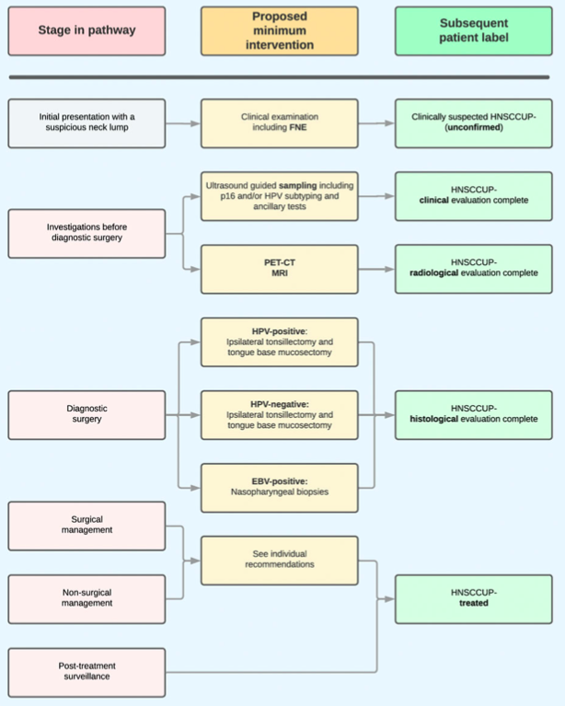

Slide 17
Does it matter?
Diagnosis:
No primary identified
Treatment:
Consider neck dissection or radiotherapy to neck + oropharynx

Slide 18
Does it matter?
Diagnosis:
Lateralised ipsilateral primary
Treatment:
Consider TORS and neck dissection or unilateral chemoradiotherapy

Slide 19
Does it matter?
Diagnosis:
Midline or contralateral primary
Treatment:
Bilateral chemoradiotherapy

Slide 20
Summary
Robotic surgery offers excellent access to oropharynx
Initial experience at UHBW encouraging
High rate of unknown primary tumours in ipsilateral tongue base
Consensus within MDT is needed

