Slide 1
SWAG Network Breast Cancer
Clinical Advisory Group
Research Update - Claire Matthews
15/03/2024

Slide 2
National Upper GI Cancer Research Recruitment
Apr 23 - Mar 24
Apr 22 - Mar 23
Source: ODP All Portfolio
Data cut: 12/03/2024

Slide 3
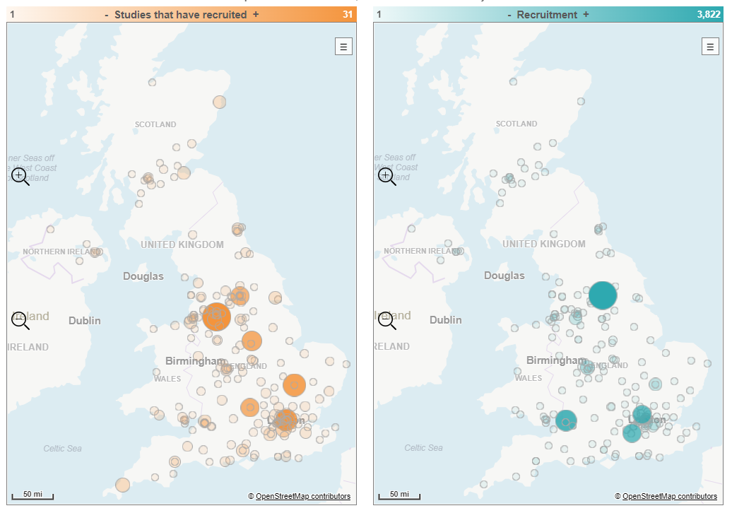
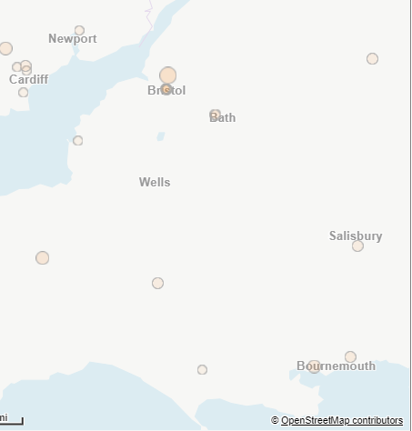
Weston
Musgrove

Slide 4
Open studies
59 Studies open in SWAG region (147 open nationally)
Link to full list https://docs.google.com/spreadsheets/d/1XCCDUvtwbE6r-tkH2kx3RZqPCiNQZhM5/edit?usp=sharing&ouid=116508400395350162569&rtpof=true&sd=true
Or search here: http://public-odp.nihr.ac.uk/

Slide 5
Studies opened in last 6 months
CPMS ID | Short Title | Open | Close | Target Eng | Recruit Eng
53671 | INAVO122 | 21/02/2024 | 30/09/2026 | 5 | 0
54398 | TROPION-Breast04 | 29/01/2024 | 31/12/2025 | - | 1
57964 | Real-World Patient-Reported Outcomes in ER+/HER2- aBC/mBC | 24/01/2024 | 27/12/2024 | 195 | 1
56957 | CAPI 292 | 10/01/2024 | 09/03/2025 | 9 | 0
37535 | BR-003 Confirmatory Study Novilase Ablation Malignant Breast Tumours | 12/12/2023 | 30/03/2025 | 20 | 0
56318 | CANFit: home-based exercise programme for patients with cancer | 04/12/2023 | 18/10/2024 | 660 | 0
56064 | DESTINY BREAST - RESPOND | 16/11/2023 | 30/05/2024 | - | 1
58029 | Predictive value of Leukocyte Immuno Test in breast cancer metastasis | 15/11/2023 | 01/05/2024 | 70 | 25
50746 | 21197 OBR | 14/11/2023 | 18/09/2024 | 6 | 1
54123 | TROPION-05 | 13/11/2023 | 13/04/2029 | 22 | 1
56106 | CAMBRIA-2 | 09/11/2023 | 24/03/2027 | - | 4
52963 | J2J-MC-JZLH / EMBER-4 / Imlunestrant for ER+, HER2- Early Breast Cancer | 02/11/2023 | 03/11/2024 | - | 1
51185 | ARV471 MetBC w 1prior line | 01/11/2023 | 16/07/2024 | - | 1
54131 | CELC-G-301 | 27/10/2023 | 18/12/2024 | 18 | 0
53010 | PEAR-MET | 13/10/2023 | 28/06/2024 | 30 | 1
56035 | ELEVATE | 19/09/2023 | 17/05/2024 | 10 | 0

Slide 6
Studies in set-up in SWAG region
CPMS ID | Comm Study | Short Name | Phase | Planned Opening | Planned Closure | Sample Size Eng | Sponsor | CI
60662 | Non-Com | Intention CDKi study | N/A | 01/04/2024 | 15/08/2025 | 100 | UH SOUTHAMPTON NHS FT | Ellen Copson
60451 | Commercial | MK2870-012 | III | 24/05/2024 | 25/10/2027 | 60 | MERCK SHARP & DOHME CORP. | -
59828 | Non-Com | FAST MRI: DYAMOND | N/A | 01/02/2024 | 31/12/2024 | 1000 | NORTH BRISTOL NHS TRUST | Dr Lyn I Jones
59329 | Commercial | Digistain Study in Solid Tumours | N/A | 25/03/2024 | 31/03/2025 | 100 | Digistain Limited | -
58079 | Non-Com | 3-Pillars | II | 01/01/2024 | 01/04/2025 | 90 | University of Liverpool | Dr Carlo Palmieri
58021 | Non-Com | The ROSETA Optimisation Trial | N/A | 29/02/2024 | 31/03/2025 | 512 | University of Leeds | Dr Sam Smith
57385 | Non-Com | SWEET | N/A | 01/03/2024 | 31/12/2025 | 860 | Newcastle upon Tyne H NHS FT | Dr Linda Sharp
56795 | Non-Com | BLUSH | IV | 30/04/2024 | 01/04/2026 | 900 | University College London | Melanie Davies
56397 | Commercial | BC-CDK4-Ph3 | III | 01/04/2024 | 03/06/2025 | - | Pfizer Inc. | -
55892 | Commercial | advanced or metastatic breast cancer | III | 01/03/2024 | 31/01/2028 | - | Olema Pharmaceuticals, Inc. | -
55251 | Commercial | MiRaDor | II | 01/04/2024 | 14/07/2025 | - | Medica Scientia Innovation Research | -
54958 | Commercial | PYX-106-101 | I | 01/10/2024 | 19/08/2025 | - | Pyxis Oncology Inc. | -
54260 | Non-Com | LION | II | 26/02/2024 | 01/04/2025 | 89 | The Christie Nhs Foundation Trust | Anne Armstrong
40689 | Non-Com | IMpALA | II | 31/01/2024 | 31/10/2024 | 42 | The Christie Nhs Foundation Trust | Anne Armstrong

Slide 7
FAST MRI
- an abbreviated form of MRI
- can identify aggressive cancers irrespective of breast density – a trait found more commonly in younger women.
DYAMOND (Diagnostic Yield study for Average MammOgraphic screeNing Density): A multicentre study offering women a FAST MRI scan in addition to their screening mammogram, to see if FAST MRI can find cancers missed by mammography
Aim: To see if FAST MRI, a new imaging test, can detect cancers that have been missed by mammograms for women with average breast density at their first screening mammogram (age 50-52).
Inviting women with breast density in category B and a normal mammogram result to have a FAST MRI scan. 1,000 women will be scanned at 4 NHS sites
Chief Investigator: Dr Lyn Jones
Co-Lead: Dr Rebecca Geach

Slide 8
Cancer PES survey results 2022 - Q58 research
SWAG regional results
SWAG region results PDF

Slide 9
https://bepartofresearch.nihr.ac.uk/

Slide 10
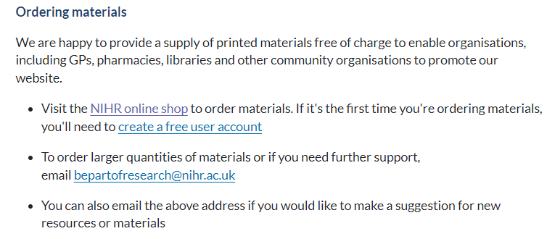
Resources and materials
https://bepartofresearch.nihr.ac.uk/promote-research/Resources/

Slide 11
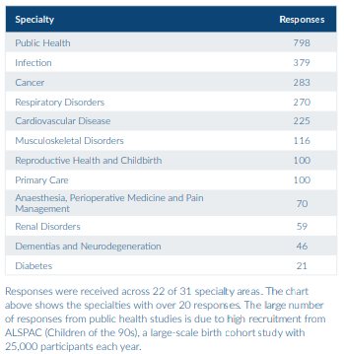
Link to full PRES report

Slide 12
What was positive about your research experience?
1,837 (70%) respondents left a comment explaining what made their
research experience positive. From these comments we identified the
following themes
• 864 comments mentioned the research delivery staff
• 537 comments related to contributing to improving healthcare
• 457 comments related to good communication
• 272 comments said the research study was easy to take part in
• 241 comments related to having a good experience
• 203 comments mentioned experiencing personal benefits
• 48 comments said "everything" was positive
• 41 comments related to where the research took place
• 35 comments mentioned gaining a feeling of hope
• 27 comments related to financial reimbursement
• 19 comments related to travel
Notes:
The same themes were identified in the 2021/22 PRES report, suggesting the positive aspects of taking part in research have remained the same. Comments related to good communication have increased from 21% to 25%, suggesting that studies may have improved how they communicate with participants.

Slide 13
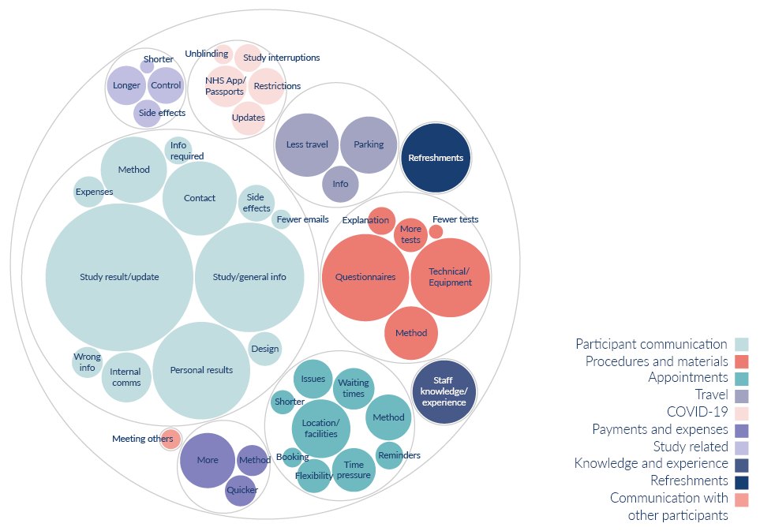
What would have made your research experience better?
603 respondents (23%) left a comment about what could have made their research experience better. From these comments we identified the following themes:
310 comments related to participant communication
98 comments related to procedures and materials
67 comments were about appointments
45 comments related to travel
28 comments were linked to COVID-19
26 comments were about payments and expenses
25 comments were about refreshments
20 comments were study related
20 comments were about knowledge and experience
2 comments mentioned they’d like to communicate with other participants
Notes:
Although fewer participants (23%) left comments about what would have made their experience better (compared to 32% in 2021/22), the themes identified are broadly the same as last year.
Whilst comments about participant communication remain the most common, these have decreased since last year (from 64% to 51%). This also aligns with an increase in positive comments around communication, indicating that studies have improved how they communicate with participants. There has also been a large decrease in the number of comments around appointments (from 27% to 11%), this is likely due to study teams being able to offer more flexibility around appointment times and methods.
Participant communication: Information about the study results/updates, general information about the study or condition, personal results, more contact from the study team, method of communication, information about side effects, internal communication, receiving incorrect information, information about what was required, information about expenses, design of communication, fewer emails.
Procedures and materials: Issues with questionnaires, technical issues with apps/equipment, method of procedures, more explanation about tests or how to use equipment, more or fewer tests
Appointments: Location, method, delays and waiting times, more time during appointments, flexibility over appointment times, issues with appointments, reminders, shorter appointments, booking of appointments
Travel: Less travel less for appointments, free or better parking, better travel information
COVID-19: Issues with travel/vaccine passports, restrictions, more information/updates, study interruptions, unblinding process
Payments and expenses: Wanting payment or to receive more money, time it took to receive payments, method of recognition
Study related: Wanting longer or shorter study, being in the control arm, side effects
Knowledge and experience: When people were approached about taking part in research, feeling like staff didn’t have the knowledge to answer questions or use required equipment. Comments under this theme also relate to awareness of Equity, Diversity, and Inclusion

Slide 14
Next steps
We have formed a PRES working group to identify and implement improvement projects based on the feedback we have received from participants via the survey. The group currently has representation from the CRN WE Direct Delivery Team, Partner Organisations and Research Champions.
The group will meet on a monthly basis. We held the first meeting in January where we discussed the feedback received and identified priority areas for the CRN. Representatives from Partner Organisations will also be looking into what they can implement at a site level.

Slide 15
Associate PI Scheme
https://www.nihr.ac.uk/health-and-care-professionals/career-development/associate-principal-investigator-scheme.htm
A six month in-work training opportunity, providing practical experience for healthcare professionals starting their research career. People who would not normally have the opportunity to take part in clinical research in their day to day role have the chance to experience what it means to work on and deliver a NIHR portfolio trial under the mentorship of an enthusiastic Local PI.

Slide 16
Principal Investigator Pipeline Programme (PIPP)
https://www.nihr.ac.uk/documents/principal-investigator-pipeline-programme-pipp/33803
A new scheme support research delivery nurses and midwives by supporting them to become Principal Investigators (PIs)
Free of charge for eligible participants
Delivered through a variety of live virtual and on-line classroom environments, combined with real world hands-on experience.
COHORT 2 key dates: Applications open 1st March 2024
31st May 2024: Close to applications
End June 2024: Applicants notified of outcome of application
September 2024: COHORT 2 begins

Slide 17
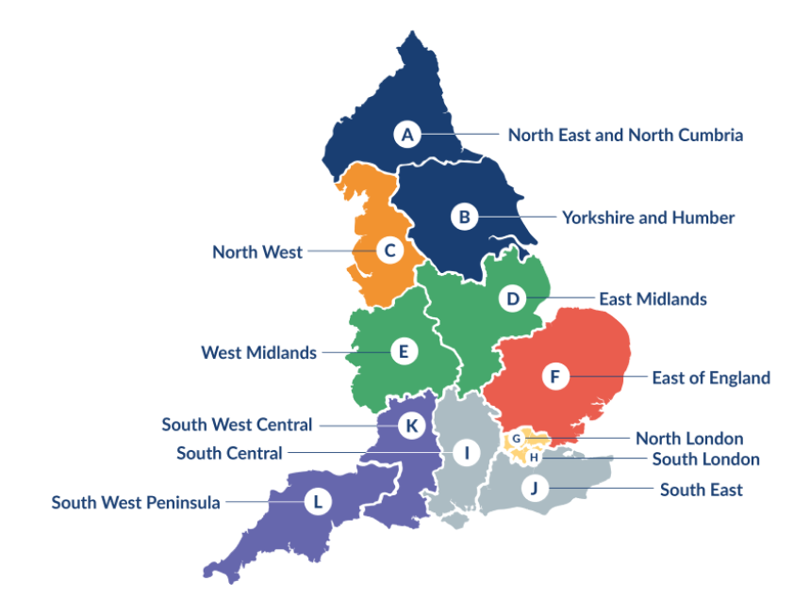
Clinical Research Network Transition to Research Delivery Network
Launching Oct 2024
The NIHR RDN has 2 primary purposes:
To support the successful delivery of high quality research, as an active partner in the research system
To increase capacity and capability of the research infrastructure for the future
Will operate as 1 organisation across England, through a network of 12 Regional Research Delivery Networks (RRDNs) and a central Coordinating Centre (RDNCC)

Slide 18
NIHR ODP
Open data platform. Data on performance across whole CRN,
including all specialty areas
NIHR Be Part of Research
See which studies are open across the country
National Cancer Research Institute Portfolio Maps
View current national portfolio of open, closed and ‘in set up’ cancer studies
Find a Clinical Research Study (ODP)
Search for a study to fit criteria. Good for horizon scanning, eligibility criteria

Slide 19
Research Delivery Manager
claire.matthews@nihr.ac.uk
Research Portfolio Facilitator
rebecca.pienaar@nihr.ac.uk
Sub-specialty Lead
mark.beresford@nhs.net

Slide 20
DETERMINE
Determining Extended Therapeutic indications for Existing drugs in Rare Molecularly defined Indications using a National Evaluation platform trial
Aim:
Evaluate the efficacy of licensed targeted therapies in unlicensed indications, in rare adult, paediatric and TYA cancers with actionable genomic alterations (including common cancers with rare actionable alterations)
Identify genomic,transcriptomic and immune contextual influences on response to therapy
The ultimate aim is to transition positive findings to the NHS (Cancer Drugs Fund [CDF]) to provide new treatment options for patients with rare malignancies.
Arm 1 Alectinib
Arm 2 Atezolizumab
Arm 3 Entrectinib
Arm 4 Trastuzumab in combination with pertuzumab
Arm 5 Vemurafenib in combination with cobimetinib

