Slide 1
Neuroendocrine Cancer Ideal Cancer Pathway
Rachael Delderfield

Slide 2
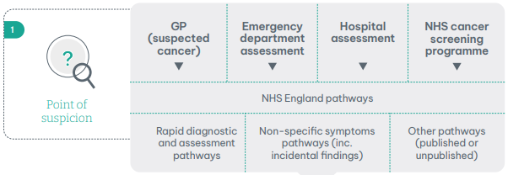
Day 0 Point of suspicion
What can we do about this?
NSSP paused for now – from GP
ED incidental findings
Bowel screening program
Referral to tumour site specific team

Slide 3
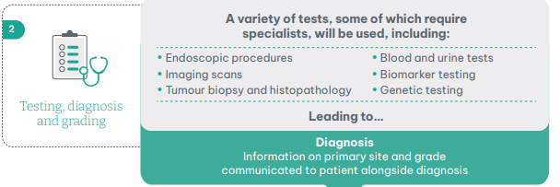
Day 28 Testing, diagnosis and grading
Requesting functioning bloods and urine 5hiaa at baseline – the results take 2 weeks to get back.
Requesting functional scan
Patients need to be informed about the diagnosis and why they need specific tests

Slide 4
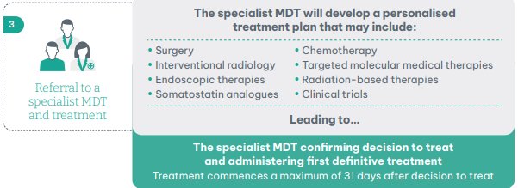
Day 62 Referral to a specialist MDT and treatment
All patient with confirmed histology of NET need to be discussed at the NET MDT.
Endocrinologist input needed.
Usually, patients will be rolled and rediscussed as relevant tests have not been done.

Slide 5
From Day 62 - Follow up care and ongoing treatment
Could PIFU be used for surveillance and pre-operative surveillance.
Guidance to be written on recommended surgical surveillance.

Slide 6
What can we do about this?
Communicate
Save patients an extra journey and wait by getting bloods and urine test when seen in clinic
Add patients to the NET MDT
Let's make patients feel they're in safe hands.

