Slide 1
QPIs and audit 2022
Daniel Raison
Hedvig Karteszi
James Skipworth

Slide 2
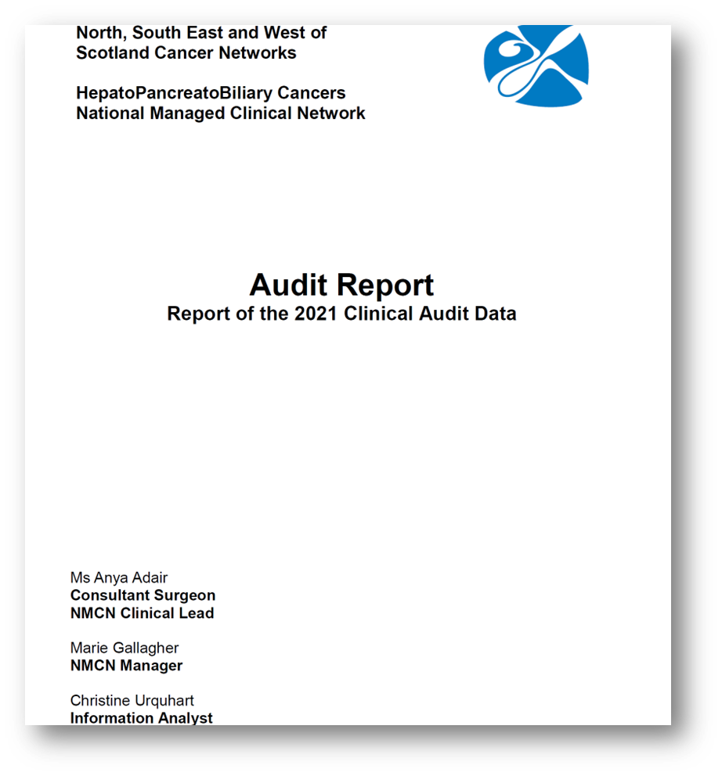
Aim:
-to measure quality of care
-to help drive continuous improvement

Slide 3
Proposal for QPI development process
Aim: - to measure quality of care and monitor change over time
-QPI development group
-identify QPIs of “local” clinical relevance
-personnel that deals with data collection, validation and analysis
-regular publication and review of the data

Slide 4
Potential QPIs
Screening, early detection, tertiary referral
1. Proportion of patients with HCC diagnosed in screening program.
2. Time from onset of symptoms to first MDT discussion.
3. Proportion of patients who underwent biliary intervention prior to referral to HPB Team.
Radiology:
1. Appropriate scanning protocols used for staging of HPB cancers.
2. Template reporting.
MDT meeting:
1. Number of discussions per patient prior to treatment decision.
2. Proportion of cases rolled due to lack of clinical information, pathology report or relevant imaging.

Slide 5
Potential QPIs
Surgery:
1. Annual volume of cases per surgeon.
2. 30 and 90-day mortality following surgical resection of HPB cancers.
3. R0 resection rate.
4. POPF rate.
Endoscopy:
1. Annual volume of cases per endoscopist.
2. Adequate stenting.
3. Success rate of ERCP stenting in pancreatic and distal biliary cancers.
4. Proportion of cases when EUS was performed prior to stenting.

Slide 6
Potential QPIs
Pathology:
1. Number of lymph nodes examined in the surgical specimen.
2. Pathology turnaround time.
Oncology:
1. Clinical trials and research study access.
2. 30-day mortality following systemic anti-cancer therapy.
3. Access to Oncology Services for inoperable HPB cancer.
Supportive care:
1. Access to nutrition & dietetic services .
2. Access to high quality supportive care.

Slide 7
Patient cohort, data analysis
Somerset Cancer Registry
No personnel that deals with data collection, validation and analysis.
Large patient cohort (258 pts were diagnosed with ampullary or pancreatic cancers between January 2022 and August 2023.)

Slide 8
Audit 2022
Cohort:
Patients who underwent Whipple’s procedure in 2022 (44 pts)
-template reporting
-adequate stenting
-R0 resection rate
-POPF rate

Slide 9
Post-op pathology
44 pts
Benign pathology: 6 (benign polyps/adenomas)
IPMN: 6 (1 contained small focus of invasive cancer)
SCA: 1 (pre-op diagnosis: IPMN)
PNET: 2
Metastasis: 1
PDAC: 17
CCA: 4
Ampullary ca: 5
Duodenal ca: 2

Slide 10
Template reporting

Slide 11
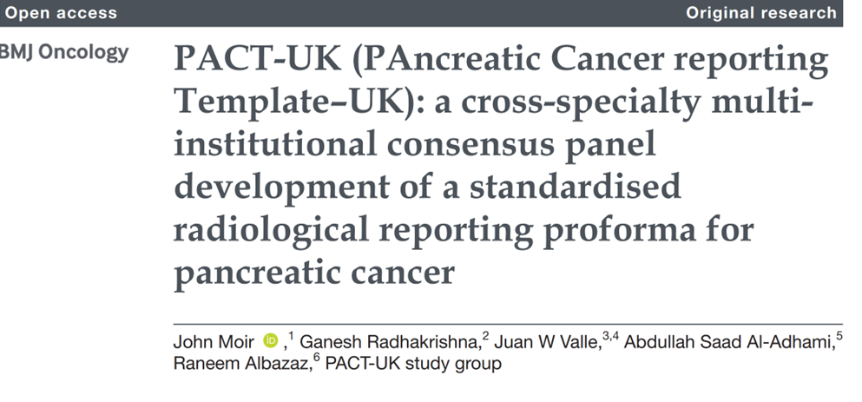
-Accurate radiological staging (and re-staging) of HPB cancers is key element of patient pathway.
-Proforma reporting of pancreatic cancer is supported by multiple organizations.

Slide 12
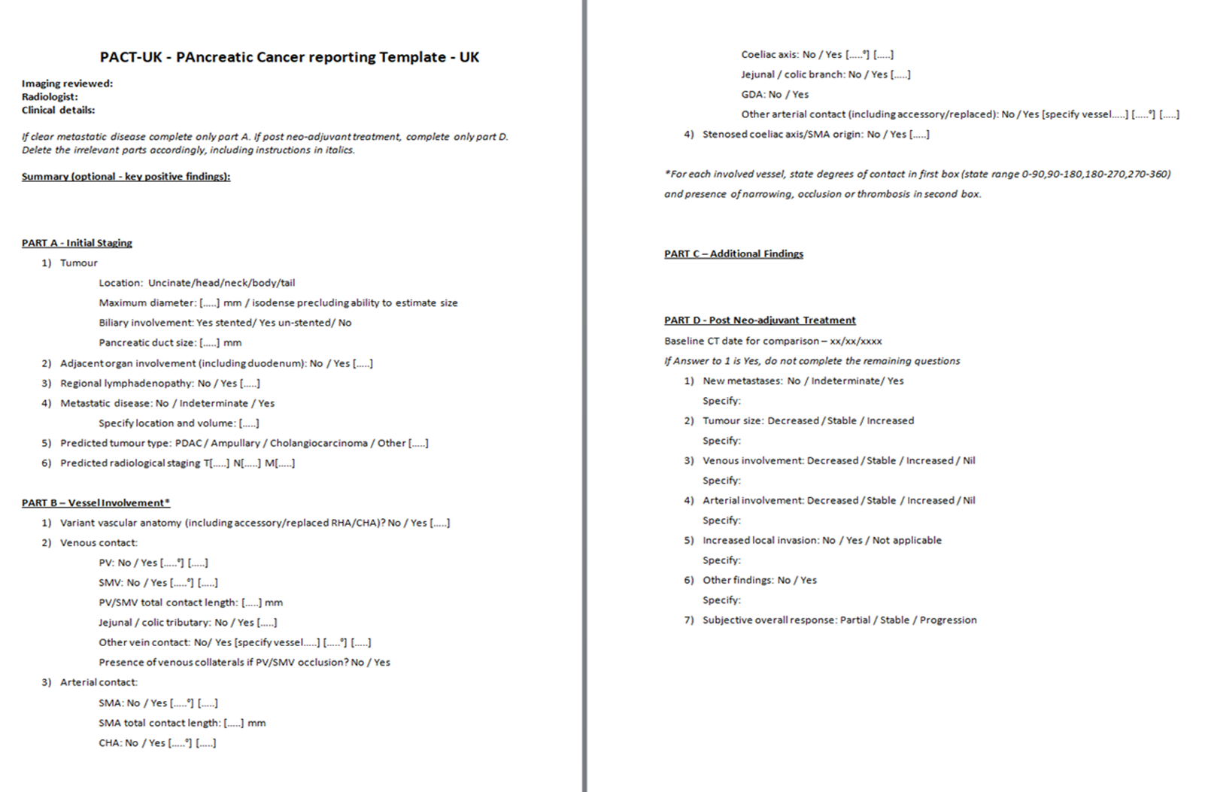
“PACT-UK proforma will be completed if patient is fit for active treatment except in metastatic cancer or localized disease with extensive multi-vessel invasion.”

Slide 13
Template reporting 2022
26 pts with periampullary or pancreatic mass (preoperative diagnosis of PDAC, CCA or ampullary ca)
12 with radiology PACT-UK proforma
14 without radiology PACT-UK proforma

Slide 14
Adequate stenting

Slide 15
ERCP is recommended as the preferred route of drainage.
If ERCP fails proceeding with EUS-BD or PTC depends on patient preference and local expertise. Recent data demonstrated the safety and efficacy of EUS-BD as the better option than PTC.
Several studies showed higher patency rates and a cost-effectiveness advantage of SEMS compared to plastic biliary stents.

Slide 16
Adequate stenting of periampullary and pancreatic tumours
CCA 4 pts
-all stented
PDAC 17 pts
-8 pts stented
-9 pts unstented (6 un-stented Whipple’s, 3 tumours didn’t involve CBD)
Ampullary ca 5 pts
-1 of the ampullary carcinomas were stented prior to surgery.

Slide 17
R0 resection rate

Slide 18
The resection margin status is an important independent determinant of postresection survival.

Slide 19
R status based on post-op histology 2022
[PDAC (18 patients; 1 pt: small focus of invasive cancer in IPMN)]
- R0 9 patients (50%)
R1 9 patients
[CCA (4 patients)]
R0 3 patients (75%)
R1 1 patient
[Ampullary ca (5 patients)]
R0 3 patients (60%)
R1 2 patients

Slide 20
POPF rate

Slide 21
Clinically relevant POPF after surgery for PDAC seems to be significantly associated with shorter disease-free and overall survival.

Slide 22
POPF rate 2022
44 patients total (includes Whipple’s for duodenal masses)
12 patients with POPF (4 grade C, 8 grade B)
32 patients with no POPF

Slide 23
Only two patients with PDAC had neoadjuvant chemotherapy.
?

Slide 24
Thank you.

