Slide 1
Stereotactic ablative radiotherapy (SABR) for liver lesions
Boris Wagner/Stephen Falk
HPB Clinical Audit & Governance
1st March 2024

Slide 2
Background
HCC is the most common type of primary liver cancer and the fourth most common cause of cancer-related death worldwide (1).
Patients with HCC frequently present with advanced disease on a background of hepatic decompensation, limiting treatment options.
Technological advances in the delivery of SABR and an increasing body of literature establishing high rates of local control with low rates of toxicity have led to SABR becoming a key treatment modality in the management of both early and more advanced HCC (12-16).

Slide 3
Audit Aim
The aim of this study was to evaluate the outcomes of HCC patients treated with SABR in a tertiary referral hepatobiliary (HPB) centre in the UK.
Primary outcomes were:
overall survival (OS) and
safety (toxicity)
Secondary outcomes were:
local control (LC),
progression-free survival (PFS) and
feasibility of SABR as a treatment for HCC

Slide 4
Methodology
All patients who received SABR for HCC liver lesions between July 2020 and August 2022 were retrospectively analysed. Eligibility for SABR was determined via the weekly HPB cancer MDT. Patient, treatment and follow-up details were obtained from online patient records and imaging.
Patients were aimed to be followed up at three months, six months and then at six-monthly intervals until two years with liver function tests, AFP estimation and CT/MRI imaging as appropriate. Reported toxicities were obtained either from clinic follow-up documentation, hospital admission or General Practitioner (GP) records where available.

Slide 5
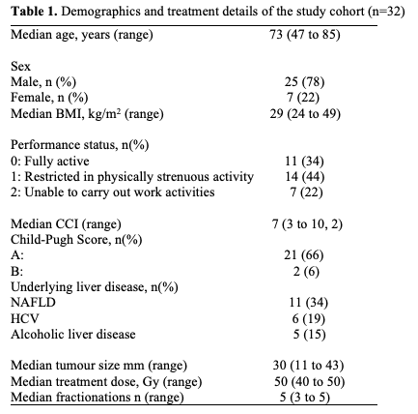

Slide 7
Results
A total of 32 patients received SABR over the study period. Median age was 73 years (range 47 to 85).
Clinical details
Overall, 47% (15/32) of patients had undergone previous liver-directed therapies for HCC (liver resection, TACE or RFA/MWA). Patients underwent SABR because; they were deemed medically unfit for surgery (22/32), treatment alternatives were deemed technically impossible (9/32) or due to patient choice (1/32).
).

Slide 8
Radiological Outcomes
Median follow-up was 12 months (range 4 to 30).
Rate of OS was 78% (25/32) at 12 months.
Overall, 72% (n=23/32) achieved LC, while progression occurred in 31% (n=10/32).
Median time to progression was 6 months (range 3 to 31).
A total of 60% of patients with disease progression received further liver-directed therapies; TACE (3/10), transplant (1/10), MWA (1/10) or systemic therapy (1/10).
Of the patients who received previous liver-directed therapies prior to treatment with SABR (n=15/32), LC was achieved in 80% (n=12/15).

Slide 9
Safety
Overall, 10 patients reported Grade 1 or 2 toxicities (10/32, 31%);
(6) gastrointestinal symptoms (nausea, diarrhoea),
(5) fatigue and
(3) localised rib discomfort.
No patients in the study cohort reported any Grade ≥ 3 toxicities.

Slide 10
Discussion
Here we present the results of a single-centre experience of the introduction of SABR for HCC. These data suggest SABR is safe in this setting, without severe toxicities (Grade ≥ 3) reported and just one in three patients experiencing mild toxicities. SABR is a suitable treatment option in patients who had previously received liver-directed therapies, as was the case in half of the patients in this cohort . We show SABR remained effective, with three-quarters of patients still alive at 12 months post-treatment and seven out of 10 patients free from disease at this stage. Despite this, one in three patients developed disease progression.

Slide 11
Conclusions
SABR is an effective treatment option for non-surgical candidates or as additional palliative treatment for patients with HCC
SABR can be delivered over a short period of time with low levels of toxicity even after previous liver-directed therapies and despite significant comorbidity
Subsequent liver-directed therapies remain feasible after SABR
Further research is warranted to examine the clinical benefits of combination treatment with SABR and other treatment

Slide 12
Future
68 patients received SABR for colorectal liver metastases over the same time period
Radiological data yet to be analysed

Slide 13
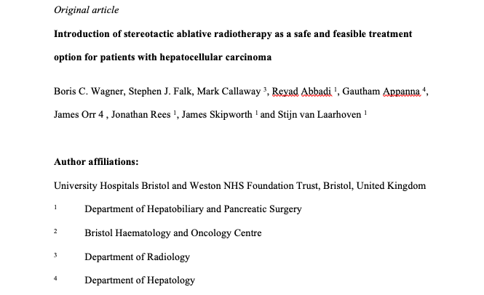
MDT Publication?

Slide 14
Acknowledgements
Thank you for listening!
Special thanks to Prof Callaway for taking the time to go through all the imaging and Dr James Orr for his helpful input!

